Slide 1
Proposed City Code Changes:
Amending Exceptions to Residential Solid Waste Collection
Pete Chism-Winfield
Program Coordinator
Notes:
Portland established a Franchise system in 1992 to authorize citywide residential garbage and recycling service specifically for single family homes and 4-unit or less housing. This system granted exclusive collection routes for franchisees.
Exceptions to the franchise were included in the original adoption, including allowing residents to take garbage to the transfer station, yard maintenance companies to haul debris from residents and construction and demolition contractors to haul materials associated with their work.
Since 1992, the solid waste system has evolved to include yard debris, food waste, and larger carts for mixed paper, bottle and container plastics and metal recycling. In addition, we recognize that our residents have and continue to seek our solutions for their disposal needs. This has included the junk service removal companies, an subscription services that offer collection options for items that would otherwise be harder to recycle.
Services provided in response to the system changes have resulted in the need to amend the Portland City Code to recognize opportunities within the solid waste system that reflect growing demand from our single family residents.

Slide 2
Timeline for Code Proposal
February - May
Research
June - August
Engagement
September - October
Council
Notes:
This project was initiated in response to the Portland Haulers Association’s feedback that the Portland City Code does not specifically address aspects of the solid waste system that have evolved.
While special items collection for reuse and recycling were identified as not being addressed in the Code, other services and community impacts were identified, such as junk removal service and the informal collection of deposit containers.
BPS staff interviewed Seattle staff and other local jurisdictions including our partners with the State DEQ and Metro to get a sense of how they were addressing these services and the responses varied from ceasing services to formalizing them. We sought guidance from the state and Metro, but ultimately it is up to each local jurisdiction to determine if these types of services should be allowed. Metro staff also inspected two facilities that provide special items collection and verified that materials were recycled.
Engagement included numerous conversations with PHA, the informal sector small equity work group, which authored the Inclusive Waste Management Report, included in the Council packet. I want to take a moment to that the informal sector equity work group whose efforts highlighted the need to recognize and support canners. We also had conversations with members of the Waste Equity Advisory Group and with companies that provide junk removal and special items collection services.

Slide 3
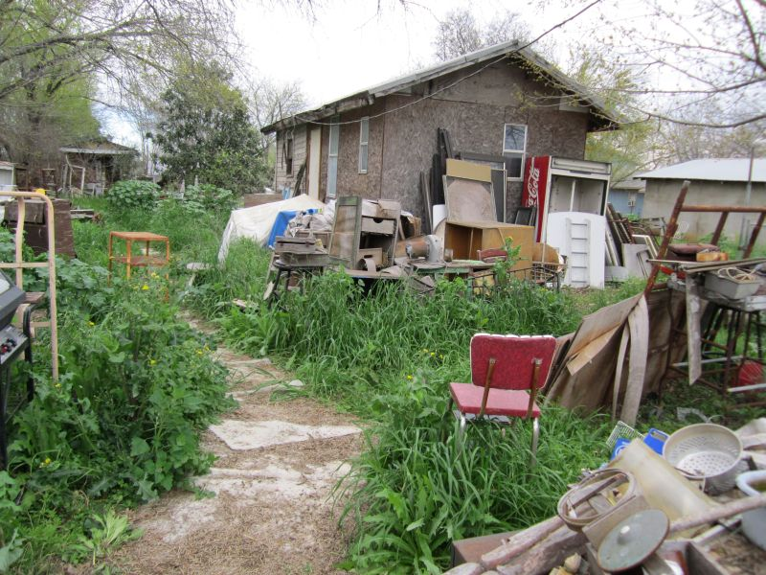
Junk Removal Services
Currently unregulated in Portland.
Includes items such as furniture, appliances and accumulated items in storage areas.
Employees manually remove materials from the property.
Notes:
Small businesses have been thriving in this space.

Slide 4
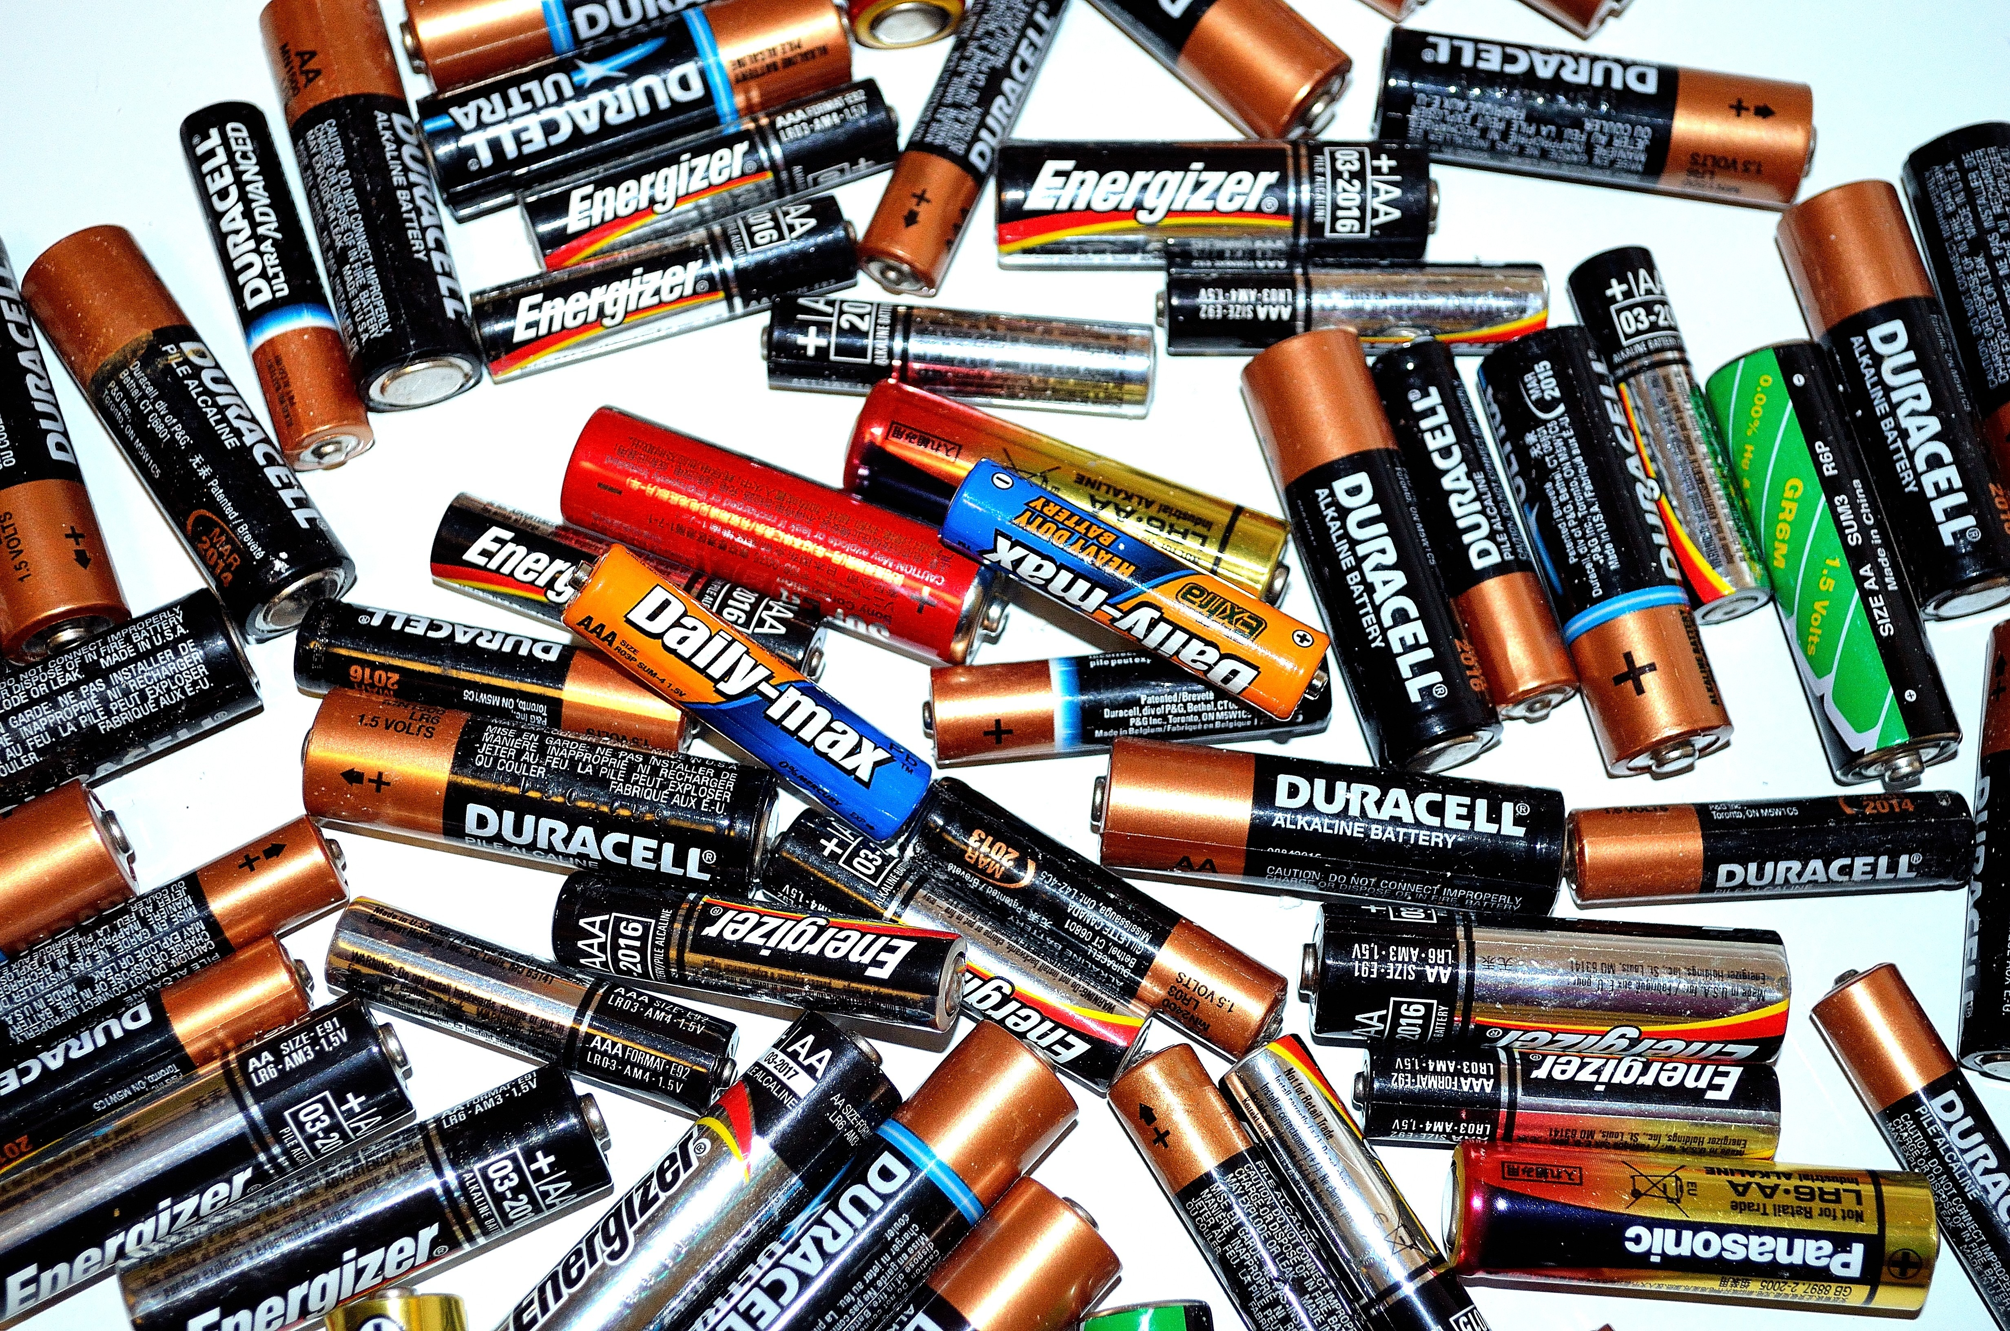
Special Items Collection
Doorstep service, includes items for reuse, some non-curbside plastics, batteries and light bulbs.
Recycling markets are stable, however, for sorting reasons, cannot be included in the blue carts.
Notes:
Special items have drop off locations that Portlanders can take for reuse and recycling.
Special items collection is a service of convenience for Portlanders that would like to save a trip to a donation non-profit, a recycling depot or a retail store.
Extended Producer Responsibility policies for paint and electronics have provided many locations for drop off at retail locations.
These services are optional.
EMPAHSIS: Tons of material for recycling for special items collections represents approximately 500 tons or .0005% of the Portland waste system.

Slide 5
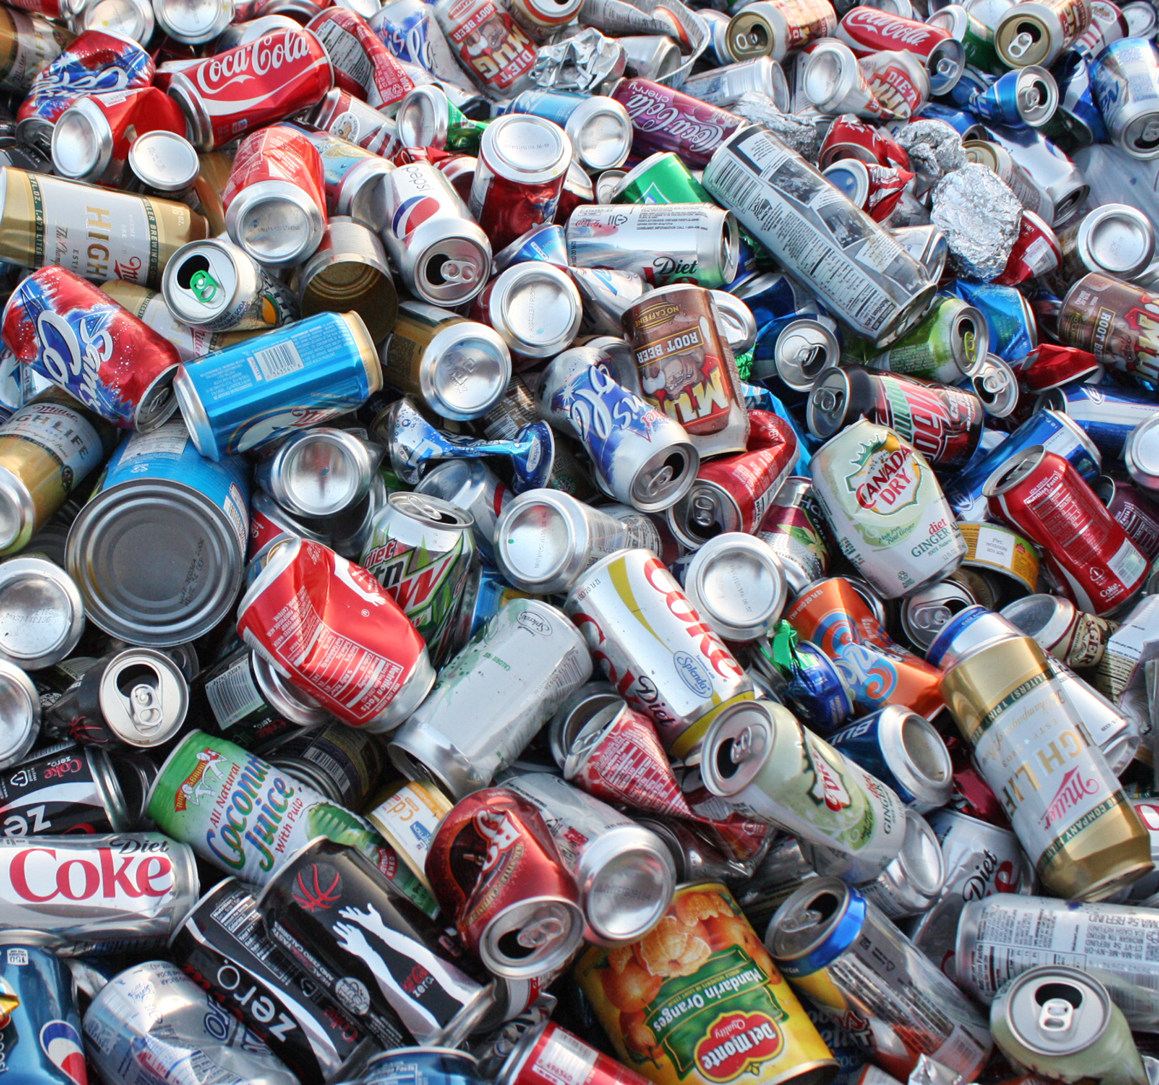
Bottle Bill Containers
Currently City Code does not acknowledge informal sector “canners”.
Common practice and one that is a source of supplemental income.

Slide 6
Why are we taking this up now?
As collection authority, the City needs to cease these services, or recognize them as exceptions to the franchise in the Code.
These exceptions maintain current services and provide opportunity for small businesses.
Rates for residential customers will not increase – special items collection is a subscription service chosen by residential customers.
Notes:
Amend Code to allow for additional exceptions for junk removal, special items collection and refundable bottles and cans collection.
Recognizes current practices and services for hire and opens opportunities for emerging small businesses.
Regulation of these services would create negligible environmental impact, potentially raise rates for Portlanders and costs to the City.
For many Portlanders collecting bottles and cans for deposit is an important source of supplemental income.

Slide 7
Addressing Equity in our Waste System
BPS continues to research and develop future programs and policies to address inequities in the solid waste system in the following areas:
Public trash can collection.
Solid waste and recycling services for City-owned facilities.
Multifamily solid waste and recycling and bulky waste collection services.
Notes:
BPS is committed to addressing inequities in the waste system. These inequities exist in two main forms: 1) addressing inequities in the ownership and management of companies providing services and 2) addressing inequities in Portlanders receiving collection services.
BPS will continue to prioritize areas of the solid waste system that
have a greater amount of material to collect and therefore have larger economic opportunity and
improve the services to multifamily residents.
By focusing less attention on continuing to build our residential collection system and more attention on improving the services provided for multifamily tenants, there is a greater win-win in terms of community impact to meet our waste equity targets.
BPS has an waste equity advisory group that is in the process of rethinking their role in the system.

Slide 8
Pete Chism-Winfield
Program Coordinator
Pete.Chism-Winfield@portlandoregon.gov
Notes:
Thank you Council, BPS recommends passing the Code to allow for these services to continue to exist, so we can continue to address the inequities in the system for larger solid waste impacts like services at City-owned facilities, multifamily service and public trash collection.

