Slide 1
Community Watershed Stewardship Program
July 21, 2021
Daryl Houtman – Environmental Services, Community Watershed Stewardship Program
Judy Bluehorse Skelton – Assistant Professor, Indigenous Nations Studies Dept., Portland State University
Naomi Rodriguez – Portland State University, CWSP Student Intern

Slide 2
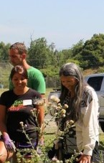
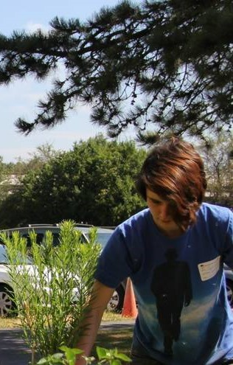
Partnership with Portland State University
Partnership with Indigenous Nations Studies Dept. at Portland State University
CWSP interns are selected from the INST Indigenous Traditional Ecological & Cultural Knowledge (ITECK) program
Students serve an overlapping 2-year internship
Community Engagement and Education with BIPOC, and underserved communities
Fostering Career Pathways

Slide 3
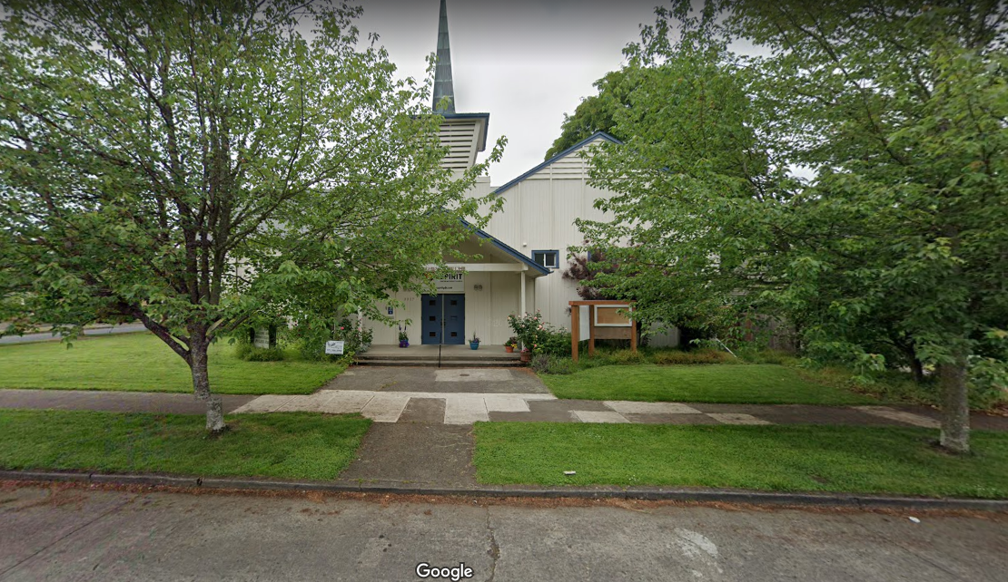
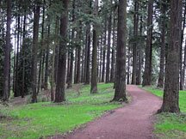
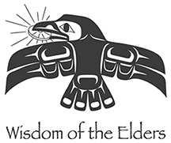
CWSP Grantees FY21-22
Wisdom of the Elders
Friends of Pier Park
Notes:
Wisdom of the Elders: Great Spirit Urban Garden will establish a pollinator garden with City Repair and students learning from a twelve-week internship with Indigenous educators.
Friends of Pier Park: Friends of Pier Park’s Understory Establishment Project will remove invasive plants and establish a native plants, selected with Indigenous partners and planting support from volunteers and ten neighborhood interns from Portland Tennis, who will receive stipends, and students from Sitton Elementary.

Slide 4
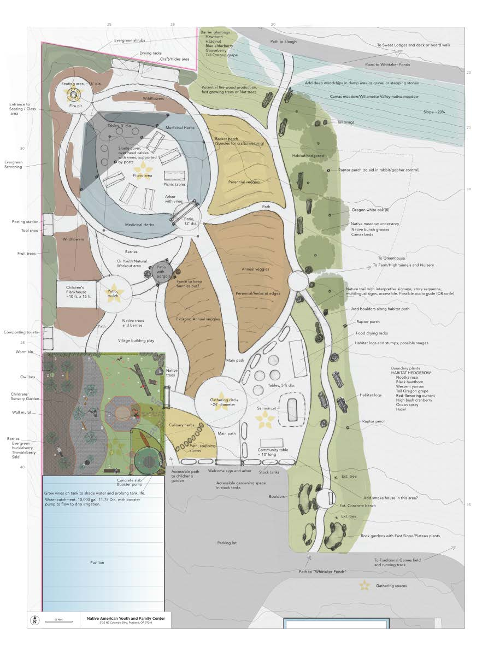
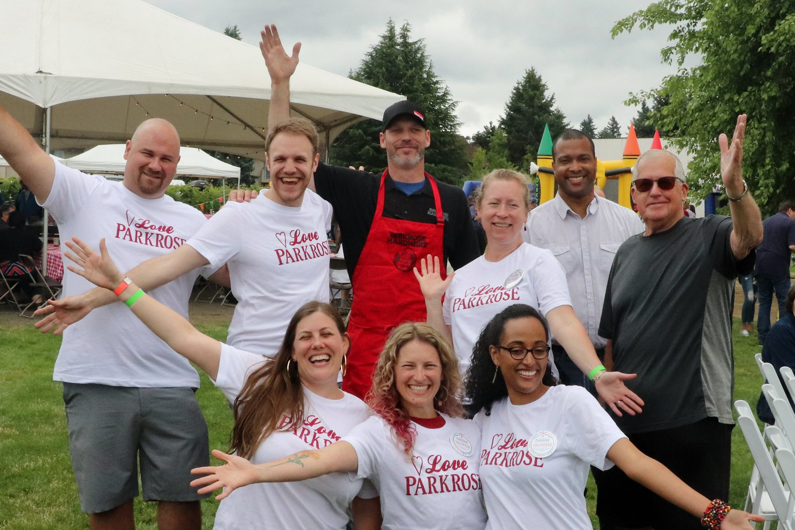
CWSP Grantees FY21-22
Historic Parkrose
NAYA Family Center
Notes:
Historic Parkrose: Parkrose’s Connecting Black & Brown Communities in Parkrose to the Columbia Slough Project will bring youth workshops oriented to the Slough, using the Historic Parkrose Greenspace Creation Team (youth).
NAYA Family Center: NAYA Family Center’s Community First Foods and Healing Project will help develop roof-top water harvesting as key step in establishing garden space to provide medicine and food gardens sought by the native community.

Slide 5
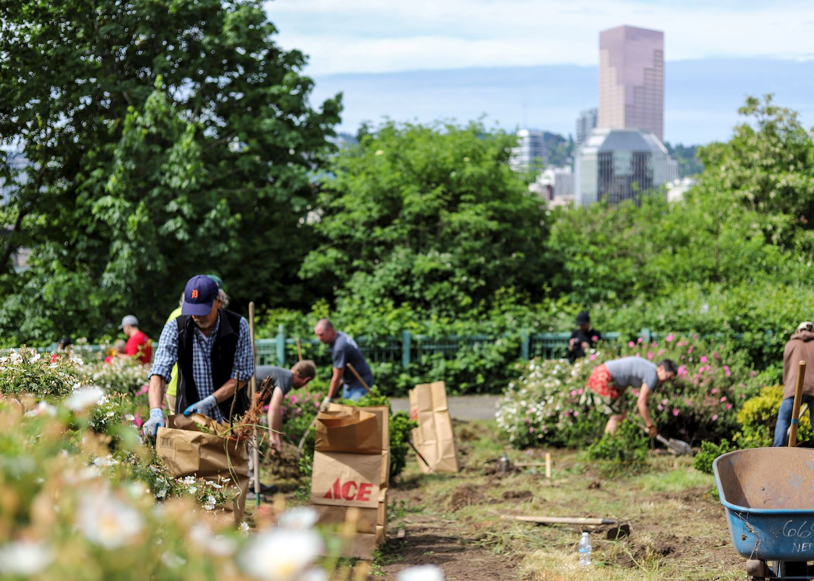
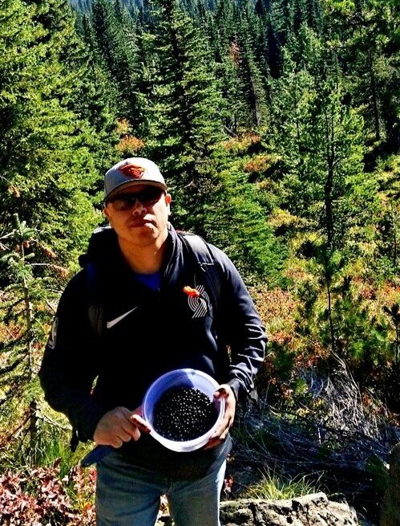
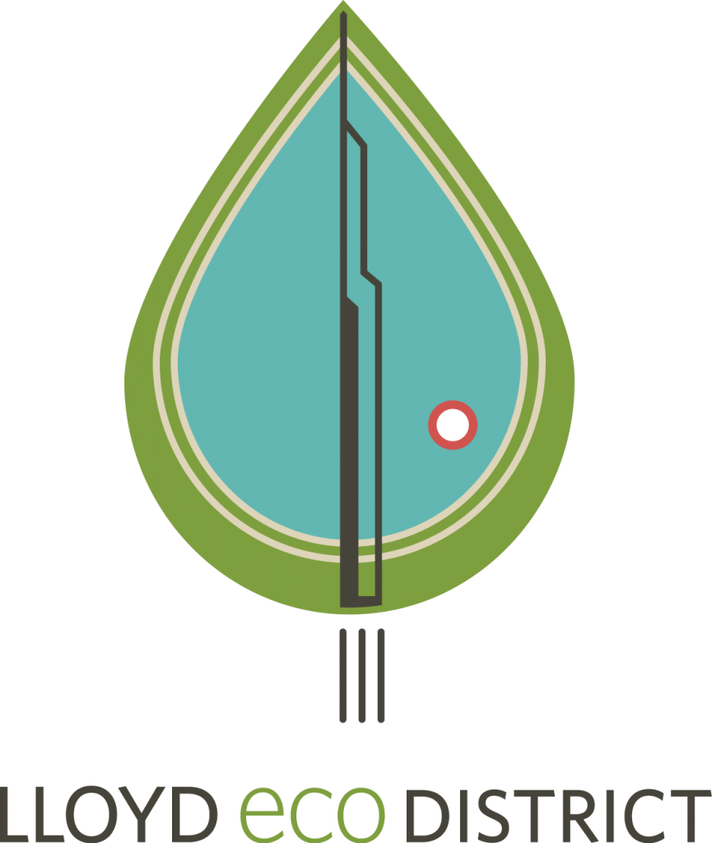
CWSP Grantees FY21-22
Lloyd EcoDistrict
Friends of Tryon Creek
Notes:
Lloyd Ecodistrict: Lloyd Eco District’s Peace Park Restoration. EcoDistrict and Veterans for Peace are collaborating to revitalize Peace Park, enlarging the current park’s message to tie together the messages of peace and pollinator protection. The project aims to create a space for teaching peace and justice through climate action.
Friends of Tryon Creek: Friends of Tryon Creek’s Healing Generations and Land Through Cultural Ecology builds authentic relationships between Indigenous communities, social service agencies and conservation partners to develop culturally inclusive environmental education programs, trauma informed healing practices and Indigenous restoration practices

Slide 6
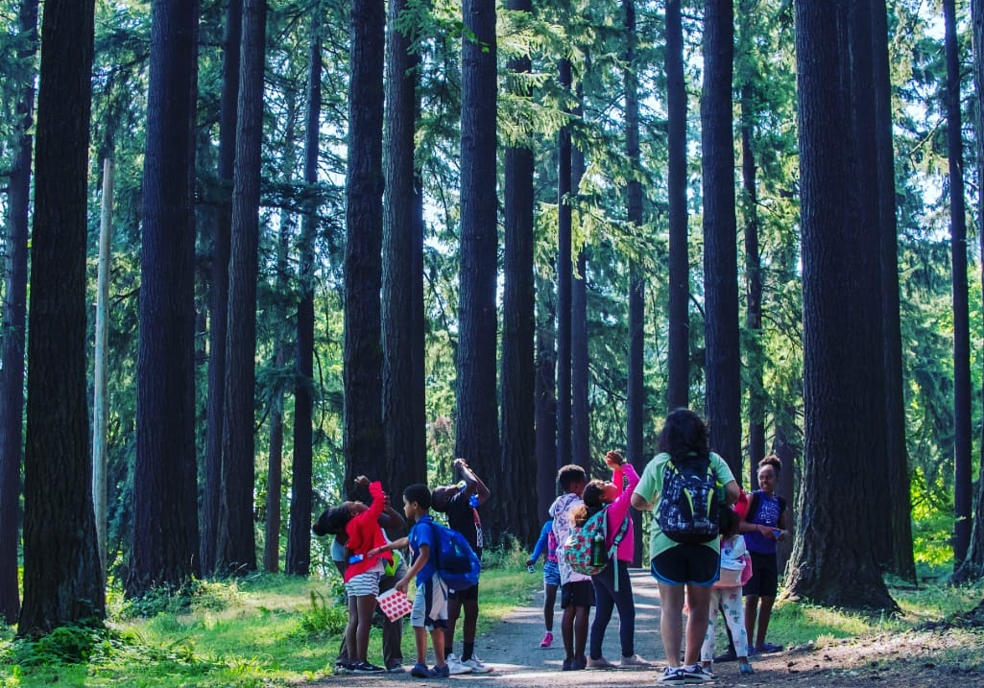
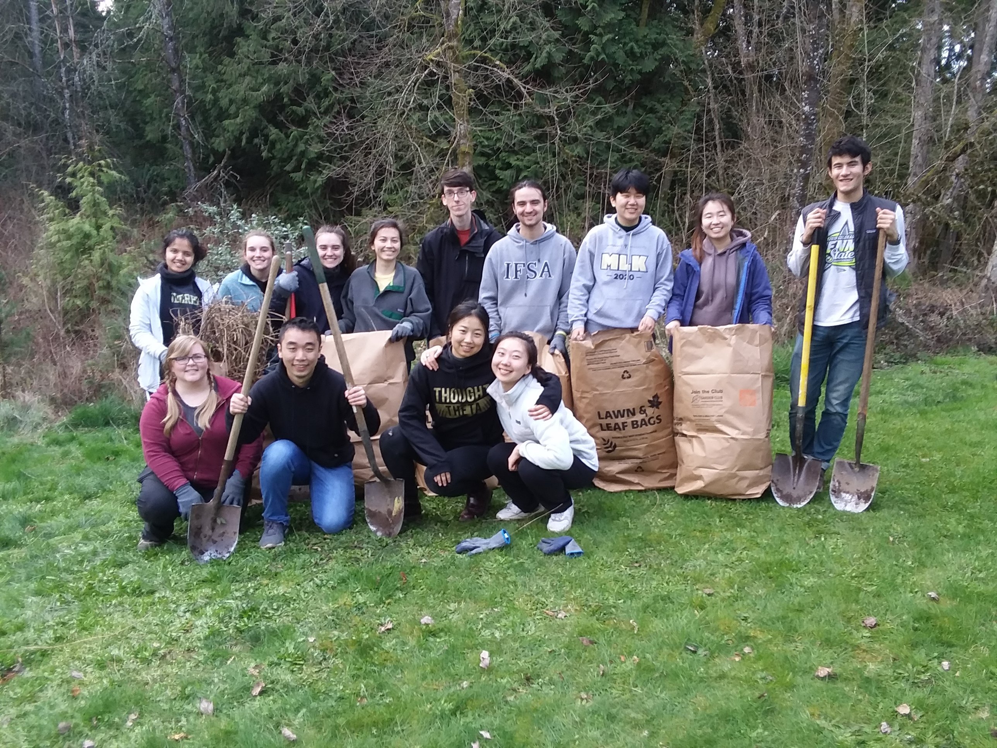
CWSP Grantees FY21-22
Camp ELSO
Tryon Creek Watershed Council
Notes:
Camp ELSO’s Wayfinders Program: Camp ELSO’s Wayfinders Camp sets out on a series of nature-based excursions that emphasize life science, ecology, community, and cultural history. Camp activities are co-led by Camp Guides and Tappin Roots Interns, who are high school and college aged youth of color.
Tryon Creek Watershed Council’s Mobile Training Program: Tryon Creek Watershed Council’s Mobile Training Program provides four-hour workshops combining restoration instruction with on-the-ground restoration practice. The workshop includes an introduction to watershed science & stewardship concepts serving westside immigrant communities.

