Slide 1
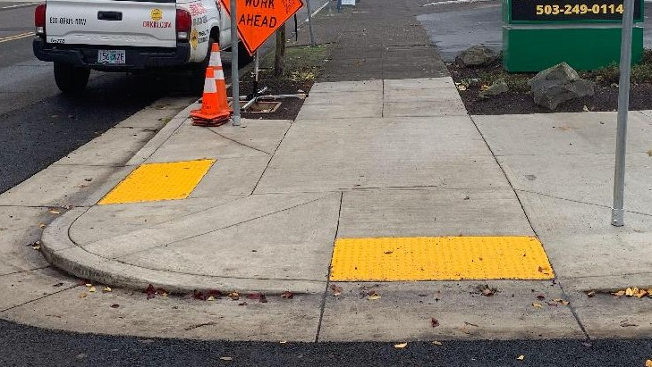
CREEC Consent Decree Update and Tie to ADA Transition Plan July 21, 2021

Slide 2
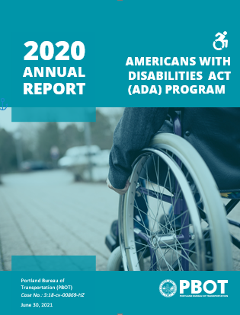
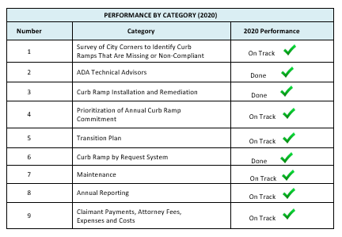
Annual Report

Slide 3
Consent Decree Requirement
Hines (CREEC) Settlement Agreement/Consent Decree and its relationship with the Transition Plan
by
Tim Fox, Esq.
Co-Executive Director
Civil Rights Education and Enforcement Center (CREEC)
Class Counsel
Tim Fox, CREEC
Martie Lafferty, CREEC
Linda Dardarian of Goldstein, Borgen, Dardarian & Ho
Matthew Serres, Disability Rights Oregon

Slide 4
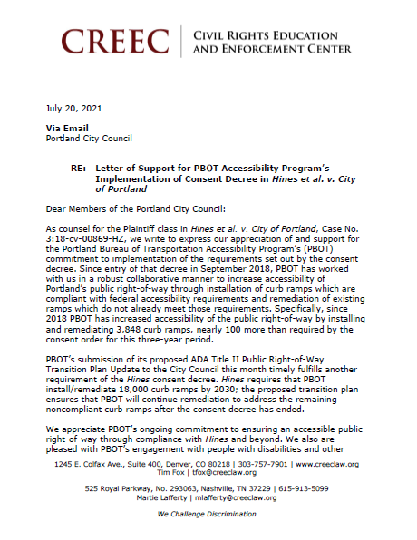
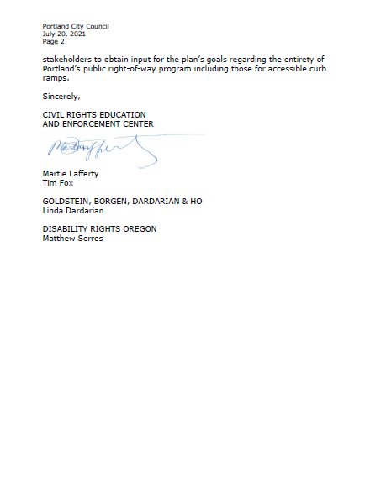
Letter of Support
Letter of Support

Slide 5
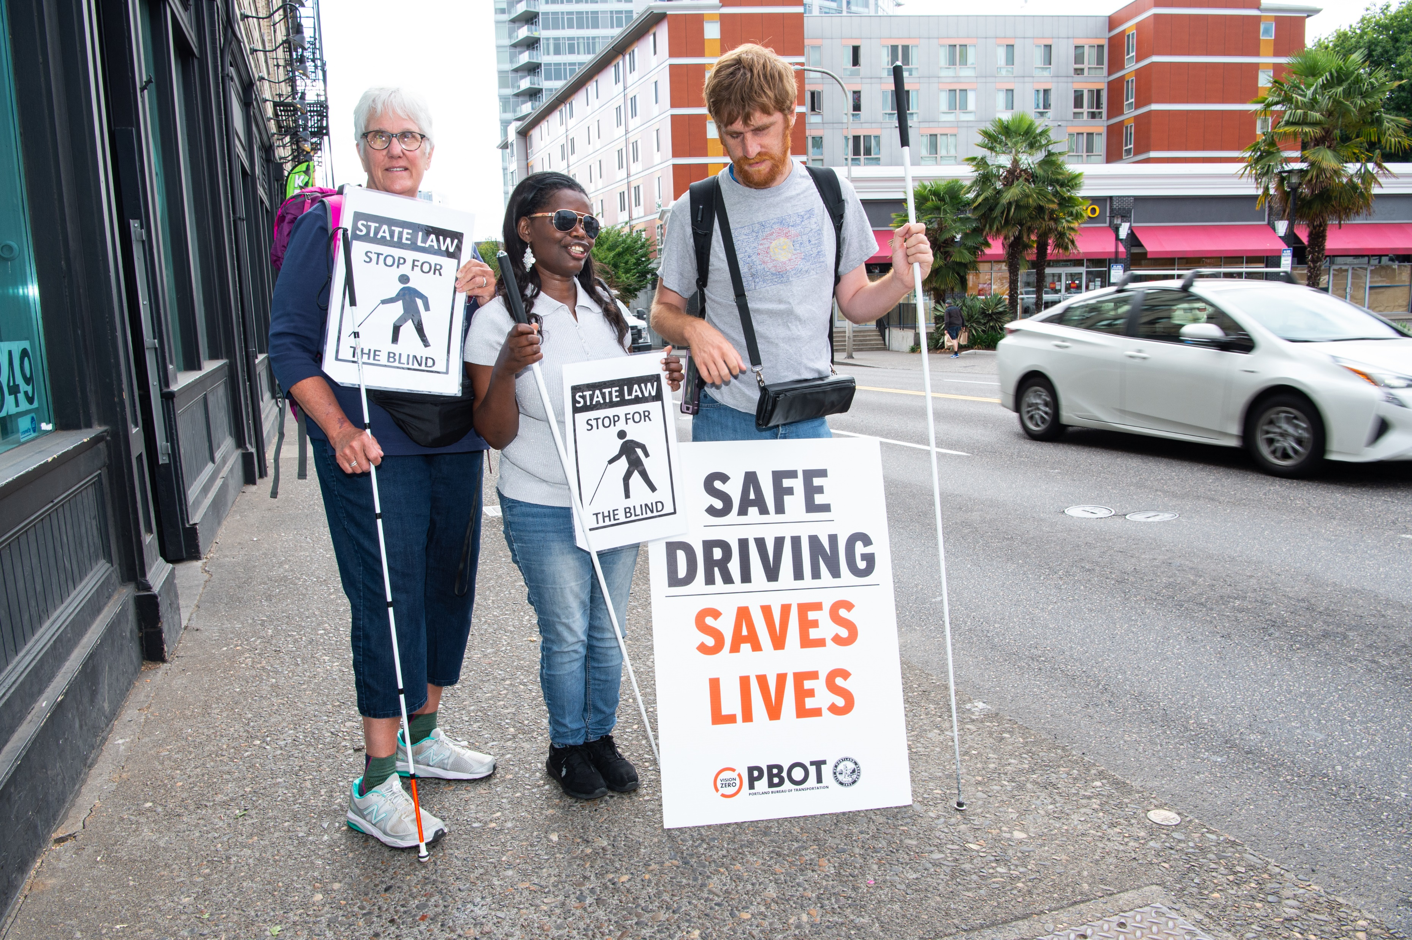
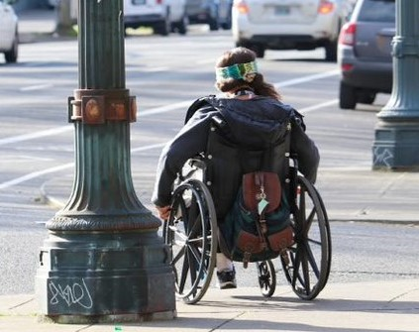
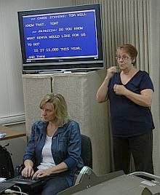
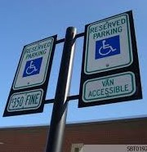
PBOT ADA Title II Public Right of Way Transition Plan Update City Council Presentation
July 21, 2021

Slide 6
What is a Transition Plan & Who Has to Have One?
Identifies how an entity will make everything it is responsible for, accessible to everyone.
Any state or local government with 50 or more employees.
Transportation part of the City’s transition plan until now.

Slide 7
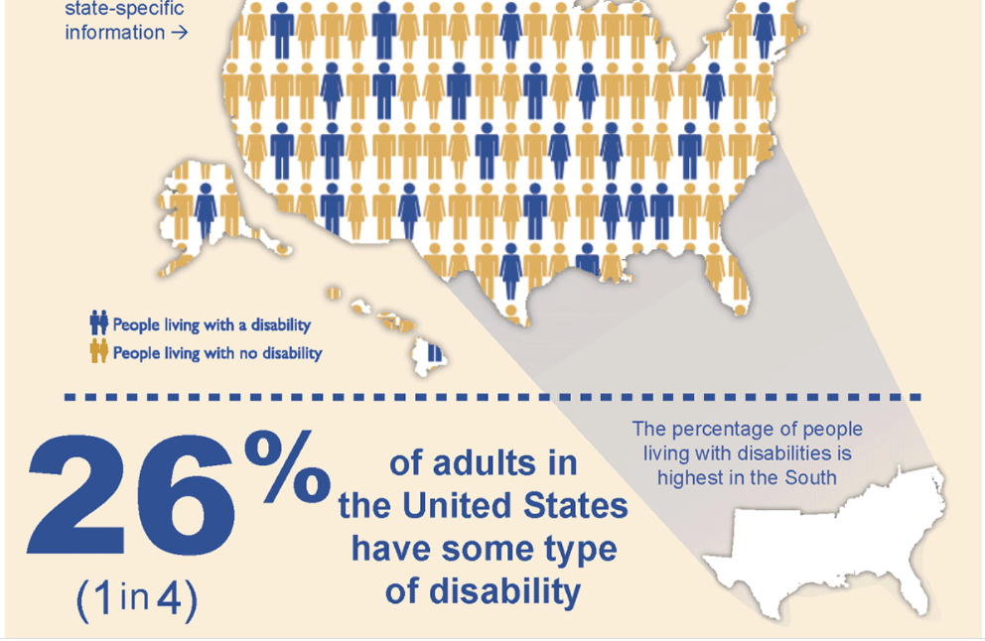
Adults with Disabilities

Slide 8
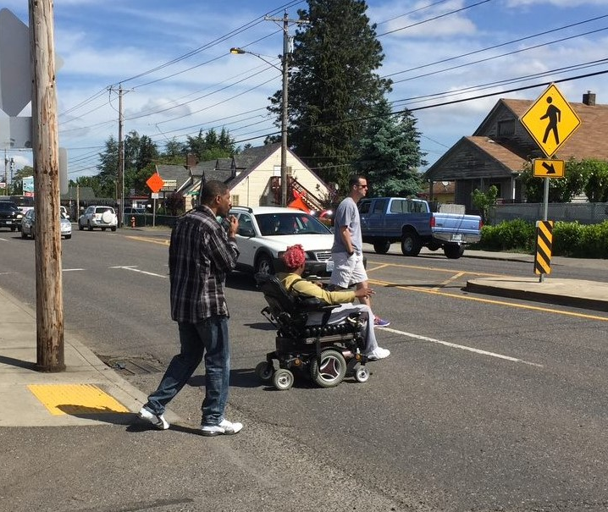
Mobility is the most common type of disability

Slide 9
Timeline and Engagement
August 25, 2020
Release fully accessible draft plan in 10 safe harbor languages to 150+ organizations
8/25/20 – 11/20/20
Public comment period with 6 open houses, 13 other presentations, interactive website, survey
Current
Plan updated based on comments, accessibility verified, translation

Slide 10
Comment Highlights
Proactive sidewalk policy
Consult before, during, after projects
Schedule to complete
Equity in historically underserved areas
Increase accessible parking
Transit Stops and transit
Coordination within PBOT & City
Safety
Cars parked too close to corners
Lighting
Consistency
Communication
Other uses on sidewalks
Notes:
Some comments reinforcing things we have heard before. Proactive sidewalk plan. PedPDX acknowledged that as well.
Accessible transit stops and transportation system is important to us both.

Slide 11
Elements of a Transition Plan
Identify barriers
Removing Barriers
Named Person
Complaint Process
Schedule/
Budget

Slide 12
PBOT Responsible for Public Right-of-Way Transportation System Elements
Curb Ramps
Pedestrian Signals
Sidewalks
Parking
Transit Stops
Full Program Access

Slide 13
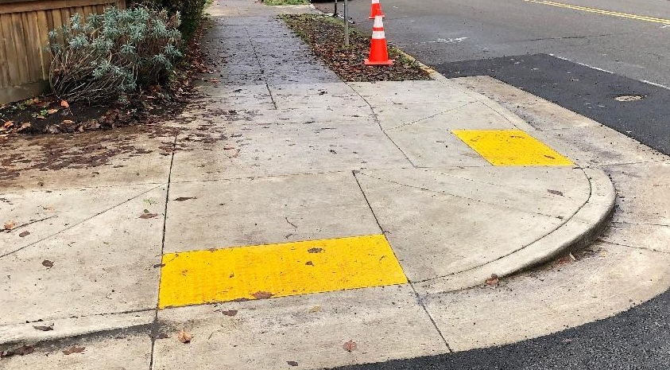
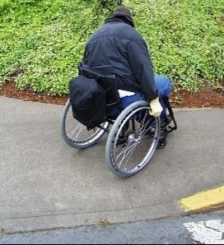
Compliant versus Non-Complaint Curb Ramps

Slide 14
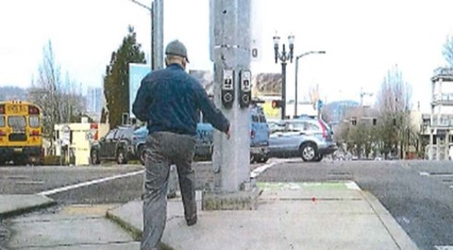
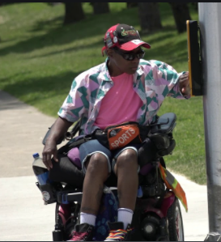
Non-Compliant versus Compliant Pedestrian Signals

Slide 15
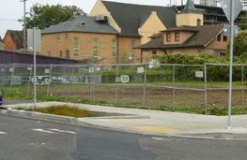
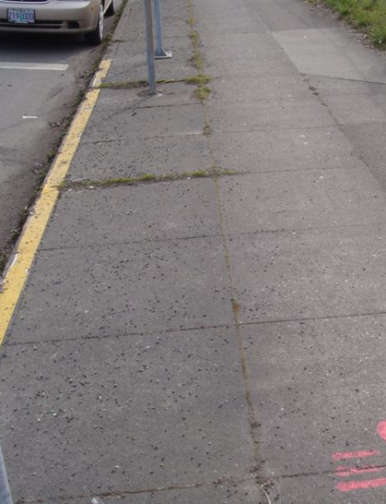
Compliant versus Non-Compliant Sidewalks

Slide 16
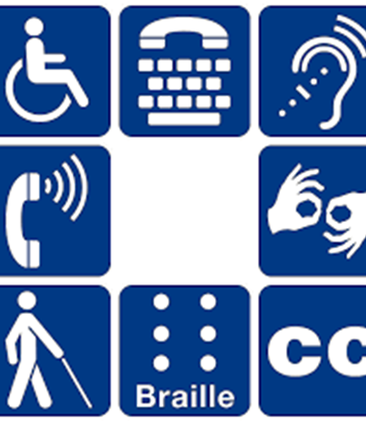
What Is Full Program Access?
Buildings
Documents & Forms
Transportation System
Communications
Employment
Meetings
Notes:
Describe slide
Explain contents

Slide 17
Implementation
Carry out 20-year implementation schedule
PBOT & other projects move the work of the transition plan
Community engagement
Review policies, practices, procedures
Collaborate with planning/design staff and review project plans
Report annually and update plan every 5-years

Slide 18
Early Actions
Ensure work included in projects
Evaluate to know more
Review policies and update as needed
Engage community

Slide 19
Planning for Accessibility

Slide 20
Maintenance Paving Project Completes Curb Ramps

Slide 21
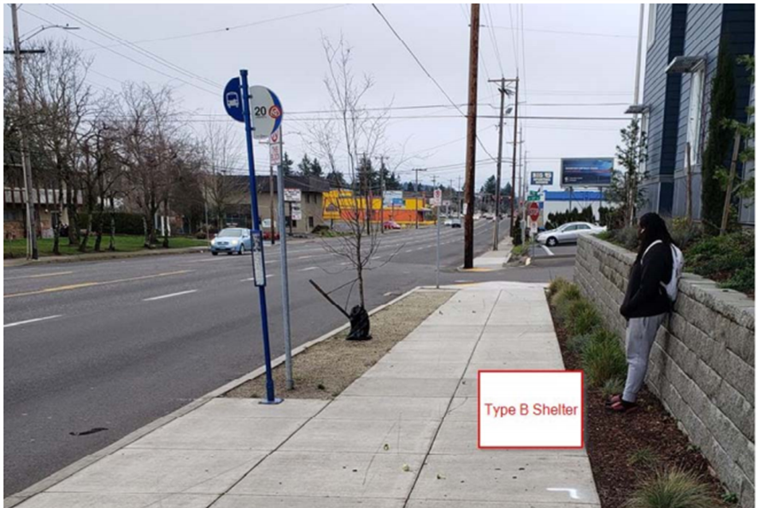
Developer Project Improves Transit Stop
Before
After

Slide 22
SRTS Crossing

Slide 23
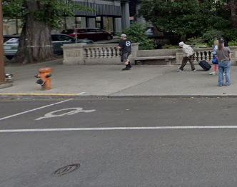
Accessible Parking Policy Update
User Focus Groups
Adding spaces
Updating policy
Location
Number
Project guidance
Van accessible

Slide 24
Questions?
https://www.portland.gov/transportation/planning/adatransitionplan

