Slide 1
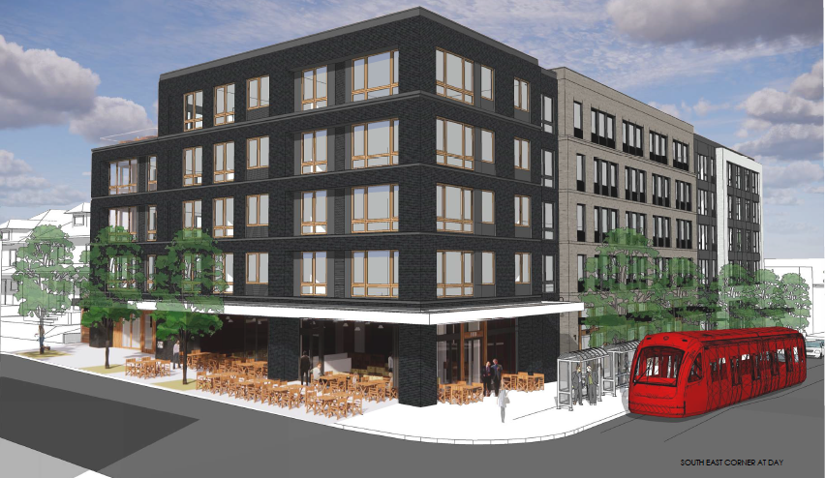
City of Portland
City Council
Appeal - Type III Land Use
LU 20-123610 DZM
NW 23rd & Marshall
July 14, 2021
Staff Presentation
Notes:
Good afternoon Mayor & Council members
Grace Jeffreys – City Planner with Design & Historic Review Team, in the Land Use Services division at BDS
I am here to present the T3 LU appeal for NW 23rd and Marshall Apartments

Slide 2
Appeal Hearing
City Council Appeal Hearings Process
For Evidentiary/ De Novo Appeals
The order of appearance and time allotments is generally as follows:
Staff Report - 10 minutes
Appellant - 10 minutes
Supporters of Appellant - 3 minutes each
Principal Opponent of the Appeal - 15 minutes
Other Opponents of the Appeal - 3 minutes each
Appellant Rebuttal - 5 minutes
Council Discussion

Slide 3
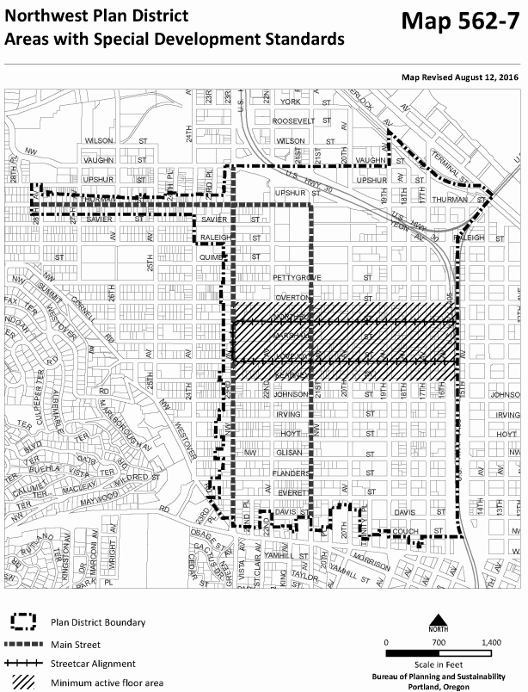
Zoning
Northwest Plan District
Also:
Main Street, NW 23rd (yellow)
Streetcar Alignment (hatched).
Notes:
The site (shown in red) is located at the western edge of the Northwest Plan District fronting NW 23rd Avenue (shown in yellow) .
In this location, NW 23rd is designated a Main Street and is on a Streetcar Alignment (shown as hatched).

Slide 4
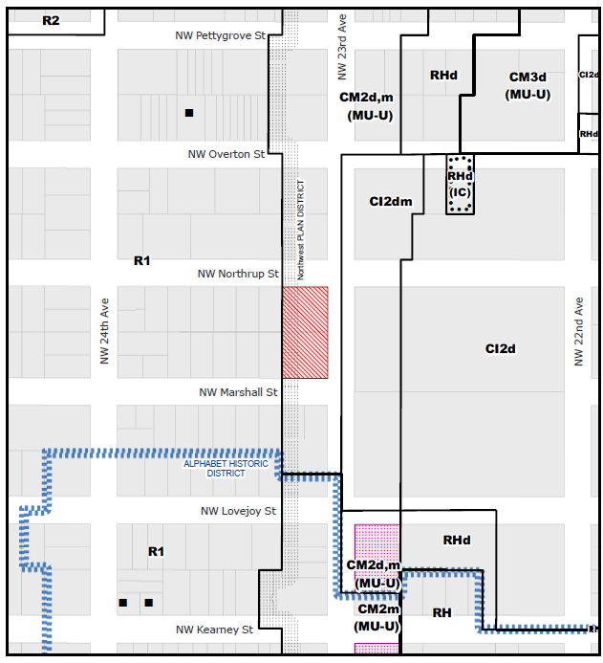
NW 23rd
Zoning
Base Zone:
CM2 - Commercial/ Mixed Use 2
Overlays:
d - Design
m - Centers Main Street
Adjacencies:
R1 - Residential Multi-Dwelling 1 to west
Zoning Map
Notes:
This is a zoning map. The site, indicated in red, is zoned Commercial/ Mixed Use 2 with Design and Centers Main Street overlays.
The added shading denotes commercial zoned areas in orange, focused on NW 23rd and the streetcar streets headed east, and residential zoned areas in green, which you can see include the areas directly west of the site and NW 23rd.

Slide 5
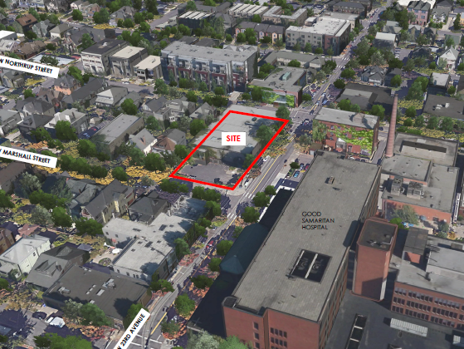
Context
Site has a full block frontage on NW 23rd, a commercial focus for district
The streetcar wraps NW 23rd here.
East across NW 23rd is the 6-story Good Sam
West is the Nob Hill residential area.
NW 23rd
Nob Hill Residential Area
Streetcar line
NW 23rd
Good Samaritan Hospital
Notes:
The site has a 200 feet long, full block frontage on NW 23rd, and lies between NW Marshall and NW Northrup Streets.
NW 23rd Avenue is a pedestrian oriented, commercial focus for the Northwest Plan District.
The streetcar wraps NW 23rd in this location.
To the east of the site across NW 23rd is the 6-story Good Samaritan Hospital.
To the west of the site is the Nob Hill Residential area.

Slide 6
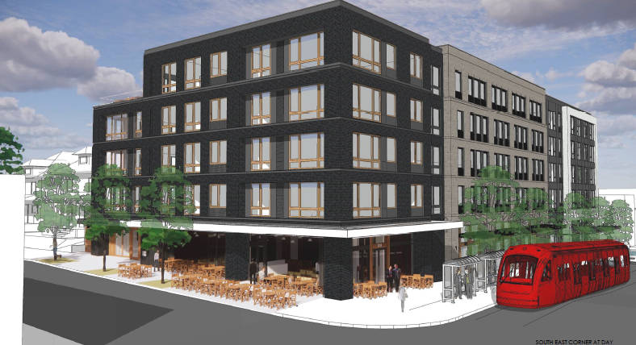
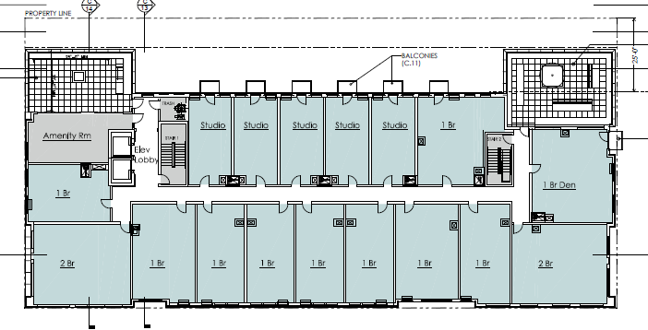
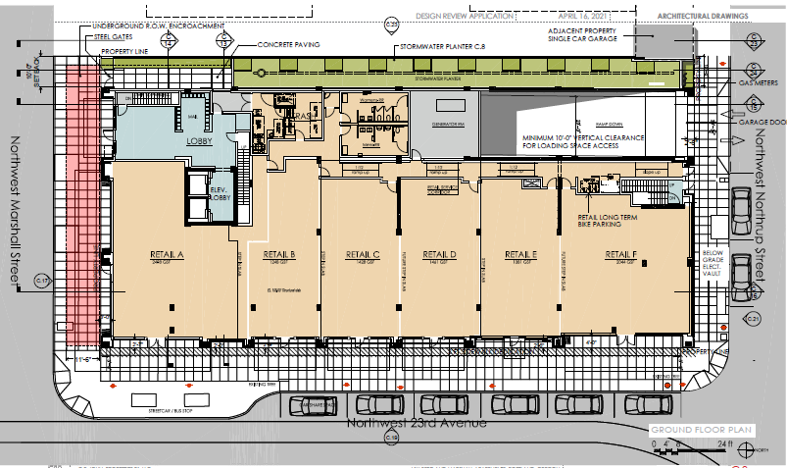
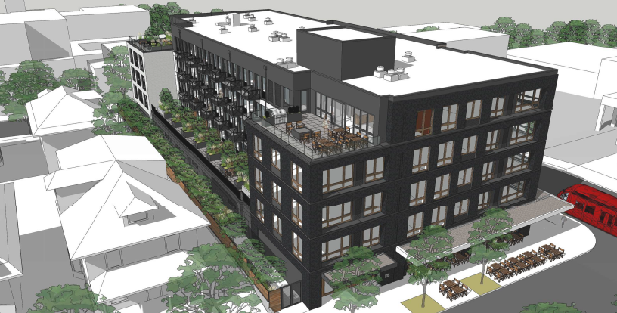
Program Overview
5-stories, mixed-use
10,000 sf Ground floor retail
74 residential units above
44 below-grade parking spaces, off Northrup
Amenities include private and communal terraces
Residential units above
East side facing NW 23rd
Ground Level (retail)
West side facing residential zone
Notes:
The applicant seeks Type III design review approval for a 5-story, mixed-use building on this site with:
10,000 sf of Ground floor retail
74 residential units in the 4 floors above,
44 below-grade parking spaces, which are accessed off NW Northrup
Resident amenities include private and communal terraces and decks
East side view (upper right image) faces NW 23rd
West Side view (lower right image) faces the Nob Hill Residential area. You can see the masing of the building has been stepped back from the west property line in a U shape.

Slide 7
Approval Criteria
Design Review
Community Design Guidelines
Modifications
Four (4) Modifications - PZC Section 33.825.040
Reduce width of vertically hung bike parking spaces.
Locate main residential entrance away from the Transit Street.
Alter landscape screening due to substantial grade differences.
Reduce depth of two vehicle parking stalls.
Notes:
In this location, the approval criteria for a Design Review are the Community Design Guidelines.
For the four modification to zoning code requests added to this review, the approval criteria are PZC Section 33.825.040.

Slide 8
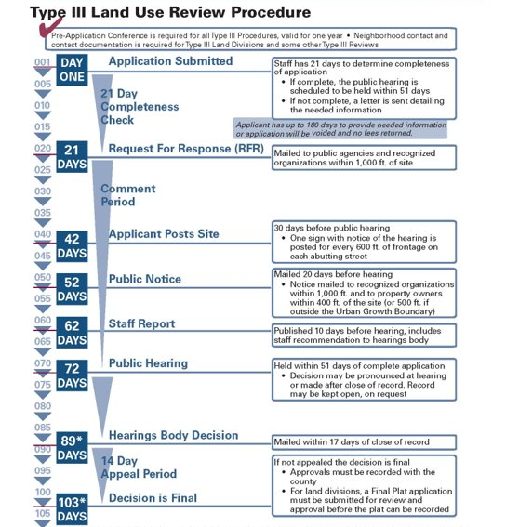
Review Procedure
LU 20-123610 DZM
Submitted - February 26, 2020
Effective Code - December 2019
Hearing Scheduled - October 15, 2020, postponed by applicant.
Public Hearing and approval - May 6, 2021
Appealed by NWDA - June 4, 2021
Notes:
The project has gone through a Type III Design Review. Consistent with reviews of this type, feedback was solicited from interagency partner bureaus, as well as the public. The site was posted with images and a description of the proposal, the contact information for the staff planner and the applicant; and a mailed notice was sent out to nearby registered organizations as well as neighboring residents.
A public Hearing was held on May 6, 2021, and at that hearing the Design Commission approved the project.
That decision of approval was then Appealed by NWDA on June 4, 2021

Slide 9
Project History
Design Commission Deliberation
Context. The design responded well to the different adjacent contexts of streetcar commercial area to the east and residential to the west.
Public realm. The active ground floor use and storefront designs enhanced the three street frontages.
Quality and Permanence. The quality materials and thoughtful details complemented the rich textures of the district.
Decision: Design Commission approved Design Review with Modifications.
Public Interest
9 written comments plus public testimony at hearing. Primary concerns, related to the approval criteria, focused on a lack of step back at the upper (fifth) story.
Notes:
At the May 6th Design Commission hearing, the commission considered whether the proposal met the guidelines. They felt that:
Context. The design responded well to the different adjacent contexts of streetcar commercial area to the east and residential to the west.
Public realm. The active ground floor use and storefront designs enhanced the three street frontages.
Quality and Permanence. The quality materials and thoughtful details complemented the rich textures of the district.
The Commission found that the proposal met all the relevant guidelines, and therefore approved the Design Review with Modifications.
Public interest included 9 written comments plus public testimony at hearing. Primary concern, related to the approval criteria, focused on a lack of step back at the upper (fifth) story.

Slide 10
Appeal
By the NW District Association
CDG P.1 - Step backs at the street facade
Appeal
The NWDA appealed the decision. In their appeal statement, they listed their concerns as follows:
The Staff Report Finding for Community Design Guideline P1. Plan Area Character, P1.1 Urban Character: District-wide Considerations does not address the content of the subject guideline regarding step backs at the street facade, and inappropriately refers to a) required step backs on other facades, and b) parapet and cornice detailing, both of which are irrelevant to complying with this guideline.
Notes:
The NWDA appealed the decision of approval. In their appeal statement, they listed their concern as follows:
The Staff Report Finding for Community Design Guideline P1. Plan Area Character, P1.1 Urban Character: District-wide Considerations does not address the content of the subject guideline regarding step backs at the street facade, and inappropriately refers to a) required step backs on other facades, and b) parapet and cornice detailing, both of which are irrelevant to complying with this guideline.

Slide 11
Appeal
By the NW District Association
CDG P.1 - Step backs at the street facade
Notes:
Before I jump into this specific issue, I’ll begin with some background information.
First – a review of the Design Review process, followed with how the design guidelines are intended to be used, and then finally to guideline P1.
For a design review, staff, and our volunteer Design Commission, weigh proposals put forward by applicants against the relevant design guidelines for that site. During the design review process, we study the surrounding context of each specific site to inform our review.
If a proposal is found to meet the design guidelines it is approved. If the proposal does not yet meet the guidelines, we work with applicants to refine the design to ensure it does meet guidelines, or, we can deny the proposal.
For this review, the approval criteria are the Community Design Guidelines.

Slide 12
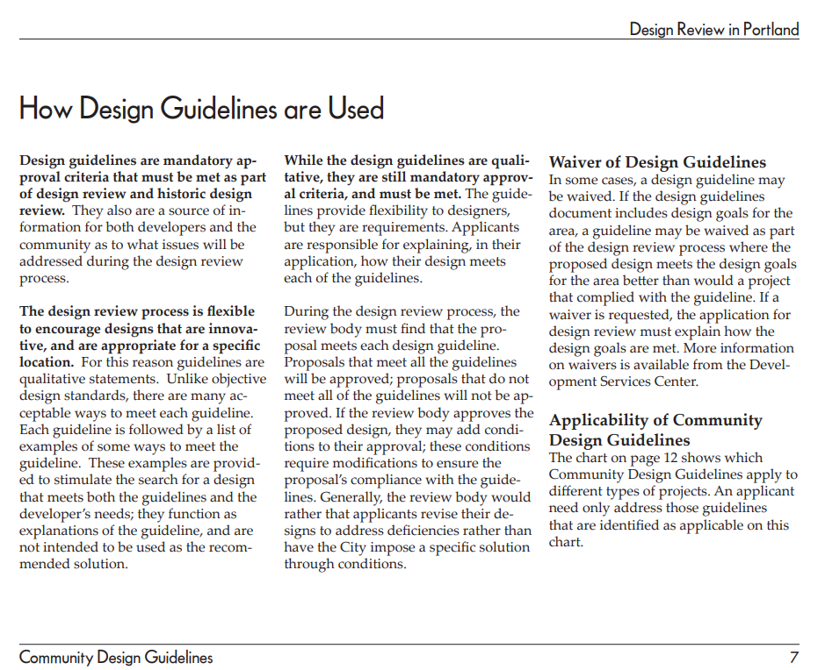
Appeal
By the NW District Association
CDG P.1 - Step backs at the street facade
From How Design Guidelines are Used
“The design review process is flexible to encourage designs that are innovative and are appropriate for a specific location. For this reason, guidelines are qualitative statements. Unlike objective design standards, there are many acceptable ways to meet each guideline.”
Notes:
Direction on how the guidelines are intended to be used can be found in the introduction to the CDG. It notes that while the design guidelines are mandatory approval criteria that must be met as part of a design review, it also notes that the design review process is designed to be “flexible to encourage designs that are innovative and are appropriate for a specific location”. And, unlike objective design standards, there are many acceptable ways to meet each guideline.”

Slide 13
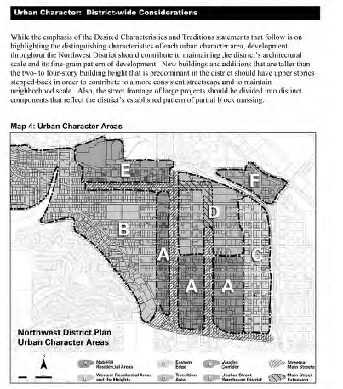
P1. Plan Area Character.
“Enhance the sense of place and identity by incorporating site and building design features that respond to the area’s desired characteristics and traditions.”
Appeal
By the NW District Association
CDG P.1 - Step backs at the street facade
Appendix J - Excerpt from Northwest District Plan, Amended Design Guidelines – Desired Characteristics and Traditions:
P1.1 District-wide Considerations (general)
P1.2 Streetcar Main Streets (area specific)
Architecture
Urban Pattern
Desired Characteristics and Traditions
Notes:
The guideline center to this appeal is Guideline P1. Plan Area Character, which asks proposals to “Enhance the sense of place and identity by incorporating site and building design features that respond to the area’s desired characteristics and traditions.”
GL P1 references Appendix J for the desired characteristics and traditions within the Northwest District Plan area.
Appendix J then provides general District-wide Considerations, shown here, which are intended to give a general sense of the qualities of the district, however, these are not area specific.
For each of the different areas that make up the NWPD, more specific considerations are provided. This site, shown in red, is in the Streetcar Main Streets area.

Slide 14
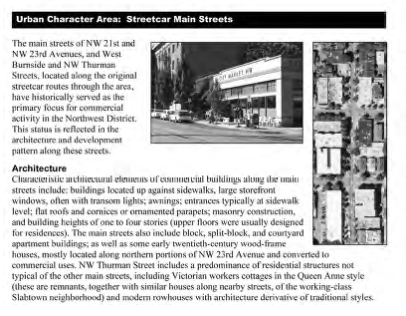
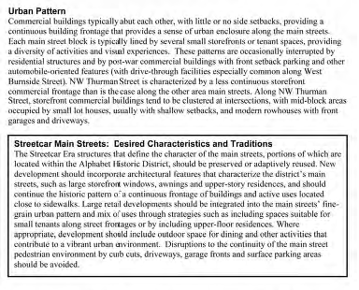
P1. Plan Area Character.
“Enhance the sense of place and identity by incorporating site and building design features that respond to the area’s desired characteristics and traditions.”
Appeal
By the NW District Association
CDG P.1 - Step backs at the street facade
Appendix J - Excerpt from Northwest District Plan, Amended Design Guidelines – Desired Characteristics and Traditions:
P1.1 District-wide Considerations (general)
P1.2 Streetcar Main Streets (area specific)
Architecture
Urban Pattern
Desired Characteristics and Traditions
Notes:
For new development of a site in the Streetcar Main Streets area, more specific direction is provided under Architecture, Urban Pattern and Desired Characteristics and Traditions.
All these factors, the general district wide and the area specific, provide guidance on how to meet guideline P1 and “Enhance the sense of place and identity” for development on this site.

Slide 15
P1. Plan Area Character.
“Enhance the sense of place and identity by incorporating site and building design features that respond to the area’s desired characteristics and traditions.”
Appeal
By the NW District Association
CDG P.1 - Step backs at the street facade
Appendix J - Excerpt from Northwest District Plan, Amended Design Guidelines – Desired Characteristics and Traditions:
P1.1 District-wide Considerations (general)
P1.2 Streetcar Main Streets (area specific)
Architecture
Urban Pattern
Desired Characteristics and Traditions
New buildings and additions that are taller than the two to four-story building height that is predominant in the district should have the upper stories stepped back in order to contribute to a more consistent streetscape and to maintain neighborhood scale.
Notes:
The appeal points to one aspect of the more general District-wide considerations, which asks that “New buildings and additions that are taller than the two to four-story building height that is predominant in the district should have the upper stories stepped back in order to contribute to a more consistent streetscape and to maintain neighborhood scale.

Slide 16
Appeal
By the NW District Association
CDG P.1 - Step backs at the street facade
The Commission found that the proposal met Guideline P1 in numerous ways:
The predominately brick clad building has a split-block massing, with storefront windows, canopies to protect pedestrians and outdoor dining opportunities, reflecting the “district’s architectural scale and its fine-grain pattern of development”.
A highly active ground floor with upper story residences continues “historic use patterns of the district” and contributes to a “more consistent streetscape”.
While the upper fifth-floor is not “stepped back” from NW 23rd, four-story building height datum is addressed to “maintain a consistent streetscape and neighborhood scale”.
On balance, the proposed design contributed to a more consistent streetscape and helped better maintain neighborhood scale for this specific site by locating the massing east toward NW 23rd, facing the commercial area, streetcar line, and the six-story hospital across the street, rather than shifting it closer towards the smaller-scaled residential area to the west.
Notes:
In their deliberations and findings, the Commission found that the proposal met GL P1. Plan Area Character in numerous ways.
The predominately brick clad building has a split-block massing, with tall storefront windows, canopies to protect pedestrians and generous outdoor dining opportunities, reflecting the “district’s architectural scale and its fine-grain pattern of development”.
A highly active ground floor with upper story residences continues “historic use patterns of the district” and contributes to a “more consistent streetscape”.
While the upper, 5th floor is not “stepped back” from NW 23rd, the four-story building height datum is addressed to “maintain a consistent streetscape and neighborhood scale”.
The Commission found that, on balance, the proposed design contributed to a more consistent streetscape and helped better maintain neighborhood scale, for this specific site, by locating the 5-story massing east toward NW 23rd facing the commercial area, the streetcar line, and the six-story hospital across the street, rather than shifting it closer towards the smaller-scaled residential area to the west.

Slide 17
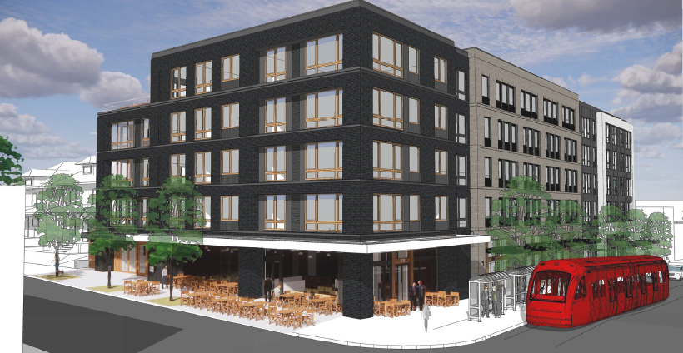
City Council Alternatives
Deny the appeal and uphold the Design Commission’s decision of approval with conditions.
Deny the appeal but modify the Design Commission’s decision of approval with conditions and instruct the applicant to revise the design and return to Council at a future date.
Grant the appeal, thereby overturning the Design Commission’s decision to approve with conditions. In this case, the project would be denied.
Notes:
As the deciding body, you have three options before you today.
Deny the appeal and uphold the Design Commission’s decision of approval with conditions.
Deny the appeal but modify the Design Commission’s decision of approval with conditions and instruct the applicant to revise the design and return to Council at a future date.
Grant the appeal, thereby overturning the Design Commission’s decision to approve with conditions. In this case, the project would be denied.
This is the end of my slide show, and I welcome your questions.

Slide 18
Questions?

Slide 19
Background References

Slide 20
Appeal
By the NW District Association
CDG P.1 - Step backs at the street facade
The Commission found that the proposal met guideline P1 in numerous ways:
The predominately brick clad building has a split-block massing, with tall storefront windows, canopies to protect pedestrians and generous outdoor dining opportunities, reflecting the “district’s architectural scale and its fine-grain pattern of development”.
A highly active ground floor with upper story residences continues “historic use patterns of the district” and contributes to a “more consistent streetscape”.
While the upper fifth-floor is not “stepped back” from NW 23rd, the four-story building height datum is addressed to “maintain a consistent streetscape and neighborhood scale”.
On balance, the proposed design also contributed to a more consistent streetscape and helped better maintain neighborhood scale for this specific site by locating the massing east toward NW 23rd, facing the commercial area, streetcar line, and the six-story hospital across the street, rather than shifting it closer towards the smaller-scaled residential area to the west.
Notes:
In their deliberation and findings, the Commission found that the proposal met GL P1. Plan Area Character.
in numerous ways.
The predominately brick clad building has a split-block massing, with tall storefront windows, canopies to protect pedestrians and generous outdoor dining opportunities, reflecting the “district’s architectural scale and its fine-grain pattern of development”.
A highly active ground floor with upper story residences continues “historic use patterns of the district” and contributes to a “more consistent streetscape”.
While the upper, 5th floor is not “stepped back” from NW 23rd, the four-story building height datum is addressed to “maintain a consistent streetscape and neighborhood scale”. The Commission found that, on balance, the proposed design contributed to a more consistent streetscape and helped better maintain neighborhood scale, for this specific site, by locating the 5-story massing east toward NW 23rd facing the commercial area, the streetcar line, and the six-story hospital across the street, rather than shifting it closer towards the smaller-scaled residential area to the west.

Slide 21
Project History
Land Use Review
LU 20-123610 DZM
Submitted – February 26, 2020
Effective Code – December 18, 2019
Hearing Scheduled - October 15, 2020, postponed by applicant.
Public Hearing – May 6, 2021
Approved - May 6, 2021
Appealed - June 4, 2021
Extended 120-day date expiration – August 19, 2021

Slide 22
Appeal
By the NW District Association
CDG P.1 - Step backs at the street facade
Appendix J, P1.1 District-wide Considerations
Development throughout the Northwest District should contribute to maintaining the district’s architectural scale and its fine-grain pattern of development.
New buildings and additions that are taller than the two to four-story building height that is predominant in the district should have the upper stories stepped back in order to contribute to a more consistent streetscape and to maintain neighborhood scale.
Also, the street frontage of large projects should be divided into distinct components that reflect the district’s established pattern of partial block massing.
Notes:
Under P1.1 the general District-wide Considerations, among numerous other characteristics, it also notes that: “New buildings and additions that are taller than the two-to four-story building height that is predominant in the district should have upper stories stepped back in order to contribute to more consistent streetscape and to maintain neighborhood scale.”

Slide 23
Appeal
By the NW District Association
CDG P.1 - Step backs at the street facade
P1.4 Streetcar Main Streets: Desired Characteristics and Traditions
The proposal incorporates “features that characterize the district’s main streets, such as large storefront windows, awnings, and upper story residences”, and continues the “historic pattern of a continuous frontage of buildings and active uses located close to sidewalks”.
The proposal integrates “the main streets’ fine-grain urban pattern and mix of uses through strategies” by “including spaces suitable for small tenants along street frontages” as well as by “including upper-floor residences”.
The proposal includes “outdoor space for dining and other activities that contribute to a vibrant urban environment”.
The proposal avoids “disruptions to the continuity of the main street pedestrian environment by curb cuts, driveways, garage fronts and surface parking areas should be avoided” by locating parking below grade, and access to parking on Northrup away from NW 23rd.

Slide 24
Appeal
By the NW District Association
CDG P.1 - Step backs at the street facade
P1.1 District-wide Considerations
The proposal maintains “the district’s architectural scale and its fine-grain pattern of development” by breaking up the massing into three distinct blocks, each with its own brick colors and detailing, window configurations, ground floor storefront and canopy details.
The proposal provides “distinct components that reflect the district’s established pattern of partial block massing” by delineating the ground floor to accommodate a variety of retail tenant sizes.
While the proposal is “taller than the two-to four-story building height that is predominant in the district”, the proposal is within the allowable building height limit. Rather than stepping the upper stories back “in order to contribute to more consistent streetscape and to maintain neighborhood scale” design elements, in addition to those listed above, include parapet details and cornices to address the four-story building height datum.
Notes:
In response to the District-wide Considerations, the commission found that the proposal:
maintains the “district’s architectural scale and fine-grain pattern of development breaking up the massing into three distinct blocks
provides “distinct components that reflect the district’s established pattern of partial block massing” by delineating the ground floor to accommodate a variety of retail tenant sizes.
While the proposal is “taller than the two-to four-story building height that is predominant in the district”, the proposal is within the allowable building height limit. Rather than stepping the upper stories back “in order to contribute to more consistent streetscape and to maintain neighborhood scale” design elements, in addition to those listed above, include parapet details and cornices to address the four-story building height datum.

Slide 25
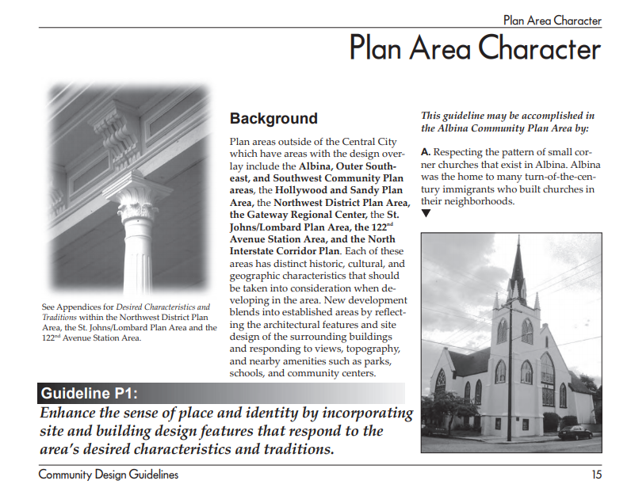
Appeal
By the NW District Association
CDG P.1 - Step backs at the street facade
Community Design Guideline P1. Plan Area Character.
“Enhance the sense of place and identity by incorporating site and building design features that respond to the area’s desired characteristics and traditions.”
Appendix J - Excerpt from Northwest District Plan, Amended Design Guidelines – Desired Characteristics and Traditions:
Notes:
Design Guideline P1. Plan Area Character. Plan Area Character directs proposals to consider distinct characteristics of an area when developing in that area. The guideline states: “Enhance the sense of place and identity by incorporating site and building design features that respond to the area’s desired characteristics and traditions.”
We are then directed to the Appendix J for the desired characteristics and traditions within the Northwest District Plan.

Slide 26
Guidelines

Slide 27
Approval Criteria
Design Review Community Design Guidelines

Slide 28
Approval Criteria
Design Review Community Design Guidelines
Decision
Approval
From How Design Guidelines are Used (CDG page 7)
“The design review process is flexible to encourage designs that are innovative and are appropriate for a specific location.”
“Each guideline is followed by a list of examples of … ways to meet the guidelines … provided to stimulate the search for a design that meets both the guidelines and the developer’s needs; they function as explanations of the guideline and are not intended to be used as the recommended solutions.”

Slide 29
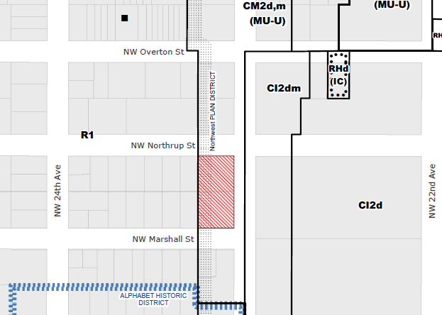
Approval Criteria
Design Review Community Design Guidelines
Under P1 Plan Area Character (page 15), Appendix J is listed as a reference for the NWPD, providing “Desired Characteristics and Traditions”. It is important to understand that these are desired characteristics rather than required design solutions.

Slide 30
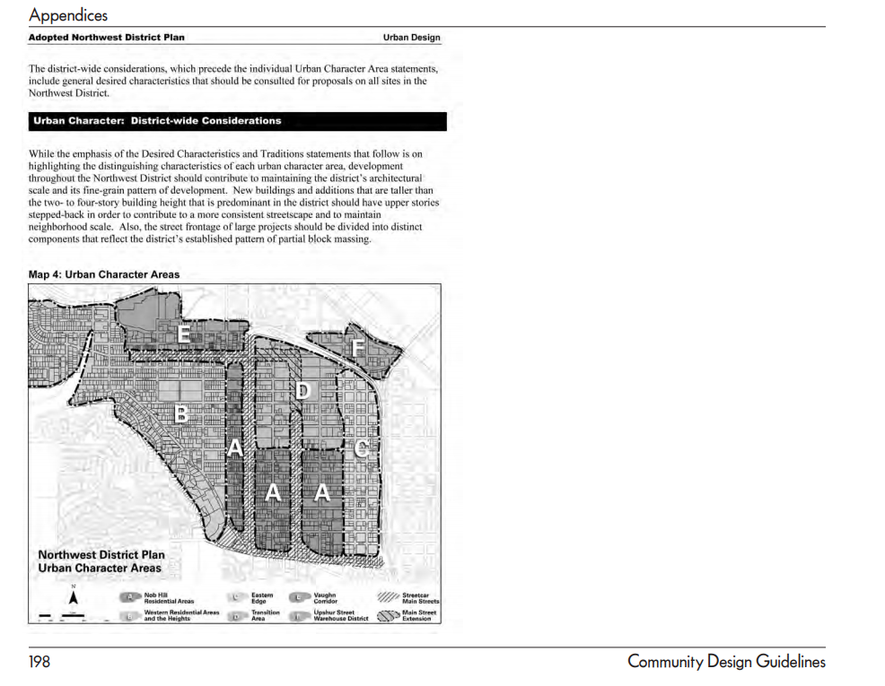
Approval Criteria
Design Review Community Design Guidelines
From CDG Appendix J: Excerpt from Northwest District Plan, Amended Design Guidelines – Desired Characteristics and Traditions (CDG page 198),
Under District-wide Considerations, it notes that “New buildings and additions that are taller than the two-to four-story building height that is predominant in the district should have upper stories stepped-back in order to contribute to a more consistent streetscape and to maintain neighborhood scale.”

Slide 31
Proposal

Slide 32
Zoning
Floor Area Ratio:
Std: 2.5:1 (4:1 w/ IH bonus)
Prop: 3.8:1
Height:
Std: 45’ (55’ w/ IH bonus)
Prop: 55’
Adjacencies:
Alphabet HD ½ block to the south
R1 (Residential Multi-Dwelling 1) to the west

Slide 33
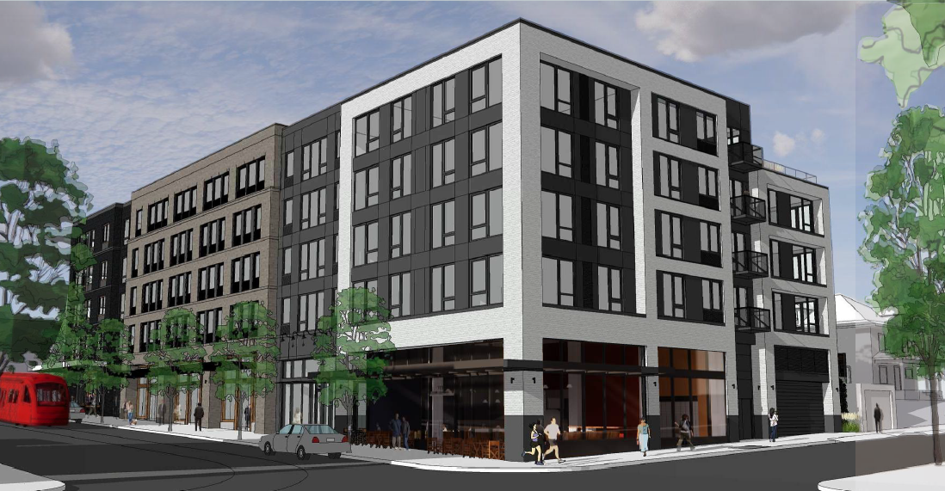
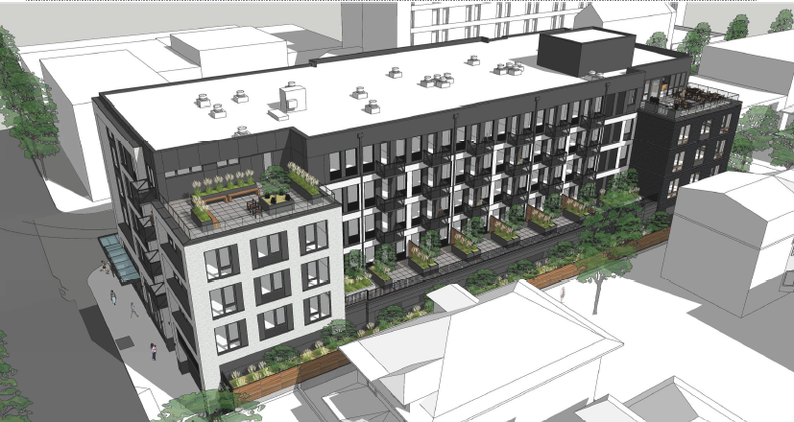
Program Overview
5-stories, Mixed-use
10,000 sf Ground floor retail
74 residential units above
44 parking spaces below-grade
Amenities include private and communal terraces
Views from the NW 23rd side (east)
Views from the residential side (west)

Slide 34
Context

Slide 35
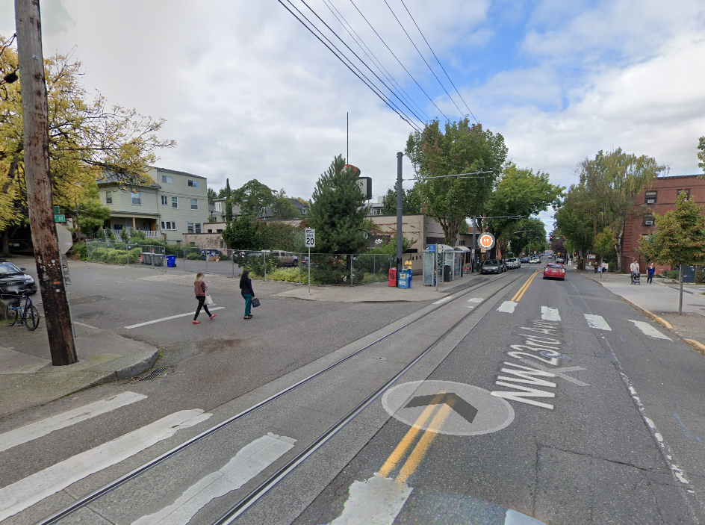
Context
View north on NW 23rd toward the site

Slide 36
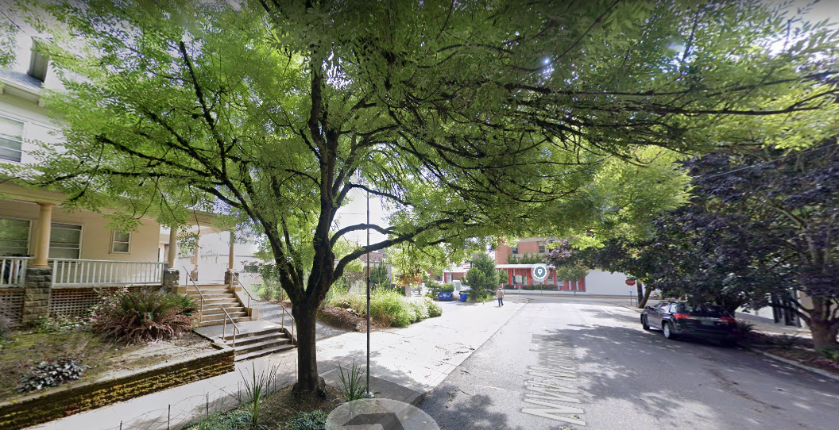
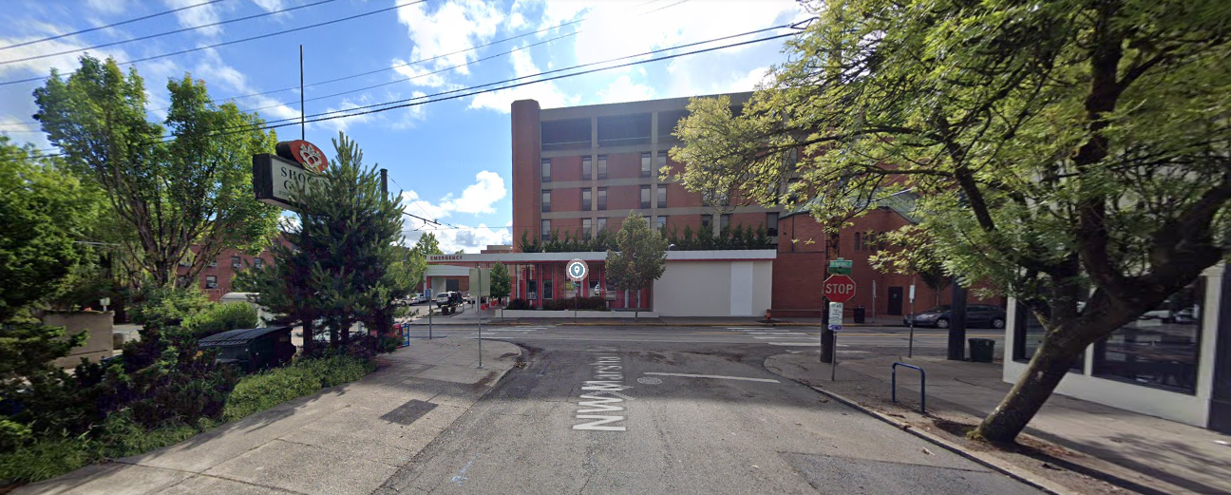
Context
Views east on Marshall

Slide 37
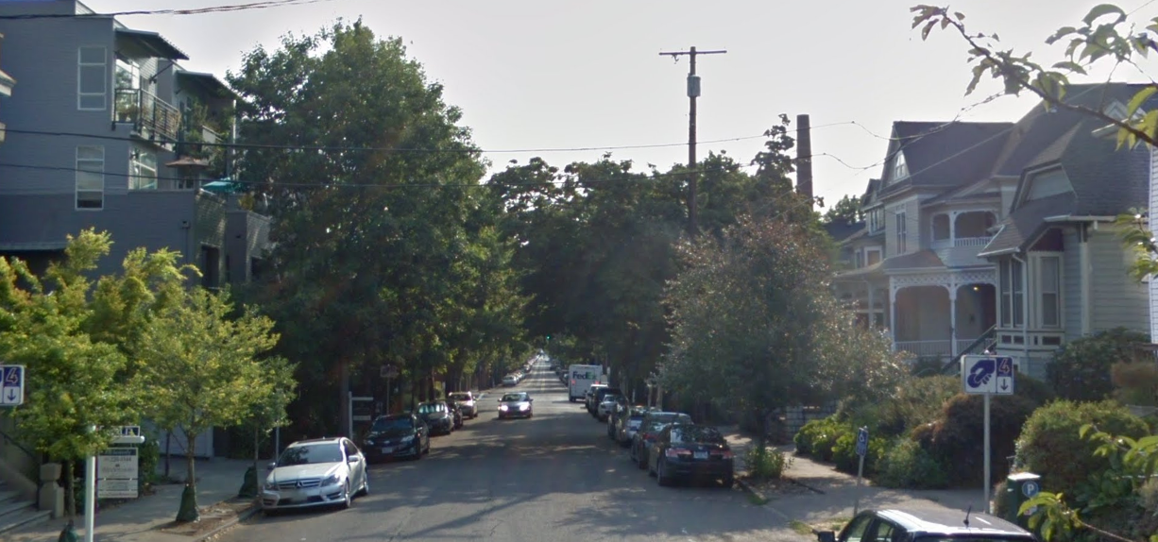
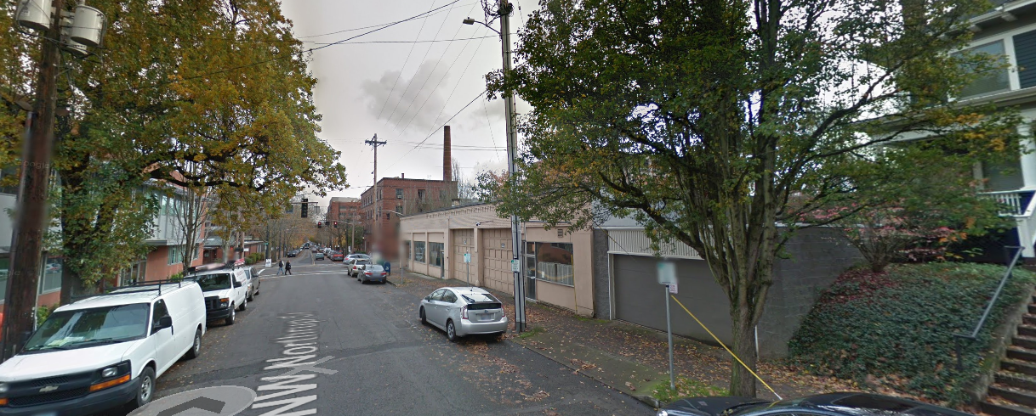
Context
Views east on Northrup

Slide 38
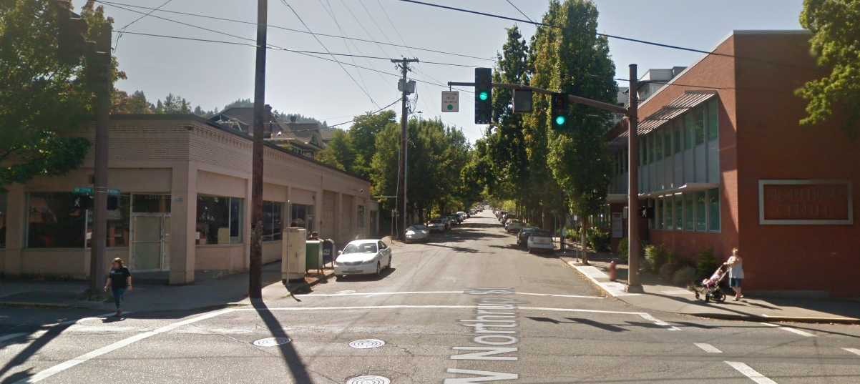
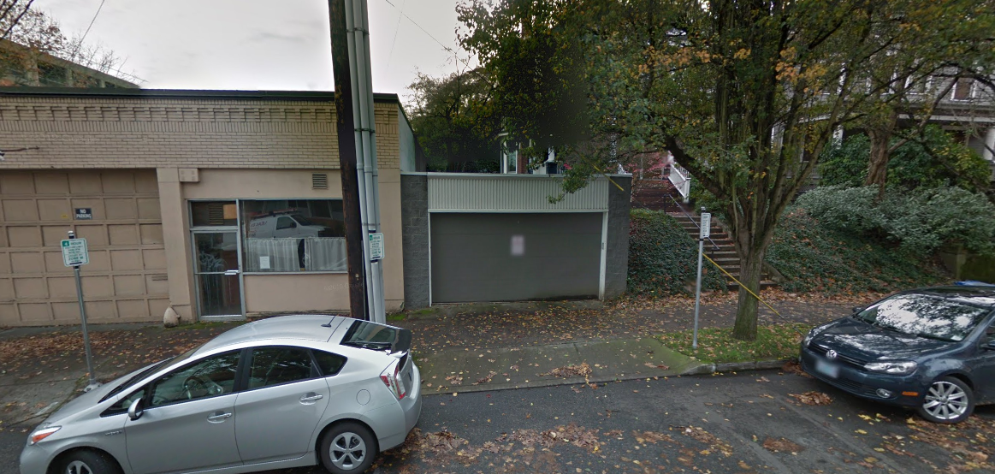
Context
Views west on Northrup

Slide 39
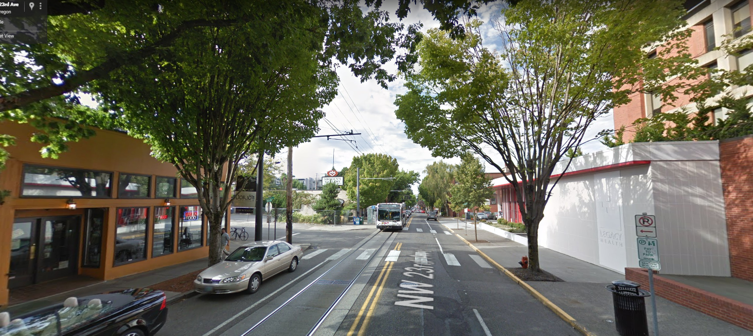
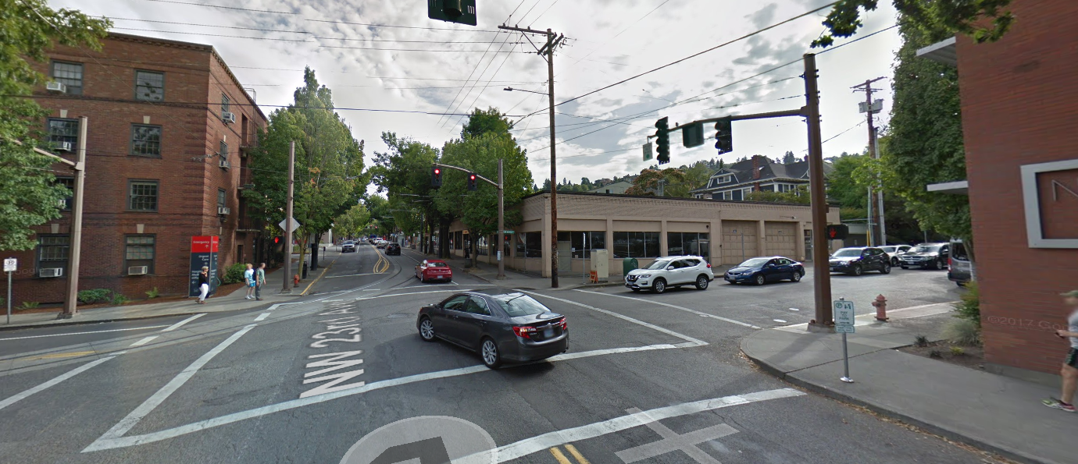
Context
View north on NW 23rd
View south on 23rd

Slide 40
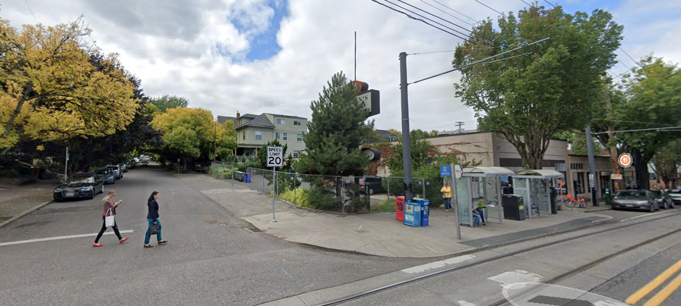
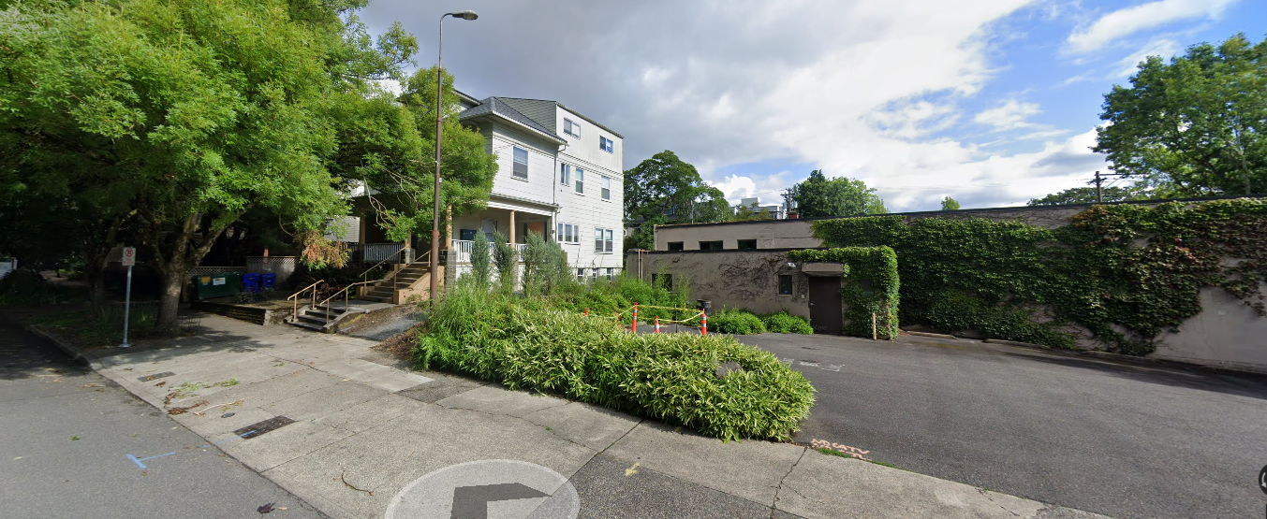
Context
Views west on Marshall

Slide 41
Modifications

Slide 42
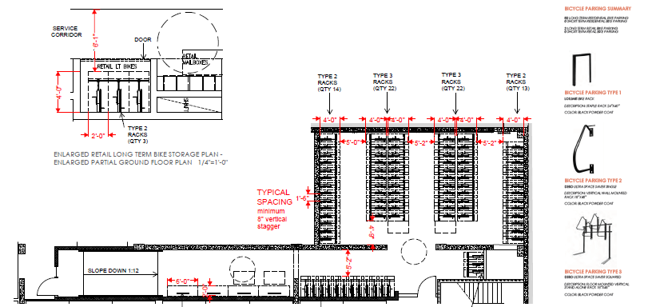
Modification
Bike Parking – Stall Widths (33.266.220.C.3.b).
Transit Street Main Entrance - Location (33.130.242.C.3.c)
Setbacks – L3 Landscape (33.130.215.B.2.b)
Vehicle Parking – Stall Size (33.130.266.130 Table 266-4)
1. Bike Parking – Stall Widths (33.266.220.C.3.b).
The Purpose: Bicycle parking is required for most use categories to encourage the use of bicycles by providing safe and convenient places to park bicycles.
The Standard: The A space 2 feet by 6 feet must be provided for each required bicycle parking space, so that a bicycle six feet long can be securely held with its frame supported so that the bicycle cannot be pushed or fall in a manner that will damage the wheels or components
The Proposal: Request to reduce the width of the vertically hung bike parking spaces from 24” to 18”, with an 8” vertical stagger.
Staff supports

Slide 43
Modification
Bike Parking – Stall Widths (33.266.220.C.3.b).
Transit Street Main Entrance - Location (33.130.242.C.3.c)
Setbacks – L3 Landscape (33.130.215.B.2.b)
Vehicle Parking – Stall Size (33.130.266.130 Table 266-4)
2. Transit Street Main Entrance – Location (33.130.242.C.3.c)
The Purpose: Locating the main entrance to a use on a transit street provides convenient pedestrian access between the use and public sidewalks and transit facilities, and so promotes walking and the use of transit.
The Standard: One main entrance to a multi-dwelling structure must be within 25 feet of the transit street; allow pedestrians to both enter and exit the building; and either face the transit street; be at an angle of up to 45 degrees from the transit street; or face a courtyard and be within 60 feet of the transit street.
The Proposal: Request to locate the proposed main entrance to the residential portion of the building on NW Marshall, approximately 70 feet from NW 23rd Avenue (transit street).
Staff supports

Slide 44
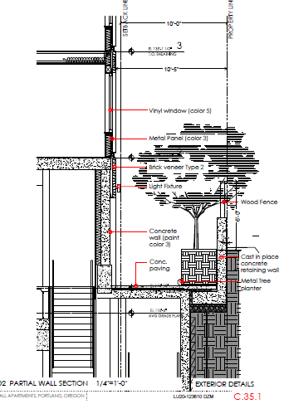
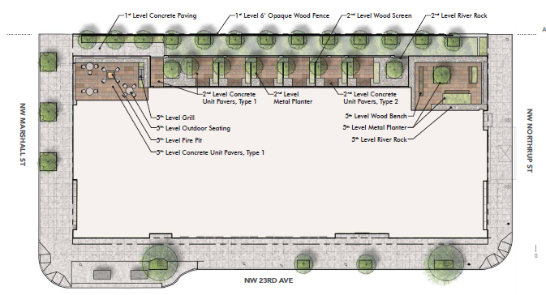
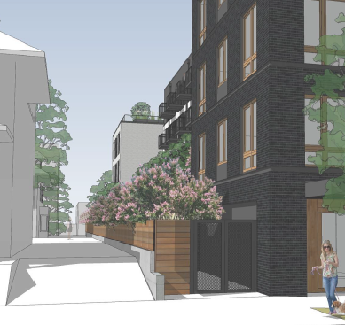
Modification
Bike Parking – Stall Widths (33.266.220.C.3.b).
Transit Street Main Entrance - Location (33.130.242.C.3.c)
Setbacks – L3 Landscape (33.130.215.B.2.b)
Vehicle Parking – Stall Size (33.130.266.130 Table 266-4)
3. Setbacks – L3 Landscape (33.130.215.B.2.b)
The Purpose: The setback requirements for areas that abut residential zones promote commercial/ mixed use developments that will maintain light, air, and the potential for privacy for adjacent residential zones.
The Standard: The required setback from a lot line that abuts an R1 zone is 10 feet and must be landscaped to the L3 standard which requires a 6-foot-tall screen (shrubs or masonry wall) and groundcover planting. Paved areas may not extend closer than 5ft to the lot line.
The Proposal: Request to alter the required L3 landscape screening to the west due to substantial grade differences.
Staff supports

Slide 45
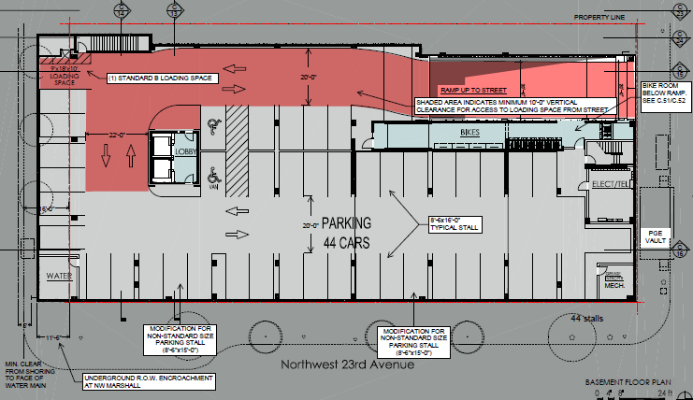
Modification
Bike Parking – Stall Widths (33.266.220.C.3.b).
Transit Street Main Entrance - Location (33.130.242.C.3.c)
Setbacks – L3 Landscape (33.130.215.B.2.b)
Vehicle Parking – Stall Size (33.130.266.130 Table 266-4)
4. Vehicle Parking – Stall Size (33.130.266.130 Table 266-4)
The Purpose: The development standards promote vehicle areas that are safe and attractive for motorists and pedestrians.
The Standard: The minimum stall size for 90-degree parking with a 20 ft drive aisle is 8’-6”x 16’-0”.
The Proposal: Request to have two stalls be slightly obstructed by structural columns at the front of the stall, effectively reducing the stall depth to 15’-0” instead of the required 16’-0”.
Staff supports

