Slide 1
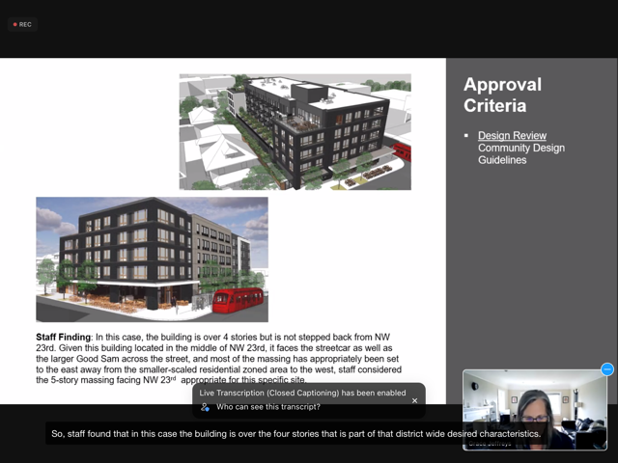
NWDA appeal of the proposal for NW 23rd and Marshall
-

Slide 2
NWDA appeal of the proposal for NW 23rd and Marshall
What is this appeal about?
One thing:
Guideline P1: Community Plan Area Character – Upper Stories Stepbacks Northwest District Plan, p. C-15; “New buildings and additions that are taller than the two- to four-story building height that is predominant in the district should have upper stories stepped-back in order to contribute to a more consistent streetscape and to maintain neighborhood scale.”
And whether this Guideline is met
Notes:
Fundamental guideline addressing scale and compatability

Slide 3
NWDA appeal of the proposal for NW 23rd and Marshall
What this appeal is not about?
Affordable housing
Step downs at the rear of the building required by the base zone
Allowable height and bonuses
Design quality
Staff opinions
Design Commission preferences
A 6” step back or a “small projecting cornice” detail

Slide 4
NWDA appeal of the proposal for NW 23rd and Marshall
The Staff Report’s Finding:
“While the building is taller than most existing buildings in the area, it is within the allowable building height limit, and design elements have been incorporated to address the four-story building height datum. A direct result of the step-down height at the west edge is a that significant portion (almost a third) of the north and south elevations are in fact 4 stories tall. The southwest parapet detail carries thru the south and southeast elevations to delineate this datum. Additionally, the middle portion of the east elevation which makes up approximately 40% of the length has a brick cornice detail at this datum height that is further enhanced with a 6-inch step back to the upper floor.”
Notes:
We believe that the Staff Report erred in its finding regarding this Guideline, and that the Design Commission erred in its Decision based on this Finding

Slide 5
NWDA appeal of the proposal for NW 23rd and Marshall
The Staff Report’s Finding:
“While the building is taller than most existing buildings in the area, it is within the allowable building height limit, and design elements have been incorporated to address the four-story building height datum. A direct result of the step-down height at the west edge is a that significant portion (almost a third) of the north and south elevations are in fact 4 stories tall. The southwest parapet detail carries thru the south and southeast elevations to delineate this datum. Additionally, the middle portion of the east elevation which makes up approximately 40% of the length has a brick cornice detail at this datum height that is further enhanced with a 6-inch step back to the upper floor.”
Notes:
The step down height at the west façade of the building is required by the base zone, and is irrelevant to the conformance with the guideline on the main street façade on the east side of the building and the streetscape that is the subject of the guideline.

Slide 6
NWDA appeal of the proposal for NW 23rd and Marshall
The Staff Report’s Finding:
“While the building is taller than most existing buildings in the area, it is within the allowable building height limit, and design elements have been incorporated to address the four-story building height datum. A direct result of the step-down height at the west edge is a that significant portion (almost a third) of the north and south elevations are in fact 4 stories tall. The southwest parapet detail carries thru the south and southeast elevations to delineate this datum. Additionally, the middle portion of the east elevation which makes up approximately 40% of the length has a brick cornice detail at this datum height that is further enhanced with a 6-inch step back to the upper floor.”
Notes:
Providing parapet and cornice details do not accomplish the intent of this guideline, which is for the building to be visually perceived in the adjacent street envelope as being four stories tall or less, consistent with context and community plan area character.

Slide 7
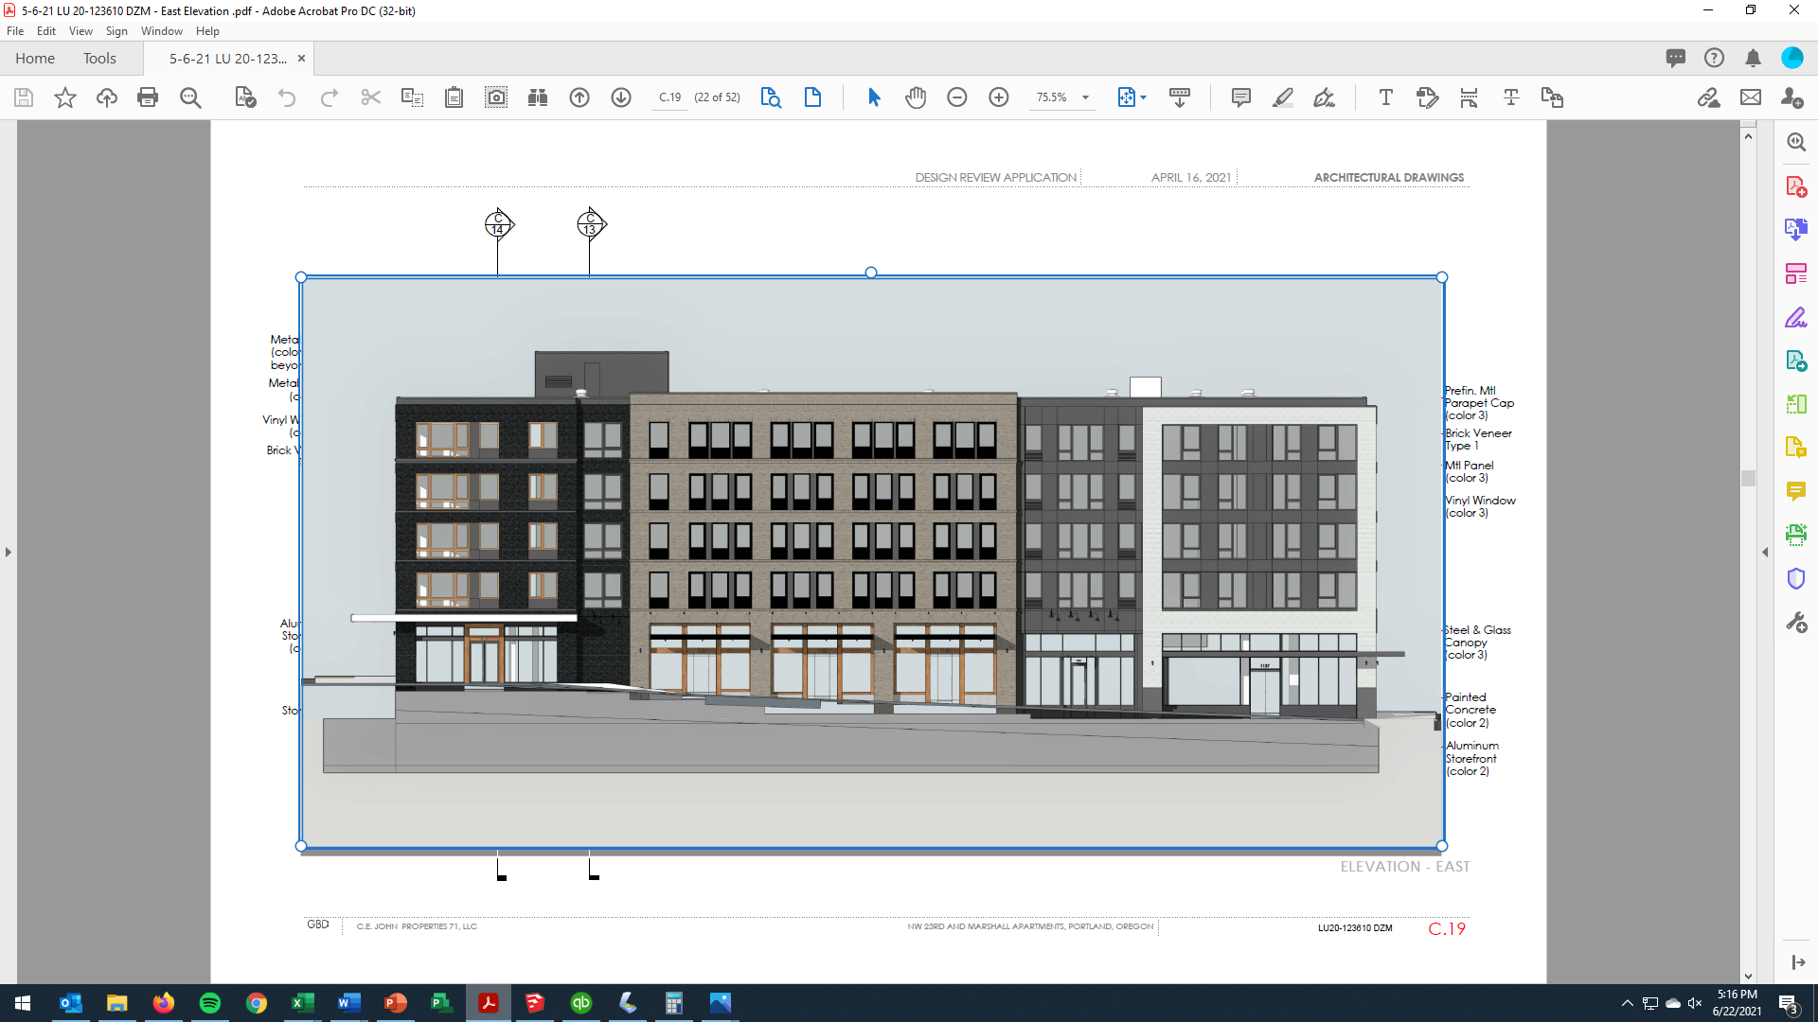
NWDA appeal of the proposal for NW 23rd and Marshall
What the Base Zoning allows:
45’ Maximum Height
45’

Slide 8
NWDA appeal of the proposal for NW 23rd and Marshall
With bonus for affordable housing:
55’ Maximum Height
55’

Slide 9
NWDA appeal of the proposal for NW 23rd and Marshall in addition the site slopes ~10’:
65’ nominal height
Cornice detail in lieu of step back
~65’
55’
Notes:
On this site, the increase in allowable height is further pronounced by the site’s slope, the northern property line being more than 10’ below the southern property line. In that the maximum building height is measured from the high point of the site, this results in the northern facades of the building being over 65’ in actual height, the equivalent of 6 stories, amplifying the need for compliance with Guideline P1.

Slide 10
NWDA appeal of the proposal for NW 23rd and Marshall with the stepbacks per Guideline P.1
45’ apparent height to the adjacent street and sidewalk
~65’
55’
~45’
Notes:
The intent of this guideline is to mitigate the impact of the scale of buildings over 4 floors on the adjacent context of 2-4 story buildings.

Slide 11
NWDA appeal of the proposal for NW 23rd and Marshall
What this appeal is about:
What Guideline actually says
Whether the proposed building conforms to the Guideline
Whether the Finding of the Staff Report accurately reflects what the Guideline says and if it is met
What basis the Commission has to approve a proposal with a clearly unmet Guideline, even for an otherwise “good” building

Slide 12
NWDA appeal of the proposal for NW 23rd and Marshall
What this appeal is about:
What happens when a “not-so-good” building shows up and asks for the same “shaded” precedent?
Respecting the thousands of citizen hours involved in developing the Northwest District Plan and its Guidelines
And whether that Plan and its Guidelines have both standing and meaning

Slide 13
NWDA appeal of the proposal for NW 23rd and Marshall
The NWDA requests that Council:
Direct BDS staff to interpret Guidelines directly and accurately
Direct the Design Commission to not approve proposals where all Guidelines are not met
And direct both entities to support and enforce the NW District Plan and the other community plans in our City

Slide 14
NWDA appeal of the proposal for NW 23rd and Marshall

