Slide 1
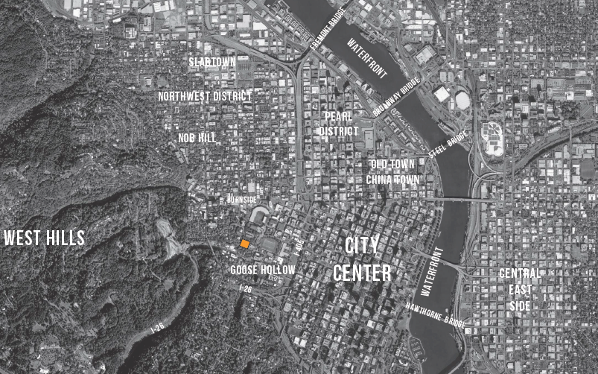
MAC Tunnel July 14th, 2021
City Engineer’s Report to City Council for a Below Grade Major Encroachment

Slide 2
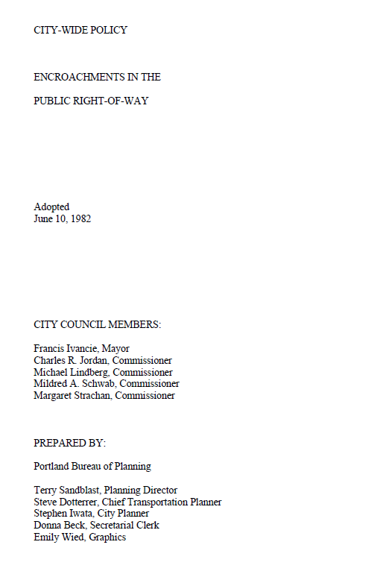
This proposal is being reviewed per the policies and standards within the 1982 document, Encroachments In The Public Right-of-Way

Slide 3
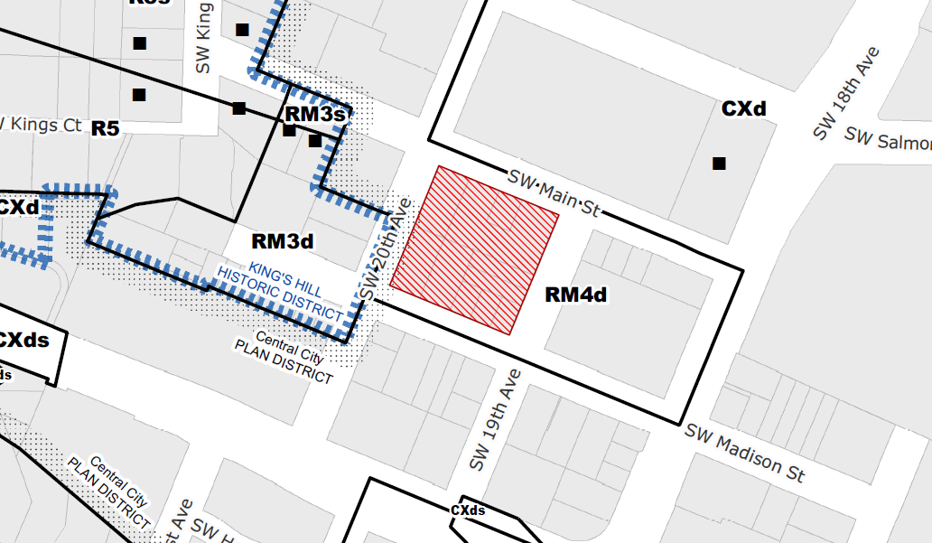
Tunnel Location
Mid-Block on SW Main between 19th and 20th

Slide 4
Types of Major Encroachments
Below-Grade Encroachments
e.g. underground walkway, underground mall, underground parking
Above-Grade Encroachments
e.g. Type I, II, III Skystructures
At-Grade Encroachments
e.g. Arcades (E Burnside)

Slide 5
Review of Encroachments in the Public Right-of-Way
All privately owned and maintained above-grade, at-grade and below-grade encroachments in the public right-of-way are subject to Encroachment Review.
The approval criteria for encroachments are the General Policies (Section III), City-Wide District Policies (Section VII) and Standards for Encroachment (Section VIII) of Chapter One of the 1982 Bureau of Planning document, Encroachments in the Public Right-of-Way.
Scope of Encroachment Review: This encroachment review will evaluate the following areas:
Tunnel access extending beyond the curb line and under SW MainStreet
Encroachment Review Process: The structure is a below-grade encroachment located in a portion of the City covered by City Wide Policies. The structure meets the definition of Other Underground Structures.

Slide 6
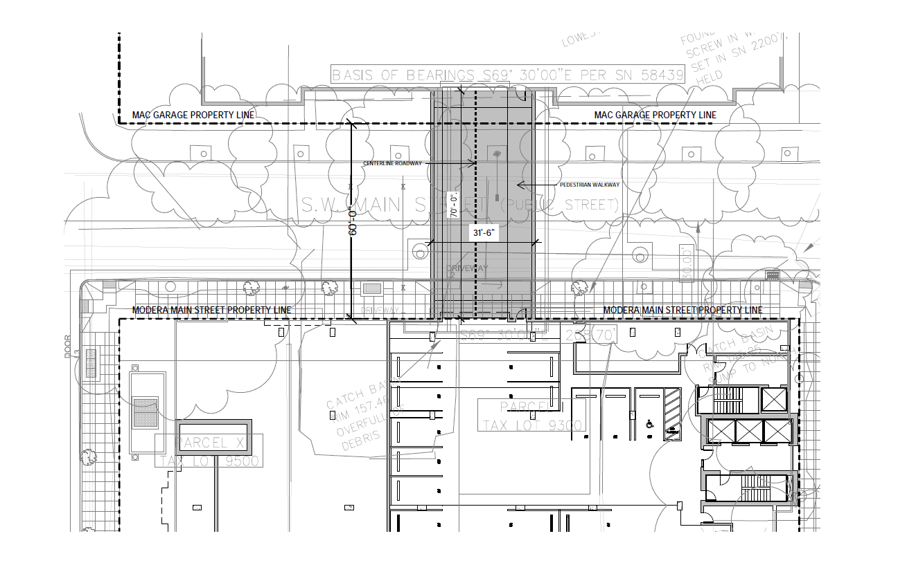

Slide 7
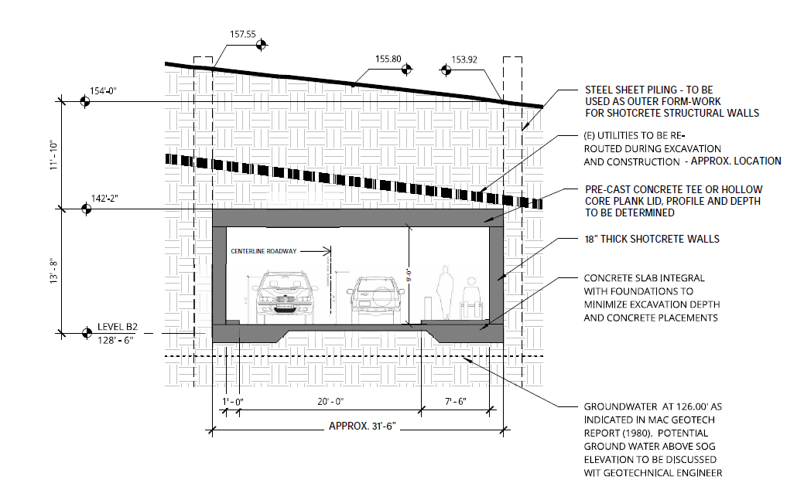
Tunnel Section
8-ft Internal Height
31.5-ft wide
60-ft long width
The tunnel will be 11-15 ft below street grade

Slide 8
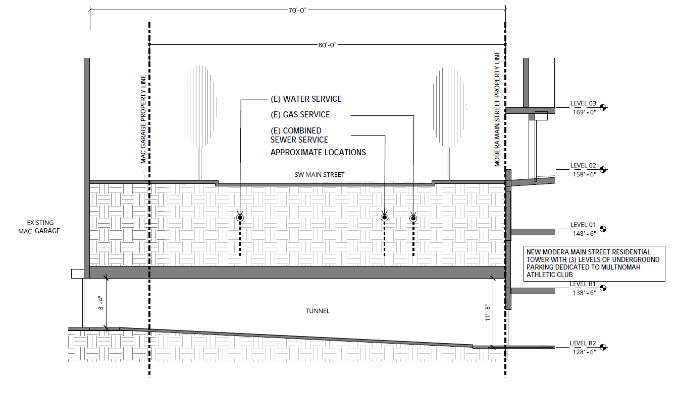

Slide 9
City Engineer’s Recommendation: Approval subject to the following conditions:
The property owner shall enter into a lease agreement with the City for use of space(s) in the public right-of-way. The lease agreement shall be completed prior to release of the Building Permit for the tunnel.
The tunnel shall be constructed in substantial compliance with preliminary plans that have been submitted by the applicant and reviewed by the City.
The applicant shall construct the tunnel in relation to the public right-of-way improvements and in a manner acceptable to the City of Portland Bureau of Transportation.
This encroachment approval is specific to the adjacent land use and is voided if the adjacent approved developments are not constructed. This encroachment approval will expire five years from the date of the approval ordinance if the building has not been constructed.

