Slide 1
City/ODOT Property Rights Reallocation – Naito West
Asset Management
Staff presenting: David McEldowney, PBOT Right of Way Acquisition Supervisor

Slide 2
Purpose
Reallocation of undivided property rights in the larger parcel so that City and ODOT ownership can be decoupled, and the land divided into two distinct parcels.
The City has identified this location for use as a sanctioned camp, but the ODOT interest in the property needs to be removed prior to use.
Process involves accepting ODOT’s deed to transfer ownership of the northern portion, and City transferring its interest in the Southern portion to the ODOT.
Due to time constraints, requirements of ADM-13.02 – Disposition of City Real Property, needs to be waived by Council in order to transfer the City’s interest to the ODOT.

Slide 3
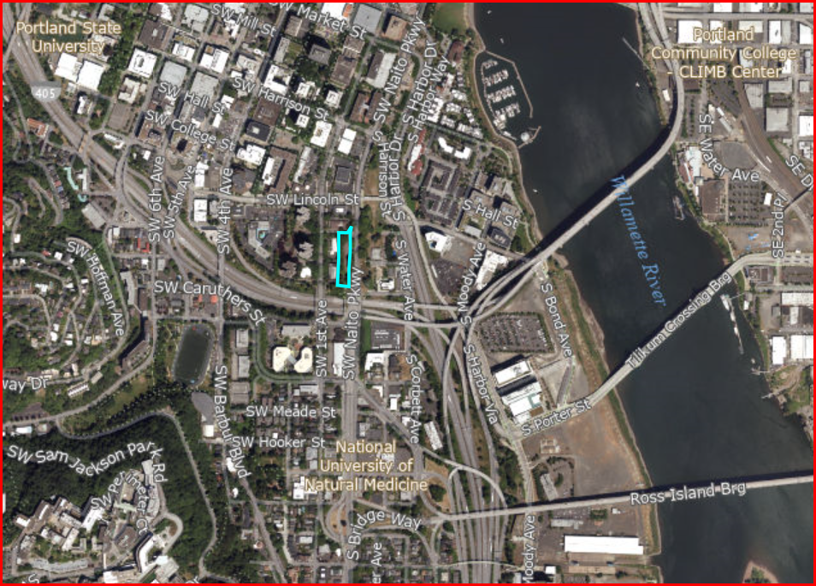
Overview of General Location

Slide 4
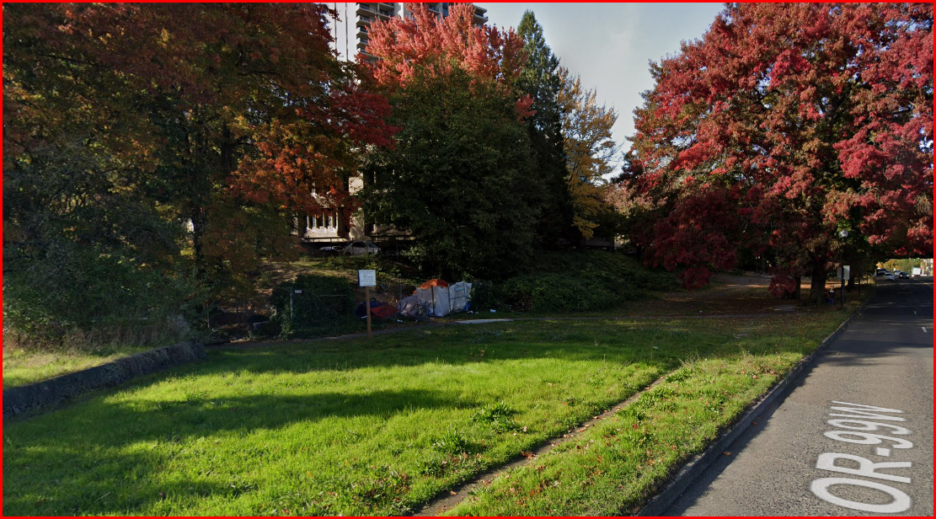
Land to be Transferred to ODOT

Slide 5
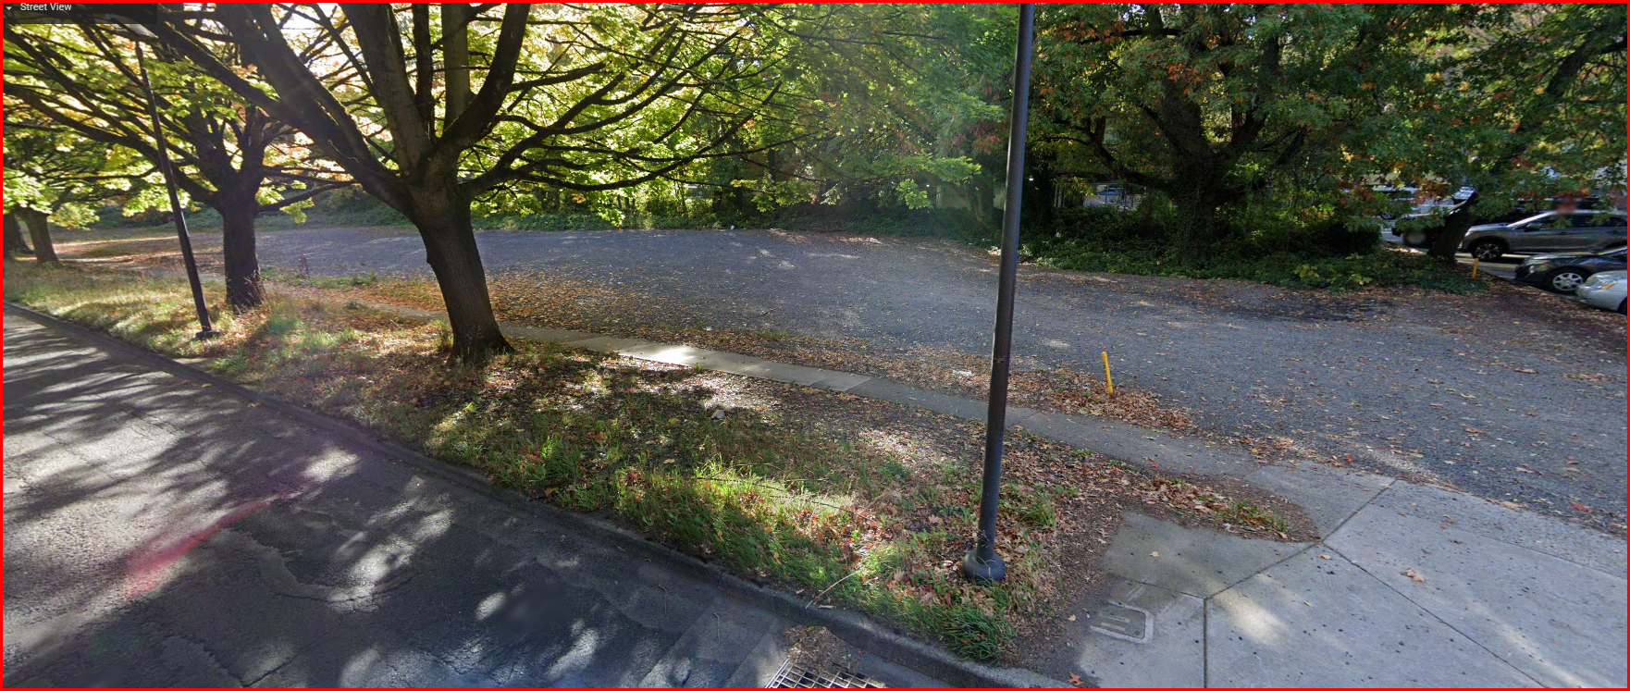
Land to be Transferred to City

Slide 6
History
The land was jointly acquired by the City and State in 1941
It was developed with the Harbor Drive Expressway
This segment carried the southbound expressway traffic onto Front Avenue (now Naito Parkway)
In the 1970’s, the expressway was removed, and the land has sat vacant since that time

Slide 7
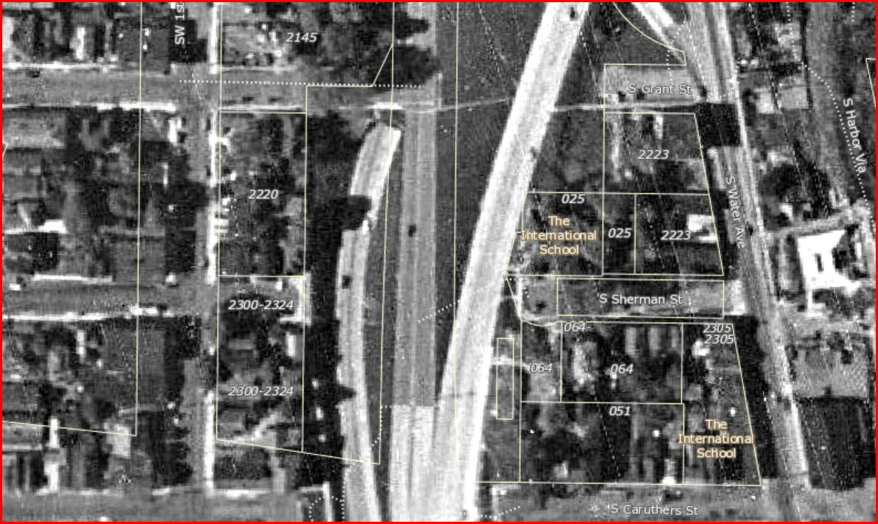
1948 Aerial Photo of the Harbor Drive Ramp (left side ramp)

Slide 8
Property Division
The land is still considered to be fee-owned right-of-way
The method for reallocation is based on both the ownership interest percentages and the location of the original platted lot lines
By keeping the original platted lots intact, future conversion of the land from fee-owned right-of-way back to lot status, will be considerably easier for redevelopment

Slide 9
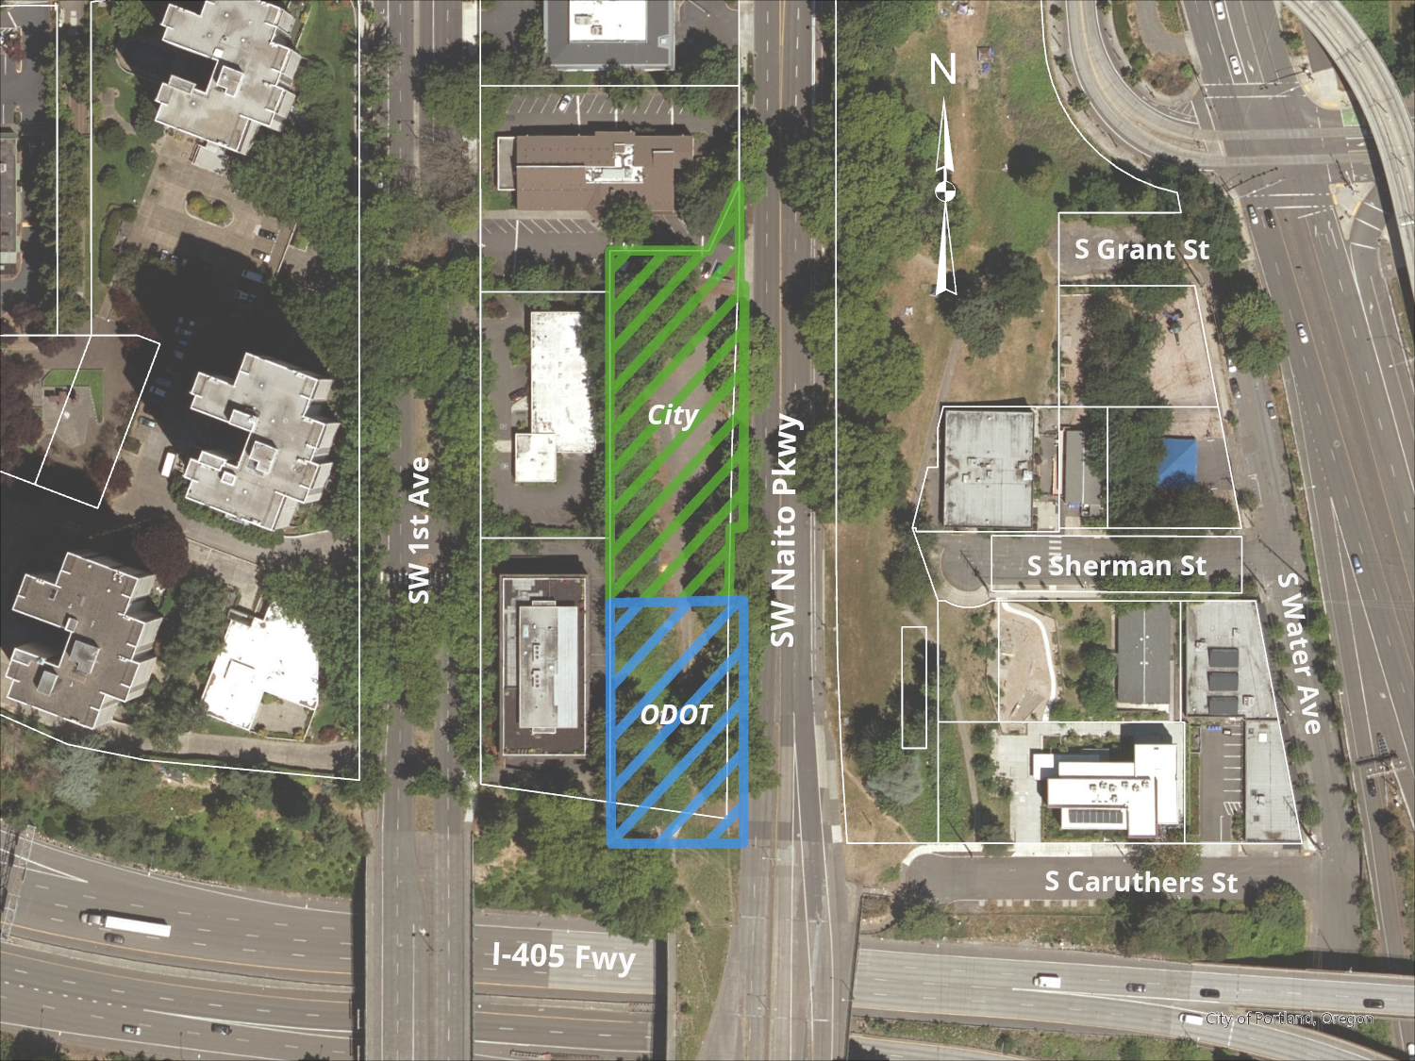
Proposed Property Rights – After Reallocation

