Slide 1
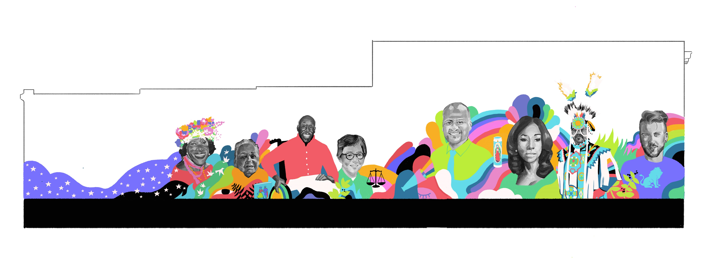
Never Look Away

Slide 2
The Mural Marsha P. Johnson Dr. Kathleen Saadat Rupert Kinnard Justice Lynn Nakamoto David Martinez Angelica Ross Asa Wright Aydian Dowling

