Slide 1
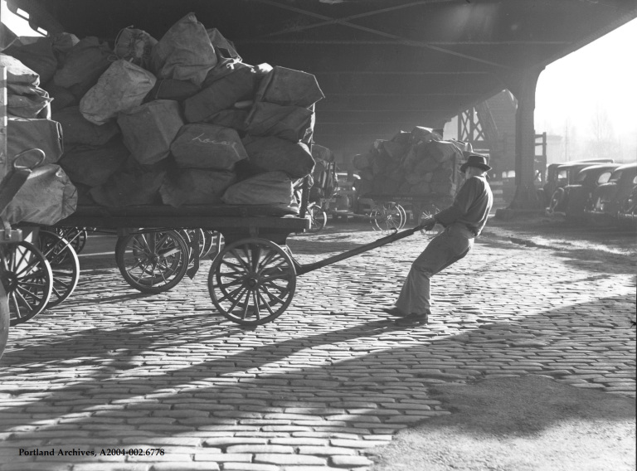
Belgian blocks deployment

Slide 2
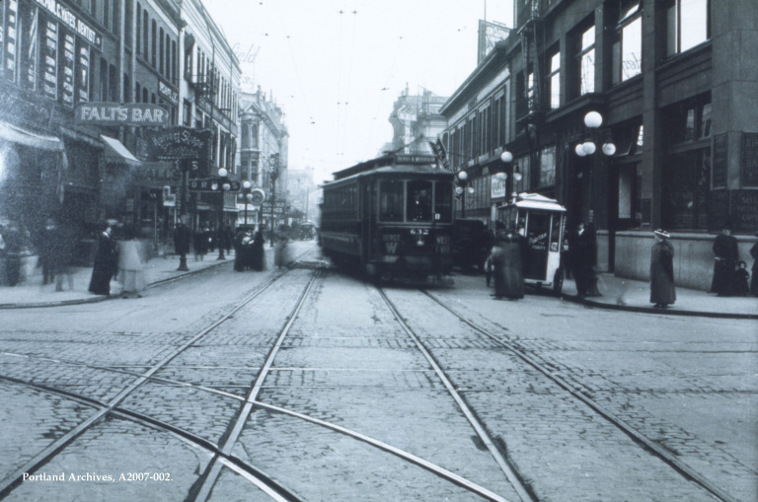
recommendations
Report summary
Key findings

Slide 3
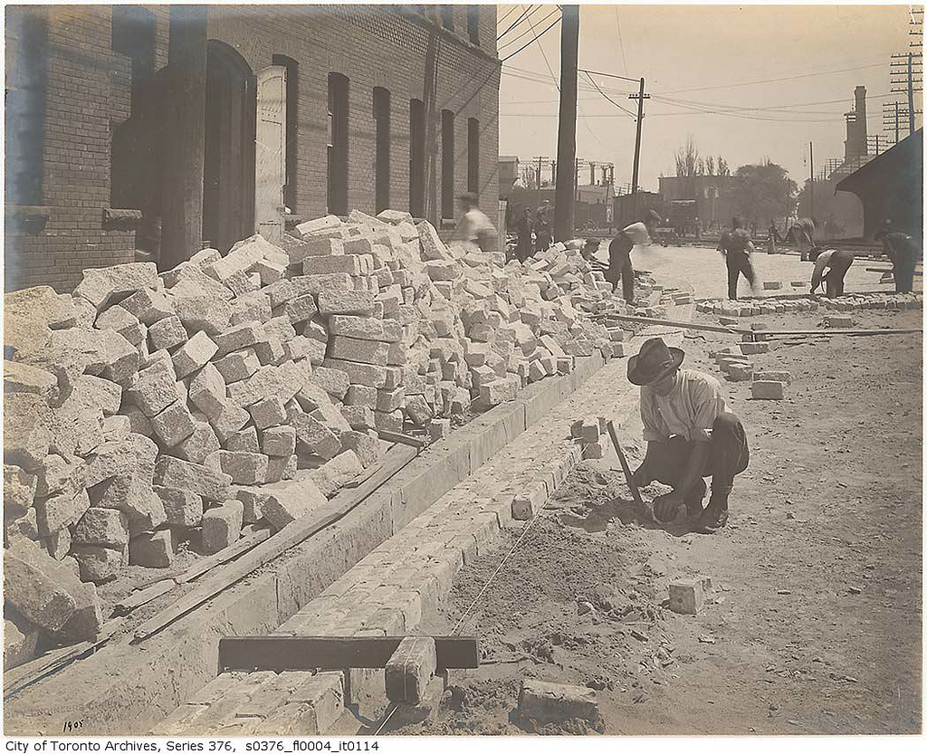
Recommendations
Update ordinances
Linear and non-linear deployment
Block modifications
Not all routes have to meet ada

Slide 4
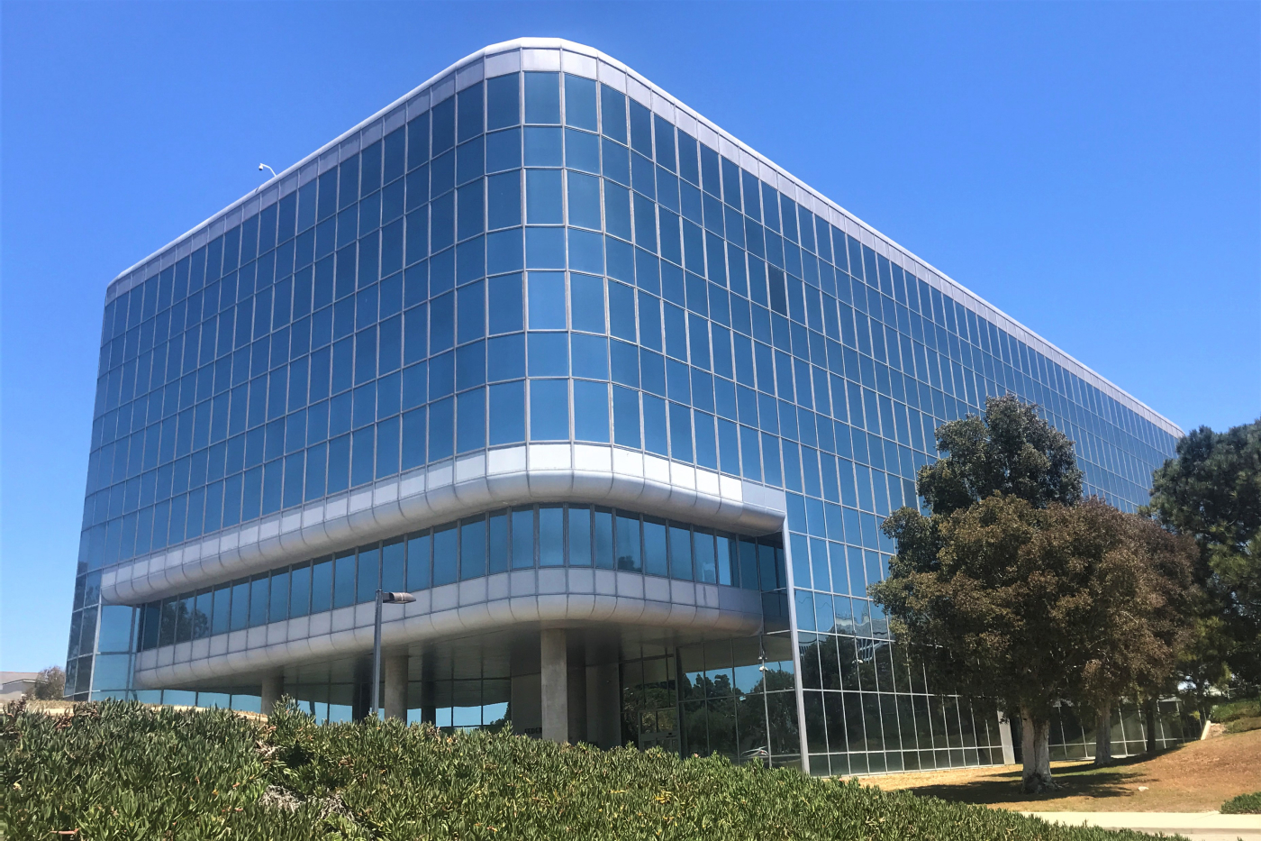
Ordinances
Image: 1970’s turn 50 - docomomo

Slide 5
NON-Linear deployment

Slide 6
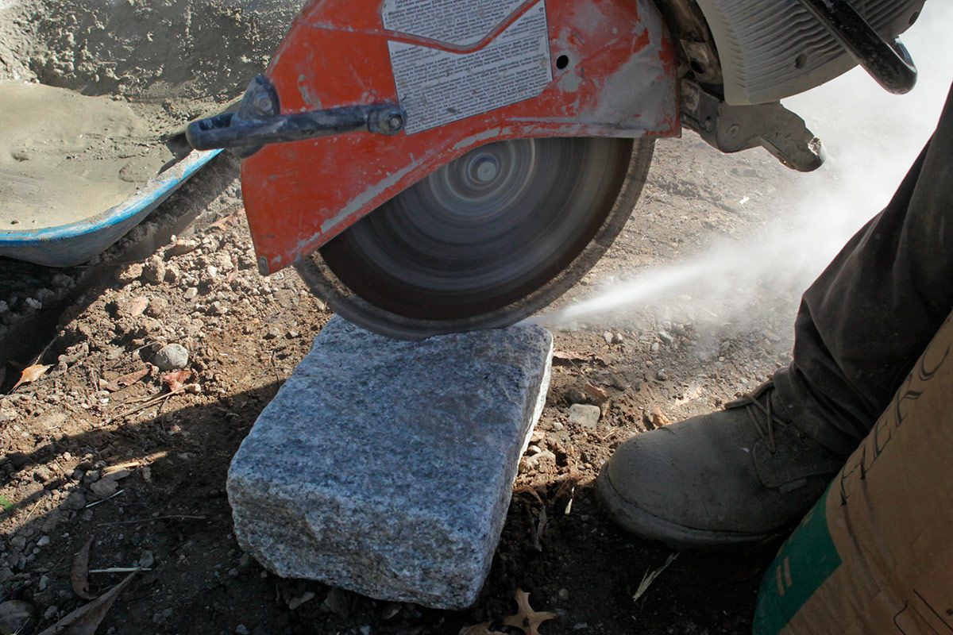
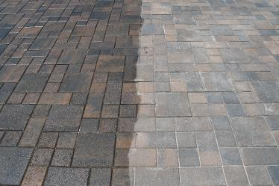
Block modifications

Slide 7
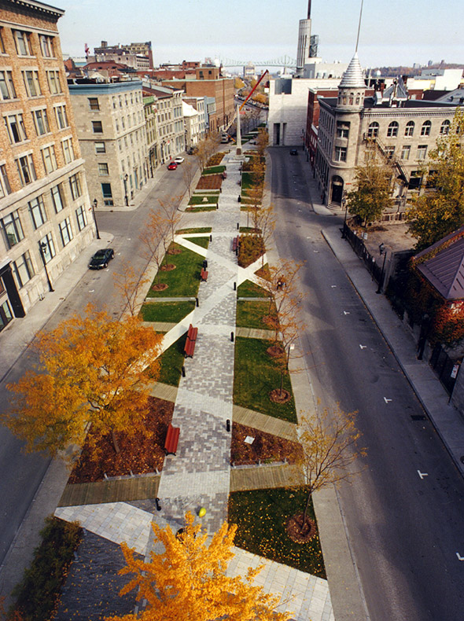
ADA

