Slide 1

Strategic Plan Presentation
Dr. Markisha Webster | Director
June 2, 2021

Slide 2

The Office of Equity and Human Rights
Born from community vision and a mandate to “get the City’s house in order in terms of equity.”
2018 Stakeholder Engagement
  Community-based organization leaders
  City staff and elected leaders
New director hired in February 2019
Strategic plan process continued through 2021
Notes:
What the Office has done well:
Equity 101 Training
Bureau Racial Equity Plans
Budget Equity Assessment Tool
Supporting the City’s equity work
The 2018 Stakeholder report noted the following areas of improvement for the Office:
Office of Equity’s support for equity work within the bureaus
Office of Equity’s support for workplace equity
Office of Equity’s support for its commissions
Office of Equity’s relationship with the community
Structural and systemic changes to strengthen Office of Equity’s work---increase authority
Note: The challenge of internal vs external focus: While primarily internally focused, our work cannot happen and is informed by the communities we serve—specifically communities that have experienced inequities in services and supports from the City.

Slide 3

Created by City Ordinance in 2011
  Promote equity and reduce disparities in City government;
  Provide guidance, education and technical assistance to all bureaus as they develop sustainable methods to build capacity in achieving equitable outcomes and service;
  Work with community partners to promote equity and inclusion within Portland and throughout the region, producing measurable improvements and disparity reductions;
  Support human rights and opportunities for everyone to achieve their full potential;
  Work to resolve issues rooted in bias and discrimination, through research, education, and interventions.
Notes:
Areas of work include:
Equity Training
Equity Tools
Title VI and Title II
Disability Equity
Black Male Achievement
Human Rights Commission

Slide 4
The Office of Equity’s Role in the City of Portland
Set the vision for the City’s equity work.
Support bureaus with implementation of collective and bureau specific equity goals and strategies.
Provide professional learning opportunities to City staff.
Apply an equity framework to City policies, practices, procedures, and decisions.
Create equity tools and policies that provide guidance to bureaus.
Monitor progress and hold City bureaus accountable for advancing equity

Slide 5

Our Mission
The Office of Equity and Human Rights leads the City of Portland’s commitment to equity. We hold the City accountable by developing policies, practices, and procedures that strive to dismantle systems of oppression and build equitable foundations for our most systemically oppressed communities. We center race and disability through education and analysis. Individuals experience multiple forms of oppression; thus, we drive equity with an intersectional framework.

Slide 6
The Magic of Constraints
Constraints force you to think creatively. Give yourself limitations or restrictions, and you push your mind to generate inventive ideas and solutions.
Examples
Description: Describe your dream bedroom.
Constraints: The walls must be painted white. The bedspread must contain the color blue.
Problem: You’re going on vacation tomorrow with your family. Your supervisor calls and tells you she needs you in the office for the next week. What do you do?
Constraints: You cannot cancel your vacation. You cannot refuse your boss.
Notes:
I was recently searching for creative ways to articulate the vision that I have for my family, my work, my life, this world. I found myself with a ton of thoughts in my head but no real way to express them coherently. I felt frustrating and I wanted to believe that maybe I didn’t have any vision and was just moving aimlessly through the world; However, I know that this isn’t the case. I am able to articulate my what vs. my what so I know that there is a vison inside. I found this exercise in a search for some creative exercises. I thought it fitting here to share with you. I ask that you take a moment to consider the examples on the slide---and ask yourself the question: what happens when we consider the constraints and the barriers, the blocks that are inevitably in our way yet we make the choice to push through to use those constraints a motivation to find creative solutions to the problems we face each day. And, how can such constraints push us to articulate vision.

Slide 7
The Constraints
Challenge:
You have been asked to serve as the Director of the Office of Equity and Human Rights and Special Advisor to the Mayor on issues of racial justice and equity, providing equity leadership and guidance Citywide.
Constraints:
The City government is founded on principles and continues to uphold principles of white supremacy. Support to advance equity Citywide is often impeded by individual, institutional, and systemic racism.
Notes:
I love a challenge/and opportunity! And I deeply believe in this work. I closed my eyes, considered the magic of constraints and this is my vision for the work of equity in the City of Portland

Slide 8

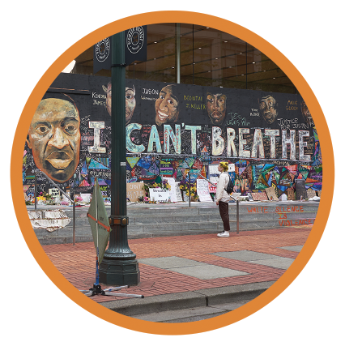

Acknowledges and is accountable to redress the harms of systemic oppression, anti-Blackness, and systems of white supremacy.
Uses language that directly names the communities who experience systemic oppression—communities that are not reduced to acronyms.

Slide 9


Creates and maintains spaces in Portland that are clean, safe, open, and free to community.
Ensures Black, Indigenous, and other individuals of color enter Portland spaces every day without fear, anxiety, and/or uncertainty about whether they will return and whether their families are safe.

Slide 10


Guarantees Black, Indigenous, and other individuals of color and those with disabilities have shelter—a safe place to return to at the end of each day.
Assures Black people are not subject to, because of anti-Black racism, unjustified arrests and police violence.

Slide 11
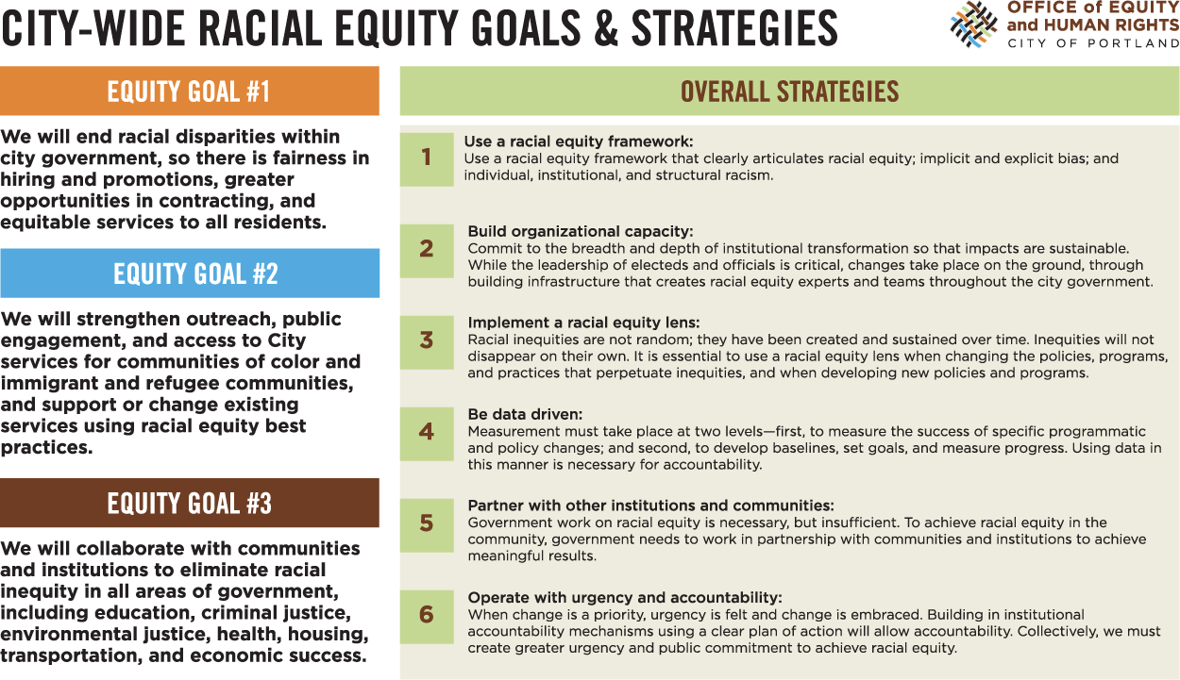
Key Initiatives from The Office of Equity

Slide 12
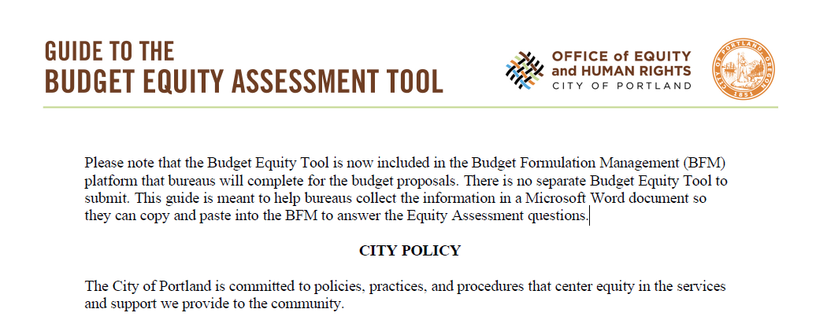
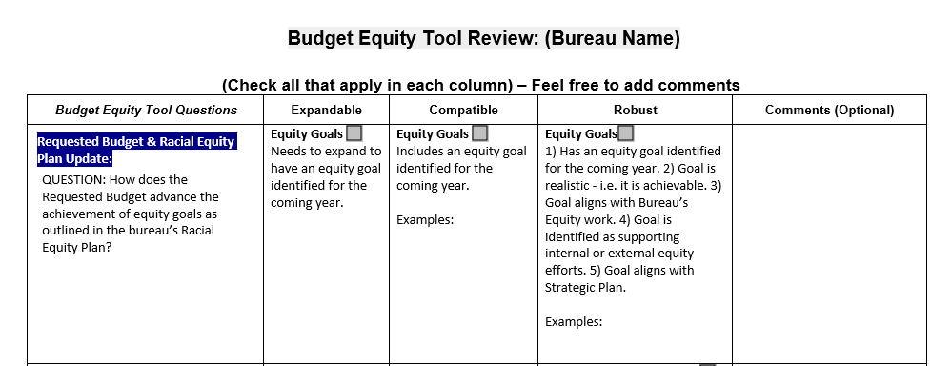
Key Initiatives from The Office of Equity Slide 2
Budget Equity Tool

Slide 13
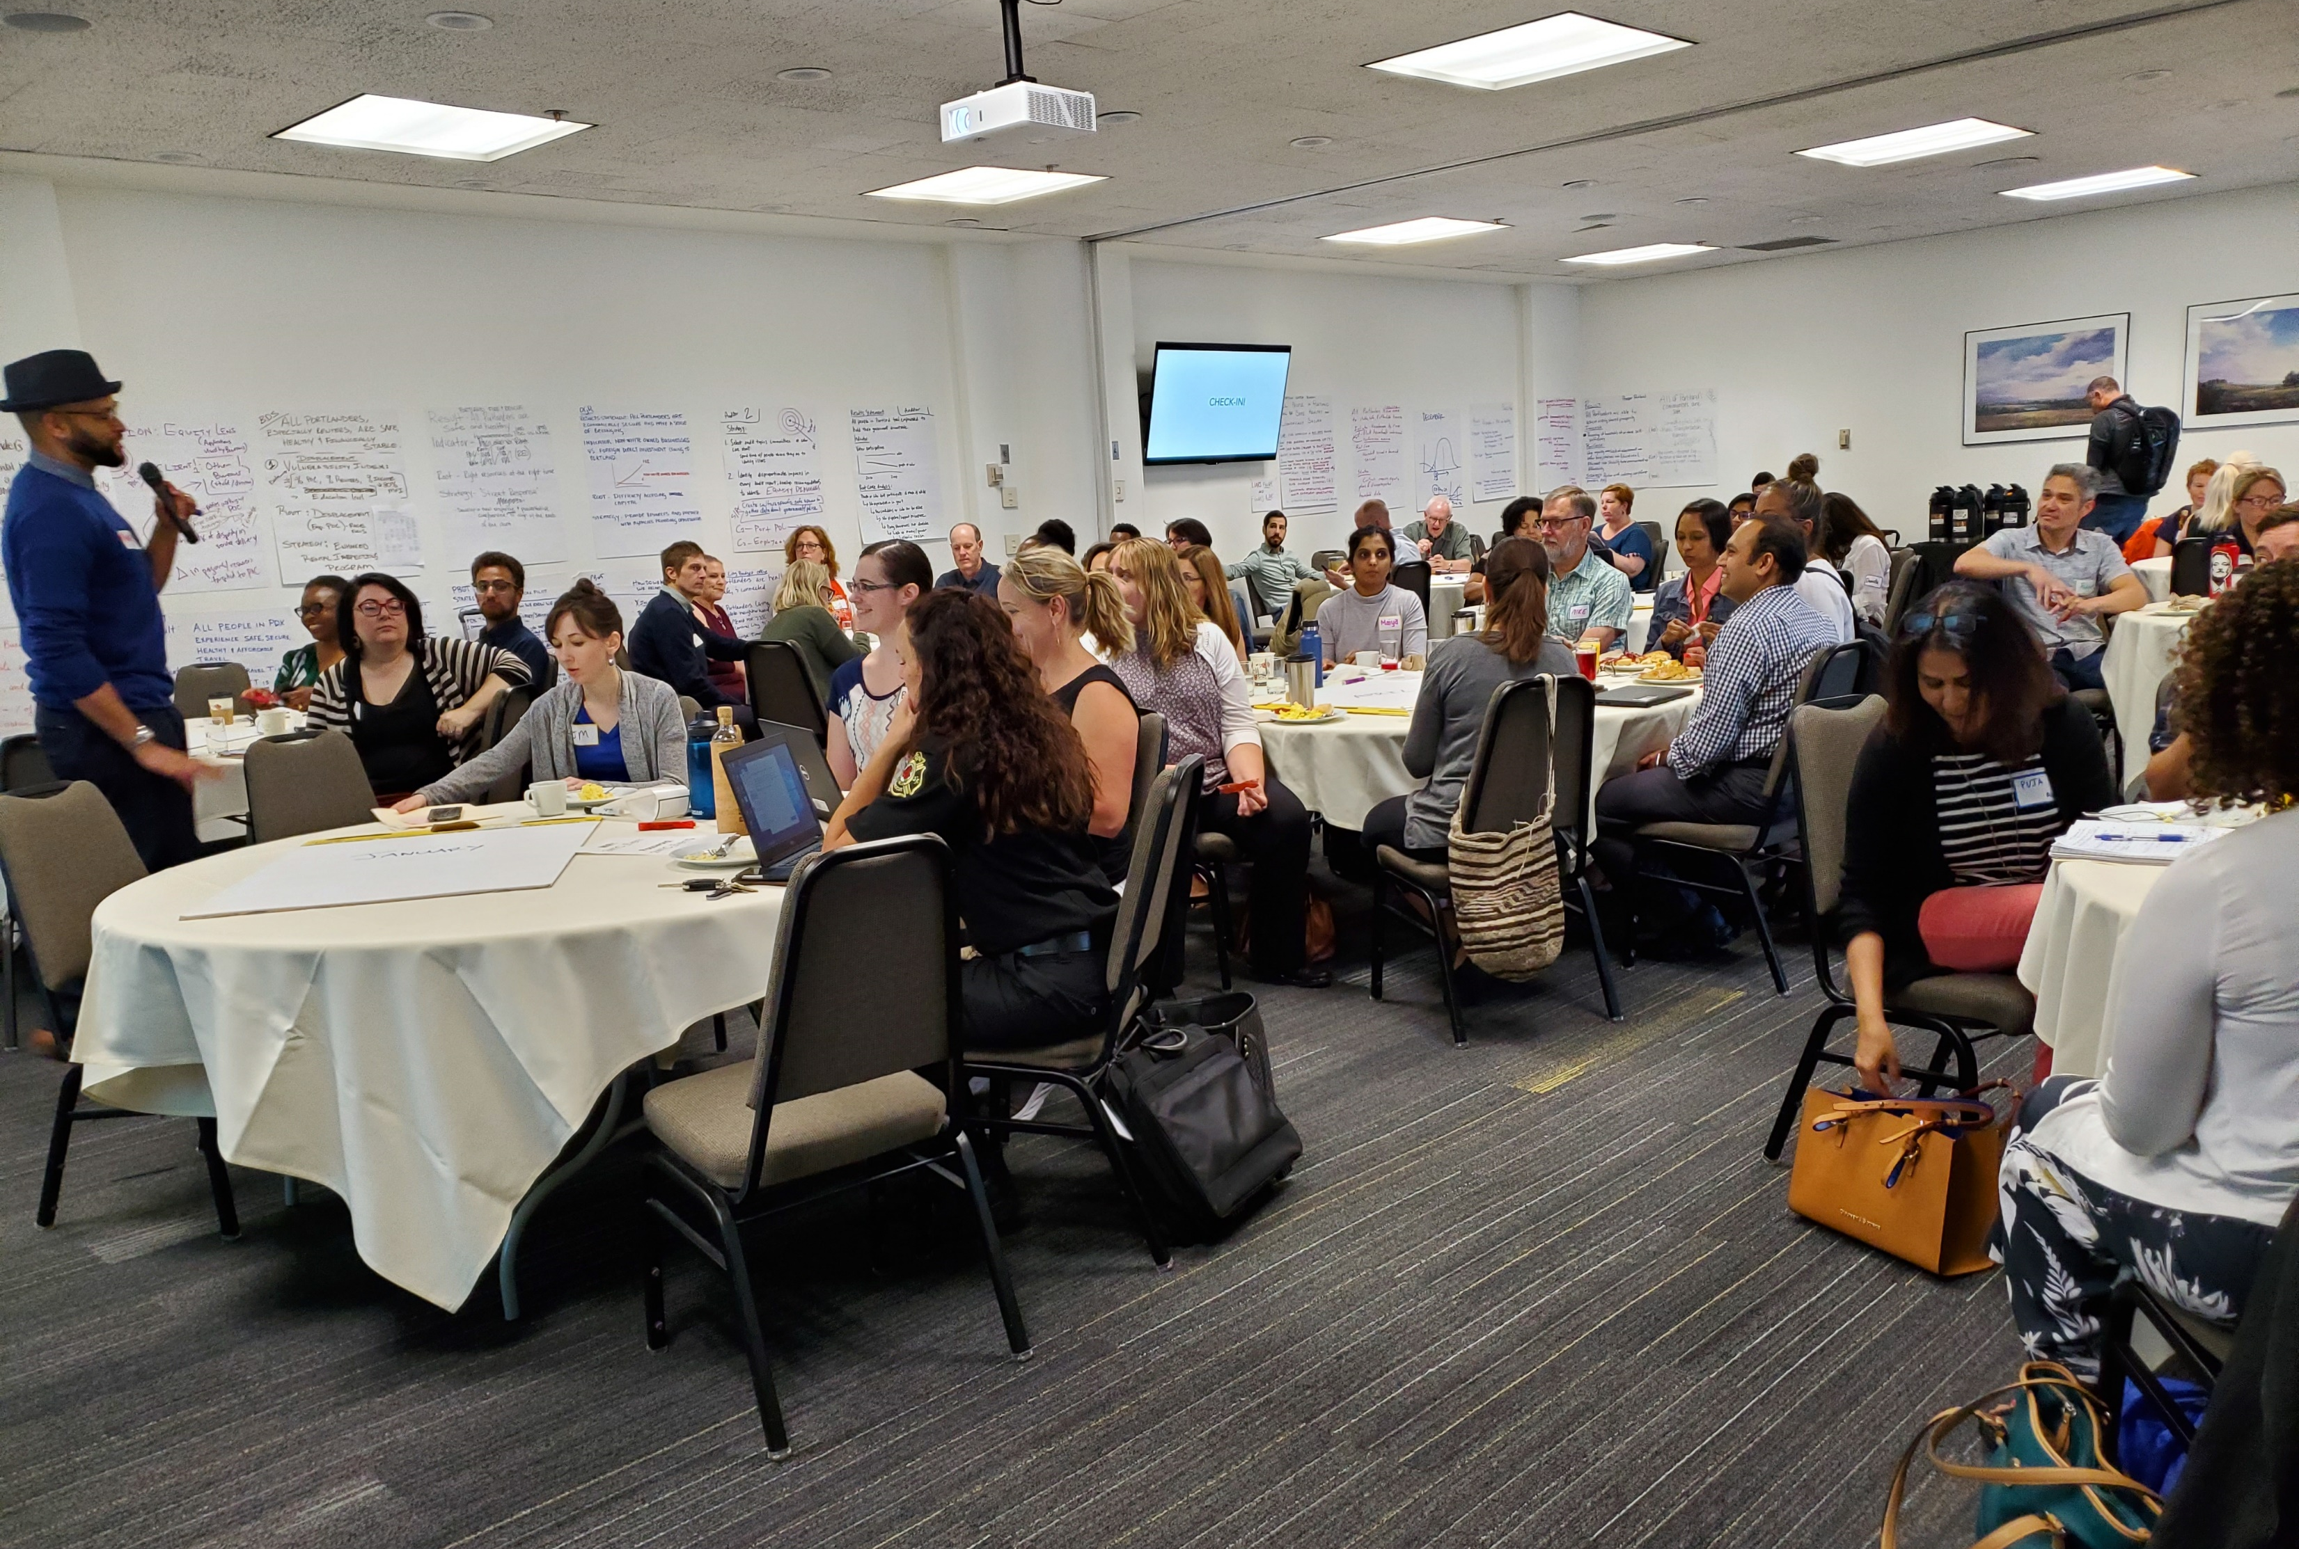
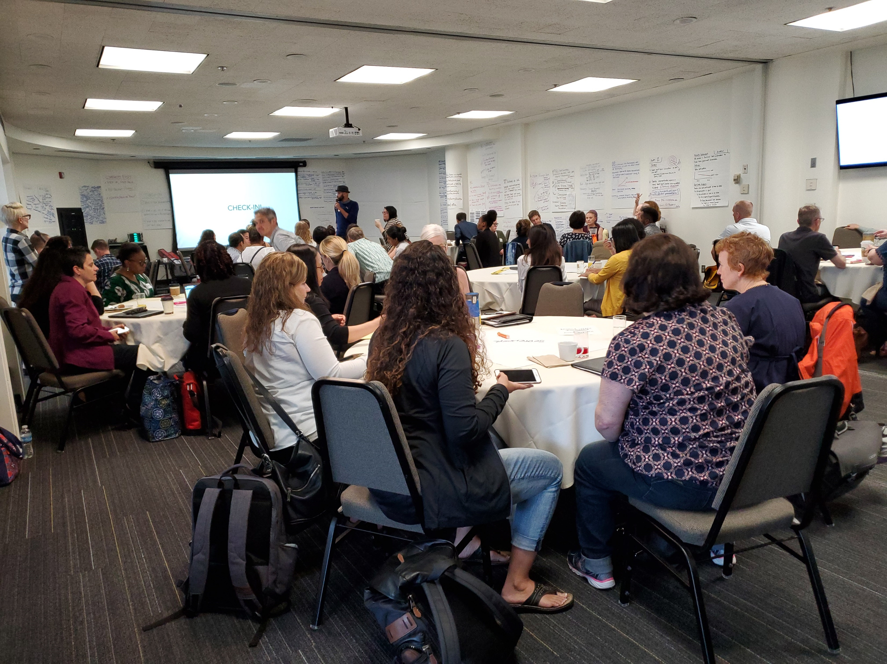
Key Initiatives from The Office of Equity Slide 3
Racial Equity Results Based Accountability

Slide 14

Key Initiatives from The Office of Equity Slide 4
Citywide Disability Equity Goals:
Equity Goal #1:
All activities, programs, facilities, and services offered by the City of Portland will provide for equitable outcomes and opportunities in accordance with the provisions of the Americans with Disabilities Act.
Equity Goal #2:
Hiring and promotions of people experiencing disabilities will be fair and in keeping with the Model Employer of People with Disabilities Policy.
Equity Goal #3:
People experiencing disabilities will be provided equitable opportunities in contracting.

Slide 15

Key Initiatives from The Office of Equity Slide 5
Language Access Policy Resolution

Slide 16

Key Initiatives from The Office of Equity Slide 6

Slide 17
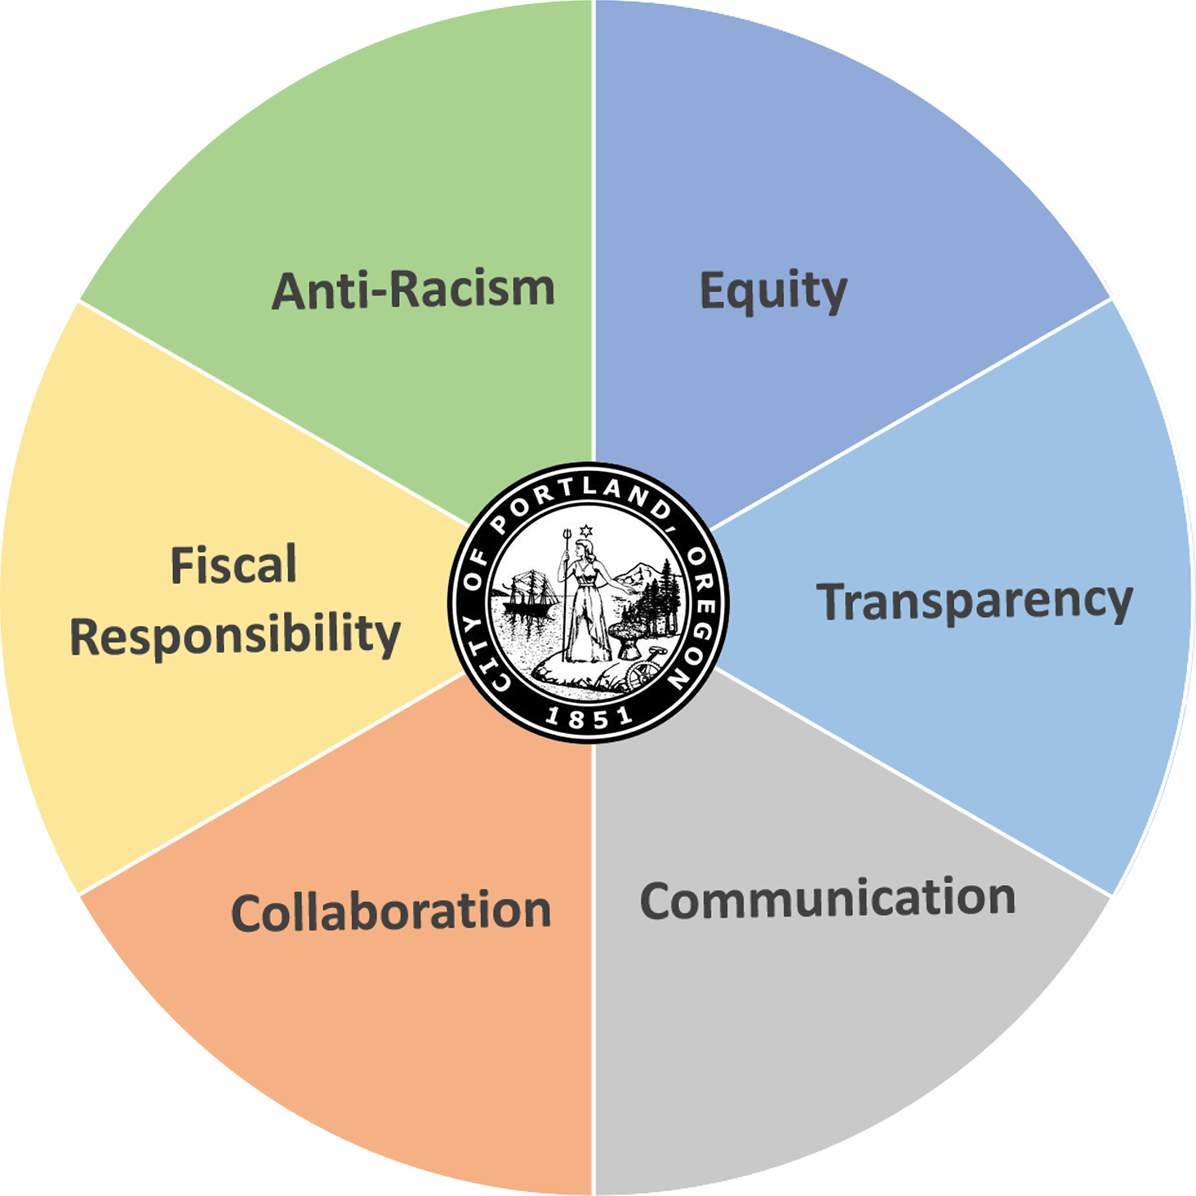
Citywide Key Equity Initiatives
  City of Portland Core Values

Slide 18

Citywide Key Equity Initiatives Slide 2
  JUNETEENTH
  Annual Day of Remembrance

Slide 19
2021-24 Goals and Plan of Action
Embedded and aligned Citywide policies, procedures, and practices to ensure collective implementation and understanding of equity work in the City is institutionalized, dismantling systemic oppression in City policy and practice.
  Accountability Partners:
  Office of Equity & Human Rights
  Bureau of Human Resources
  City Budget Office
  Bureau of Technology Services
  Procurement
  Tribal Relations Office
  Equity Managers
Notes:
Establish an anti-racist intersectional foundation within the City of Portland.
Change internal policy, practice, and procedure to eliminate institutional and structural racism.
Facilitate gatherings, events, and listening sessions
with City employees and community to advance our
understanding of racism and ableism and efforts to
reimaging a just City.

Slide 20
2021-24 Goals and Plan of Action Slide 2
Nurturing authentic, trusting community relationships/ partnerships; supporting the co-creation of City policy with community.
  Accountability Partners:
  Office of Equity & Human Rights
  Office of Community and Civic Life
  Bureau of Planning and Sustainability
  Tribal Relations Office
  Equity Managers
Notes:
To inform,
organize, and strengthen relationships with
communities who are currently and historically
impacted by systemic racism and ableism, by aligning
our equity efforts with the local communities.

Slide 21
2021-24 Goals and Plan of Action Slide 3
Equitable, anti-racist and anti-ableist City policies.
  Accountability Partners:
  Office of Equity & Human Rights
  City Council Offices
  City bureaus and offices
  Equity Managers
Notes:
Provide guidance to Council and Bureaus on existing
and/or new ordinances, resolutions, and policies.

Slide 22
2021-24 Goals and Plan of Action Slide 4
Front-end accountability systems for bureaus
  Accountability Partners:
  Office of Equity & Human Rights
  Bureau of Human Resources
  City Budget Office
  Bureau of Technology Services
  Tribal Relations Office
  Office of Community and Civic Life
  Equity Managers
Notes:
Establish for bureaus to implement racial equity and
disability equity goals through policy, education, and
compliance

Slide 23
2021-24 Goals and Plan of Action Slide 5
Citywide priority of Civil Rights education/compliance.
  Accountability Partners:
  Office of Equity & Human Rights
  Bureau of Human Resources
  Equity Managers
Notes:
Develop criteria for how to move the
City and its bureaus into alignment with the expressed
goals, intents, and provisions of Civil Rights Laws, ADA
Title II and Civil Rights Title VI, specific to race,
language, and disability

Slide 24
2021-24 Goals and Plan of Action Slide 6
6. Anti-racist, anti-ableist City workforce.
  Accountability Partners:
  Office of Equity & Human Rights
  Bureau of Human Resources
  City Budget Office
  Tribal Relations Office
  Office of Community and Civic Life
  Equity Managers
Notes:
Build equity
framework capabilities through Citywide education
and training

Slide 25

Thank You

