Slide 1
Office of Community & Civic Life
Cannabis Program
2021 SEED Grant Fund Ordinance
May 26, 2021
Jo Ann Hardesty, Commissioner
Michael Montoya, Interim Director
Dasheeda Dawson, Cannabis Program Supervisor

Slide 2
Today's Agenda
Council Action Requested: Approve 17 proposed grant recipients for the 2021 SEED Grant cycle
Equity-Centered Regulatory Framework (Current & Vision)
Historical Overview of Grant Fund (2017-2020)
About SEED Initiatives (2020-Beyond)
2021 SEED Grant Fund
Timeline
Selection Committee
Applicant Pool
Proposed Recipients
Fiscal Details
Notes:
Licensing, Compliance & Policy (LCP) are the core operations for the City's Cannabis Program. The growth of the overall cannabis program depends on operational success of LCP, across all three core competencies.

Slide 5
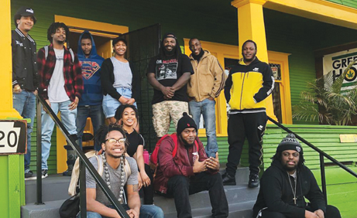
Historical Overview of the Grant Fund
$1.6M
72
15
One-Time Allocated
Total Applications
Grants Disbursed
Key Insight: Priorities limited applications and grants primarily supported established programs and organizations across Expungement, Workforce Development and Re-entry Services
Notes:
Licensing, Compliance & Policy (LCP) are the core operations for the City's Cannabis Program. The growth of the overall cannabis program depends on operational success of LCP, across all three core competencies.

Slide 6
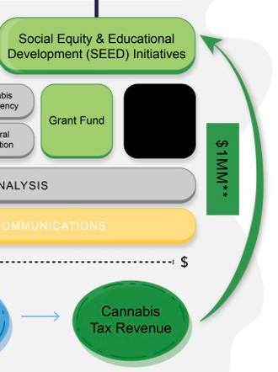
2020-Beyond: SEED Initiatives Overview
SEED Initiatives, launched in 2020, is the cannabis program's vehicle for single-source monitoring, measuring and reporting on the city's cannabis tax revenue's equity investment.
Annual Budget: $1 million ongoing allocation
SEED Initiatives includes:
SEED Grant Fund ($800,000) -- this will be the 5th cycle
SEED Technical Assistance Program ($200,000)
SEED Partnerships – Opportunity to grow funds & improve monitoring, measuring & reporting
Cannabis Tax Revenue is the sole funding source for SEED Initiatives and the SEED Grant Fund (formerly Cannabis Social Equity Grants)
​SEED Initiatives Annual Report: Report on cannabis tax revenue's Return on Equity Investment (ROEI)
National Benchmark for Equity & Restorative Justice community reinvestment tied to cannabis tax revenue
Notes:
Licensing, Compliance & Policy (LCP) are the core operations for the City's Cannabis Program. The growth of the overall cannabis program depends on operational success of LCP, across all three core competencies.

Slide 7
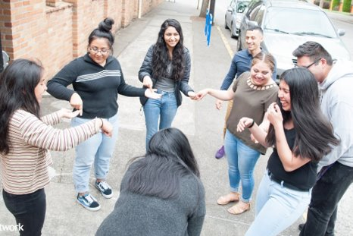
2021 SEED Grant Fund
The SEED Grant Fund aims to aid, strengthen, and serve restorative justice, community reinvestment, and wealth creation in Black, Indigenous & Latino/a/x communities, which have been disproportionately impacted by over 80 years of cannabis prohibition laws.​
​
*NEW* Priority Areas: Education, Economic Development, & Criminal Justice​
Objective 1: To support programs, projects, initiatives and/or businesses that uniquely serve BIPOC communities across 3 priority areas​
​
Objective 2: To increase the number of BIPOC-led and women-led small businesses and projects funded by SEED ​
Notes:
Licensing, Compliance & Policy (LCP) are the core operations for the City's Cannabis Program. The growth of the overall cannabis program depends on operational success of LCP, across all three core competencies.

Slide 8
2021 SEED Grant Fund Timeline & Milestones
Milestone Activities:
September: Funding Announcement & Round 1 Application Released (10/1)
October – November: Multiple Live/On-Demand Info Sessions; Round 1 Application Due (10/31)
December: Final Round Application Due
COVID-19 Impact: Two months delayed in Reviewing & Scoring
Key Insight: More time is required for stronger administration and best if RFP process is completed prior to allocation
Notes:
Licensing, Compliance & Policy (LCP) are the core operations for the City's Cannabis Program. The growth of the overall cannabis program depends on operational success of LCP, across all three core competencies.

Slide 9
2021 SEED Grant Selection Committee
SEED Grant Fund Selection Committee (11 individuals)​
Council-appointed members of the committee (5)
City employees (3)
CPOT Member (2)
Facilitator: Cannabis Program Supervisor
Key Insight: SEED needs a "Standing" Committee going forward
Notes:
Licensing, Compliance & Policy (LCP) are the core operations for the City's Cannabis Program. The growth of the overall cannabis program depends on operational success of LCP, across all three core competencies.

Slide 10
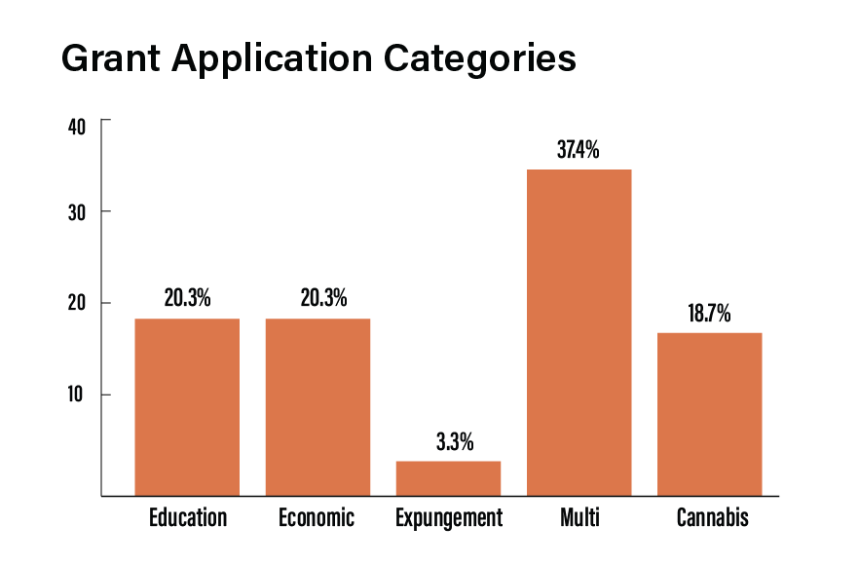
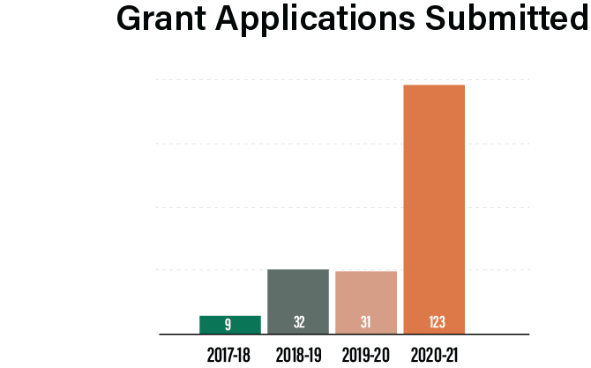
2021 SEED Grant Fund – Applicant Pool
Notes:
Licensing, Compliance & Policy (LCP) are the core operations for the City's Cannabis Program. The growth of the overall cannabis program depends on operational success of LCP, across all three core competencies.

Slide 11
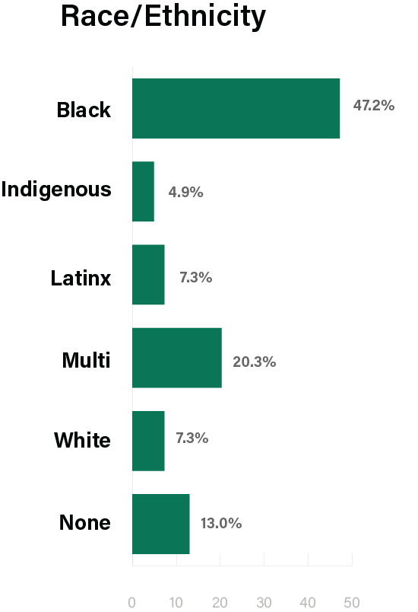
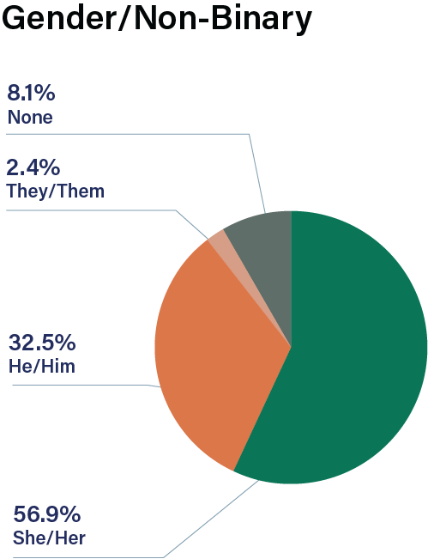
2021 SEED Grant Fund – Applicant Pool
Notes:
Licensing, Compliance & Policy (LCP) are the core operations for the City's Cannabis Program. The growth of the overall cannabis program depends on operational success of LCP, across all three core competencies.

Slide 12
2021 SEED Grant Fund Proposed Recipients
Notes:
Licensing, Compliance & Policy (LCP) are the core operations for the City's Cannabis Program. The growth of the overall cannabis program depends on operational success of LCP, across all three core competencies.

Slide 13
FY 2020-21: $1,000,000 FY 2021-22: $800,000 1. All recipients will complete work July 2021- June 2022 and considered 2021 SEED Grant cohort. 2. 2022 SEED Grant will have RFP on same timing but now before the allocation. Ensures money is disbursed to community reinvestment sooner. 3. Remaining $200,000 will be used for SEED Technical Assistance Program
2021 SEED Grant Fund Fiscal Details
Notes:
Licensing, Compliance & Policy (LCP) are the core operations for the City's Cannabis Program. The growth of the overall cannabis program depends on operational success of LCP, across all three core competencies.

Slide 14
THANK YOU! QUESTIONS?
Notes:
Licensing, Compliance & Policy (LCP) are the core operations for the City's Cannabis Program. The growth of the overall cannabis program depends on operational success of LCP, across all three core competencies.

