Slide 1

New Portlanders Policy Commission Appointments
Spring 2021
Marco Mejía, NPPC Staff

Slide 2

Portland has an involved, diverse and thriving immigrant & refugee community

Slide 3
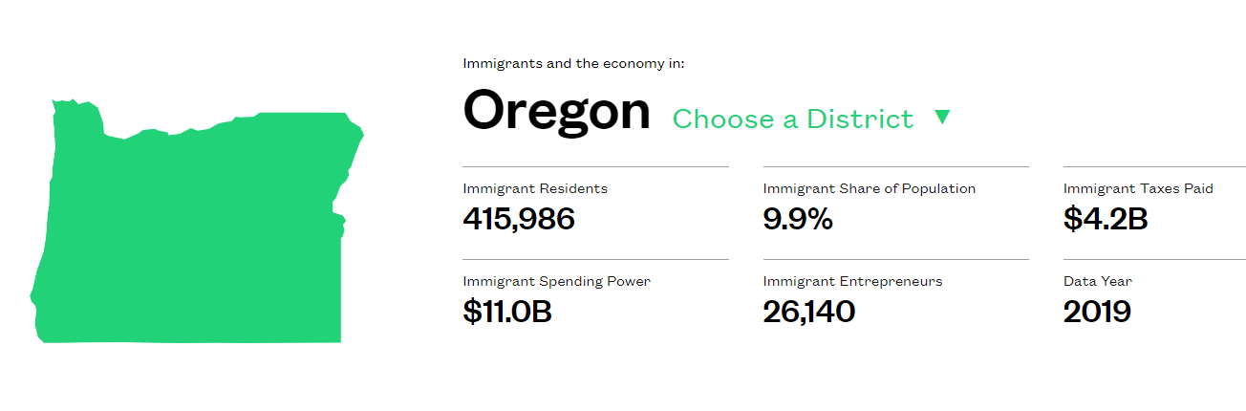

Contributions of migrants and refugees by the New American Economy:

Slide 4


1. reviewing and refining past recommendations on immigrant and refugee community integration policies and practices,
2. developing policy and practice recommendations for improving immigrant and refugee community integration,
3. providing expert support and technical advice to City Council and City bureaus, and
4. providing expert support and technical advice to partnering schools, local governments, state, and federal agencies in developing and implementing a comprehensive body of immigrant and refugee policies and practices.

Slide 5
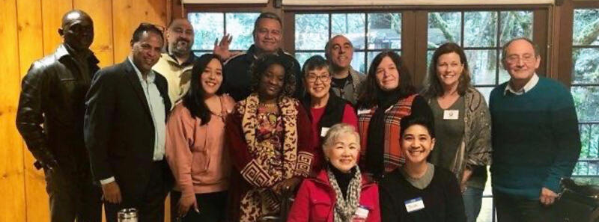

New Portlanders Policy Commission - NPPC -
Selection Committee:
Evelyn Liu, Blanca Gaytan-Farfan, Salome Nanyenga, Ahmed Alzubidi, and Baher Butti

Slide 6

New Portlanders Policy Commission
Candidates
- NPPC -
Massarra Eiwaz-Ransom
Victor Tran
Erick Ruiz
Nabin Dhimal
Mia Sabanovic
Jessica Marks
Vania Lucio-Mancilla
Rama Youssef
Hussein Idow
Appointment Candidates

Slide 7

New Portlanders Policy Commission
- NPPC -
Office of Community & Civic Life
Portland, May 19th, 2021
Marco Mejía / he, him, él
Community Engagement Coordinator
NPPC staff
Touk Keo / they, them
Adapt to Impact Supervisor
Blanca Gaytan-Farfan / she, her
NPPC - Selection Committee
Salome Nanyenga / she, her
NPPC - Selection Committee

