Slide 1
On-Call Engineering Services as a Vehicle for Contract Equity
Eva Huntsinger, P.E., JD, PBOT Civil Engineering and Drafting Division Manager
Cary Watters, PBOT Contract Equity Coordinator
Kathleen Brenes-Morua, Chief Procurement Officer

Slide 2
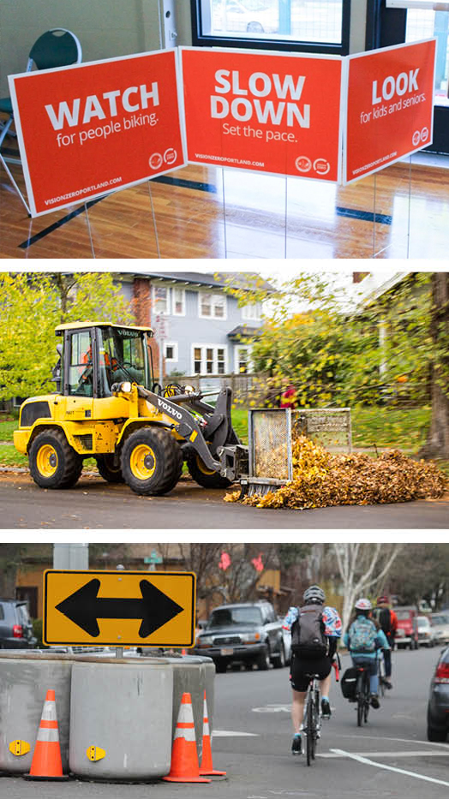
Connecting people to places.
PBOT manages the roads, sidewalks, bike lanes, transit and trails that help Portlanders get from place to place easily, safely and sustainably.

Slide 3
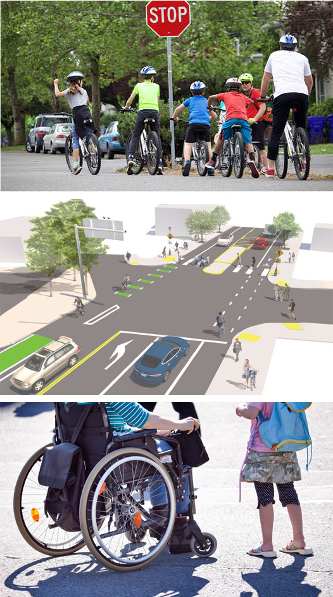
THREE MAIN GOALS
Safety
Moving People and Goods
Asset Management
committed to transportation justice

Slide 4
*Authorize a competitive solicitation and execution of price agreements in support of the Portland Bureau of Transportation Capital Improvement Program in an amount up to $54,000,000 (Ordinance)
Category | Service Area | Maximum Number of Price Agreements to be Awarded | Maximum Price Agreement Amount for the Five-year Period (EACH CONTRACT) | Task Order Maximum
I | Street Design Engineering Services – large scale | 8 | $5.00M | $1M
II | Traffic Signals, Street Lighting, Intelligent Transportation Engineering Services | 4 | $1.50M | $300K
III | Street Design Engineering Services – small scale | 8 | $1M | $200K
On-call engineering resources to deliver PBOT’s Capital Improvement Program
More opportunities for COBID* firms - 30% minimum aspirational equity goal
Opportunities for large and small sized firms (build further capacity)
****COBID: Certification Office for Business Inclusion and Diversity

Slide 5
Subconsultant Equity Performance: Payments (2017 – 2021)
 | Non-Pilot | Pilot
Non-Specified | $11,891,283.81 | $10,692,106.04
Asian-Pacific American | $194,352.35 | $306,252.09
Female | $29,415.00 | $142,012.96
Male | $164,937.35 | $164,239.13
Black American | $39,906.23 | $18,100.00
Female | $36,546.23 | $18,100.00
Male | $3,360.00
White | $1,300,327.76 | $685,113.57
Female | $769,457.98 | $509,727.26
Male | $530,869.78 | $175,386.31
Hispanic American | $671,018.12 | $1,931,899.46
Female | $359,544.62 | $1,827,215.41
Male | $311,473.50 | $104,684.05
Native American (Male) | $20,934.65
Subcontinent Asian American (Male) | $591,018.84 | $1,531,843.19
Grand Total | $14,708,841.76 | $15,165,314.35
Total BIPOC value | $1,517,230.19 | $3,788,094.74
Total BIPOC rate | 10% | 25%
Total Women value | $1,194,963.83 | $2,497,055.63
Total Women rate | 8% | 16%
 | Non-Pilot | Pilot
Non-COBID certified | $11,870,283.81 | $10,692,106.04
DBE | $1,966,706.92 | $4,070,954.45
ESB | $551,869.78 | $179,685.31
WBE | $319,981.25 | $222,568.55
Grand Total | $14,708,841.76 | $15,165,314.35
Total COBID value | $2,838,557.95 | $4,473,208.31
Total COBID rate | 19% | 29%
Notes
QBS PTE Pilot includes Solicitation 223 (March 2016) and Solicitation 699 (September 2017)
Non-Pilot includes all other QBS PTE contracts

