Slide 1
2020 State of Housing Report
Bimal RajBhandary, Analyst
May 12, 2021

Slide 2
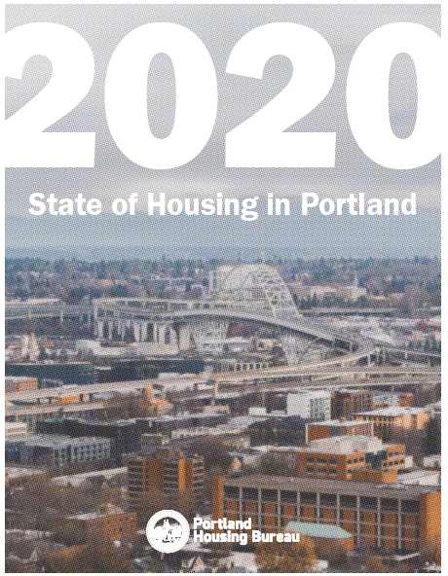
State of Housing Report
Published annually since 2015
Data collected fall/winter 2020
Demographics: 2013-2018 ACS
2020 Housing market data
Special Section: COVID19 Impacts on Housing and Beyond
Notes:
http://Portland.gov/phb/state-of-housing-report
Published annually since 2015
Data collection throughout the Fall with a Spring publish date

Slide 3
Part 1
Demographics and Housing Stock
Part 2
Housing
Market
Affordability
Part 3
City and Neighborhood
Profiles
Part 4
Policies and Programs
Part 5
Housing Program
Funding

Slide 4
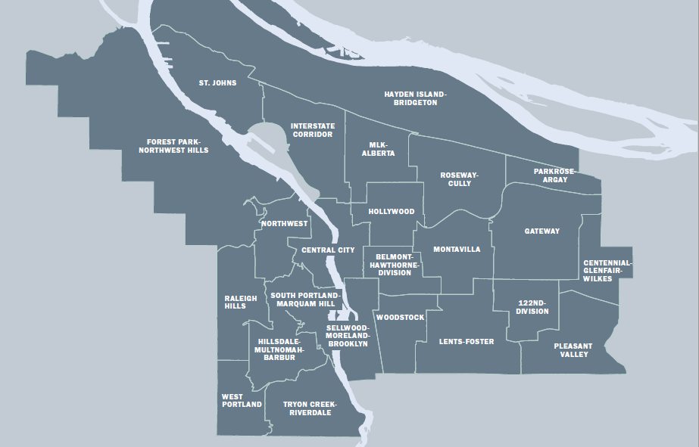
Neighborhood Study Areas

Slide 5
2020 Key Findings
Growth in population, wealth, median age, and diversity from 2013-2018
Persistent income disparities by housing tenure and race/ethnicity despite rising incomes overall
COVID-19 impacts on housing market:
Asking rents decreased for first time in a decade
Central City asking rents decreasing while vacancy rates at an all time high
East Portland vacancy rates decreasing while rents increasing slightly
Single-family home sales consistently stronger in 2020 than 2019
The City and Housing Bureau have played new roles in response to the economic impact of COVID19

Slide 6
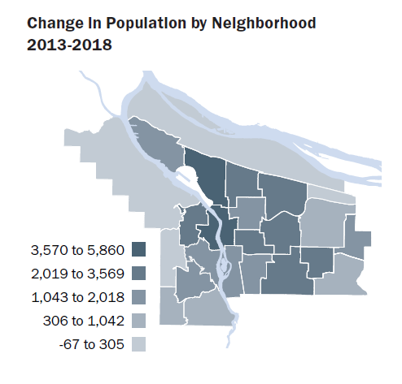
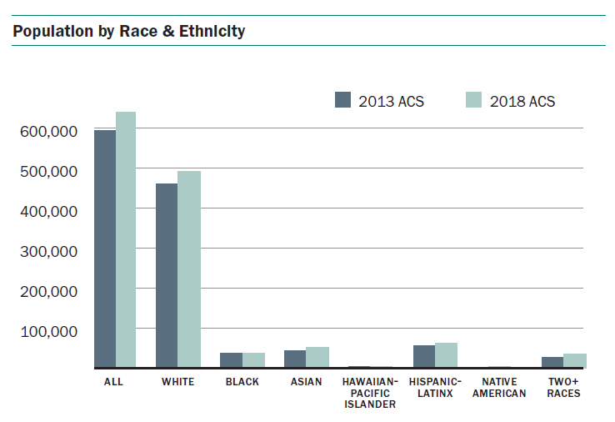
Population

Slide 7
Median Household Income by Race & Ethnicity

Slide 8
Rentership

Slide 9
Homeownership Rates

Slide 10
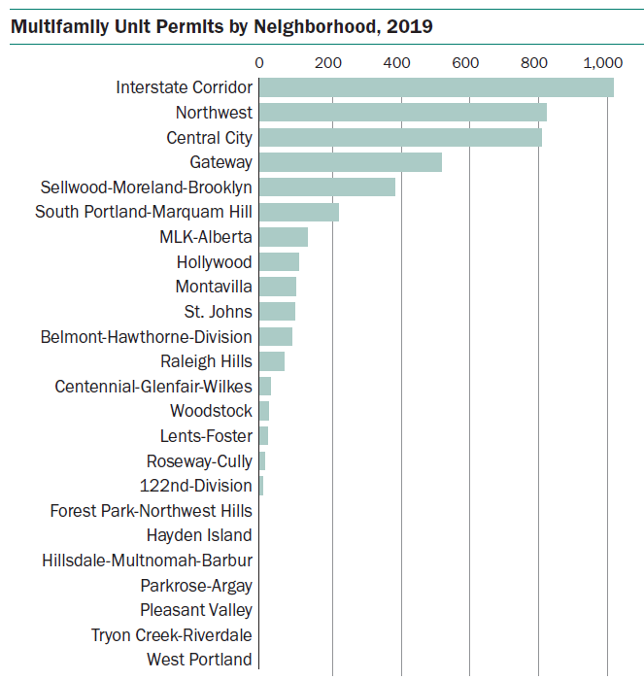
Multifamily Unit Permits by Neighborhood

Slide 11
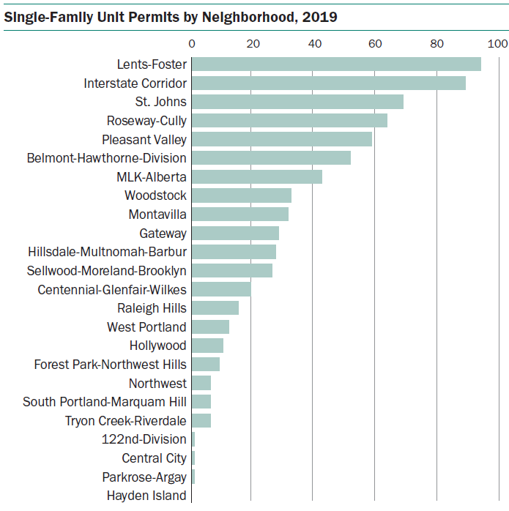
Single-Family Unit Permits by Neighborhood

Slide 12
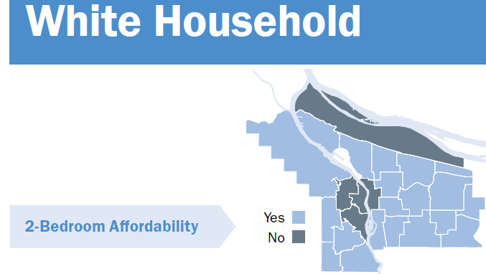
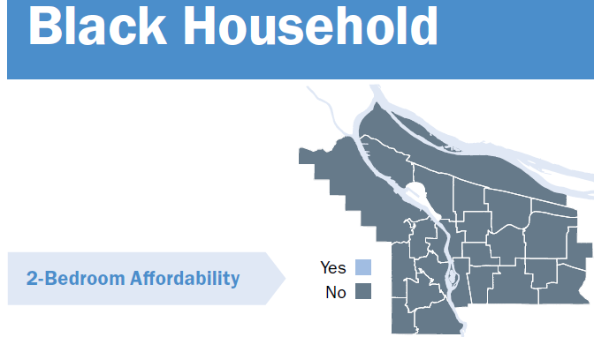
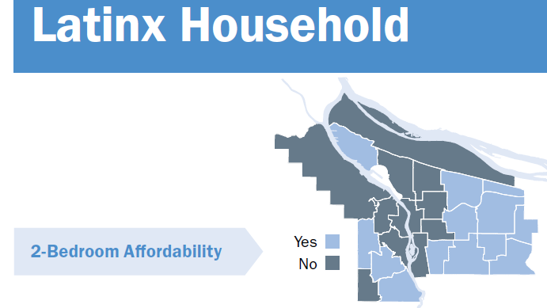
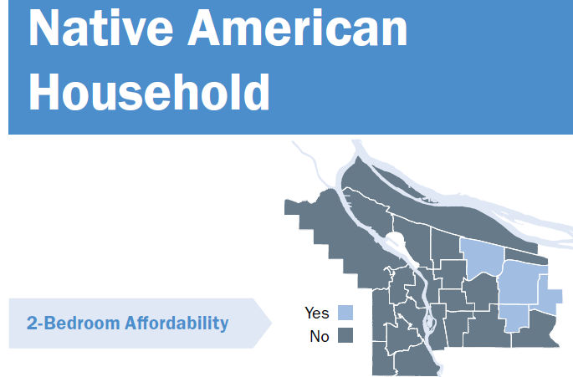
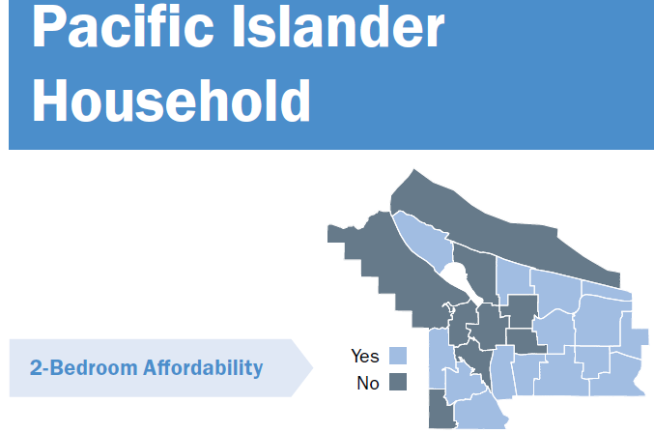
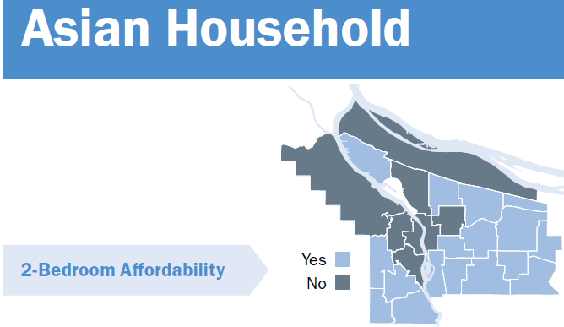
Rental Affordability

Slide 13
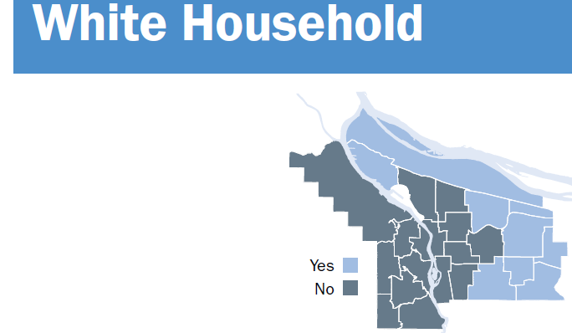
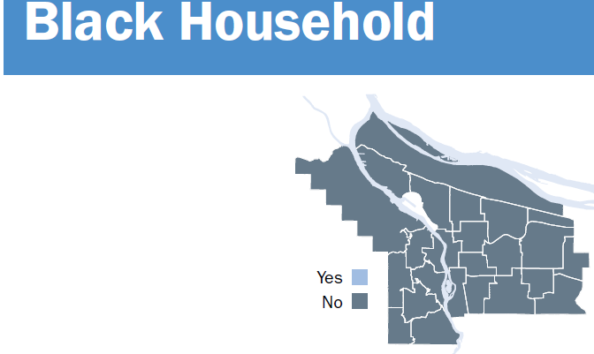
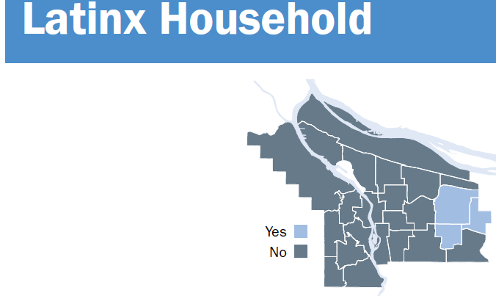
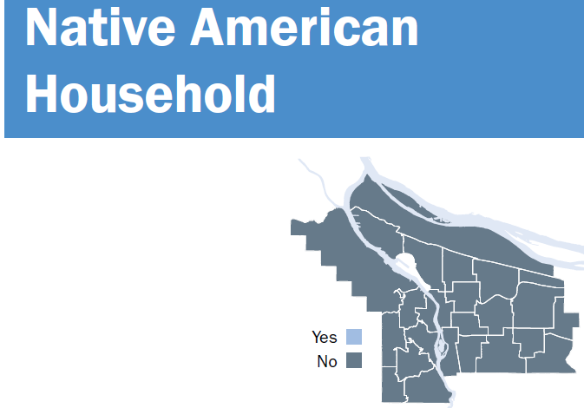
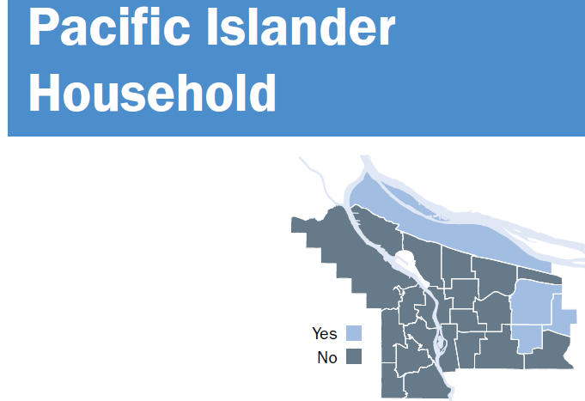
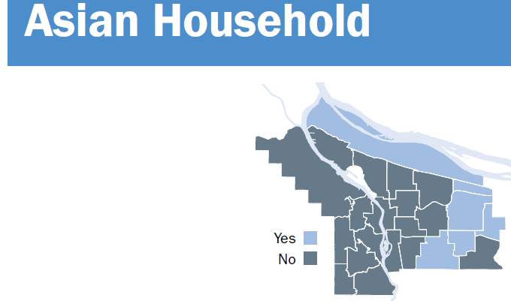
Homeownership Affordability

Slide 14
Change in Rent Per Year

Slide 15
Vacancy Rates

Slide 16
Asking Rents

Slide 17
Rent Concession Rates

Slide 18
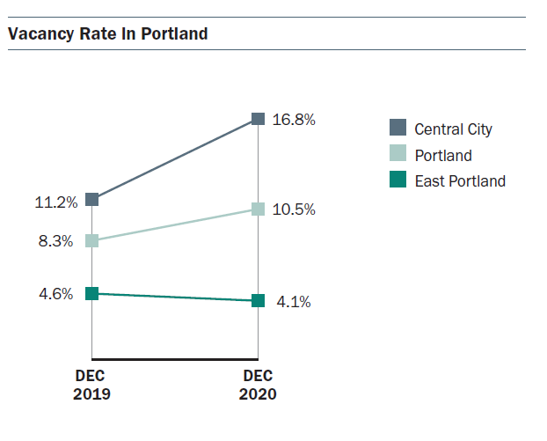
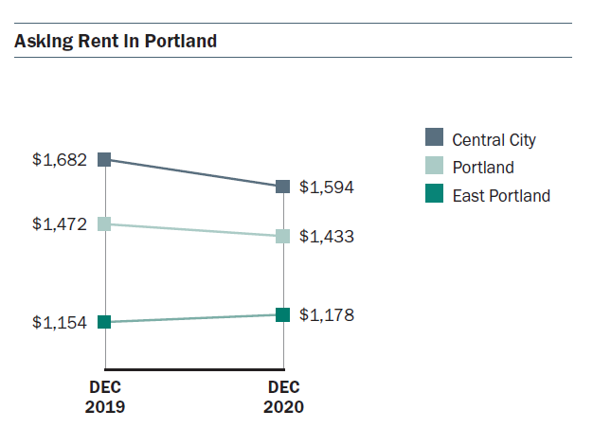
COVID19 Impacts on Housing
Notes:
Just looking at last one year

Slide 19
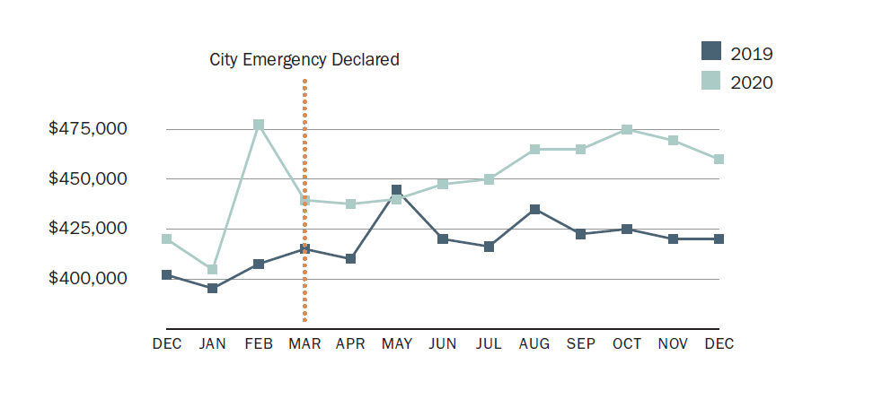
Median Home Sales Price

Slide 20
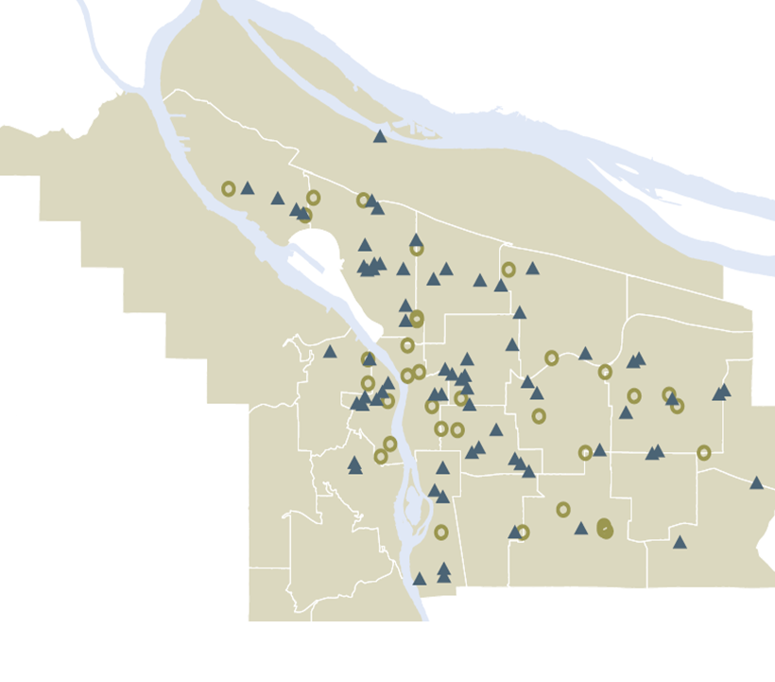
Housing Development Since State of Emergency
5,858+ affordable homes (open or in progress)
11,000 Portlanders stably housed
1/3 of units deeply affordable
Notes:
In 2015, the City declared a Housing Emergency - the Portland Housing Bureau accelerated our resources to create more affordable housing sooner.
Since that time, the Housing Bureau has worked to create a pipeline of over 5,700 new affordable homes. That will stably house 11,000 Portlanders
- Nearly 3,000 of which are already housing Portlanders
- 23% of which are as from the Inclusionary Housing program
- 1/3 of which are deeply affordable meaning they are affordable to people with little to no income.
---
Regulated Affordable Housing open and in pipeline:
Total open: 2,997 units
Total pipeline: 3,401
77% of units are PHB, 23% IH/MULTE
7,137 bedrooms
30% (1,348) of PHB units in opened and in pipeline are deeply affordable (0-30%AMI)
Providing homes for approximately 11,000+ people in the future

Slide 21
Discussion

