Slide 1
Sunnyside/Ladd’s South Reconst & Green Streets
BES Project #: E10368
Kerry Rubin, P.E | Interim Chief Engineer | Bureau of Environmental Services
Ronda Fast | Project Manager| Bureau of Environmental Services
MINGUS MAPPS, COMMISSIONER MICHAEL JORDAN, DIRECTOR

Slide 2
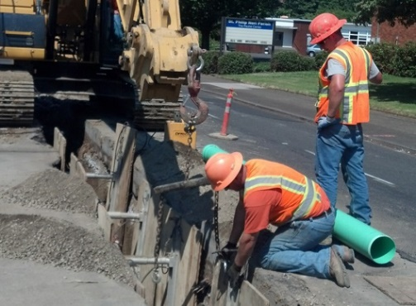
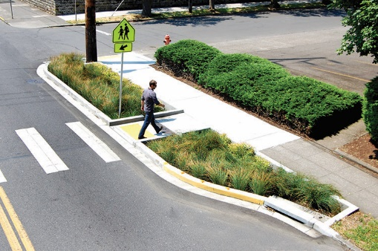
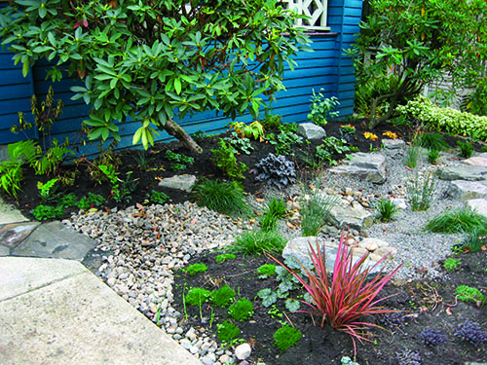
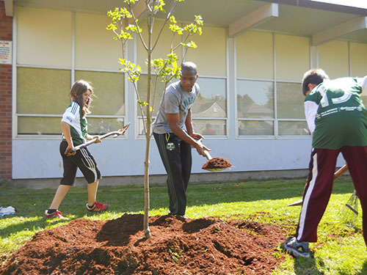
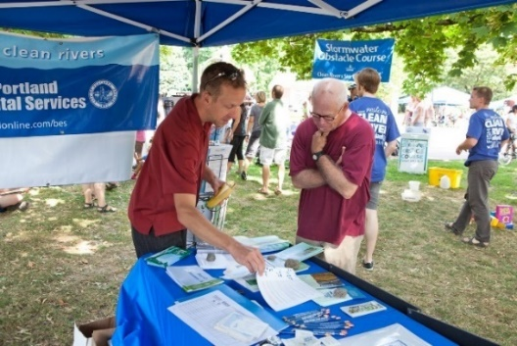
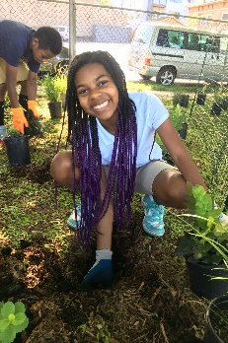
Program Background
Address undersized and old pipes
Prevent basement sewer backups and structural failures
Prevent Combined System Overflows (CSO’s)
Pipe Projects
Green Streets
Private Property Retrofits
Tree Planting
Community Outreach
Vegetation Projects
Notes:
This project is part of the larger from you N2R Program. This is an integrated delivery
The N2R program is an Integrated Delivery program – a specialized delivery program within the Bureau that combines traditional pipe projects with natural solutions to protect and restore our rivers and streams. Today you will hear about the Pipe and Green Street portions of this effort, however this project will work in concert with the 4 additional program elements highlighted here. This program also works:
with private property owners on stormwater management - usually in the form of residential rain gardens,
on planting trees,
on reaching out to residents and community partners many times through neighborhood projects that reduce impervious area and enhance vegetation.
Now Brandon Wilson, the Project Manager, will provide an overview of the capital project.
Additional Information:
N2R project areas are formed around a clustering of capital improvement projects – i.e. pipe upsizing in the combined system and stormwater treatment facilities in the separated system. Focus on community-led partnerships with schools and local organizations for outreach and vegetation projects.
We currently have four project areas: 1) the Columbia Corridor, which encompasses parts of N, NE and outer NE Portland, 2) the Boise-Eliot Neighborhood, 3) the Alder Basin, including the Richmond, Sunnyside neighborhoods, and parts of the Buckman and Kerns neighborhoods and 3) the Tanner Creek Area, including the Pearl District and Goose Hollow
If you want to discuss further or if people ask questions about T2R:
*N2R evolved from The Tabor to the River Program. Successful efforts include planting 3,500 trees; Adding 500 green streets; Building 100 private stormwater projects; Repairing or replacing 81,000 feet of sewer pipe; Removing invasive plants from parks and natural areas; Improving wildlife habitat, cleaning the air and making neighborhoods healthier. T2R proved to be a successful model for community involvement in CIP activity.

Slide 3
Project Location(s)
SE 12th Avenue
SE Belmont Street
SE Hawthorne Blvd.
SE Cesar Chavez Blvd
SE Division Street

Slide 4
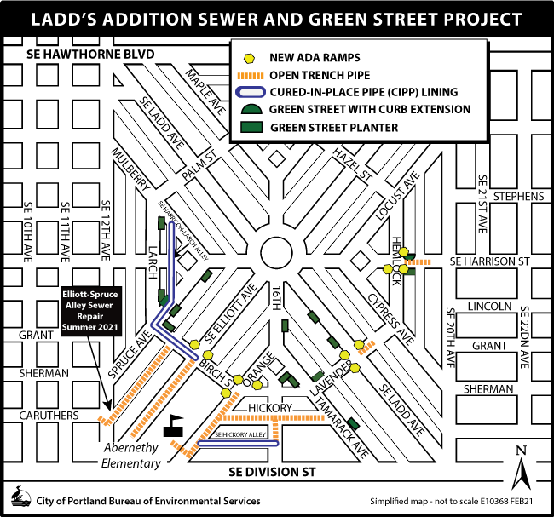
Project Location – Ladd’s South

Slide 5
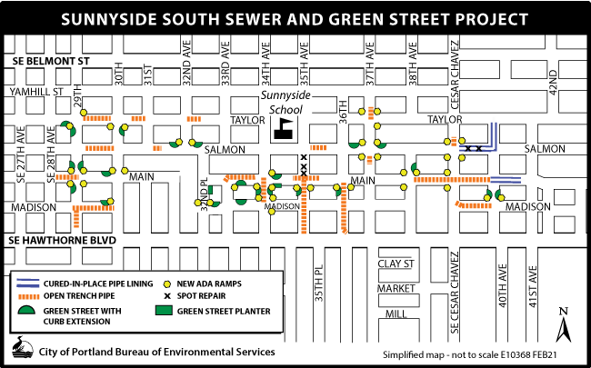
Project Location – Sunnyside South

Slide 6
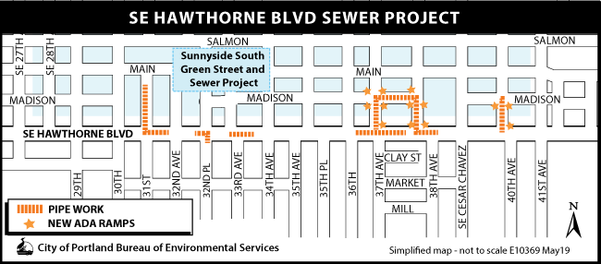
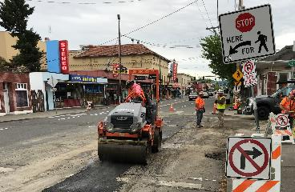
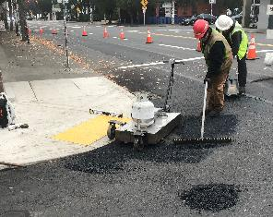
Related work: Hawthorne (E10369)
Expedited summer 2020, during COVID-19 business closure, and ahead of PBOT project

Slide 7
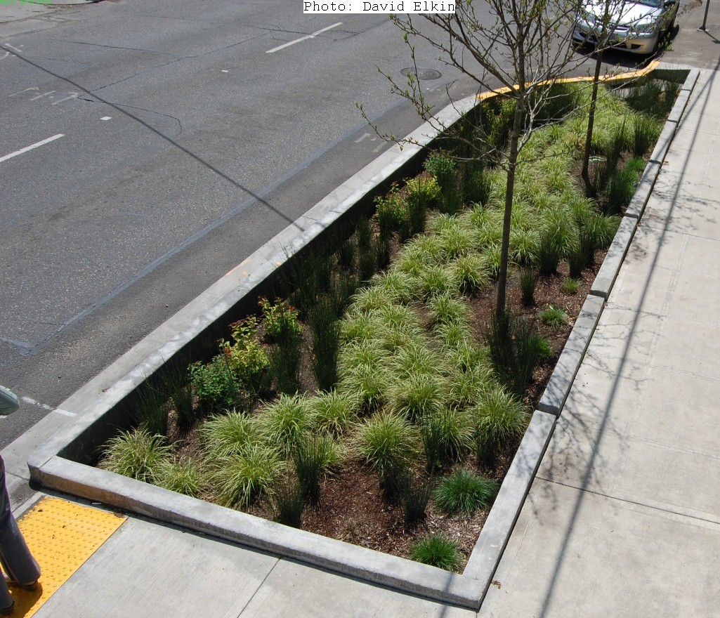
Project Details
~ 2 miles of combined sewer pipe replacement or rehabilitation
55 non-conforming sewer extensions
58 vegetated green street stormwater facilities
75 curb ramps updated to meet ADA

Slide 8
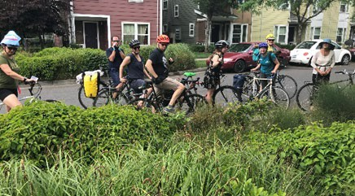
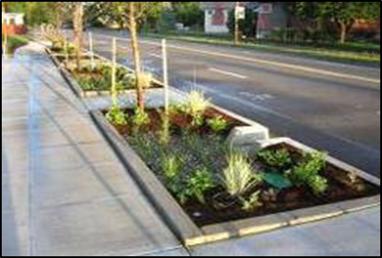
Public Involvement
Early and extensive public input and outreach
Other projects nearby:
(Sunnyside East, Sunnyside North,
Buckman-Stark, Hawthorne)
Early feedback from property owners and residents helped inform the final design

Slide 9
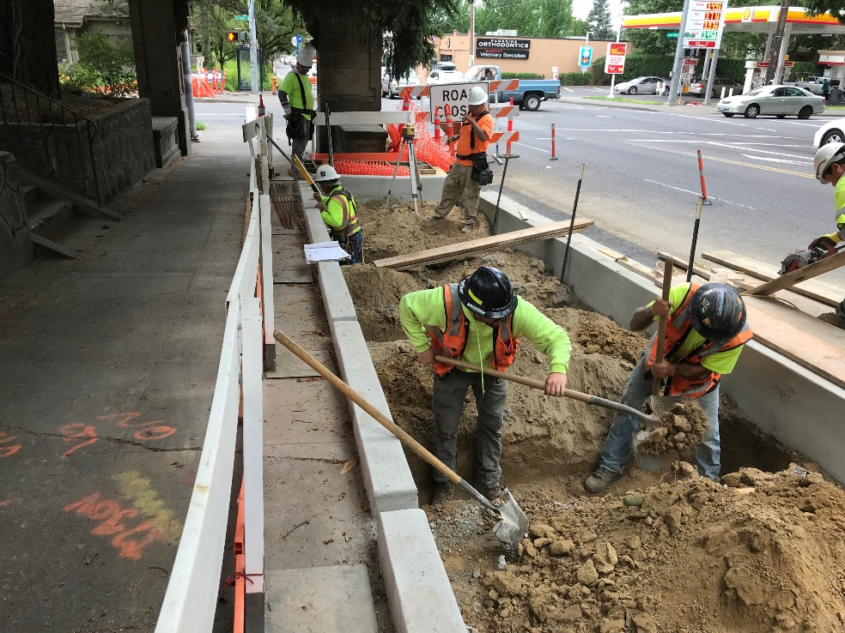
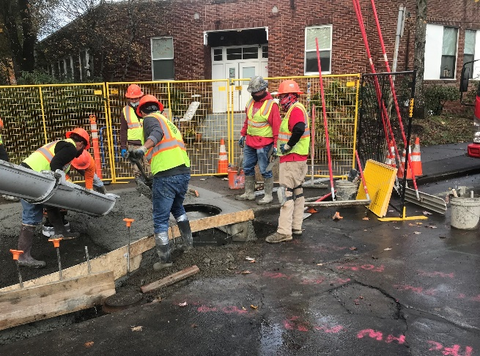
Social Equity in Contracting
Outreach to COBID-certified firms
Open trench sewer construction
Excavation
Saw cutting
Grinding
Trucking and hauling
Paving, asphalt and concrete
Traffic control, and flagging
Stormwater facility construction
Temporary bypass pumping /dewatering
Soil remediation and mitigation
Locates / Underground GPR
Cured in Place pipe lining
Pipe Bursting & trenchless sewer installation
Notes:
State - Certification Office for Business Inclusion and Diversity

Slide 10
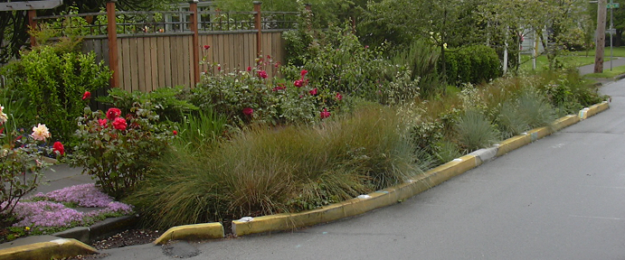
$10.3
Million
Project Budget and Schedule
Jan
2022
Begin Construction
Jun
2023
End Construction
Construction Estimate
Level of Confidence—High

Slide 11
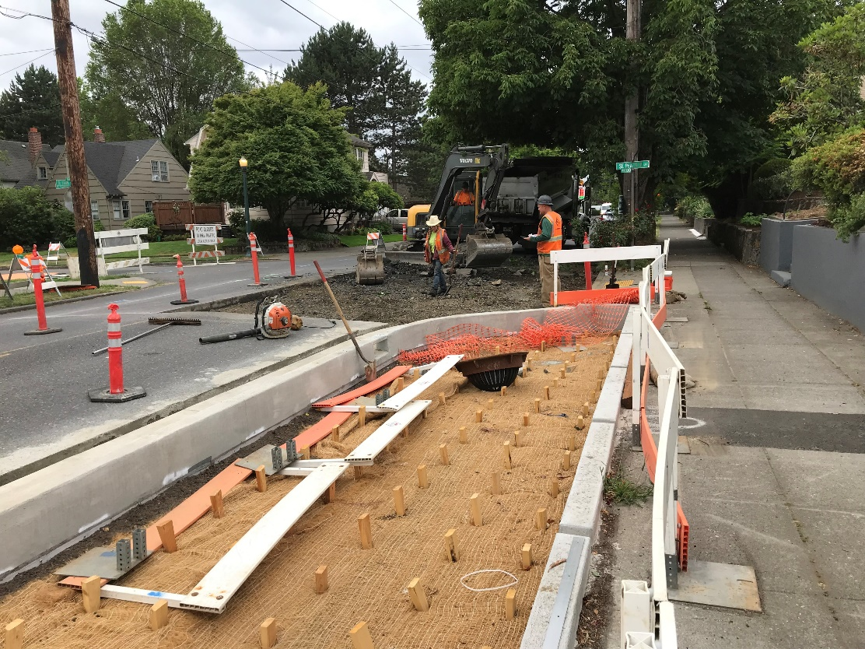
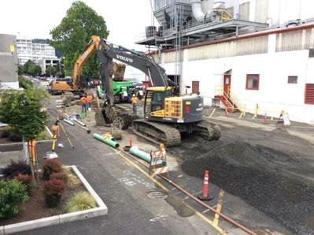
Questions?

