Slide 1
Amend City Building Code Provisions to Clarify Permit Abandonment, Expiration, Extensions, and Reactivation (Life of Permits)
City Council Hearing
March 31, 2021

Slide 2
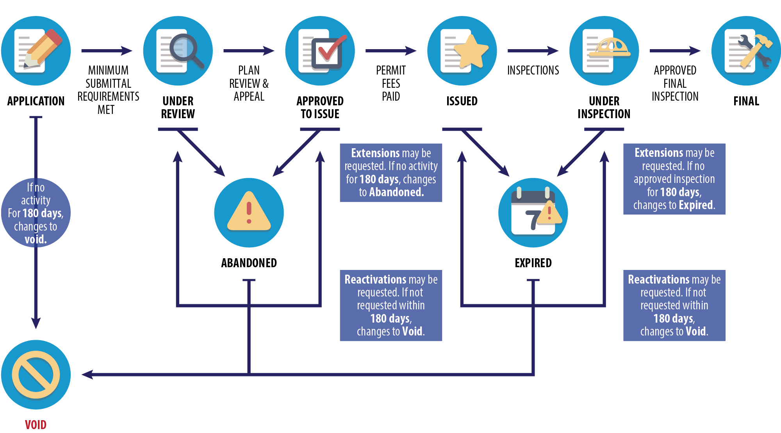
Life of Permits

Slide 3
General Amendments
Applies to building, plumbing, mechanical, electrical and sign permits
Separates requirements for:
Permit applications,
Permits under review, and
Issued permits.
Separates requirements for:
Abandoned or Expired status; and
Void status
Allows more than one extension
Removes specific fee requirements

Slide 4
Wireless Facility Permit Amendments
 | Type of Shot Clock (Calendar Days) | Qualifying Features | PWSF Appl. Form # | # of Calendar Days for BDS Completeness Review | # of Calendar Days for Review of Checksheet Responses | Subsequent Reviews that Stop Shot Clock
47 U.S.C. §322(c)(7)
 | 90 Days | Adding antennas to any existing structure: tower, light pole, rooftop, water tank, etc. | 1 | 30 days for completeness review, then shot clock stops once Checksheet issued | 10 calendar days to review submitted items. If missed, then shot clock does not stop. | Shot clock stops again only if new Checksheet send within 10 calendar days of Checksheet response. Otherwise, shot clock is not stopped.
 | 150 Days | New structure: freestanding tower, light pole, etc. | 2 | 30 days for completeness review, then shot clock stops once Checksheet issued | 10 calendar days to review submitted items. If missed, then shot clock does not stop. | Shot clock stops again only if new Checksheet send within 10 calendar days of Checksheet response. Otherwise, shot clock is not stopped.
47 U.S.C.1455 - Section 6409(a) Wireless Facility Modifications
 | 60 Days | Modify existing facility by replacing or adding new antennas, accessory equipment, or equipment cabinets | 3 | 30 days for completeness review, then shot clock stops once Checksheet is issued | 10 days for review of new information. No new discoveries can be Checksheeted, unless part of new information submitted. Shot clock stops each time new Checksheet sent. | Review limited to issues identified in original Checksheet; shot clock tolled.
Declaratory Ruling and Third Report and Order – Small Wireless Facilities That Are Not 6409(a)
 | 60 Days | Additions/alterations to a base station by carrier. Antennas are no more than 3 cubic feet in volume. Equipment (existing and new) is no more than 28 cubic feet in volume. | 4 | 10 days for completeness review, then shot clock stops once Checksheet is issued. | Clock restarts to 60 days, but only for first Checksheet response. 10 days to review information provided. No new discoveries can be Checksheeted, unless part of new information submitted. Shot clock stops for each new Checksheet. | Shot clock stops again only if new Checksheet sent w/in 10 calendar days of Checksheet response. Otherwise, shot clock does not stop.
 | 90 days | A new base station (freestanding tower or new building or structure-mounted location) with no previous permits or land use approvals for cell facilities | 5 | 10 days for completeness review, then shot clock stops once Checksheet is issued | Clock restarts to 90 days, but only for first Checksheet response. 10 days to review information provided. No new discoveries can be Checksheeted, unless part of new information submitted. Shot clock stops each time new Checksheet sent. | Shot clock stops again only if new Checksheet sent w/in 10 calendar days of Checksheet response. Otherwise, shot clock does not stop.
Notes:
These are the “shot clocks,” or time frames in which the City has to get a permit issued, for Personal Wireless Service Facilities.

Slide 5
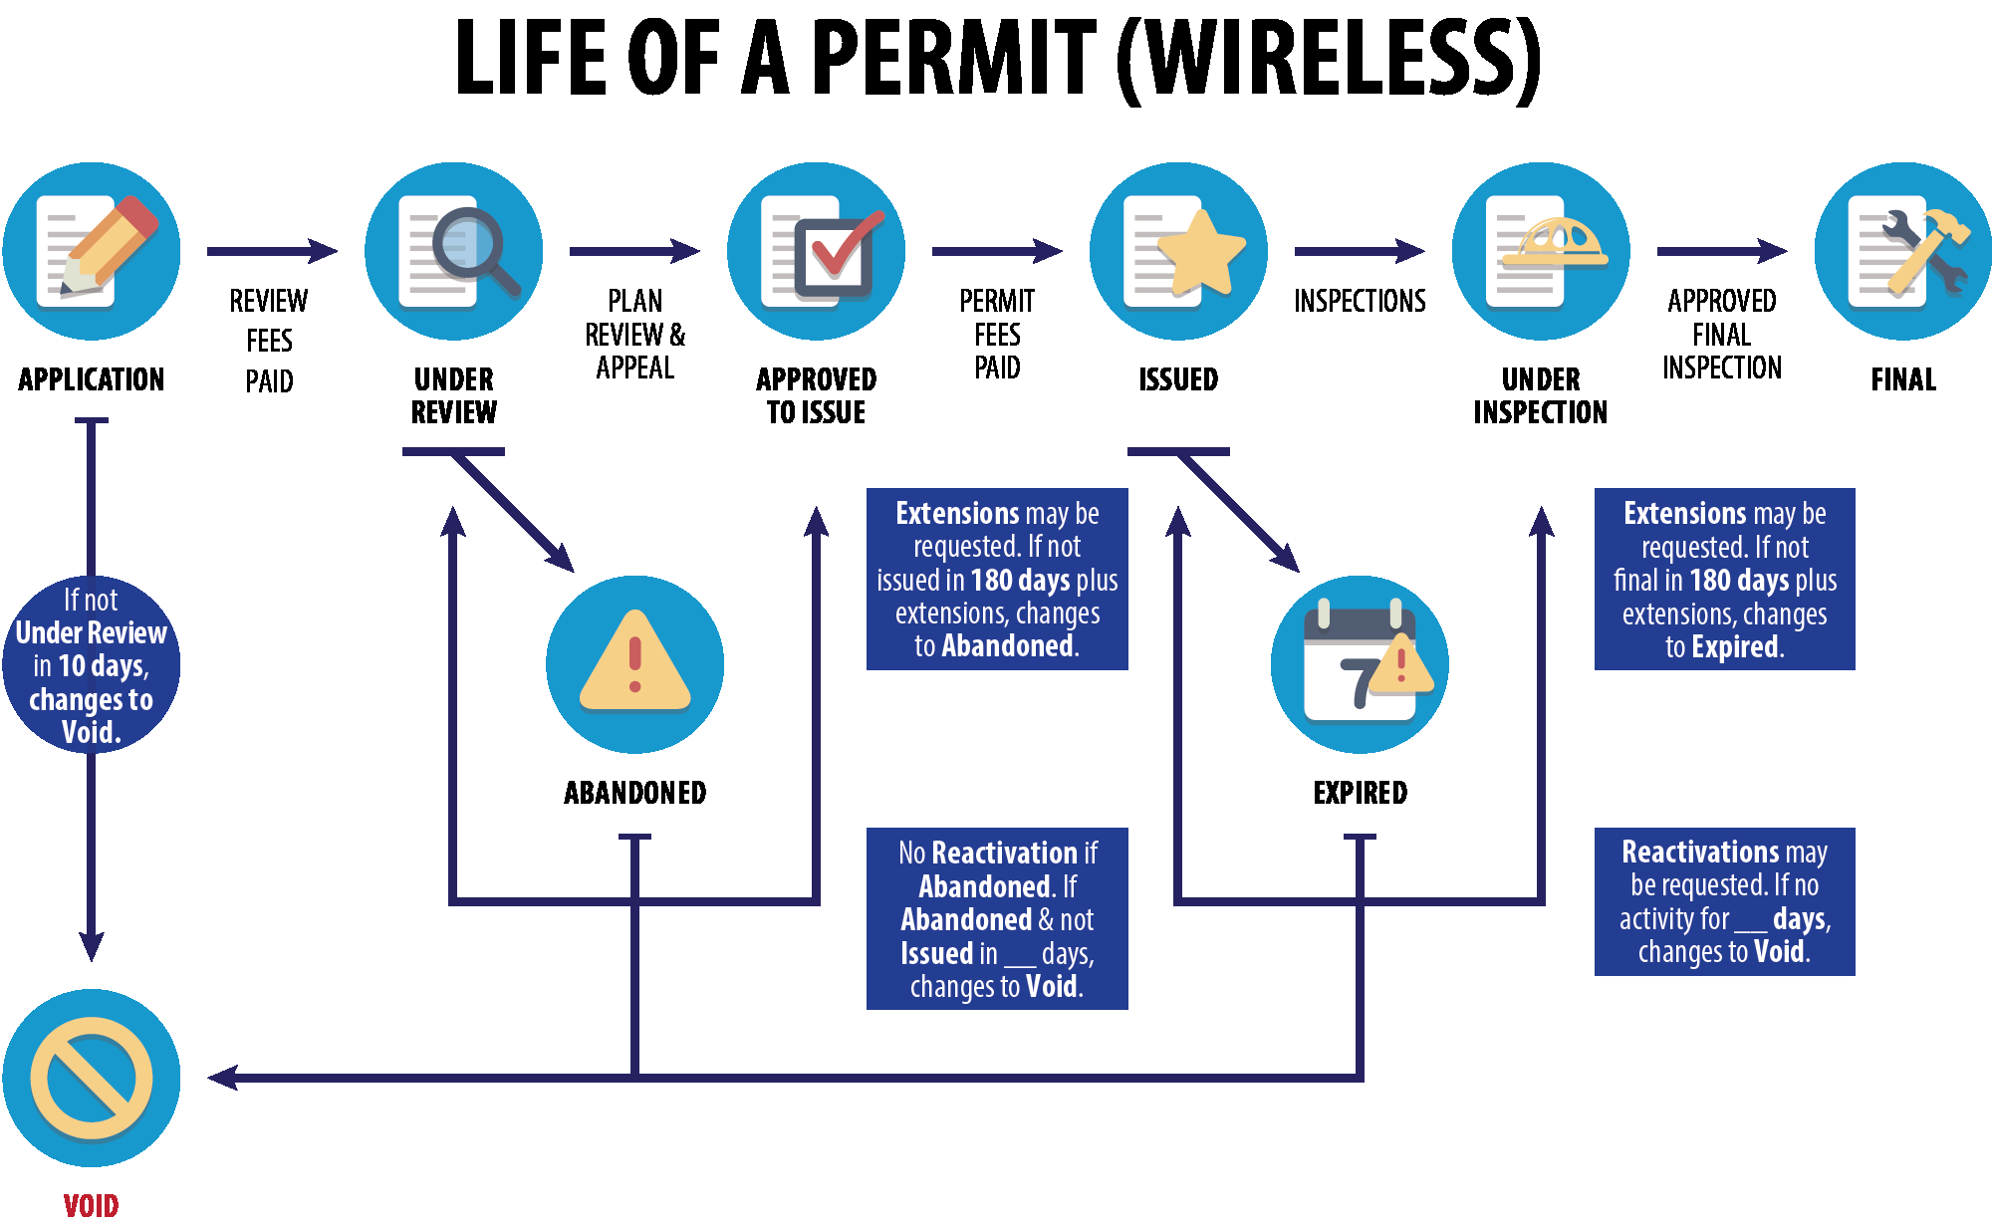
Wireless Facility Permit Amendments

Slide 6
Other Presenters:
Meridee Pabst – AT&T
Kathy Putt – Crown Castle

Slide 7
QUESTIONS?

