Slide 1
Fair Housing Month 2021
Director Shannon Callahan
Portland Housing Bureau
April 7, 2021

Slide 2
Fair Housing Council of Oregon
Allan Lazo
Executive Director

Slide 3
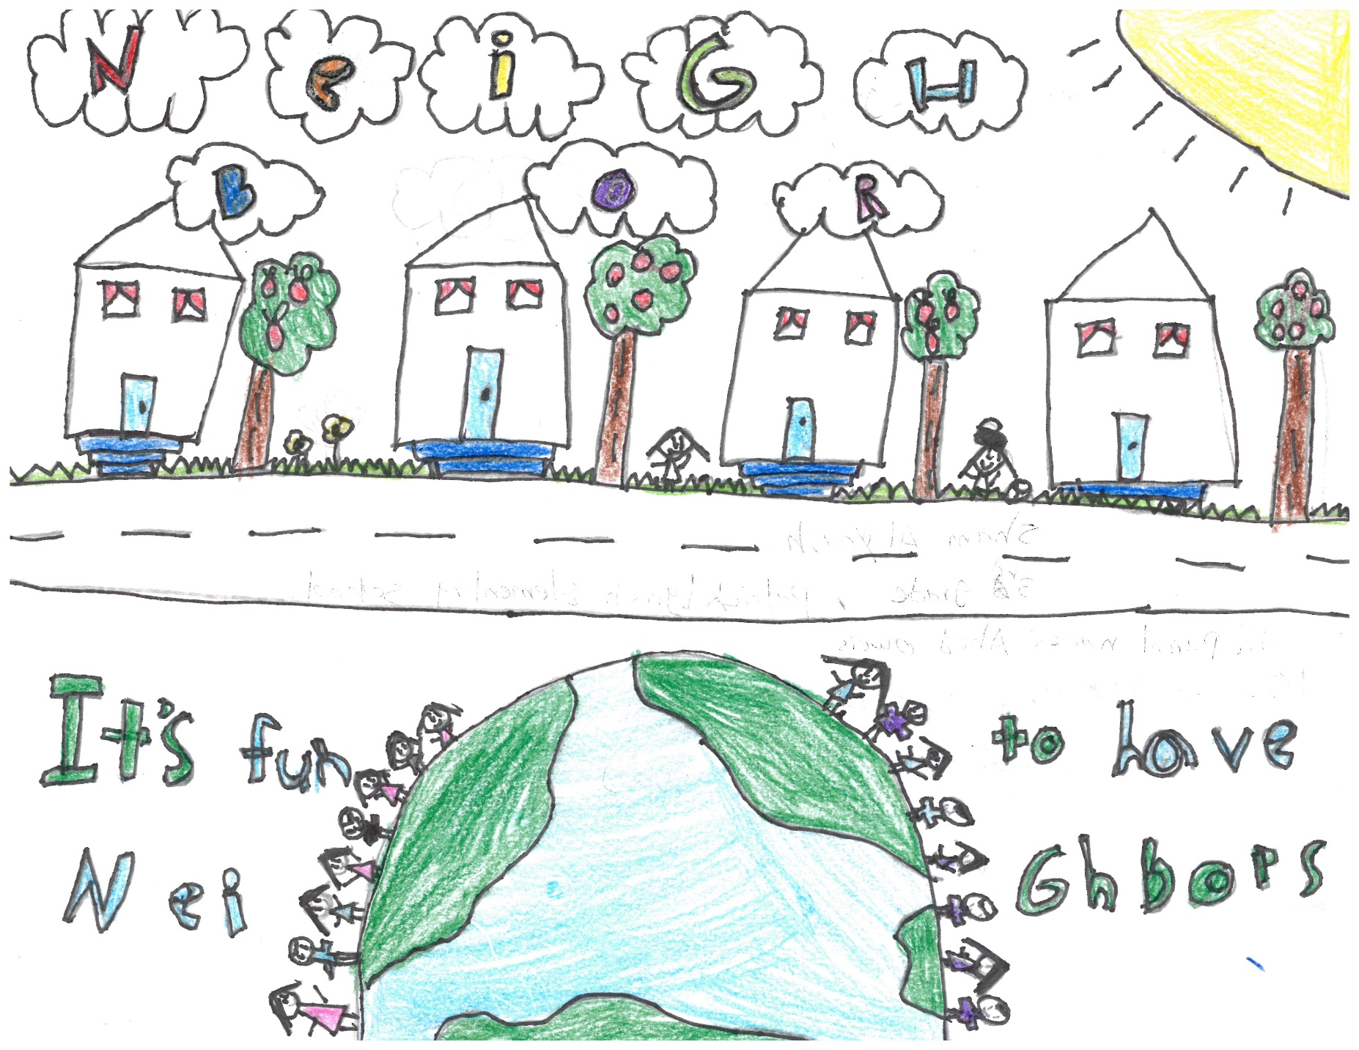
Sham Alayoush
3rd Grade
Patrick Lynch Elementary School

Slide 4
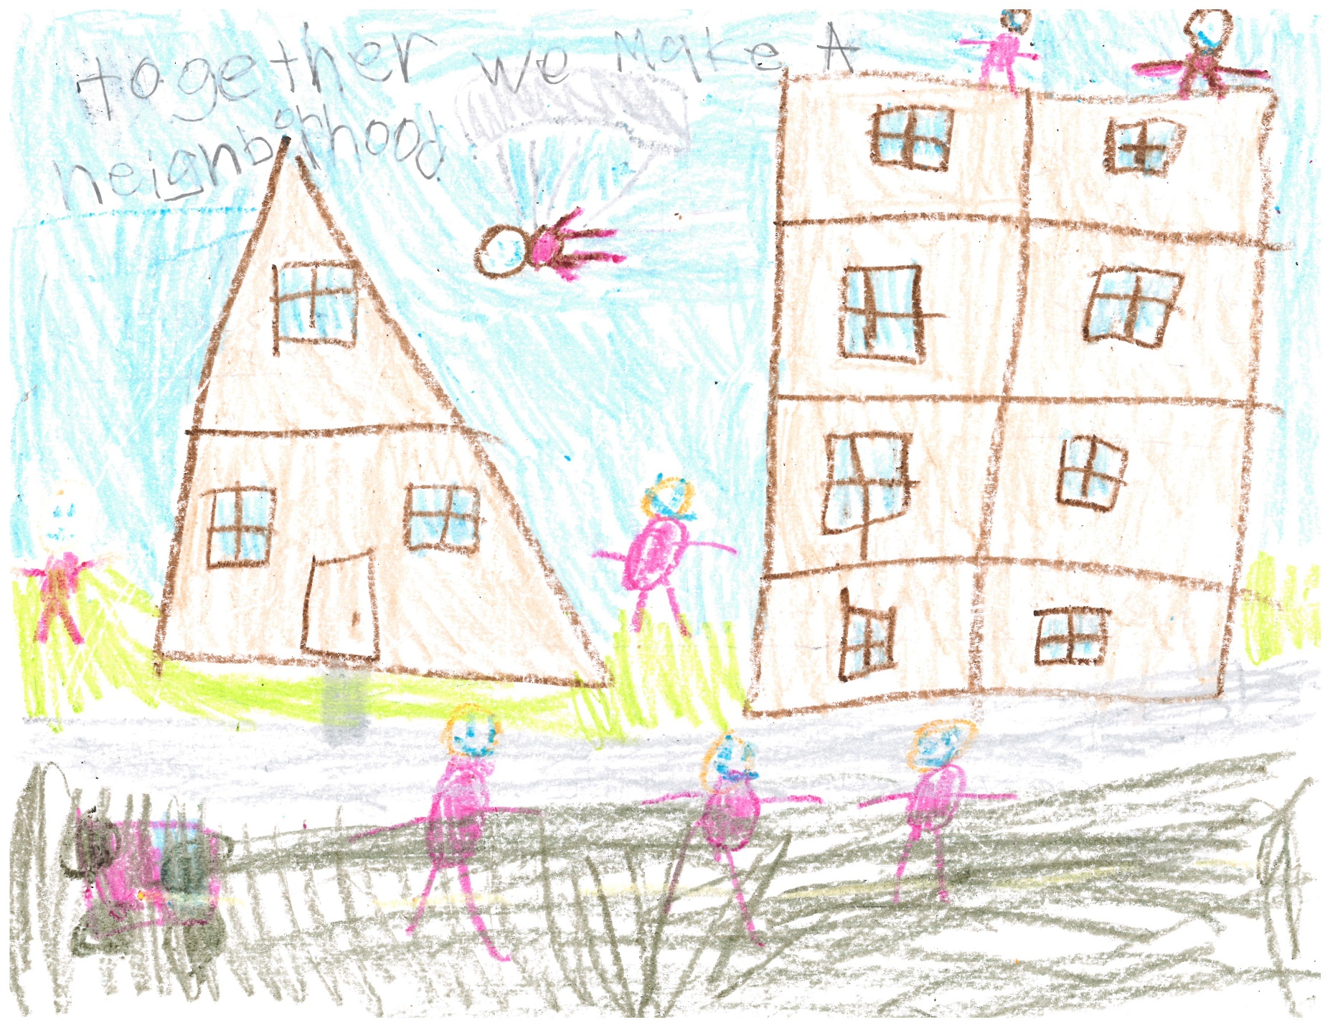
Jack Williams
7th Grade
Reynolds Middle School

Slide 5
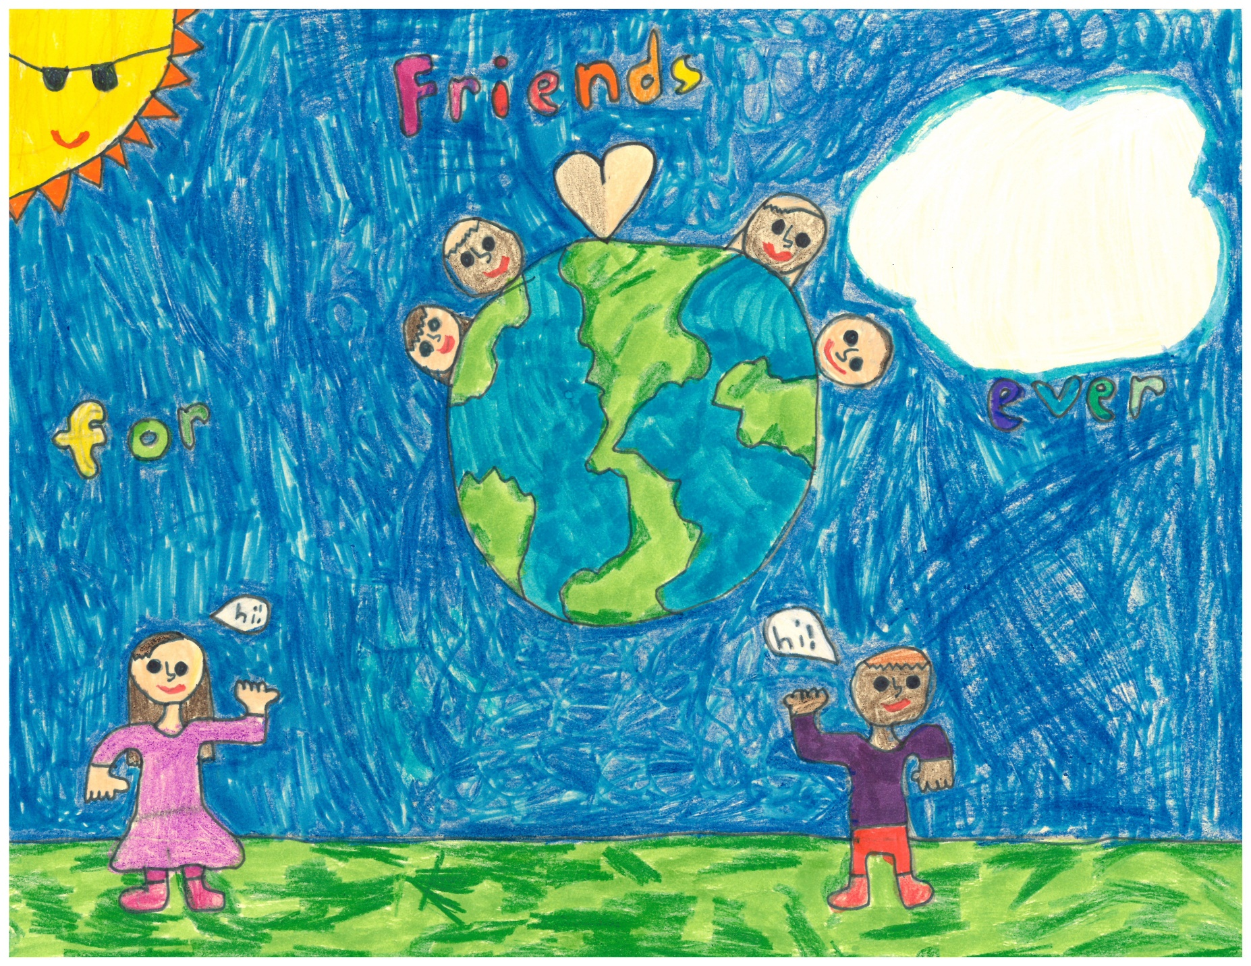
Rosa Shuman
3rd Grade
The Ivy School

Slide 6
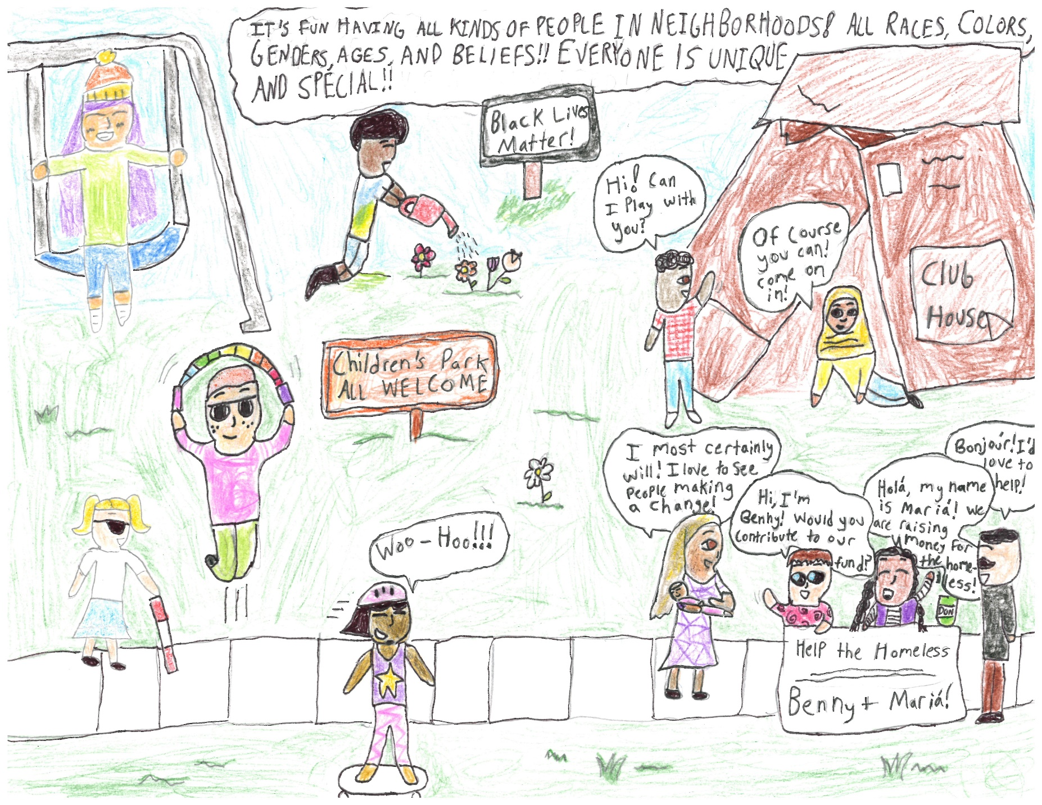
June Afeman
5th Grade
The Ivy School

Slide 7
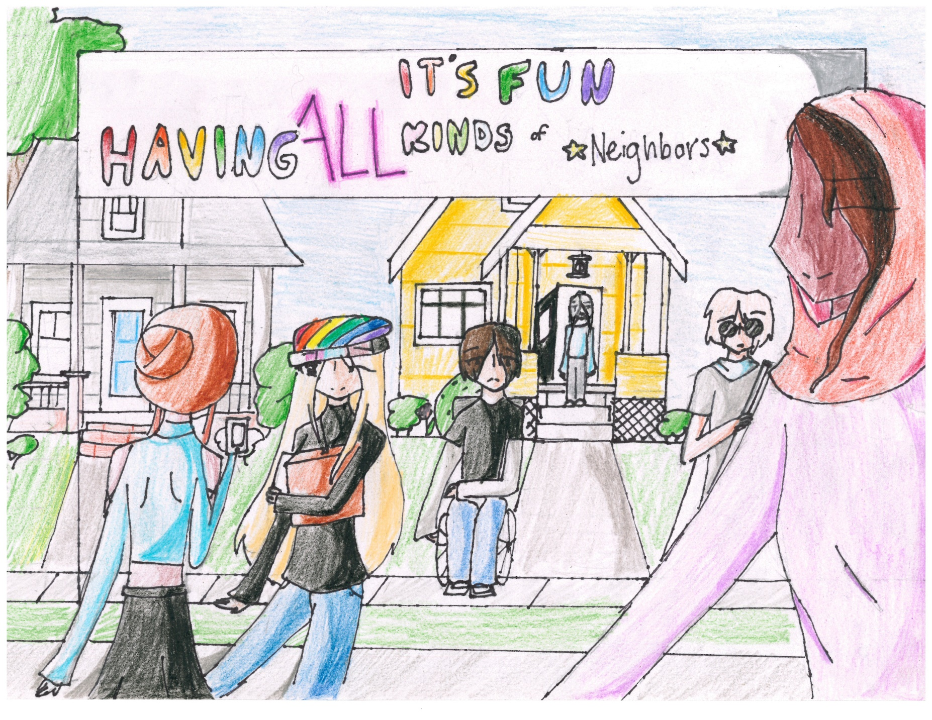
Annaliese DuPont
4th Grade
Beverly Cleary School
GRAND PRIZE WINNER

