Slide 1

City of Portland
City Council
APPEAL - Type III Land Use Review
LU 20-176578 DZ
1000 SW Broadway
February 10, 2021
Staff Presentation
Notes:
Good afternoon Mayor & Council members
Hannah Bryant – City Planner with Design & Historic Review Team, in the Land Use Services division at BDS
Here to present the T3LU appeal for 1000 SW Broadway

Slide 2
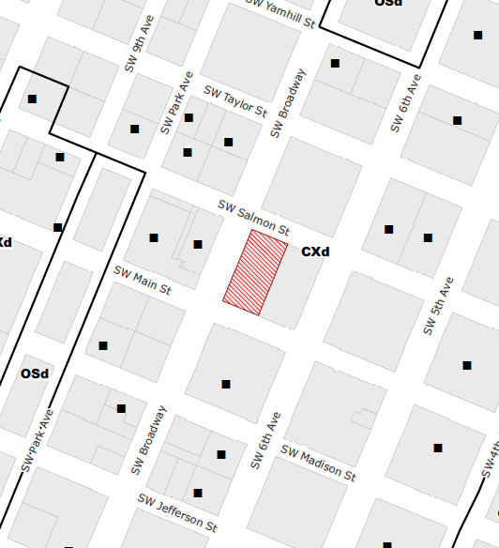
Location
Central City Plan District
Downtown Subdistrict
Base Zone
CX - Central Commercial zone Design Overlay

Slide 3
Approval Criteria
Design Review
Central City Fundamental Design Guidelines
Modifications & Adjustment
None Requested.

Slide 4
Program Overview
Partial ground level remodel of existing building.
Enclose existing arcade at sidewalk.
Replace vacant below-grade movie theaters with new ground level commercial tenant space and large lobby.
Remove existing movie theater sign.
Maintain existing driveways.
Existing Ground Level
Proposed Ground Level
Notes:
The applicant seeks approval to enclose an existing ground level arcade (shown in the top right image). The arcade was developed to provide shelter for movie theater guests as they queued to buy tickets and enter the basement level theater. The former movie theater has been closed for over a decade. Building ownership is pursuing a large building remodel to remove the former theaters, create new ground level commercial tenant spaces, and a large new building lobby.

Slide 5
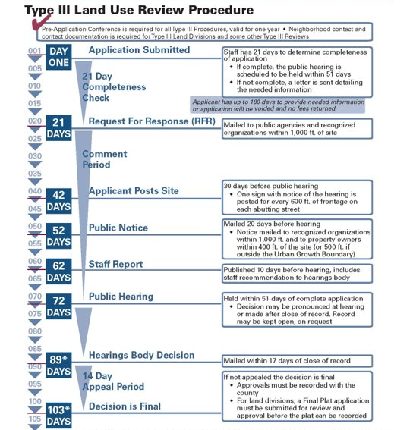
LU 20-176578 DZ
Submitted – August 11, 2020
Effective Code – August 2020 (includes changes to PZC 33.510)
Public Hearing – November 19, 2020
Review Procedure
Notes:
The project has gone through a Type III Design Review. Consistent with all reviews of this type, feedback was solicited from other interagency partner bureaus, as well as the public. The site was posted with images and a description of the proposal, the contact information for the staff planner and applicant; and a mailed notice was sent out to all nearby registered organizations as well as neighboring residents.
Only one comment was received – a letter from the Downtown Neighborhood Association. No other written or oral testimony was received from the public related to this proposal.
A public Design Commission hearing was held on November 19th. At that hearing, the Design Commission voted to approve the project. No additional conditions of approval or revisions were requested.

Slide 6
Project History
Design Commission Focus
Enhanced quality of pedestrian experience with significant new storefront windows into active ground level spaces;
Increased weather protection on all three streets;
Multiple new pedestrian entrances onto SW Broadway;
Thoughtful details to protect existing stone cladding at base of building.
Public Interest
1 written comment received from Downtown Neighborhood Association (DNA). No other testimony or comments.
Basis of DNA opposition: The DNA believes the existing sign warrants protection.
Notes:
At the November 19th Design Commission hearing, the Commission’s deliberations focused on the ways the proposal would enhance the pedestrian environment, including adding large windows into active ground level uses; increased weather protection in the form of glass and steel canopies on all three streets; multiple new pedestrian entrances; and the thoughtful detailing designed to protect the existing stone cladding on the building from damage during construction.

Slide 7
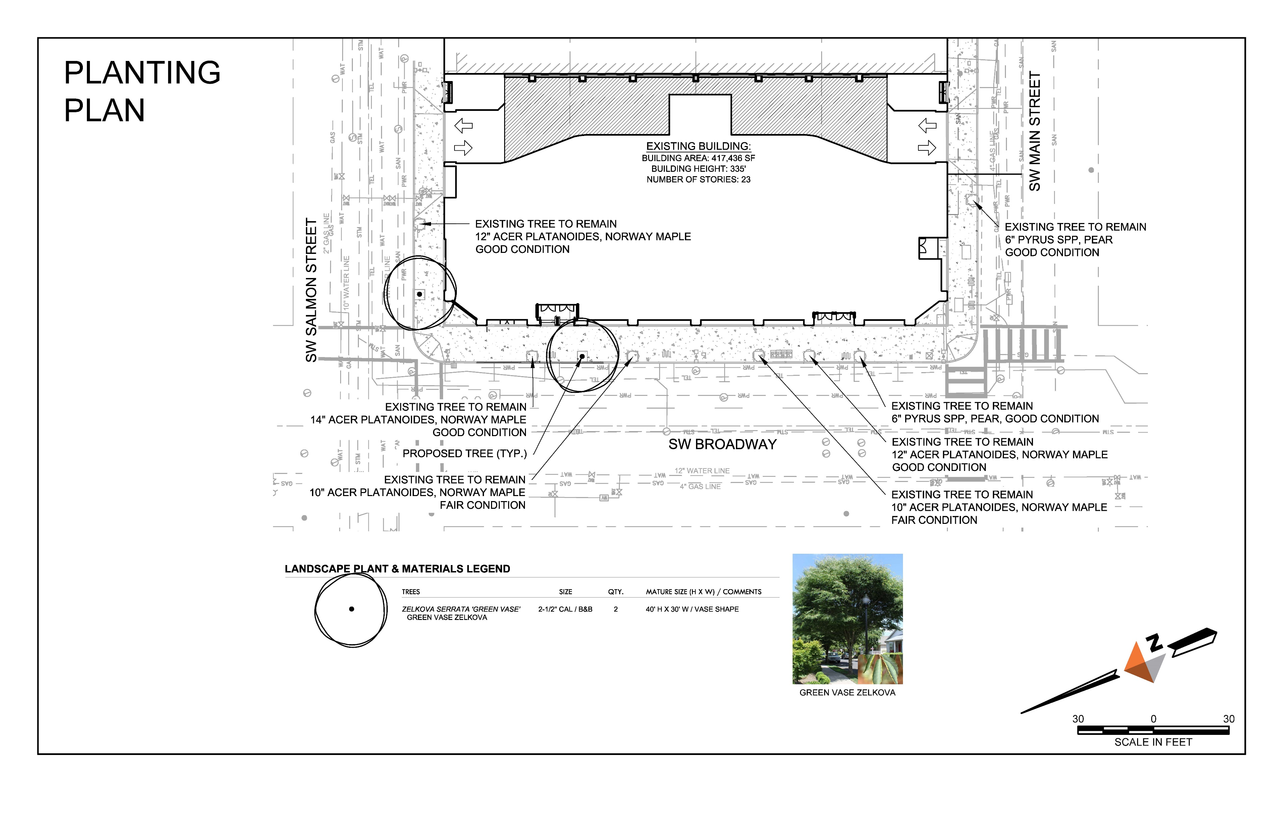
APPEAL ITEM 1
Street Tree Palette
WITHDRAWN – The applicant has worked with Urban Forestry and the appellant to revise the street tree plan. The DNA has withdrawn this issue from the appeal.
Notes:
The DNA is the appellant in this appeal. In its appeal statement, the DNA listed two issues… The first issue is related to the street tree palette. This issue has been resolved. The applicant worked with Urban Forestry and the appellant to revise the street tree plan. Urban Forestry has approved the revised plan, and the DNA has withdrawn this issue from the appeal.

Slide 8
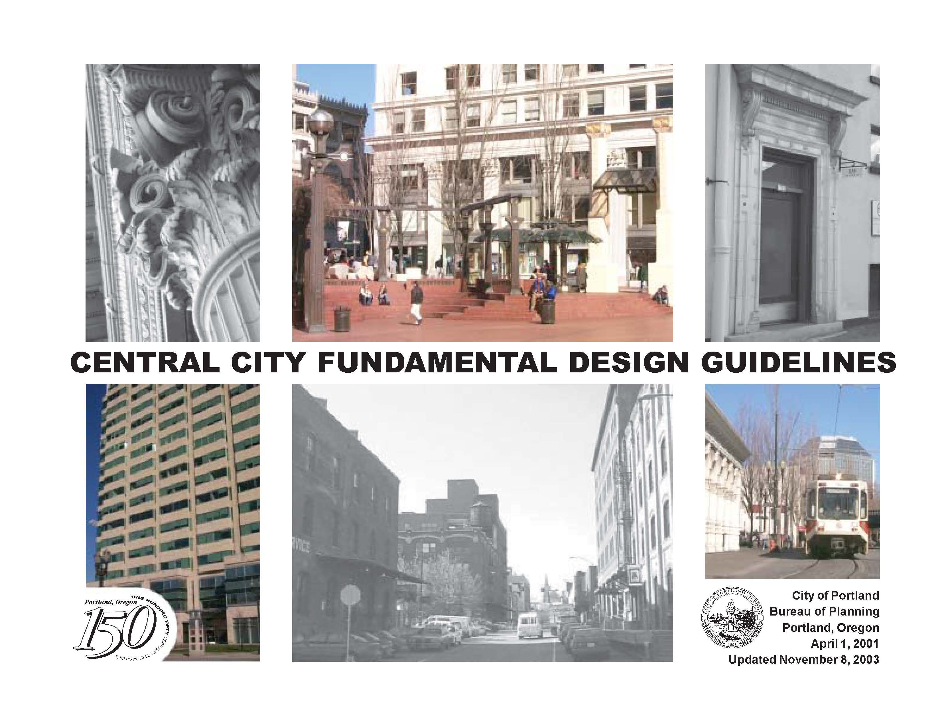
APPEAL ITEM 2
Removal of Existing Former Theater Sign
Notes:
The second appeal item is the retention of the existing movie theater sign. The removal of this existing sign was approved, as part of the overall Design Review approval for the project. The Downtown Neighborhood Association objects to that portion of the approval, and it is the basis for this appeal.
Before I jump into the nuance of this, I’ll begin with some background information. First – a review of the Design Review process, followed with some background on this particular sign.
Simply put, Design Review staff, and our volunteer Design Commission, weigh the proposals that are put forward by applicants against the relevant design guidelines for that site. If a proposal meets the design guidelines as it is presented by the applicant, it is approved. If the proposal does not meet the guidelines, we work with applicants to refine the design to ensure it does meet guidelines, or we can deny the proposal.
During the design review process, we study the historic reviews for the site, and the previous decisions to inform our current review.

Slide 9
APPEAL ITEM 2
Existing Sign
Notes:
This sign – from the horizontal marquee at the bottom to the detailing at the top (not including the base), is almost 40’ tall. The sign is exclusively supported by its large base, which comes down to the ground in front of the chamfered building corner, beside the sidewalk right-of-way. There is currently only a single lateral tie to the building, and no other attachments.
This building was approved through a 1989 review. That review found that the building – without the sign – met the approval criteria. The sign was approved later, in 1991, through an Adjustment Review. The Adjustment review approved a sign size larger than that which is allowed through Portland’s Sign Code, Title 32. This increased size was justified based on the history of large, illuminated signs along SW Broadway. This context-specific allowance is reflected in the current Central City Fundamental Design Guideline D3 – Broadway Unique Sign District.

Slide 10
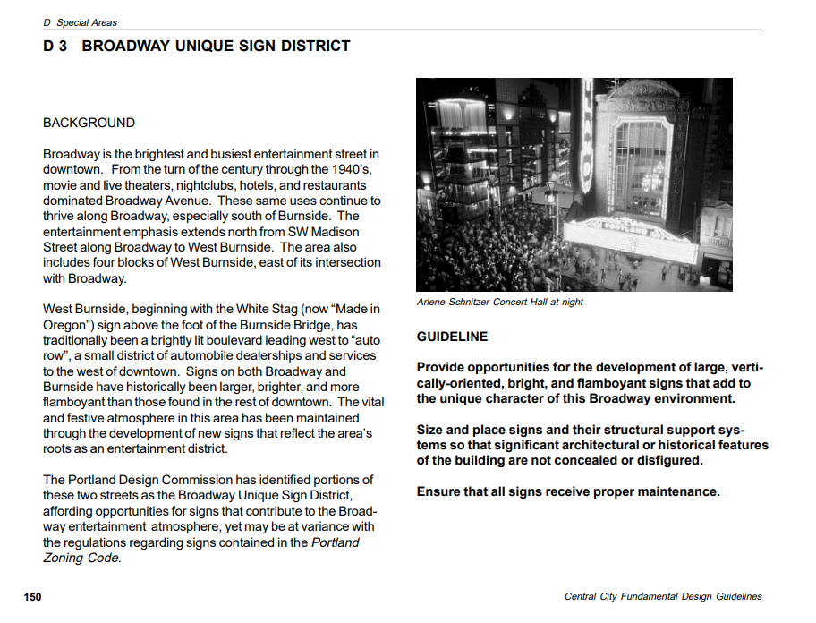
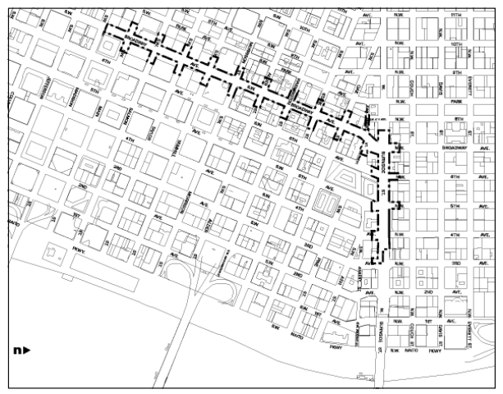
Notes:
This Design Guideline – which I can bring up again if you would like to review it – recognizes that Portland has a very restrictive sign code, and it says that in this area, we allow people do something special, beyond that which is outright allowed by sign code. It is a permissive guideline, but has not previously constituted a requirement – in that we have not required every new development on Broadway to include a large, illuminated sign but have allowed them when they are proposed and desired by the applicants.

Slide 11
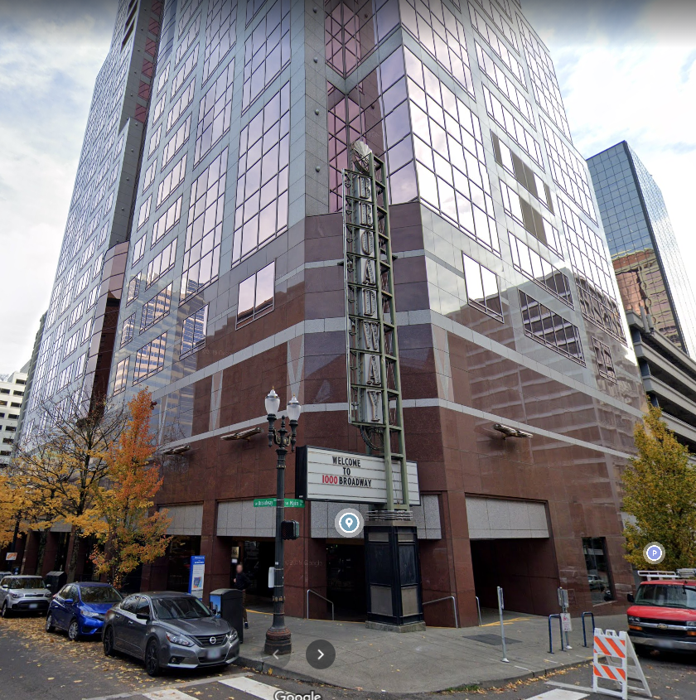
APPEAL ITEM 2
Removal of Existing Former Theater Sign
Design Commission felt removal of the sign better met the following:
  A6 – Reuse / Rehabilitate / Restore Buildings
  A8 – Contribute to a Vibrant Streetscape
  B1 – Reinforce and Enhance the Pedestrian System
  B2 – Protect the Pedestrian
  B3 – Bridge Pedestrian Obstacles
  B6 – Develop Weather Protection
  C3 – Respect Architectural Integrity
  C7 – Design Corners That Build Active Intersections
Notes:
When considering this item, the Design Commission determined that as a product of the 1990s, the sign does not have historic significance and that its retention creates an awkward pedestrian condition. The Design Commission determined that removing the sign and its base to allow unobstructed views into a new active commercial space, plus the additional canopy coverage at this corner, better meets the approval criteria than retaining the sign. It saw this proposal as a “repair to the urban fabric” and celebrated the revitalization of this building, particularly during such a challenging time in our downtown.
While staff and the Design Commission indicated appreciation for the existing sign, it was determined that the proposal, as presented by the applicant, which included the removal of the sign, met the Design Guidelines and was approvable.

Slide 12
APPEAL ITEM 2
Option 1: Deny the appeal; Uphold the previous Design Commission approval
Notes:
As the deciding body, you have three options before you today. For the sake of clarity, I’ve attempted to illustrate each of these options.
Option 1: to Deny the appeal and uphold the previous design commission agenda, would result in this outcome:
This option would remove the sign and its base, and uphold the approval that includes new storefront between the columns and new canopies.

Slide 13
APPEAL ITEM 2
Option 2: Deny the appeal; Modify the Design Commission’s decision of approval; Instruct the applicant to revise the design and return to Council at a future date.
Notes:
Option 2, to deny the appeal, and instruct the applicant to revise the sign and return to council at a future date, could result in numerous design outcomes.
This image is just one possible outcome of this option. Council may direct the applicant to explore options for retaining the sign, with or without its base. Removing the sign base will require the applicant to remove existing stone cladding and attach the sign to existing building structure. If canopy coverage is to be retained, the sign would need to be reduced in size to remove the horizontal marquee element or mounted at a different height.

Slide 14
APPEAL ITEM 2
Option 3: Grant the appeal, thereby overturning the Design Commission’s decision to approve with conditions. In this case, the project would be denied.
Notes:
And option 3, to grant the appeal and overturn the design commission’s decision of approval, will deny the project it its entirety. The outcome would be a continuation of the conditions that exist in the building today, including the below grade arcade element and the retention of the sign.

Slide 15
CITY COUNCIL ALTERNATIVES
Deny the appeal and uphold the Design Commission’s decision of approval with conditions.
Deny the appeal but modify the Design Commission’s decision of approval with conditions and instruct the applicant to revise the design and return to Council at a future date.
Grant the appeal, thereby overturning the Design Commission’s decision to approve with conditions. In this case, the project would be denied.
Notes:
Here are those three options again. I’ll leave them up for now.
I welcome questions, and note that staff from Urban Forestry are also present on this call in case you have any questions related to the street tree issue.

Slide 16
QUESTIONS

Slide 17
Project History
Land Use Review
LU 20-176578 DZ
Submitted – August 11, 2020
Effective Code – August 2020 (includes changes to PZC 33.510)
Public Hearing – November 19, 2020
Hearing Outcome – Unanimous approval, with no added conditions of approval.

