Slide 1
The Westwind
Shannon Callahan, PHB Director
March 17, 2021
Portland's Housing Bond

Slide 2
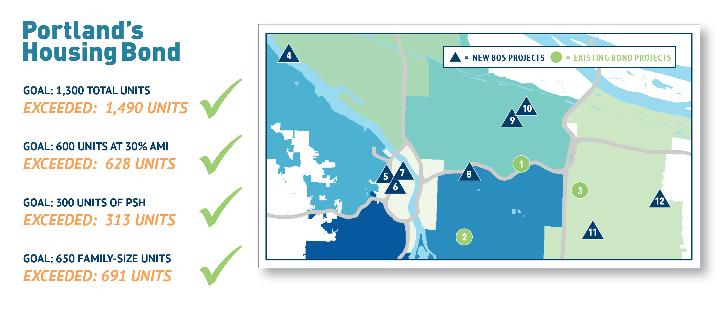
Bond Goals Met!

Slide 3
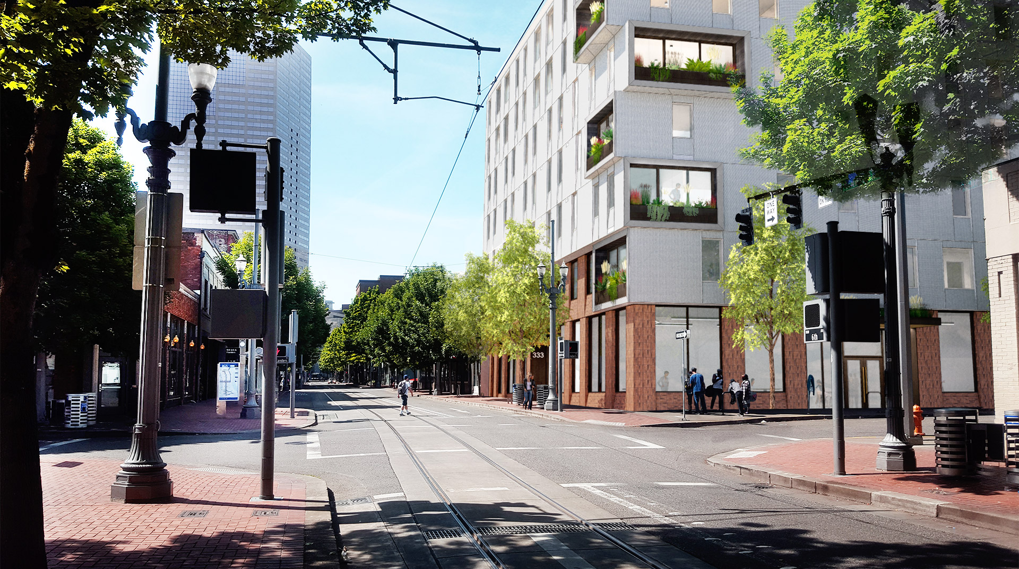
The Westwind
333 NW Sixth Ave
Portland

Slide 4
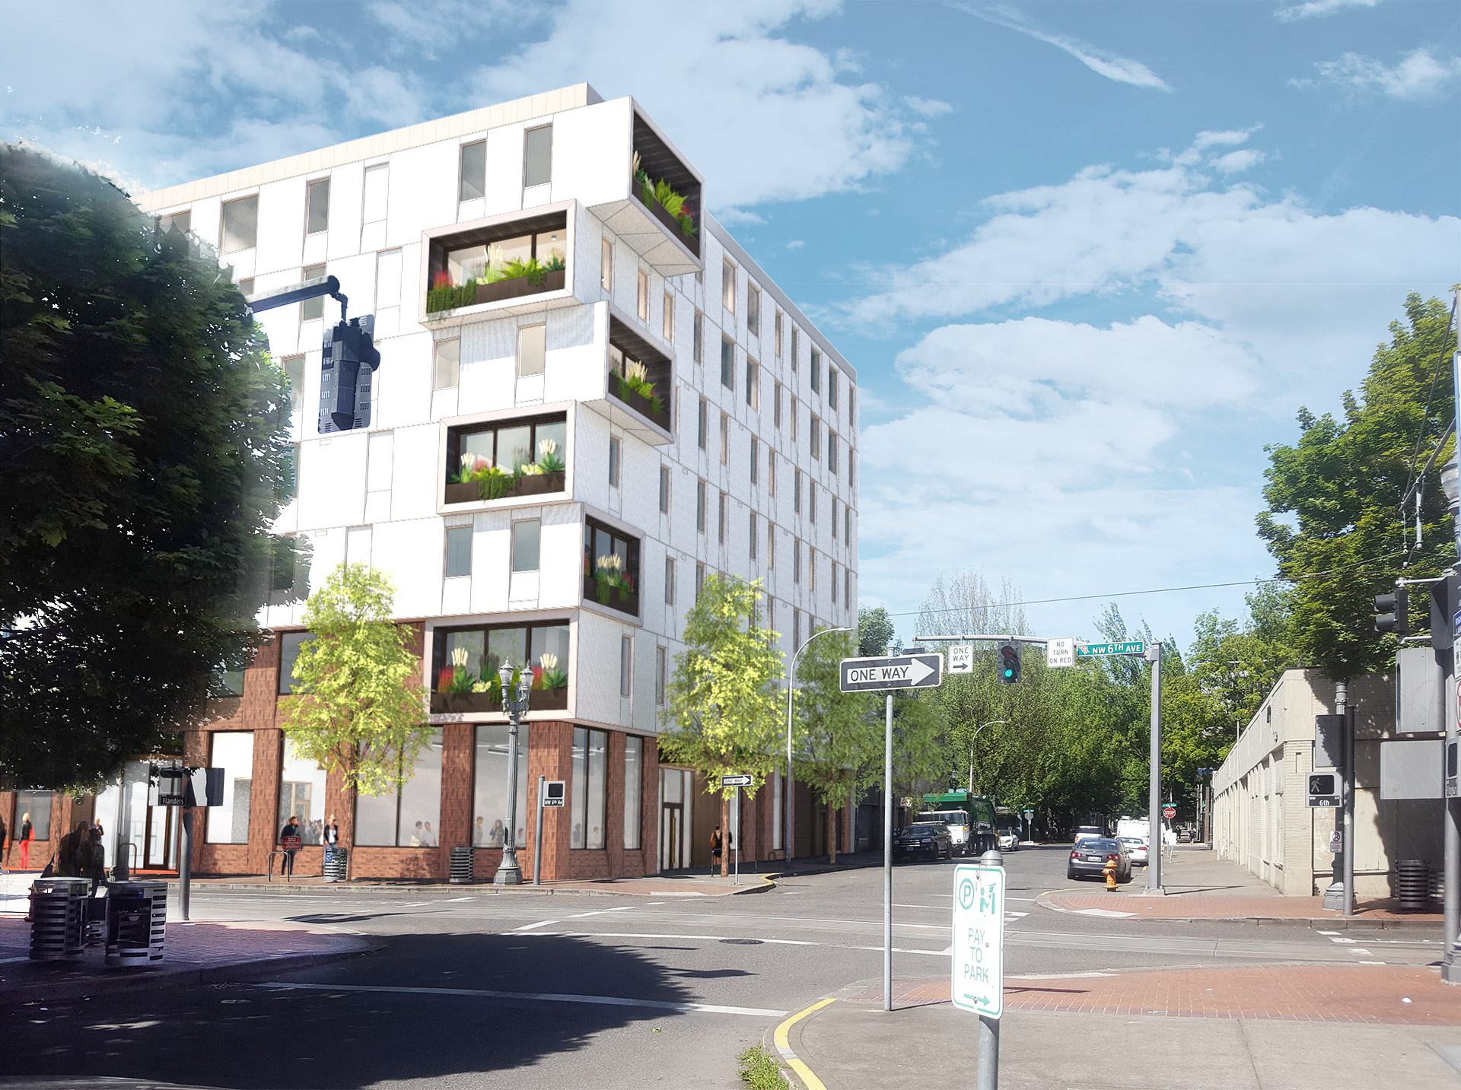
Formerly a PHB-owned site in Oldtown neighborhood; replaces a vacant, unsafe building
Near all MAX Lines
0.2 miles (6 min walk) to Richard L Harris Building and the Old Town Recovery Center
Small retail/commercial space on ground floor
Targeted for very low-income households who are homeless or exiting homelessness
Project Highlights

Slide 5
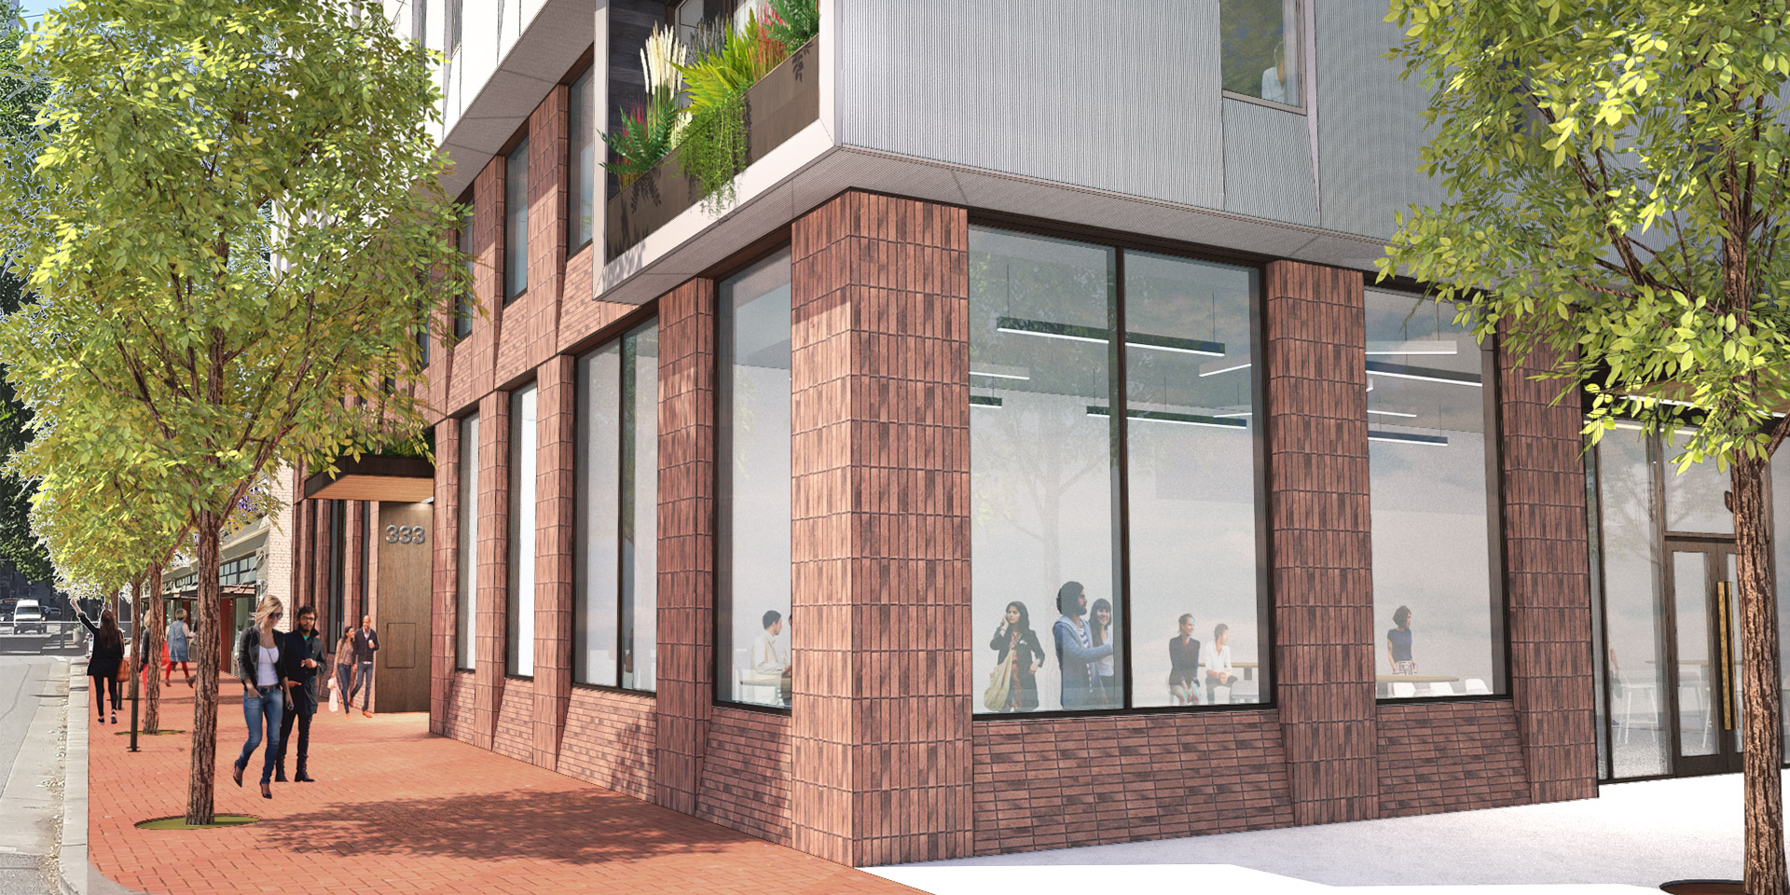
7-story new construction
100 affordable units anticipated to house 100 high need individuals
Priority Communities Served:
Chronically Homeless
African American and Native American
Targeted Supportive Services from CCC and NARA
Project Highlights

Slide 6
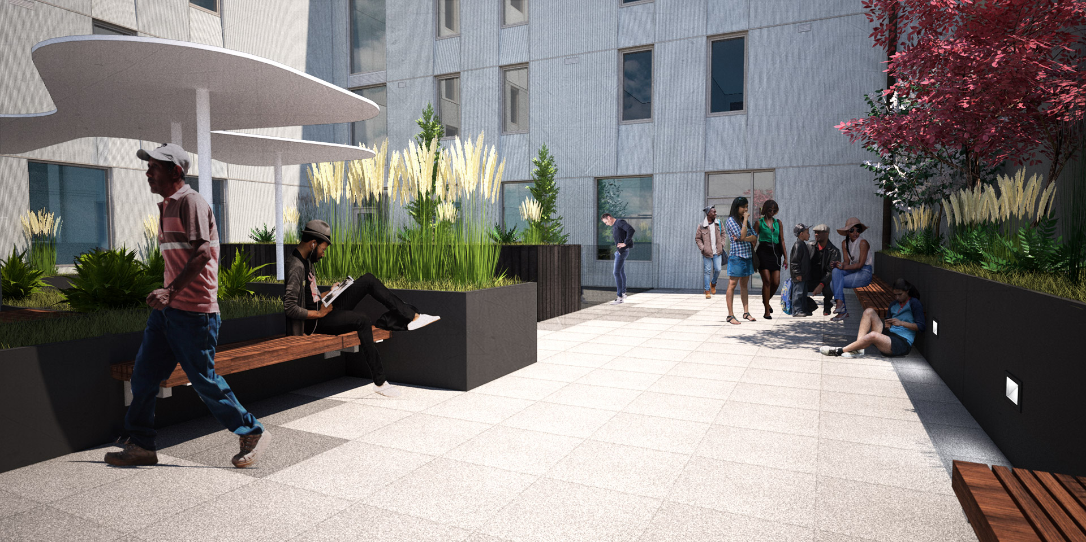
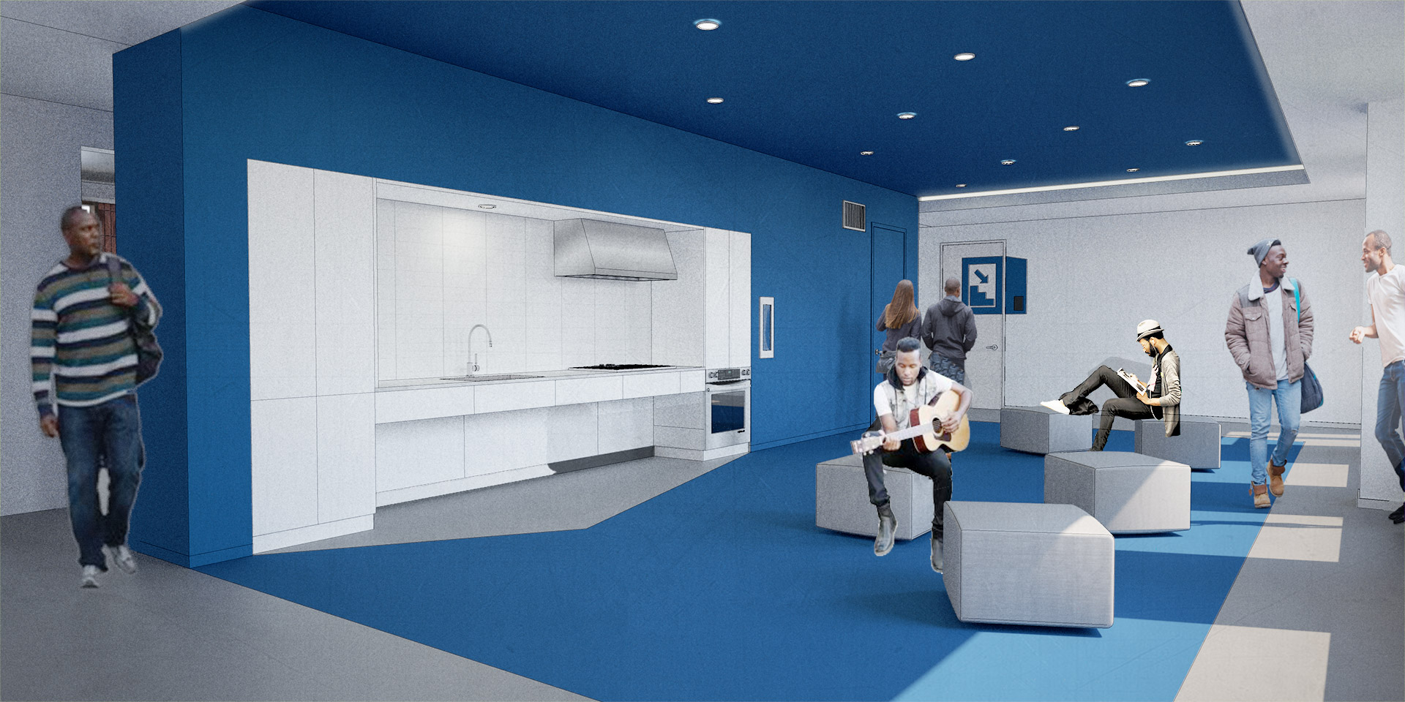
All units are studios or SROs
70 units of Permanent Supportive Housing, with rent support and services
92 units for residents at 30% AMI or below
8 units for residents at 60% AMI or below
Regulated for 99 years
Project Details

Slide 7
Project Services
Joint Office of Homeless Services to provide $9,770/unit in operational support for 70 Permanent Supportive Housing (PSH) units
NARA to provide culturally specific support services for up to 20 residents
CCC to provide wrap around services for homeless and those exiting homelessness
106Halsey/Gateway Park l 07/10/2019 l Portland Housing Bureau 5

Slide 8
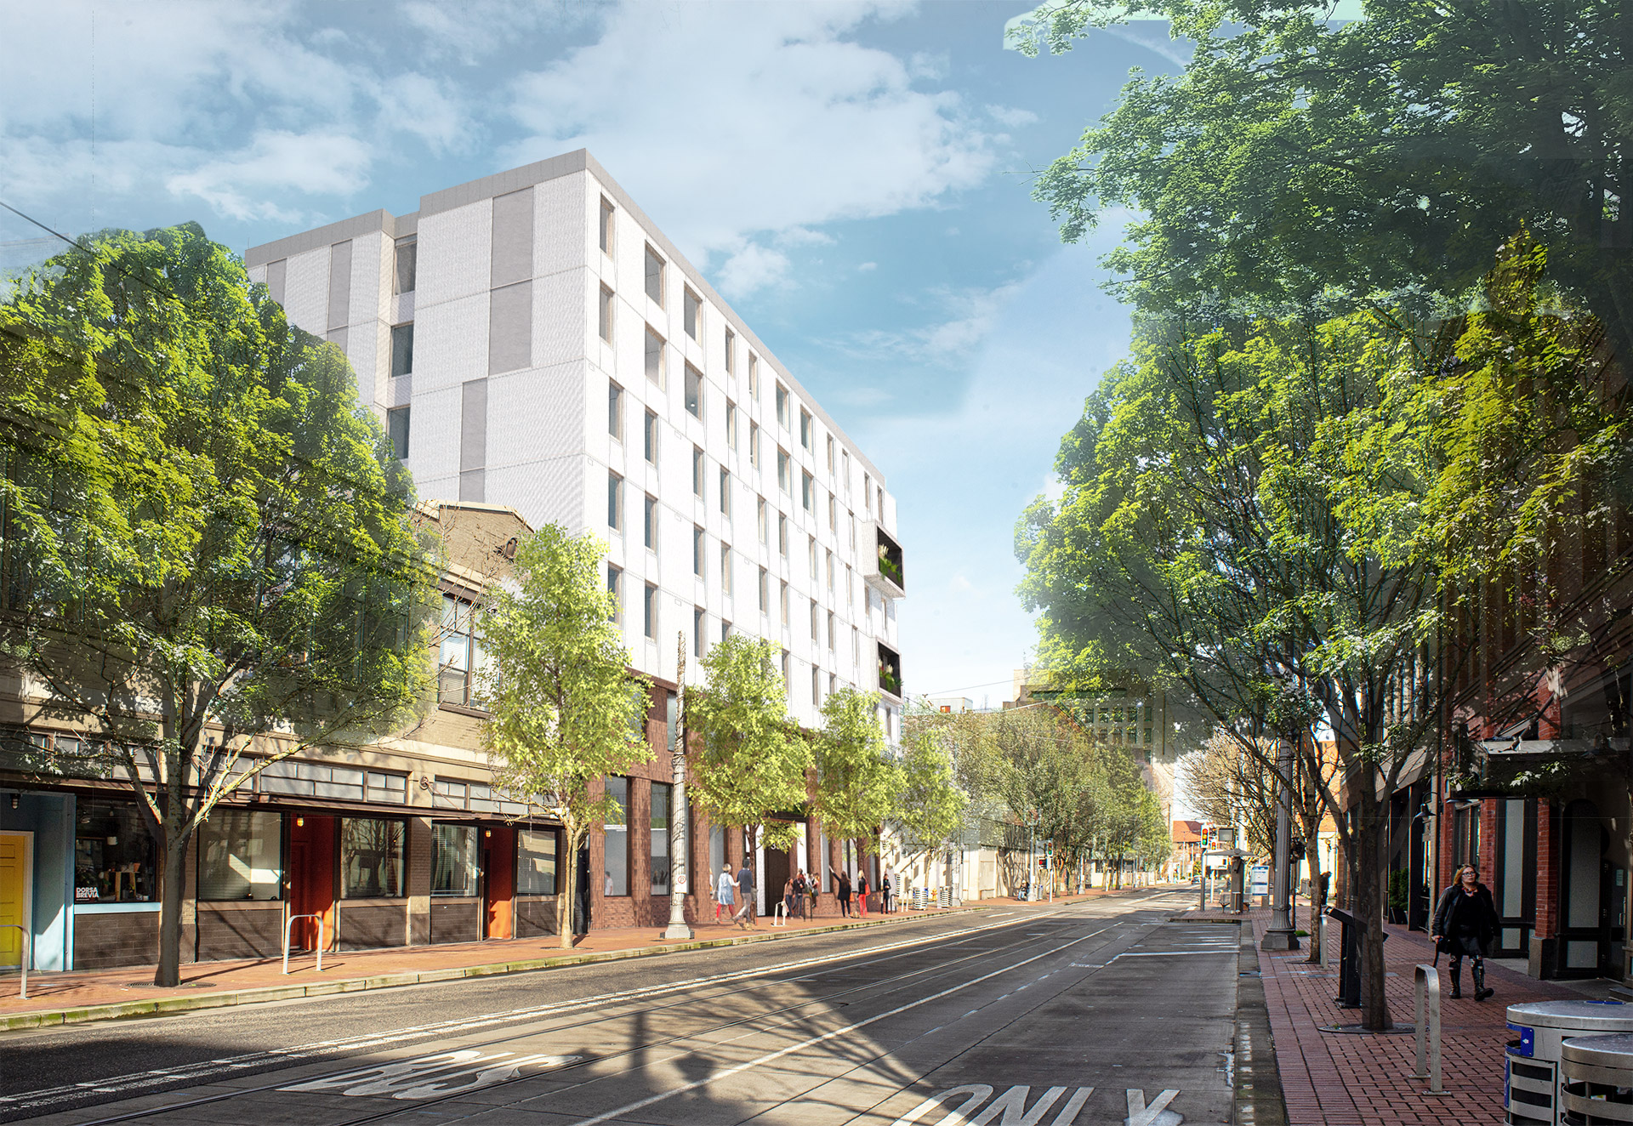
Project Funding Sources
Portland Housing Bonds | $12,662,077
Multnomah County Funds (PHB) | $4,375,000
Low Income Housing Tax Credits | $13,457,651
OHCS, Grants & Solar Equity | $167,030
Deferred Fee and CCC Contribution | $2,488,572
SDC Exemptions | $688,773
Total Project Costs | $33,817,463
PHB funding = $17.1 million, leveraged 2 times

Slide 9
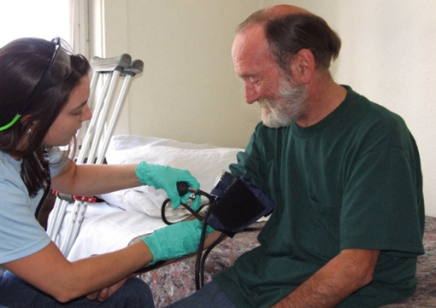
Summary
Authorize:
Funding in an amount not to exceed $17,037,077
Director of PHB to execute all documentation needed for this project
9
The Westwind | March 17, 2021 | Portland’s Housing Bond
Division Street Apartments 04/22/2020 Portland Housing Bureau 5
Notes:
Ordinance(s) ask for BOS funding for new construction + conveyance of the land via DDA

