Slide 1
Stark Street Housing
Shannon Callahan, PHB Director
March 17, 2021
Portland's Housing Bond

Slide 2
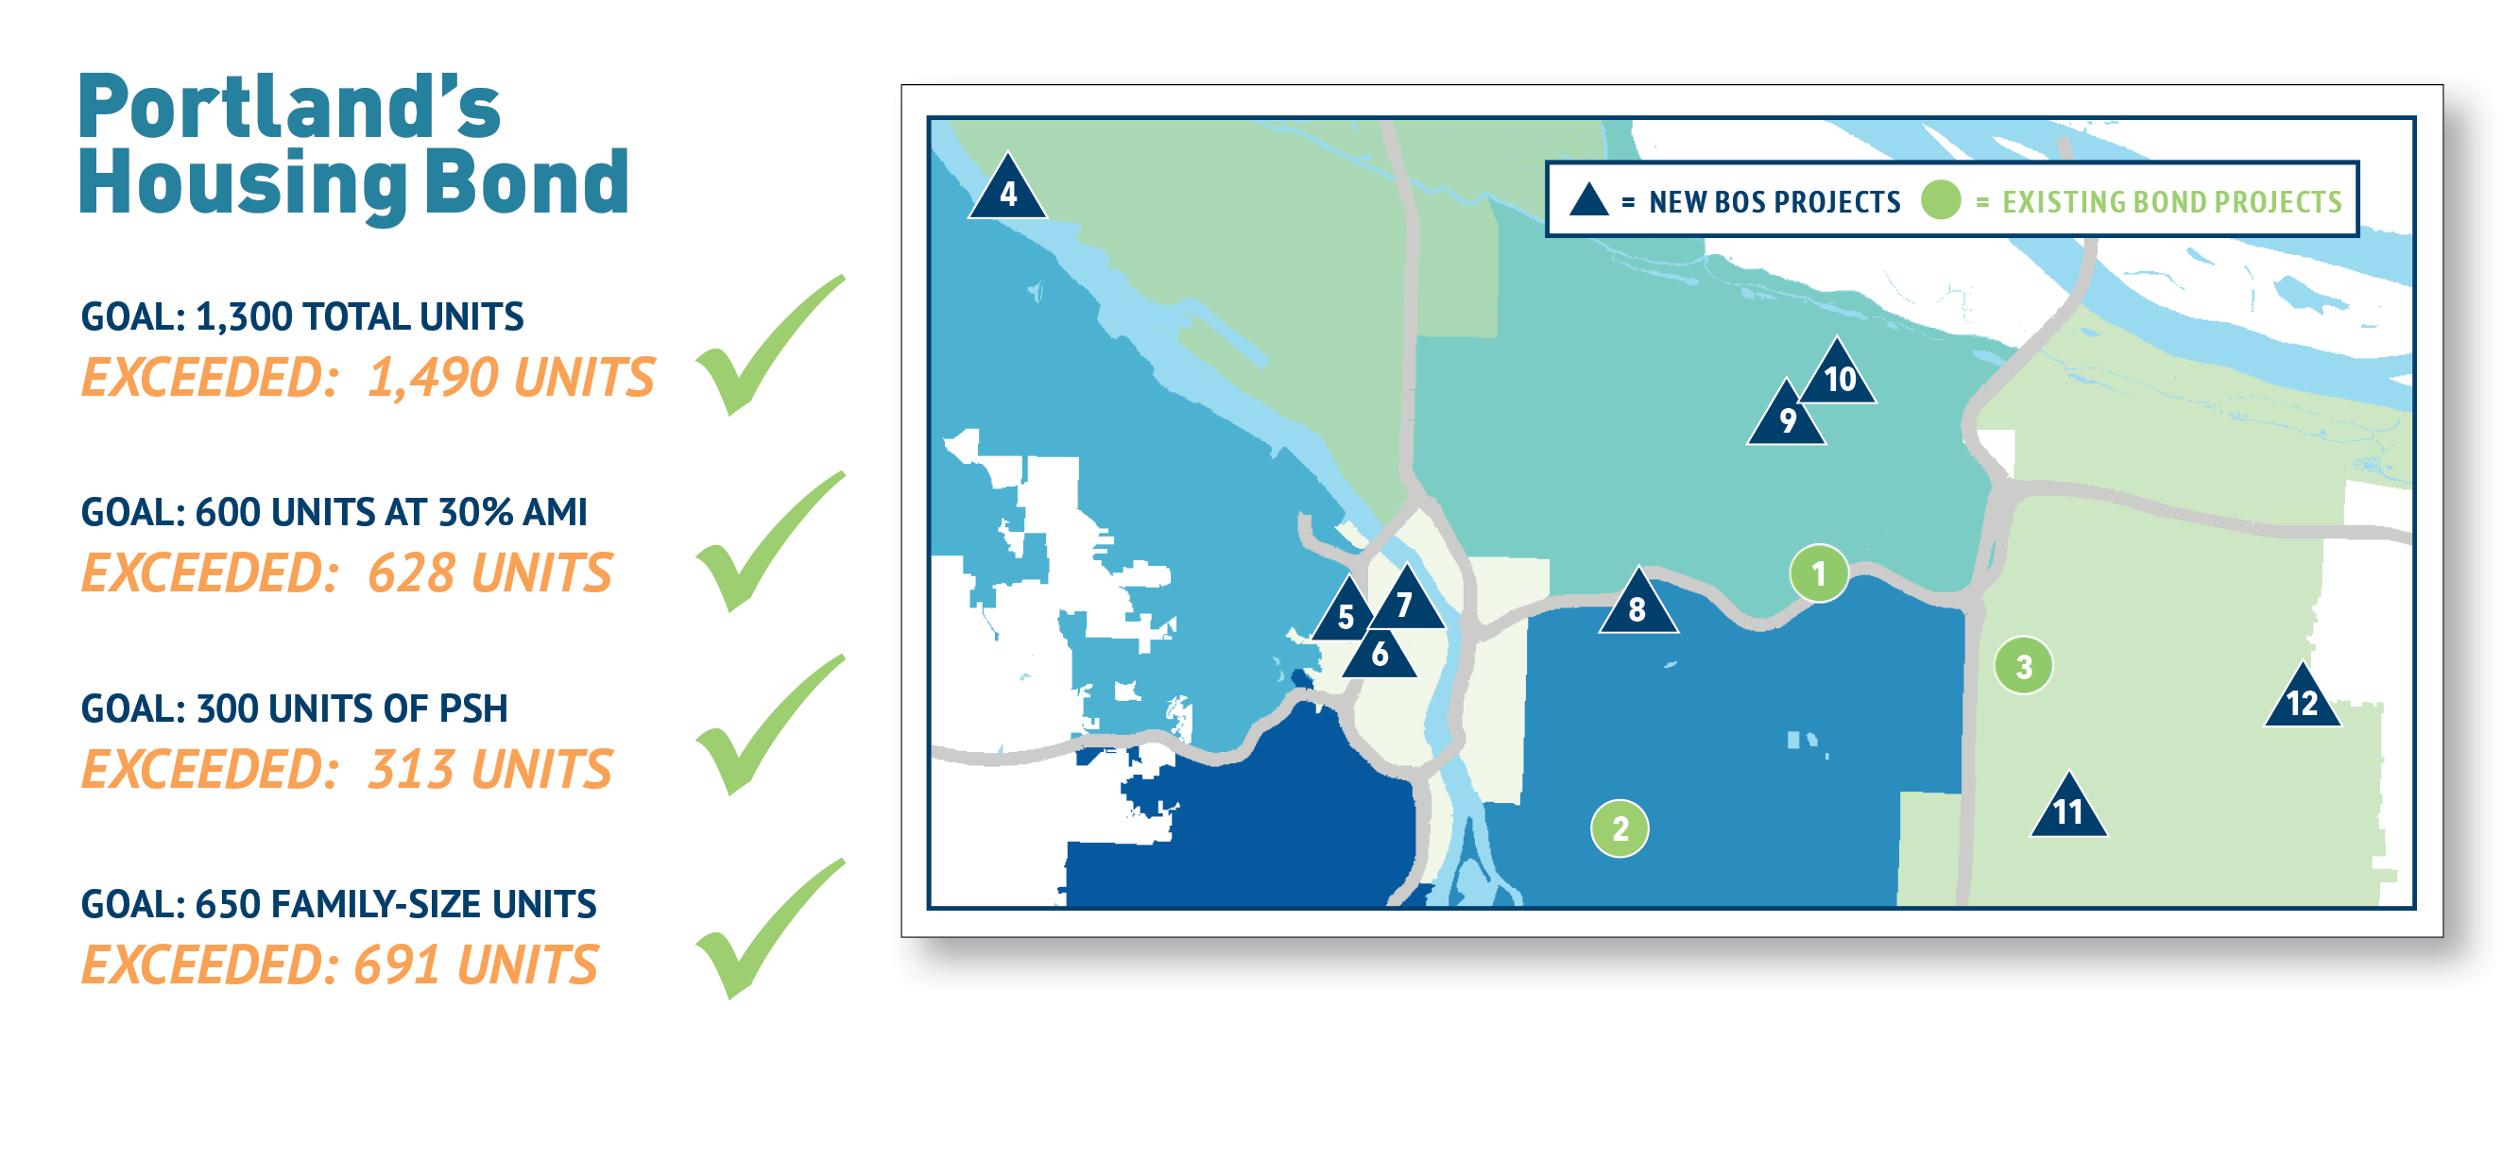
Bond Goals Met!
Stark Street Housing Portland Housing Bureau

Slide 3
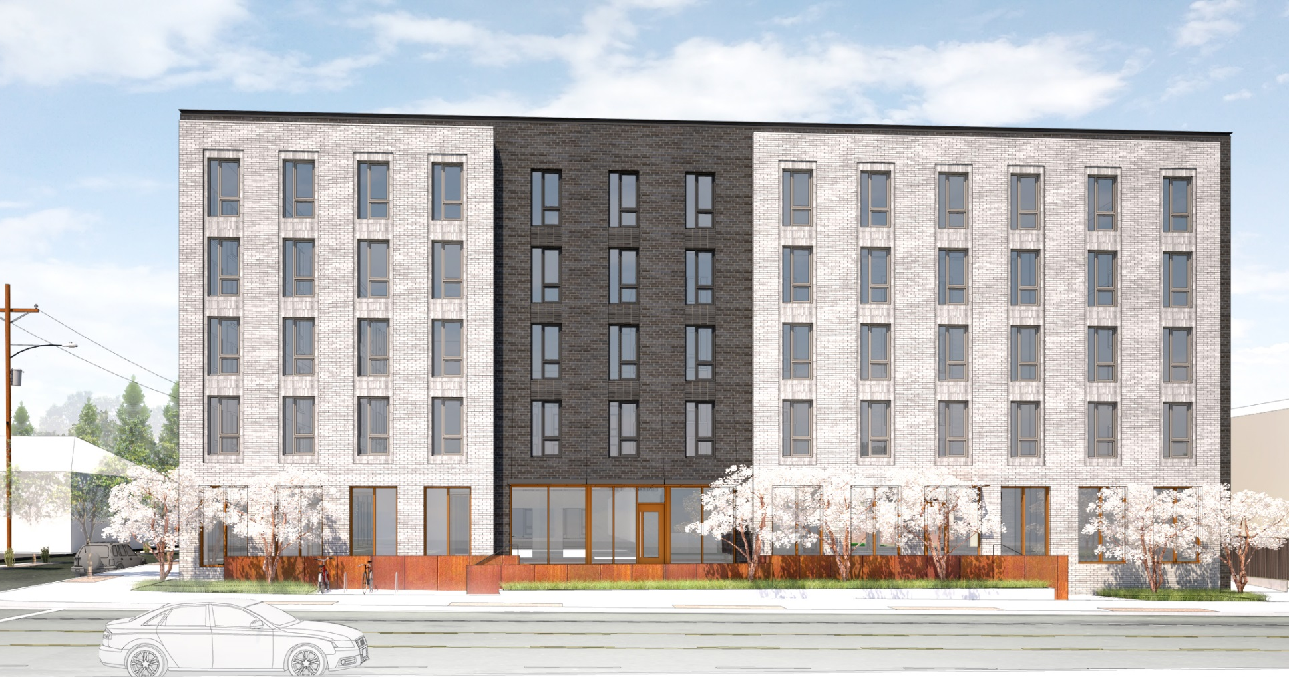
Stark Street Housing
Shannon Callahan
Director, Portland Housing Bureau
March 17, 2021
Stark Street Housing Portland Housing Bureau

Slide 4
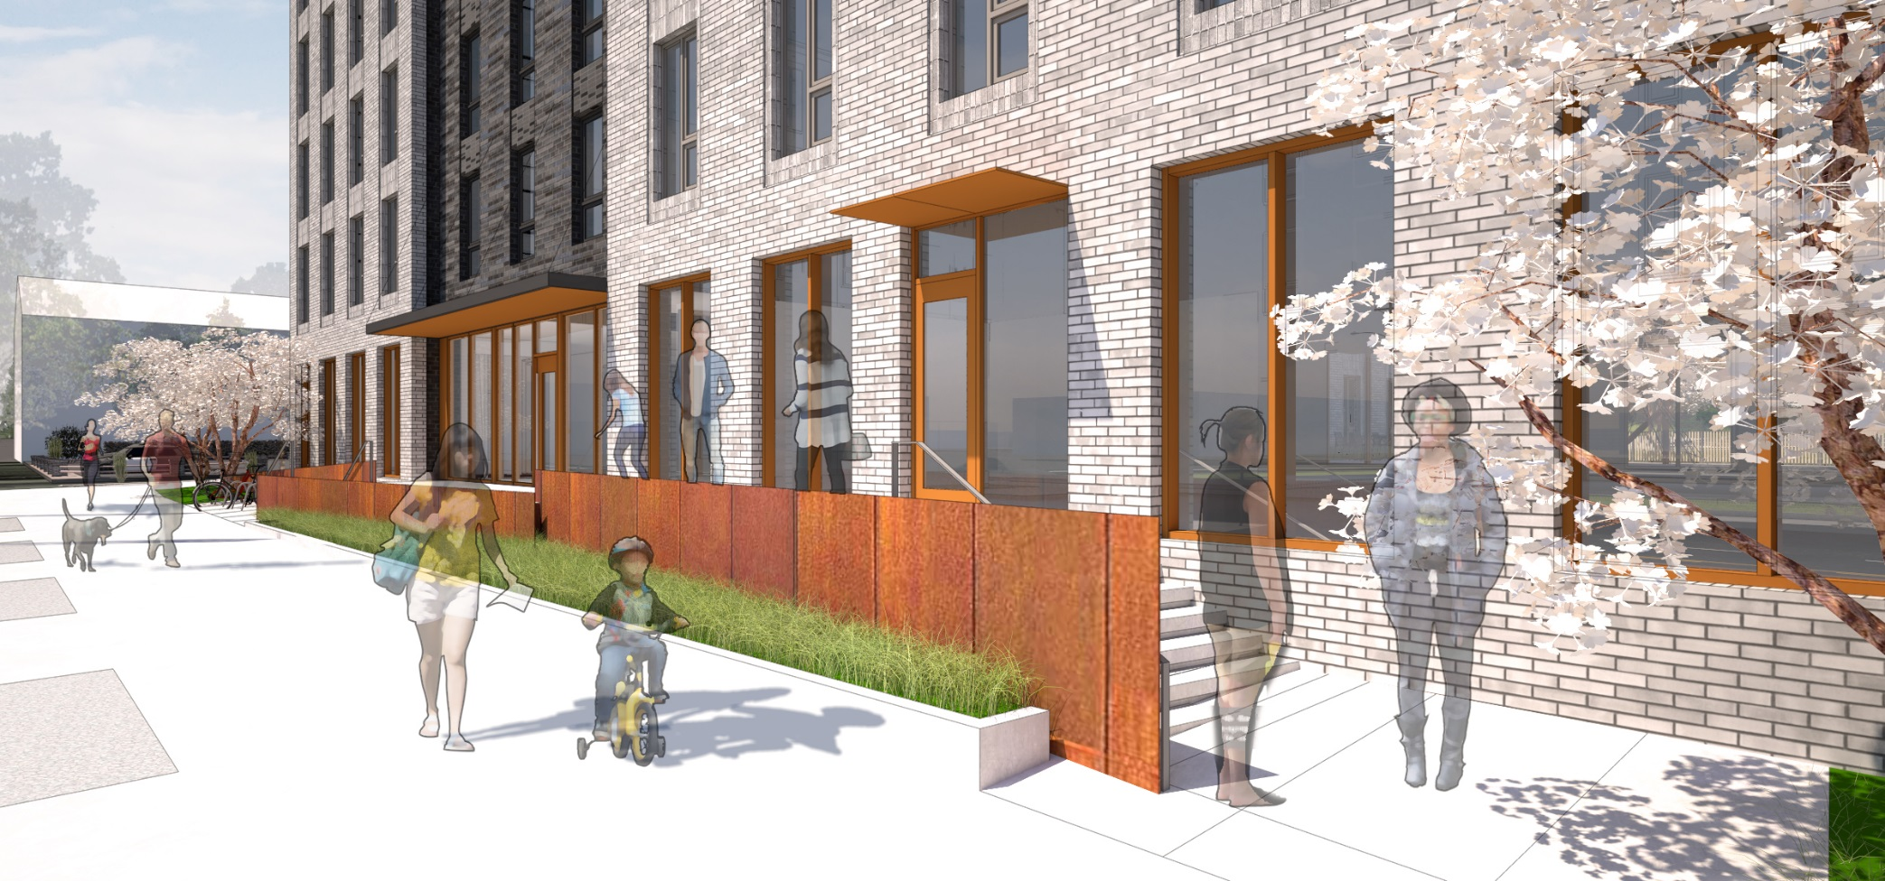
Glenfair neighborhood; Rosewood area
Near grocery stores, services & transit, incl. MAX Blue Line
Replaces an aging, unsafe commercial structure
Targeted to low-income families and people exiting homelessness
Project Highlights
Stark Street Housing Portland Housing Bureau

Slide 5
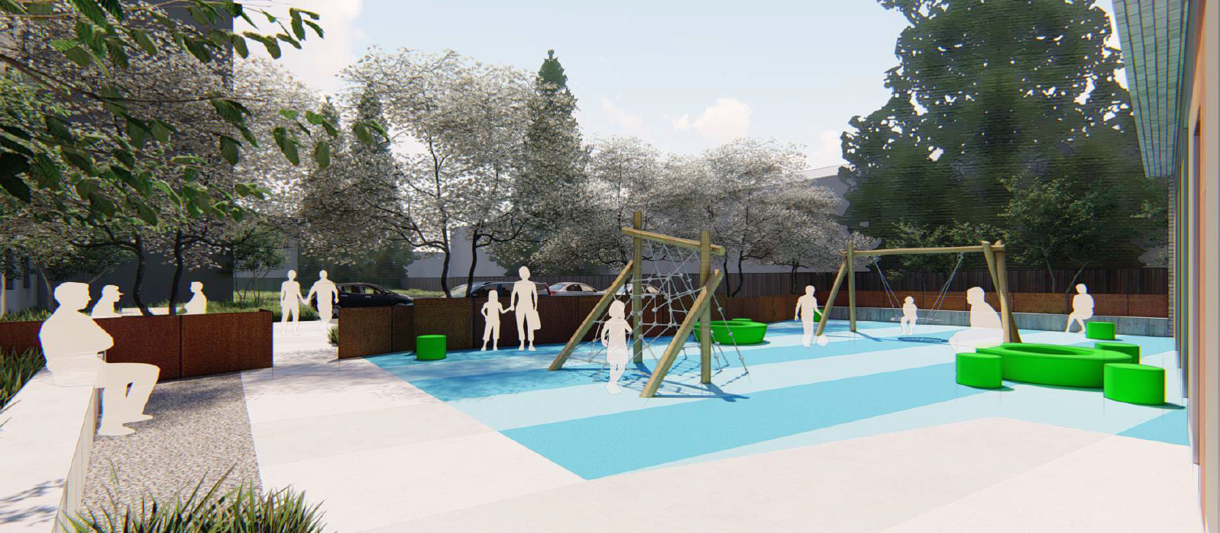
Project Highlights
5-story new construction
93 affordable units; anticipated to house 221 people
27 parking spaces
Children’s playground
Earth Advantage Multifamily Platinum Certification
Construction: June 2021 - Nov. 2022
Stark Street Housing Portland Housing Bureau

Slide 6
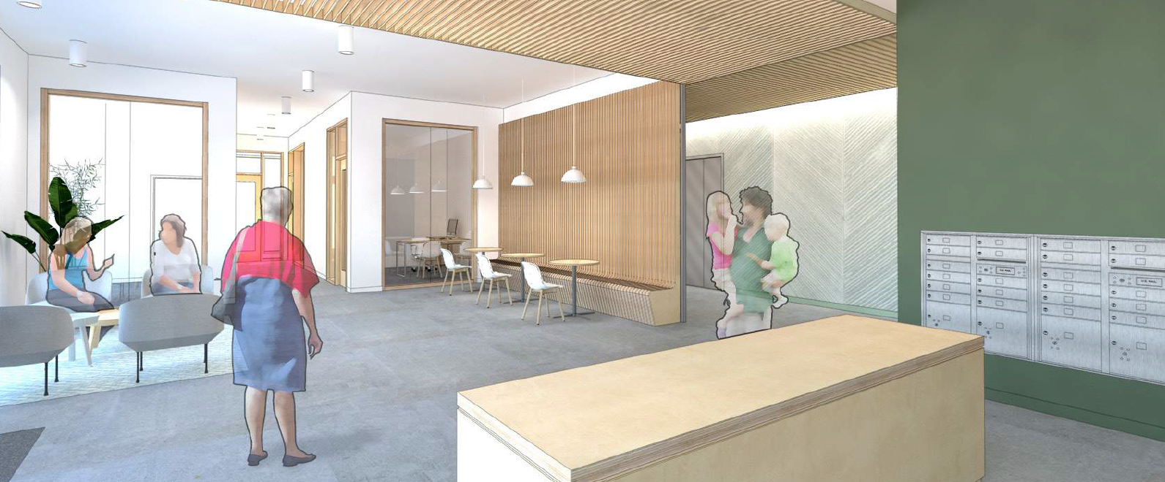
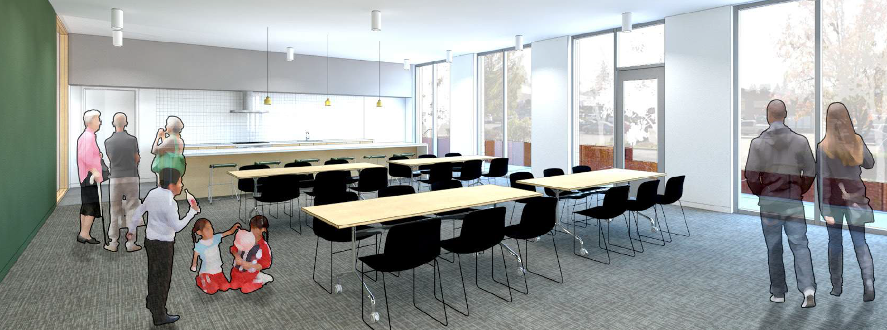
93 units
47 1-BR
33 2-BR
13 3-BR
16 units of Permanent Supportive Housing
31 units at 30% AMI (33% of all units)
62 units at 60% AMI
Regulated affordable for 99 years
Project Details
Stark Street Housing Portland Housing Bureau
Notes:
No manager’s units
Aspirational goal of EarthAdvantage Platinum; currently tracking for Gold

Slide 7
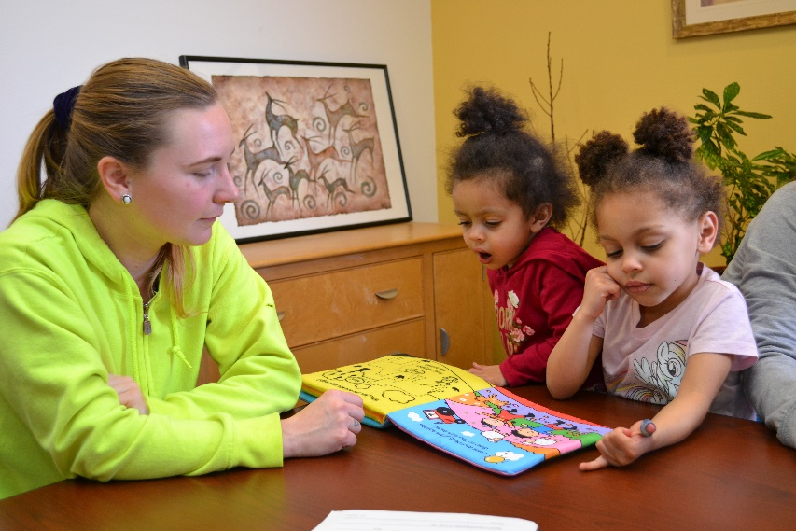
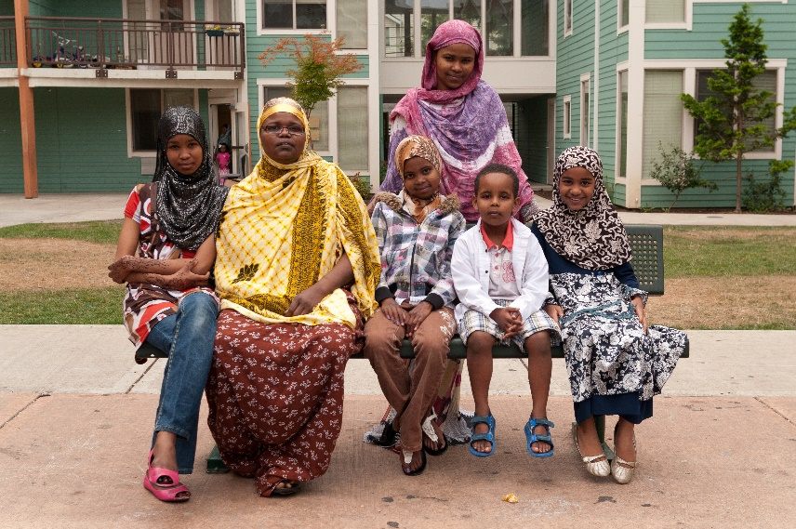
Project Services
Joint Office of Homeless Services to provide $10,000/unit in operational support for 16 Permanent Supportive Housing (PSH) units
Human Solutions, Inc to provide resident services, family advocacy and assistance, and case management
Lifeworks NW to provide mental health services and health care navigation
Stark Street Housing Portland Housing Bureau
115th and Division Portland Housing Bureau 4
Notes:
NARA to provide resident and PSH services:
Housing First model with case management and peer support, focused on housing stability and retention
Services related to mental health, income support, wellness, social connection
Access to culturally-specific and supportive programming including pow-wows, elder support groups, and after-school activities

Slide 8
Project Funding Sources
SOURCES
Portland Housing Bond | $14,926,500
4% Low Income Housing Tax Credit (LIHTC) Equity | $11,237,103
JP Morgan Chase Bank Permanent Loan | $5,966,346
OHCS LIFT Loan and MEP Grant | $3,947,500
Grants (Metro TOD, Collins Fdn, MMT) | $1,080,000
SDC Exemptions | $1,539,740
Deferred Developer Fee | $1,000,000
TOTAL SOURCES | $39,697,189
PHB funds leveraged approximately $24 million of other funding
Stark Street Housing Portland Housing Bureau
115th and Division Portland Housing Bureau 4

Slide 9
Summary
Authorize:
Funding in an amount not to exceed $14,926,500
Director of PHB to execute all documentation needed for this project
9
Stark Street Housing Portland Housing Bureau
Division Street Apartments 04/22/2020 Portland Housing Bureau 5
Notes:
Ordinance(s) ask for BOS funding for new construction + conveyance of the land via DDA

