Slide 1
NW Front Avenue - Naito Parkway
Local Improvement District
Final Assessment Hearing
March 3, 2021 – Agenda Item #124
Staff presenting: Andrew Aebi, Local Improvement District Administrator and Gabe Graff, PBOT
Photos taken on 1/10/17 (slides #4 - #7), 10/28/19 (#8), 8/21/20 (#9 and #10) and video on 11/07/19 (#11)

Slide 2
Key Events and Milestones
Four (4) Street Projects Including One (1) LID
1/30/1994: Nancy Kerrigan evidence found at Dockside
7/10/1996: Front Ave. south of NW 9th Ave. renamed Naito Pkwy.
9/14/2005: Council authorizes first bike lanes and pavement
reconstruction from NW Davis St. to SW Market St.
3/15/2017: Council approves NW Front Ave. – Naito Pkwy. LID
2018: Field Office opens at 2035 NW Front Ave.
12/20/2019: Substantial completion of LID
6/03/2020: Council approves SW Salmon St. to I-405 bid
2/10/2021: Council approves Better Naito Project bid

Slide 3
Project Recap
NW 9th Avenue to north of NW 19th Avenue
LID: $1,078,000 voluntary for offsite improvements
PBOT: $ 608,000 for overhead costs
General Fund: $1,500,000 for pavement preservation
Total: $3,186,000 total cost
Transit: Curb extension transit islands added
Line #16 Sunday service added to serve houseless
Bus stops spacing reduced from 1/2 mile pre-LID
to 1/4 mile after completion of LID construction
Bicyclists: 3/4 mile of buffered and protected bike lanes
Pedestrians: Curb ramps and conduit for future sidewalk infill

Slide 4
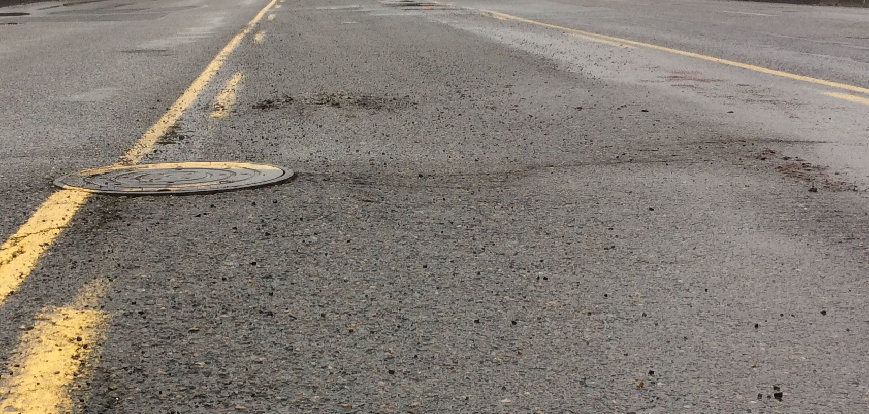
NW Front Avenue – Naito Parkway
Street Conditions Prior to LID

Slide 5
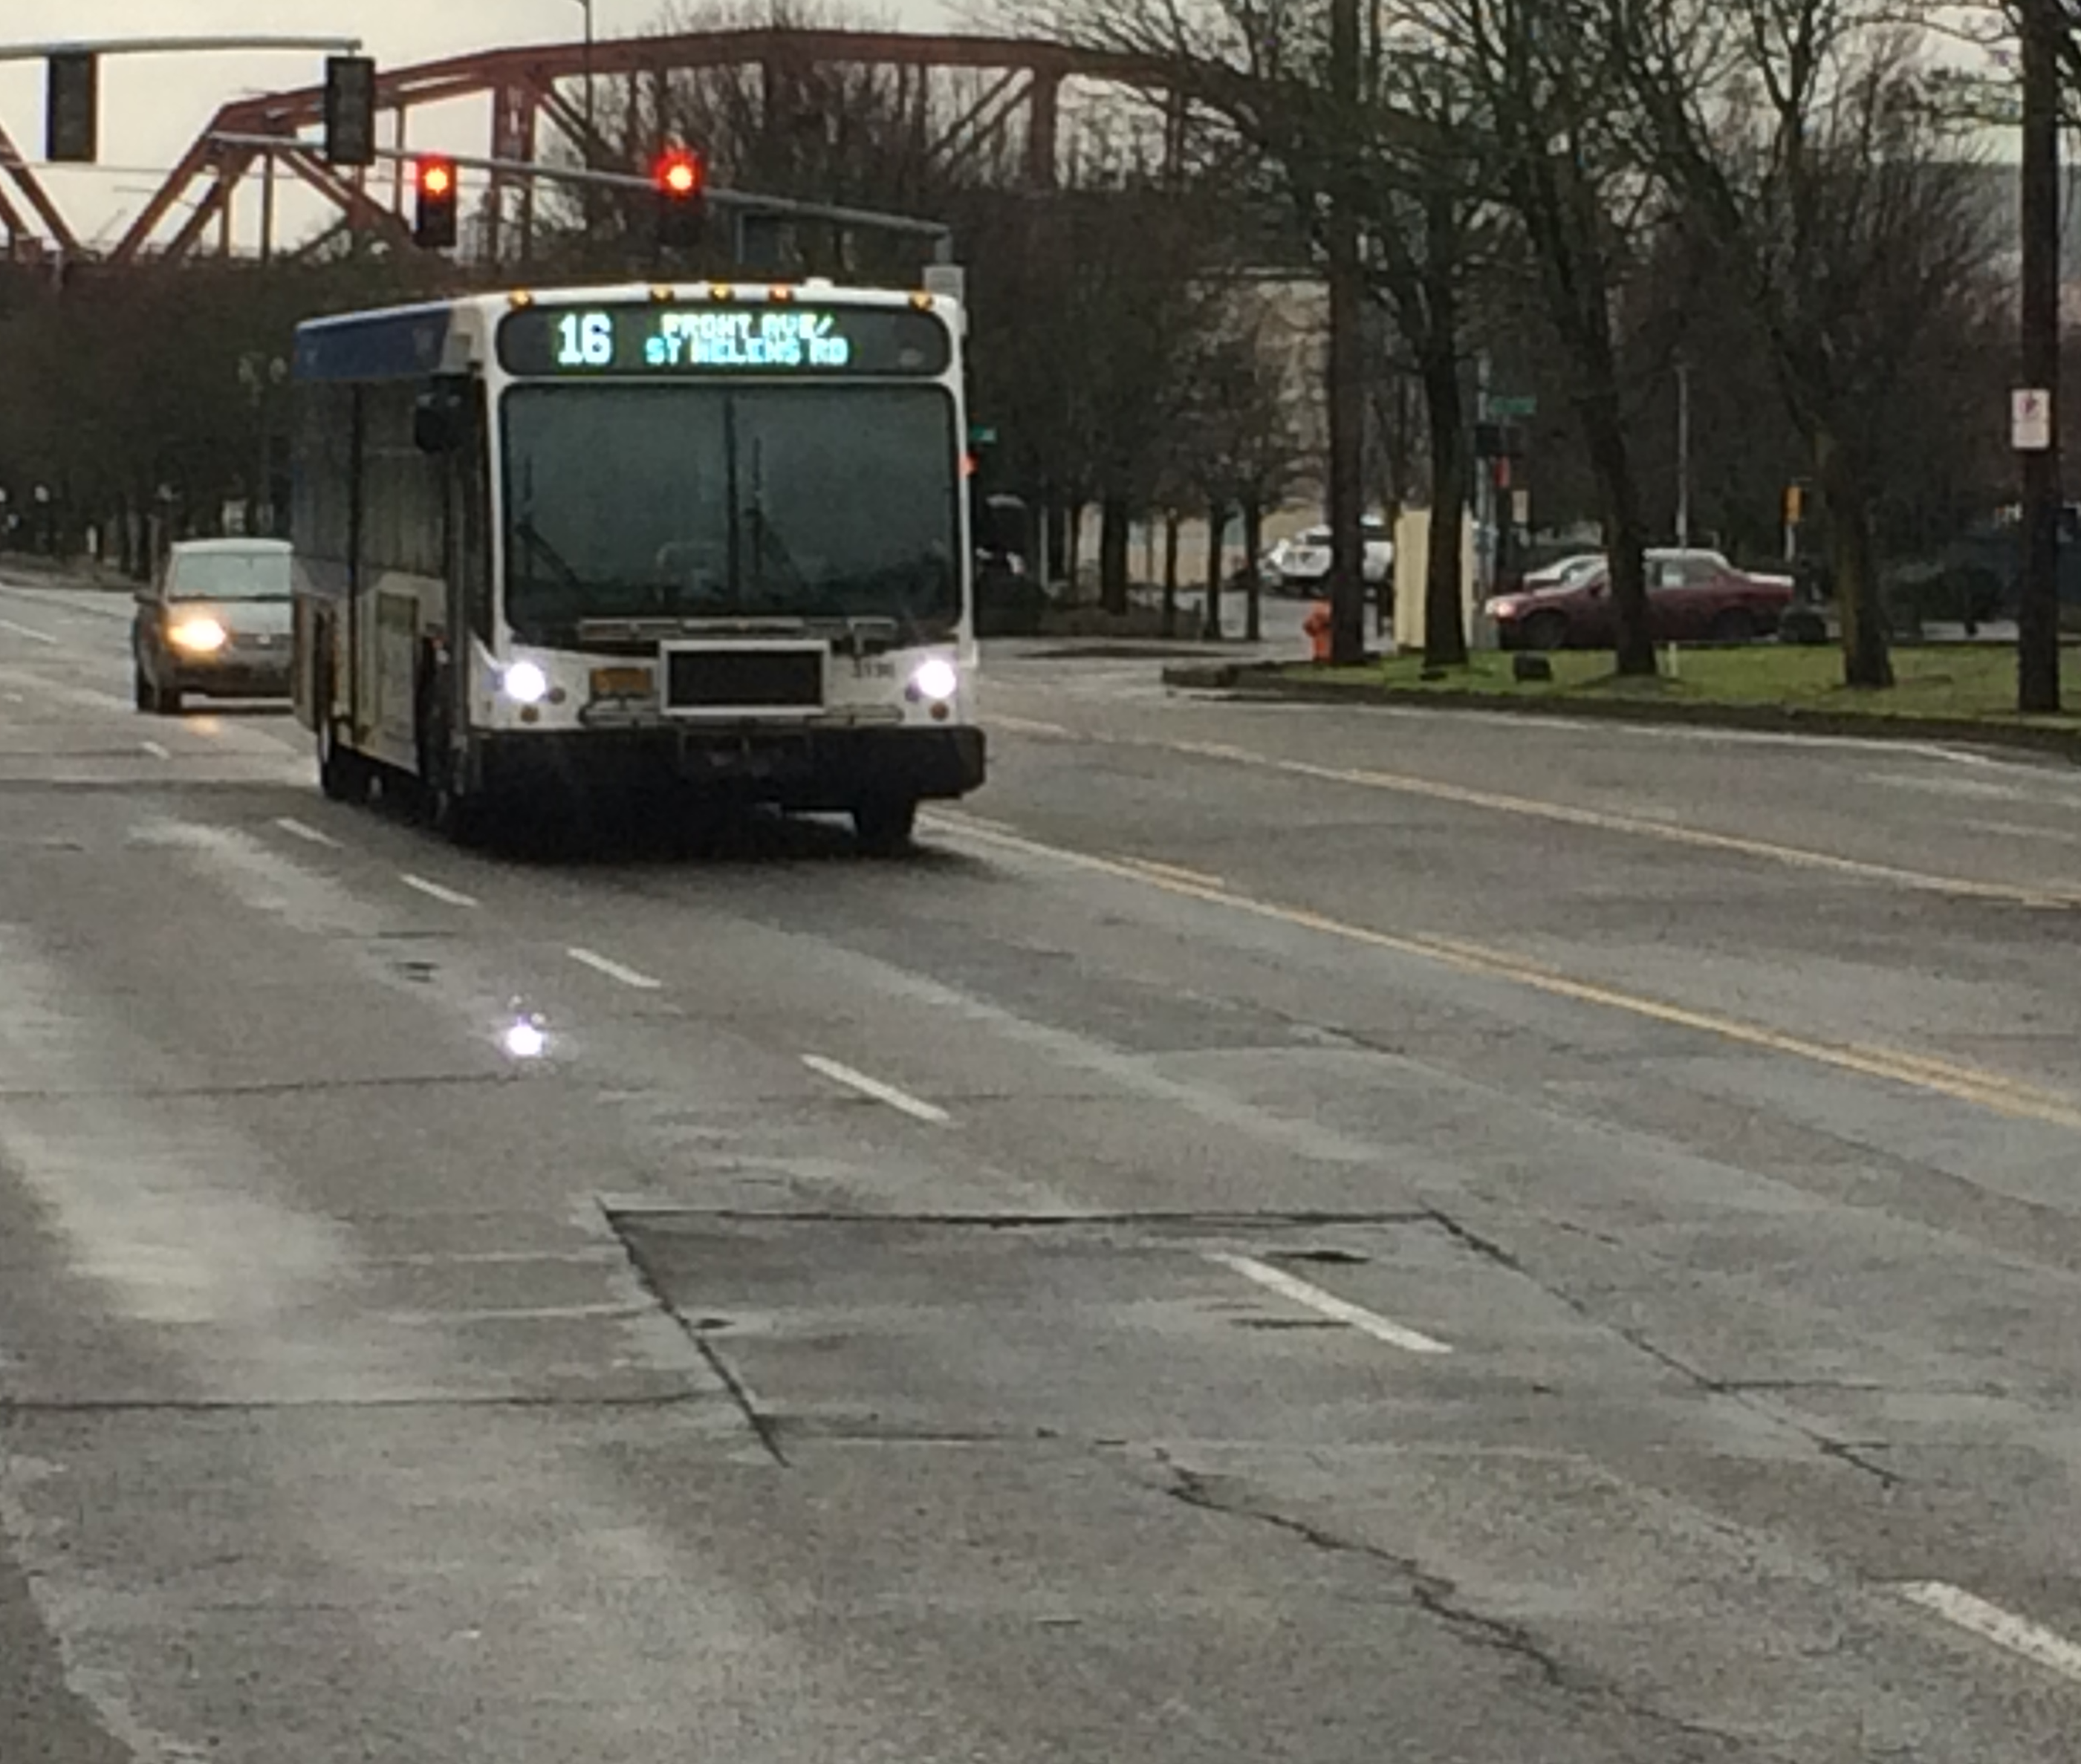
NW Front Avenue – Naito Parkway
Street Conditions Prior to LID

Slide 6
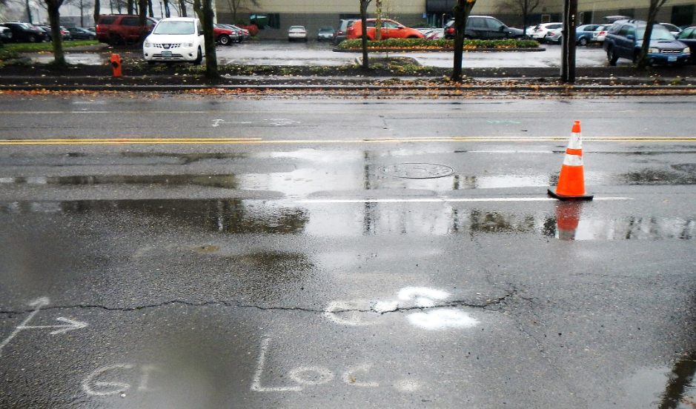
NW Front Avenue – Naito Parkway
Poor Drainage and No Bicycle Lanes Prior to LID

Slide 7
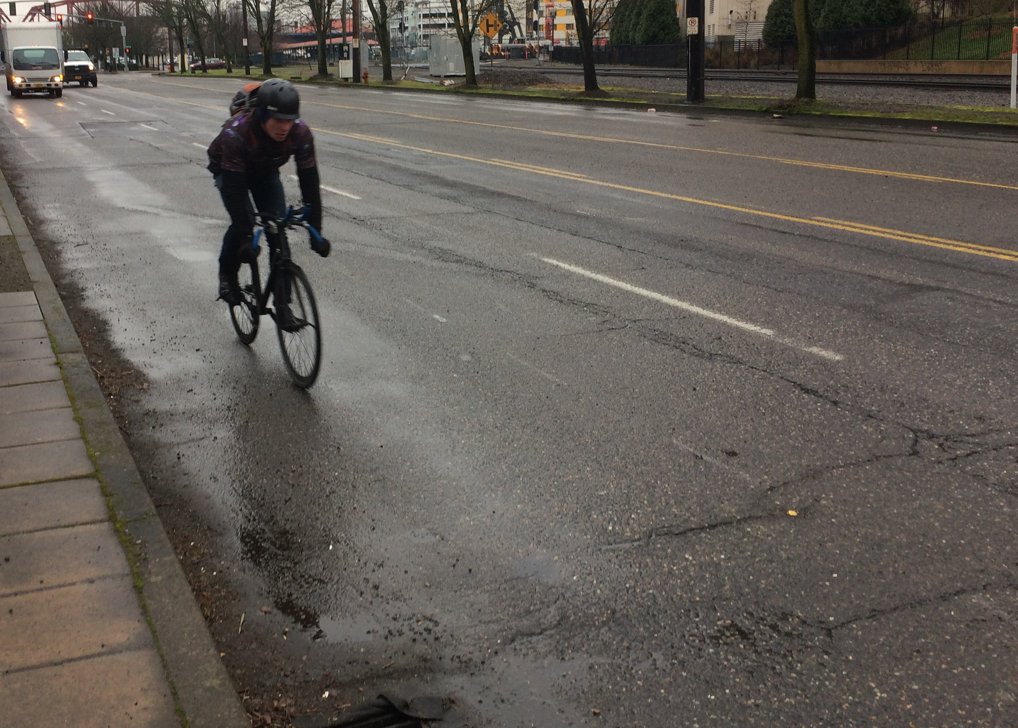
NW Front Avenue – Naito Parkway
Poor Pavement Condition for Bicyclists Prior to LID

Slide 8
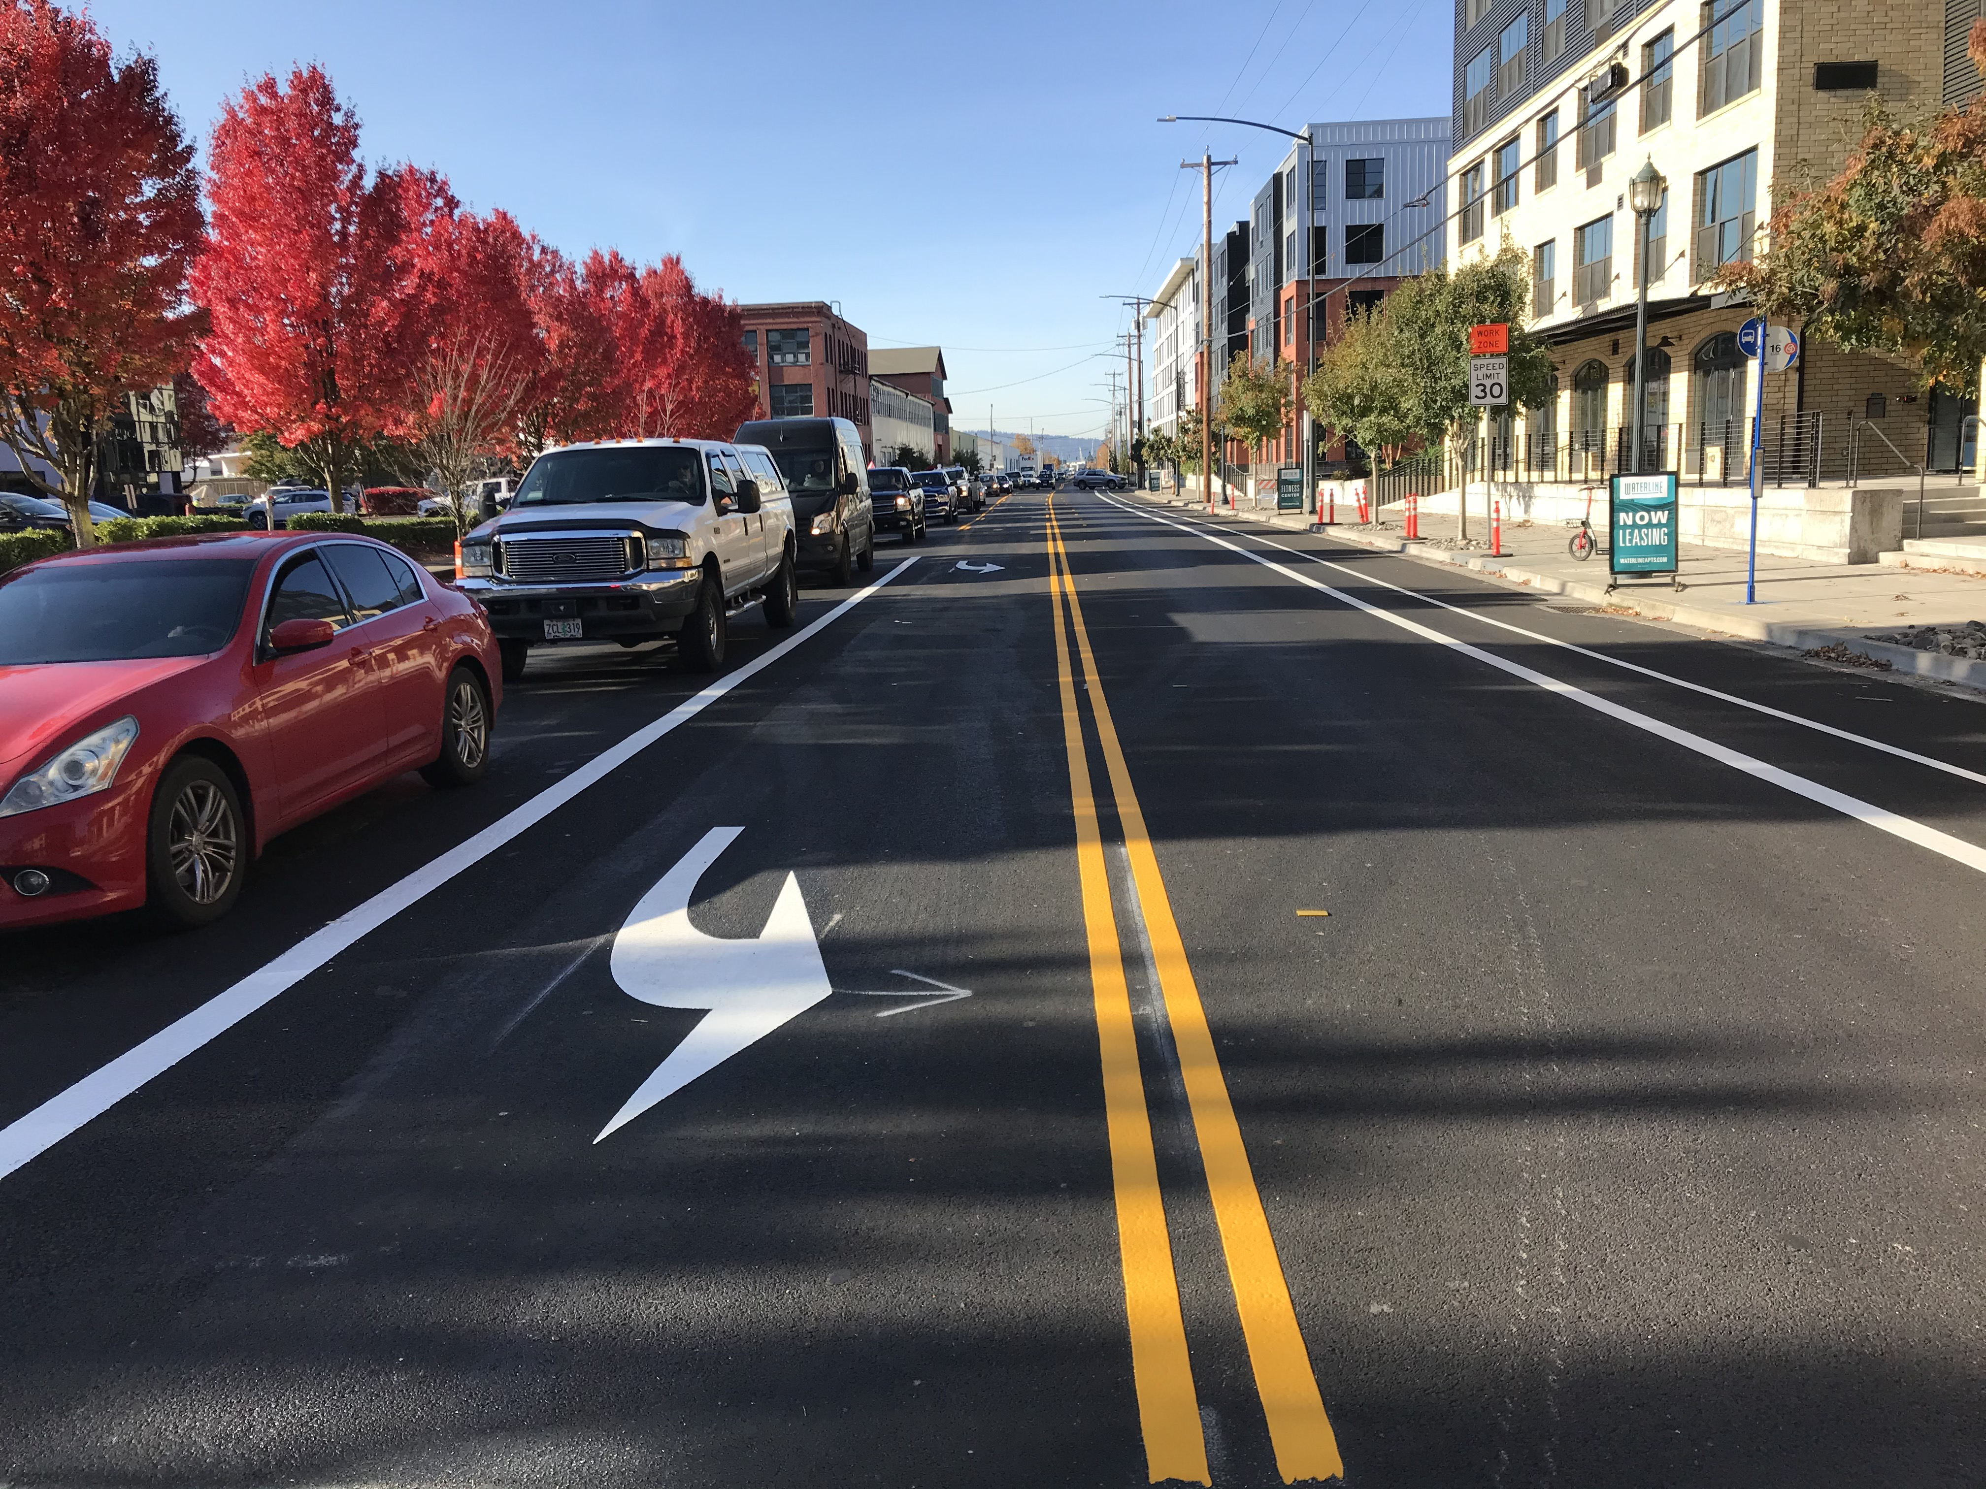
NW Front Avenue – Naito Parkway
New Pavement and Striping on 10/28/2019

Slide 9
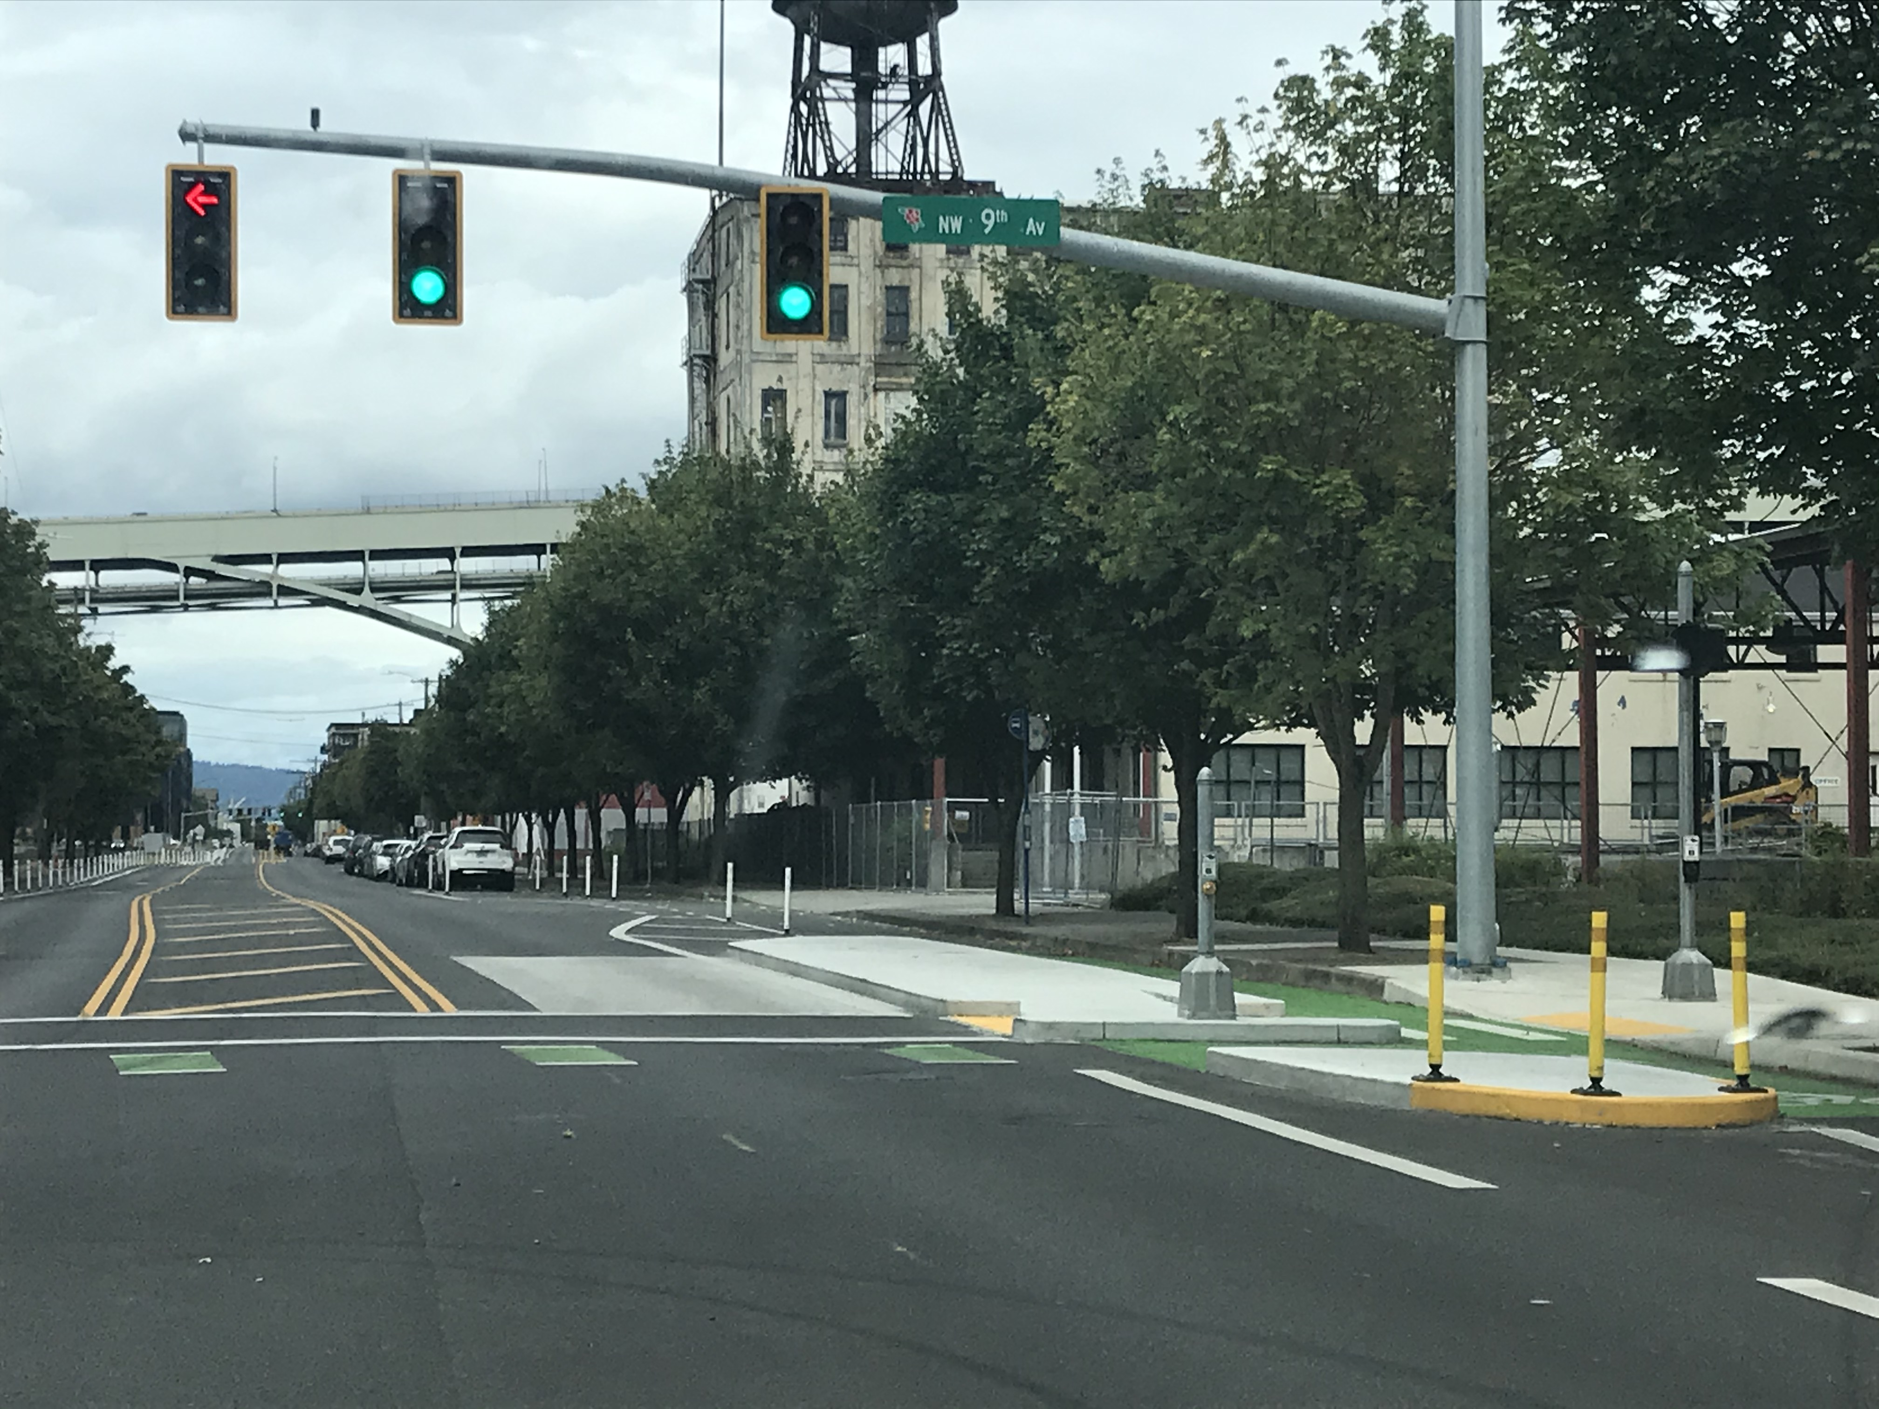
NW Front & 9th Avenues
New Transit Island Curb Extension

Slide 10
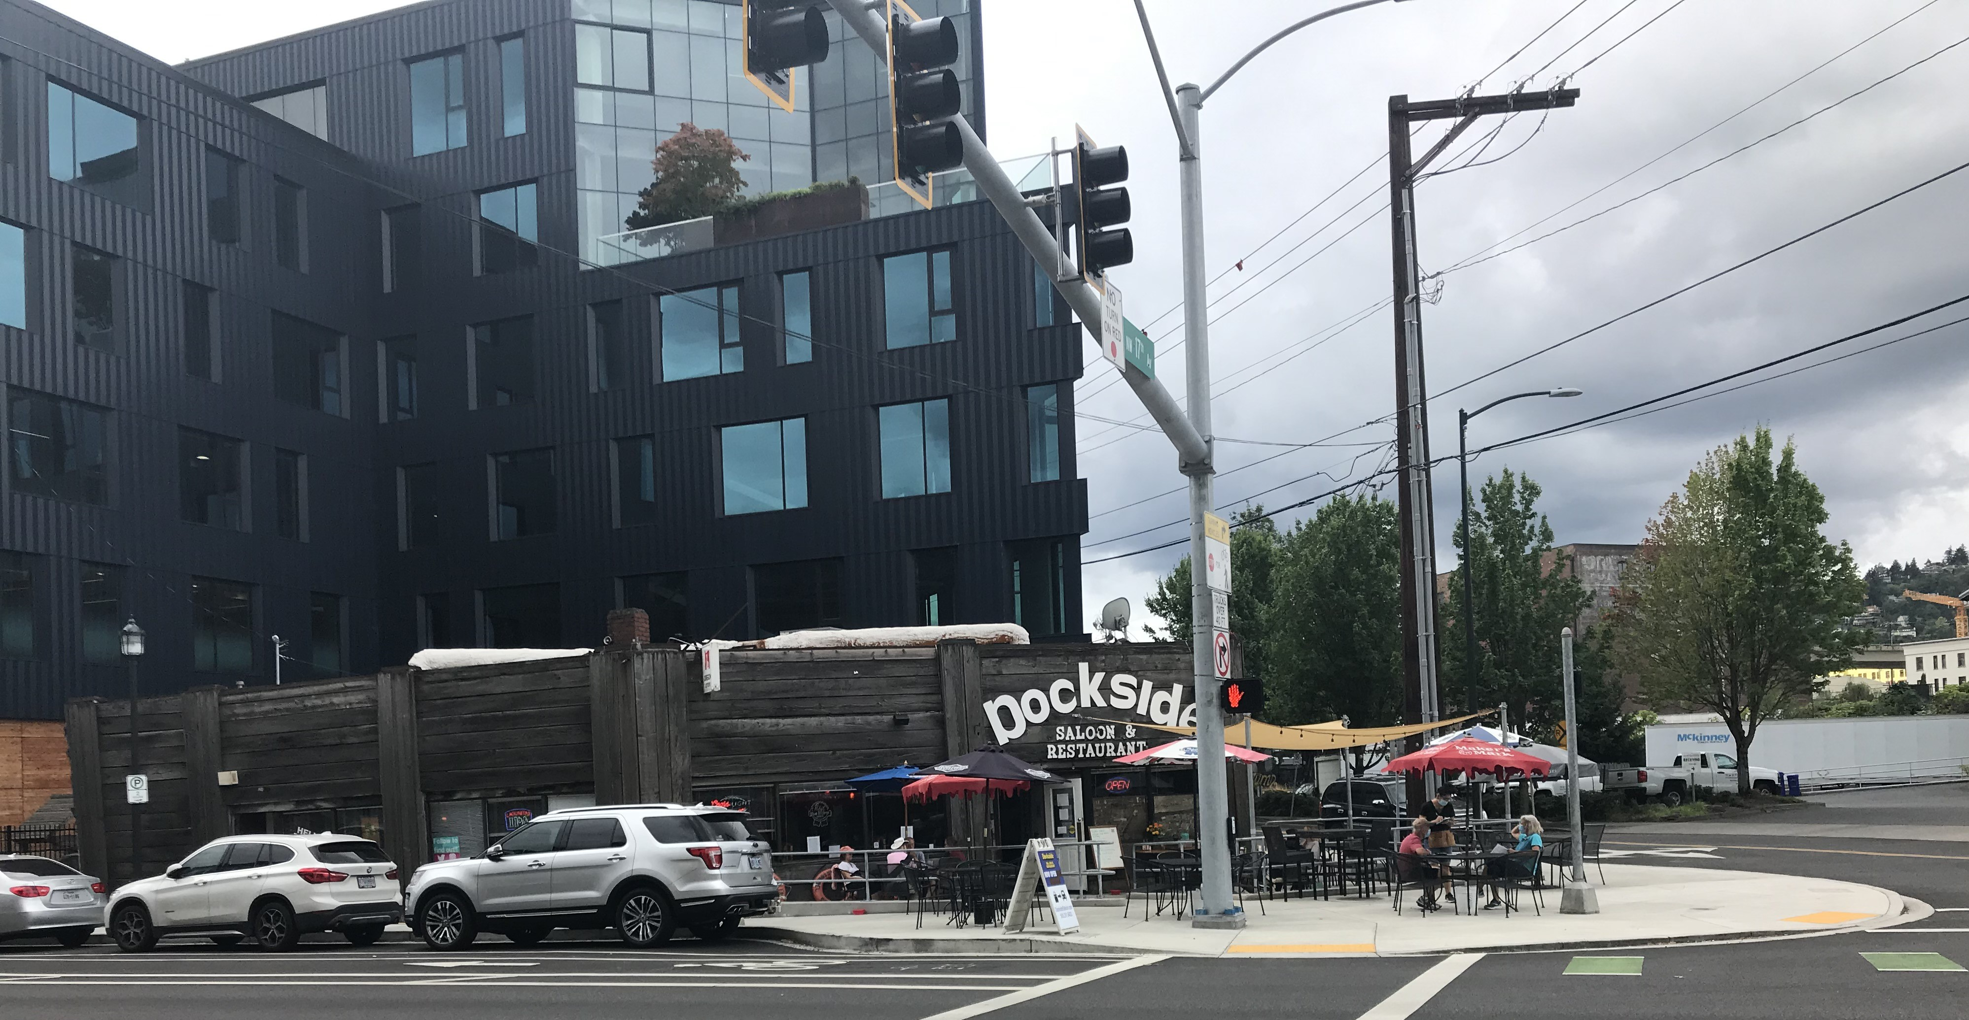
NW Front & 17th Avenues
Expanded Sidewalk, New ADA-Compliant Curb Ramps

Slide 11
New Traffic Signals at 3 Intersections
NW Front & 17th Avenues at 1:15 AM on 11/07/19

Slide 12
NW Front Ave. & NW/SW Naito Parkway
Pavement Condition Improved from Poor/Very Poor

