Slide 1
Expanding Opportunities for Affordable Housing – Package B
City Council Hearing – March 3, 2021

Slide 2
How we got here
Expanding Opportunities for Affordable Housing – Phase 1
Zoning Code, Comprehensive Plan Map, and Zoning Map amendments to facilitate the development of affordable housing on sites with community-based organizations
Rezoned 19 CBO properties
Five additional sites were identified as potential rezone sites but needed further study
Council directed BPS staff to report back with a recommendation for consideration of those five sites
Notes:
We have about 2 hours for our work session today and we’ll be sharing…
[Introduce topic and speakers]

Slide 3
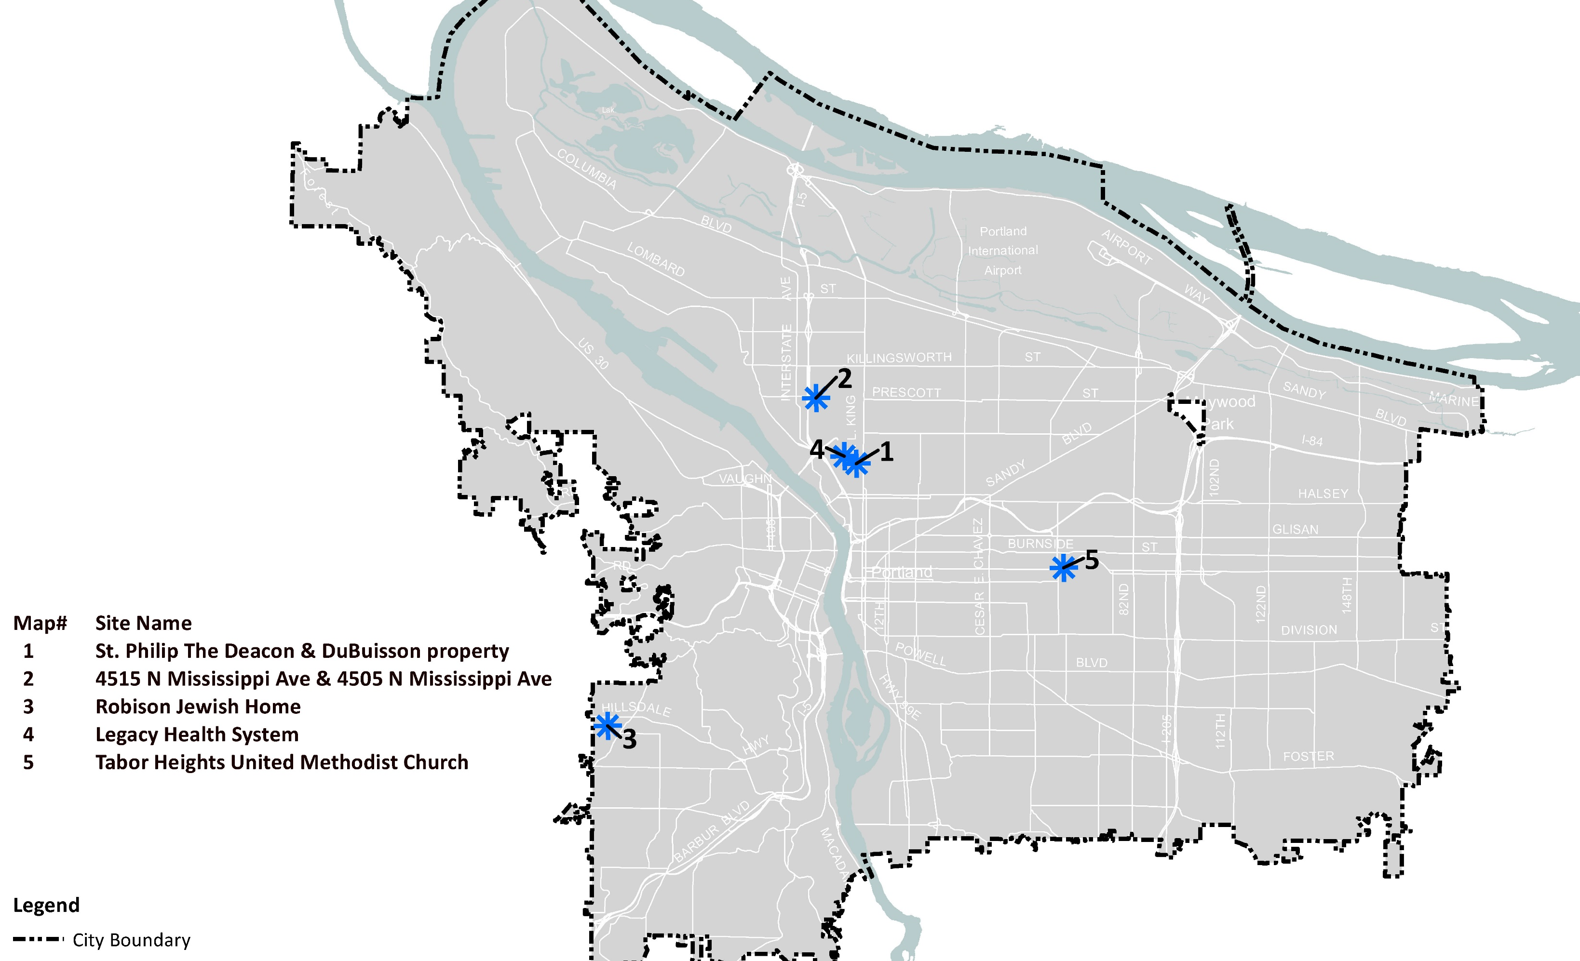
EOAHB Sites
Notes:
We have about 2 hours for our work session today and we’ll be sharing…
[Introduce topic and speakers]

Slide 4
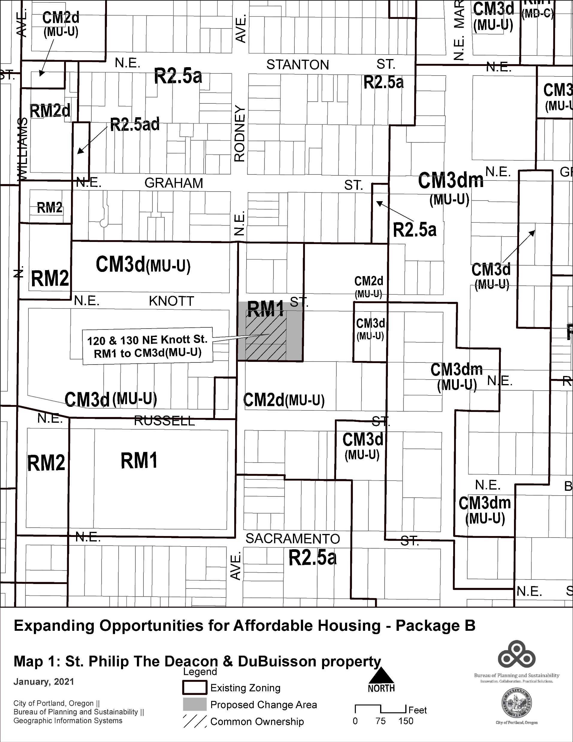
#1 – St Phillip the Deacon Site
Proposed Zone Map amendment:
RM1 to CM3d
Property details:
Current use: Church and residential use
Proposed use: Affordable housing and community service
Staff recommendation:
Rezone property to CM3d
Notes:
We have about 2 hours for our work session today and we’ll be sharing…
[Introduce topic and speakers]

Slide 5
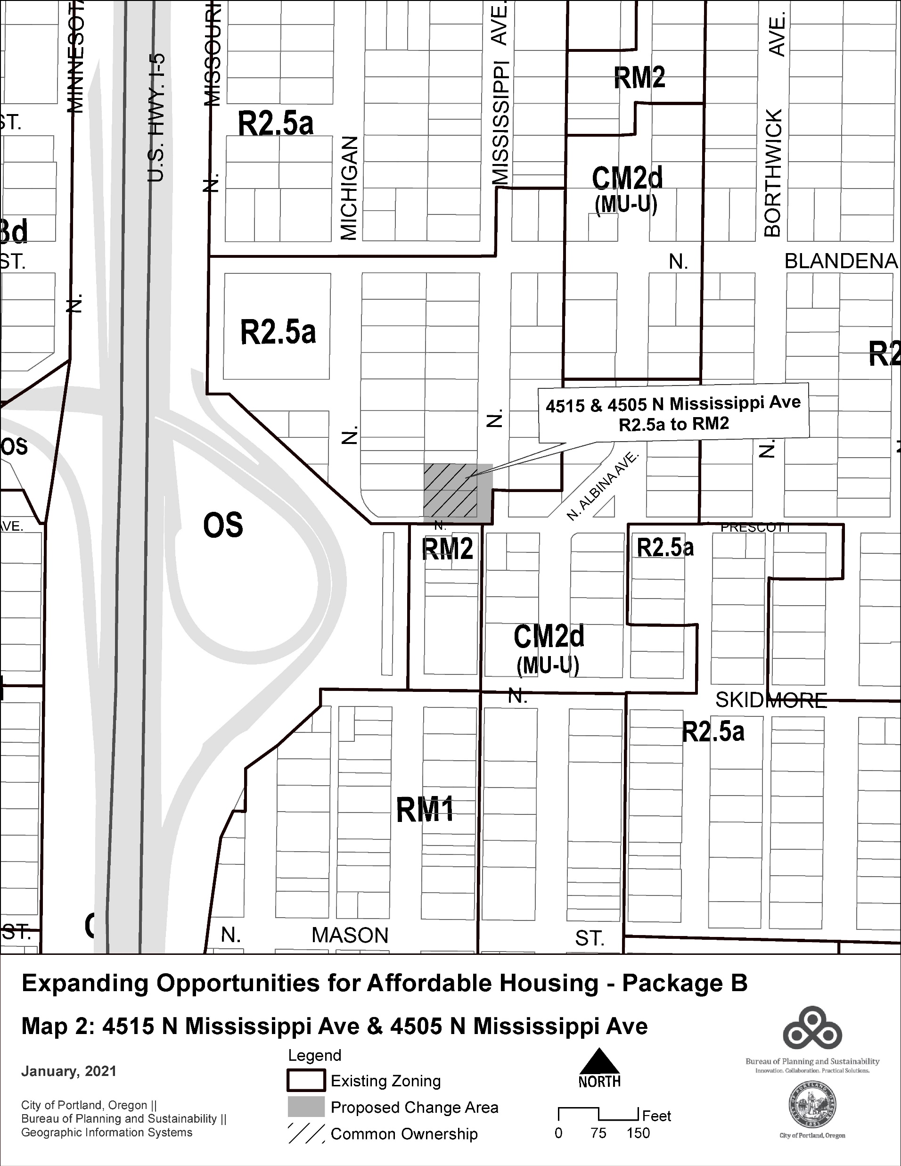
#2 – Mississippi Site
Proposed Zone Map amendment:
R2.5 to RM2
Property details:
Current use: Residential use – single dwelling and rooming house rented at below market rates
Proposed use: Continue existing use and improve/expand community-based housing
Staff recommendation:
Rezone property to RM2
Notes:
We have about 2 hours for our work session today and we’ll be sharing…
[Introduce topic and speakers]

Slide 6
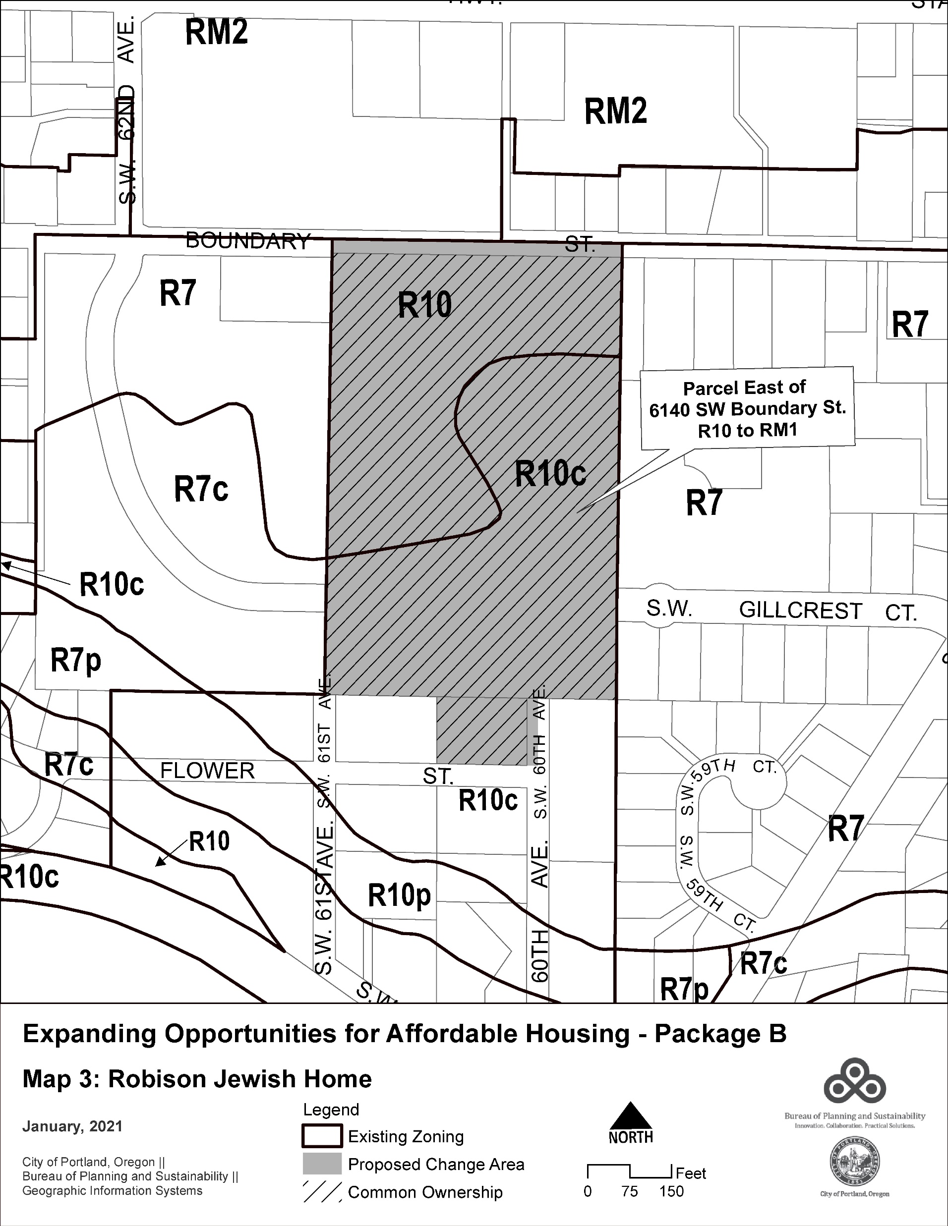
#3 – Cedar Sinai Park Site (Robison Jewish Home)
Proposed Zone Map amendment:
R10/R10c to RM1/RM1c
Property details:
Current use: Vacant with small parking lot
Proposed use: Affordable housing for seniors
Staff recommendation:
Maintain existing zoning
Applicant can apply for zone change through quasi-judicial process
Infrastructure and neighbor concerns better addressed through QJ procedure
Notes:
We have about 2 hours for our work session today and we’ll be sharing…
[Introduce topic and speakers]

Slide 7
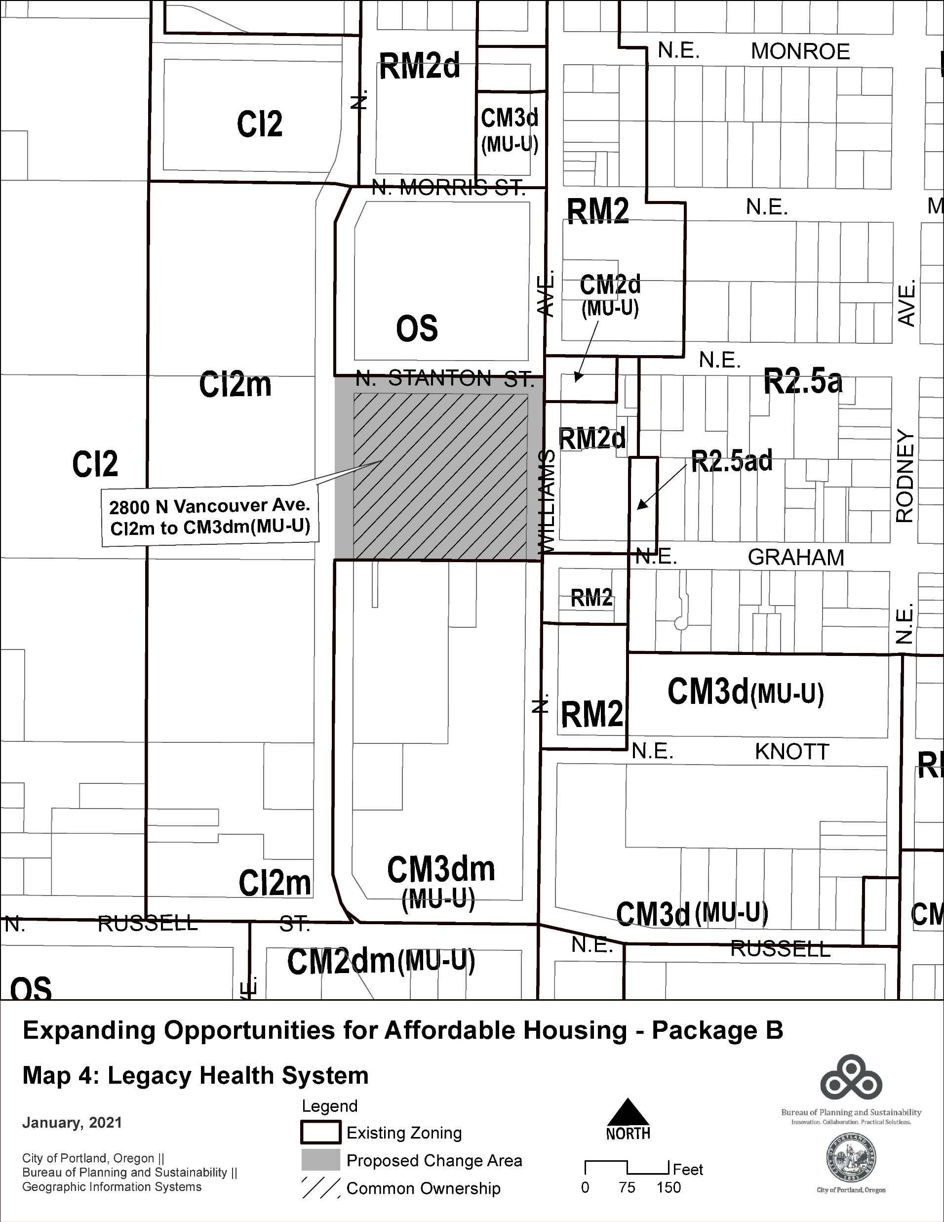
#4 – Legacy Site
Proposed Zone Map amendment:
CI2m to CM3dm
Property details:
Current use: Medical office and parking lot
Proposed use: No proposed changes
Staff recommendation:
Maintain existing zoning
Property owner not interested in zone change
Zone change itself would not result in desired results for neighborhood interests
Notes:
We have about 2 hours for our work session today and we’ll be sharing…
[Introduce topic and speakers]

Slide 8
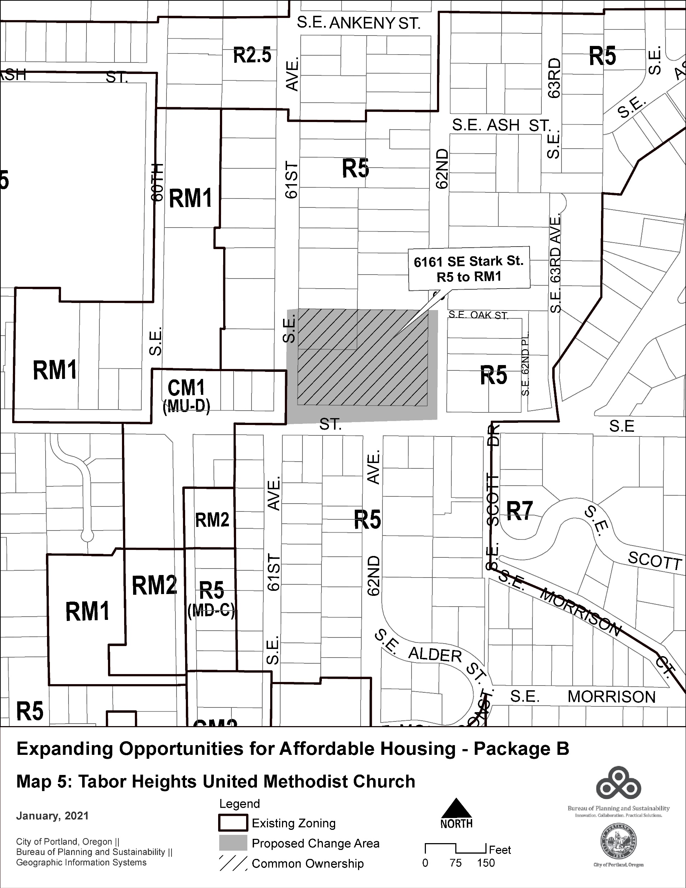
#5 – Tabor Heights United Methodist Site
Proposed Zone Map amendment:
R5 to RM1
Property details:
Current use: Church and parking lot
Proposed use: No proposed change
Staff recommendation:
Maintain existing zoning
No advocate for rezoning proposal
Notes:
We have about 2 hours for our work session today and we’ll be sharing…
[Introduce topic and speakers]

Slide 9
Testimony
8 piece of written testimony to City Council as of March 2, 2021
3 testifiers registered for the hearing
Notes:
We have about 2 hours for our work session today and we’ll be sharing…
[Introduce topic and speakers]

Slide 10
For more info:
Project webpage: portland.gov/bps/ah-grant
Notes:
We have about 2 hours for our work session today and we’ll be sharing…
[Introduce topic and speakers]

