Slide 1

NW Portland Sanitary Sewer Extensions
E11128
Joe Dvorak, PE | Engineering Manager
Raechel Frogner, EIT | Senior Engineering Associate
January 6, 2021
MINGUS MAPPS, COMMISSIONER
MICHAEL JORDAN, DIRECTOR

Slide 2
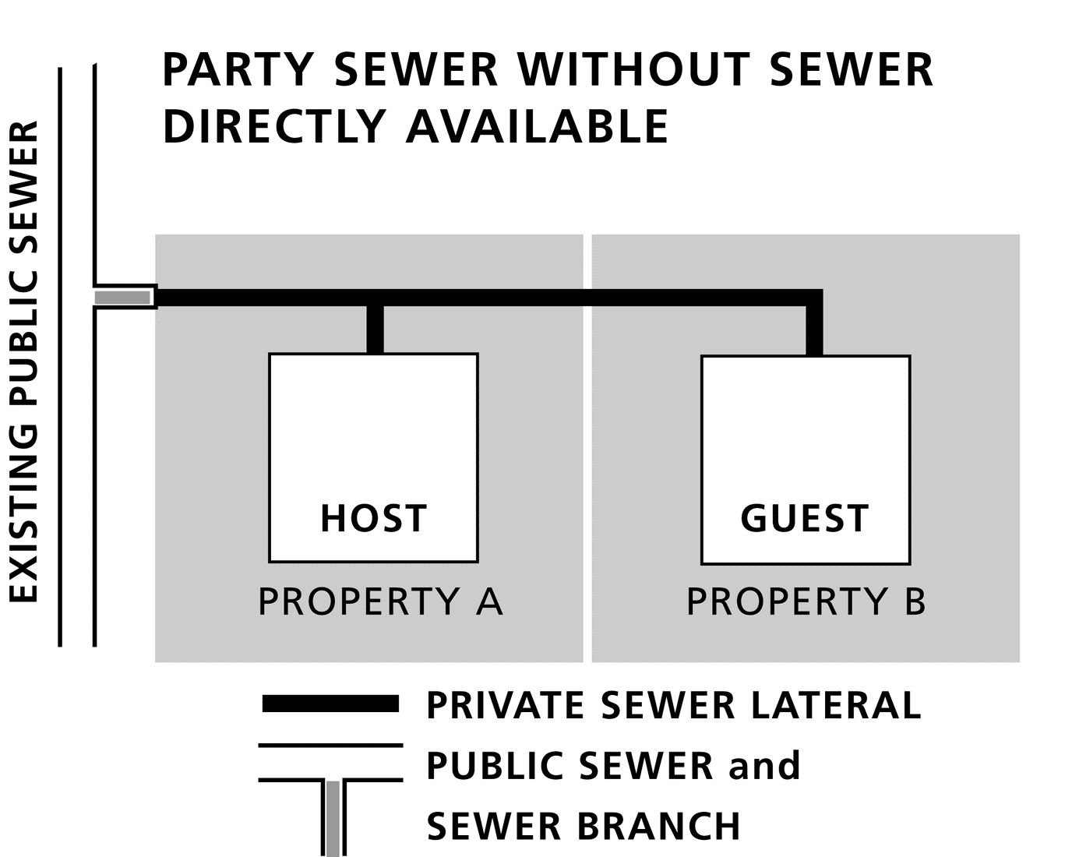
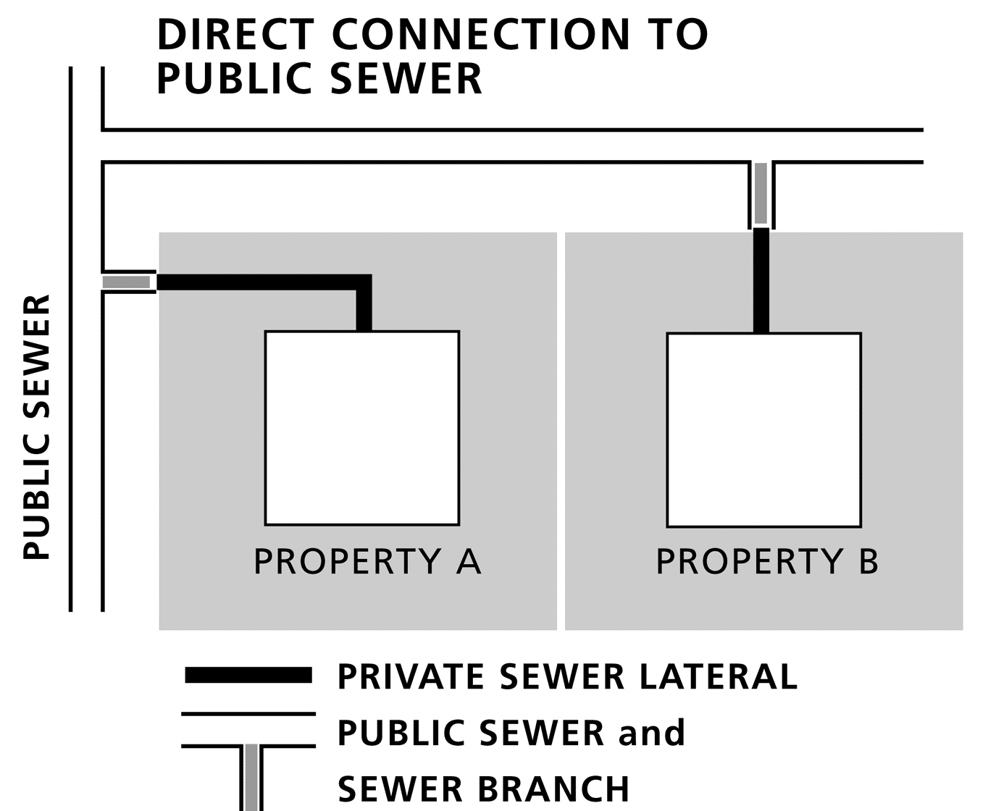
Project Requirements
Nonconforming Sewer Conversion Program
  BES constructs public sewer extensions in areas where public sewer is not immediately available
Public Sewer Utility Waivers (PSUWs)
  2008-2012 offer to nonconforming properties to “lock-in” the sewer conversion charge
    Average “locked-in” rate: $5,721
    FY20/FY21 rate: $7,103
NW Portland Area
  Area with a concentration of nonconforming sewers with PSUWs

Slide 3
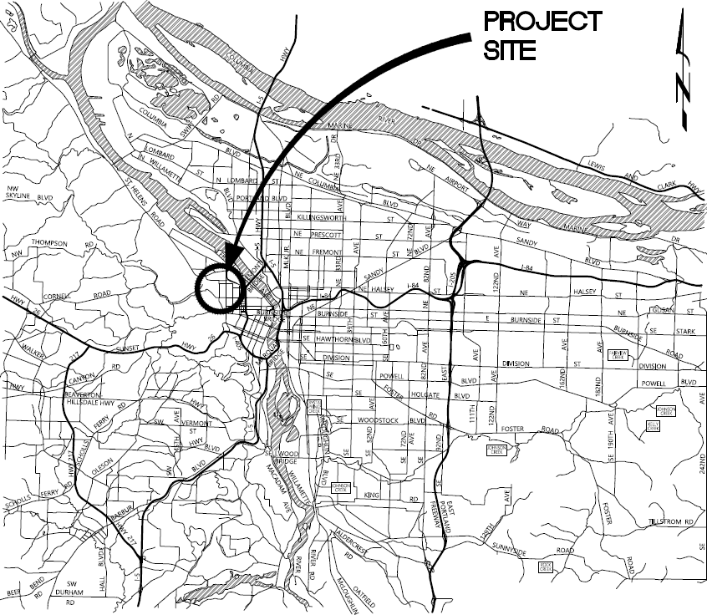
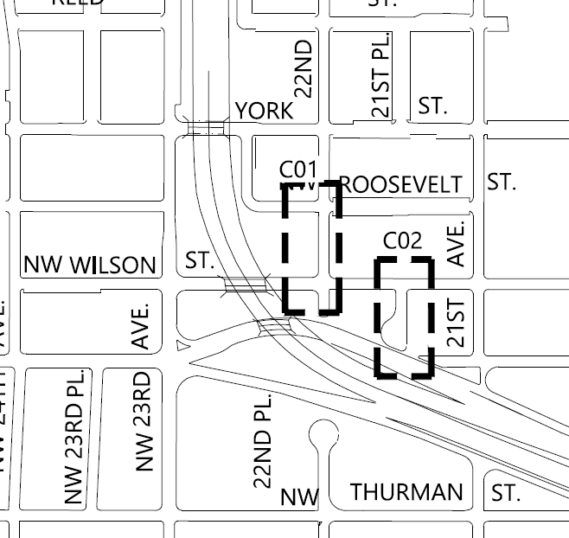
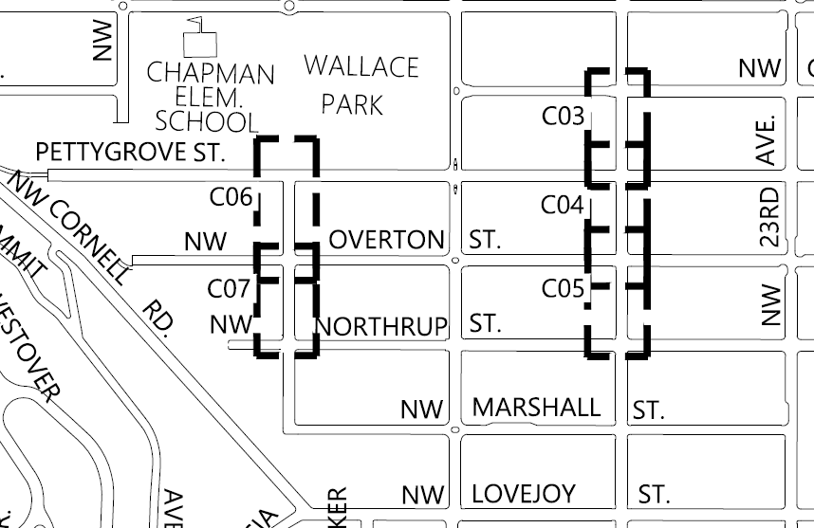
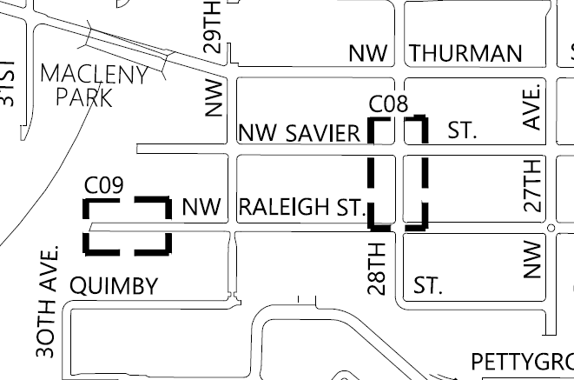
Project Objectives & Overview
Construct nine public sewer extensions totaling:
  1,040 linear feet of new sewer mainline
  Twenty-one new sewer service laterals
Extensive outreach to affected properties

Slide 4
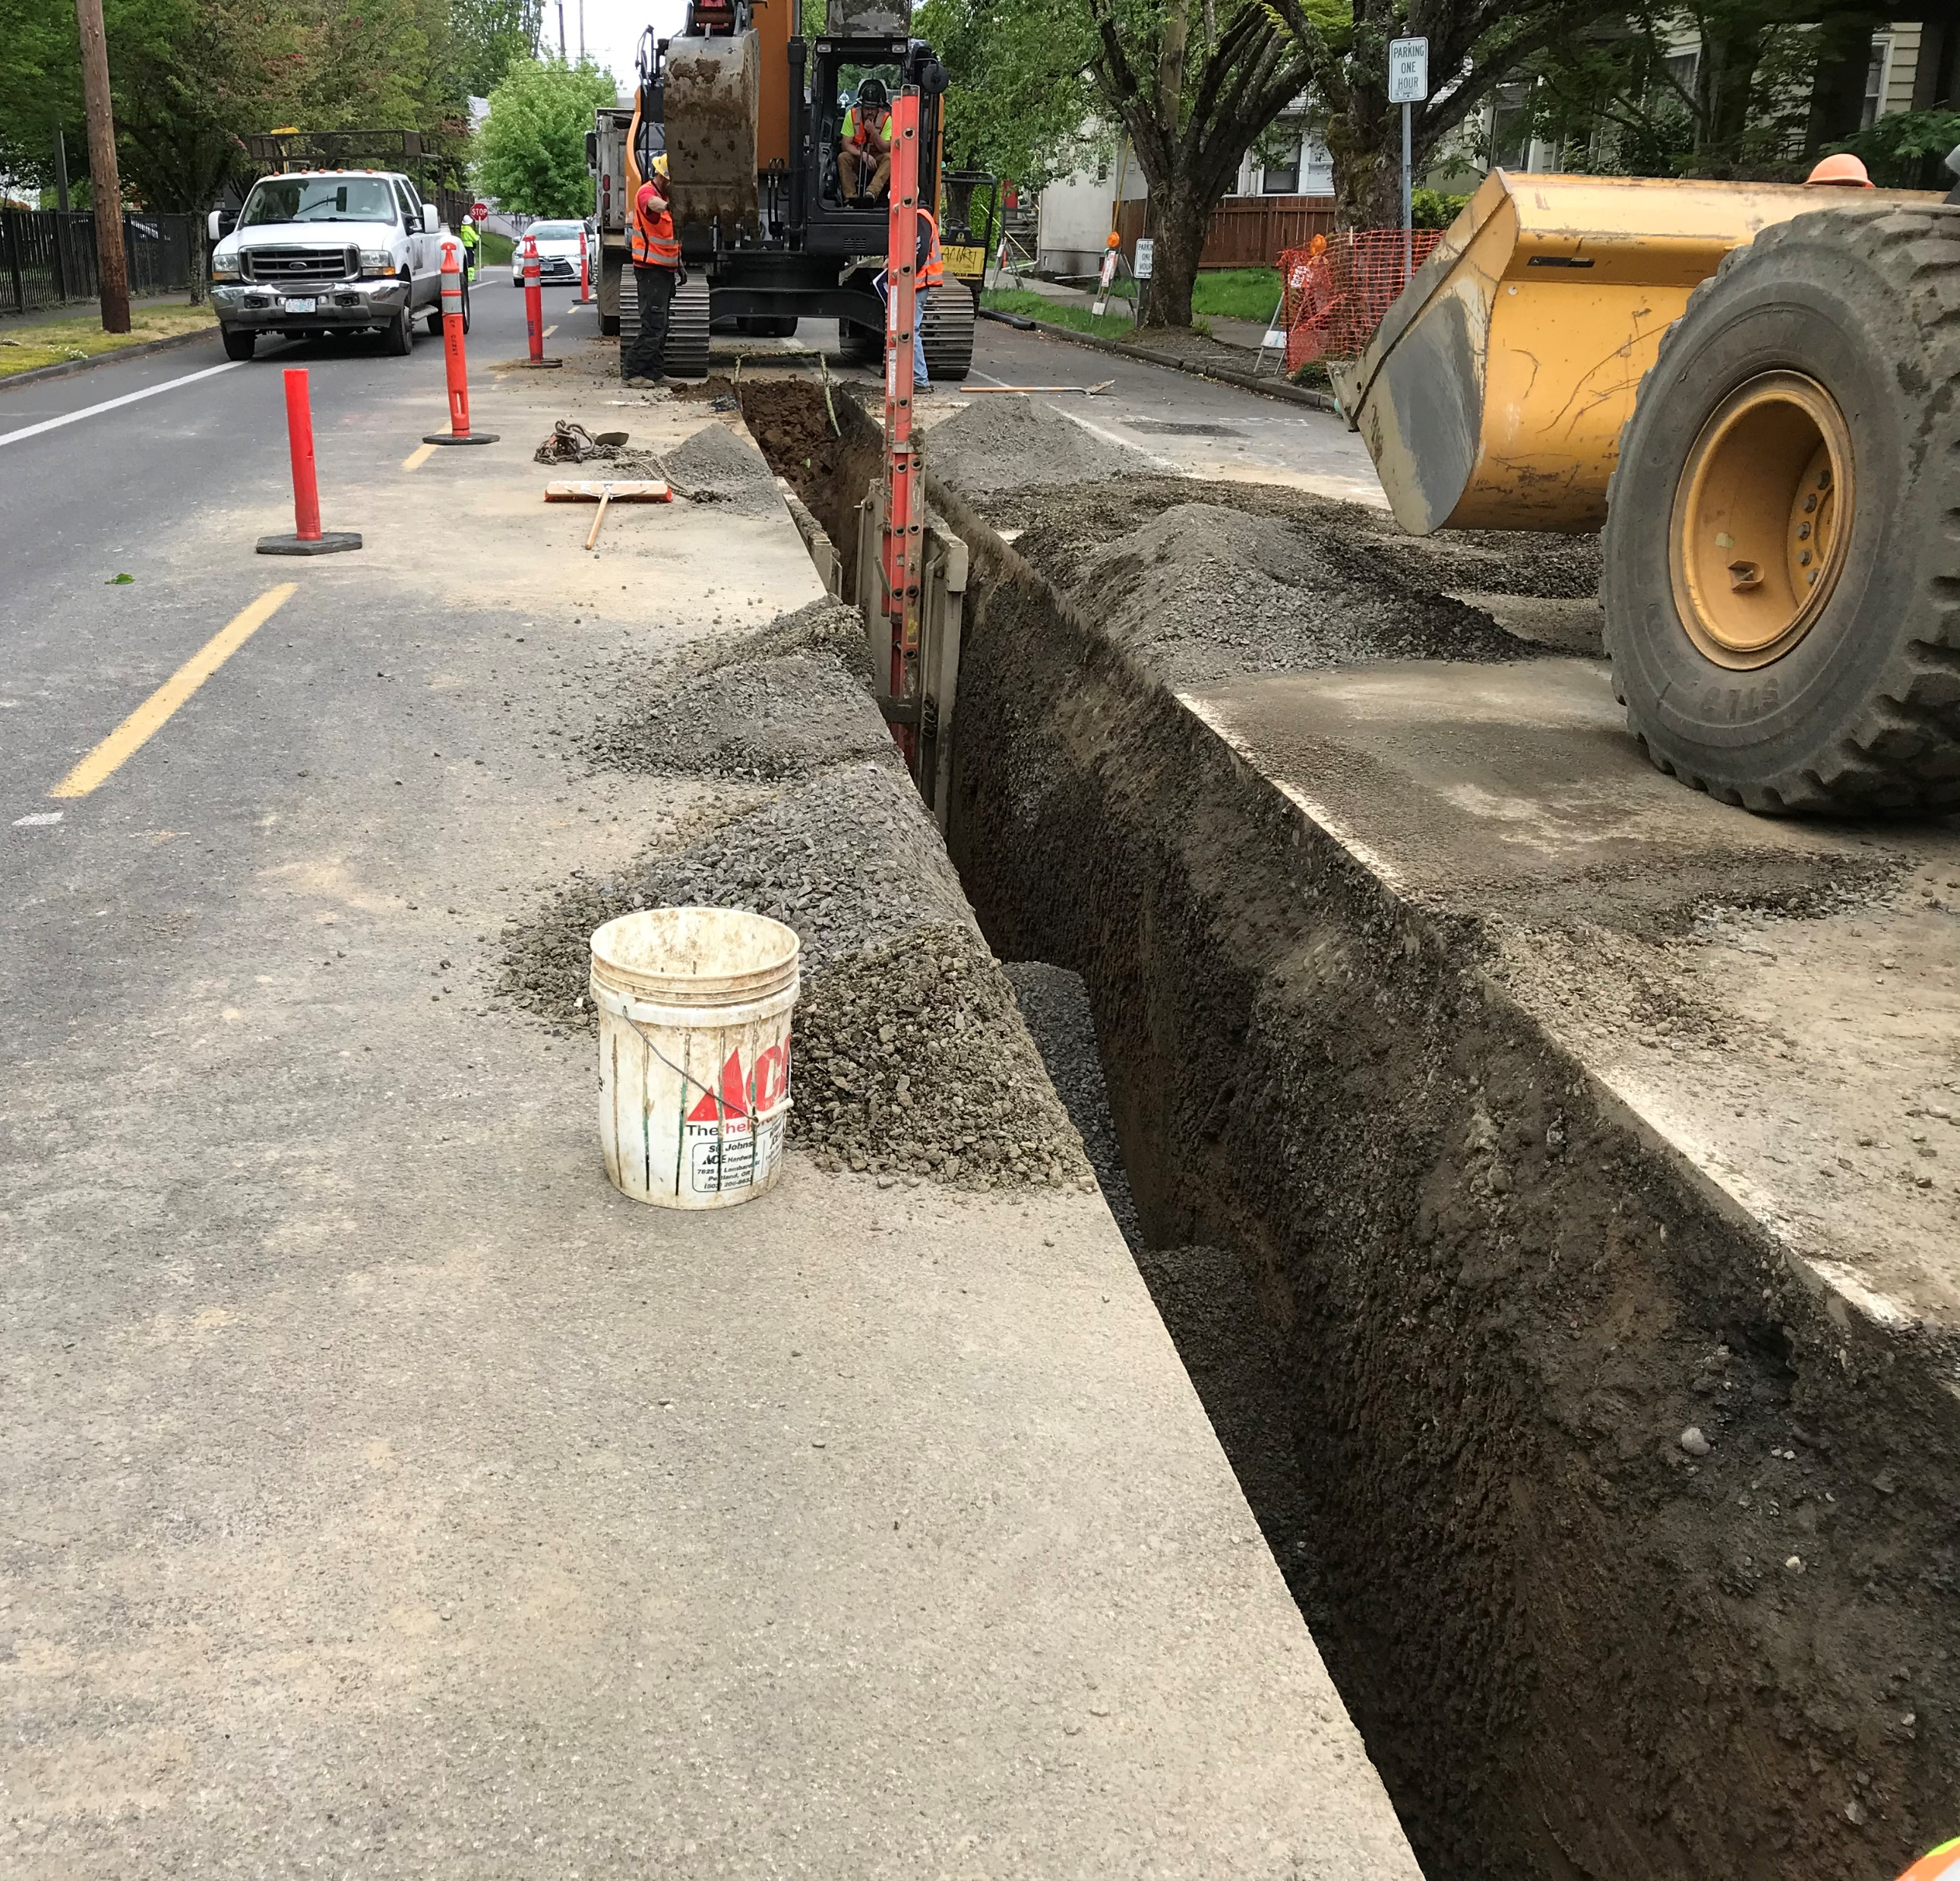
Project Budget and Schedule
Engineer’s Estimate
  $1,020,000
  Optimal Confidence Level
Advertise Project
  February 2021
  Release to Prime Contractor Development Program
Begin Construction
  May 2021
Construction Duration
  Spring 2021 through Winter 2021

Slide 5
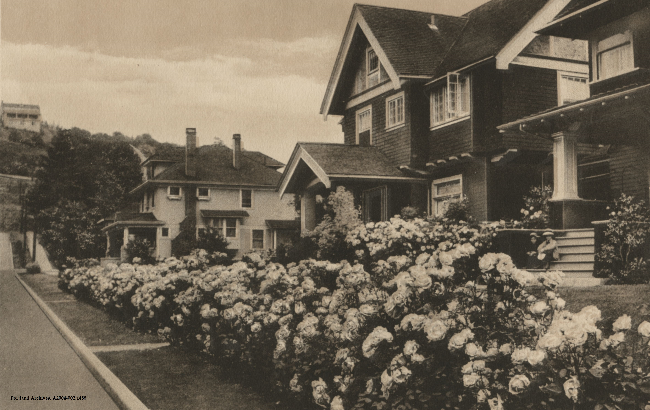
Questions
City of Portland (OR) Archives, A2004-002.1458
Thank you

