Slide 1


Portland Housing Advisory Commission
2021 Planning

Slide 2
2018 Focus
Funding sources
Homeownership
Rental housing
Housing: East Portland
Permanent supportive housing
Mobile home parks
Barriers to accessing housing
Workforce housing
Review land use decision
2

Slide 3
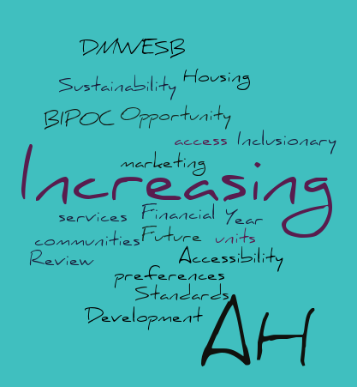
2021 Concepts
DMWESB – Increasing Opportunity
Accessibility – Standards for Future AH Development
Increasing access to AH units for BIPOC communities (marketing, preferences, and services)
Financial Sustainability
Inclusionary Housing – 4 Year Review
3

Slide 4

Brainstorm
4

