Slide 1
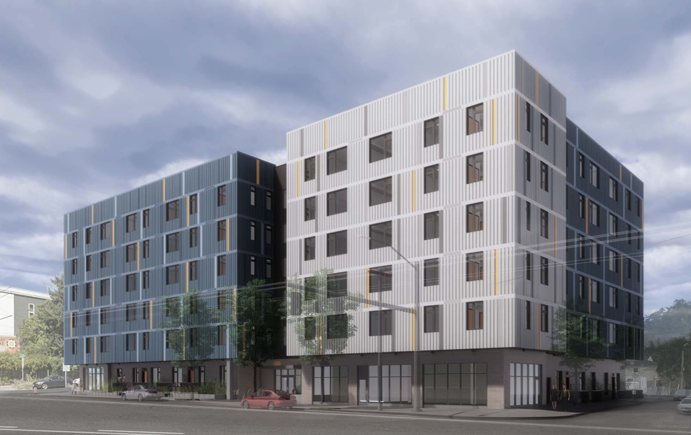
5020 Condos Update
Shannon Callahan,
Director, Portland Housing Bureau
September 10, 2020

Slide 2
5020 Condo – Unit Mix and Affordability
N/NE Oversight Committee | 9/10/20 | Portland Housing Bureau
Notes:
Full set in-unit appliances
1,400 sft outdoor play
Raised box landscaping
Bike parking

Slide 3
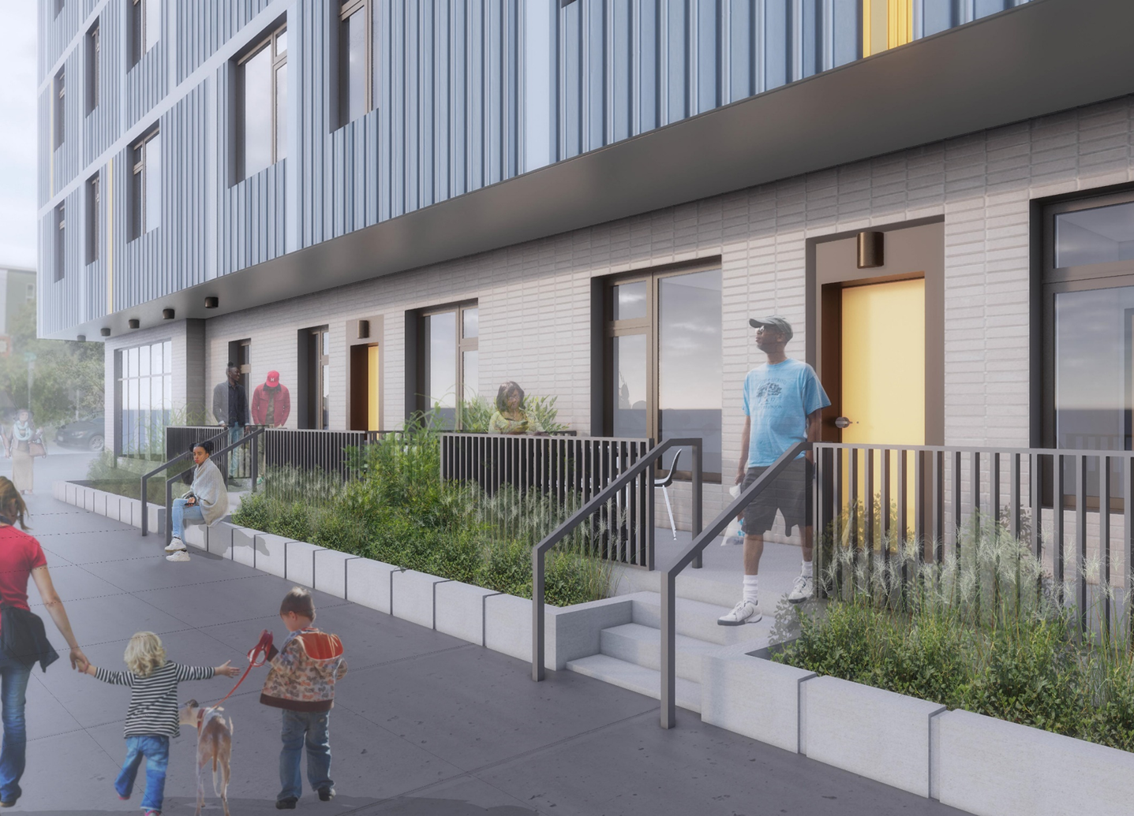
5020 Condo – Funding
Commercial Bank | $ 11,000,000
OR Housing & Community Services LIFT | $ 1,625,000
Grants: Metro, MMT, OCF, Collins, Enterprise, ETO | $ 1,008,702
Habitat For Humanity | $ 390,000
PHB Funding – Permanent Subsidy | $ 5,000,000
PHB Funding – Bridge Loan (incl $1MM add’l buydown) * | $ 4,500,000
PHB Site – granted to PG (shown PHB purchase price) ** | $ 2,000,000
Total Project Funding Sources | $ 25,523,702
N/NE Oversight Committee | 9/10/20 | Portland Housing Bureau

Slide 4
5020 Condo - Timeline for Closing & Start of Construction
Date | Action
9/30/2020 | Decision on 5020 by Bank, PHB, OHCS and PG to move forward
10/1/2020 | Request for updated project costs /bids and schedule
10/1/2020 | Request for updated appraisal for Bank and PHB
10/22-31/2020 | Agreed upon Pro Forma w updated costs, schedule and appraisal
11/5-12/2020 | PHB update to Housing Investment Committee
11/15/2020 | Bank Final Credit Approvals for $11 million
11/15/2020 | Restart Documentation / Legal Work
12/23/2020 | Finalize Documentation
12/24/2020 | Funding PHB loan (2-3 Bus Days) / Pre-Close
12/31/2020 | Expiration of ROF / Financial Close & Start of Construction for 5020 Condos
10
N/NE Oversight Committee | 9/10/20 | Portland Housing Bureau
Notes:
Metro reporting templates being discussed.
PHB Metro – 30% hard, 20% soft
Washington County NOFA 20% DMWESB

