Slide 1

Corrosion Control Improvements Project
Guaranteed Maximum Price (GMP)
Report to Council
July 8, 2020
Notes:
1

Slide 2
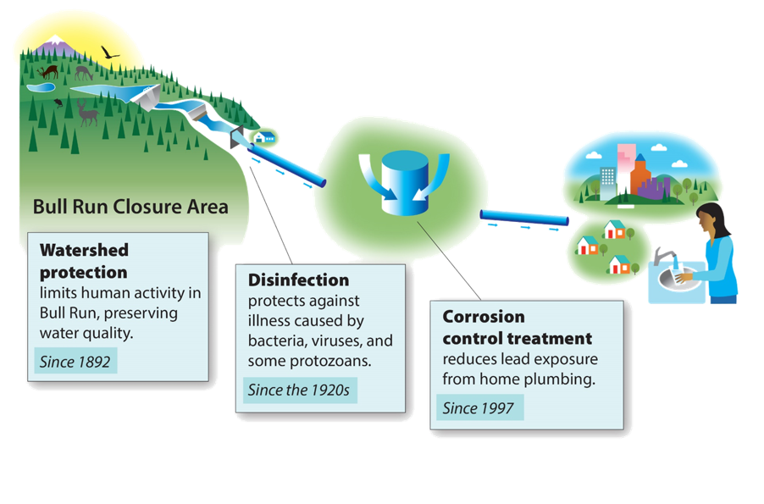
How water treatment works today

Slide 3
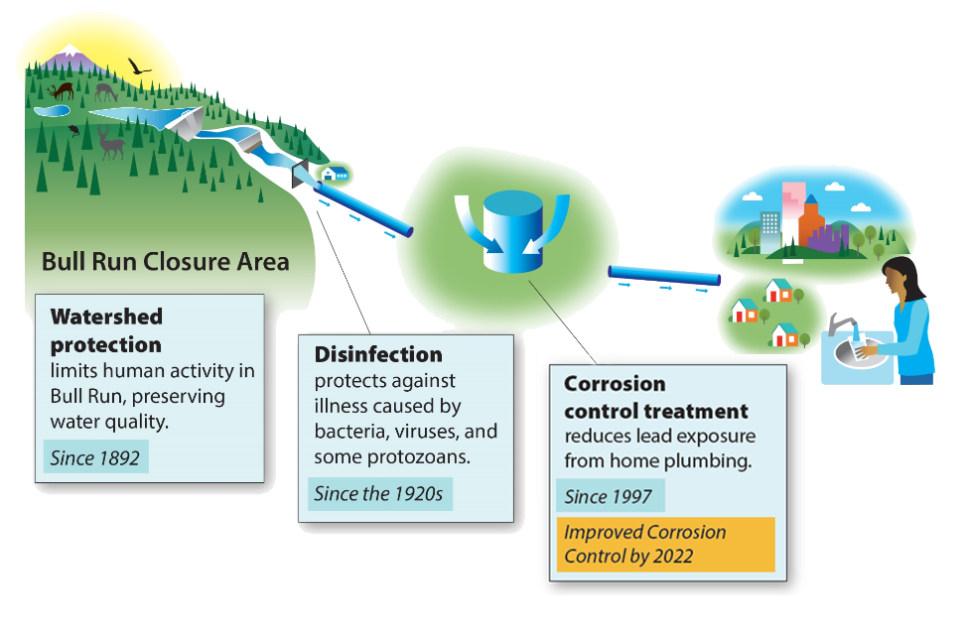
Improved Corrosion Control Treatment

Slide 4
Corrosion Control Improvements Project
This project is being built to meet the requirements of the Environmental Protection Agency (EPA) Lead and Copper Rule (LCR). Oregon Health Authority has set a compliance schedule.
Improved Corrosion Control Treatment will adjust the chemistry of the water to reduce levels of lead at the tap.
Expansion of existing Lusted Hill facility will meet project objectives.

Slide 5
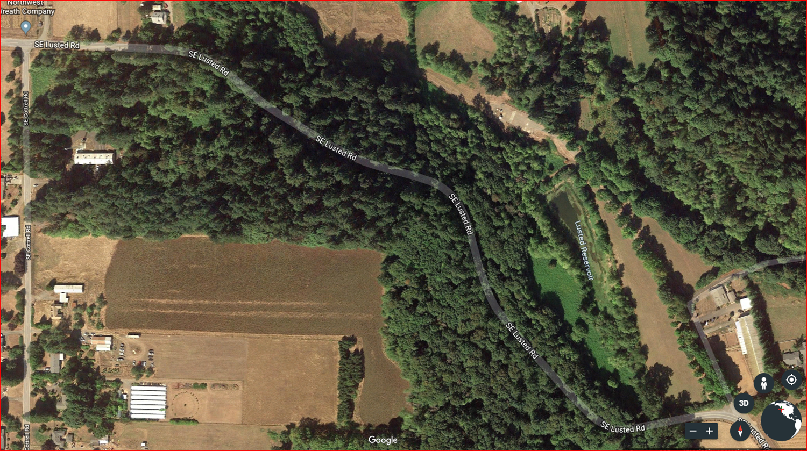
Project Site
New underground chemical feed piping
Lusted Hill Facility Site
New facilities
Existing facility

Slide 6
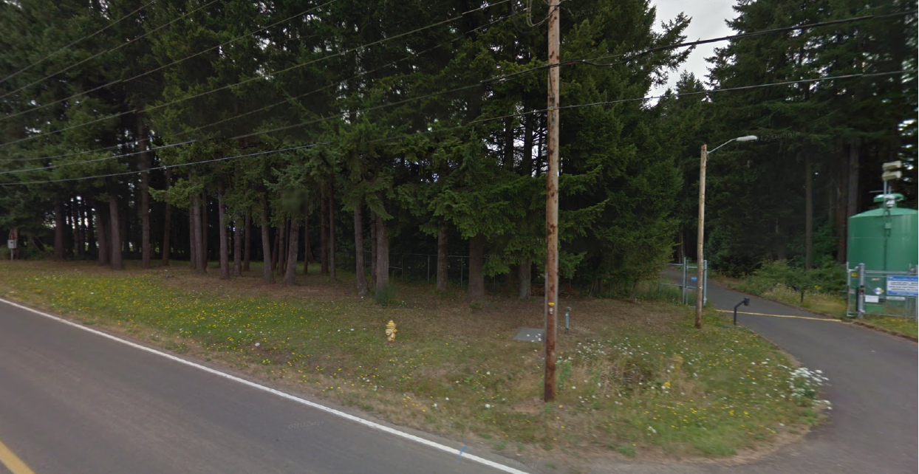
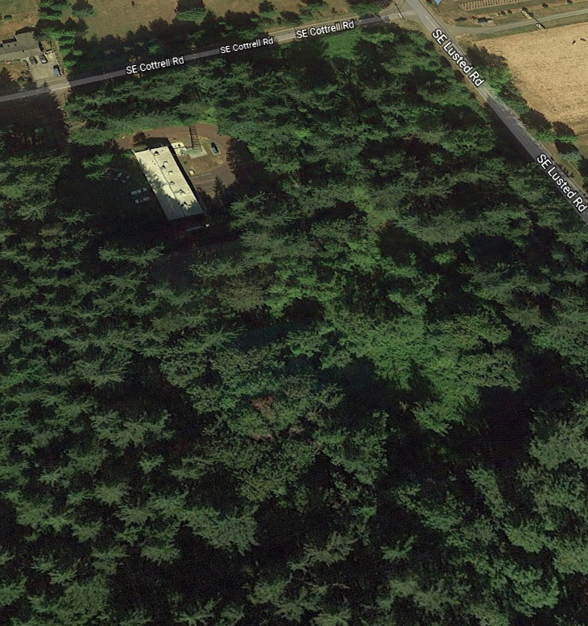
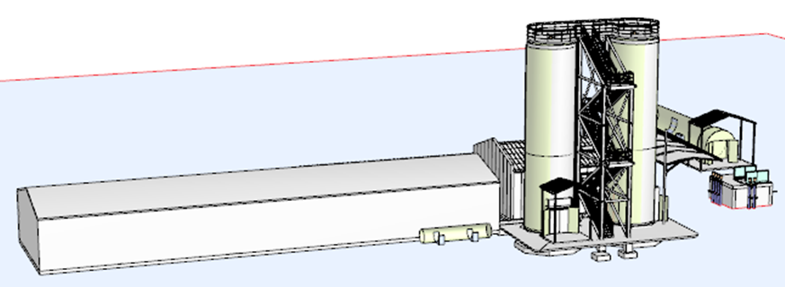
The improved corrosion control treatment facility will be located alongside the existing facility
SE Cottrell Rd
SE Lusted Rd
Existing facility
New facilities

Slide 7
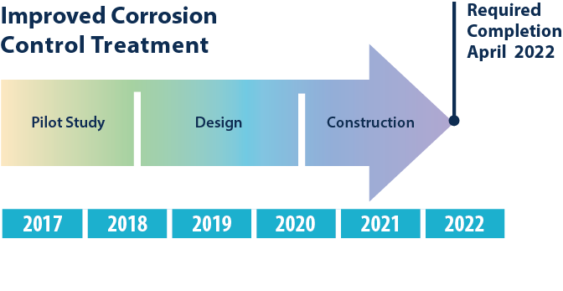
Project Schedule

Slide 8
Project Schedule (cont)
Ordinance Number 188621, authorized on September 27, 2017
  Allows Procurement Services and the Water Bureau to use a Construction Manager/General Contractor (CM/GC) procurement method for the Project in lieu of the traditional low bid contracting method.
CM/GC procurement method is a two-step procurement process
  Begins with a Pre-Construction Services Contract followed by Construction Contract
  Pre-Construction Services allows early involvement with the construction team and provides the following benefits:
    Concurrent acquisition, design, and construction functions
    Ability to acquire materials and order fabrication incrementally
    Reduction of risk of construction delays and unanticipated costs
    Evaluation of total project costs based on project design

Slide 9
Project Schedule (cont)
Procurement Services advertised the RFP on December 21, 2018, for pre-construction services and construction of the Corrosion Control Improvements Project.
Three (3) proposals were received on January 29, 2019.
The proposals were reviewed, evaluated, and scored by a five (5)-member evaluation committee consisting of representatives from PWB and one member from the Minority Evaluator Program.
The evaluation committee selected MWH Constructors, Inc. as the highest scoring proposer.
PWB entered into a Pre-Construction Services Contract with MWH Contractors, Inc. for a not to exceed amount of $332,500.

Slide 10
Project Benefits
Improved Corrosion Control Treatment will adjust the chemistry of the water to reduce levels of lead at the tap.
Construction of the Corrosion Control Improvements Project is anticipated to include:
  21 subcontract work packages
  4 equipment procurement packages
  25.91% of the hard construction costs for Disadvantaged, Minority-Owned, Women-Owned, and Emerging Small Businesses (DMWESB) firms.
Notes:
• The pH of Portland’s water will gradually increase from 8.2 to a minimum target of 8.6. Water with a higher pH is less acidic, or corrosive. This will result in less lead and other metals leaching from building plumbing into drinking water.
• The alkalinity of Bull Run water will increase to 25-40 mg/L. Alkalinity, or hardness, is the level of minerals in the water. Increased alkalinity improves the stability of the pH, which increases the effectiveness of treatment.
Construction of the Corrosion Control Improvements Project will include 21 subcontract work packages and 4 equipment procurement packages that will be solicited through local advertisement and outreach and benefit the local contracting community.
MWH Constructors, Inc. and their subcontractors have committed to utilizing 25.91% of the hard construction costs for Disadvantaged, Minority-Owned, Women-Owned, and Emerging Small Businesses (DMWESB) firms.
Some work is required to be performed by the prime contractor.

Slide 11
Project Benefits (cont)
The City’s Community Equity Inclusion Plan (CEIP) applies to this project.
The purpose of the CEIP is to:
  improve and increase construction contracting and employment opportunities for racial and ethnic minorities, women, and economically disadvantaged individuals on City projects;
  ensure that the City is making conscious and specific efforts through its contracting processes to not discriminate or indirectly perpetuate the historic under-inclusion of racial and ethnic minorities, women, and economically disadvantaged individuals in the construction industry and trades; and
  ensure that the City receives the benefit of a highly skilled and well-trained workforce and provides opportunities for firms that reflect the diversity of Portland in the Contractor and Subcontractor pools.
Notes:
• The pH of Portland’s water will gradually increase from 8.2 to a minimum target of 8.6. Water with a higher pH is less acidic, or corrosive. This will result in less lead and other metals leaching from building plumbing into drinking water.
• The alkalinity of Bull Run water will increase to 25-40 mg/L. Alkalinity, or hardness, is the level of minerals in the water. Increased alkalinity improves the stability of the pH, which increases the effectiveness of treatment.
Construction of the Corrosion Control Improvements Project will include 21 subcontract work packages and 4 equipment procurement packages that will be solicited through local advertisement and outreach and benefit the local contracting community.
MWH Constructors, Inc. and their subcontractors have committed to utilizing 25.91% of the hard construction costs for Disadvantaged, Minority-Owned, Women-Owned, and Emerging Small Businesses (DMWESB) firms.
Some work is required to be performed by the prime contractor.

Slide 12
MWH Constructors
Contract Work
The MWH CEIP requirements include the following workforce diversity construction aspirational goals for minority and women workers:
  22% overall subcontracting (12% D/MBE, 5% WBE, 5% D/M/W/ESB/SDVBE)
  31% of total apprenticeable labor hours by trade (22% for Minorities, 9% for Women)
  28% of total journey level hours (22% for Minorities, 6% for Women)
MWH’s objective for this project is to use the goals as a beginning point and the spirit of the CEIP to maximize the utilization of certified contractors and suppliers, maximize the utilization of apprentices and encourage the highest possible participation of minorities and women in the workforce.
Notes:
Early procurements packages have been advertised for procurement of the carbon dioxide storage and feed equipment, the soda ash storage and feed systems, the pre-engineered steel building, and the tree removal.
The Steel Building package was competitively bid with COBID firms specifically invited to participate.
The Tree removal package was provided exclusively to COBID firms for competitive bidding with 3 firms attending the pre-bid site visit and 2 firms submitting bids.

Slide 13
MWH Constructors
Guaranteed Maximum Price
*MWH Constructors submitted the Guaranteed Maximum Price (GMP) to complete the work shown on or in the 90% design | $16,139,637
Owner’s Allowance reserved for chemical feed piping which was not fully defined at the 90% design milestone | $850,000
~6% Owner Controlled Contingency of the anticipated GMP value for unknown or unanticipated work be required | $1,000,000
Total Requested Contract Value | $17,989,637
*Hard Construction Costs = $14,118,944;
MWH Contingency, Fees, Bonds, Taxes = $2,020,693
Notes:
MWH Constructors submitted the Guaranteed Maximum Price(GMP) of $16,139,637 to complete the work shown on or in the 90% design documents.
Hard Construction Cost = $14,118,944; Fees, Bonds, Taxes = $2,020,693
PWB is requesting an addition $1,850,000 be included as an Owner’s Allowance/Contingency resulting in a total requested contract value of $17,989,637.
$850,000 of the Owner’s Allowance is reserved for chemical feed piping which was not fully defined at the 90% design milestone.
Carrying this work as an allowance will minimize inclusion of excessive contingency in the in the Contractor’s GMP.
The remaining $1 million of the Owner’s Allowance represents ~6% of the anticipated GMP value and is being carried for Contingency should unknown or unanticipated work be required.
*Hard Construction Cost: $14,118,944
MWH Contingency $494,163
CM/GC Fee (9.61% of Subtotal) $1,356,831
Payment and Performance Bonds $106,999
Oregon Corporate Tax (effective 1/1/2020) $62,700

Slide 14
MWH Constructors
Contract Work
As the Prime Contractor, MWH Constructors, Inc. is required to:
  Manage the project
  Self-perform the procurement
  Install and startup of the Soda Ash and Carbon Dioxide systems
This specialty work is excluded from the requirements of the Community Equity and Inclusion Plan (CEIP) and totals ~$4.7 Million of the Hard Construction Costs.
The remaining ~$9.5 Million of Hard Construction Costs will be distributed through a subcontracting plan in accordance with the CEIP.
Notes:
The Prime Construction Contractor is required to manage the project and self-perform specific specialty work which is excluded from the requirements of the CEIP. Cost for these self-performed elements of work are as follows:
Procurement, Installation, startup and testing of the Soda Ash and Carbon Dioxide Feed systems: ~$3.2 Million
Management of the Project/General Conditions: ~$1.5 Million
MWH Constructors Inc. has submitted a subcontracting plan in accordance with the CEIP, which details how their bid packaging plan will be structured to distribute the remaining ~$9.5 Million of “Hard Construction Costs” to achieve the goals and requirements of the CEIP.

Slide 15
MWH Constructors
Contract Work
Early procurements packages have been advertised for:
  Equipment for the carbon dioxide storage and feed
  Equipment soda ash storage and feed systems
  Pre-engineered steel building equipment and installation
  Tree removal
Notes:
Early procurements packages have been advertised for procurement of the carbon dioxide storage and feed equipment, the soda ash storage and feed systems, the pre-engineered steel building, and the tree removal.
The Steel Building package was competitively bid with COBID firms specifically invited to participate.
The Tree removal package was provided exclusively to COBID firms for competitive bidding with 3 firms attending the pre-bid site visit and 2 firms submitting bids.

Slide 16
MWH Constructors
Plan Selected by Bid Selection Method
Packages Procured |  | Opportunity Tier | D/M/W/ESB $ | % of Package | % of Project
Informal Selection | $282,460 | 1st/2nd | $282,460 | 100% | 2.97%
Best-Value Selection | $5,678,595 | 1st/2nd | $1,751,092 | 31% | 18.44%
Price Based Selection | $3,535,338 | 2nd | $426,857 | 12% | 4.49%
Total | $9,496,393 |  | $2,460,409 |  | 25.91%

Slide 17
MWH Constructors
Project Bid Packaging Plan
Hard Construction Cost = $9,496,393; D/M/W/ESB $2,460,409; D/M/W/ESB 25.91%

