Slide 1
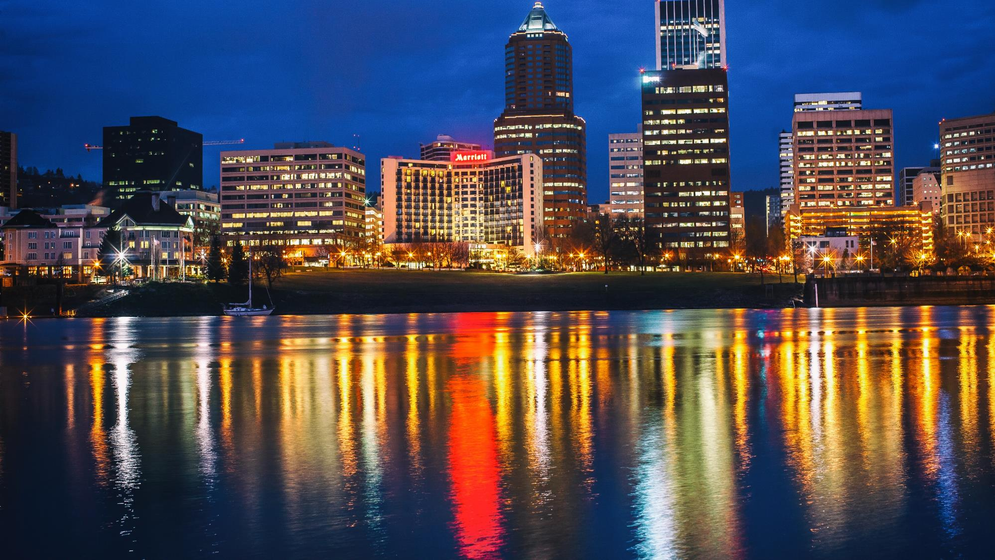
Leadership on
Climate Action
Multi-Bureau Efforts

Slide 2
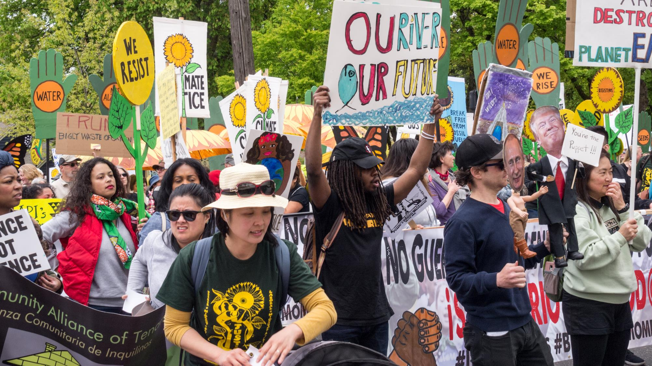
Notes:
ANDREA:
Our climate is in crisis.
The science is indisputable, and we see the effects of climate change every day—from the devastating extreme weather events happening all around the world to the impacts we feel close to home, like choking wildfire smoke in the summertime.
But the truth is that climate change doesn’t impact us all in the same way. Our frontline communities, including Portland’s Black, Indigenous and communities of color, are being hit first and worst by the impacts of the climate crisis and Portland’s youth will be facing the consequences of today’s decisions for the rest of their lives.

Slide 3
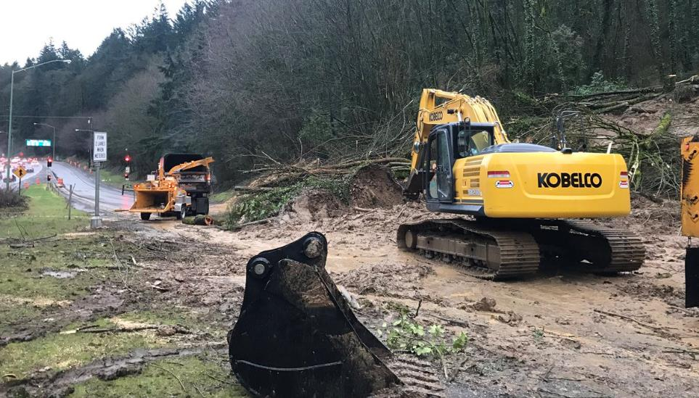
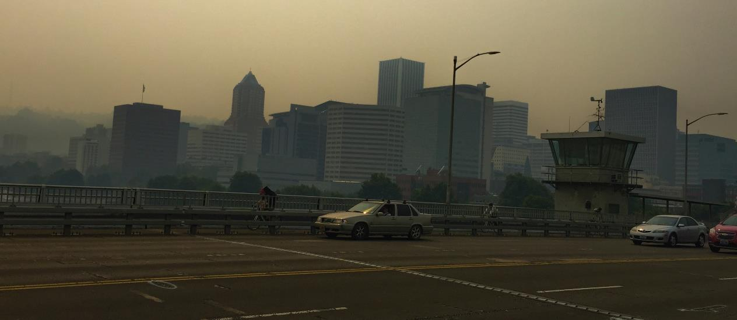
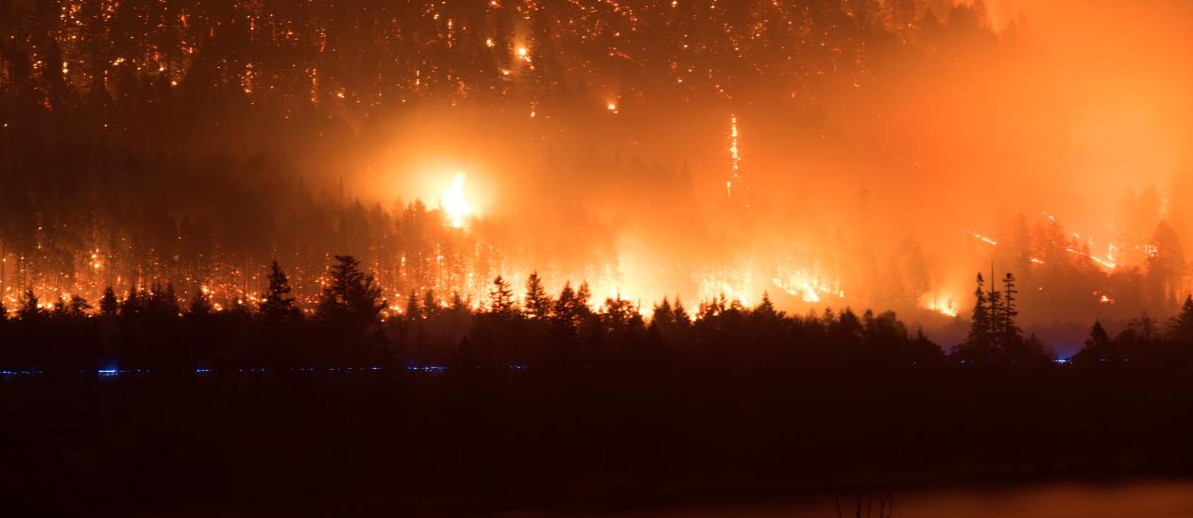
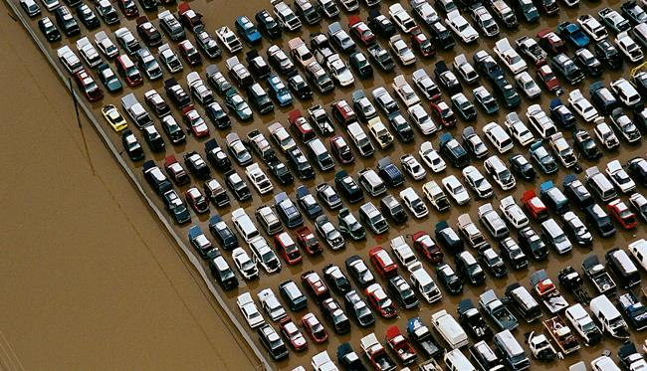
Notes:
ANDREA:
Before the global pandemic, we were already experiencing the climate crisis, and that crisis hasn't gone away.
Although we'll expect to see a dip in carbon emissions associated with the stay-at-home restrictions both here and around the world, as well as during the recession that follows, we expect emissions to return to pre-COVID levels, if not higher, without significant intervention.
COVID-19 is likely to change business, travel and household activities into the future and there's an opportunity for Portlanders to adopt lower-carbon lifestyles during this time that will benefit our efforts to tackle climate change into the future.
Experts agree that we need to limit global temperature rises to 1.5 degrees to avoid irreversible, devastating impacts and that global carbon emissions must peak in 2020.
The actions that we take over the coming year and over the next ten years are critical to our future.
We must make the right decisions now to bend the curve and protect our communities, reduce the harm and impact for frontline communities and increase the community benefits.
As we begin to recover our economy, and our community, from the COVID-19 crisis, we need to ensure that we don't exacerbate the climate crisis and that we make decisions and investments that put us on a path for climate justice. That was one of the goals for the COVID-19 Resiliency Resolution that City Council passed recently.

Slide 4
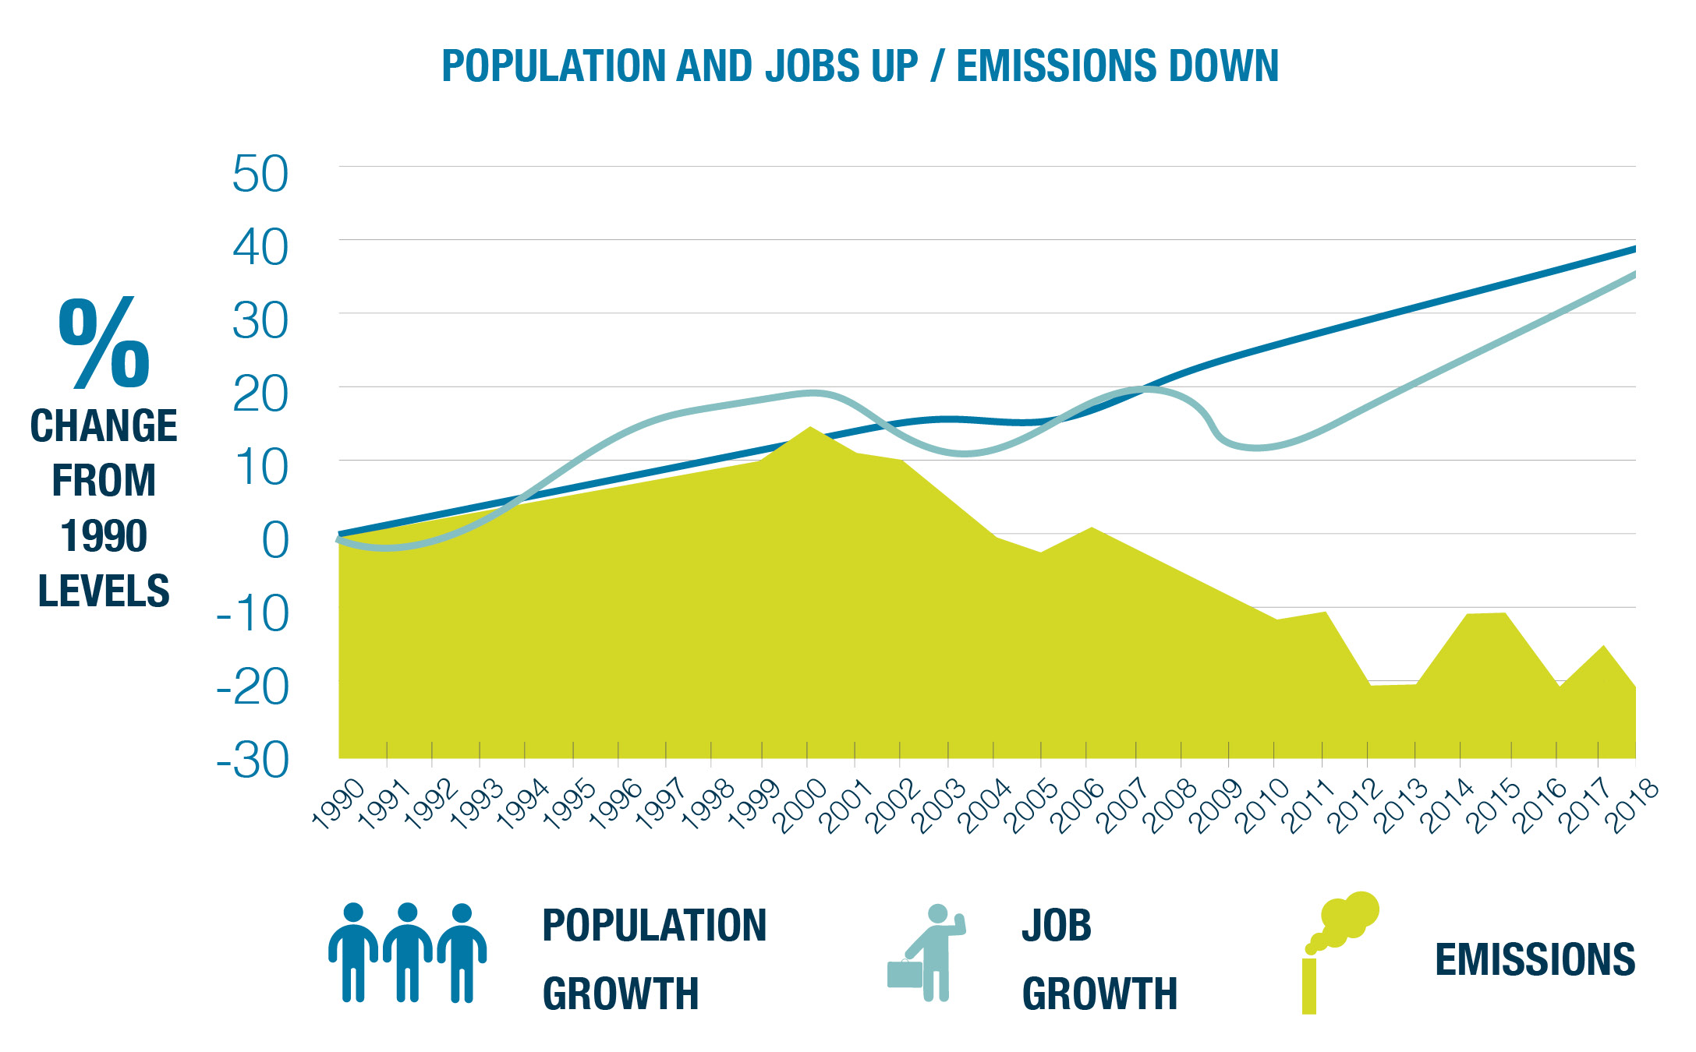
Notes:
ANDREA:
Over the next decade, Portland must halve our community-wide carbon emissions.
For comparison, over the last almost 30 years, we’ve only managed to drop emissions 19% (the green area shown in this chart). This is a remarkable achievement when you consider our population grew by 39% and our economy grew by 36% more jobs during that same time (indicated by the blue lines in the chart).
But those reductions aren’t nearly enough. We need to more than triple our rate of change.
Together with Multnomah County, we recently released a progress report on the implementation of the 2015 Climate Action Plan – which is posted on BPS’s website. That document contains a snapshot of the status of the nearly 250 climate actions contained in the 2015 plan. It shows that we've made progress in many areas, and not enough in others.
But the major message is that we need to change the way that we are doing climate work. We need to move away from these big, multi-year planning processes that generate a laundry list of actions to work on for the next five – some impactful, some less.

Slide 5
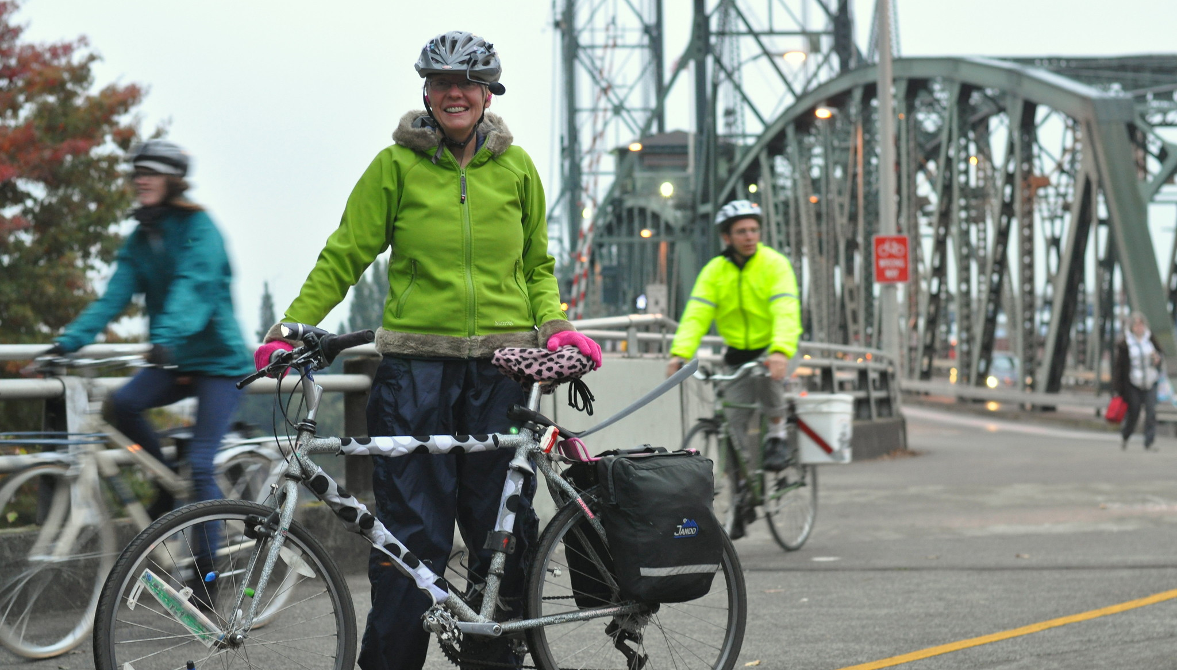
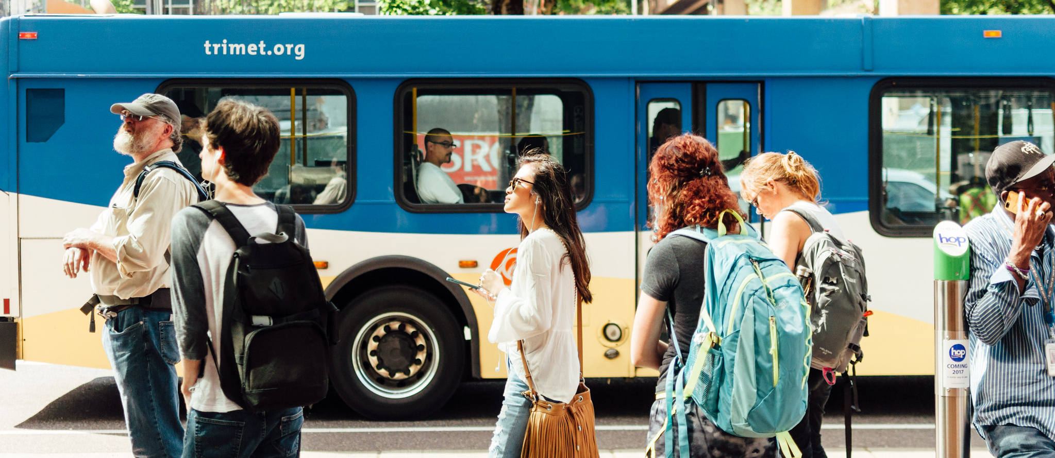
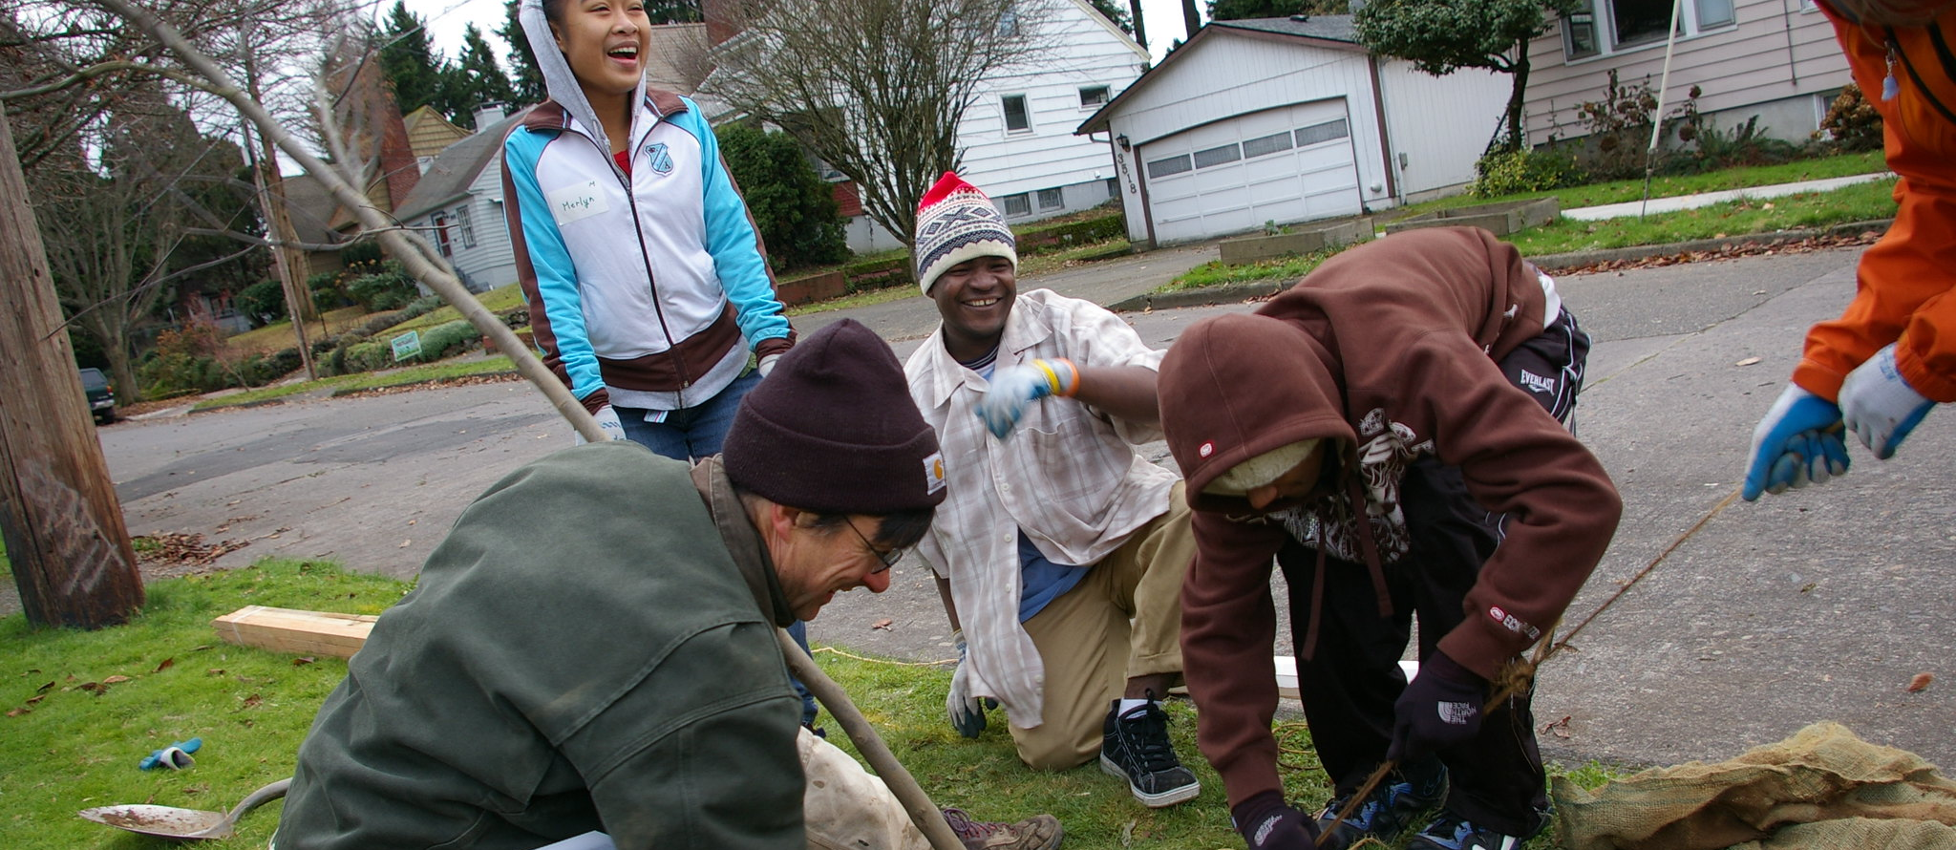
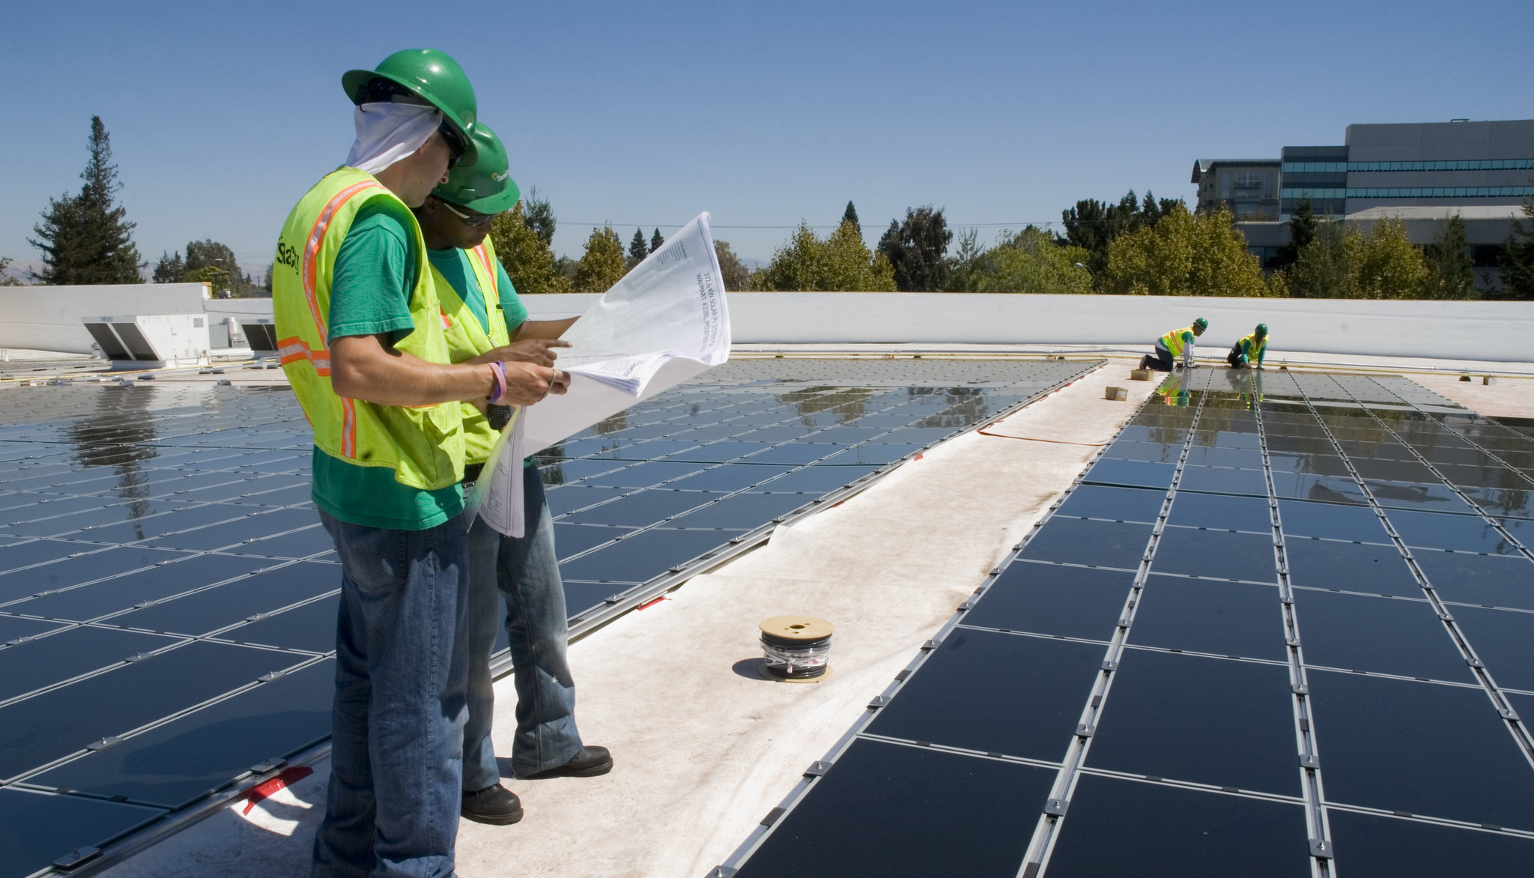
Notes:
ANDREA:
The crisis is before us – we have 10 years to act with conviction and to make meaningful change.
We need to pivot from the old way of doing business on climate to a new way that is iterative, adaptive and sets bigger, bolder actions and focuses that action on what we can do each year over the next ten years to drive the transformational change we need to see in our city, our economy and our communities. And that work needs to start with frontline communities and center climate justice.
It is that shift in how we are doing our work on climate that is the significance of today's resolution and the Climate Emergency Declaration for Portland. This is more than declaring that the climate emergency is real. This is a commitment, timeline and structure for how we are going to change the work and a public commitment to all Portlanders that we are going to lead with more bold action that drives down carbon emissions AND increases community benefits, especially for those most impacted by the climate crisis: Black, Indigenous and people of color.
The Climate Emergency Declaration maps out the principles, priorities and processes that will guide our climate work over the coming decades.
But before we dive into reviewing the Climate Emergency Declaration, we have invited other bureau directors including myself, Chris Warner from PBOT, Adena Long from Portland Parks & Recreation, and Tom Rinehart with OMF to give you an overview of the climate action work actively underway and what we’ll be delivering on in the coming year.

Slide 6
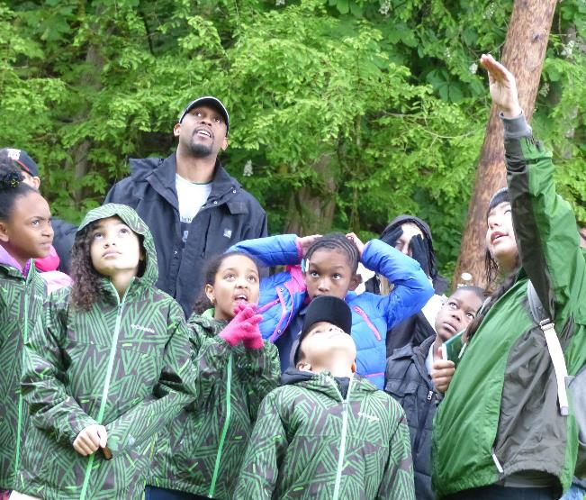
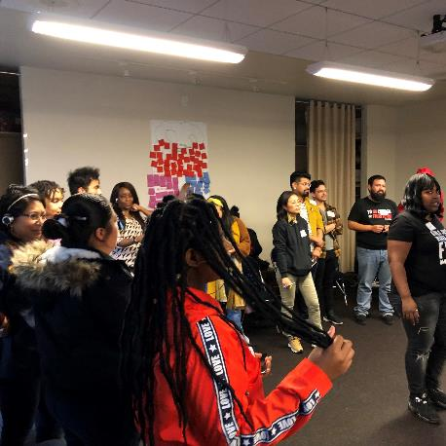
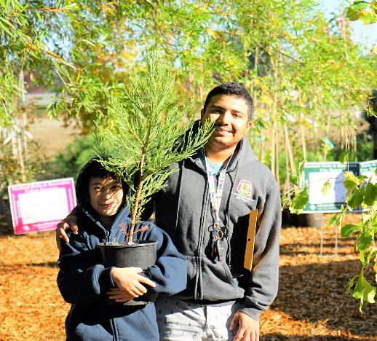
Centering the priorities and following the leadership of Portland’s frontline communities including Black, Indigenous and communities of color, and youth from those communities.
Notes:
ANDREA:
We are working to centering the priorities and following the leadership of Portland’s communities that are on the frontlines of climate change including Black, Indigenous and communities of color, and youth from those communities.
In the coming year, the City will support community partners through the first round of grant funds from the Portland Clean Energy Community Benefits Fund, helping to make the vision of community-led clean energy projects and jobs that benefit low-income populations and communities of color a reality.
We’ll continue to support the capacity building of frontline communities to fully engage in building energy and climate policy development through the Zero Cities initiative which Council heard about earlier this year, with a specific focus on reducing the energy cost burden experienced by many low-income renters.
We will develop an EV-ready code, starting with multi-family housing first, to expand access and options for communities of color and low-income residents to have access to electric vehicles and reduce the costs of owning and operating fossil fuel vehicles.

Slide 7
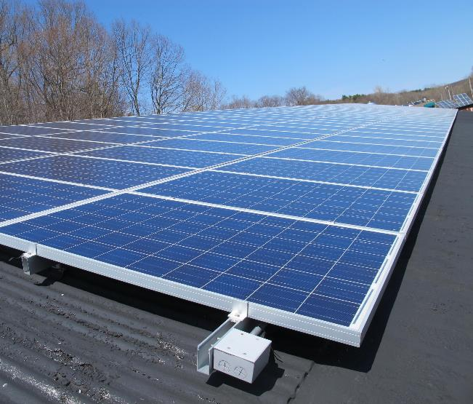
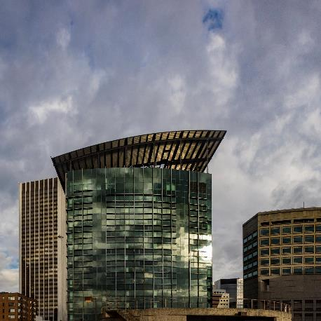
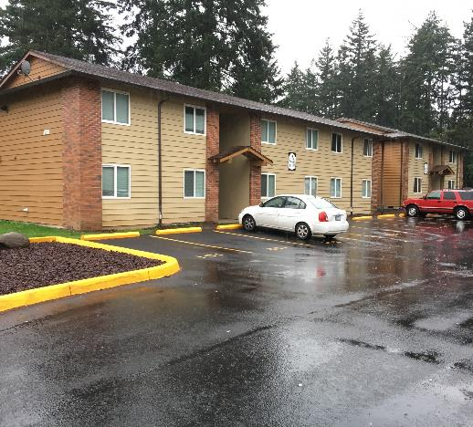
Expanding community ownership of renewables and driving down emissions from commercial and multifamily residential buildings.
Notes:
ANDREA:
We are also advancing efforts focused on expanding community ownership of renewables and driving down emissions from commercial and multifamily residential buildings.
For example, the City is working to become an anchor tenant in at least one large-scale community solar project and reducing the time, cost and complexity of solar and energy efficiency permitting processes.
The Portland Clean Energy Community Benefits Fund will begin investing millions of dollars in clean energy projects in the building sector and bureaus are working to identify and remove permitting and code barriers that could slow those projects down.
Policy efforts undertaken in the coming year to decarbonize the building sector are following the lead of communities of color and will emphasize improved comfort and utility savings for renters and protections for low-income tenants.
And we are working to move away from a fossil fuel based economy in Portland, both by addressing storage of fossil fuels in our community, and strengthening renewable fuel programs that also reduce air pollution and improve community resiliency.

Slide 8
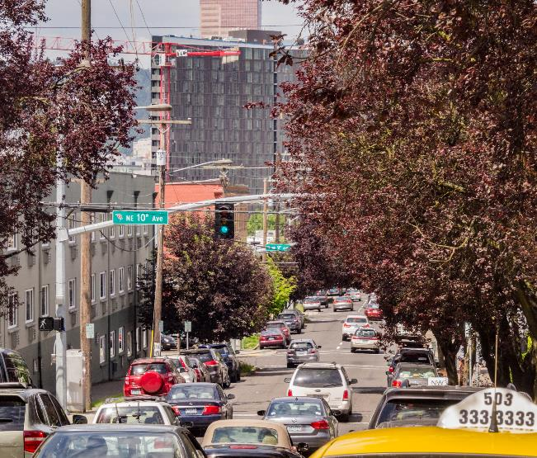
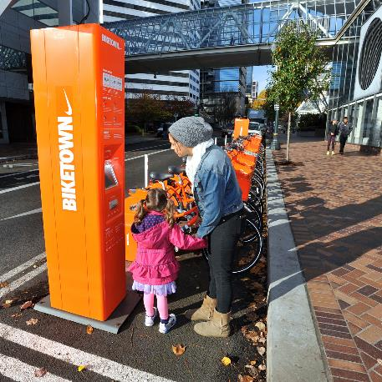
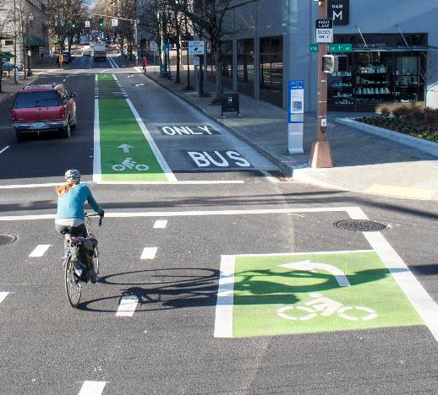
Advancing transportation justice and reducing racial disparities in our mobility system while cutting carbon emissions and overall drive alone trips.
Notes:
CHRIS:
Hello, I’m Chris Warner – Director of the Portland Bureau of Transportation
We are advancing transportation justice, which means always asking ourselves if our projects and policies will reduce carbon emissions while advancing racial equity.
Transportation accounts for more than 40 percent of Portland’s carbon emissions.
That means to meet our climate goals, we need to help Portlanders drive less and choose more low-carbon modes of transportation whenever possible—including transit, biking, walking or rolling, carpooling, telecommuting or electric vehicles.
But the reality is that today, not everyone can make those choices, because our transportation system is inequitable. Black Portlanders, Indigenous communities, people of color, low-income individuals and persons with disabilities have less access to safe, convenient, affordable and high-quality transportation options. And beyond access, we know many do not feel welcome on our streets or safe from discrimination, harassment and violence. We have serious work to do.
Centering PBOT's work around transportation justice requires us to think holistically about our mobility system. There are no silver bullet solutions that will accomplish our climate and equity goals—instead, we are moving forward a multifaceted strategy that includes:
Allocating more space on our roads for transit, bicycles and pedestrians through initiatives like the Rose Lane Project and our Safe Streets COVID-19 response, so those modes become more reliable and comfortable.
Making our streets safer, which involves reducing crash risk but also means thinking beyond traffic safety and ensuring hate has no place in our right-of-way.
Expanding mobility services and options that provide good alternatives to driving, including supporting community-led efforts to secure a free youth transit pass for all and making it easier and more affordable to install EV charging infrastructure
Encouraging more sustainable behavior through programming and incentives, like the expanded Transportation Wallet
And engaging the Pricing Options for Equitable Mobility community task force to explore if and how new transportation pricing strategies can help improve congestion, reduce climate impacts and improve equity across our system

Slide 9
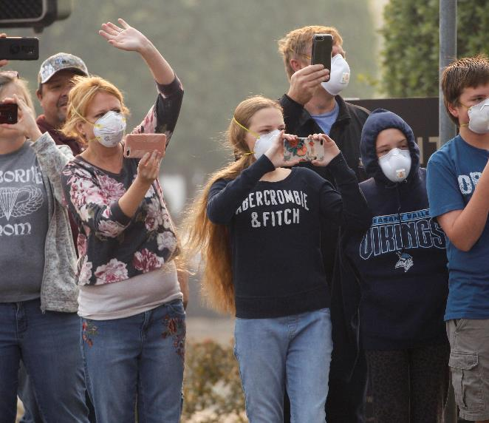
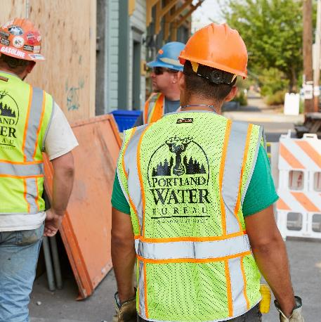
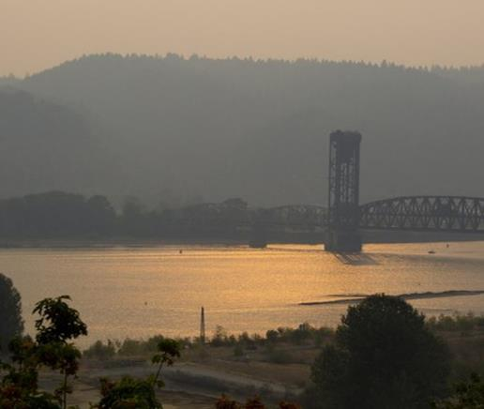
Building our community resilience to the impacts of climate change like flooding, landslides, heatwaves and wildfire smoke.
Notes:
ADENA:
Hello, I’m Adena Long, Director of Portland Parks & Recreation
We are building our community resilience to the impacts of climate change, such as flooding, landslides, heatwaves, and wildfire smoke so that we can be better on a good day and rebound faster on a bad day. ​
​
Bureaus are assessing and making investments to reduce the risks to critical built infrastructure, natural systems, and outdoor workforces to episodes of extreme heat and flooding. ​
​
Infrastructure bureaus continue to collaborate to develop a citywide resilience and recovery strategy, and governance structures to establish investment priorities and enable a faster recovery after a natural hazard event.
This includes advancing a pilot project concept to create an island of resilience centered around the East Portland Community Center – which will enable multiple infrastructure bureaus, together with community, to test out new ways to collaborate and make targeted investments that build resilience. The COVID-19 crisis has shown us all how critical Park facilities are in disaster response, and there are countless opportunities to improve the resilience of those facilities so they are available and functioning when we need them in a crisis. ​

Slide 10
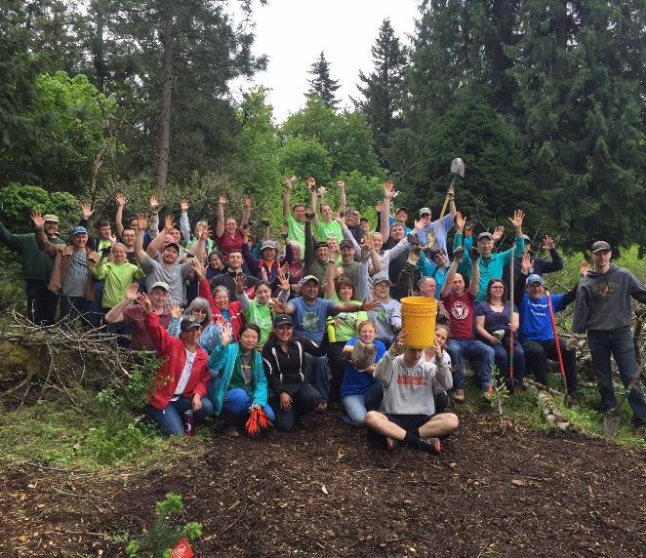
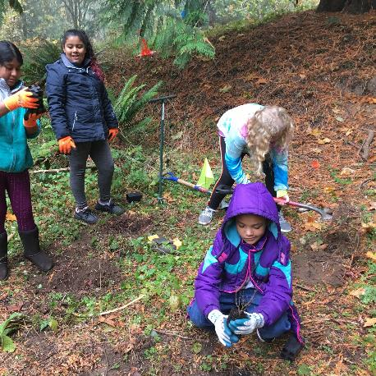
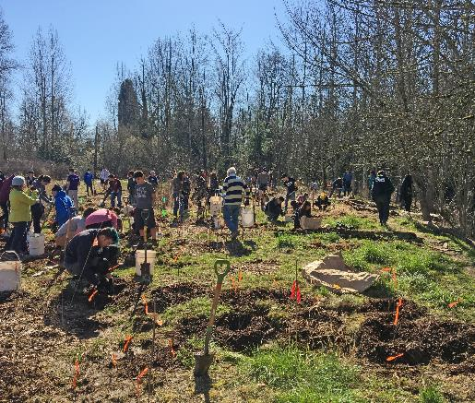
Protecting, restoring and managing our urban natural resources to sequester carbon and build resilience to the impacts of climate change.
Notes:
ADENA:
We are also taking actions to protect, restore and manage our urban natural resources to sequester carbon and build resilience to the impacts of climate change. ​
​
Portland’s natural systems provide important services to human physical and mental health. We must protect the value of natural ecosystems and biodiversity. ​
​
In the coming year, the City will continue to prioritize tree protection, tree planting, and forest and natural area restoration and expansion. Portland Parks and Recreation manages 1.4 million park and street trees – trees that can both mitigate the impacts of climate change and reverse them. Long-term,​ as part of its efforts to build a Sustainable Future for our parks and recreation system, the City must aggressively care for and build its tree canopy.
​
Bureaus are also working to increase natural flood storage on Portland’s rivers and streams, including the Willamette and Columbia Rivers, within the city limits.
Bureaus will continue to take steps to protect threatened species such as Coho salmon, Chinook salmon, and steelhead trout.​

Slide 11
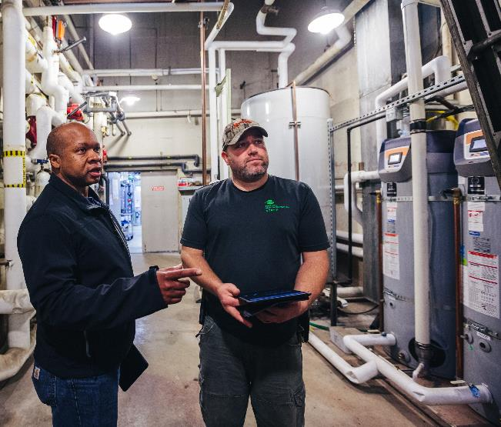
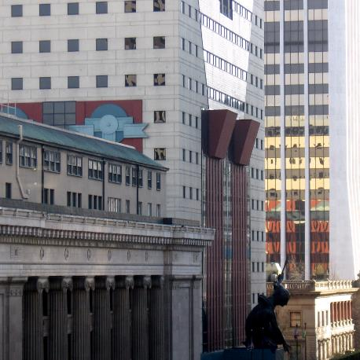
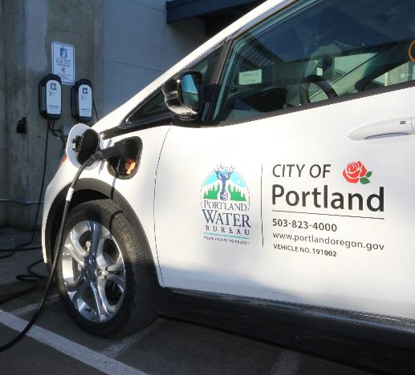
Making bold investments toward carbon neutral City-owned buildings, fleets and operations.
Notes:
TOM:
Hello, I’m Tom Rinehart, the City’s Chief Administrative Officer
To achieve our aggressive climate goals we need to walk the talk by making the bold investments needed to try to hit the goal of all City-owned buildings, fleets and operations being carbon neutral in the coming decade.
Bureau are advancing various policies to ensure more climate-friendly operational decisions.
For example, adopting a suite of policies requiring bureaus to buy electric vehicles instead of gas- or diesel-powered vehicles whenever possible and requiring carbon offsets be purchased for City air travel.
We will be developing a strategy to accelerate the greening of the City’s fleet, which will include powering some of our trucks with the renewable natural gas that will be produced from treating Portland’s sewage.
We will develop a climate test or carbon budget to guide decision-makers toward lower-carbon choices like purchasing more biofuels instead of fossil fuels or using cement with lower embodied-carbon.
We’ll continue to purchase 100% renewable energy for City operations and seek opportunities to expand the installation of solar panels on City facilities.
We will begin implementing an Energy Action Plan for city buildings and will continue improving the efficiency of our operations, pumps and other infrastructure systems.

Slide 12
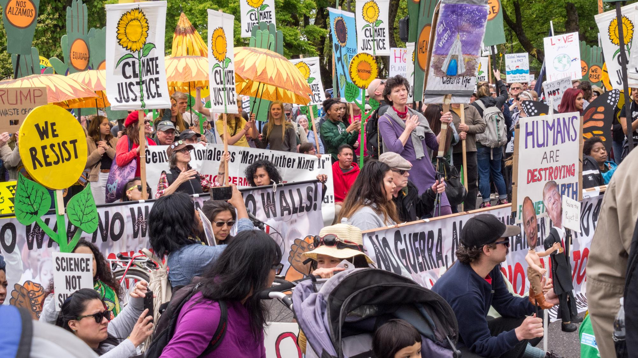
Notes:
ANDREA
The Climate Emergency Declaration you are considering today builds on Portland’s important climate work over the past 25-plus years…
…but makes an intentional pivot toward not just measuring our success by how many tons of carbon we reduce, but move us closer to a vision where success is also measured by how we are making people’s lives better today, most especially those that have been denied the benefits of our past climate investments, programs and policies.
I’d like to introduce our next speakers, Amanda Watson – Senior Policy Advisor with Mayor Wheelers office, and Alisa Kane – the Climate Action Manager at the Bureau of Planning and Sustainability.
They’ll be sharing more of the details on the Climate Emergency Declaration before you today.

