Slide 1

State of Housing in Portland 2019
Presentation to PHAC
Bimal RajBhandary, PHB Data Team
May 5, 2020

Slide 2
https://portland.gov/phb/state-of-housing-report

Slide 3
PHB Neighborhood Study Areas

Slide 4
Summary Findings

Slide 5
Citywide
Portland has entered a period of stable growth in population and housing costs
Record numbers of market and affordable units, but more are needed to keep up with population trends
Increasing disparities require more resources and programs for lower income Portlanders
Notes:
2011-16 focus

Slide 6
Population
Portland grows in population, wealth, age, diversity
26th most populous city in the U.S. (+1.5% annual growth)
29% of households making $100K annually
Population growth for Communities of Color
Income and Wealth remains uneven across the board, disparities persist

Slide 7
Change in Population by Neighborhood 2012-2017

Slide 8
Population by Race and Ethnicity 2012-2017

Slide 9
Income
Change in Median Income by Neighborhood 2012-2017
More income inequality
By Housing Tenure
Renters: $39,988
Owners: $87,249
By Race
White: $65,945
Communities of Color: $42,324
Source: 2013-2017 5-Yr ACS Estimates

Slide 10
Rentership by Race & Ethnicity
Rentership Continues to Increase among African American, Asian and Hawaiian Pacific Islander
Source: U.S. Census Bureau-2012 5-Yr ACS Estimates, 2017 Yr ACS Estimates

Slide 11
Homeownership
Homeownership rates have decreased in the last five years Except for Hispanic-Latino and Native American
Source: U.S. Census Bureau-2012 5-Yr ACS Estimates, 2017 Yr ACS Estimates

Slide 12
Racial Diversity
Changes in the Proportion of the Non-White Population – Show Significant Shift to Greater Diversity
Communities of Color Continue to Increase in Outer East and Southeast Portland
Source: U.S. Census Bureau – 2017 5-Year ACS Estimates

Slide 13
Housing Stock
2017 production at highest level in last 15 years
2018 production in line with pre-2017 years
Source: Multnomah County, Portland Tax Lot Data, and Metro Multifamily Inventory 2019

Slide 14
Completely Priced Out
ON Average
0-30% AMI Households
Single Mother Households
Black Households
Native American Households
Pacific Islander Households
On average, these households can’t afford 2-Bedroom rents anywhere in the city
Notes:
Native Americans Households
Studio in 122-Division
Pacific Islanders Households
Studio or 1bd in 122-Division
Studio in Raleigh Hills

Slide 15
Homeownership Affordability
17 Neighborhoods have median home sales prices over $425K
City median price is $426,988
+$97K increase in median city price from 2014 – 2018
Homeownership rates decreased over last 5 years
Change in Homeownership Rate by Neighborhood 2012-2017
Source: U.S. Census Bureau – 2012 5-Year and 2017 5-Year ACS Estimates
Notes:
Lents-Foster and 122-Division have seen steepest increase in median sales price 2011-17
LF= +113% ($153K -$327K)
122-D= +90% ($146K- $279K)

Slide 16
Completely Priced Out
0-60% AMI Households
Single Mother Households
Black Households
Latino Households
Native American Households
Pacific Islander Households
Seniors
Foreign-Born Households
On average, these households can’t afford to buy a home anywhere in the city
Notes:
Average Portlander can only afford in three areas (122nd-Div, Centennial-Wilkes, and Hayden Island)

Slide 17
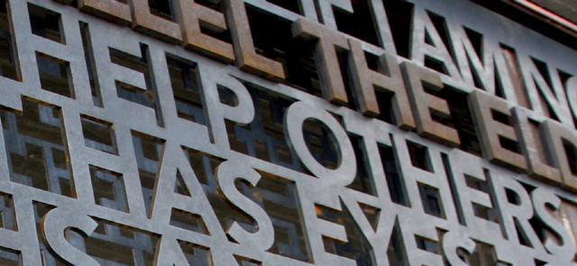
PHB Strategic Initiatives and Focus Areas
Portland Housing Bond
N/NE Housing Strategy
Inclusionary Housing
Supportive Housing Plan
Rental Services Office
Joint Office of Homeless Services: A Home for Everyone

Slide 18
Housing Production and Pipeline
State of Housing Emergency
City Regulated Units by the Numbers Since 2015
5,263
Affordable Units
6,831
Affordable Bedrooms
10,098
Est. People Housed

Slide 19
Questions/Comments
Thank You!

