Slide 1

LU 19-192268 CU
Conditional Use Review for the Portland Japanese Garden’s continued use of the house at 369 SW Kingston Ave. as administrative office space
BDS STAFF PRESENTATION TO CITY COUNCIL
JANUARY 30, 2020

Slide 2






Slide 3
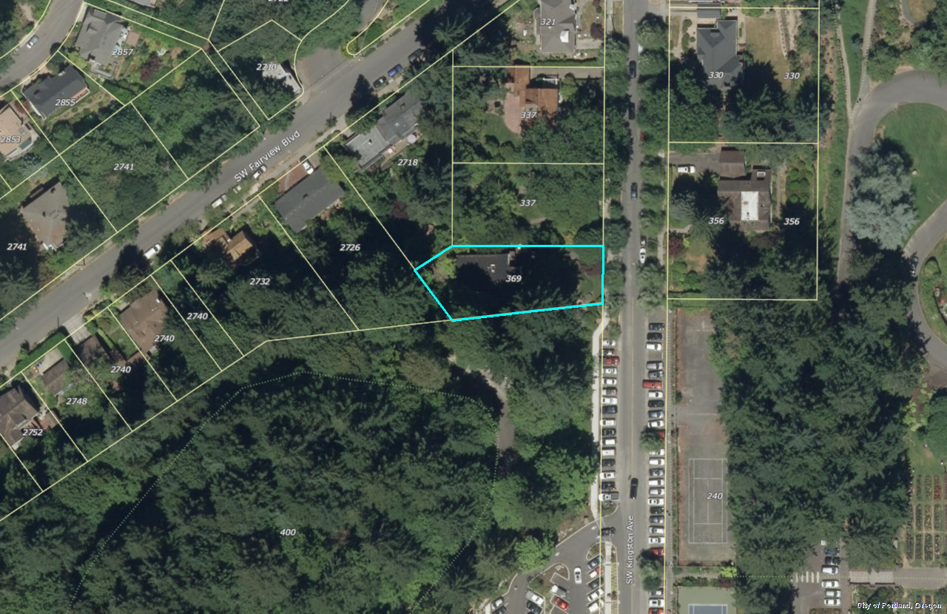

Slide 4
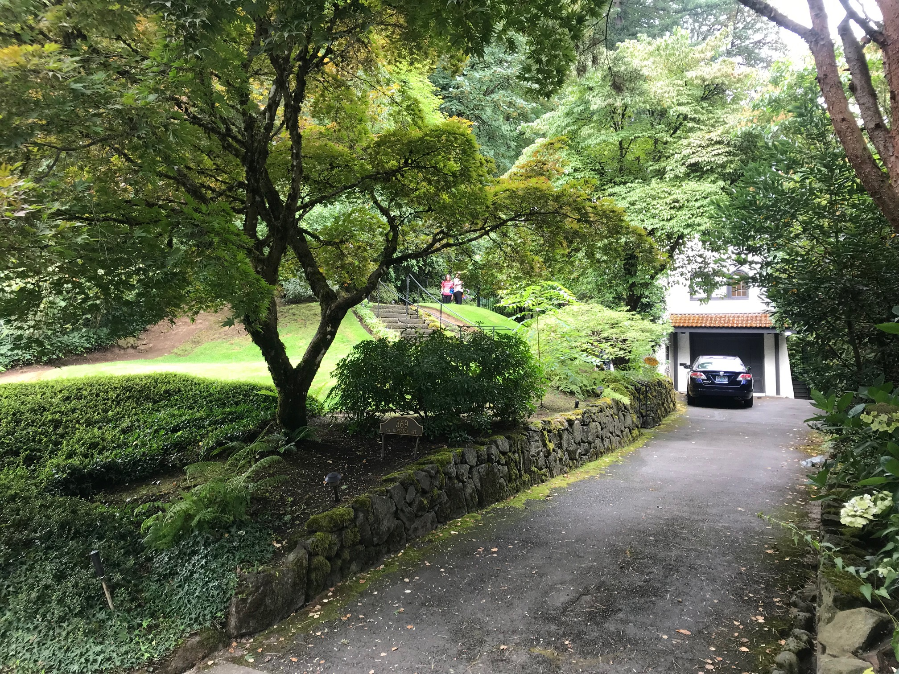
SW Kingston Ave

Slide 5
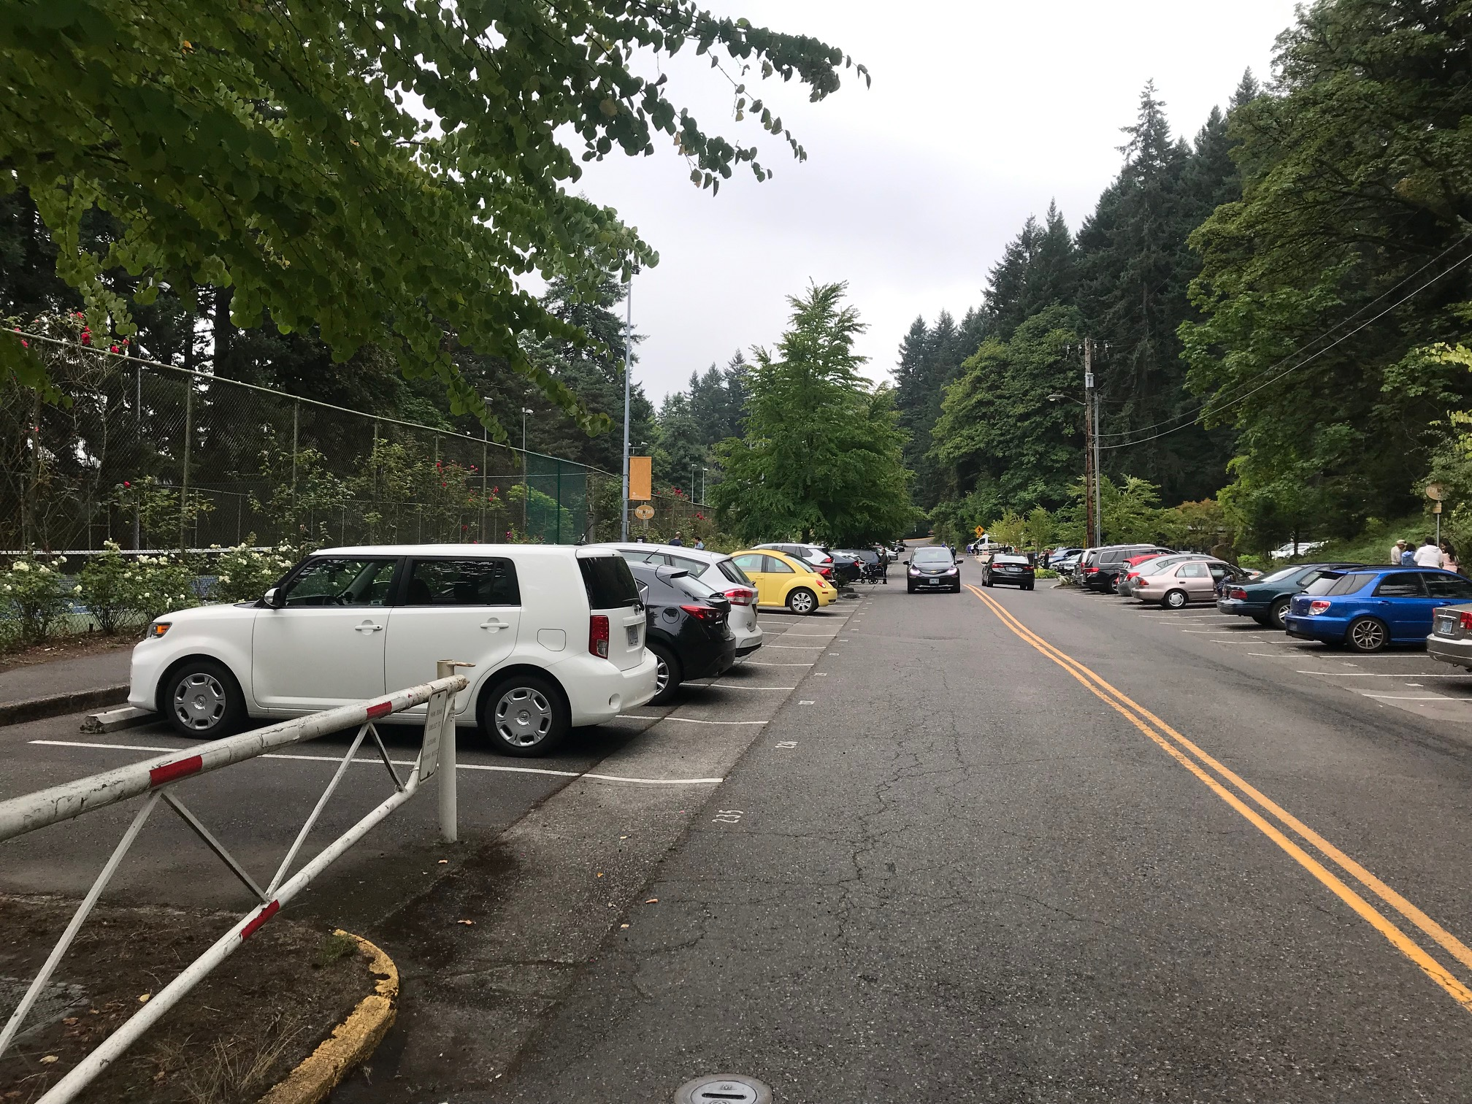
SW Kingston Ave

Slide 6
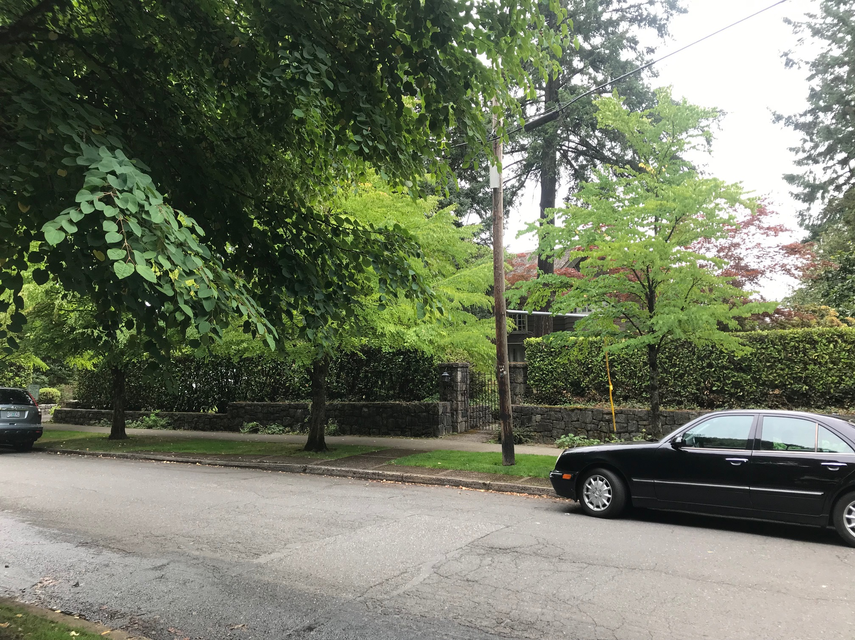
SW Kingston Ave

Slide 7
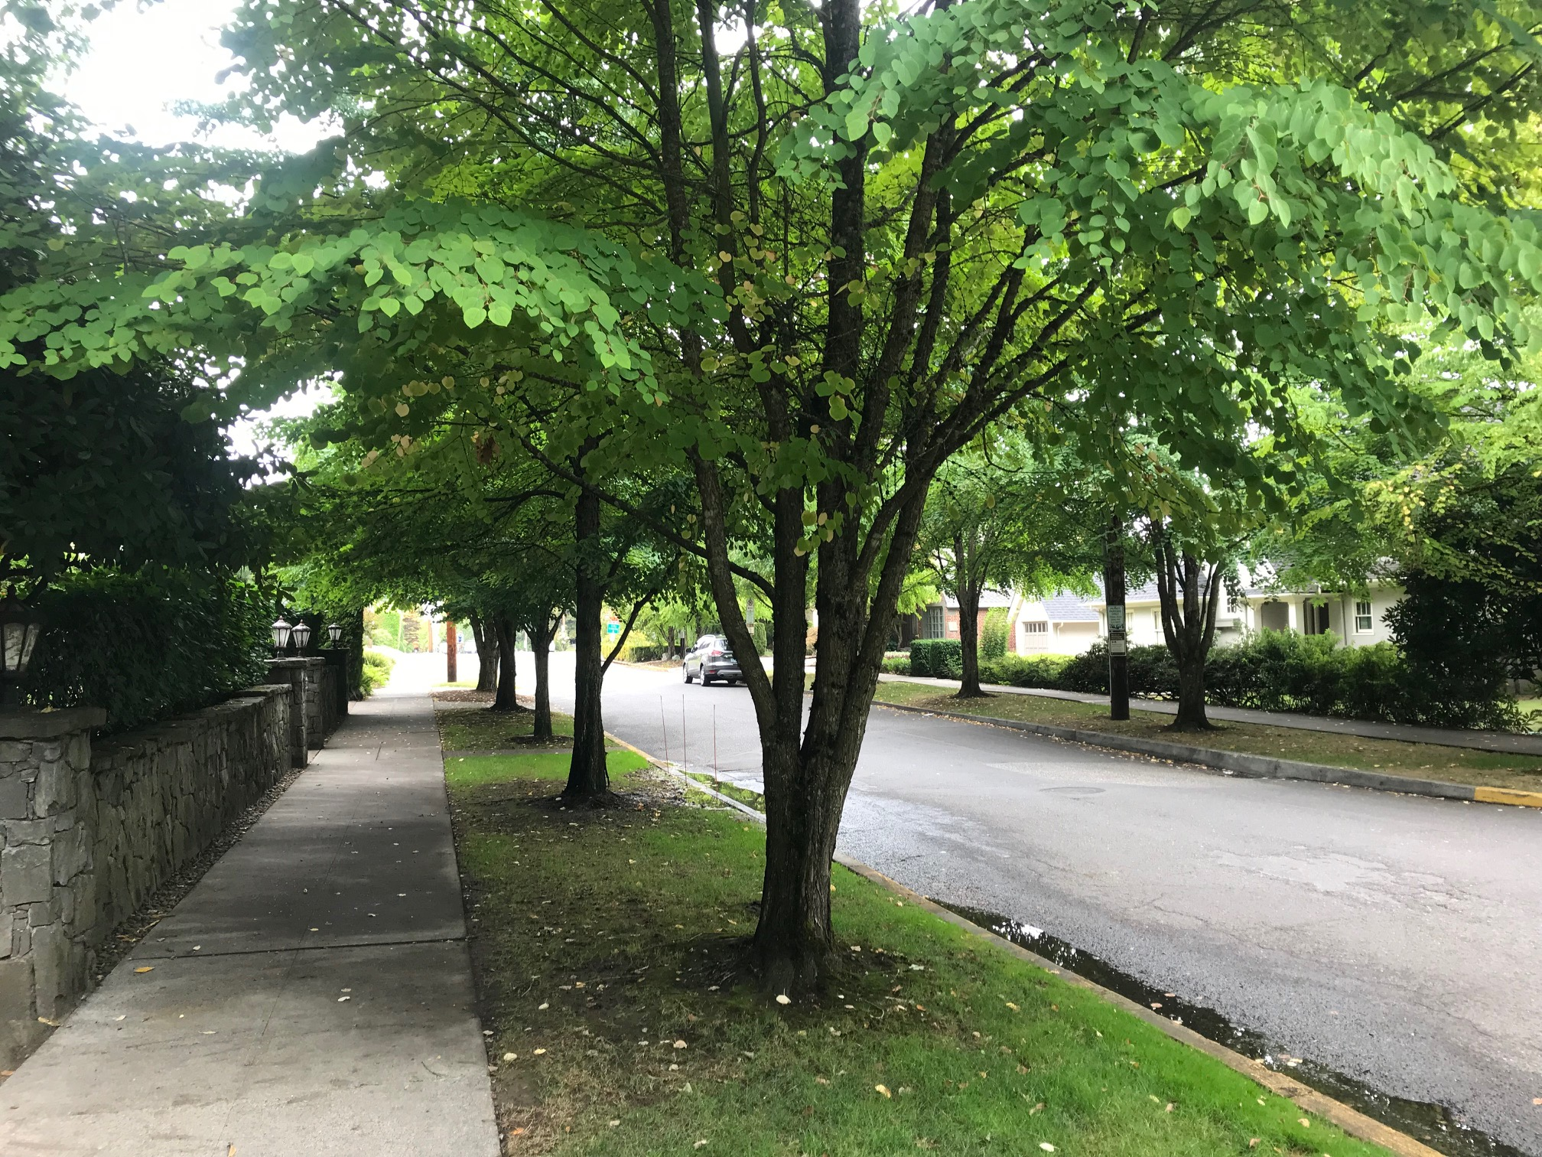
SW Kingston Ave

Slide 8
Conditional Use Approval Criteria
33.815.105: Institutional and Other Uses in R Zones
Proportion of Household Living uses
Physical compatibility
Livability
Public services
Oregon Statewide Planning Goal 10: Housing

Slide 9
Hearings officer decision:
Approval of Conditional Use with conditions:
Approval to expire in 4 years
Regular office hours limited to 7am to 7pm weekdays
Meetings must be held on weekdays, must end by 9:30pm, and must be limited to 12 attendees
Maximum occupancy limited to 12 people at any one time, including regular office staff and meeting attendees
Exterior of the house must retain the appearance of a private residence
No signage except for address identification sign and small signs near the front door
Provide Neighborhood Association with contact information for after-hours security concerns
Parking must be on the property (up to 2 vehicles on the driveway at a time) or in the park

Slide 10
APPLICANT’S APPEAL REQUEST:
Modify the Hearings Officer’s decision to extend the Conditional Use approval from 4 more years to 10 more years.
ALTERNATIVES FACING CITY COUNCIL:
Deny the appeal and uphold the Hearings Officer’s findings and conditions of approval, including the condition of approval limiting the office use to 4 more years.
Deny the appeal and uphold the Hearings Officer’s decision to limit the office use to 4 more years, but with modified findings or conditions.
Grant the appeal and modify the Hearings Officer’s findings and conditions to allow office use for more than 4 years, up to a maximum of 10 years.

