Slide 1
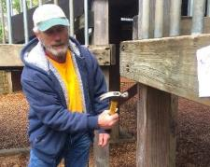
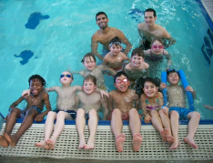
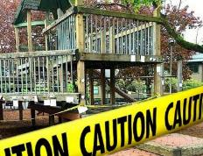
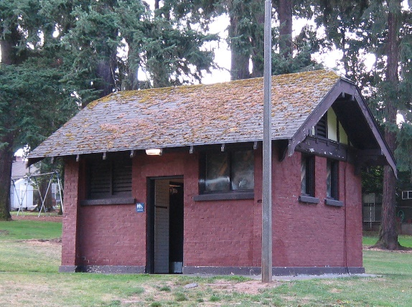
PARKS
REPLACEMENT
BOND
Creston Park Play Area Improvements Project
CITY COUNCIL – Wednesday March 11, 2020
Mayor Wheeler | Director Adena Long
Notes:
(RML)
Hello Mayor Wheeler and members of Council. My name is Robin Laughlin, I am the Capital Renovations Program Manager with Portland Parks & Recreation
With me today is Gary Datka, Capital Project Manager with PP&R.
We are here today to request Council accept the bid from Faison Construction for the Creston Park Playground Project for the amount of $1,332,810.

Slide 2
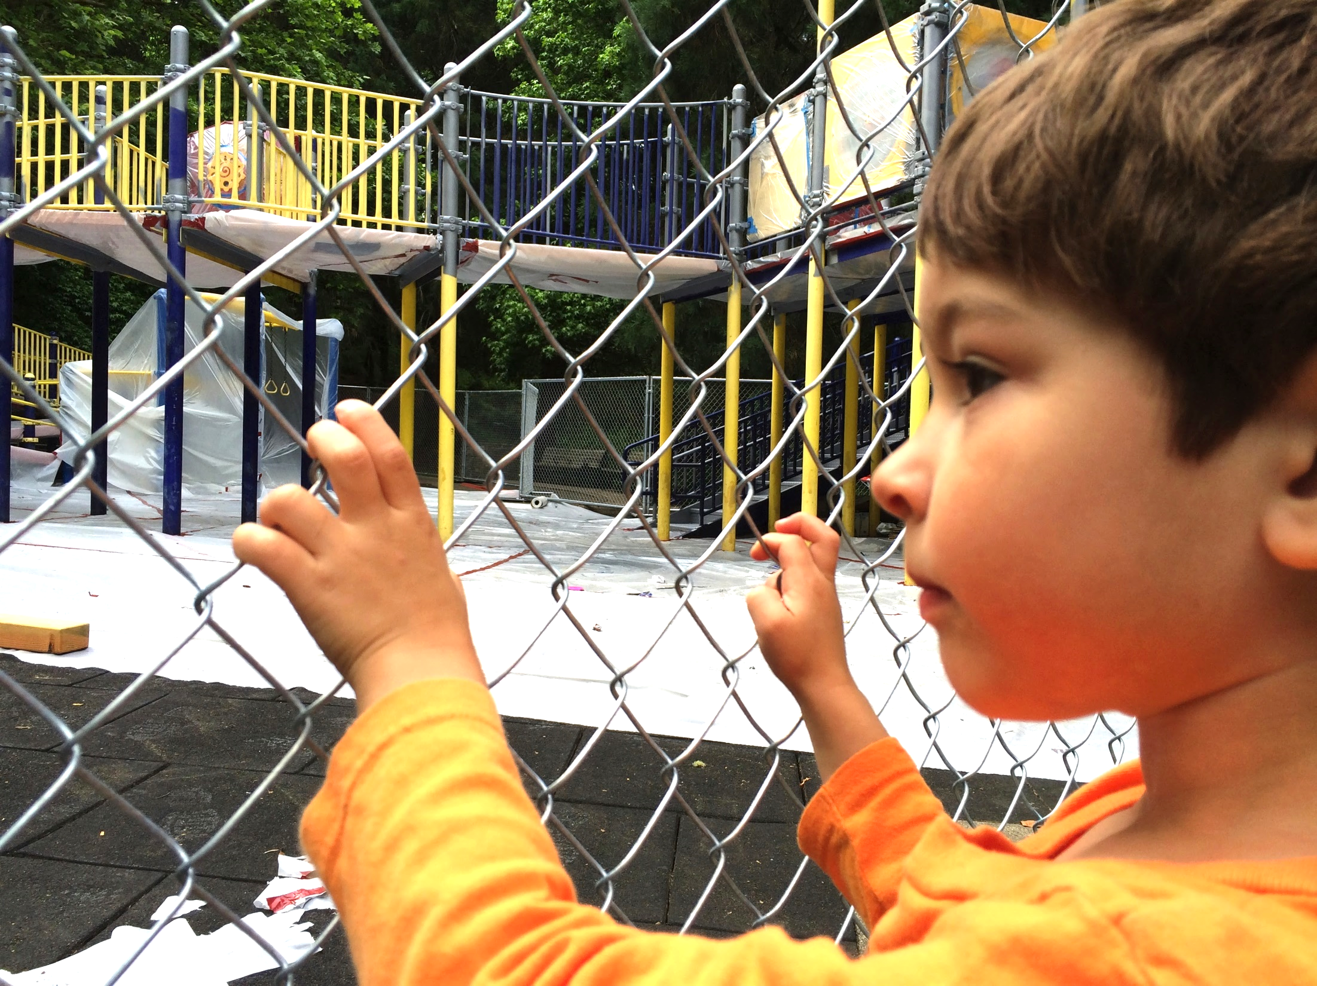
FOCUS
PLAYGROUNDS
Fix, improve play areas that are closed, at risk of closure, or deficient.
Notes:
(RML)
The Creston Park project is part of the 2014 Parks Replacement Bond Program that was generously passed by voters who approved the $68 million Bond Measure to address critical park needs without increasing tax rates.
As you know the bond funding goes towards Park’s most urgent needs in seven priority areas.
Playgrounds
Trails and Bridges
Pools
Accessibility
Protecting Workers
Pioneer Courthouse Square
Restrooms and Other Facilities
This project fits into the Playgrounds focus area and will renovate the existing deficient playground. This is the 9th Replacement Bond Playground Project to go into construction.
In addition to Bond funding of $1.1 million, the project also received funding from PP&R System Development Charges in the amount of $950,000 to expand the playground, and $290,000 from the PP&R Capital Fund ADA Program (total allocation is $2.34M) to address accessibility issues.

Slide 3
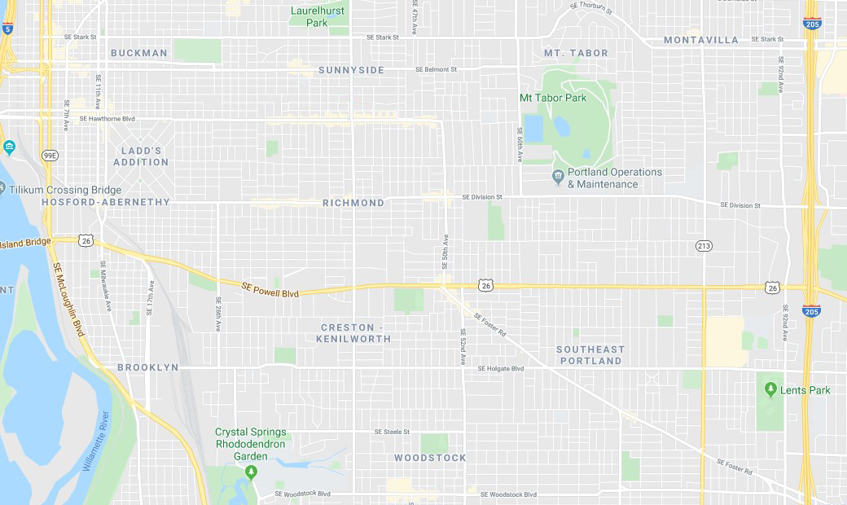
PARK LOCATION
SE 45th Avenue and SE Powell
Creston-Kenilworth Neighborhood
½-mile walk radius
Notes:
(GD)
Mayor Wheeler, Commissioners, thank you for having me here today, my name is Gary Datka, I am a Capital Project Manager for Portland Parks & Recreation and am here today to give a brief overview of another great Parks Replacement Bond playground project. I will discuss its location and neighborhood characteristics, current conditions, the public process we used to arrive at the design, and some of the details of the improvements this project will make.
Creston Park, located in South East Portland generally at SE 45th and SE Powell, is a Community Park in the Creston-Kenilworth Neighborhood, and is adjacent to PPS Creston Elementary School.
This map shows the park location just west of Foster Road and south of Powell Boulevard. The park serves two census tracts split by Powell Boulevard within its ½ mile radius, or 15 minute walk boundary.
Based on past combined census data, the population served is typical of Portland’s race and origin characteristics.
White 83%
Asian 6%
Hispanic 5%
Black 3%
Native American / Alaskan 0%
2+ 3%

Slide 4
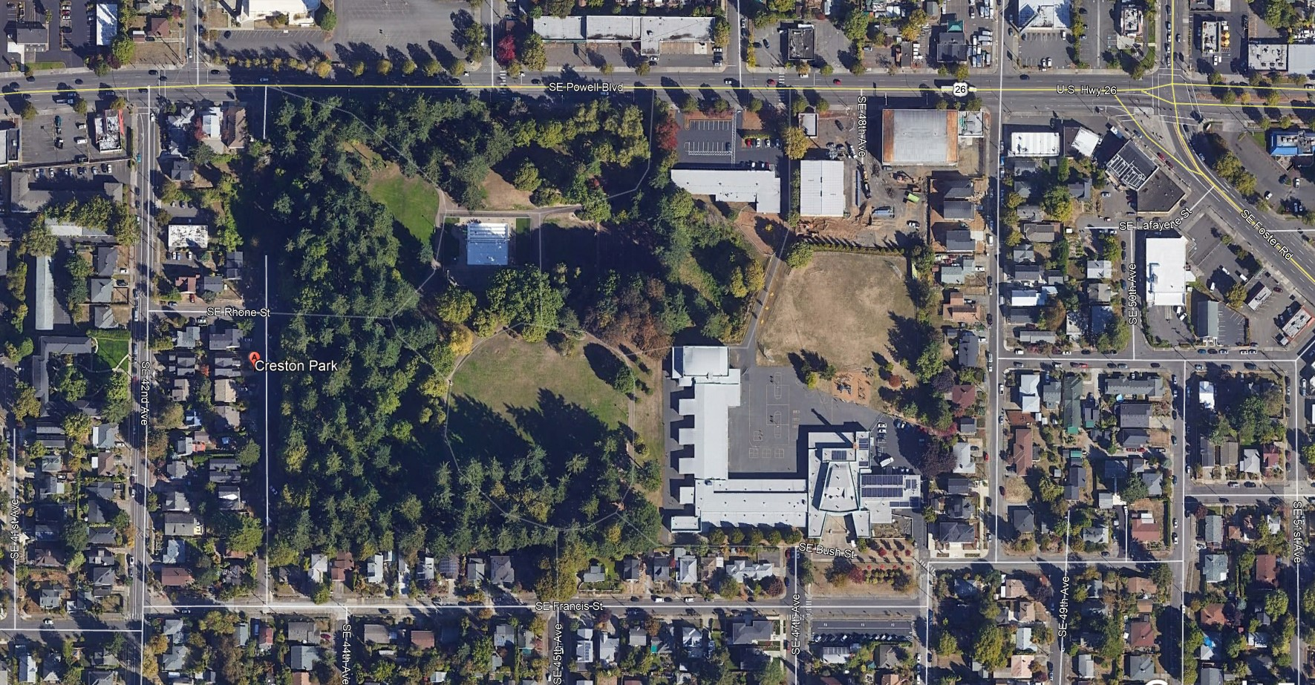
PROJECT SITE
CRESTON PARK
Notes:
(GD)
Acquired by PP&R in 1920, Creston Park is a developed and pastoral 14.5-acre park featuring a play area, tennis courts, restrooms, picnic areas, outdoor pool and pool house, a parking lot, and a decommissioned wading pool.
The park boundary is shown here in the red box, the playground is located toward the south-east corner of the park, with main access from SE Francis.
The renovated playground and picnic spaces will provide much needed improvements for this park which receives heavy use by an active neighborhood, and the accessible pathway improvements will create ADA-compliant path of travel access to other major assets in the park.

Slide 5
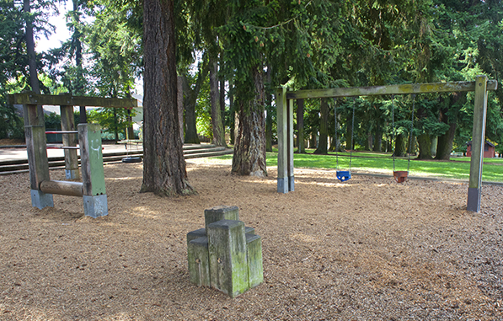
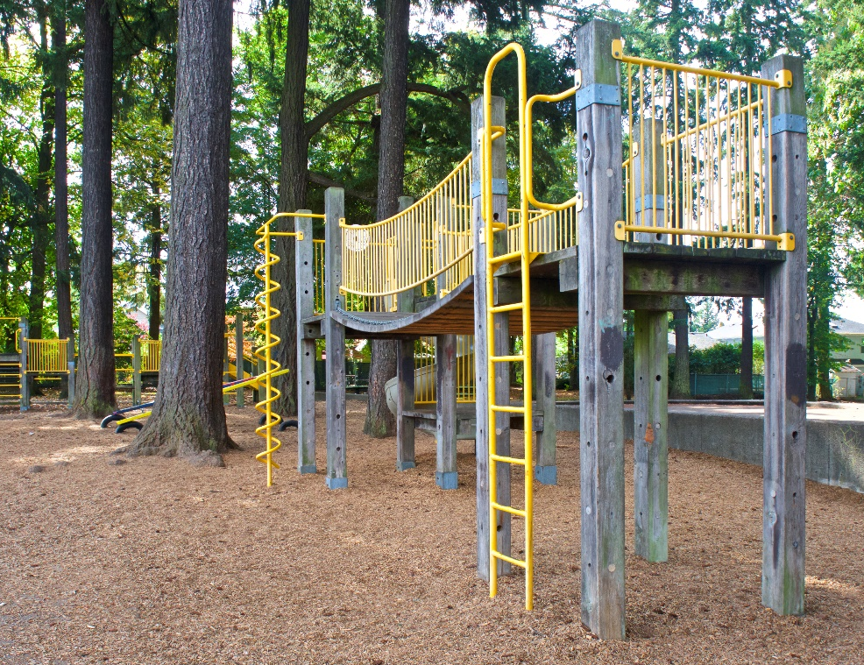
EXISTING CONDITIONS
Notes:
(GD)
Installed in the early 1980’s, the post and platform play structure, wood play equipment, and few swings are disjointed play components spaced too closely for kids to make a play circuit, and create a cramped space for unprogrammed physical play.
The existing equipment is no longer ADA-compliant to current standards, lacks play value for collaborative and imaginative play opportunities, and has ongoing maintenance concerns. For these reasons they have reached the end of their useful life and must be replaced.
Additionally, the play equipment, intermixed within large mature Douglas Fir trees, is surfaced with engineered wood fiber, making access and mobility difficult for some playground users.

Slide 6
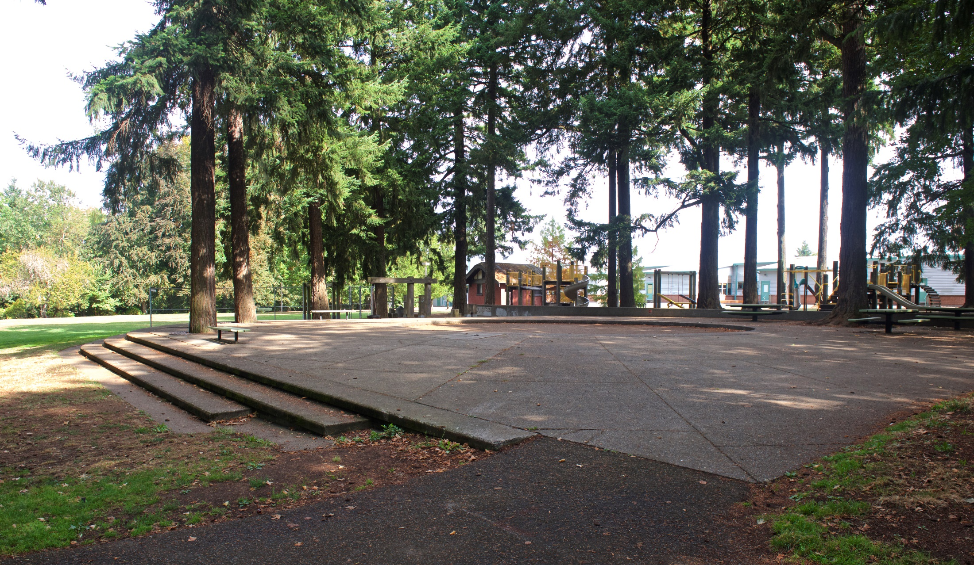
EXISTING CONDITIONS
Notes:
(GD)
Directly adjacent to the playground and occupying a large space, the decommissioned concrete wading pool will be removed as part of this project to expand the playground size, increasing capacity and adding much play value and needed play space.
Throughout the playground renovation, PP&R does not anticipate the project will remove any of the existing mature fir trees, and only two smaller trees within the park may be removed to accommodate the accessible pathway renovations.

Slide 7
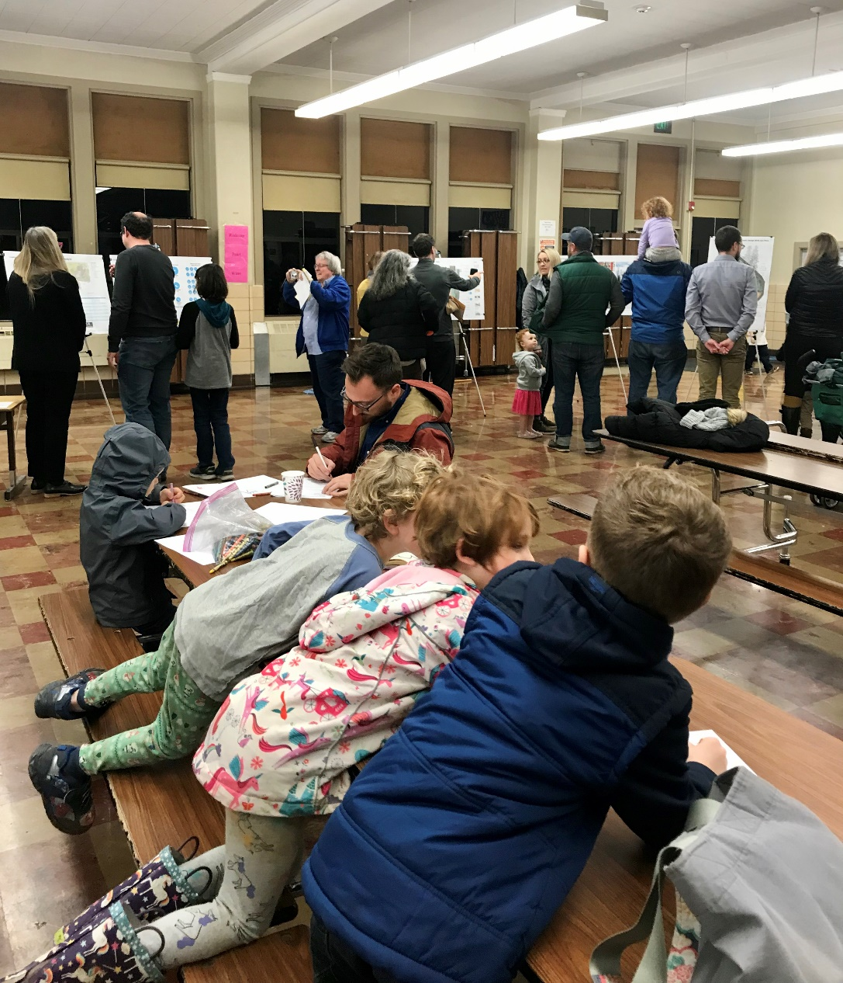
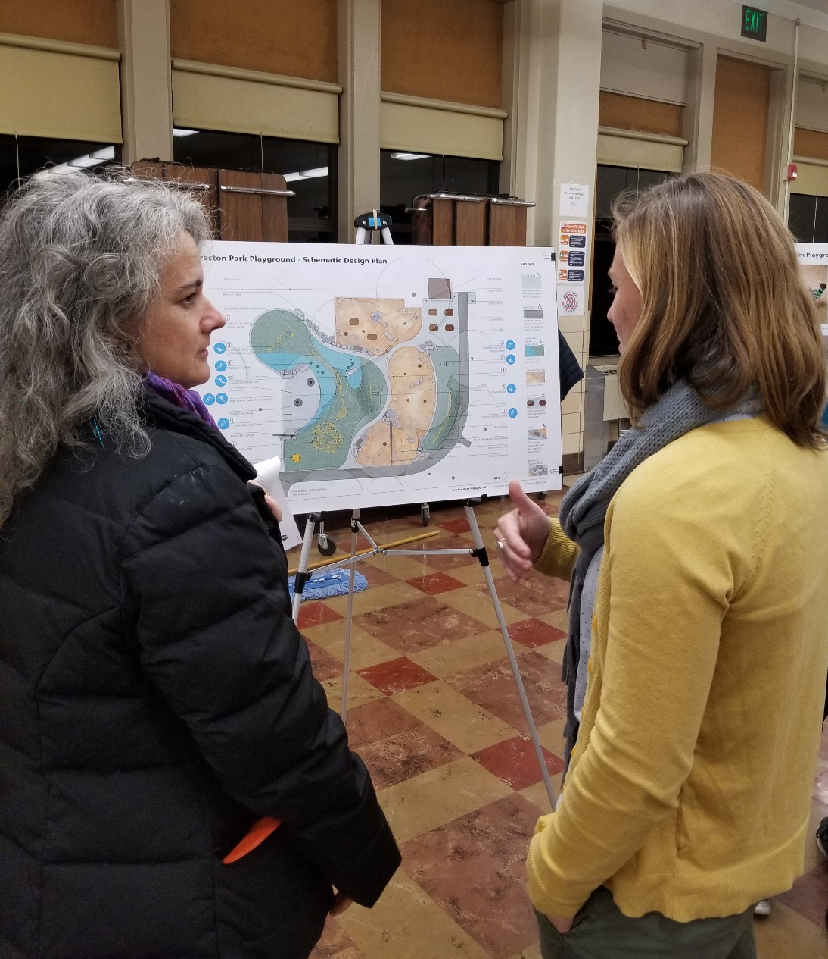
PUBLIC INVOLVEMENT
One community focus group meeting
Two Open Houses
Notes:
(GD)
PP&R conducted public involvement with students, parents and park neighbors through a community focus group meeting and two public Open Houses, in order to:
Understand their perspective regarding the current use of the playground; what’s missing from the playground and what activities neighborhood children want most in play,
Connect with neighbors about the positive aspects of making improvements to the park, and
Solicit and discuss public feedback for design, to gain support for the design of the play area improvements.
At the final Open House, PP&R received 73 responses and 90% of respondents loved or liked the playground design.

Slide 8
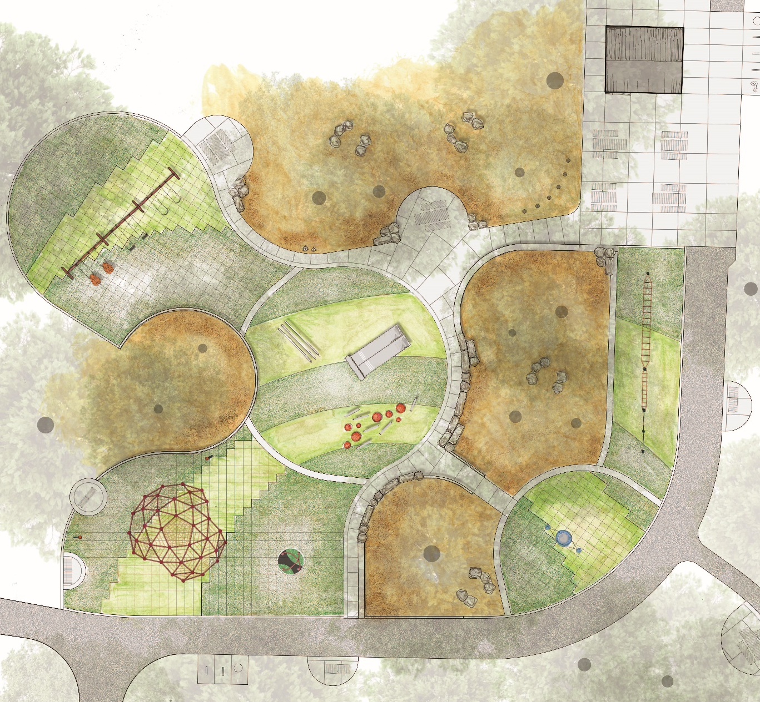
PROJECT DETAILS
Play area with ADA play features
Accessible picnic tables and benches
Pathway renovations
O&M budget ~$13,320.00/year
85% of PTE fees to Certified businesses
Notes:
(GD)
With community input and support, PP&R developed a final design that will construct key park improvements focusing on:
Accessible play features, such as slides, climbers, swings, balance play, and spinning elements.
Durable, accessible rubber safety surfaces that provide access to all play equipment in an equitable way.
Accessible picnic tables, benches and other gathering spaces.
Other site amenities, such as new accessible drinking fountain, trash receptacles, and much needed bike racks.
We will also make ADA accessibility improvements to interior pathways around the play area, to existing restrooms, and to the playground from the park entry at SE Francis and from the parking area at SE 43rd.
PP&R has an anticipated ongoing annual O&M for this renovation of $13,320.
The design consultant team lead by Mayer/Reed landscape architects, utilizing a PP&R on-call contract, supported 74% of contract fees to WBE businesses, an additional 8% to DBE businesses, and 3% to ESB businesses, totaling 85% of the $178k fees.

Slide 9
WHY ARE WE HERE?
58% of construction contract work to certified businesses
Accept bid by Faison Construction, Inc. for Creston Park Play Area Improvements Project for $1,332,810
Notes:
(GD)
The successful bidder for project construction is Faison Construction, for the amount of $1,332,810. Faison Construction is a certified M/DBE business performing 48.6% of the contract work. Included in the construction contract, an additional 9.3% of the work will be performed by certified firms. 1.9% WBE and 7.5% ESB.
We are here to ask Council to accept the low bid from Faison Construction for the Creston Park Playground. With the acceptance of this bid by Council, we would then proceed with construction set to begin late this spring. We anticipate construction completion date by the end of fall 2020.
I am happy to answer any questions you might have at this time. Thank you!

