Slide 1
North/Northeast Neighborhood Housing Strategy Oversight Committee
Annual Report to Portland City Council
Thursday March 11, 2020

Slide 2
Oversight Committee Members
Dr. Steven Holt, Sr. Pastor Kingdom Nation Church, Chair
Dr. Lisa K. Bates PhD, Associate Professor Portland State University
Dr. T. Allen Bethel, Sr. Pastor Maranatha Church
Triston Dallas, Attorney, Epiq Global
Dr. Karin Edwards EdD, Cascade Campus President, Portland Community College
Jilian Saurage Felton, Saurage Consulting
Sheila Holden, Regional Community Manager, Pacific Power
Marlon Holmes, Community Member
Virgie Ruiz-Houston, Community Member
Felicia Tripp, Executive Director, Portland Leadership Foundation

Slide 3
Funds committed but not spent in Goals 2 and 3: $28,353,854.00
PHB has non-committed funds remaining in Goal 1: Preventing Displacement. $9,620,999.00.
Notes:
Add information about remaining funds.

Slide 4
2019 Accomplishments
One multi-family building, the Magnolia II was completed in 2019, leasing began in September 2019
Three multi-family projects were under construction: Songbird, renaissance commons and king+parks
PCRI’s first home ownership development under the preference policy was completed and sold to 4 preference policy families.
Preference Policy Home Buyers increased from 7 in 2018 to 33 in 2019

Slide 5
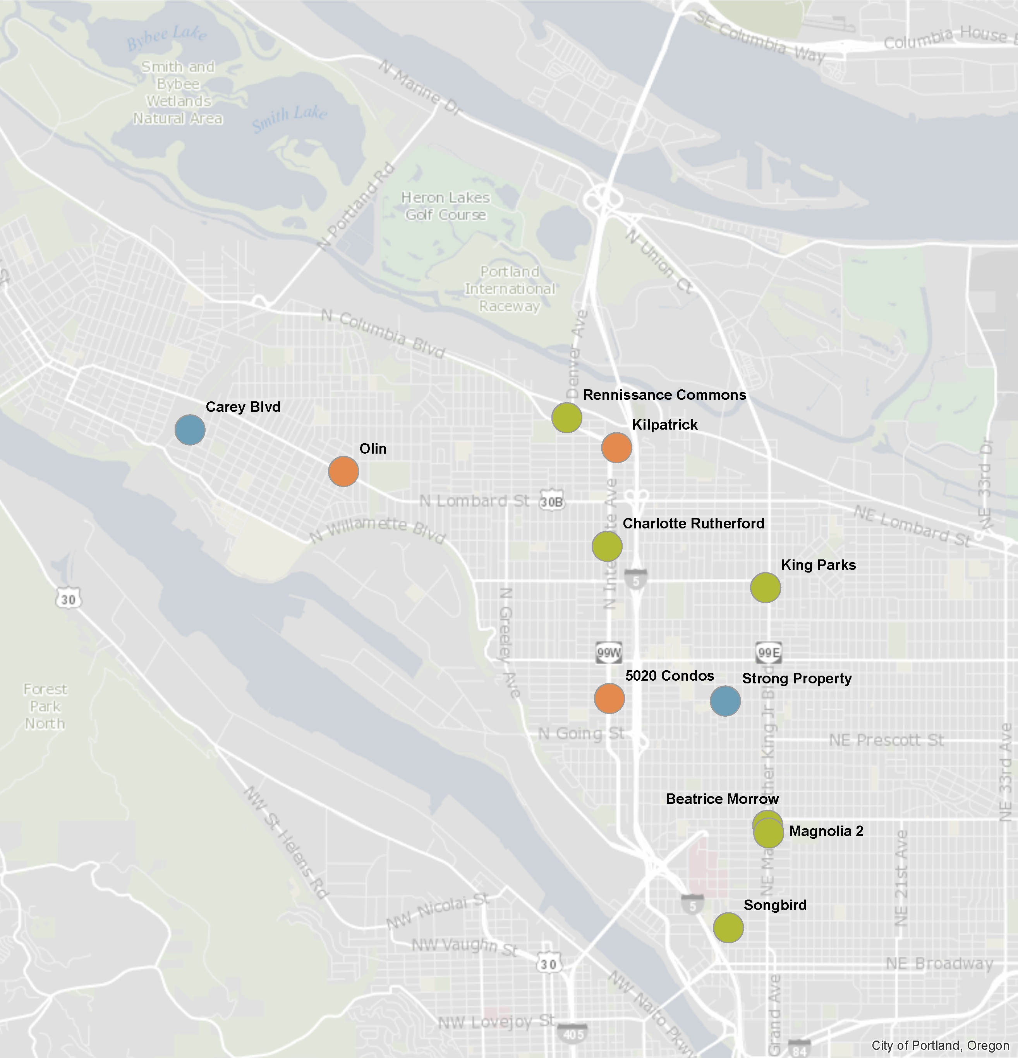
PHB N/NE Investments

Slide 6
Strategy 1: Preventing Displacement
Home Repair Grants:
793 total grants awarded to 556 Households

Slide 7
Strategy 1: Preventing Displacement

Slide 8
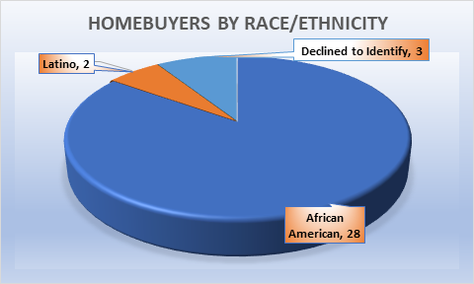
Strategy 2: Creating New Homeowners
Notes:
The 17 N/NE DPAL Home Buyers count towards PHB’s goal of 110 by 2022
As of 3.2.2020 we have 25 NNE DPALs, 5 Prosper, 9 CET and 6 without any subsidy.

Slide 9
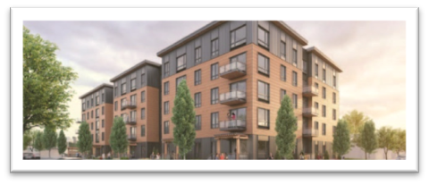
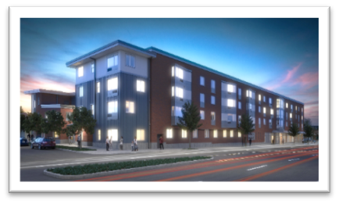
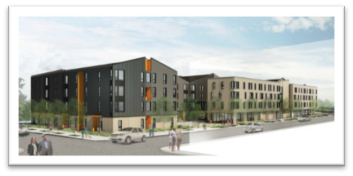
Strategy 3: Creating Rental Homes
IHI/Magnolia II – 24 families moved in, 6 scheduled to move in as of February 7th
PCRI/King+Parks – Expected completion of construction and occupancy in June 2020
Bridge/Songbird – Expected completion of construction and occupancy in June 2020
Reach/Renaissance Commons – Expected completion of construction and occupancy in June 2020

Slide 10
Strategy 3: Creating Rental Homes
PHB has exceeded the goal of 380 rental units, with a total of 501 units between 6 buildings.
52% of the units are family sized with 2+ bedrooms
We will be able to serve very low income families through a combination of Project Based Section 8 vouchers and PSH.
Approximately 1254 people will be housed in these units

Slide 11
Strategy 4: Land Banking
PHB completed negotiations with the Strong family to purchase property within the district.
PHB purchased the Carey blvd property from the Water bureau for future home ownership development, at it’s April meeting Prosper Portland’s Board voted to include the property in the Interstate TIF district

Slide 12
Policy Goal: DMWESB Participation Home Repair

Slide 13
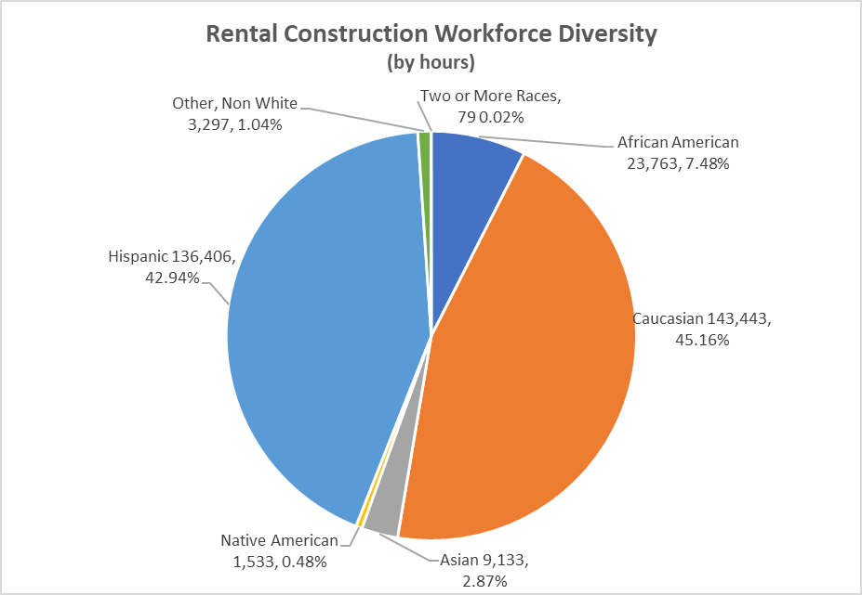
Policy Goal: DMWESB Participation Rental Construction

Slide 14
Policy Goal: Preference Policy
5020 N. Interstate Round (Home Ownership)– April 22nd to May 3rd
651 applicants claimed point preference
115 applicants claimed Eminent Domain Preference
80% of applicants identified as a Race/Ethnicity other than White
Magnolia II Round (Multi-family rental) September 3rd-16th
717 applicants claimed point preference
73 applicants claimed Eminent Domain Preference
73% of applicants identified as a Race/Ethnicity other than White

Slide 15
Policy Goal: Preference Policy
Study Progress Report: The Impact of the Preference Policy on Wellbeing
Co-Investigators: Lisa Bates (PSU CUPA) and Amie Thurber (PSU SSW)

Slide 16
The Impact of the Preference Policy on Wellbeing
Initial Objectives
Broad Goals
To understand the experiences and needs of those served by policy.
To assist the Oversight Committee and Portland Housing Bureau in evaluating the policy and shaping ongoing implementation.
To inform similar policies across the county.
To understand resident’s motivations for applying to the Preference Policy.
To learn about resident’s experiences in the neighborhood and sense of community well-being.
To begin to gather recommendations to improve social, cultural, civic, economic, and environmental well-being.
Notes:
As a reminder- there are a few broad goals of this study:
- First – this policy was designed to serve a particular population of folks – those who had been displaced from the neighborhood in the past – and it’s critical to know how it’s working. As you wrote in your 2017 report – we need to make sure families can do more than exist. But to find out how folks are doing in this changing neighborhood – have to ask them…
Hearing directly from residents can assist both this body and PHB in evaluating the policy, and also imnfor the ongoing implementation of the policy. We didn’t want to miss the opportunity to learn from residents ways to make this work even better. We anticipated the study might surface possibilities for community collaboration to enrich experiences of residents…
Finally- As the Preference Policy is the first of its kind in the nation, findings of this study are expected to be of broad interest. As you know, the patterns of displacement and gentrification are not unique to Portland, and planners and city housing organization are watching Portland to see how this works; community advocates want to know how this works. If we can share some best practices and lessons learned, that will be a great help to other communities…
In summary – we want to understand how this is working here, help identify ways to improve it, and share what we learn…
We see this as a longitudinal study – it will take time to fully understand the impacts on residents and the broader community. As a starting point this summer, we had the following objectives:…IMPORTANT to note – this is not an evaluation of how people feel about the quality of their housing, or their relationship with the housing providers, it’s trying to get at the heart of the preference policy itself – which was a belief that families displaced from this community ought to have the opportunity to live in this community – and now that they are back…how does it feel? How is it going?

Slide 17
1. The preference policy is serving the intended population.
Age range 19-71 average 43
Lived in the neighborhood an average of 32 years: on average, lived 72% of life in the neighborhood; 65% lived entire life in the neighborhood.
84% Black
68% Women
54% had no children living in the home

Slide 18
2. One of the central underlying themes of the policy is that “place matters”
80% reported their connection to the neighborhood was their primary motivation for applying
80% believed this was best chance to move from waitlist into housing
Convenience to work or school was NOT a primary motivation
91% agree that the history of this neighborhood matters to me
87% feel I belong in this neighborhood
83% have friends and family in neighborhood

Slide 19
78% participate in arts and cultural events
53% indicate increased participation since moving in
56% spend time volunteering
24% report increased civic engagement since moving in.
50% report getting to work and/or school is more convenient
3. Residents are generally experiencing improvements in their well-being

Slide 20
4. … and residents also reported risks/vulnerabilities to their wellbeing.
Only 48% agreed that people who want to can find a good job in the neighborhood.
Some are still precariously housed.
Most interviewed described needs for more low-cost stores and amenities
70% agree that people different backgrounds get along
37% agree there’s “a lot” of prejudice in the neighborhood.
30% experienced discrimination in area businesses

Slide 21
Ongoing advertising/marketing efforts to increase awareness and participation of communities of color, especially African Americans, with the home repair loan and grant program.
Consideration for increasing the grant amount for home repair.
Must re-establish quarterly newsletter to keep the community informed about the work of the committee, PHB and the development partners.
Continue to remove barriers for MWESB at all levels of construction and development, including the home repair grant/loan program.
In 2019, the Oversight Committee voted to recommend maximizing the indebtedness of the Interstate TIF district. We understand that Prosper Portland’s Board will be reviewing this recommendation this spring. It is our anticipation, that City Council will be in support of the recommendation to maximize indebtedness for the purpose of creating increasing affordable housing opportunities in NE Portland.
We support the inclusion of the Williams & Russell Project (property) inclusion in the Interstate TIF District for the opportunities it will provide.
The Preference Policy continues to be the most effective way in connecting families with affordable housing opportunities in N/NE Portland. We request City Council and PHB to seek ways to provide funding to support additional evaluation of the impacts of the Policy.
Opportunities

Slide 22
As I reflect on 5 years of investment, I’m encouraged with the sincere efforts that have been made and are being made to do things differently. Change has occurred around this work, such as three Housing Bureau Directors, two Housing Commissioners, and leadership changes in partner organizations. But those specific changes have not been a hindrance to the work moving forward. This illustrates the value this work holds for the city, it’s leadership and the community. We acknowledge that the damage that has occurred can never be repaired or replaced, but each housing unit-built matters to the families who will live in them. The simple truth is, we cannot do enough.
I want to express sincere appreciation to the people who have given themselves to this endeavor: N/NE Oversight Committee members, Portland Housing Bureau Staff, City Council past and present, and all of our community partners. Our time continues to be limited; this moment won’t last forever. Let’s continue to do our best to ensure that the “promises made will be promises kept.”
Summary

