Slide 1
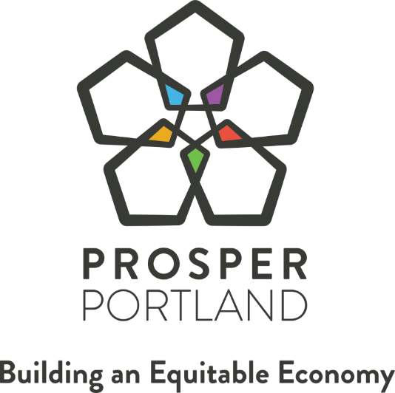
Notes:
Program overview
Accomplishments
Lessons learned
Next steps
Today we are providing you a 7 year update to the Neighborhood Prosperity Network
This update will include a program overview, Network Accomplishments, Lessons Learned and Next Steps.
After we provide a staff update, we have several community partners providing testimony

Slide 2
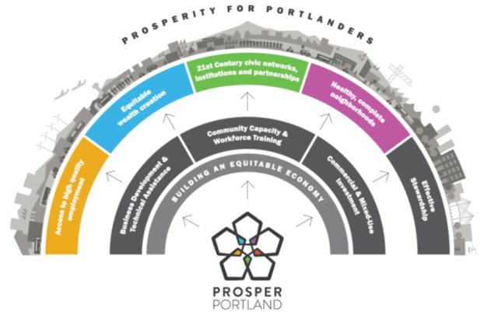

STRATEGIC PLAN
Notes:
The Neighborhood Prosperity Network is our signature Community Economic Development program for the City of Portland
The over arching focus of the Neighborhood Prosperity Network is a human centered inclusive economic development approach
Priorities of the Network are:
Business Stabilization through Business Development and Business District Improvements
Community Stabilization of community members through Employment
District visibility – through events and promotions
And Community and Business Stabilization through community led property development
All led by strong community economic development organizations.
Place based grassroots economic development driven by community non-profit organizations
Hired a full time District Manager,
Community directed Board
Powered by volunteer and community support

Slide 3
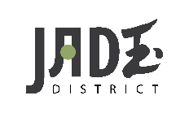


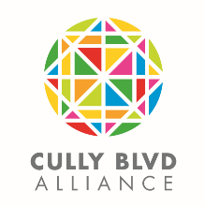


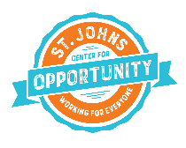
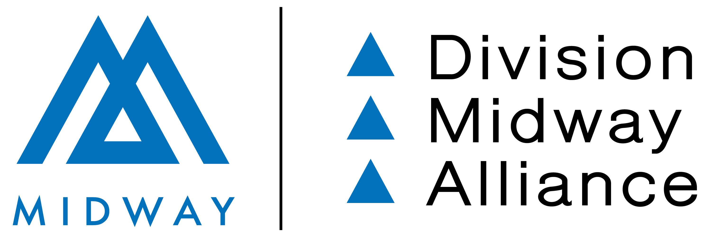
PROGRAM OVERVIEW
  Community driven economic development program
  Network includes seven districts in priority neighborhoods
  Reason for priority neighborhood focus
    Higher level of poverty
    Lagging commercial investments
    Higher concentration of diverse
    community members
Notes:
The Neighborhood Prosperity Network is our signature Community Economic Development program for the City of Portland
The over arching focus of the Neighborhood Prosperity Network is a human centered inclusive economic development approach
Priorities of the Network are:
Business Stabilization through Business Development and Business District Improvements
Community Stabilization of community members through Employment
District visibility – through events and promotions
And Community and Business Stabilization through community led property development
All led by strong community economic development organizations.
Place based grassroots economic development driven by community non-profit organizations
Hired a full time District Manager,
Community directed Board
Powered by volunteer and community support

Slide 4
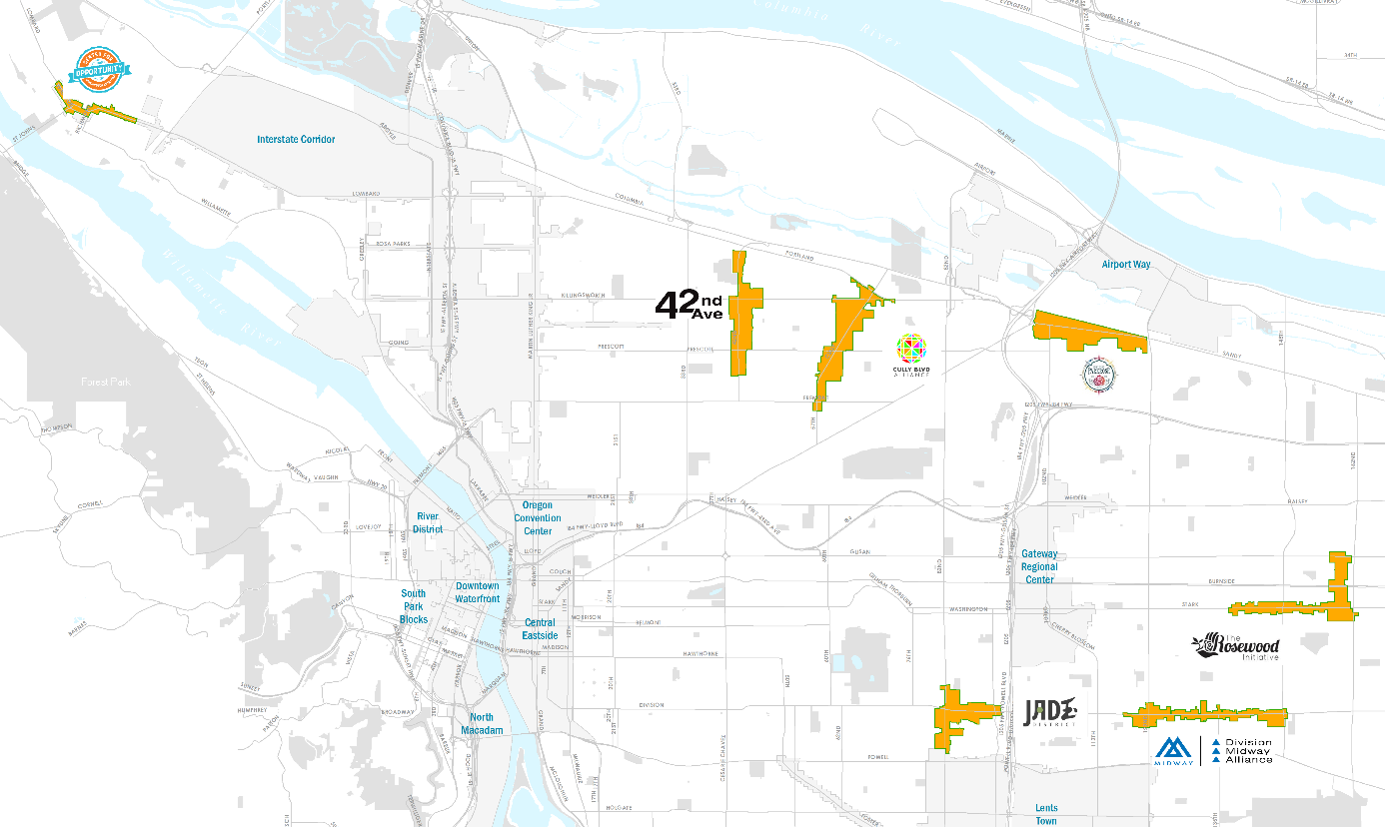
PROGRAM OVERVIEW
Notes:
East Portland is home to the largest percentage of disadvantage and under-represented community members
This map depicts where the 7 districts are focused. The NPI are focused on East Portland and are funded with Micro-TIF districts.
In addition to community driven model, to create a small source of physical improvement funds to ensure the Community based organizations could help impact the physical environment. This was done by creating 6 micro-URAs to surround the Commercial districts to ensure that $1.25 million was generated over a 7-10 year period to be used by the communities to impact the local economic development.
St Johns is in North Portland and is included in the Interstate URA.

Slide 5
DISTRICT DEMOGRAPHICS
African American
2.3%
16.1%
Pacific Islander
6.3%
0.6%
42nd Ave
City of Portland
Parkrose
City of Portland
Asian
23.1%
Hispanic
23%
8.3%
10.1%
Jade District
City of Portland
Rosewood
City of Portland
Notes:
A key priority of the program is to ensure that historically marginalized communities can remain and grow in the neighborhood.
And therefore, The Network areas were chosen for investment due to
lower-than-average income.
Higher Concentration of diverse community members
And at higher risk of displacement compared to the city averages
Here are a few demographic data point to illustrate these realities. For example:
Our 42nd Avenue has 16.1 % of African American as compared to 6.3% in the City.
23% Hispanic population in Rosewood compared to 10% in the City
There are 23.1% Asian communities in the Jade District where the City has 8.3%
More than double the percent of Pacific Islanders in Parkrose compared to the City

Slide 6
DISTRICT DEMOGRAPHICS
$60,859
50%
Median Household Income
Bachelor’s Degree or Higher
$53,600
14%
Cully
City of Portland
Division Midway
City of Portland
Percent Renters
53%
Students of Color
72.3%
51.8%
46%
Rosewood
City of Portland
St. Johns
City of Portland
Notes:
And highlighted the income disparities and education levels
Finally, the community members have a significantly lower education level, indicating that obtaining high quality employment for these communities is more difficult to achieve.
14% of Division Midway residents have Bachelor's Degree or Higher compared to 50% in the City.
Cully communities median Household income is $53,600 compared to nearly $61,000 median in the City
Rosewood has 53% renters compared to the City of 46% renting

Slide 7
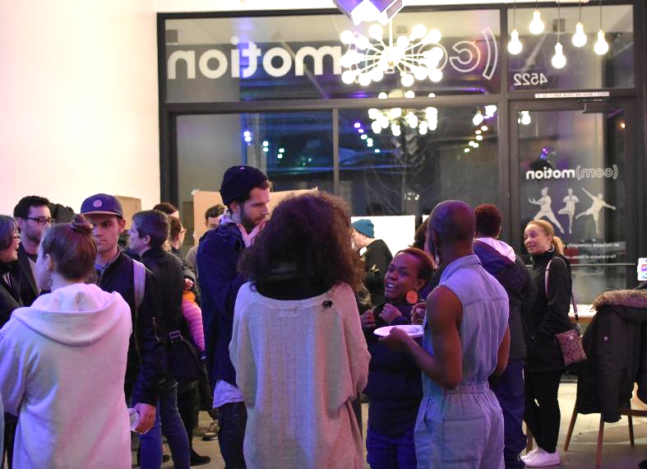
PROGRAM FUNDING
  Grants:
  Administration & Operations
  Promotions
  Technical Assistance
  District Improvements
  Revenue Share
    Multnomah County
    City of Portland
Notes:
Photo: Commotion Grand opening (a Movement Center operated by Our 42nd Ave) community resident purchased property and developed building with 19 housing units with 2 commercial ground floor spaces. Our 42nd Ave leases the space and offers space for community movement teachers (yoga, dance and more) to offer affordable space and in return affordable classes.
The Neighborhood Prosperity Network is supported by Prosper Portland provides financial support to each District in the form of
Admin and Operations up to $75,000– to support a full time District Manager
Promotions - $3,000 to increase the visible and community connections
Technical Assistance $8,000 – to building the organizations capacity
District Improvements (variable based on tax revenue for District)– the TIF fund for physical improvements
And the Revenue share funds were the support from Multnomah County and the City of Portland providing this flexible source of funds to allow the districts to expand programming or other non-property development activities.
Additionally, there are 2 Prosper Portland staff (myself and Damian) who are the district liaisons that lead the partnership connections for the Commission to these communities. In addition to traditional grant administration, we are thought partners, and work closely with District manager and board members to implement the economic development activities with in the districts.
Damian will now provide an overview on how the organizations are utilizing our support and creating community driven program to impact the residents and businesses in their districts.

Slide 8
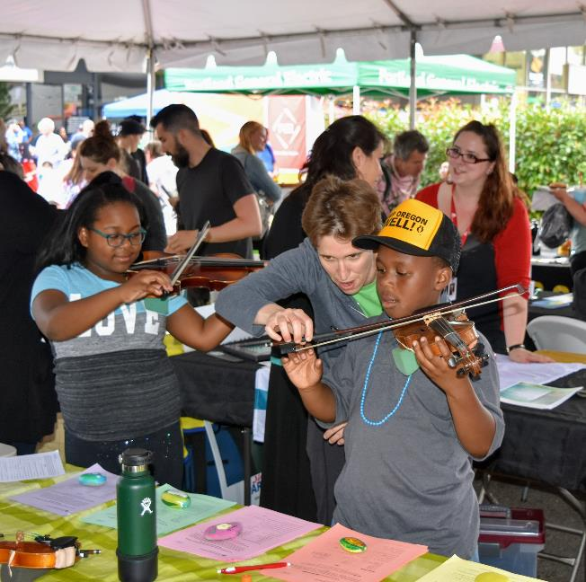
COMMUNITY BUILDING
Signature Events
Farmers Markets
Community Clean Ups
Monthly Business Seminars
Cultural Connections
Notes:
This photo is from Rosewood’s National Night Out.
Not at business association / Not a neighborhood associations and community organization tasked with creating thriving communities for both residents and businesses.
Districts grew these community building activities to :
Signature Events –Jade Night Market – The 5th year of this event, the two August Nights event brought 25,000 visitors and community members to the district, to celebrate the diversity and culture of the community that lives and works around the district.
Farmers Markets – two Districts now are the sponsoring organizations of the community Farmers Markets. Both St. Johns Center for Opportunity and Our 42nd Avenue are providing access to fresh fruits and vegetables from local farmers to low income community members, as well as a place for community businesses members to sell there arts and crafts, on a weekly bases through out the summer. Food equity program
Specifically, St Johns Farmers Market.
57 vendors
35% people of color
42% are women
$310,000 in Revenue
Food Equity Program, vege voucher program that distributes $20 vouchers through strategic partners Mult County Health Department, Bridge Meadows, and village gardens. Last years they had 74 households enrolled and a redemption rate of 66%

Slide 9
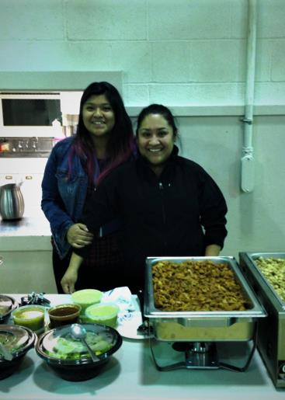
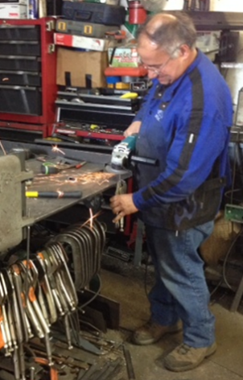
NETWORK PRIORITY: BUSINESS DEVELOPMENT
  GOAL: Create, grow and strengthen micro and small businesses through technical assistance and training
  SERVICES: business plan development, cash flow analysis, bookkeeping, loan packaging, marketing
  Businesses received:
  Long Term Business Technical Assistance
  Light Touch Business Technical Assistance
Notes:
Photo: Rosario and staff with Santa Domingo and Guierrmo with NW Iron Works
Prosper Portland has held contracted with Business Technical assistance providers provided long term business technical assistance for qualifying small businesses through out the city.
Commercial Stabilization
What was made clear early on, is that many local businesses with in Network districts needs technical assistance but did not necessarily qualify for the Long Term program, and we were committed to assisting existing businesses to grow and strengthen with in the Districts. And so we expanded the programming to create a light touch technical assistance businesses with in Network service areas.
62 businesses and residents within Network Districts received business development services in FY 18/19.
In addition, 134 businesses within the NPI districts received Light Touch Business support services in FY 18/19.

Slide 10
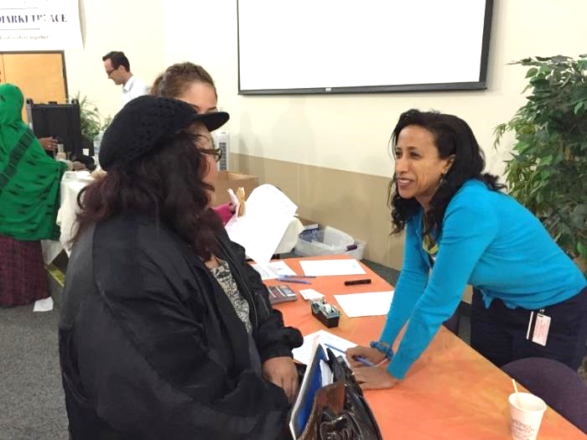
NETWORK PRIORITY: CONNECTIONS TO EMPLOYMENT
GOAL: Ensure disadvantaged community members have the ability to access jobs
  Workforce Navigator
  Job boards
  Career fairs
Notes:
As I mentions earlier, Our initial program goals of Community Economic Development did not initially include Workforce. What we learned very quickly was that our community members needed jobs to help stabilize their lives. Worksource had training programming that assisted many underemployed community members. But there were many community members that were not interested training but jobs to fill the immediate needs.
Network Districts began to take the lead to fill this need by maintaining
Job Board and
Host Career Fairs for their residents
Prosper Portland piloted the Workforce Navigator program was launched in 2015, to strengthen the existing worksource services. This picture is of Mulu the Workforce Navigator that is the Cully and 42nd Ave and Historic Parkrose NPI., working with a resident at a Career Fair supporting community member.
Mulu the has become a trusted advisor in the community and has been very successful to assisting local residents in finding employment.
We expanded to add a Navigator to assist community members in all NPN districts, now there are 4 Navigators
Worksytems, Inc (WSI )is now the contract manager of Workforce Navigator program
As of May 2019, the Navigator program had served 1,602 people, 81.6% POC

Slide 11
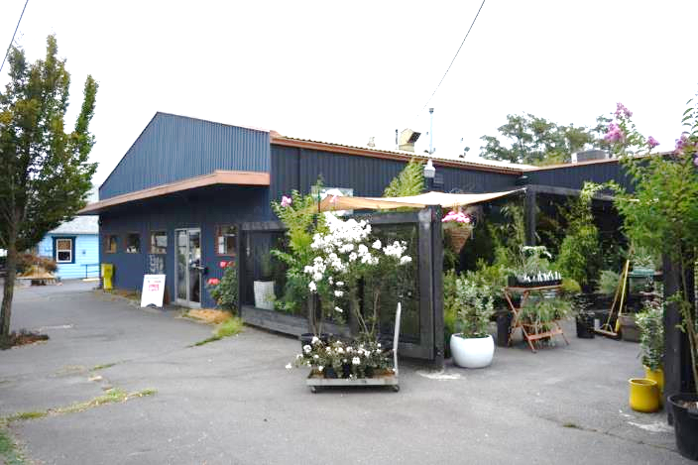
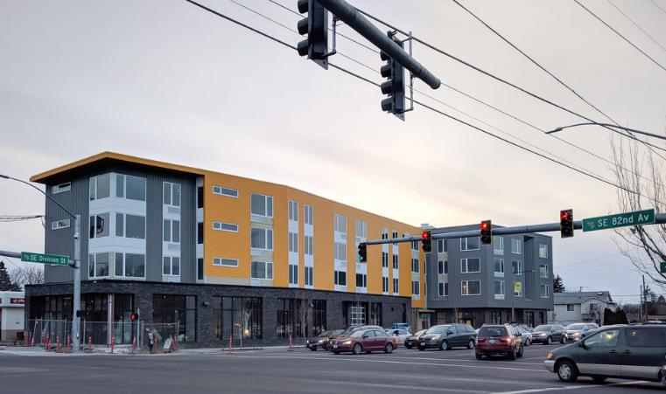
NETWORK PRIORITY: COMMUNITY LED PROPERTY DEVELOPMENT
  Commercial Affordability
  Provide affordable storefront space for diverse community members
  Access to Capital
  NPI Opportunity Fund
Notes:
Our 42nd Avenue purchased the property shown on the slide, from a long time property owner with the assistance of the NPI Opportunity Funds. The district is now negotiating with a local business owner to purchase the building and negotiate community benefits agreement to ensure priority community members can stabilize his business in the district.
And Photo of Orchards on 82 – Affordable Housing by ROSE CDC and ground floor commercial/community space operated by APANO
Community Led Development is more than just small scale projects such as storefronts, signage and lighting
It involves being connected with the business and property owners in the district to understand the pulse of the community, and be able to get ahead of property transfer discussions
District Managers are able to provide Property Owners information about lease activity and interest in the districts.
And utilize the TIF funds to assist with Tenant improvements to off set lease rates, and create some affordable commercial space for priority community members.
Commercial affordability – Barrier to entry is more around Tenant Improvements, which is where TIF can assist.
Access to Capital was identified as a challenge.
Prosper Portland Created the NPI Opportunity to fill the gap of funding for acquisition funds. It is a revolving loan fund, to assist in slowing down the market pressures and ensuring that community minded developers have the opportunity to invest in the community.
New Business loan products have created additional opportunities for businesses to fund Property Tis…

Slide 12
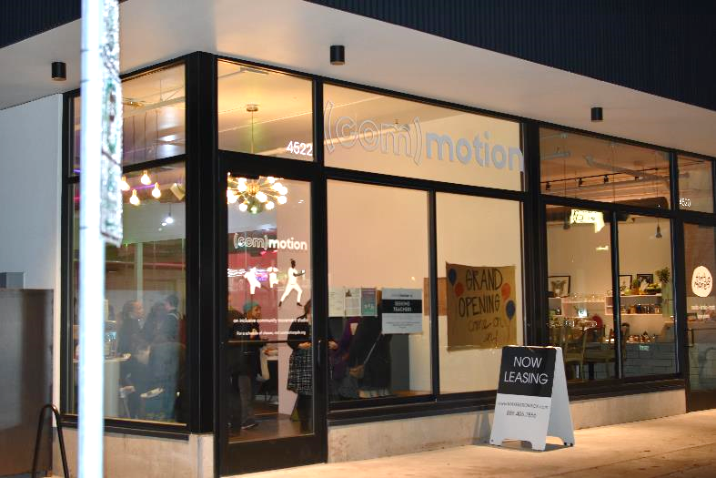
NETWORK PRIORITY: DISTRICT PROGRAMS
  (Com)motion
  Legal Services Day
  Cultural liaison
  Clothing closet
Notes:
Photo: (Com)motion – Our 42nd Avenue Movement Studio
And finally another example of Community problem solving came from Rosewood. They found that many community members had barriers to access employment due to criminal history. In order to reduce this barrier and clear up criminal records they piloted a Legal Services Day. In partnership with DAs Office, Metropolitan Public Defenders. The goal was to remove fines in exchange for community service hours, and reduce and in some cases expunge criminal records. These actions had direct and immediate impacts on the community members ability to access employment. Clearing the way to gain a drivers license and being a success job applicant. 2,000 individuals have been served and over $6 million in fines have been waived.
Cultural Liaison – Division Midway
Clothing Closet – St. Johns

Slide 13
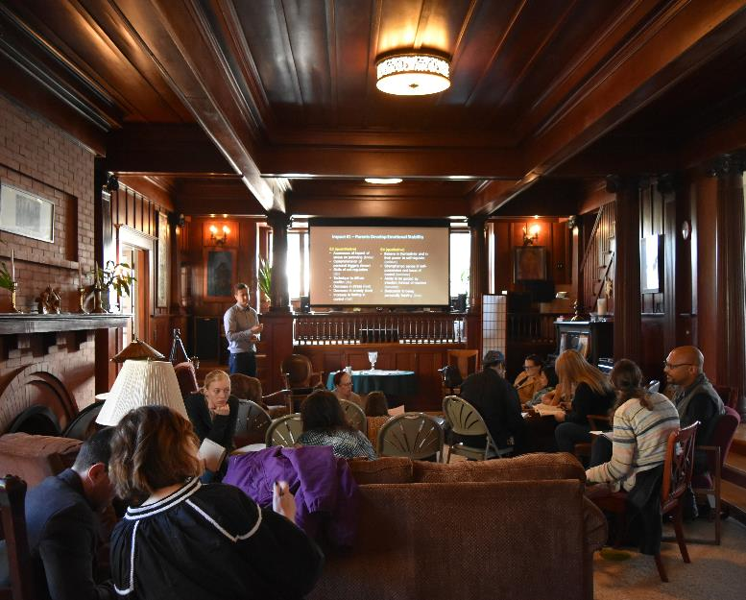




NETWORK METRICS
Outcomes (7 Years)
$4.4M
184,180
Private Leverage
Volunteer Hours
180
1,196
Net New Businesses
New Jobs
Notes:
Now we have a Network of Human focused economic development professionals that are working together to build a dynamic community economic development model in the City of Portland.
Network Outcomes (7 Years)
Private Leverage - $4.4 million
Volunteer Hours – 184,180
Net New Businesses - 180
New Jobs- 1,196
DIA – Shared Impact
Traditionally Marginalized Businesses Thrive
Business Owners create local economic vitality
Business leaders contribute to their community
Community members are economically stable and thriving
Neighbors are engaged in community building

Slide 14
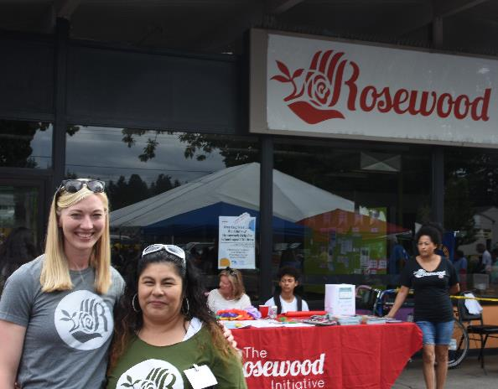
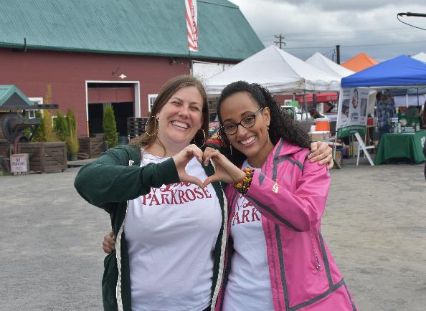
LESSONS LEARNED
  Each district needs a tailored approach
  Building relationships are key and take time
  Local fundraising is very challenging
  Access to capital is necessary to gain community benefits
Notes:
Photos: Rosewood National Night Out and Taste of Parkrose
we have had many Lessons Learned:
Each district needs tailored approach
Building relationships is key and takes time
Local fundraising is very challenging and time consuming
Access to capital is necessary to incentivize community benefits
Community benefits, property development are larger than storefronts – access to capital
Community economic development is more than just physical improvements
Multicultural, multilingual competency is essential
Public/private partnerships are important
Access to Transportation is critical to access employment
Organizational and board development takes time and is on going

Slide 15
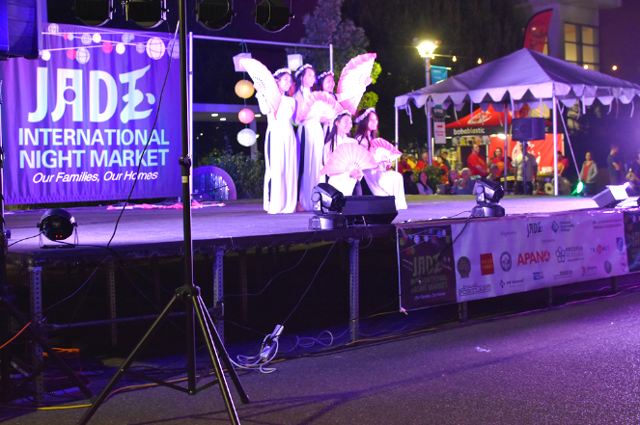
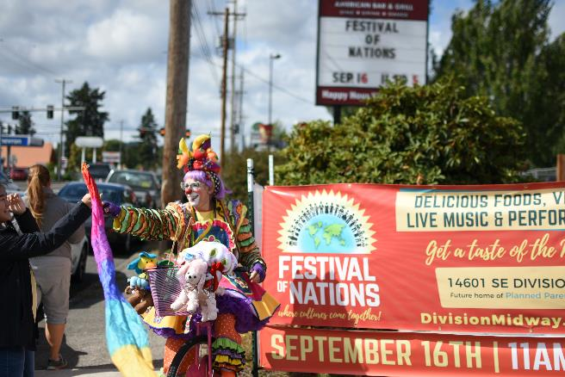
NEXT STEPS
  Support Community Led Property Development
  Explore future funding mechanisms
  Strengthen NPN Community Boards
Notes:
Photos: Jade Night Market and Division Midway Festival of Nations
What’s Next:
Support Community Led Property Development and investigate access to capital to fund this work. Currently several districts are exploring the viability of a Community Led TIF District.
Strengthen Boards and Organizations – to create the Economic Development CBO infrastructure that we were initially focused on. Ongoing

Slide 16
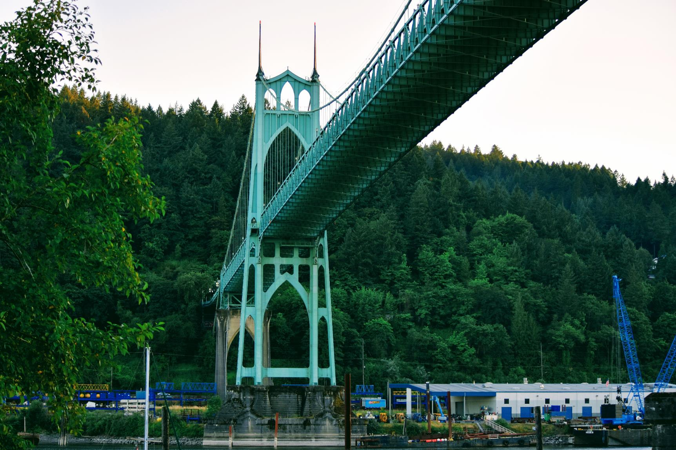
QUESTIONS?
Notes:
Photo: Iconic St. Johns Bridge
Questions
Community Testimony

