Slide 1
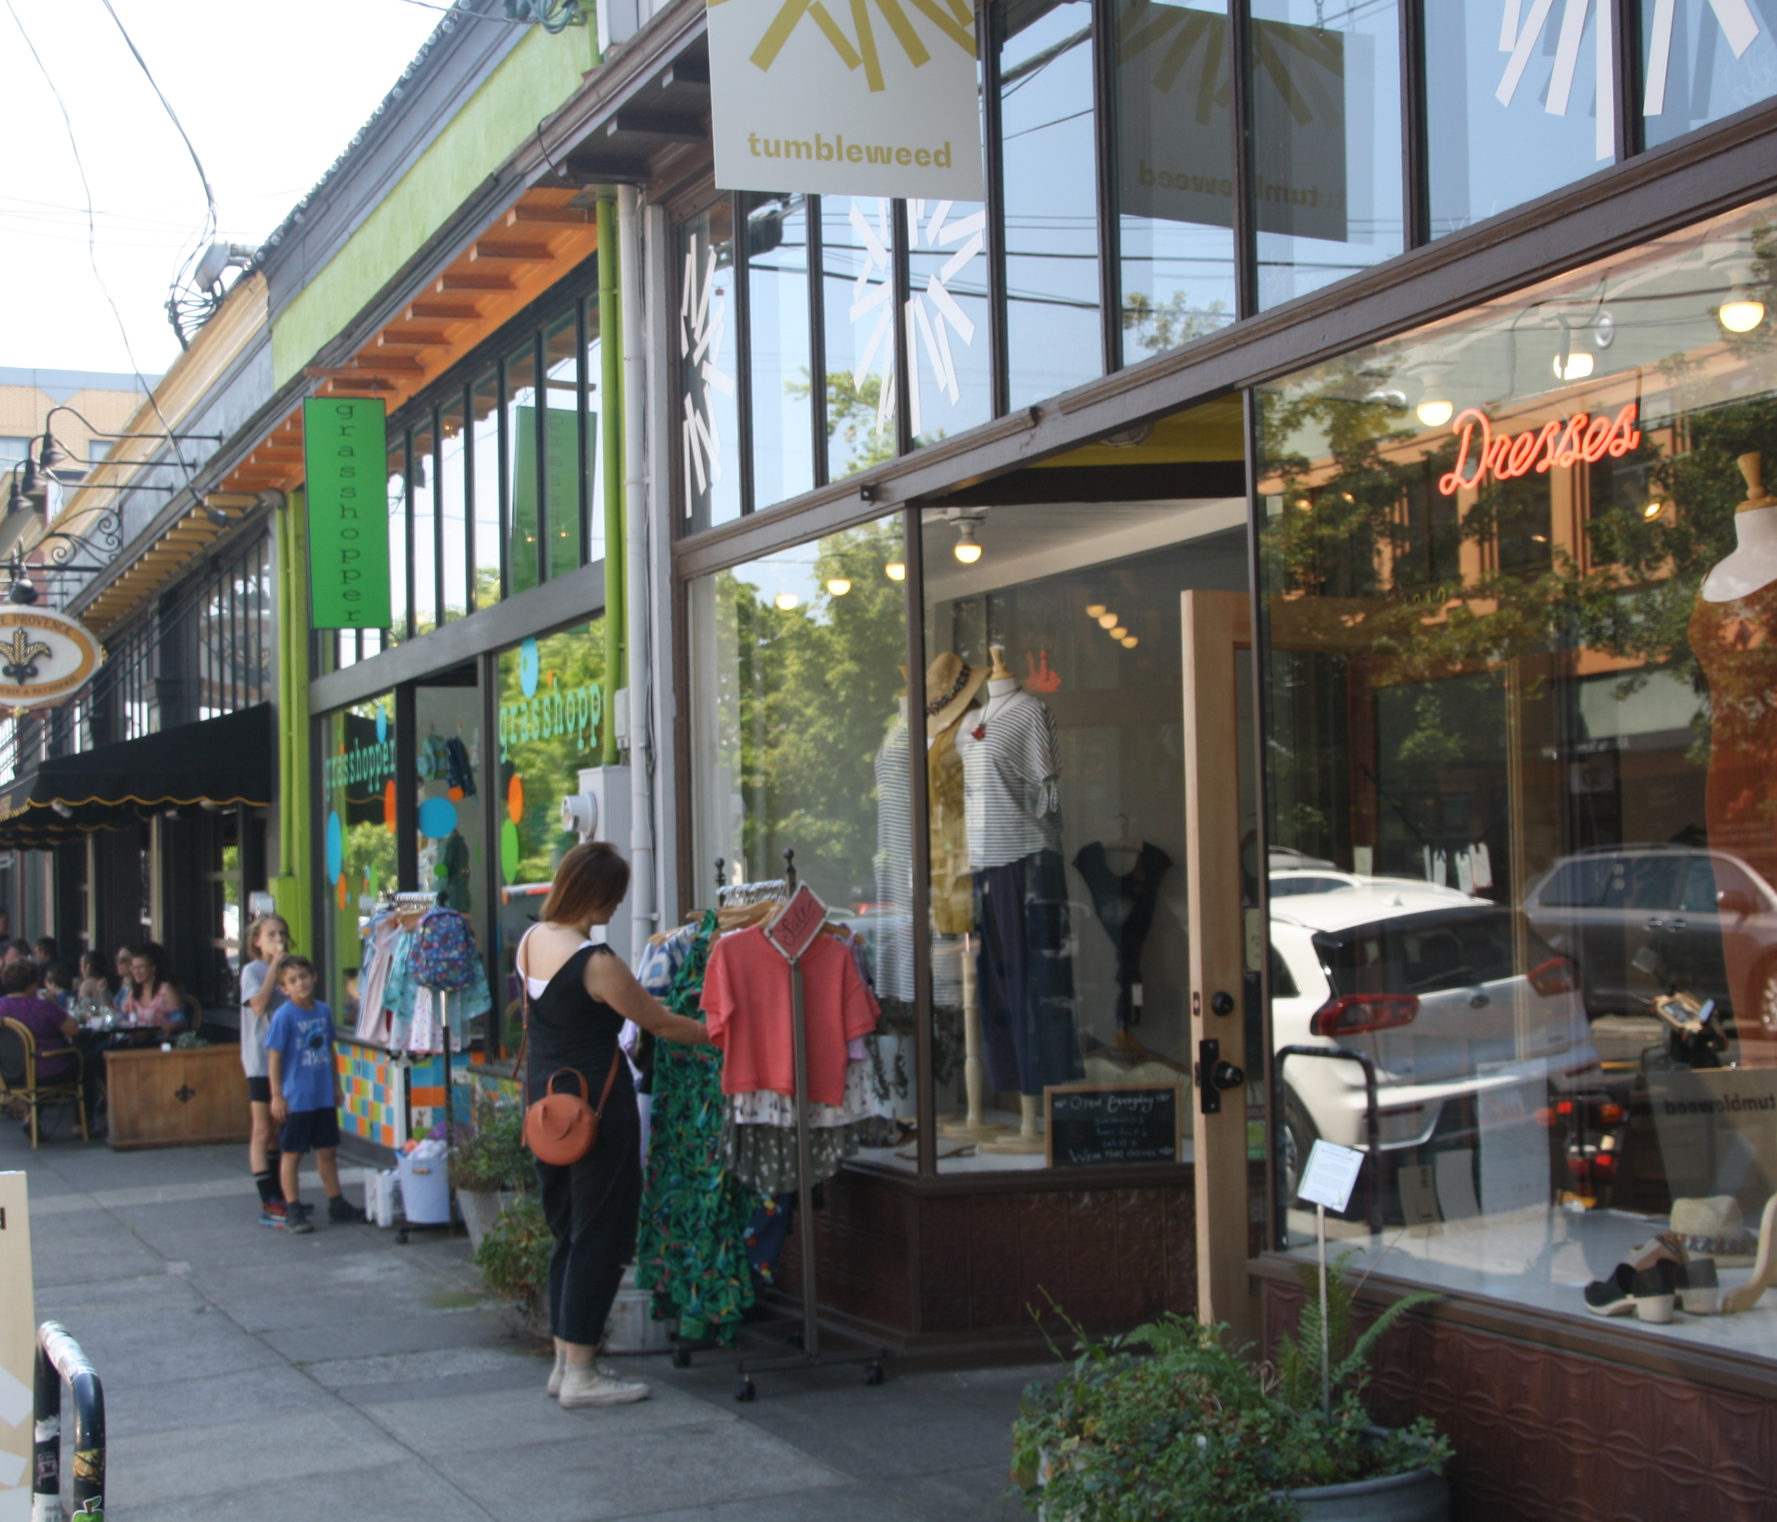
Work Session 6 Design Commission March 12, 2020
DOZA
Design Overlay Zone Amendments

Slide 2
Agenda
5 min
Intro and Disclosures
Portland Citywide Design Guidelines Proposed Draft (List of Amendments)
What will be discussed during 3x3: Tools (3/16/20) – Lora
What is missing/needs clarification? – Design Commission
What will be discussed during 3x3: Process (3/13/20) – Phil
(~ 3 hrs total)
45 min
45 min
45 min

Slide 3
What’s in the DOZA Proposed Draft?
Volume 1: Staff Report
Volume 2: Code and Map Amendments
Volume 3: Portland Citywide Design Guidelines
Volume 4: Appendices (portlandoregon.gov/bps/doza)
Appendix A: BDS Administrative Improvements
Appendix B: Housing Affordability Memo (February 6, 2017)
Appendix C: What We Heard Report
Appendix D: Consultant Testing of Draft Standards and Guidelines

Slide 4
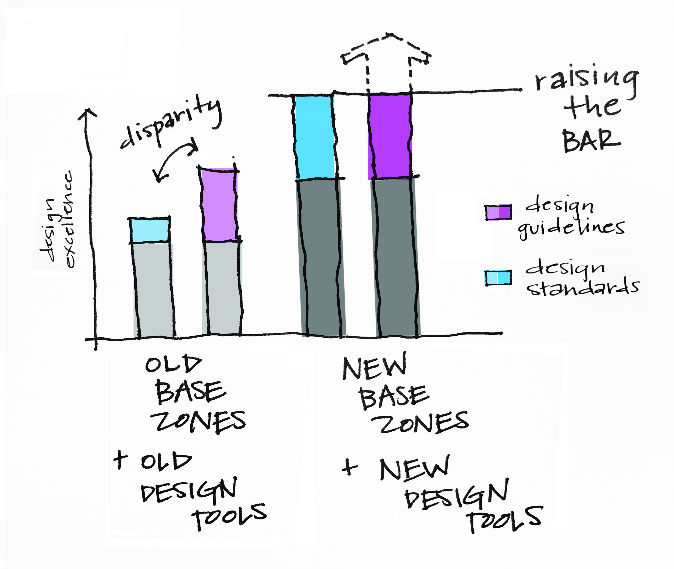
Guidelines vs. Standards: Assessment Findings

Slide 5
Guidelines vs. Standards: DOZA Approach

Slide 6
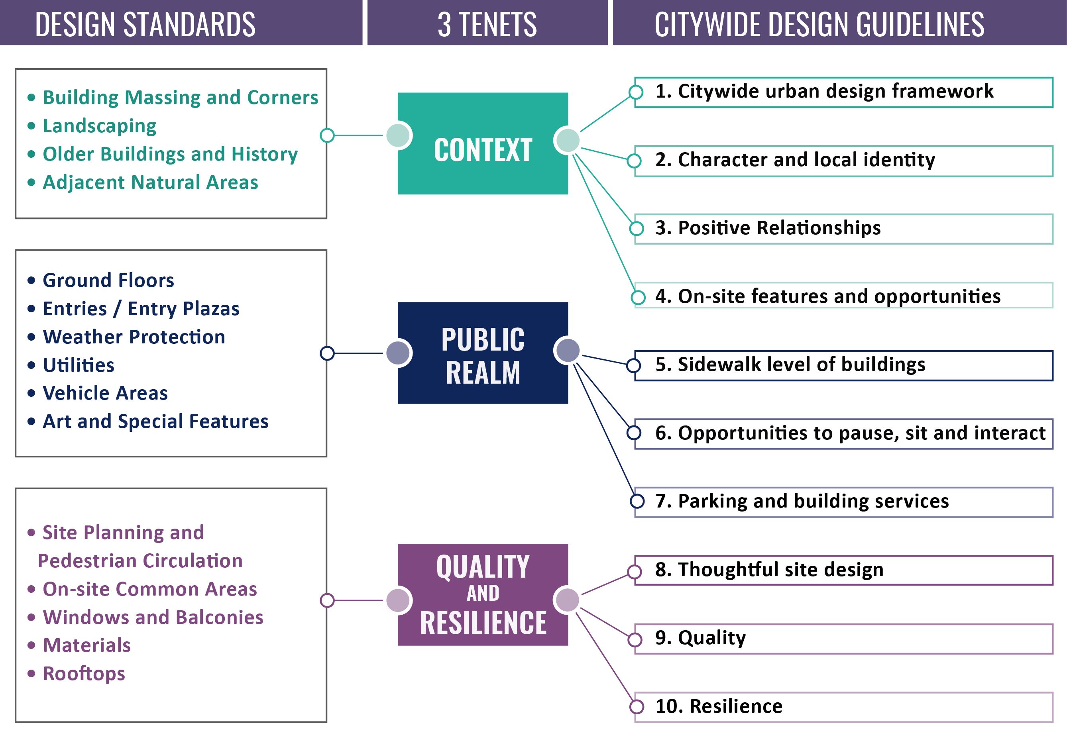
List of Amendments (to discuss with 3x3:Tools)

Slide 7
List of Amendments (to discuss with 3x3:Tools)
GENERAL | Item # | Page #
A: Purpose Statement | 15 | 4
B: Delete Guideline 01 | 21 22 23 | 12 12-21 12-21
C: Public Participation | 30 32 | 23 23
D: Future Work | 33 | 23
CONTEXT | Item # | Page #
E: Define “Adjacent” | 40 | 26-27
F: Historic Landmarks vs. historic buildings | 44 | 26-27
Discuss with 3x3

Slide 8
List of Amendments (to discuss with 3x3:Tools)
PUBLIC REALM | Item # | Page #
G: Blank Walls | 66 68 77 | 34-35 34-35 35
H: Oriel Windows | 71 | 34-35
I: Weather Protection | 74 | 35
J: Universally-Designed Features | 87 | 39
K: Zero-lot-line furnishing | 91 | 39
L: Utilities | 101 104 | 42-43 42-43
M: Bike Parking | 106 | 43
QUALITY & RESILIENCE | Item # | Page #
N: Equitable Access | 130 | 46-47
O: Project Concept | 147 | 50
P: Materials | 153 | 51
Q: Resilience | 162 163 | 54 54
R: Adaptability | 164 | 54

Slide 9
WHAT’S NEXT
DATE
THURSDAY, MARCH 12 | Design Commission Work Session #6 to confirm List of Amendments (Volume 3)
FRIDAY, MARCH 13 | 3x3: PROCESS
MONDAY, MARCH 16 | 3x3: TOOLS
MONDAY, APRIL 13 | BPS sends PSC, DC all Amendments (Volume 2, Volume 3)
TUESDAY, APRIL 28 | PSC Work Session #8 to vote on Amendments
THURSDAY, APRIL 30 | DC Work Session #7 to Discuss Amendments
FRIDAY, MAY 8 | BPS sends DC Amendments
THURSDAY, MAY 14 | DC Work Session #8 to vote on Amendments

Slide 10
WHAT’S NEXT
DATE
THURSDAY, MARCH 12 | Design Commission Work Session #6 to confirm List of Amendments (Volume 3)
FRIDAY, MARCH 13 | 3x3: PROCESS
MONDAY, MARCH 16 | 3x3: TOOLS
MONDAY, APRIL 13 | BPS sends PSC, DC all Amendments (Volume 2, Volume 3)
TUESDAY, APRIL 28 | PSC Work Session #8 to vote on Amendments
THURSDAY, APRIL 30 | DC Work Session #7 to Discuss Amendments
FRIDAY, MAY 8 | BPS sends DC Amendments
THURSDAY, MAY 14 | DC Work Session #8 to vote on Amendments
Summer | BPS publishes Recommended Draft
Fall | City Council
ADD’L AMENDMENTS 4/30:
Need to Review | Don’t need to Review
(short list)

Slide 11
Continue Work Session until 4/30/20

