Slide 1
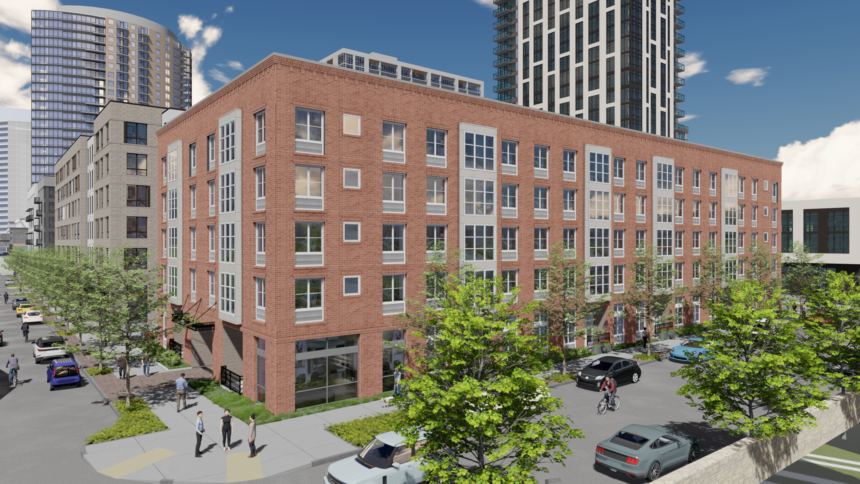
BLOCK 45 SOUTH

Slide 2
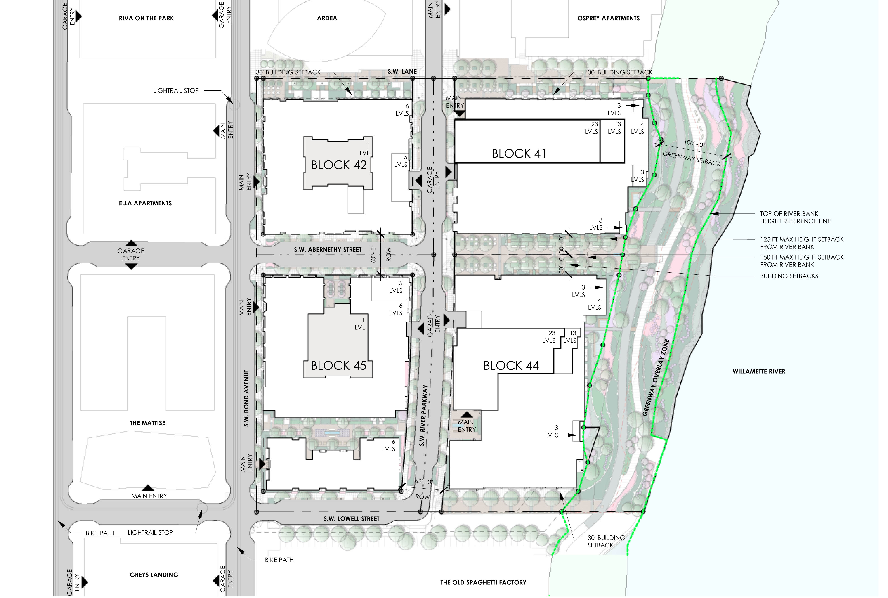

Slide 3
BUILDING SIMPLIFICATION

Slide 4
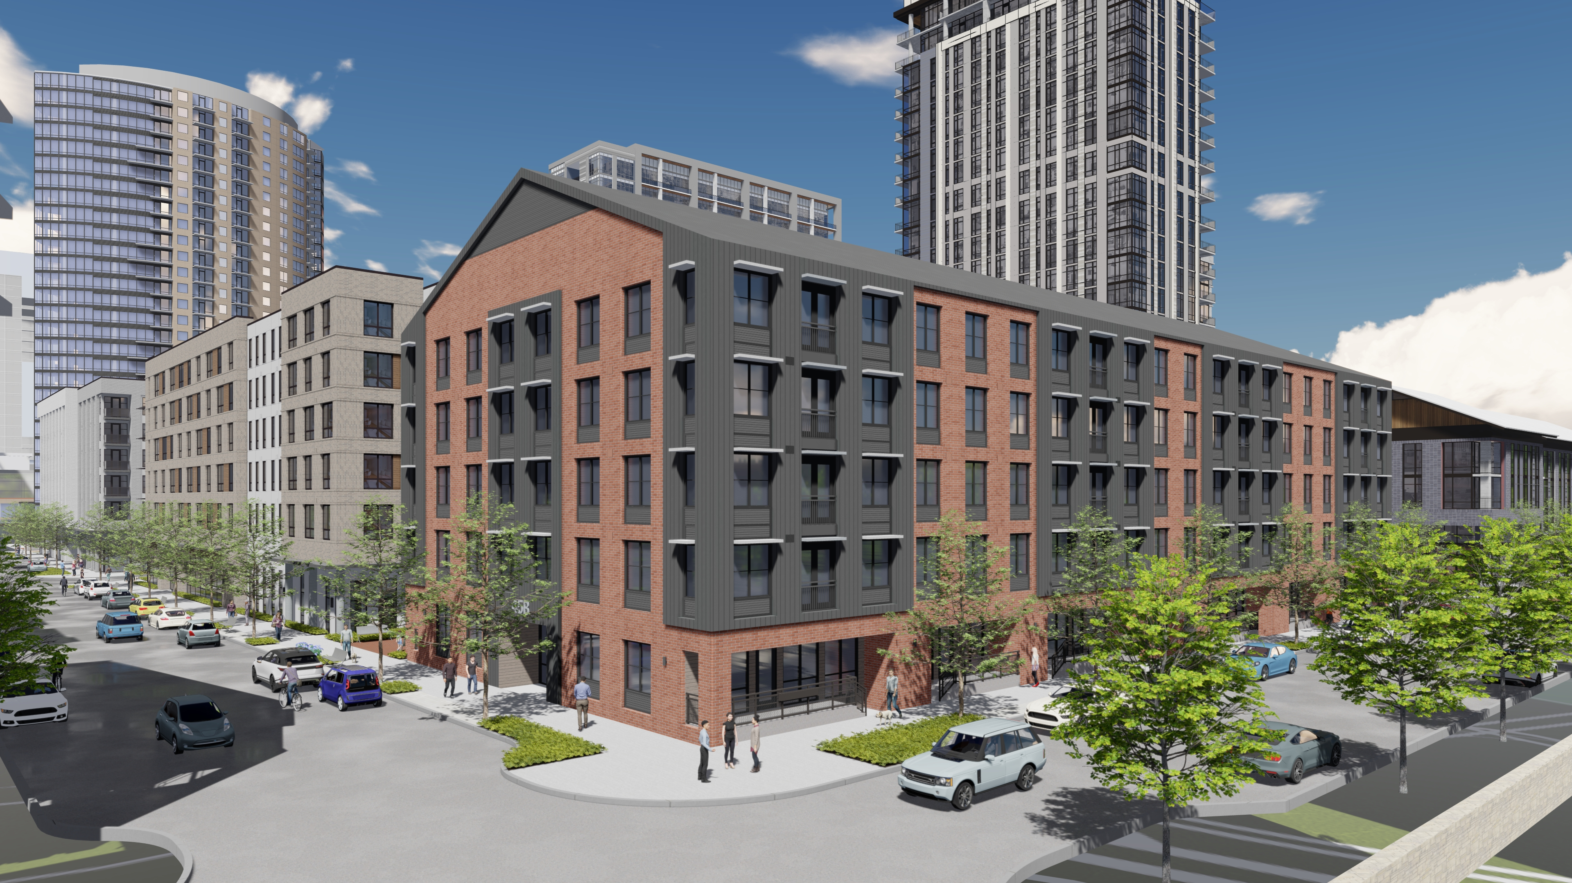
DR1
REVISED
Notes:
REMOVE GABLE
TRADITIONAL WAREHOUSE BUILDING MASSING
PUNCHED WINDOWS FOR ARTICULATION
INTEGRATED LOUVERS TO WINDOWS
REVISED FIRST FLOOR HEIGHT – RANGES FROM 12 FT TO 14 FT
WINDOWS ON GROUND LEVEL REFLECT THE FLOOR HEIGHT
METAL CLAD BAY WINDOWS TO SOFTEN THE TRADITIONAL BRICK LOOK
RESIDENTIAL USES ARE BUFFERED FROM THE SIDEWALK WITH A COMBINATION OF LANDSCAPE AND HEIGHT SEPARATION

Slide 5
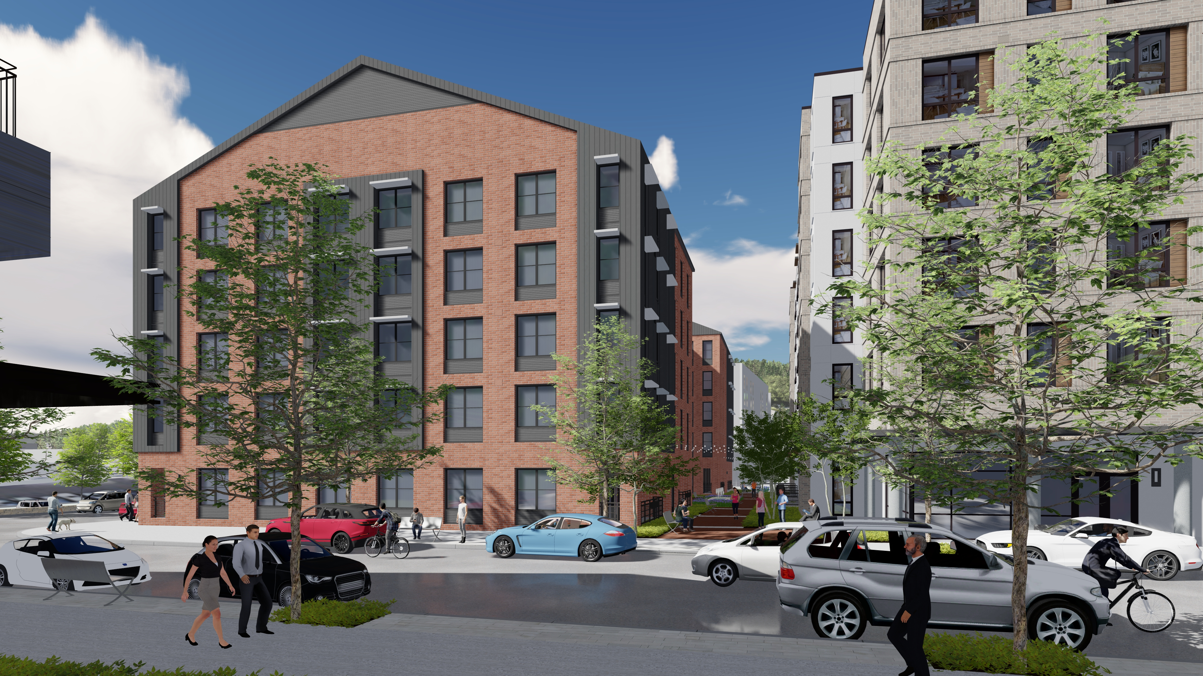
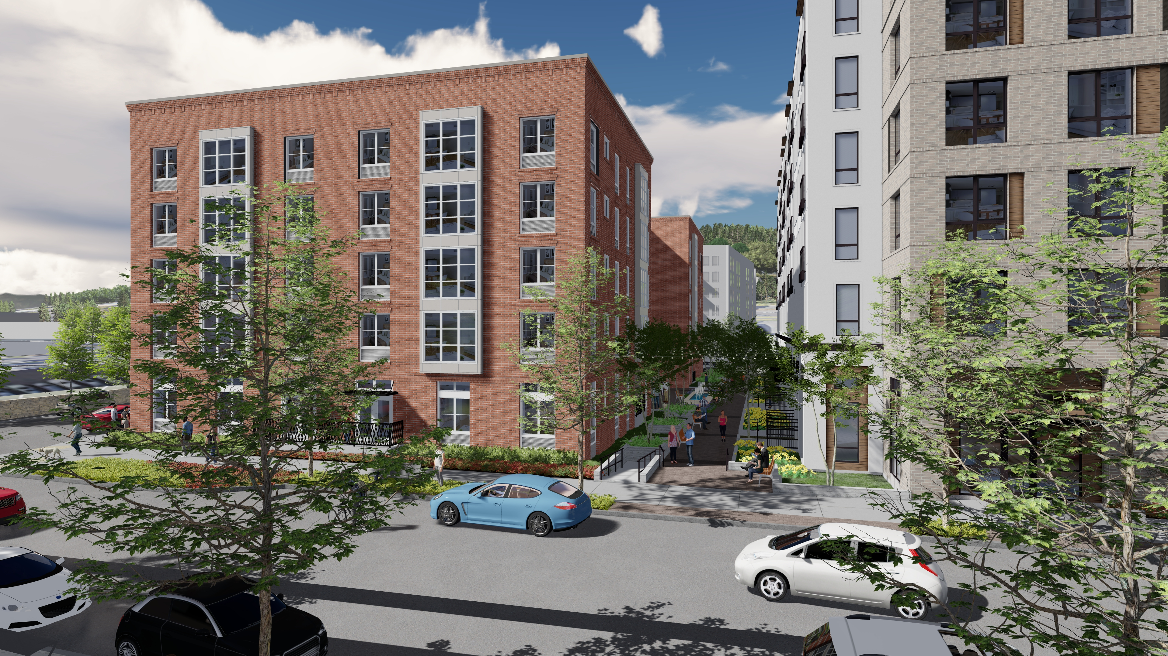
DR1
REVISED
Notes:
REMOVE GABLE
TRADITIONAL WAREHOUSE BUILDING MASSING
PUNCHED WINDOWS FOR ARTICULATION
INTEGRATED LOUVERS TO WINDOWS
REVISED FIRST FLOOR HEIGHT – RANGES FROM 12 FT TO 14 FT
WINDOWS ON GROUND LEVEL REFLECT THE FLOOR HEIGHT
METAL CLAD BAY WINDOWS TO SOFTEN THE TRADITIONAL BRICK LOOK
RESIDENTIAL USES ARE BUFFERED FROM THE SIDEWALK WITH A COMBINATION OF LANDSCAPE AND HEIGHT SEPARATION

Slide 6
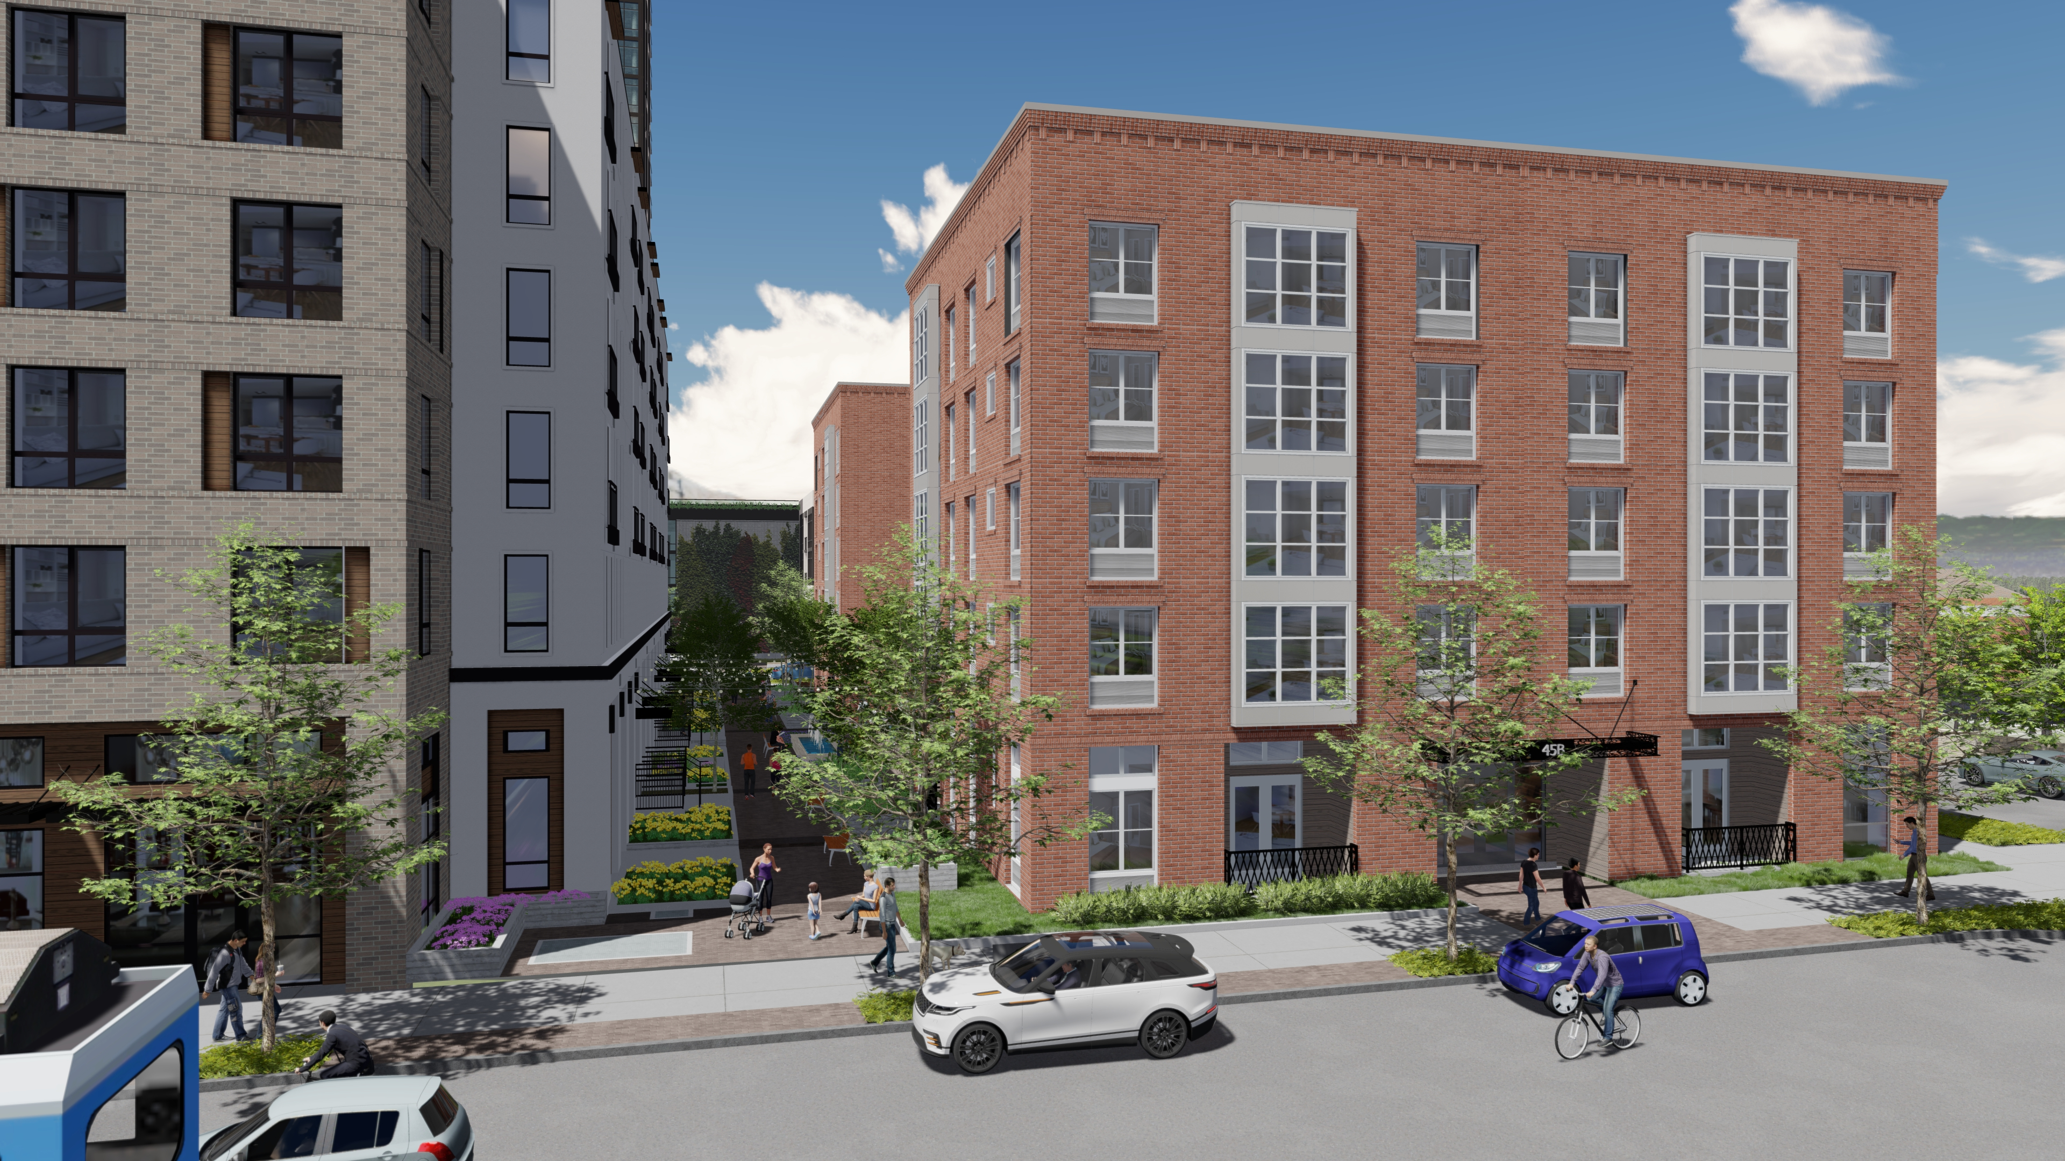
BOND AND PASEO
Notes:
REMOVE GABLE
TRADITIONAL WAREHOUSE BUILDING MASSING
PUNCHED WINDOWS FOR ARTICULATION
INTEGRATED LOUVERS TO WINDOWS
REVISED FIRST FLOOR HEIGHT – RANGES FROM 12 FT TO 14 FT
WINDOWS ON GROUND LEVEL REFLECT THE FLOOR HEIGHT
METAL CLAD BAY WINDOWS TO SOFTEN THE TRADITIONAL BRICK LOOK
RESIDENTIAL USES ARE BUFFERED FROM THE SIDEWALK WITH A COMBINATION OF LANDSCAPE AND HEIGHT SEPARATION

Slide 7
BOND AND LOWELL
Notes:
REMOVE GABLE
TRADITIONAL WAREHOUSE BUILDING MASSING
PUNCHED WINDOWS FOR ARTICULATION
INTEGRATED LOUVERS TO WINDOWS
REVISED FIRST FLOOR HEIGHT – RANGES FROM 12 FT TO 14 FT
WINDOWS ON GROUND LEVEL REFLECT THE FLOOR HEIGHT
METAL CLAD BAY WINDOWS TO SOFTEN THE TRADITIONAL BRICK LOOK
RESIDENTIAL USES ARE BUFFERED FROM THE SIDEWALK WITH A COMBINATION OF LANDSCAPE AND HEIGHT SEPARATION

Slide 8
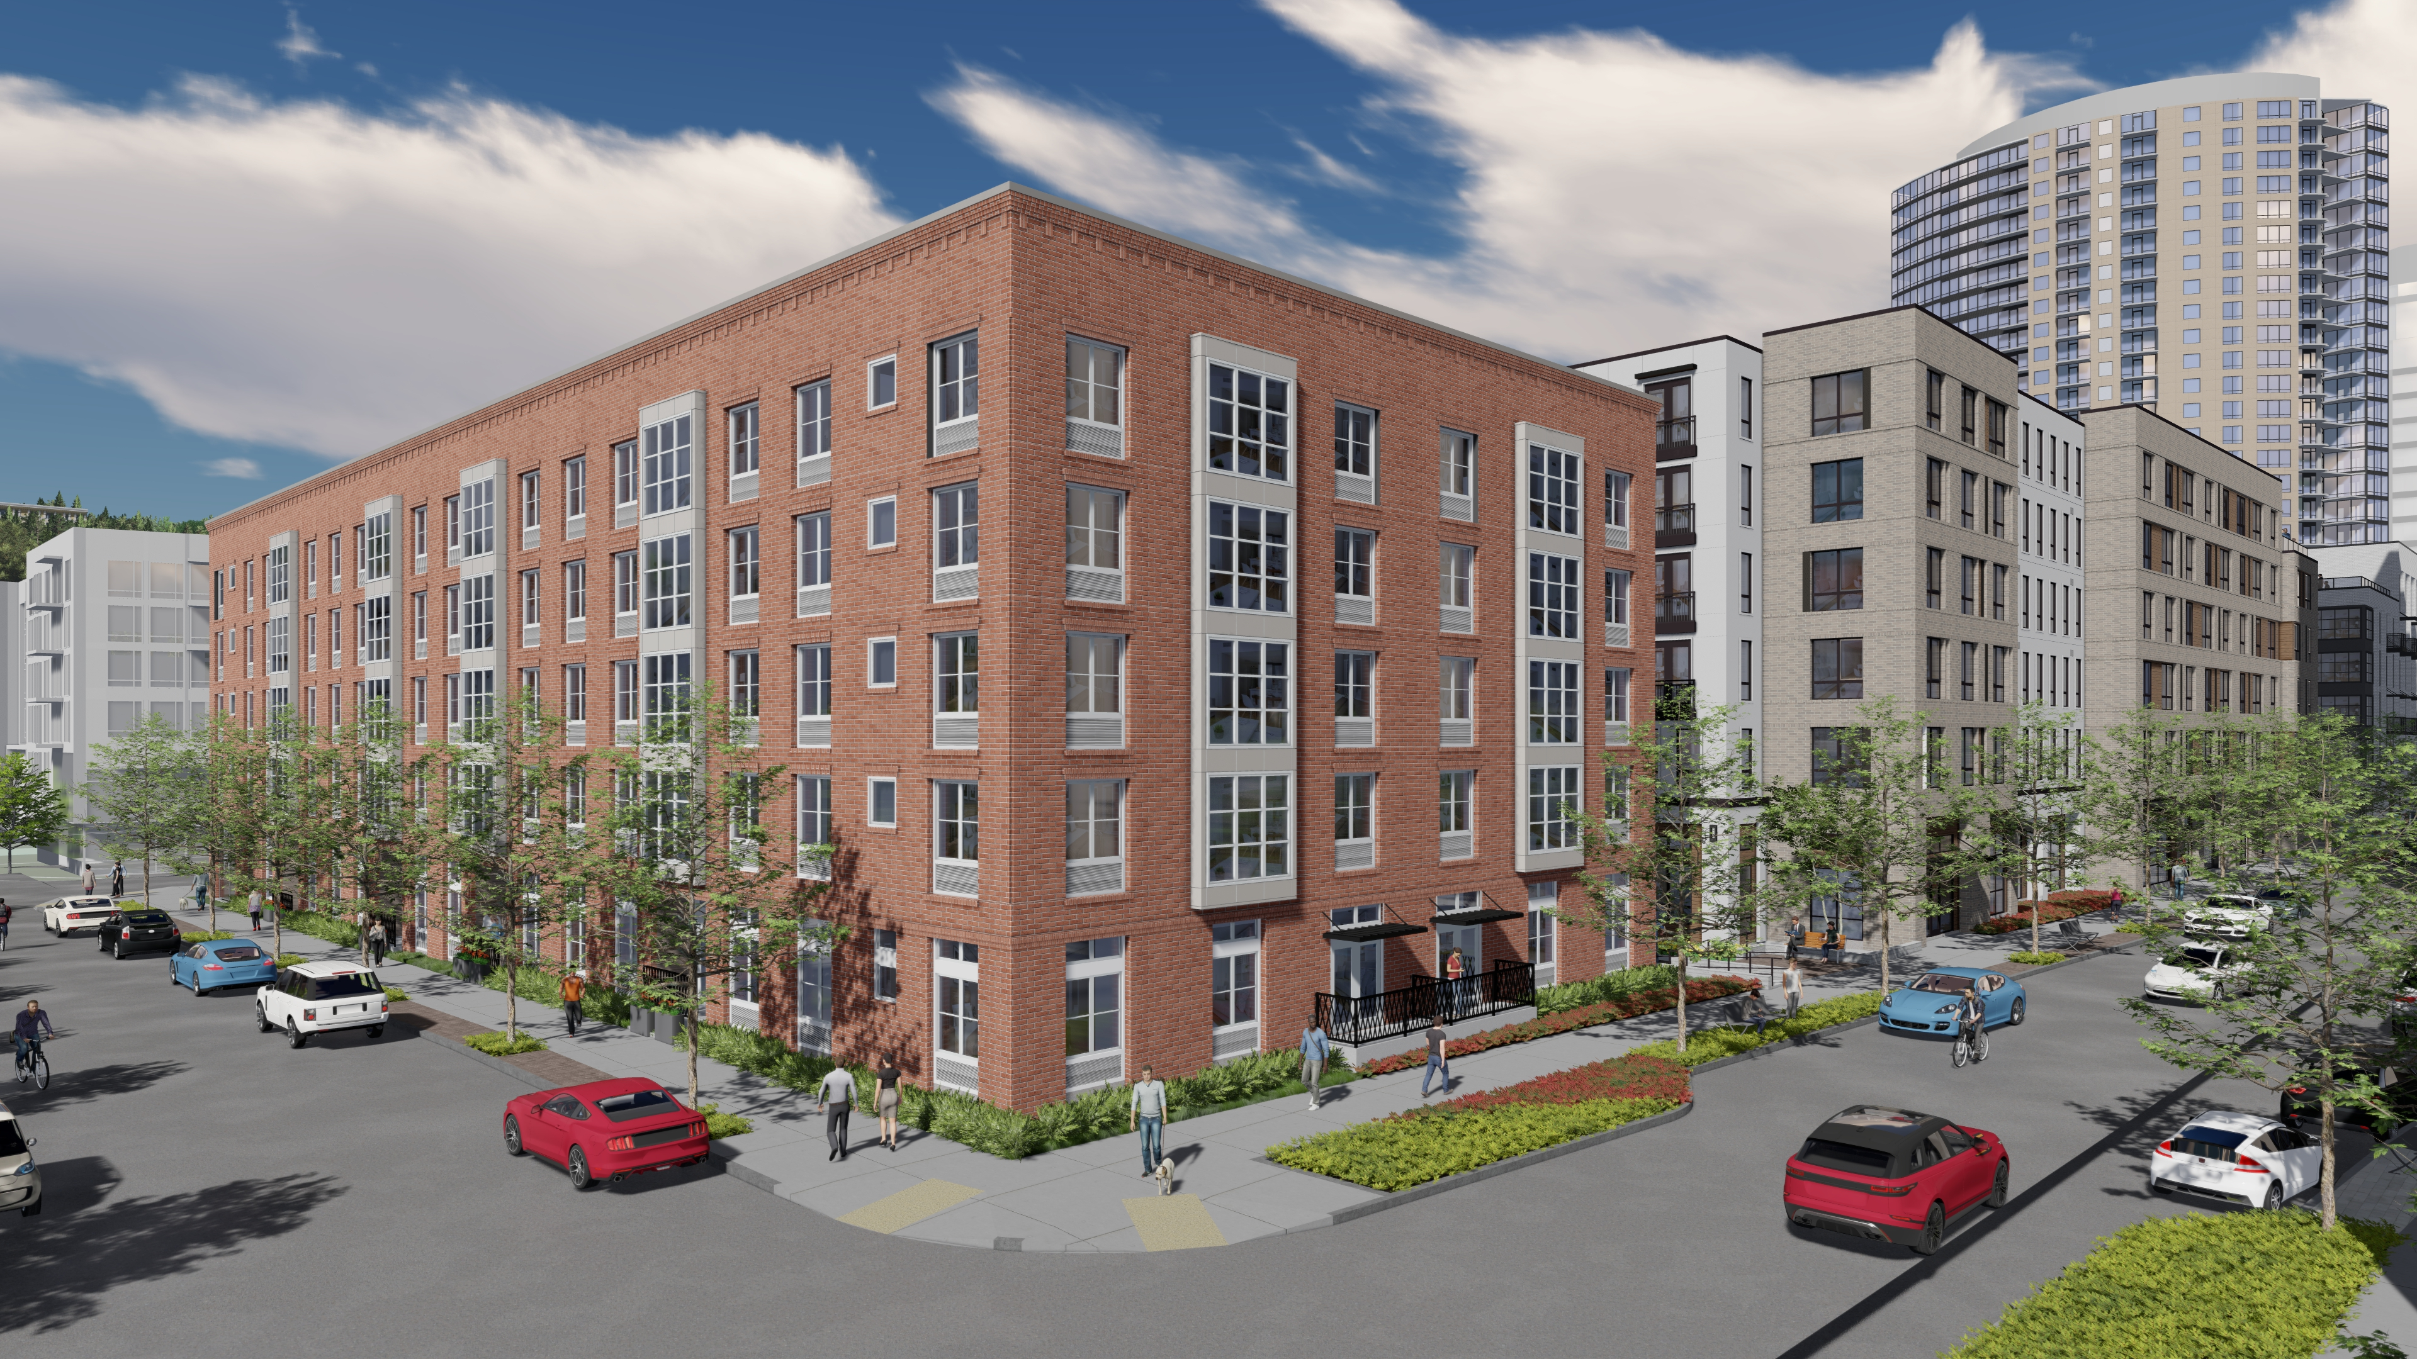
LOWELL AND RIVER PARKWAY
Notes:
REMOVE GABLE
TRADITIONAL WAREHOUSE BUILDING MASSING
PUNCHED WINDOWS FOR ARTICULATION
INTEGRATED LOUVERS TO WINDOWS
REVISED FIRST FLOOR HEIGHT – RANGES FROM 12 FT TO 14 FT
WINDOWS ON GROUND LEVEL REFLECT THE FLOOR HEIGHT
METAL CLAD BAY WINDOWS TO SOFTEN THE TRADITIONAL BRICK LOOK
RESIDENTIAL USES ARE BUFFERED FROM THE SIDEWALK WITH A COMBINATION OF LANDSCAPE AND HEIGHT SEPARATION

Slide 9
RIVER PARKWAY AND PASEO
Notes:
REMOVE GABLE
TRADITIONAL WAREHOUSE BUILDING MASSING
PUNCHED WINDOWS FOR ARTICULATION
INTEGRATED LOUVERS TO WINDOWS
REVISED FIRST FLOOR HEIGHT – RANGES FROM 12 FT TO 14 FT
WINDOWS ON GROUND LEVEL REFLECT THE FLOOR HEIGHT
METAL CLAD BAY WINDOWS TO SOFTEN THE TRADITIONAL BRICK LOOK
RESIDENTIAL USES ARE BUFFERED FROM THE SIDEWALK WITH A COMBINATION OF LANDSCAPE AND HEIGHT SEPARATION

Slide 10
PUBLIC REALM

Slide 11
DR1
REVISED
Notes:
AMENITY SPACE PROVIDED ON CORNER OF BOND AND LOWELL FOR STREET ACTIVATION
ENHANCED BUILDING ENTRY ON BOND
RECESS PATIOS ON GROUND FLOOR FOR MASSING ARTICULATION – TALK ABOUT RESTRICTED ACCESS FOR SECURITY
LANDSCAPE BUFFER ALONG ALL RESIDENTIAL USES - 2FT ALONG ALL WINDOWS / 1FT ALONG PATIOS

Slide 12
WEATHER PROTECTION
Notes:
DEVELOPED A SYSTEM OF CANOPIES THAT RELATE TO THE USES THEY SERVED
TALK ABOUT CANOPIES ALONG LOWELL

Slide 13
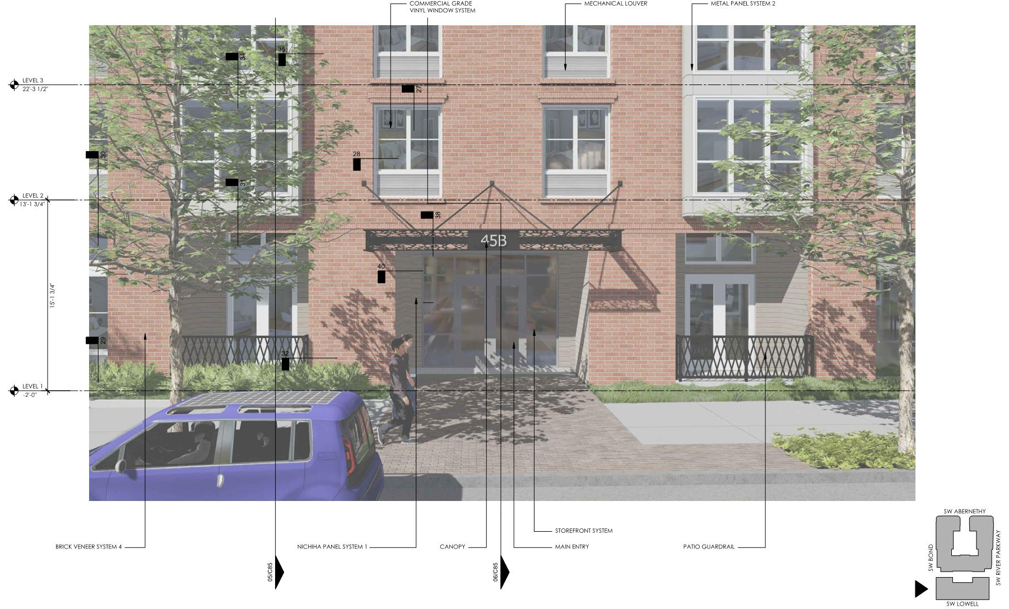
MAIN ENTRY
Notes:
ENHANCED ENTRY ALONG BOND
PEDESTRIAN SCALE CANOPY
LANDSCAPE BUFFER ALONG RESIDENTAIL USES

Slide 14
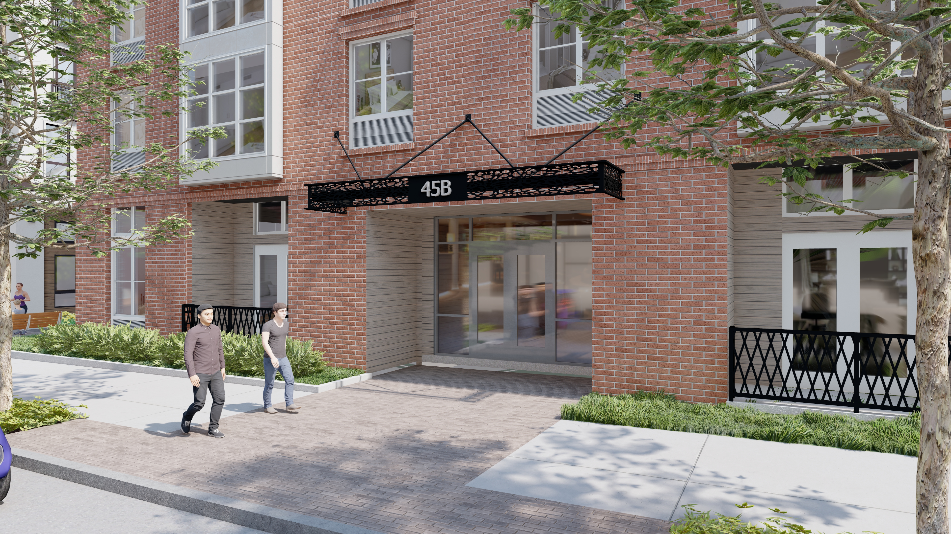

Slide 15
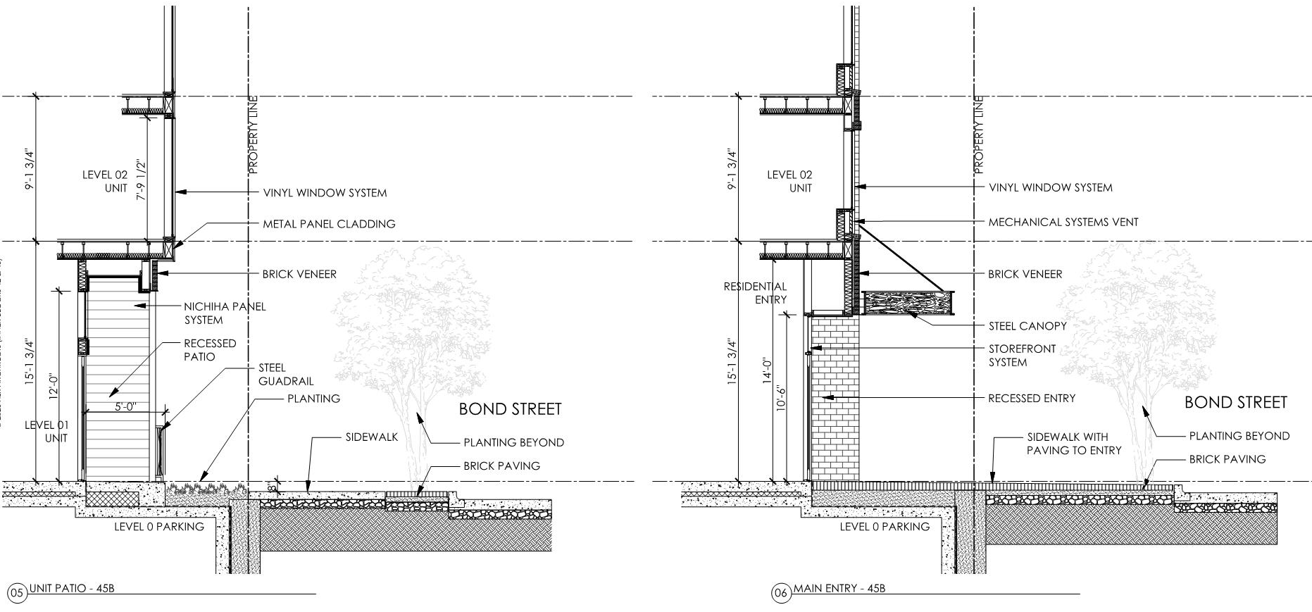
MAIN ENTRY

Slide 16
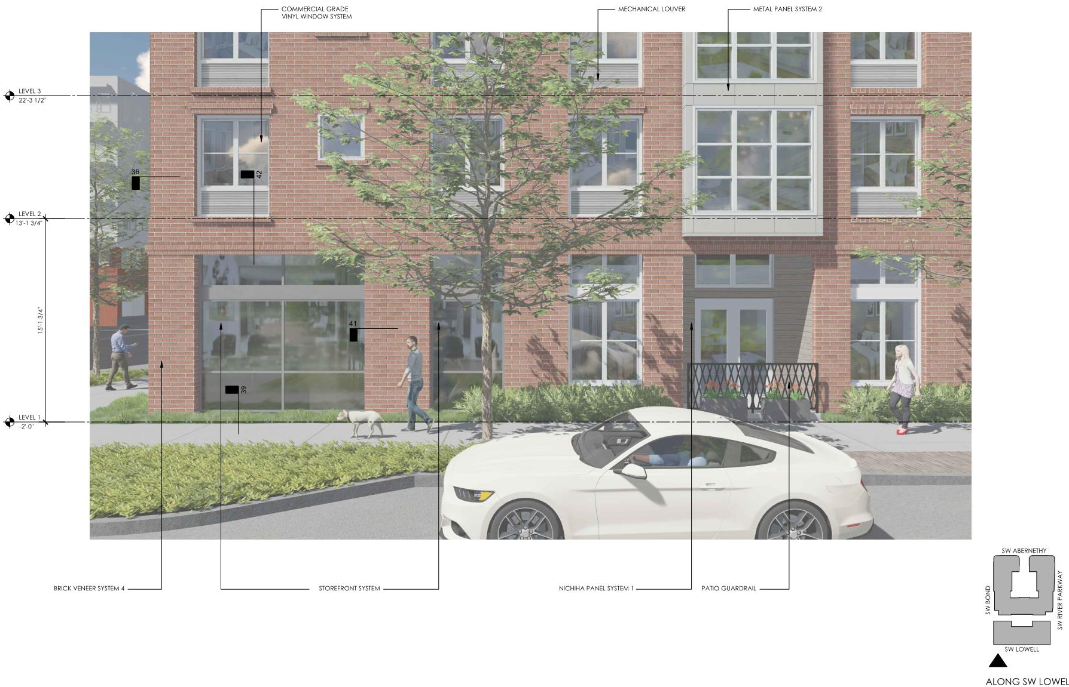
AMENITY / RESIDENTIAL
Notes:
LANSCAPE BUFFER ALONG RESIDENTAIL USES
TALLER WINDOWS AT GROUND FLOOR
AMENITY SPACE AT CORNER OF BOND AND LOWELL

Slide 17
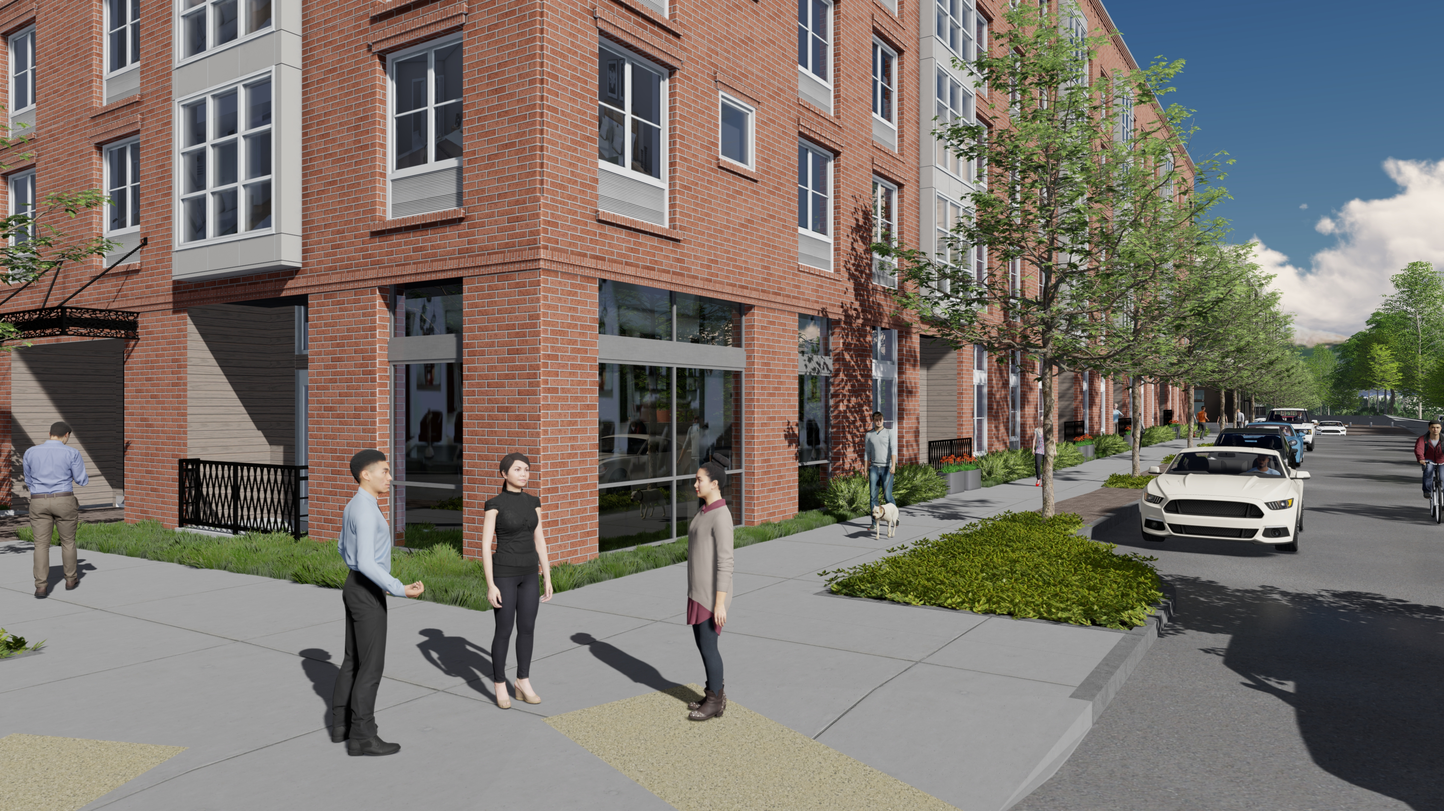

Slide 18
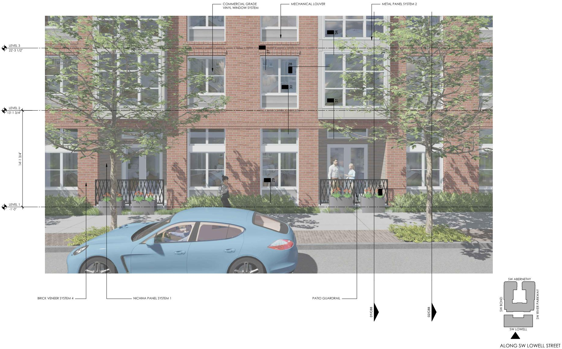
RESIDENTIAL
Notes:
LANSCAPE BUFFER ALONG RESIDENTAIL USES
RAISED FINISH FLOOR ALONG SIDEWALK FOR SECURITY AND PRIVACY
TALLER WINDOWS AT GROUND FLOOR
RAISED PLANTERS ALONG PATIOS FOR PRIVACY SEPARATION FROM SIDEWALK

Slide 19
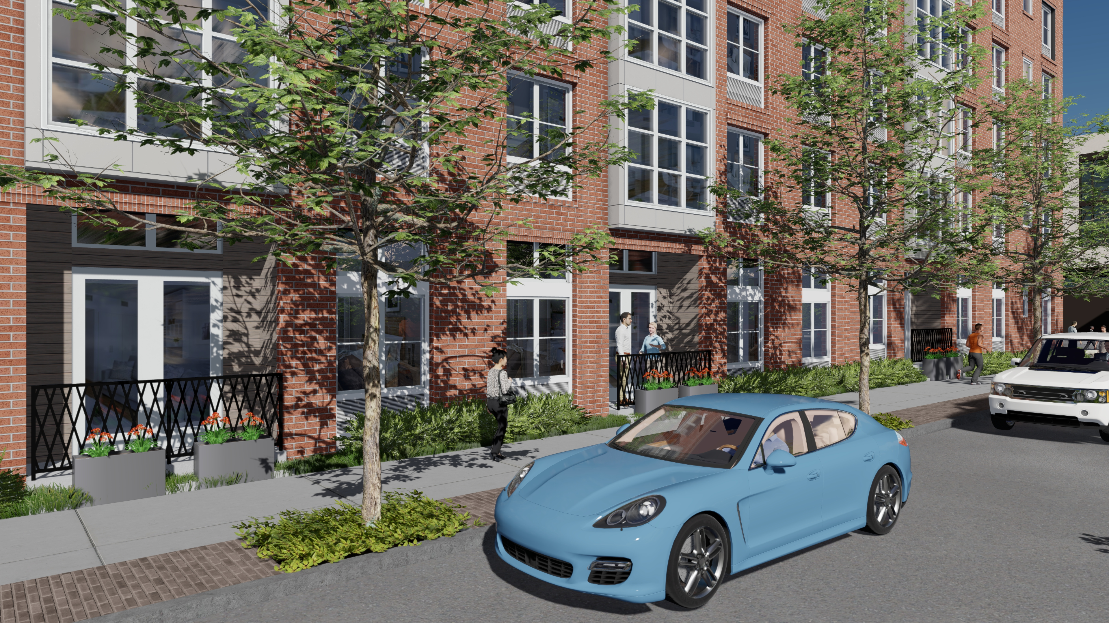

Slide 20
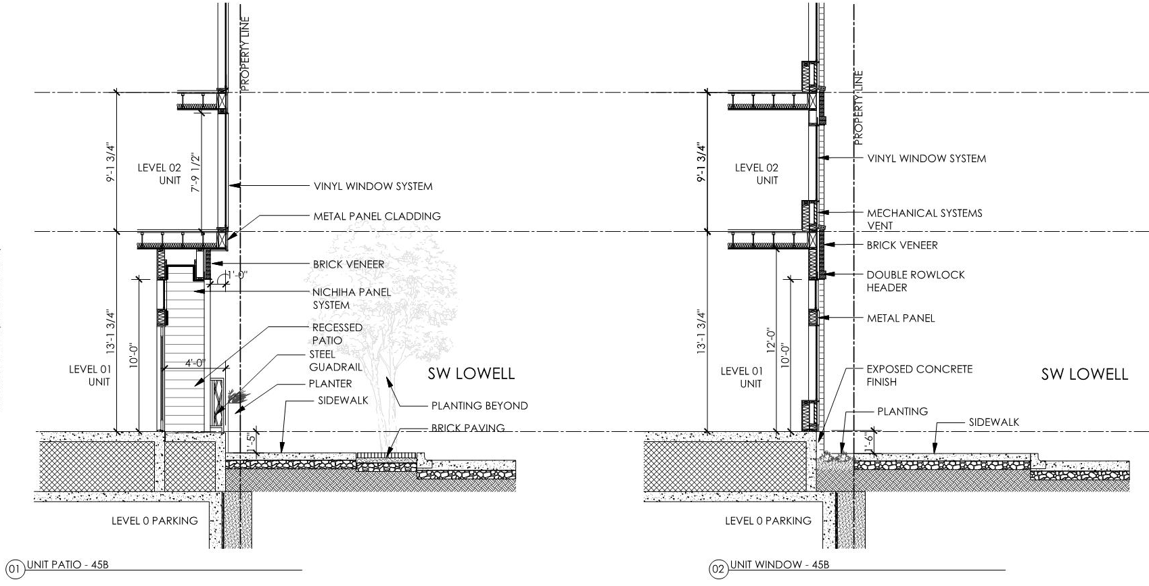
RESIDENTAIL

Slide 21
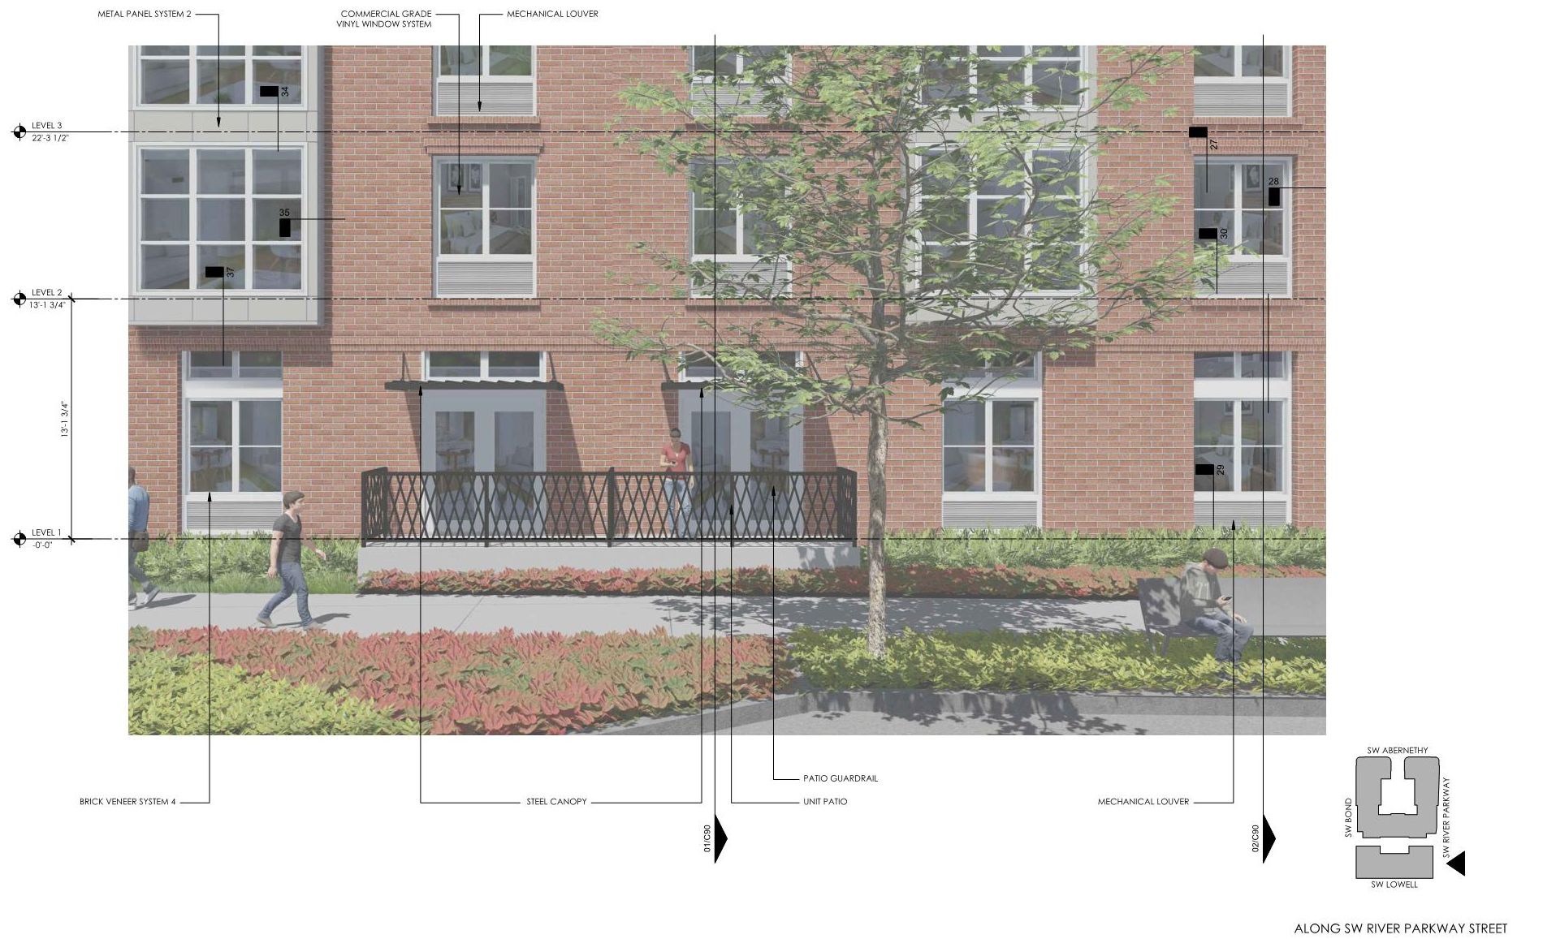
RESIDENTIAL
Notes:
LANSCAPE BUFFER ALONG RESIDENTAIL USES
RAISED FINISH FLOOR ALONG SIDEWALK FOR SECURITY AND PRIVACY
TALLER WINDOWS AT GROUND FLOOR

Slide 22
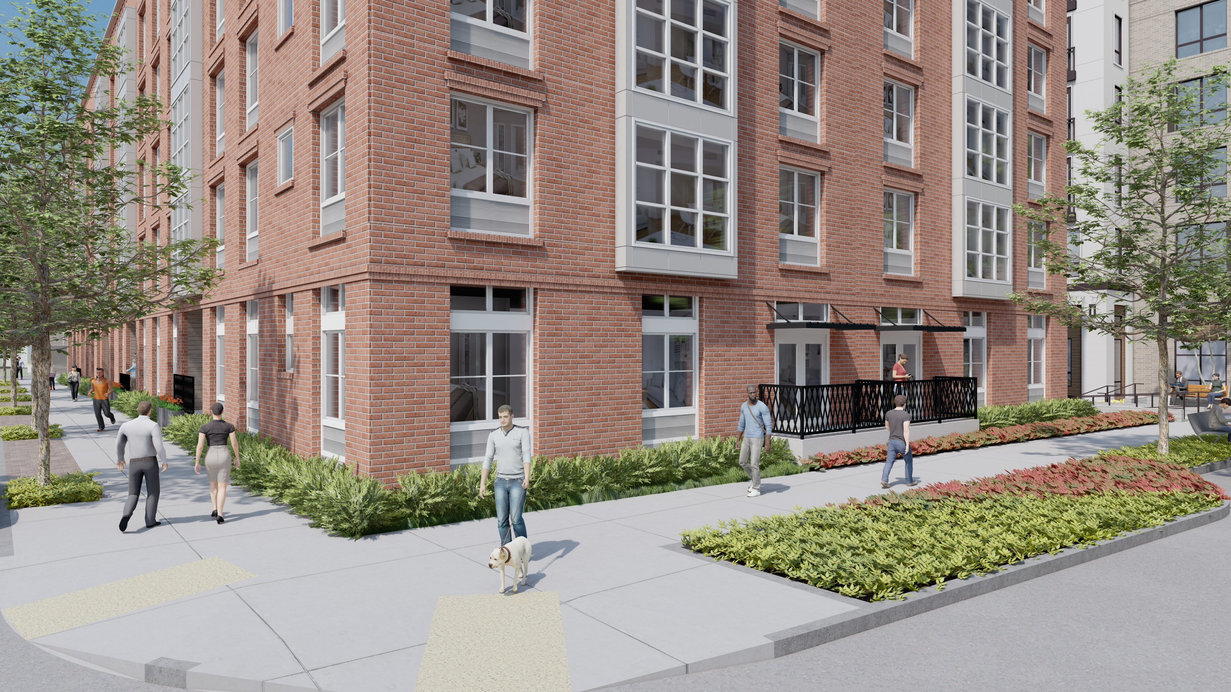

Slide 23
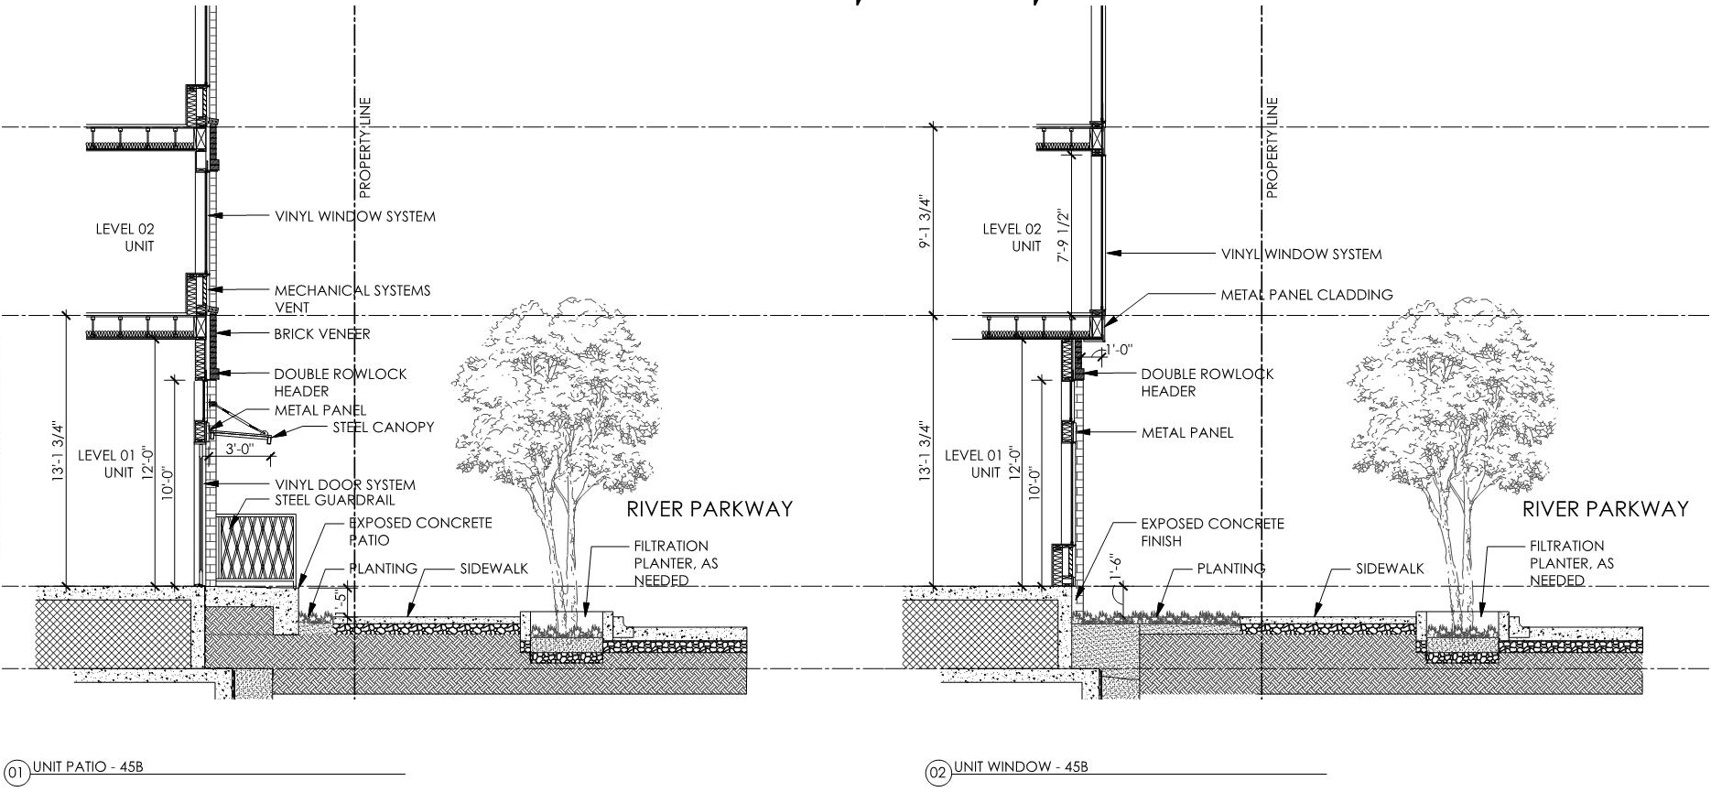
RESIDENTIAL
Notes:
LOCATED ON RECESS MASSING – CONNECTING ELEMENT
LOWER SCALE AWNING

Slide 24
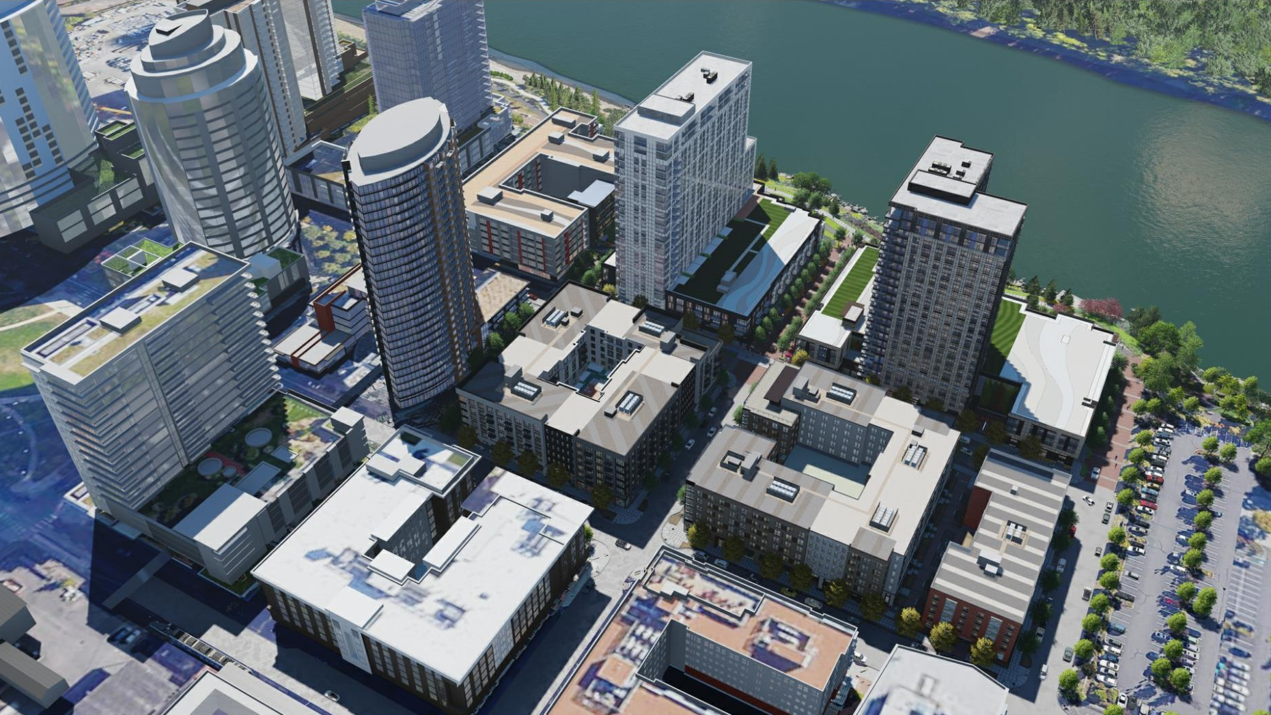

Slide 25
MATERIAL SAMPLES

Slide 26
BLOCK 45 SOUTH

Slide 28
