Slide 1
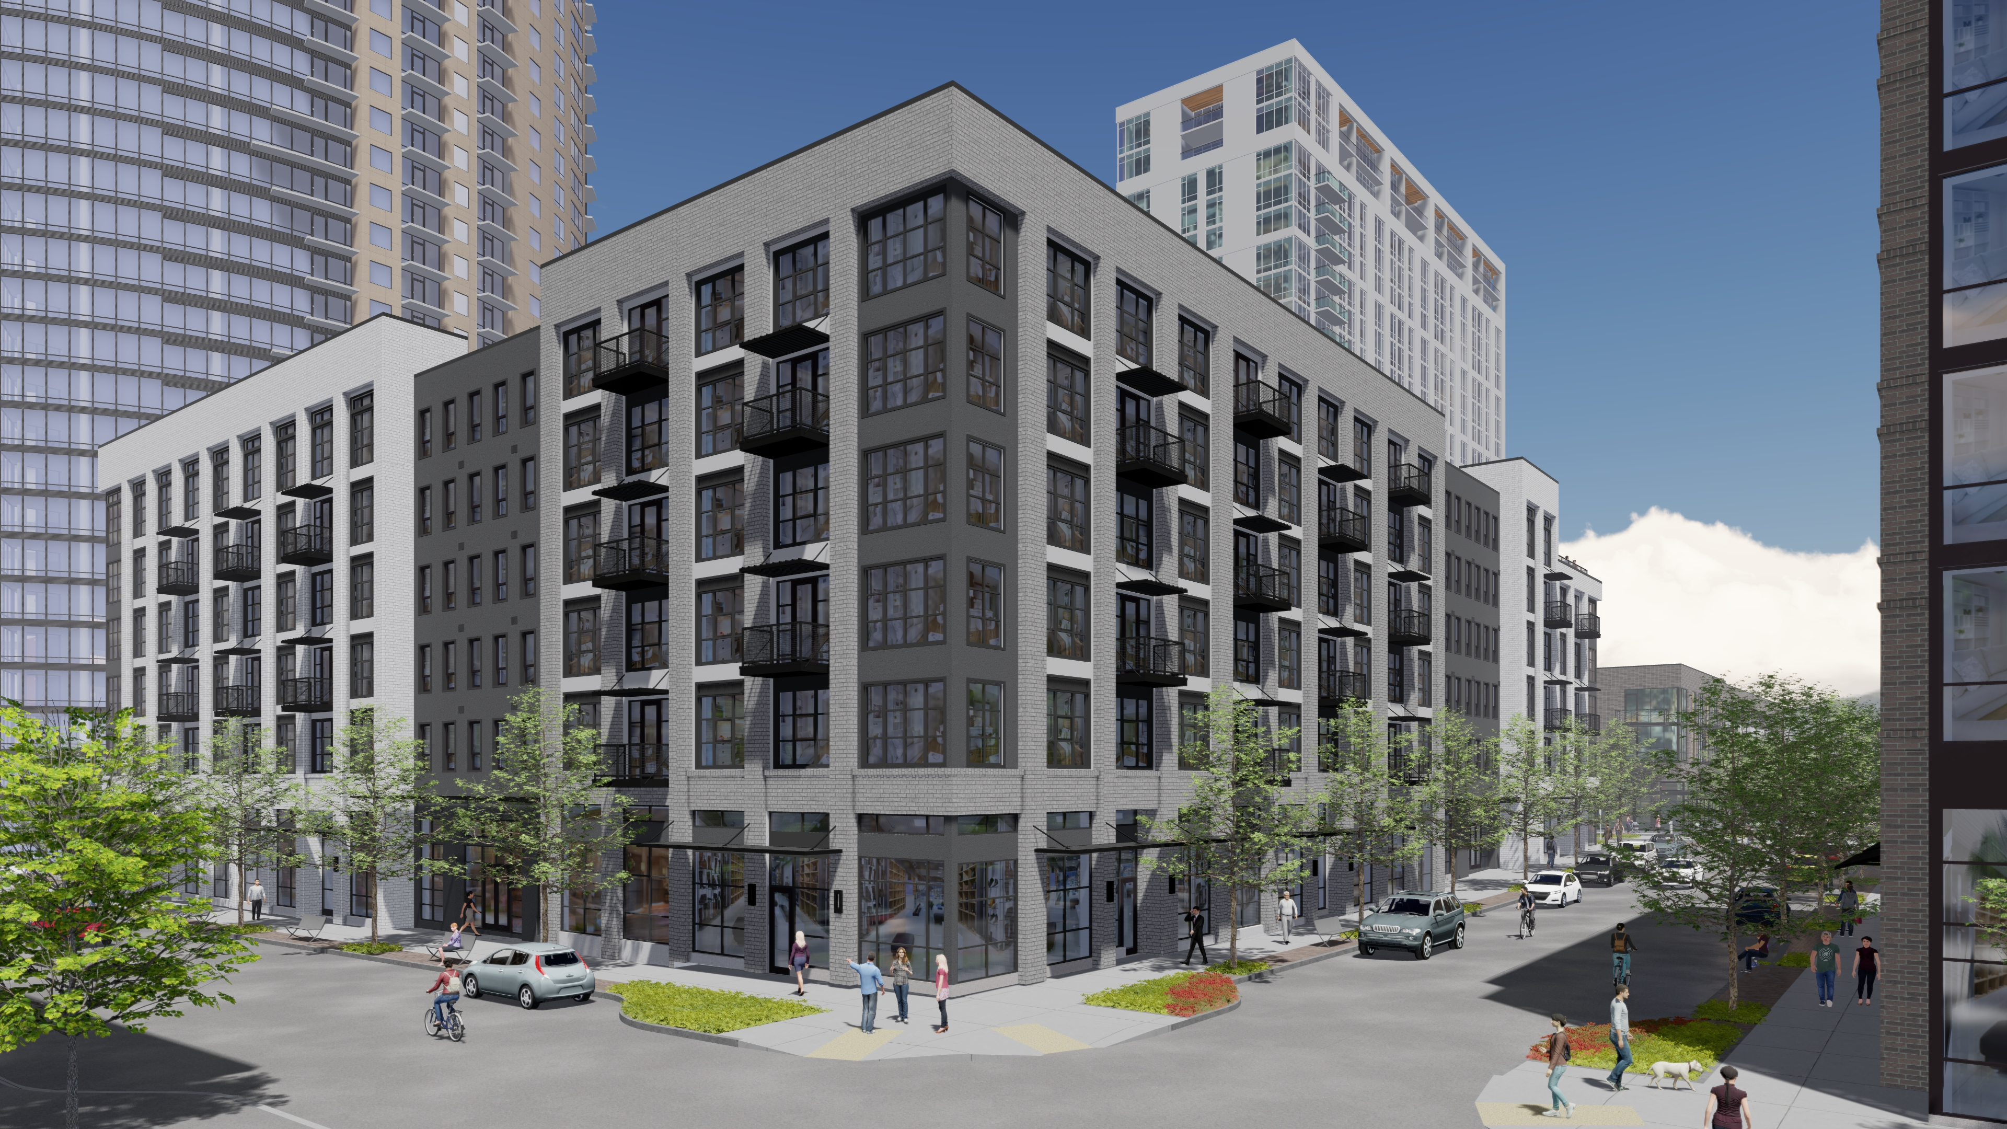
BLOCK 42

Slide 2
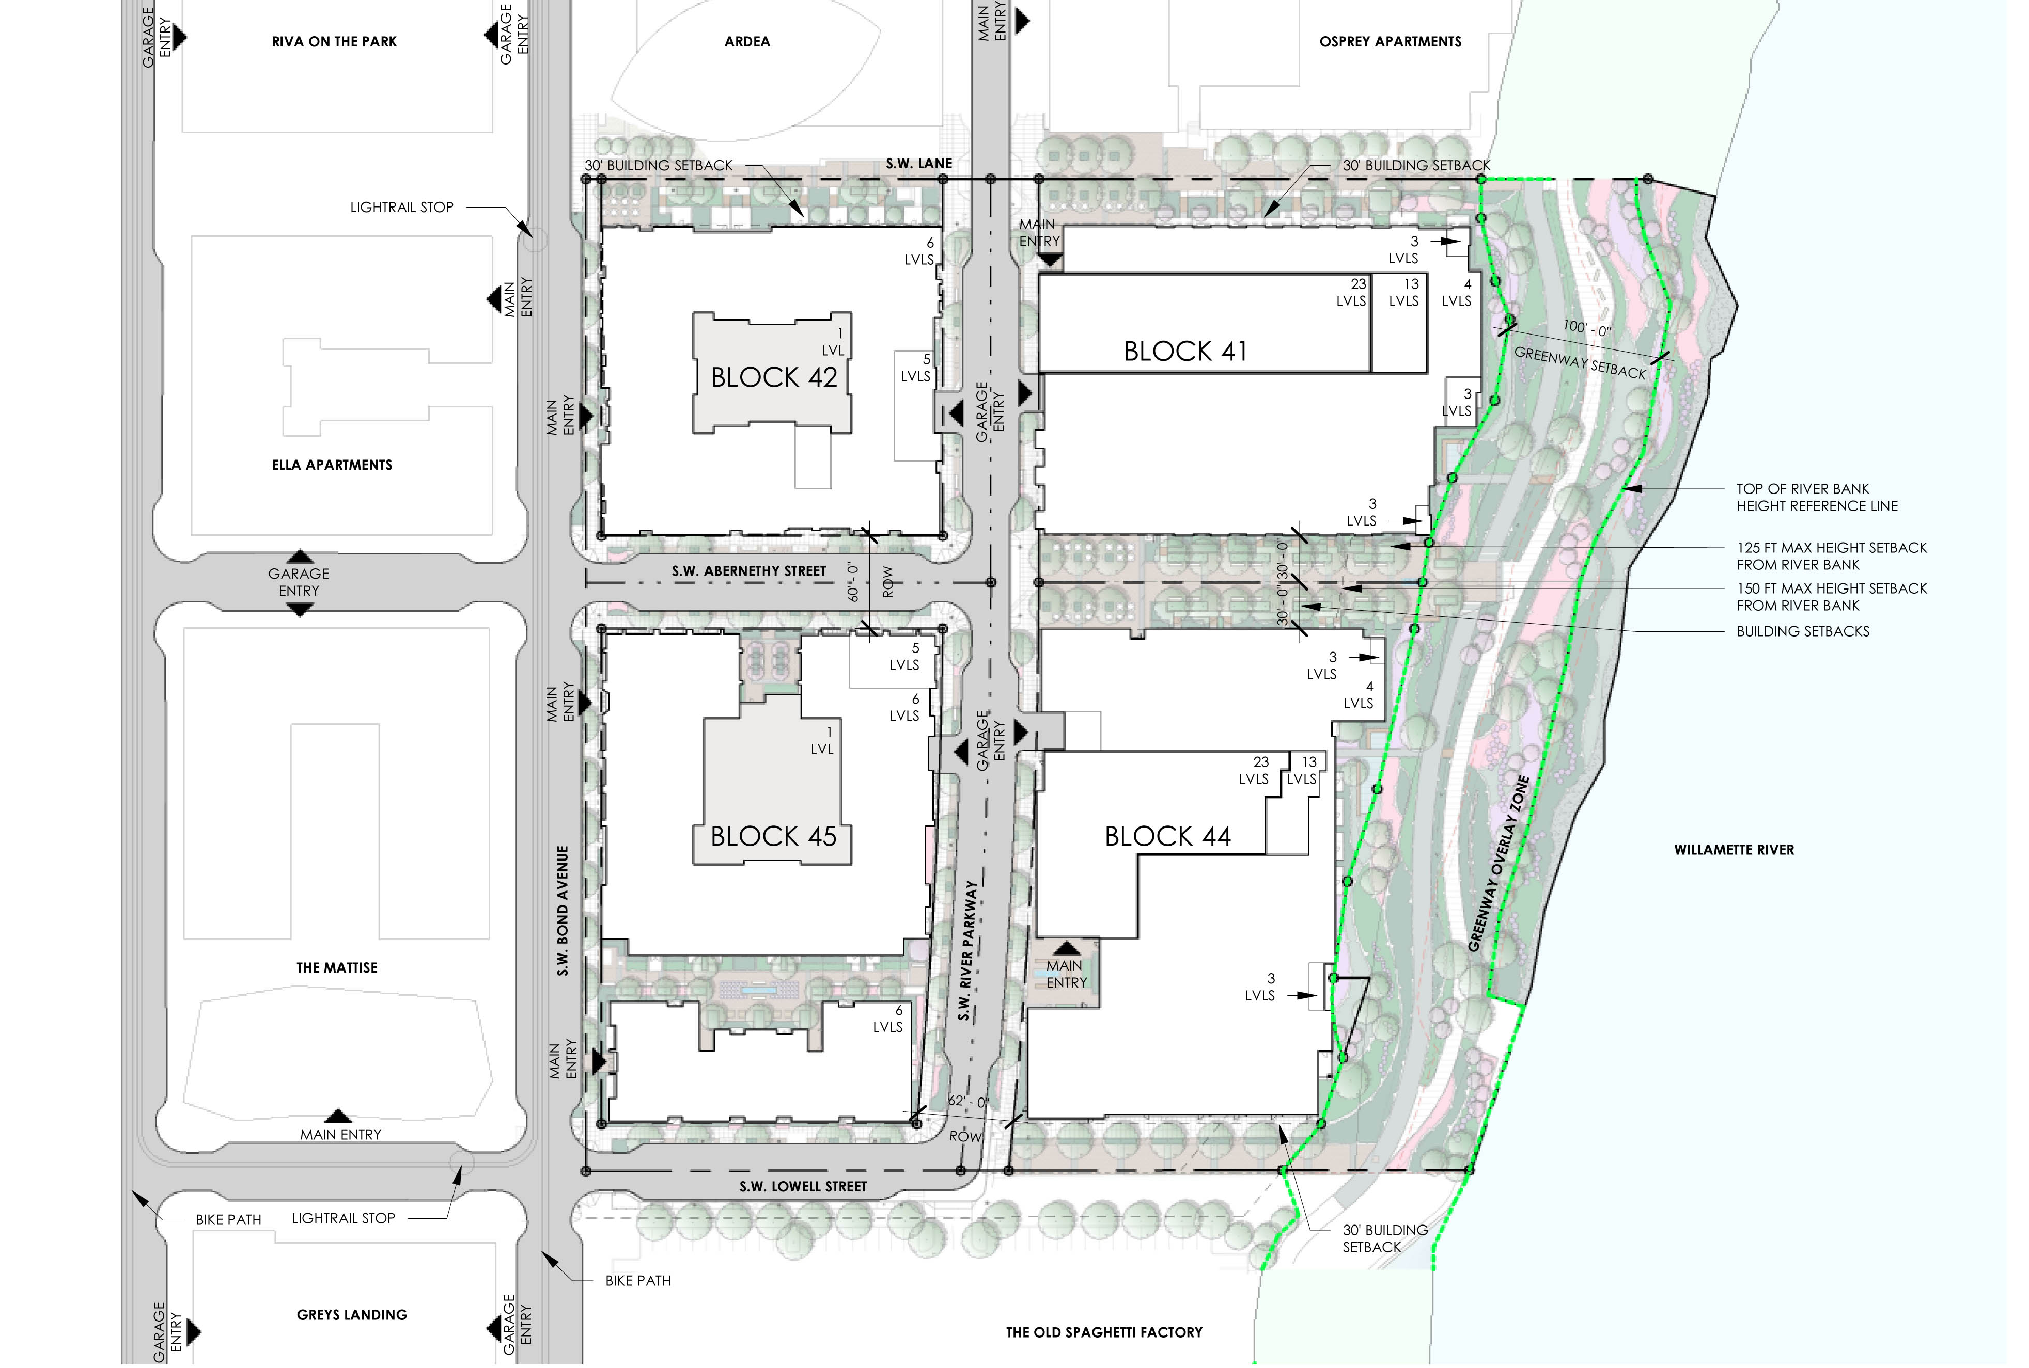

Slide 3
BUILDING SIMPLIFICATION

Slide 4
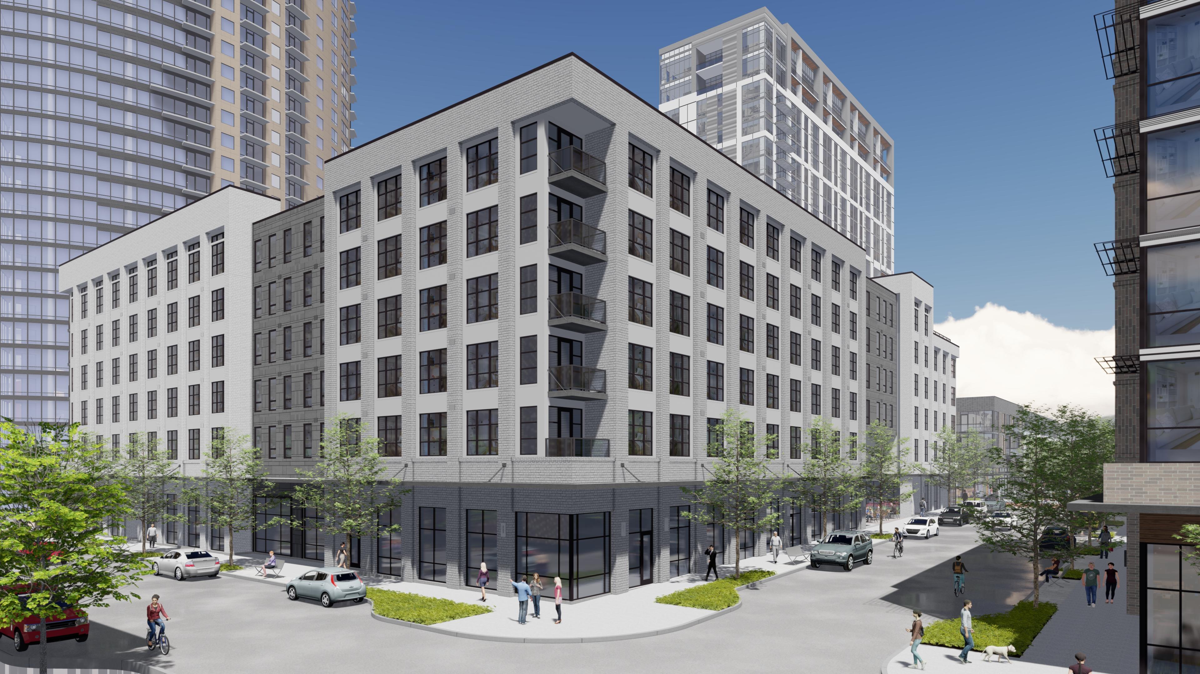
DR1
REVISED
Notes:
CONSISTENT 4FT RECESS PLANES BETWEEN BRICK MASSES
MORE RESTRAINED MATERIAL PALETTE
TOP FLOOR MASSING ARTICULATION
STRONGER BUILDING CORNERS
ADDED BALCONIES FOR MASSING ARTICULATION
PEDESTRIAN SCALED AWNINGS
INTERGRATED LOUVERS TO WINDOWS

Slide 5
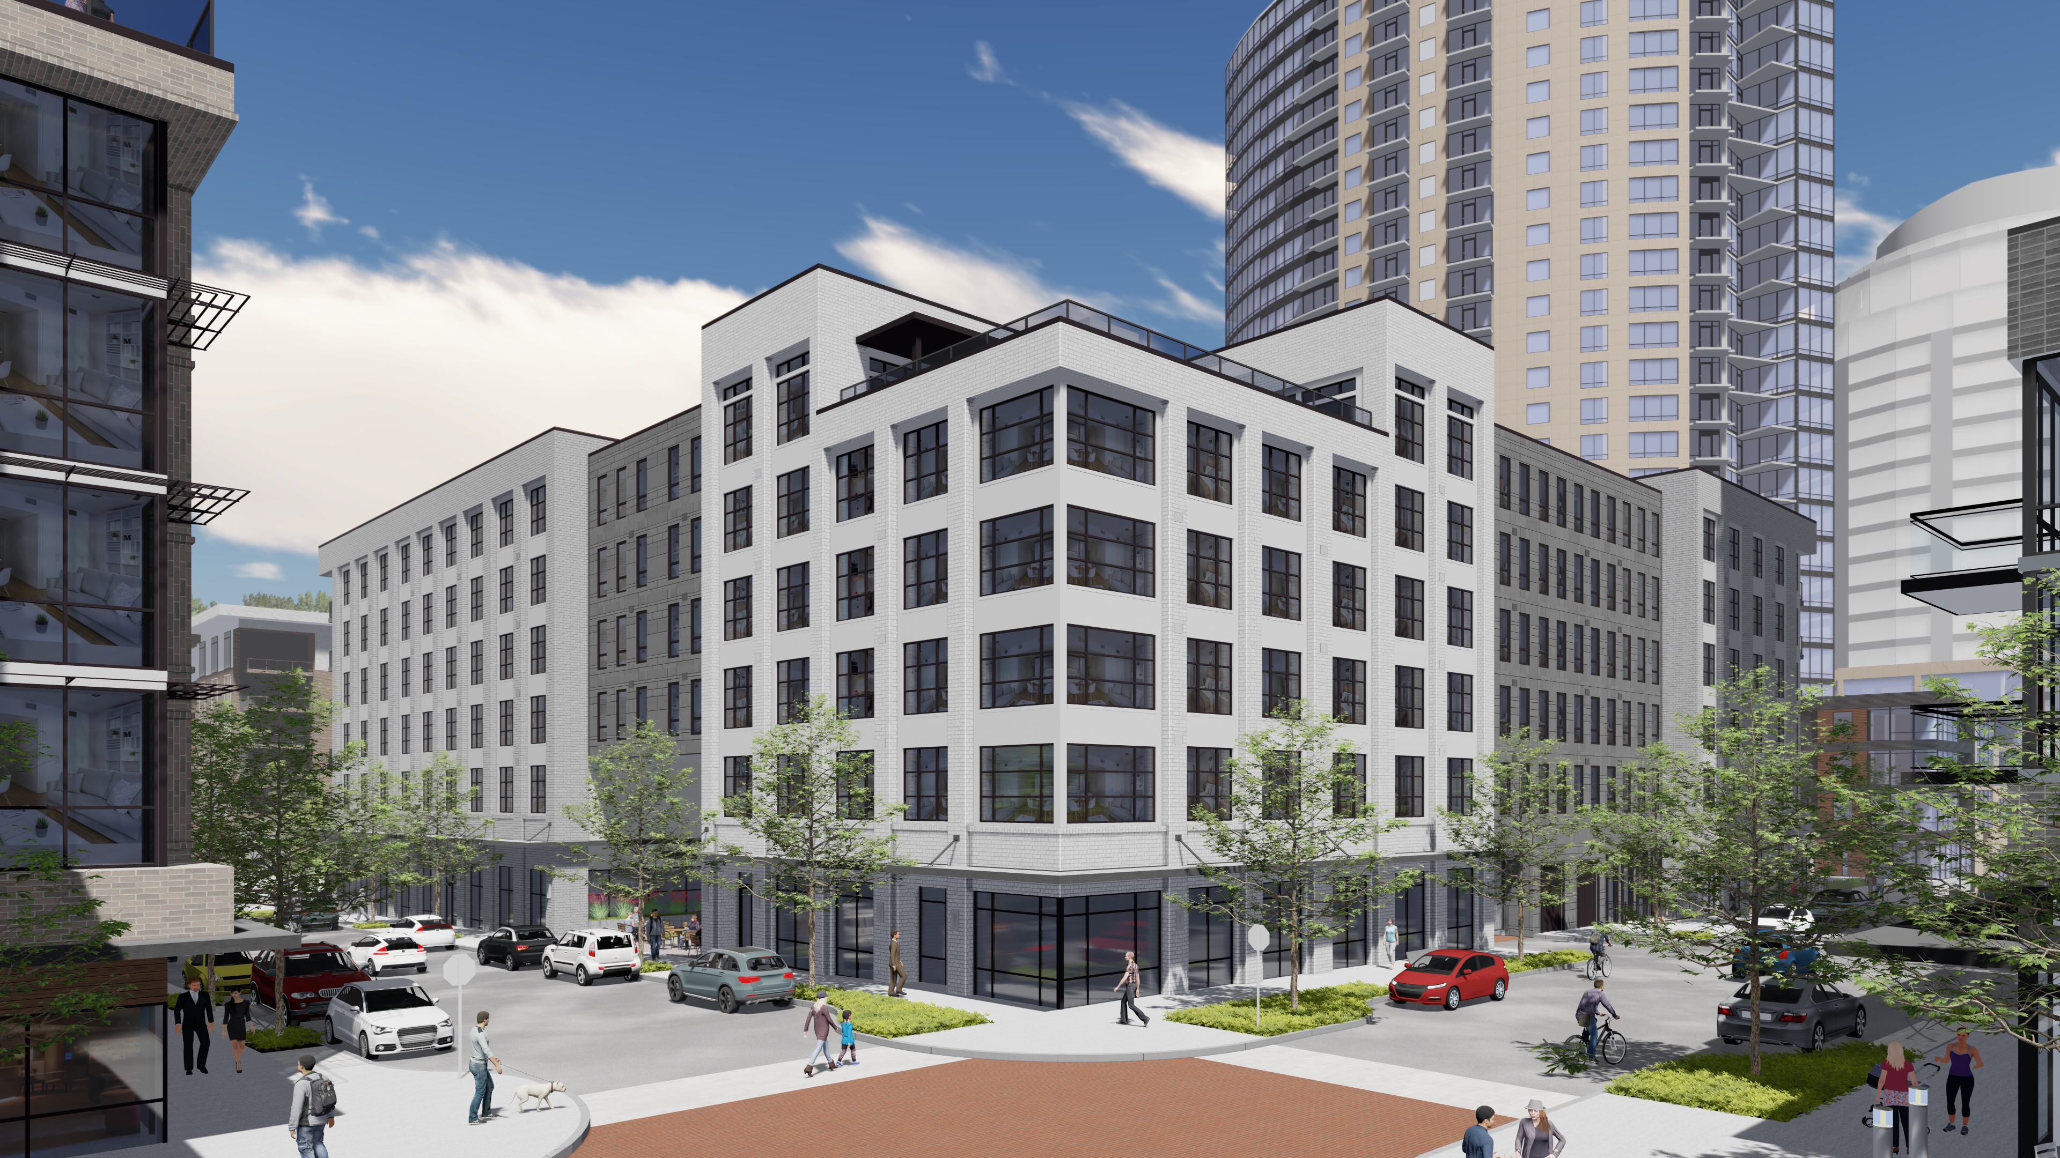
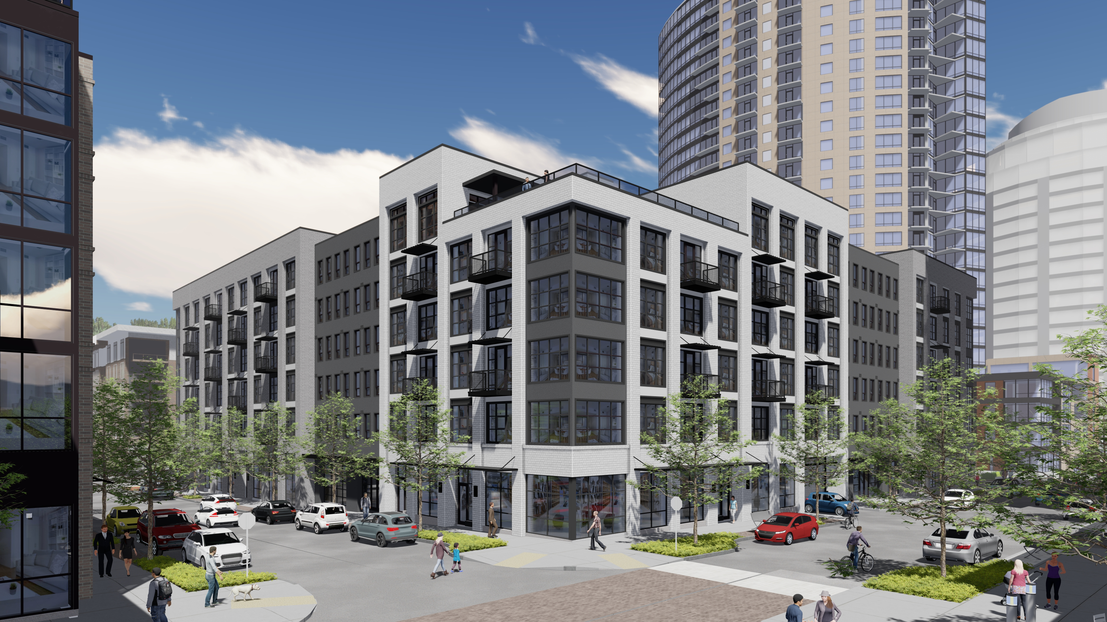
DR1
REVISED
Notes:
CONSISTENT 4FT RECESS PLANES BETWEEN BRICK MASSES
MORE RESTRAINED MATERIAL PALETTE
TOP FLOOR MASSING ARTICULATION
STRONGER BUILDING CORNERS
ADDED BALCONIES FOR MASSING ARTICULATION
PEDESTRIAN SCALED AWNINGS
INTERGRATED LOUVERS TO WINDOWS

Slide 6
BOND AND ABERNETHY
Notes:
CONSISTENT 4FT RECESS PLANES BETWEEN BRICK MASSES
MORE RESTRAINED MATERIAL PALETTE
TOP FLOOR MASSING ARTICULATION
STRONGER BUILDING CORNERS
ADDED BALCONIES FOR MASSING ARTICULATION
PEDESTRIAN SCALED AWNINGS
INTERGRATED LOUVERS TO WINDOWS

Slide 7
ABERNETHY AND RIVER PARKWAY
Notes:
CONSISTENT 4FT RECESS PLANES BETWEEN BRICK MASSES
MORE RESTRAINED MATERIAL PALETTE
TOP FLOOR MASSING ARTICULATION
STRONGER BUILDING CORNERS
ADDED BALCONIES FOR MASSING ARTICULATION
PEDESTRIAN SCALED AWNINGS
INTERGRATED LOUVERS TO WINDOWS

Slide 8
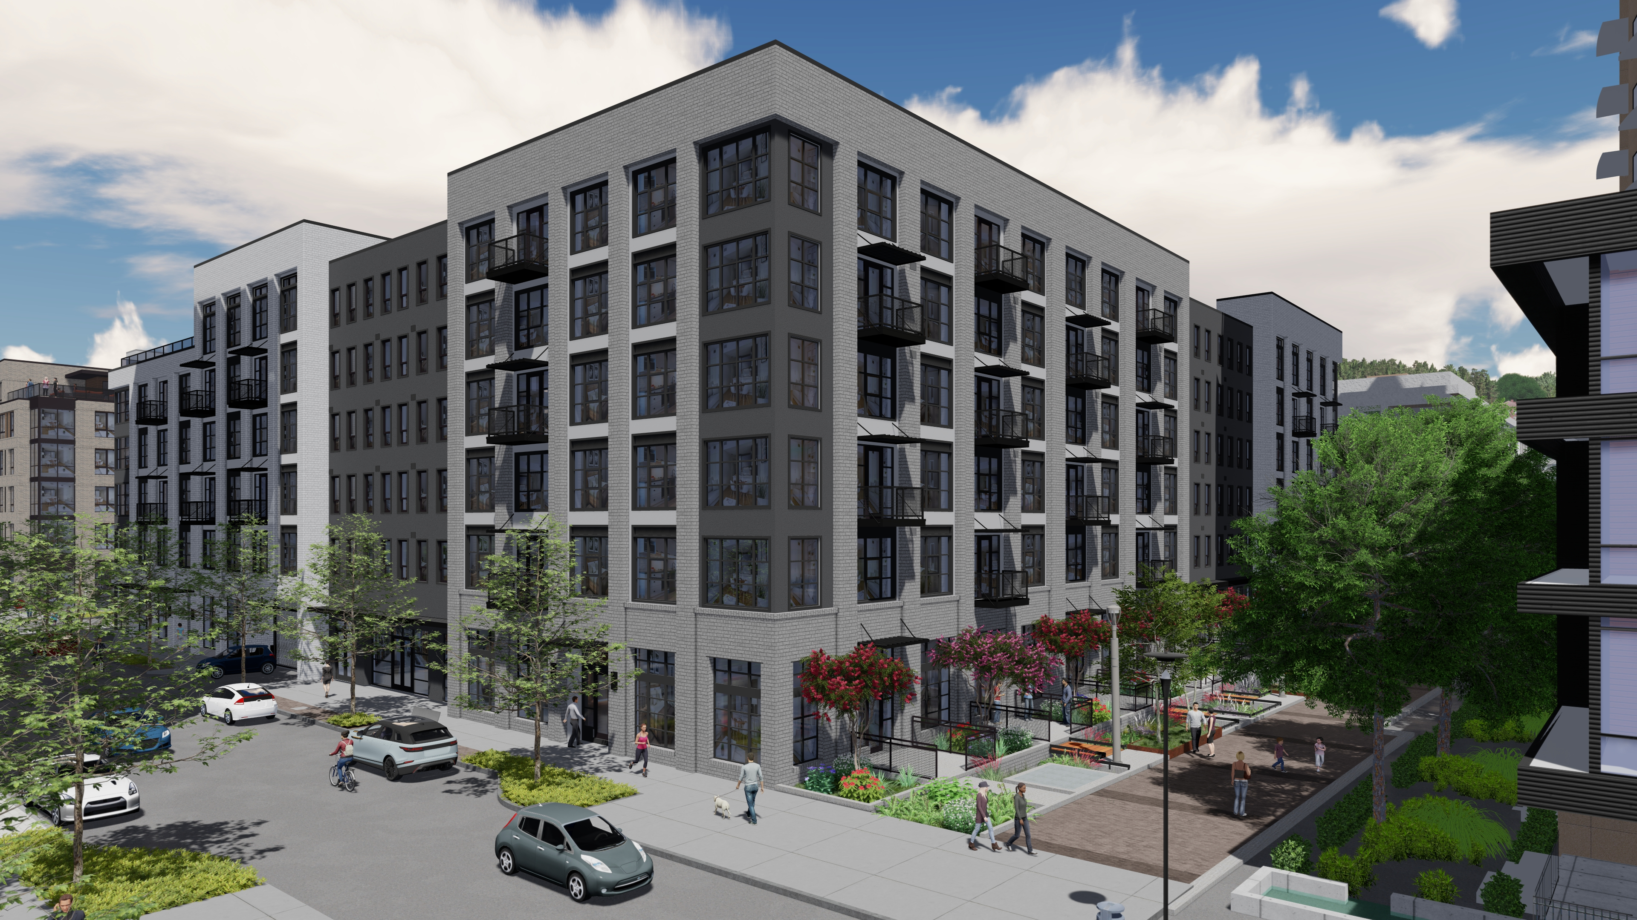
RIVER PARKWAY AND LANE
Notes:
CONSISTENT 4FT RECESS PLANES BETWEEN BRICK MASSES
MORE RESTRAINED MATERIAL PALETTE
TOP FLOOR MASSING ARTICULATION
STRONGER BUILDING CORNERS
ADDED BALCONIES FOR MASSING ARTICULATION
PEDESTRIAN SCALED AWNINGS
INTERGRATED LOUVERS TO WINDOWS

Slide 9
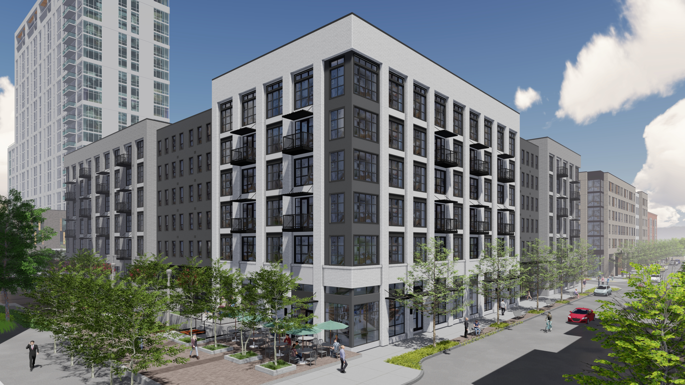
LANE AND BOND
Notes:
CONSISTENT 4FT RECESS PLANES BETWEEN BRICK MASSES
MORE RESTRAINED MATERIAL PALETTE
TOP FLOOR MASSING ARTICULATION
STRONGER BUILDING CORNERS
ADDED BALCONIES FOR MASSING ARTICULATION
PEDESTRIAN SCALED AWNINGS
INTERGRATED LOUVERS TO WINDOWS

Slide 10
PUBLIC REALM

Slide 11
DR1
REVISED
Notes:
REMOVE PLAZA UNDER BUILDING ON ABERNETHY
REMOVE SINGLE UNIT ON RIVER PARKWAY
REWORK BUILDING SERVICES ALONG RIVER PARKWAY

Slide 12
WEATHER PROTECTION
Notes:
DEVELOPED A SYSTEM OF CANOPIES THAT COMPLEMENT THE ARTICULATION OF THE BUILDING AND THE FUNCTION OF THE SPACES THEY SERVE.

Slide 13
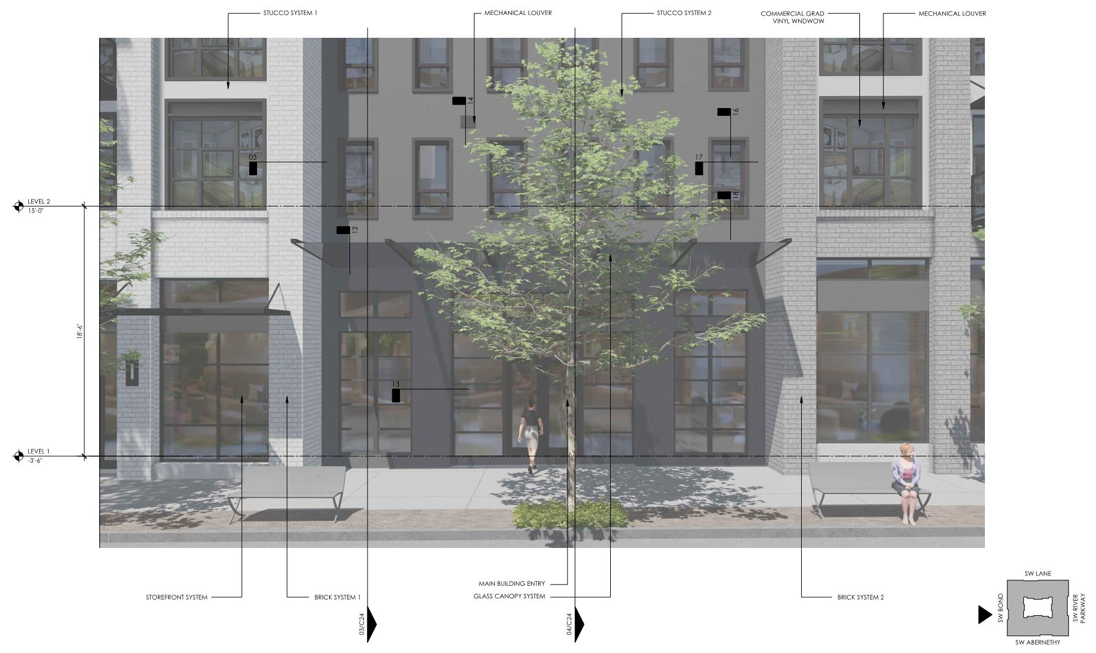
MAIN ENTRY
Notes:
LARGE GLASS CANOPY AT MAIN BUILDING ENTRANCE
TALK ABOUT RELOCATING THE TREES ALONG THE STREET
BENCHES OUTSIDE FOR SEATING OPPORTUNITIES

Slide 14
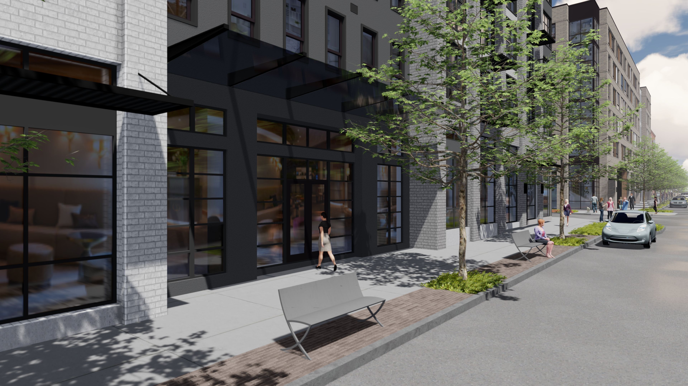

Slide 15
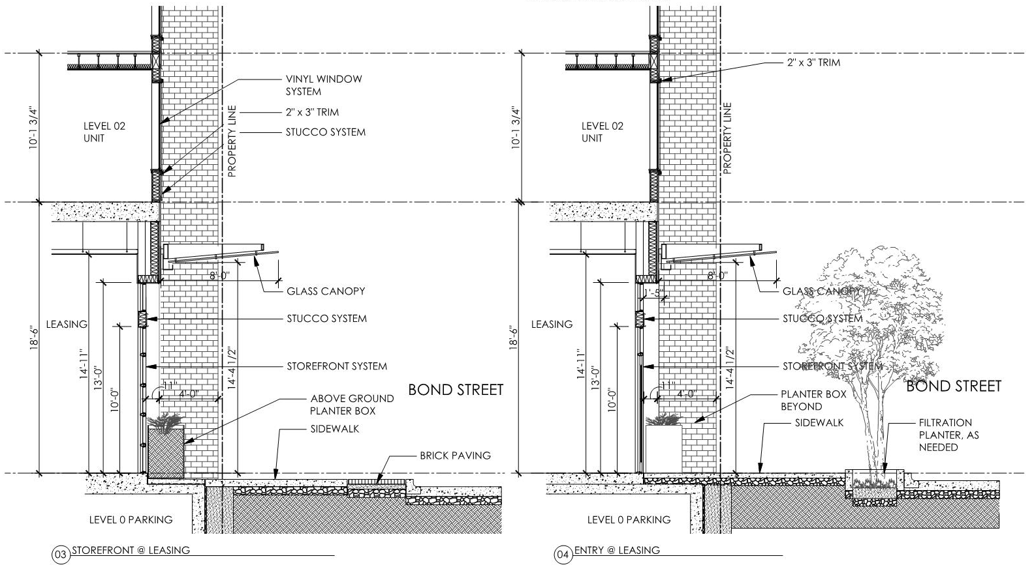
MAIN ENTRY

Slide 16
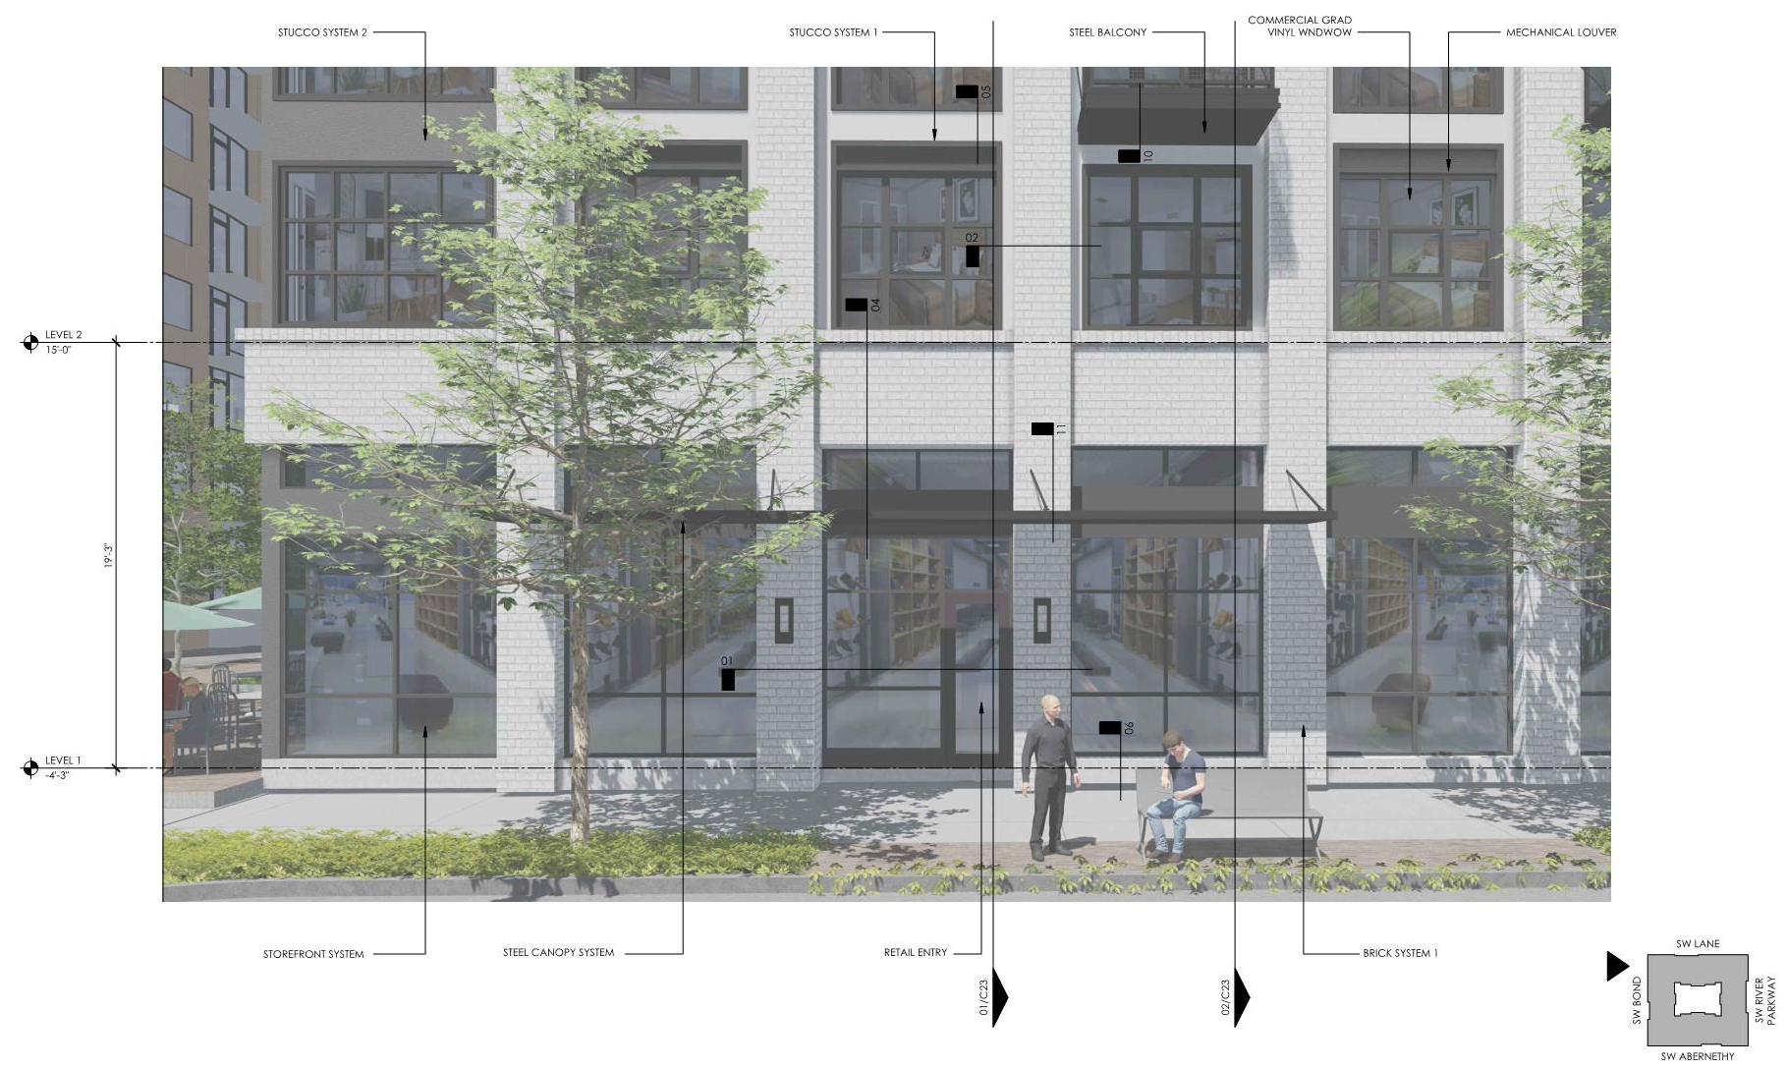
COMMERCIAL SPACES
Notes:
LOCATED ON PREDOMINANT MASSING
PEDESTRIAN SCALE CANOPIES
EXTERIOR LIGHTING BY ALL ENTRANCES
CONSISTENT STOREFRONT SIZES
SEATING OPPORTUNITIES ALONG SIDEWALKS

Slide 17
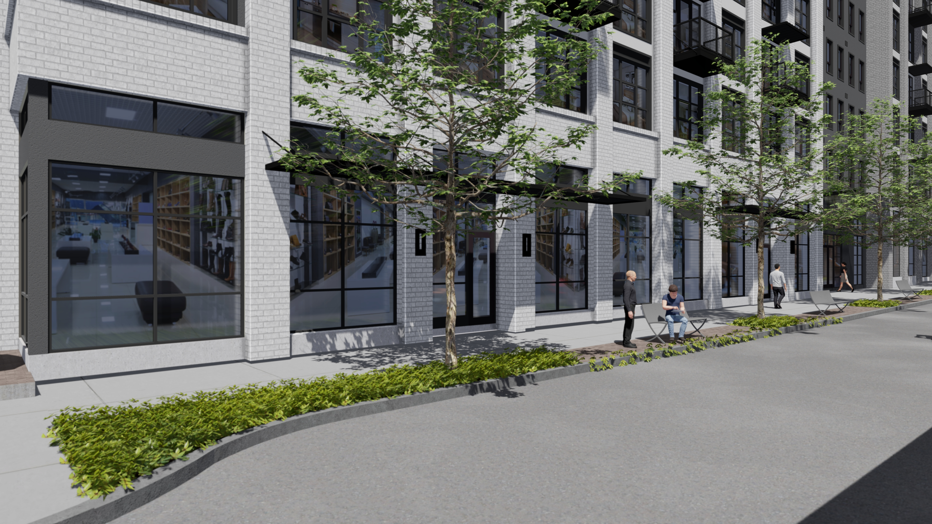

Slide 18
COMMERCIAL SPACES
Notes:
TYPICAL SECTION ALONG PUBLIC SIDEWALKS
BIKE RACKS / BENCHES
PEDESTRAIN SCALE CANOPIES

Slide 19
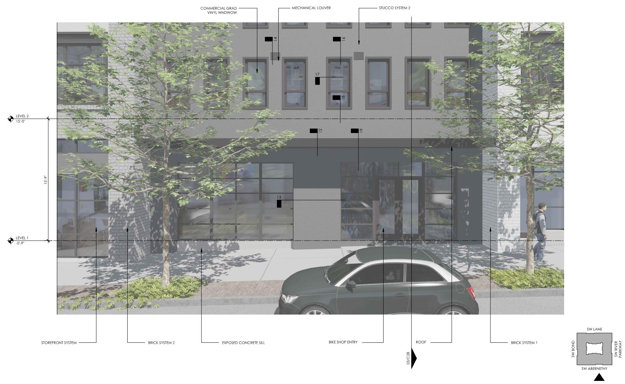
AMENITY SPACES
Notes:
LOCATED ON RECESS MASSING – CONNECTING ELEMENT
LOWER SCALE AWNING

Slide 20
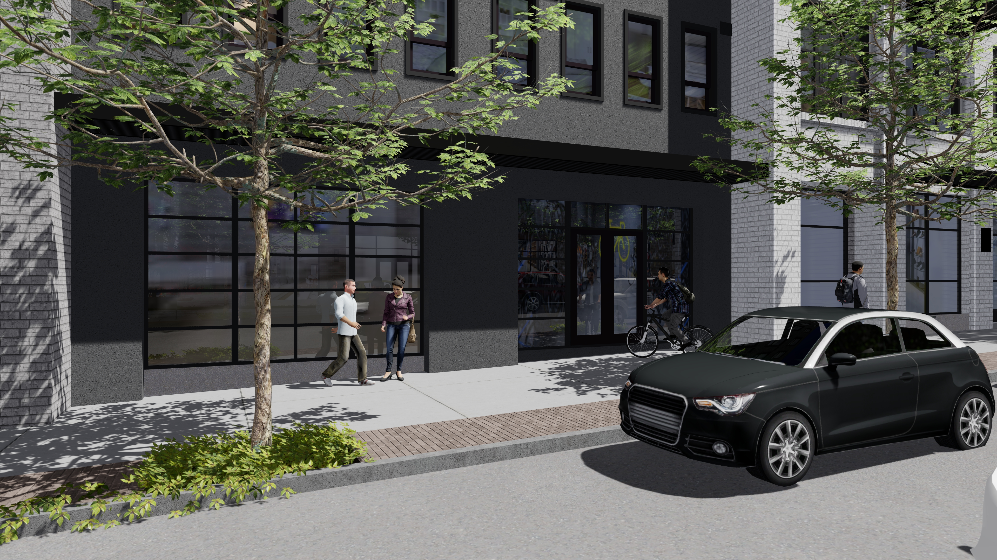

Slide 21
AMENITY SPACES
Notes:
LOCATED ON RECESS MASSING – CONNECTING ELEMENT
LOWER SCALE AWNING

Slide 22
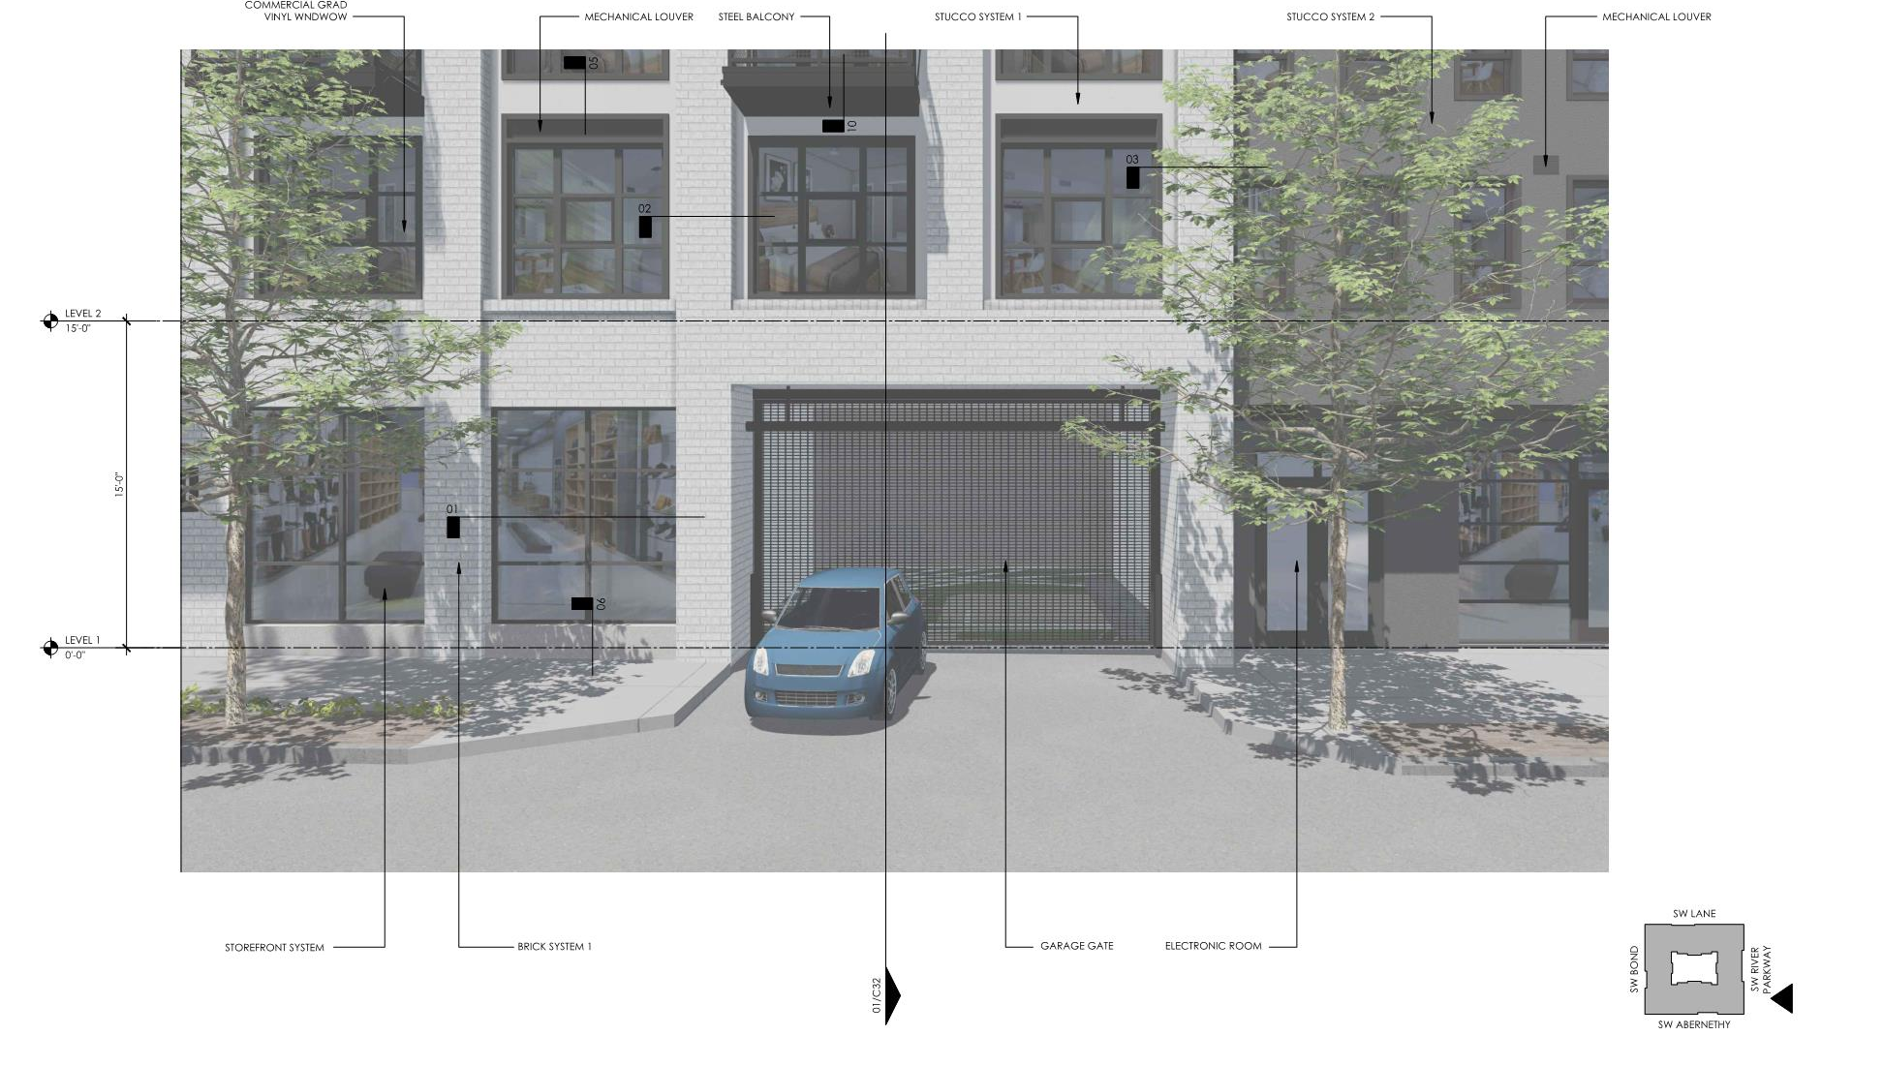
BULDING SERVICES
Notes:
LOCATED ON RECESS MASSING – CONNECTING ELEMENT
LOWER SCALE AWNING

Slide 23
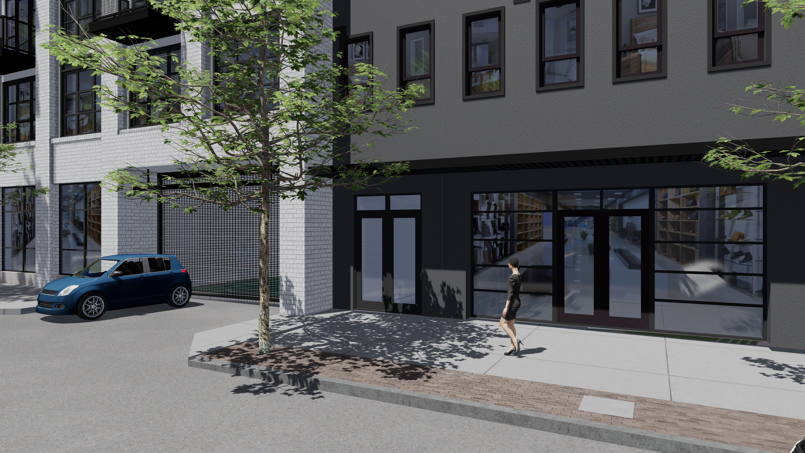

Slide 24
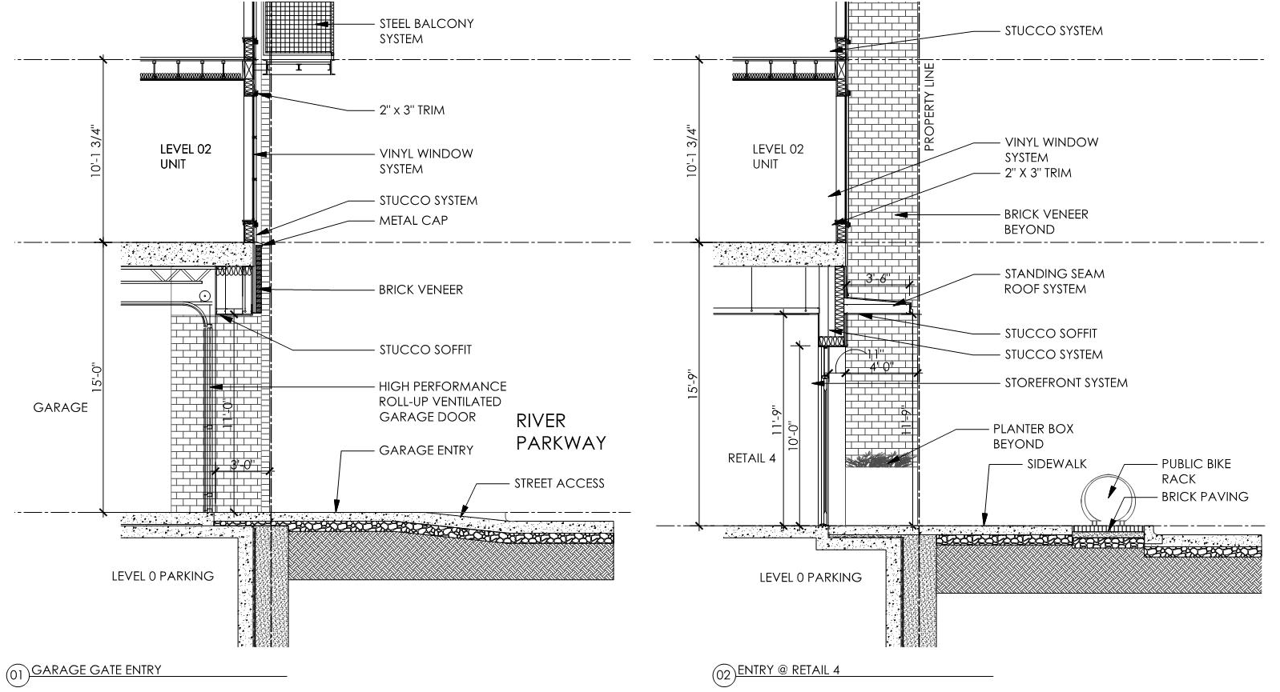
BUILDING SERVICES

Slide 25
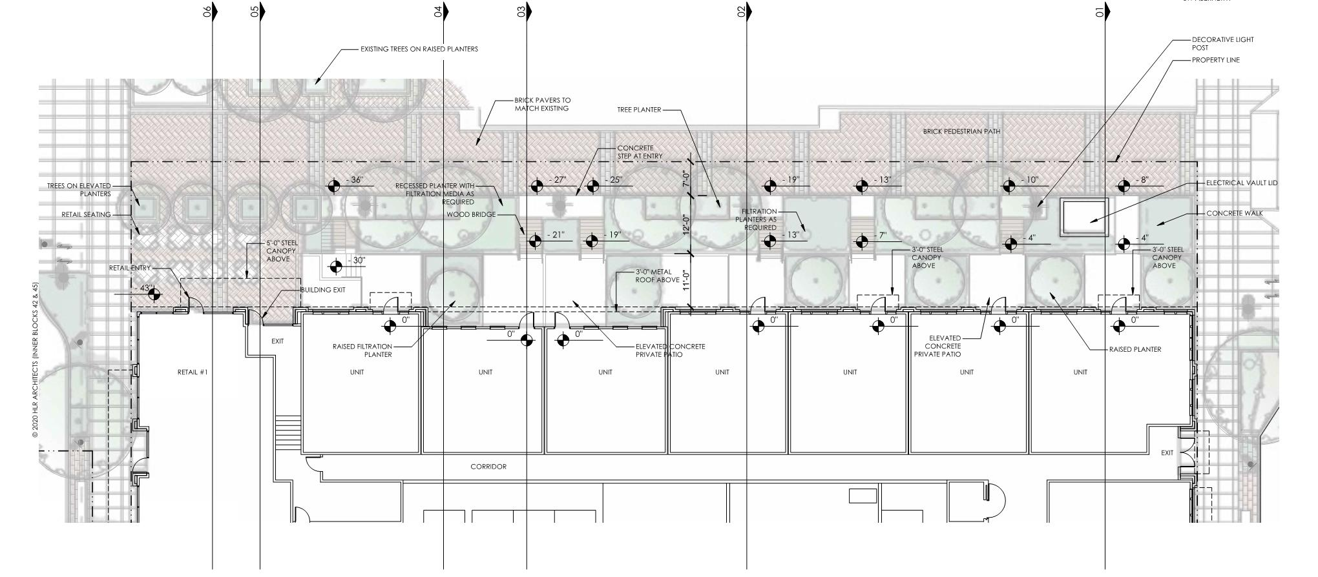
LANE STREET
Notes:
SEATING AT RETAIL CORNER
TREE GRID TO PRESERVE CONDITION ON OPPOSITE SIDE
TRANSTITION LANDSCAPE TO RESIDENTIAL
PLANTER AND BRIDGE LAYERING FOR SEPARATION FROM WALKWAY TO PRIVATE PATIOS

Slide 26
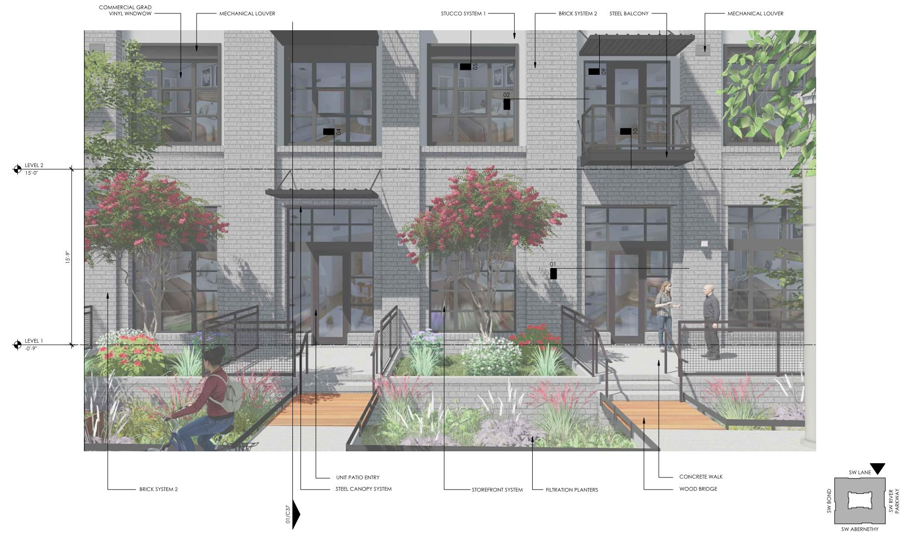
LANE STREET
Notes:
SEATING AT RETAIL CORNER
TREE GRID TO PRESERVE CONDITION ON OPPOSITE SIDE
TRANSTITION LANDSCAPE TO RESIDENTIAL
PLANTER AND BRIDGE LAYERING FOR SEPARATION FROM WALKWAY TO PRIVATE PATIOS

Slide 27
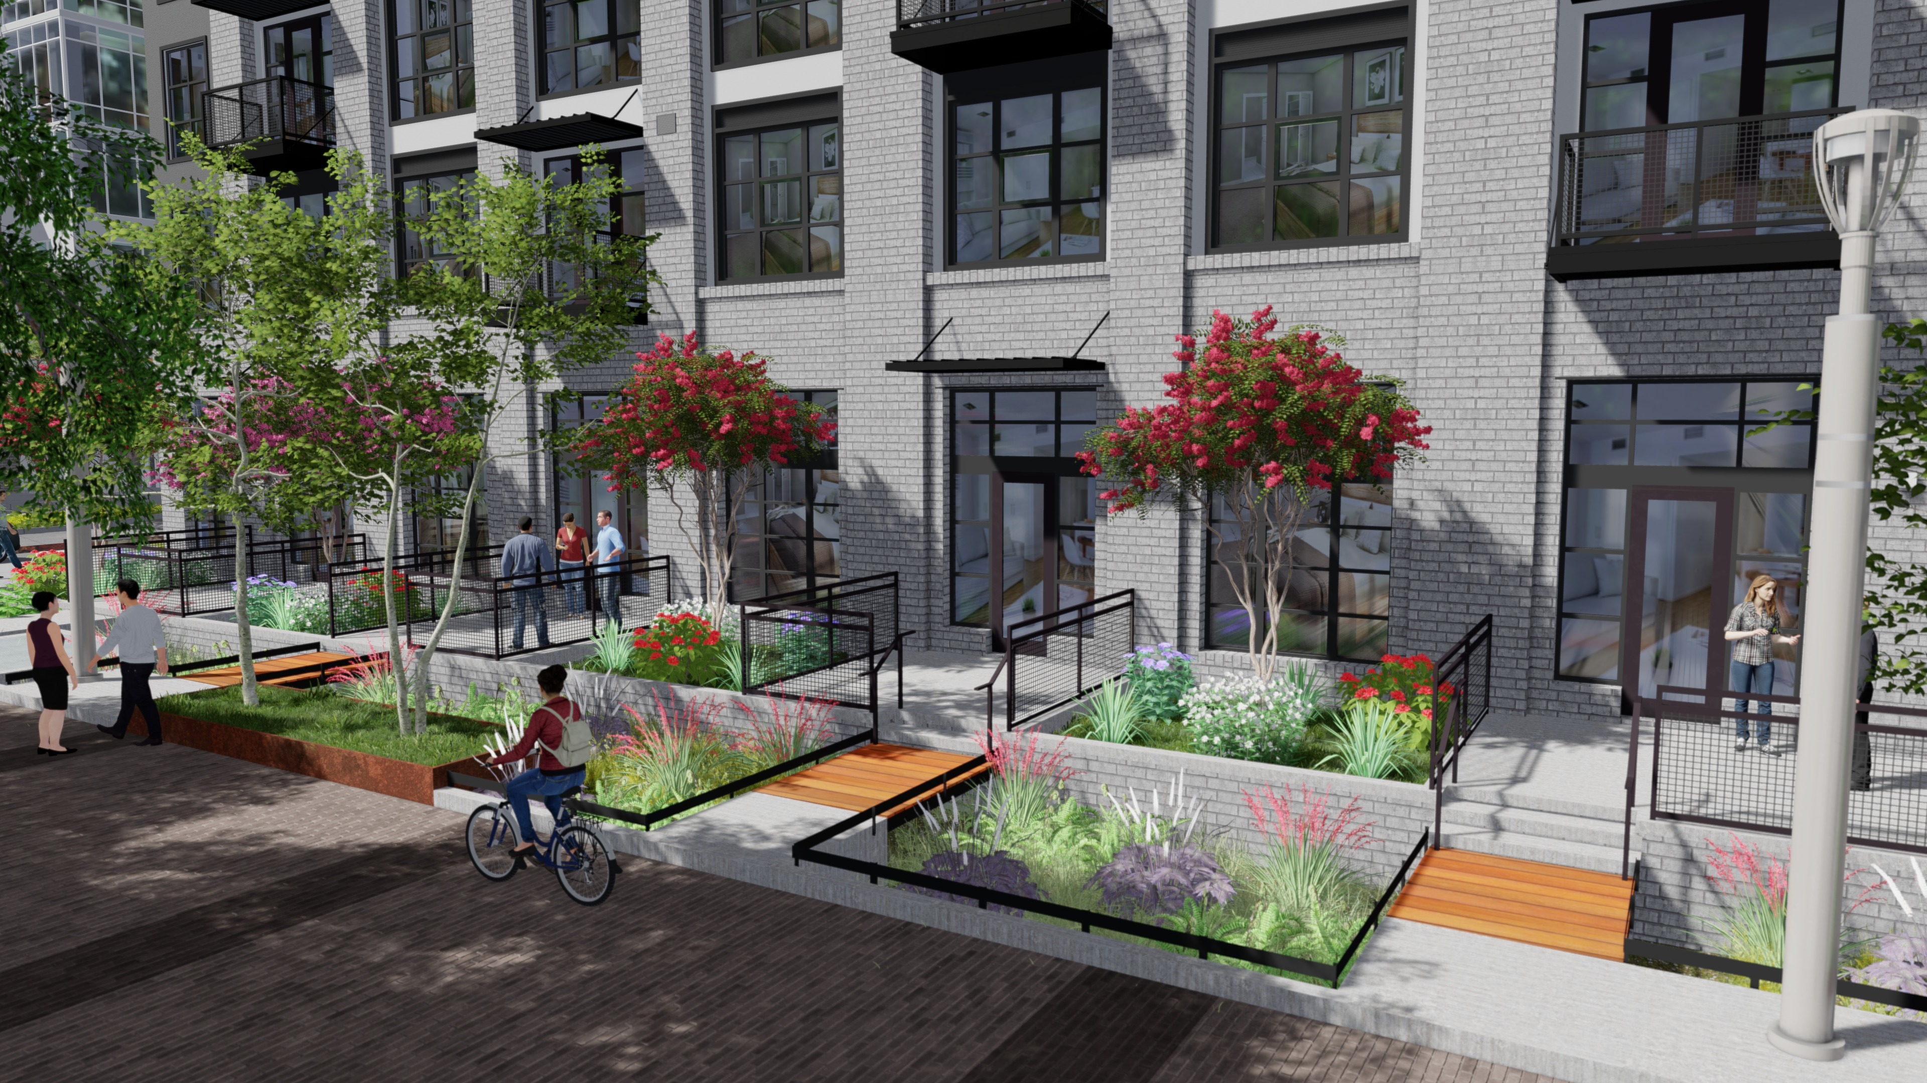
Notes:
SEATING AT RETAIL CORNER
TRANSTITION LANDSCAPE TO RESIDENTIAL
PLANTER AND BRIDGE LAYERING FOR SEPARATION FROM WALKWAY TO PRIVATE PATIOS

Slide 28
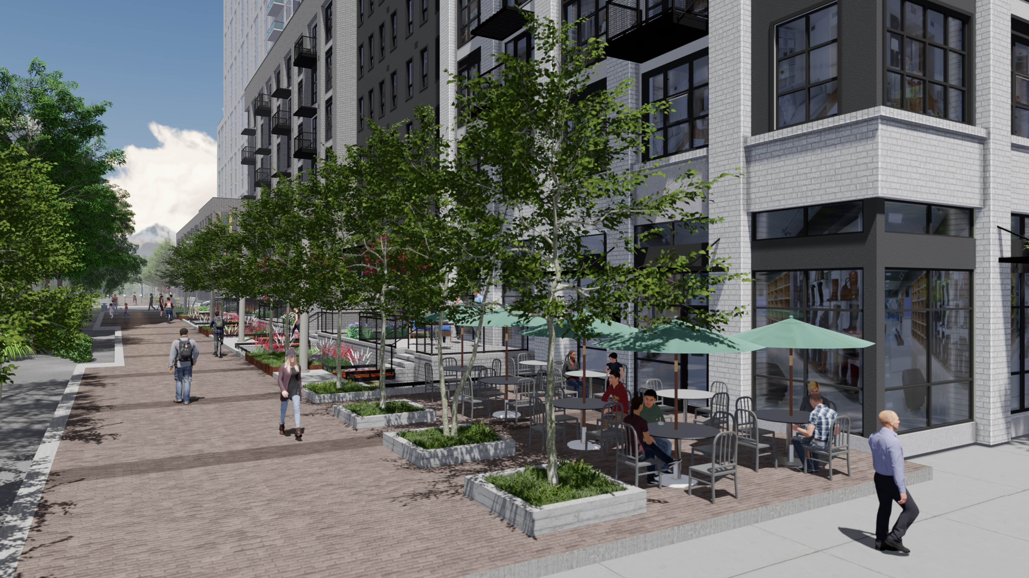
Notes:
SEATING AT RETAIL CORNER
TRANSTITION LANDSCAPE TO RESIDENTIAL
PLANTER AND BRIDGE LAYERING FOR SEPARATION FROM WALKWAY TO PRIVATE PATIOS

Slide 29
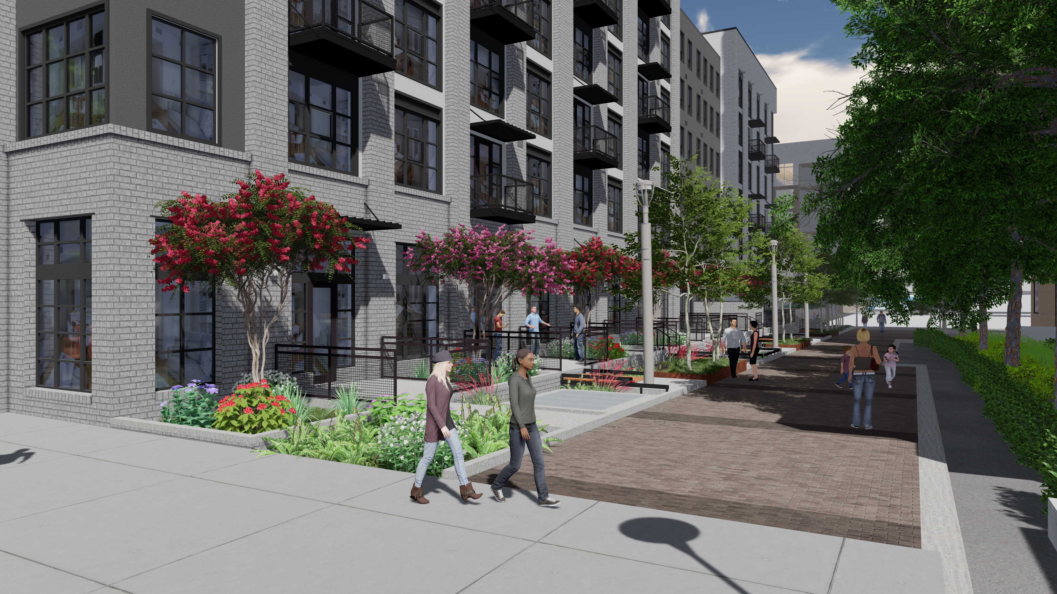
Notes:
SEATING AT RETAIL CORNER
TRANSTITION LANDSCAPE TO RESIDENTIAL
PLANTER AND BRIDGE LAYERING FOR SEPARATION FROM WALKWAY TO PRIVATE PATIOS

Slide 30
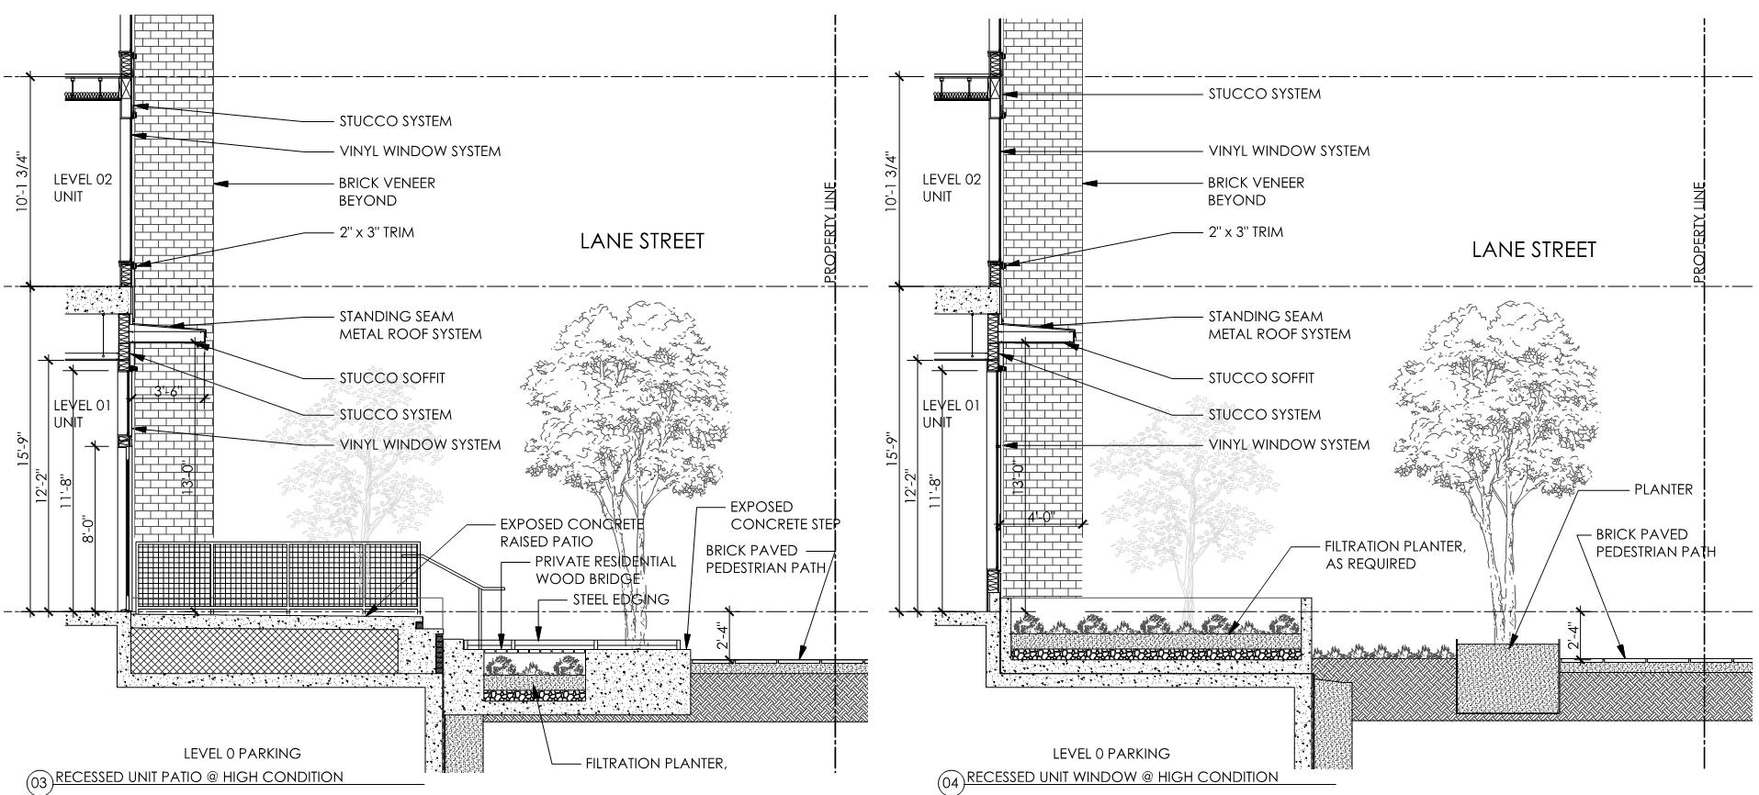
LANE STREET
Notes:
SEATING AT RETAIL CORNER
TRANSTITION LANDSCAPE TO RESIDENTIAL
PLANTER AND BRIDGE LAYERING FOR SEPARATION FROM WALKWAY TO PRIVATE PATIOS

Slide 31
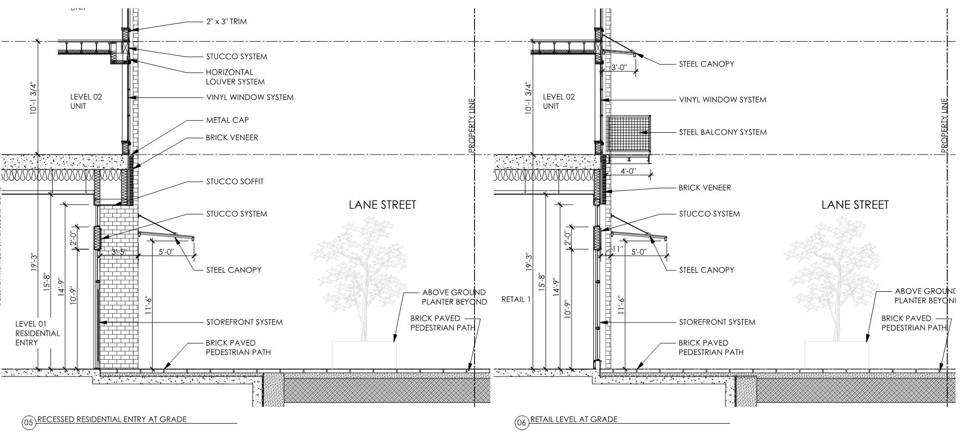
LANE STREET
Notes:
SEATING AT RETAIL CORNER
TRANSTITION LANDSCAPE TO RESIDENTIAL
PLANTER AND BRIDGE LAYERING FOR SEPARATION FROM WALKWAY TO PRIVATE PATIOS

Slide 32
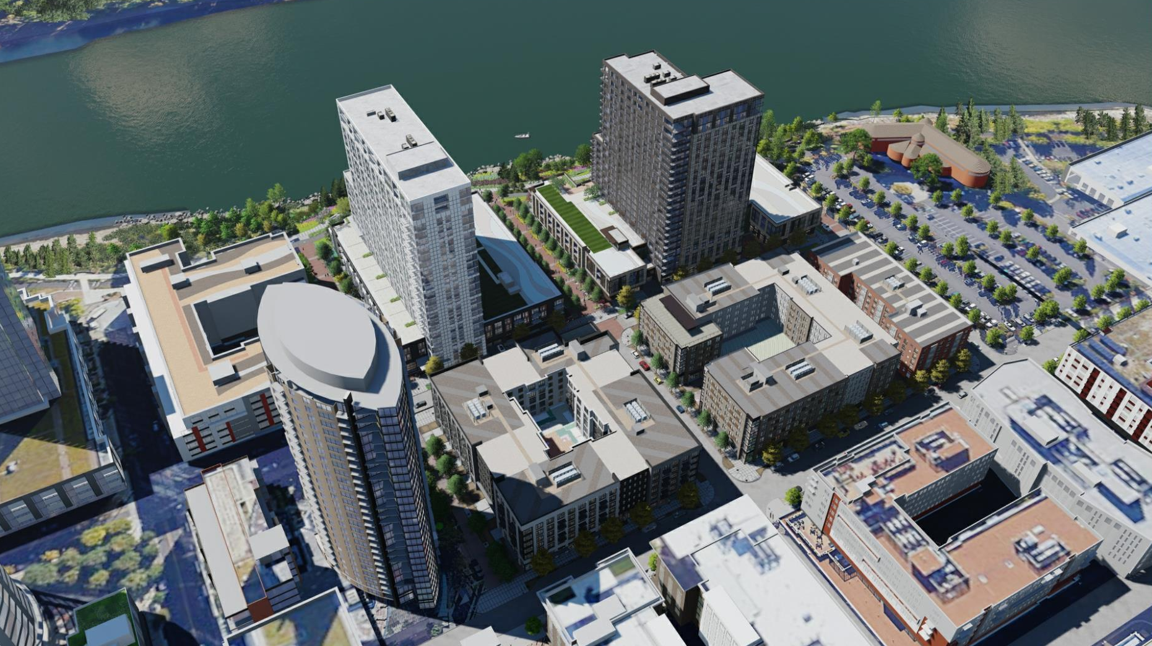

Slide 33
MATERIAL SAMPLES

Slide 34
BLOCK 42

Slide 36
