Slide 1
Residential Demolition Ordinance
Report to City Council
February 26, 2020

Slide 2
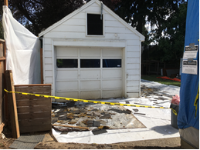
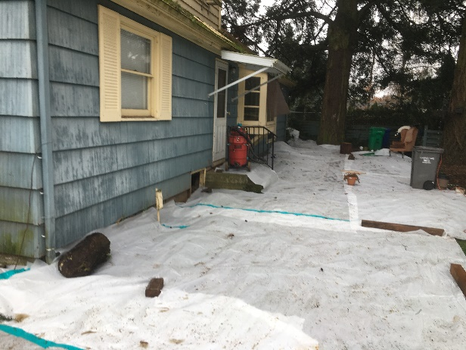
Background
Purpose of Ordinance: To protect surrounding properties from dust and debris generated from demolitions.
Regulations accomplish this by the following:
Laying plastic or geotextile fabric on the ground adjacent to the structure

Slide 3
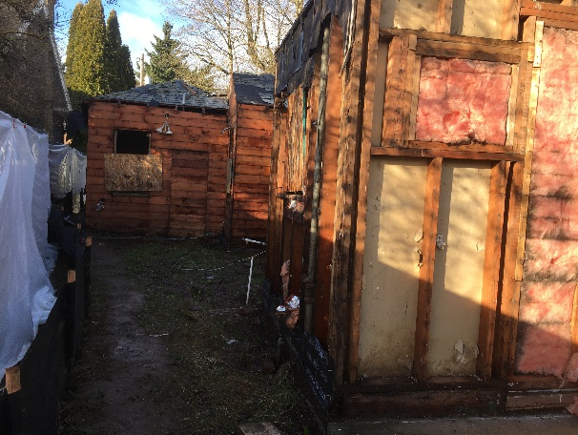
Background
Removing painted exterior (non-structural) materials

Slide 4
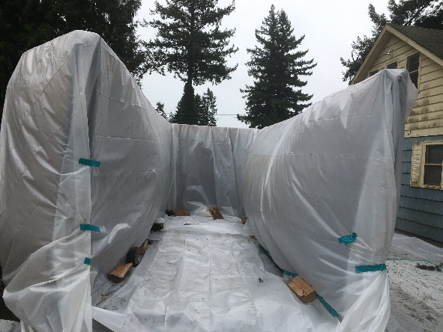
Background
Lining dumpster with plastic

Slide 5
Background
Wetting the structure, equipment, and debris to prevent dust from leaving site

Slide 6
Background
Stopping mechanical demolition if wind speed exceeds 25 m.p.h.

Slide 7
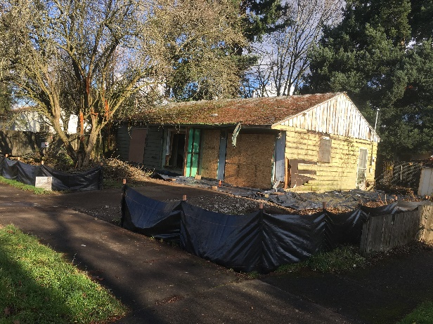
Background
Containing demolition debris on-site, including any water

Slide 8
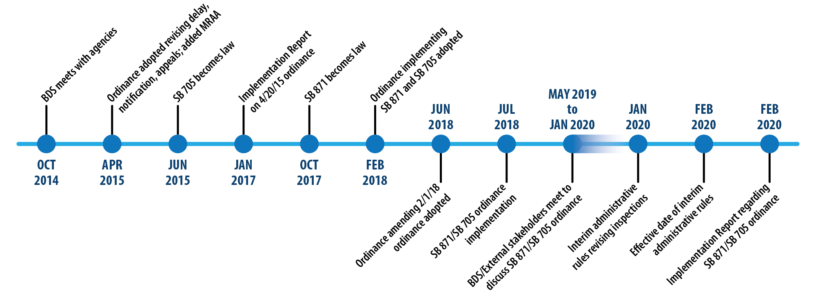
Timeline for Residential
Demolition Regulations

Slide 9
Demolition Permit Highlights
Pre July 1, 2018
1
APPLIES TO
2
DEMO DELAY
One & two family dwelling units
35 Days
3
PERMIT REVIEW
4
NEIGHBORHOOD
NOTIFICATION
5
INSPECTIONS
Over-the-counter
One

Slide 10
Demolition Permit Highlights
July 1, 2018 – February 10, 2020
1
APPLIES TO
1
APPLIES TO
2
2
DEMO DELAY
DEMO DELAY
One & two family dwelling units
One to four dwelling units & accessory structures
35 Days
35 Days
3
3
PERMIT REVIEW
PERMIT REVIEW
4
NEIGHBORHOOD
NOTIFICATION
5
INSPECTIONS
4
NEIGHBORHOOD
NOTIFICATION
5
INSPECTIONS
Over-the-counter
Taken in for review
Three
One
Expanded

Slide 11
Demolition Permit Highlights
July 1, 2018 – February 9, 2020
1
APPLIES TO
2
2
DEMO DELAY
DEMO DELAY
One to four dwelling units & accessory structures
35 Days
35 Days
3
PERMIT REVIEW
4
NEIGHBORHOOD
NOTIFICATION
5
INSPECTIONS
Taken in for review
Three
Expanded
WETTING DURING
MECHANICAL DEMOLITION
6
ASBESTOS ABATEMENT
7
LEAD HAZARD
REDUCTIONS
8

Slide 12
Demolition Permit Highlights
Post February 10, 2020
1
APPLIES TO
2
2
DEMO DELAY
DEMO DELAY
One to four dwelling units & accessory structures
35 Days
35 Days
3
PERMIT REVIEW
5
INSPECTIONS
4
NEIGHBORHOOD
NOTIFICATION
5
INSPECTIONS
Taken in for review
Three
Four
Expanded
WETTING DURING
MECHANICAL DEMOLITION
6
ASBESTOS ABATEMENT
7
LEAD HAZARD
REDUCTIONS
8

Slide 13
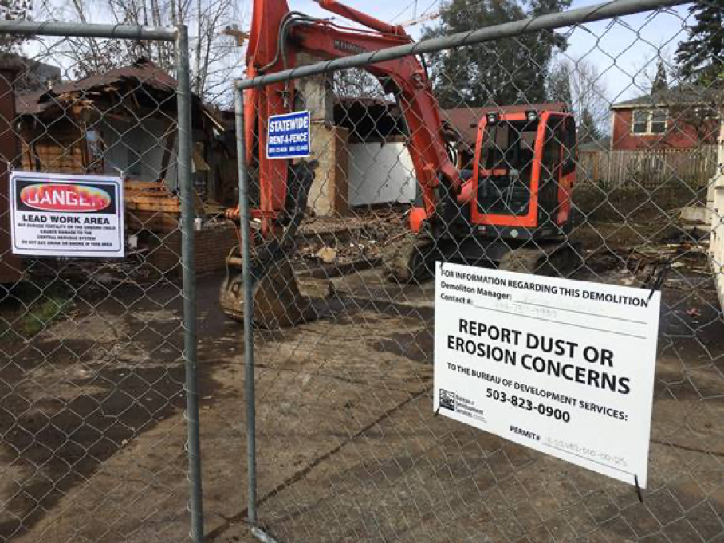
Recommendations
Amend Demolition Ordinance to move details to the administrative rules and clarify language
Require anyone doing a demolition to have lead-based paint certifications
Require all residential demolitions to have full asbestos abatement per DEQ regulations

Slide 14
Next Steps
Continue public outreach and engagement
Draft ordinance and present it to Council in approximately April 2020
Continue monitoring program and recommending changes as necessary

Slide 15
QUESTIONS?

