Slide 1
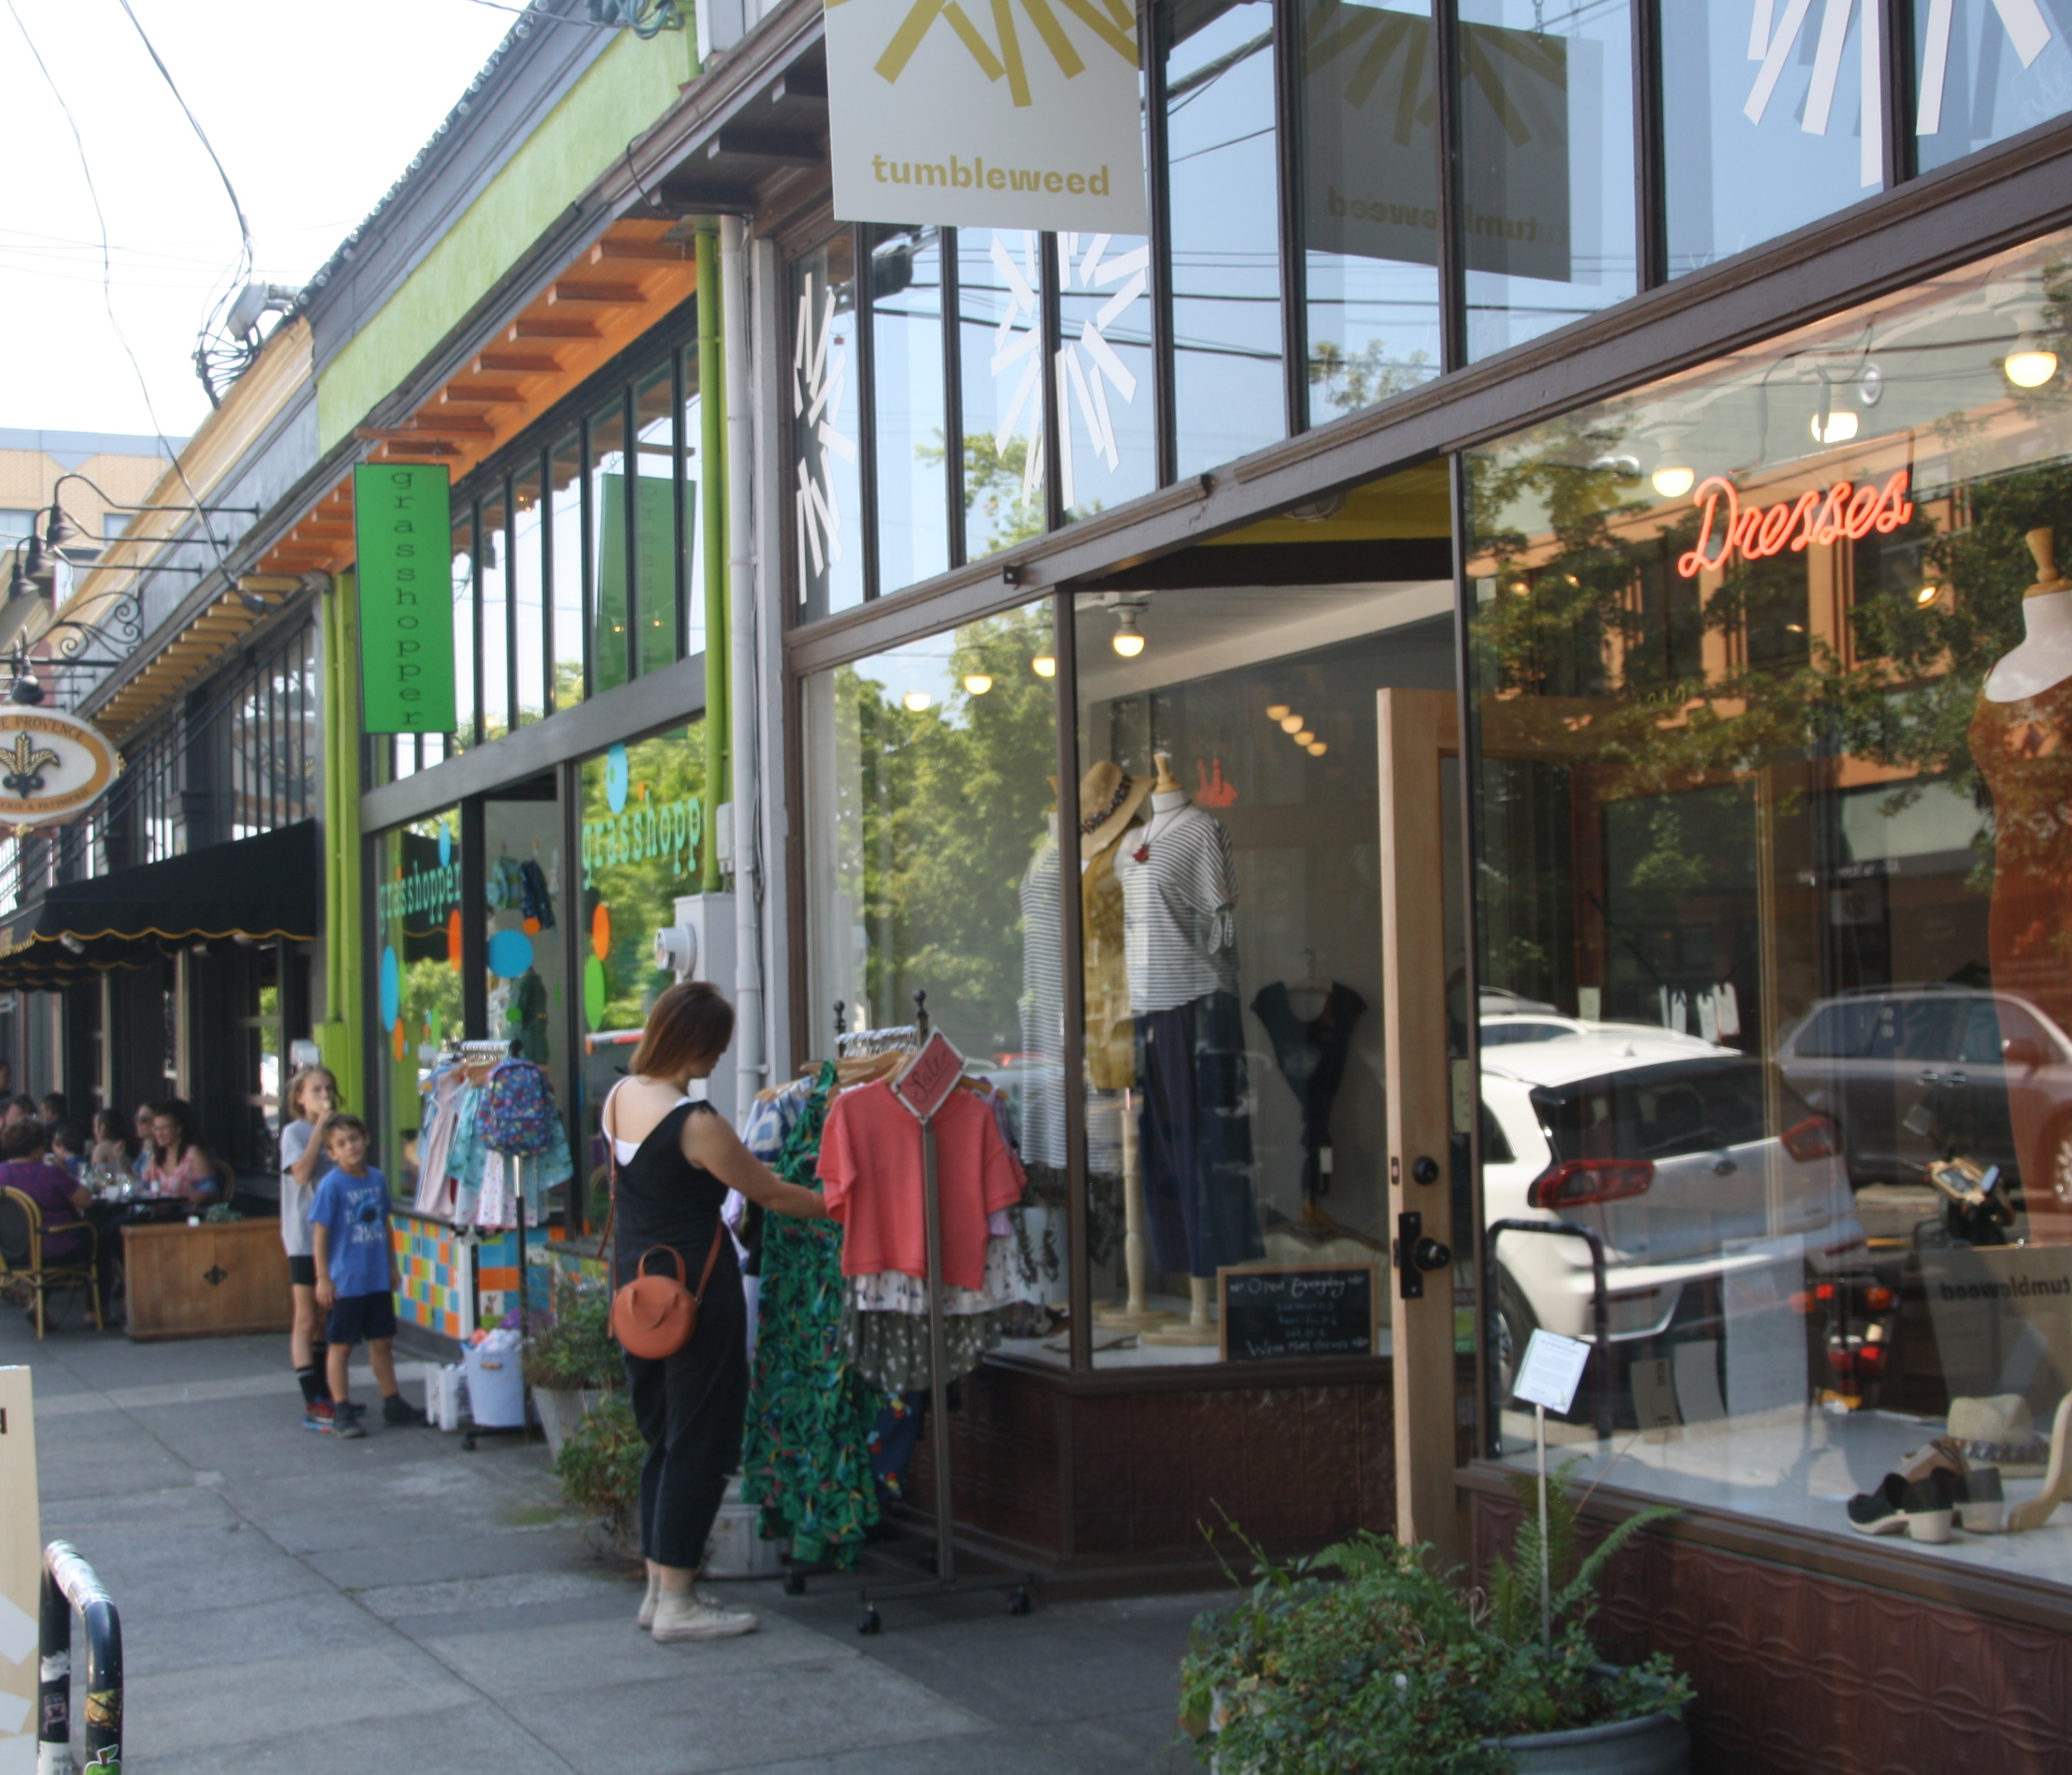
Work Session 5 Design Commission February 20, 2020
DOZA
Design Overlay Zone Amendments

Slide 2
Agenda
5 min
Intro and Disclosures
Proposal: Portland Citywide Design Guidelines
INTRODUCTION
PHOTOS
(~ 3 hrs total)
55 min
120 min

Slide 3
What’s in the DOZA Proposed Draft?
Volume 1: Staff Report
Volume 2: Code and Map Amendments
Volume 3: Portland Citywide Design Guidelines
Volume 4: Appendices (portlandoregon.gov/bps/doza)
Appendix A: BDS Administrative Improvements
Appendix B: Housing Affordability Memo (February 6, 2017)
Appendix C: What We Heard Report
Appendix D: Consultant Testing of Draft Standards and Guidelines

Slide 4
WHAT’S NEXT
DATE
TUESDAY, FEBRUARY 25 | PSC Work Session #7 to confirm List of Amendments (Volume 2: Code and Map)
THURSDAY, FEBRUARY 27 | BPS sends Design Commission List of Amendments (Volume 3: Design Guidelines)
THURSDAY, MARCH 12 | Design Commission Work Session #6 to confirm List of Amendments (Volume 3)
TBD MONDAY, MARCH 16 | 3x3
TBD TUESDAY, MARCH 17 | 3x3
TBD MONDAY, APRIL 13 | BPS sends PSC, DC all Amendments (Volume 2, Volume 3)
TUESDAY, APRIL 28 | PSC Work Session #8 to vote on Amendments
TBD THURSDAY, MAY 7 | DC Work Session #7 to vote on Amendments
Design Commission

