Slide 1
Portland Streetcar
2019 Annual Report
Presentation to City Council
Dan Bower, PSI Executive Director
February 5, 2020

Slide 2
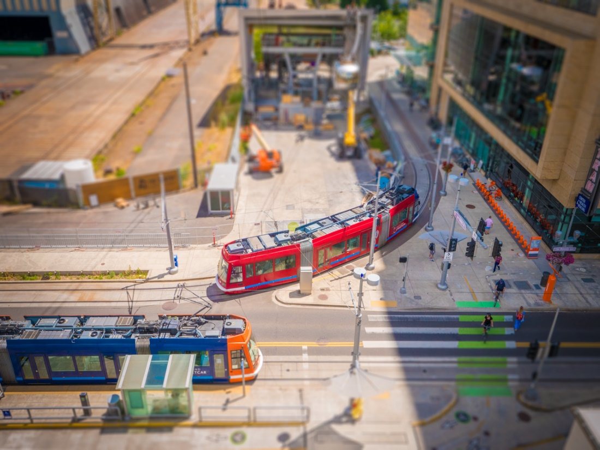
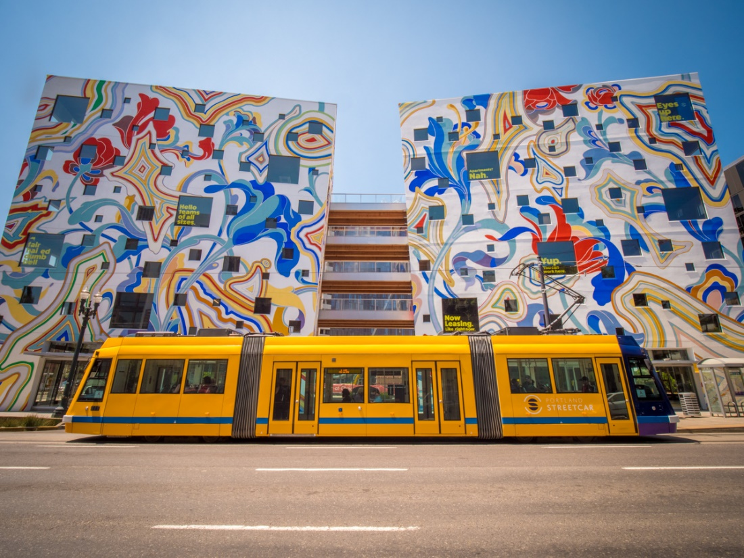
“…the Portland Streetcar is one of the most successful and cost-effective economic development drivers anywhere in America in the new millennium.” – Congress for New Urbanism
100% Renewable Energy
13,000 - 14,000 daily riders
Zero fatalities in 19 years of operations
50% of ALL housing in Portland built since 2001 is on the streetcar line
39% of subsidized affordable housing is on the streetcar line.

Slide 3
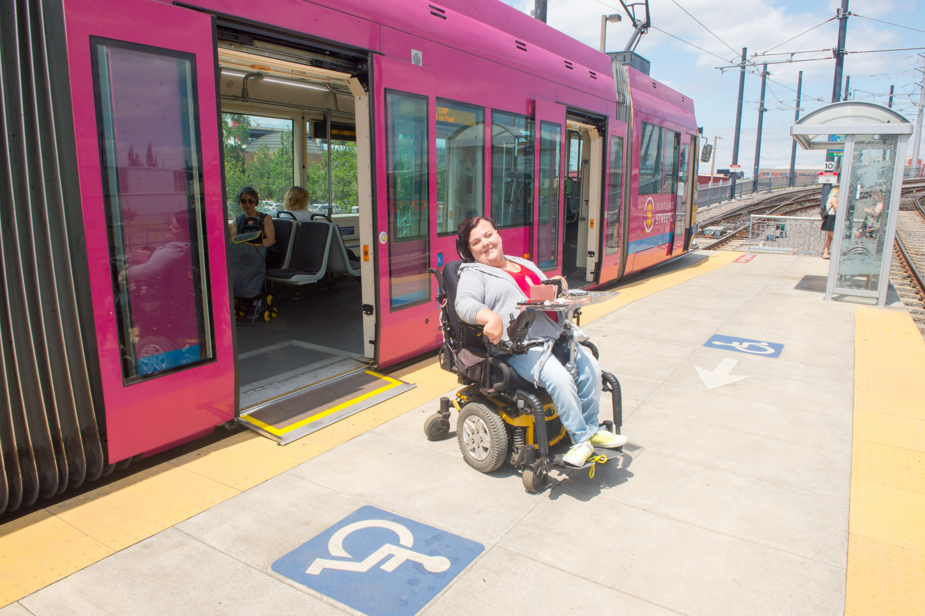
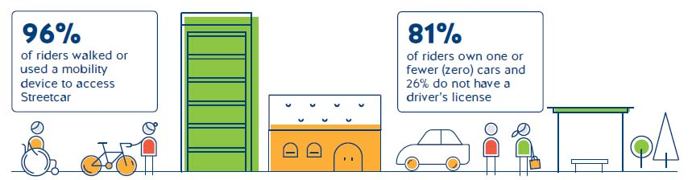

Slide 4
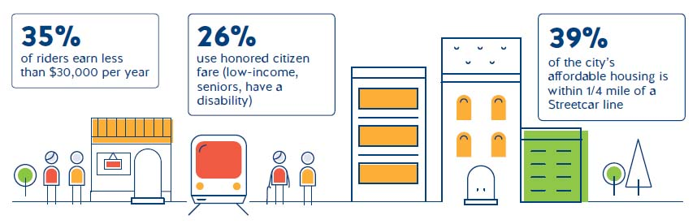
A System that Serves Everyone

Slide 5
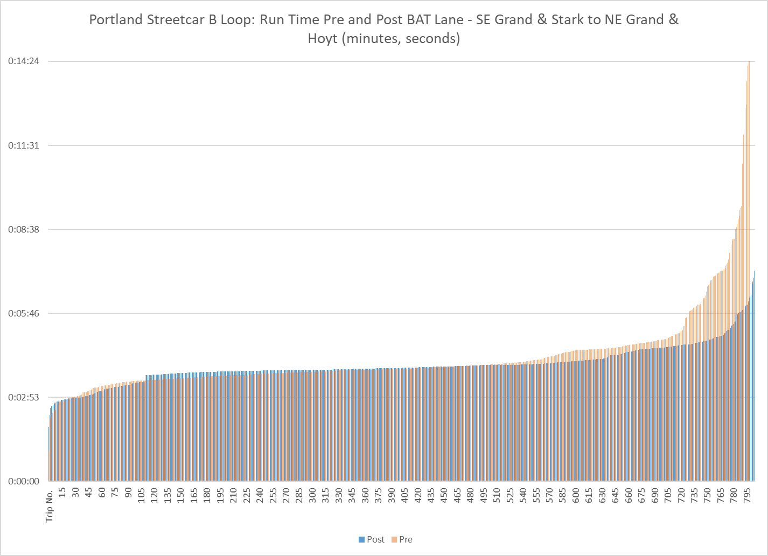
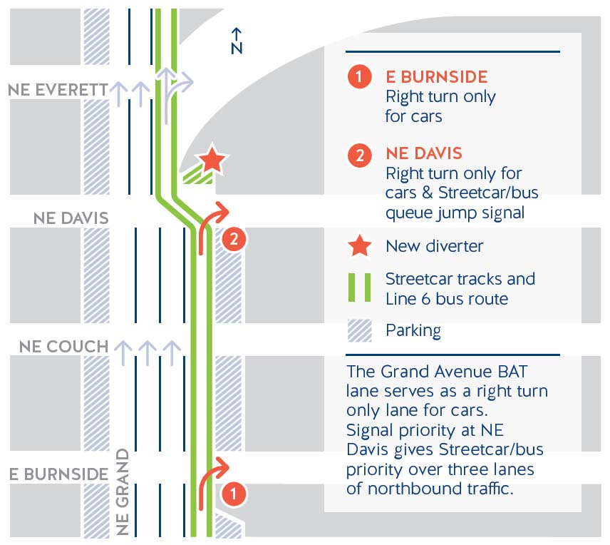
Streetcar Operations- NE Grand Ave

Slide 6
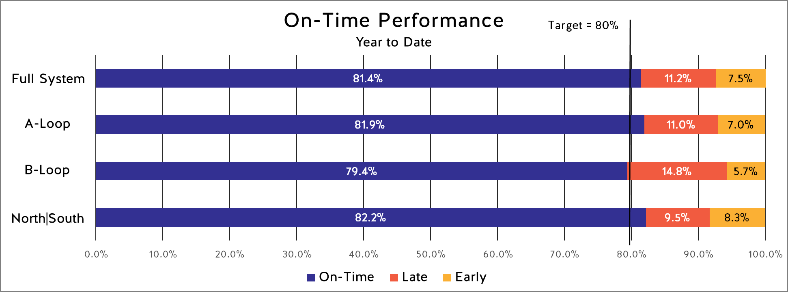
Ridership
& Service
Partial Service Restoration
Service reduced to 20-minutes on eastside – Fall 2018
Decrease in ridership through Sept. 19
Full service to be restored Sept. 2020

Slide 7
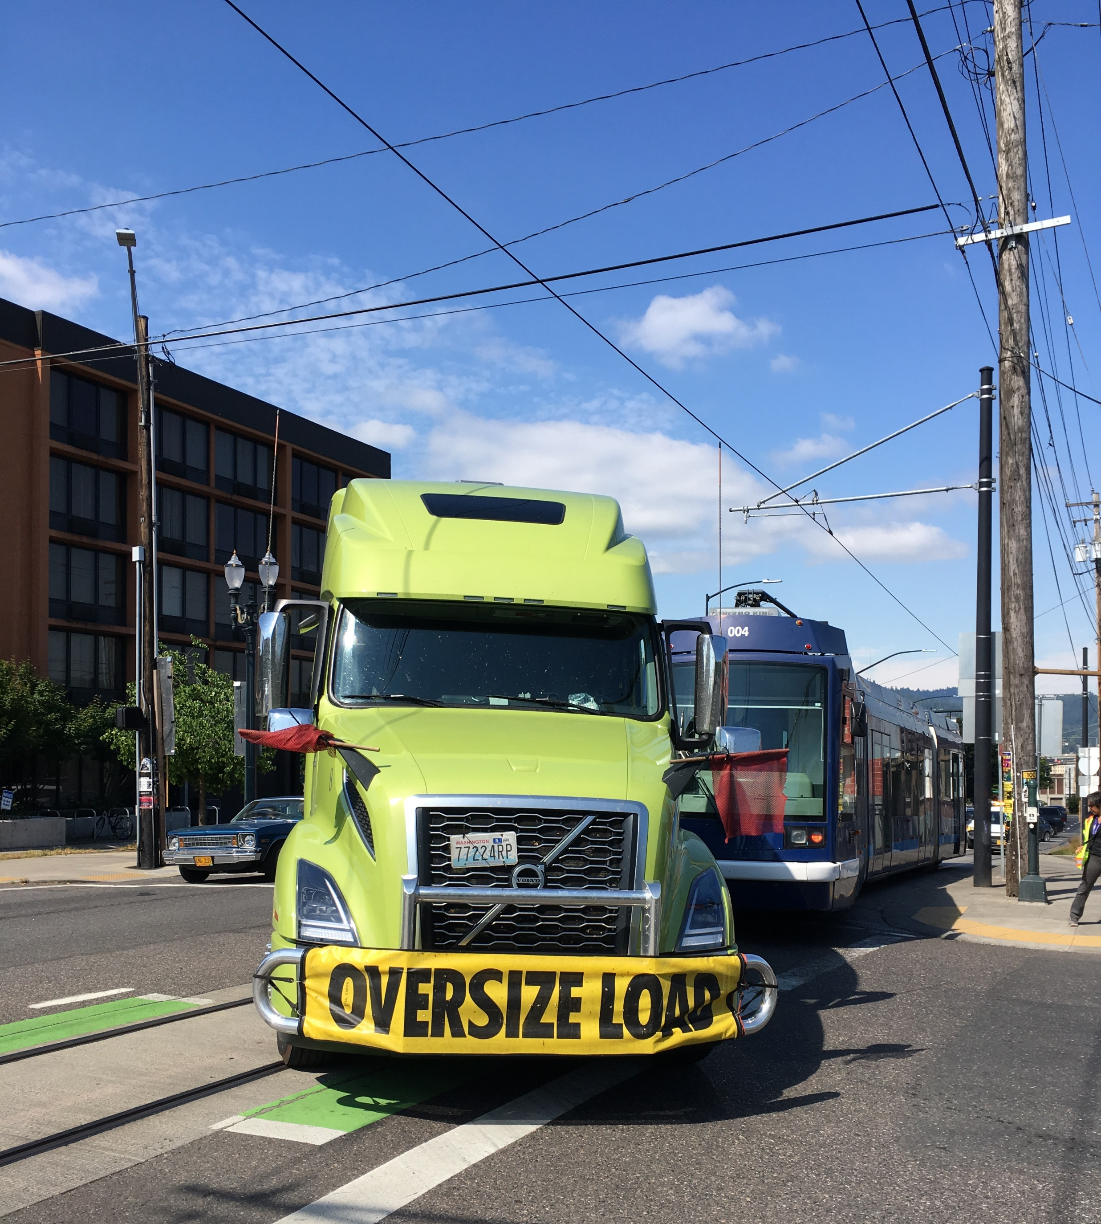
Safety and Security
 | 2016 | 2017 | 2018 | 2019
Total Collisions Per Year | 51 | 61 | 45 | 34
% +/- prior year | +68% | +20% | -26% | -24%
Safety Officer Hired
45% Reduction in Collisions since FY 2017/18
Most Common Collisions: 2019
Private vehicle lane change in- to streetcar (26%)
Parking of private vehicles (24%)
Private vehicle turning right in front of streetcar from middle lane (17%)
Significant improvement in rear-end collisions since 2018 due to operator training.

Slide 8
On the Horizon
Planning for the Future
Improving Existing Service
PBOT/BPS and Prosper Portland managing FTA Transit Oriented Development grant for NW Portland and Hollywood.
  Considering land use and transportation investments in developing neighborhoods
Preliminary engineering for future alignments to better understand cost, opportunities and constraints
Coordination with partners on I-5 Rose Quarter project, other major regional projects
Procurement and installation of CCTV on all cars
Continued partnership with Rose Lane projects to improve operations
Customer amenities such as new seats, platform upgrades, new signage
Transit Asset Management (TAM) Plan
Condition assessment for Cars 01 – 10
- Rebuild, or buy new?
Accepting 3 new streetcars from Brookville in 2021 will allow for improved and more reliable service

Slide 9
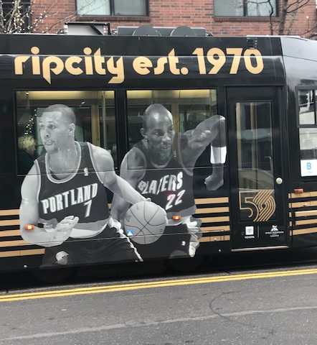
Thank you
Kathryn Levine, PBOT
Dennis Allen, PSI Board Chair
Dan Bower, PSI
February 5, 2020

