Slide 1
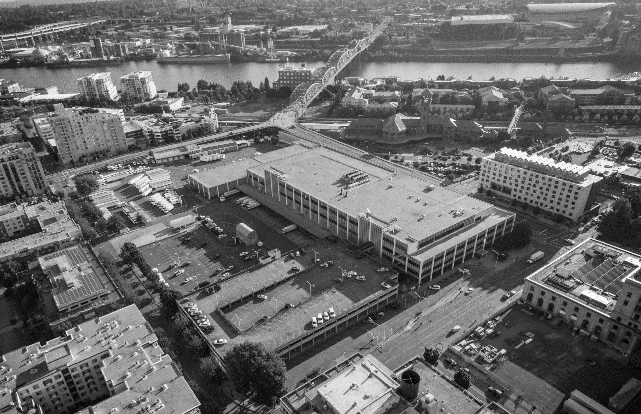



January 30, 2020
Notes:
Good afternoon, Mayor Wheeler and Commissioners.
I'm Kimberly Branam, Executive director of Prosper Portland.
I'm joined by Shannon Callahan, Director of the Portland Housing Bureau, Vivian Satterfield, with the Healthy Communities Coalition, and Mark Falcone, CEO of Continuum Partners.
We are excited to be here with you this afternoon at a pivotal moment for the Broadway Corridor project.
We have two goals for our time together today:
to provide Council with an overview of the progress we've made in planning for the development of the Broadway Corridor from multiple perspectives
to understand City Council's key priorities and values as we prepare to bring forward legal agreements with our city, private and community partners later this Spring
There are two areas that we're not going to address today:
We are not seeking a pre-determination of any Master Plan approval issue for the USPS site currently being considered by Design Commission.
We are not planning to dig into the details of project funding or the draft legal agreements with our partners.

Slide 2
Agenda
Project Overview, Plan, Vision, Next Steps
Kimberly Branam, Executive Director, Prosper Portland
Affordable Housing Priorities
Shannon Callahan, Director, Portland Housing Bureau
3. Key Community Benefit Priorities
Vivian Satterfield, Healthy Communities Coalition
4. Development Partnership & Approach
Mark Falcone, CEO, Continuum
5. Panel 1: Public Partners
Adena Long, Chris Warner, Andrea Durbin
6. Panel 2: Steering Committee Members
Sam Rodrigues, James Paulson, Victoria Lara, Tyrone Poole
7. Panel 3: Healthy Communities Coalition
Marcus Mundy, Kelly Kupcak, Yasmin Ibarra
8. Q&A
Notes:
So, I'm going to take about 20-25 minutes to give an overview of the project and process to date.
Shannon, Vivian and Mark will each share their perspective and priorities with you.
And then we’ll hear from key partners who have helped shape the project before you – including, representatives from our public partners, steering committee members and the Healthy Communities Coalition.
Everyone has agreed to keep their comments focused to ensure we have time at the end to hear your questions and priorities.

Slide 3
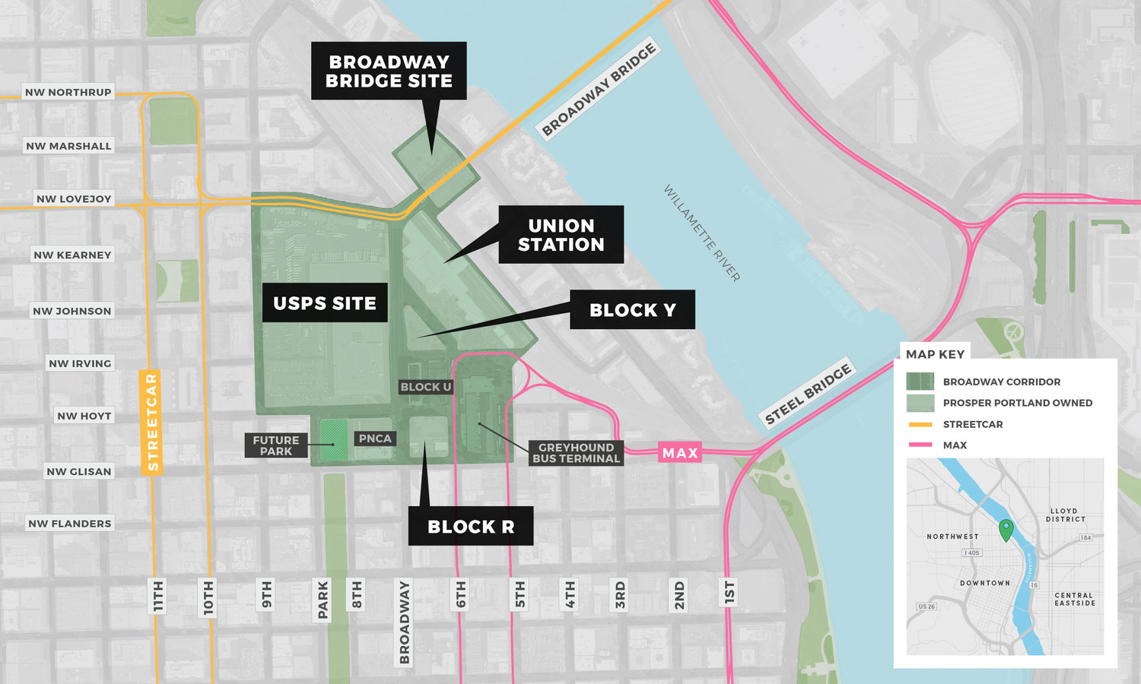
Overview
Notes:
So, what do we mean when we say “Broadway Corridor”?
The Broadway Corridor is a 34-acre district – in green on the slide – that includes:
The 14 acre USPS site – jointly owned by Prosper Portland the Portland Housing bureau
As well as Prosper Portland owned development opportunities on Block R and the Broadway Bridge Site, where the Oregon Harbor of Hope is currently located
It also includes Union Station – owned by Prosper Portland
The former Greyhound Bus Terminal, PNCA and
The adjacent future park block owned by Portland Parks & Recreation.
So – this is a site with a lot of development potential – in the heart of our city.

Slide 4
Opportunity
The Broadway Corridor offers a once-in-a-generation opportunity to create a unique, vibrant, mixed-use, dense urban district seamlessly integrated with a regional multi-modal transportation hub in a Portland way.
The district vision is one that honors history and culture, fosters social equity and inclusion, and reimagines how Portlanders live, work, enjoy and move through the city.
- Project Vision Statement
Notes:
The project’s vision statement notes that we have a "once in a generation opportunity"
And speaks to the our desire to create a uniquely Portland, vibrant, forward-looking, mixed-use, dense urban district that has
history and culture
smart growth and
social equity and inclusion at its core.

Slide 5
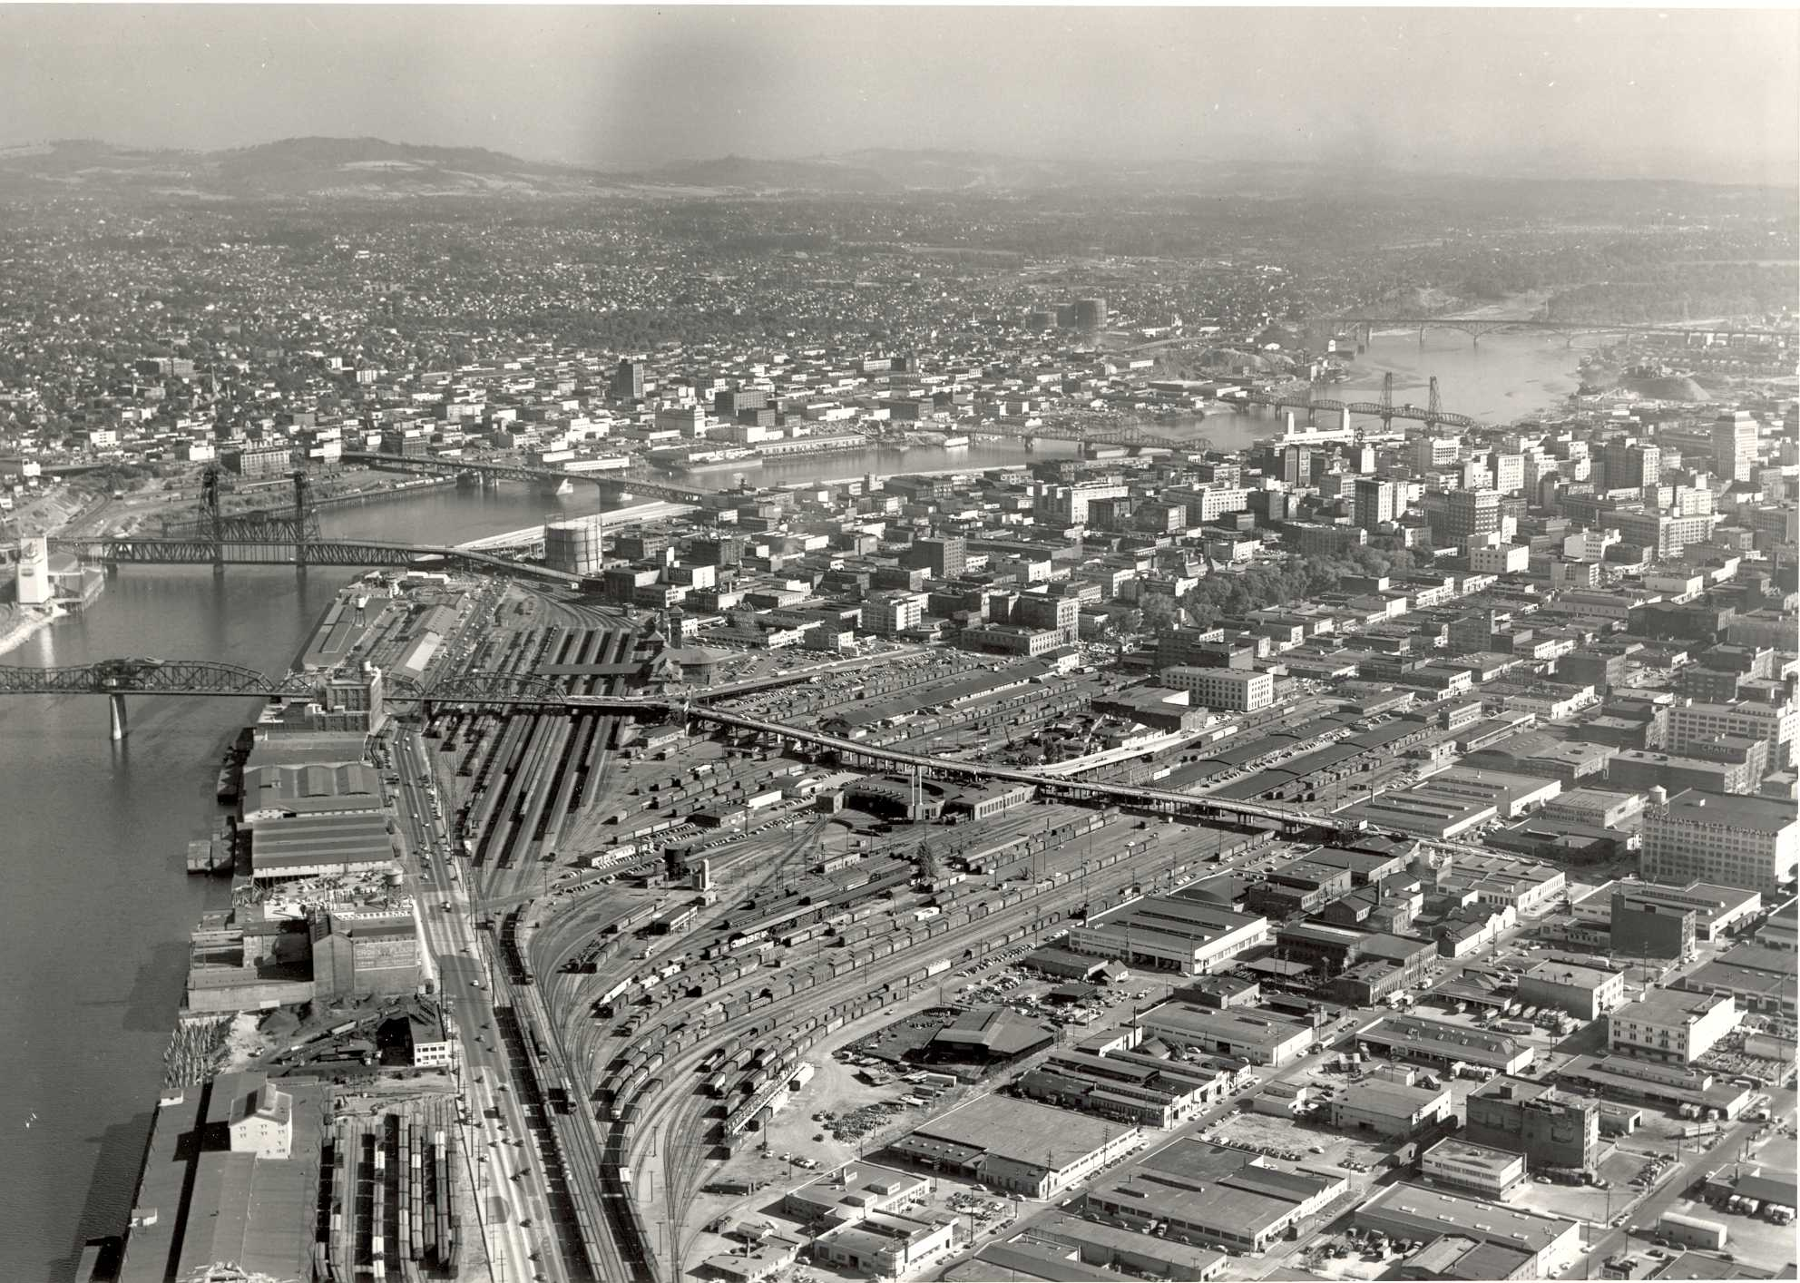
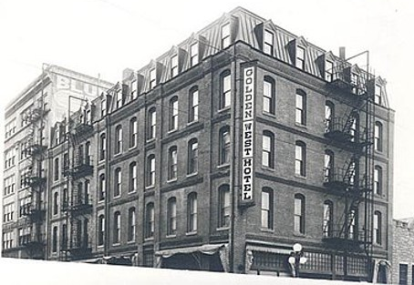
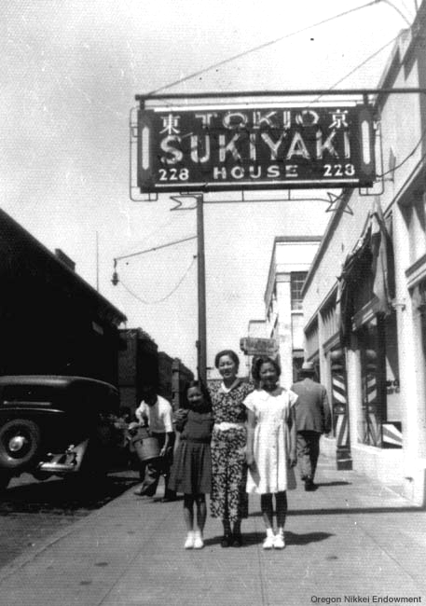
History
Native American
African American
Japanese American
Chinese American
Notes:
From 1964-2019, Broadway Corridor was home to the main US Postal Service processing facility for all of Oregon and southwestern Washington.
But Broadway Corridor and adjacent blocks have a longer history as a center of commerce and a landing port for new Portlanders. This includes:
a Chinookan center of commerce and home to Wapato Valley people;
Chinese-American rail workers and a train station once envisioned to be the largest rail terminal in the nation;
the site of the first performance of jazz in the city at the Golden West Hotel;
and a thriving Japantown before Japanese-American residents were forced into internment camps during WWII
BACKGROUND
Golden West Hotel – launched in 1906; provided "all the conveniences of home" for Black workers denied accommodation in Portland's white owned hotels, and was a center of African American social life until the hotel's closure in 1931.
Chinese New Year Parade – year? Unknown
Japanese School on NW 5th & Flanders – Year/
The Tokio Sukiyaki House restaurant at 228 NW 4th Avenue (between Davis and Everett) in Portland's Japantown, was operated by Tomhei Kawasaki.
(left to right) Sue Kawasaki, Kusuno Kawasaki, Margie Kawasaki, circa 1939. Courtesy Oregon Nikkei Endowment

Slide 6
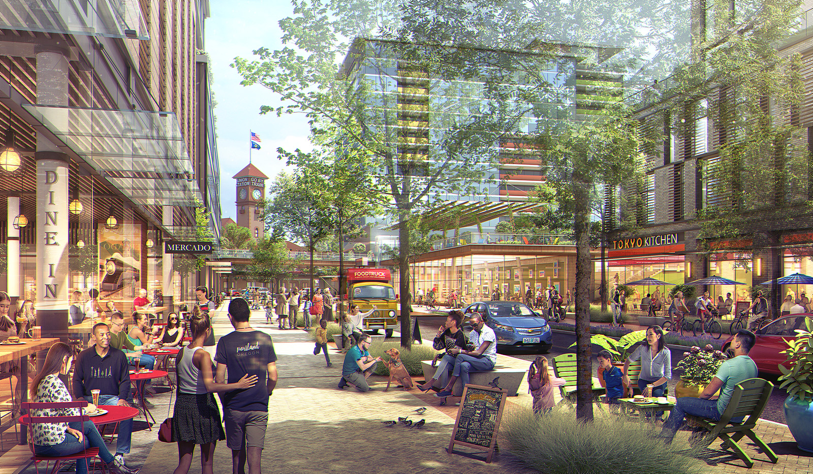



Potential
4,000,000
SQ. FT. OF DEVELOPMENT
4,000 to 8,800
JOBS
1,800 to
2,400
NEW HOUSEHOLDS
Notes:
The USPS site provides us with the opportunity to reimagine to central portion of Broadway Corridor into a 21st century center of commerce as a welcoming place for new Portlanders and those whose families and communities have long ties to the district .
Connecting the Pearl and Old Town/Chinatown, development of the USPS Property could house between 1,800 to 2,400 new households and support between 4,000 and 8,800 jobs.
This reflects nearly 10% of the jobs and residence projected to be added to the Central City by 2035
If this growth needed to be absorbed into other locations in our region, it could take 400 acres of land and hundreds of millions of dollars of infrastructure investments to serve this same number of jobs and families with greater climate and transportation impacts for our region.

Slide 7
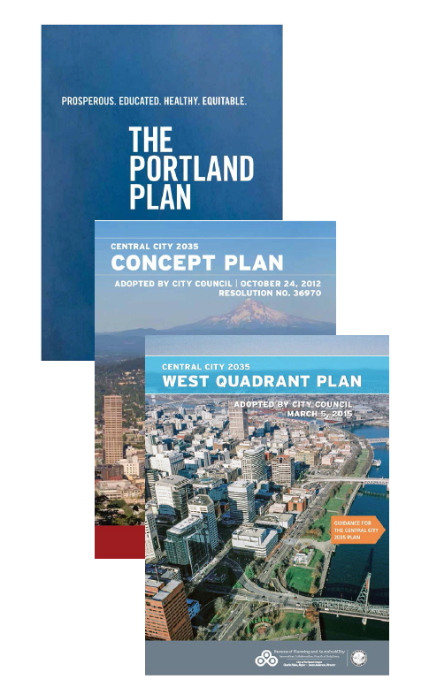


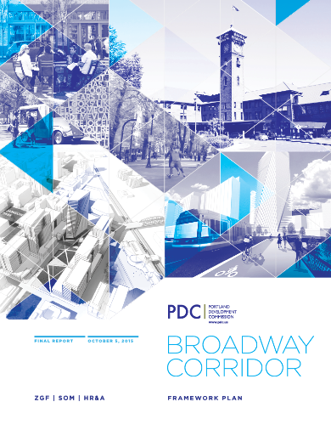

Context & Background
ACQUISITION
$74.5M
Prosper Portland
$14.5M
PHB
10%
Accommodated over next 20 years
GROWTH
LOAN
$35M
City Line of Credit
Notes:
Redeveloping the Post Office site has long been a goal of the City of Portland – going back to at least the 1988 central city plan. In the West Quadrant and Central City 2035 plans the site was identified as perhaps the most significant opportunity within Portland’s Central City.
In October of 2015, as negotiations with the USPS showed promise, City Council approved the Broadway Corridor Framework Plan, which provided information on the financial viability of acquisition and public investment.
To execute on the acquisition and the Framework Plan, Council authorized an up to $40 million line of credit backed by River District income which includes USPS land sales as the first line of repayment - anticipated to be repaid in 2021 or 2022
At that time, Council action also established high-level expectations for the site – including that 30% of the residential units would be affordable
In partnership with Portland Housing Bureau, Prosper Portland then acquired the site in 2016 for an acquisition price of $88M, which was used by USPS for relocation to Collwood Industrial Park
Pursuant to the 2015 Framework Plan, City Council also approved increased height and FAR entitlements on the site.
With those changes, the site can accommodate 4M sf of mixed use development

Slide 8
“...people of color, most of us have been really pushed aside. And I think we owe it to the fabric of our community, to make it so that it [the Broadway Corridor] addresses everyone in it.”
Participant in Displaced Residents Roundtable
Community
Notes:
As we gained ownership of the site, we set out to approach this project differently than past major development opportunities that Prosper and the City have been involved with.
We undertook an Racial Equity Impact Assessment, where we examined ways Prosper previously engaged in large development agreements and identified ways to interrupt the status quo and bring about more equitable outcomes.
As a result we engaged diverse stakeholders through a steering committee and our community engagement process very early in the project – even before we selected our development partner – and committed to engaging in a community benefits agreement.

Slide 9
Steering Committee
Bridget Bayer, Main Street Alliance
Andre Bealer, NAMC-Oregon / MCIP
Gale Castillo, Hispanic Chamber
Joy Alise Davis, Portland African American Leadership Forum
George Devendorf, Transition Projects
David Dysert, Pearl District Neighborhood Assn.
James Faison, Faison Construction
Elaine Friesen-Strang, AARP
George Galster, Retired Economics Professor
Donald Genasci, University of Oregon
Jose Gonzalez, Miracle Theatre Group
Kelly Haines, Metropolitan Alliance for Workforce Equity
Mike Houck, Urban Greenspaces Institute
Nathan Kadish, Ecotrust
Christian Kaylor, Oregon Employment Department
Elizabeth Leach, Leach Gallery
Janet LaBar, Greater Portland Inc.
Neil Lee, Chinese Consolidated Benevolent Assn.
Peg Malloy, Portland Housing Center
Ana Muñoz, Latino Network
Willy Myers, Prosper Portland/Columbia Pacific Bldg Trades
James Paulson, JMPDX LLC / Worksystems Inc. Board
Tyrone Poole, OneApp
Jay Richmond, Oregon Tradeswomen
Sam Rodriguez, Mill Creek Residential
Vivian Satterfield, Verde
Amanda Saul, Home Forward
Jeremy Simer, SEIU Local 49
Sarah Stevenson, Innovative Housing, Inc.
Nate Stokes, IUOE, Local 701
Michael Szporluk, Self-employed
Rick Turoczy, PIE
Don Tuski, Pacific Northwest College of Art
Alicia Daniels Uhlig, International Living Future Institute
Paul Vanderford, Sustainable Northwest
Oscar Arana, NAYA
Ian Williams, Deadstock
Notes:
The Broadway Corridor Steering committee was comprised of 37 people representing a diversity of community, private and non-profit organizations, geographies and lived experiences.
From Spring 2017 to Summer 2019, the Steering Committee advised Prosper Portland and the Portland Housing Bureau on goals for the project including:
Criteria for and selection of a development partner(s) ;
Priorities for mix of uses, equitable engagement, and community benefits; and
The physical configuration of streets, parks, greenry and sustainable practices.

Slide 10





Community Engagement
1,004
TOTAL ATTENDEES
5
PUBLIC
MEETINGS
6
POP-UP
EVENTS
22
COMMITTEE
MEETINGS
4
ONLINE
FORUMS
10
FOCUS
GROUPS
Notes:
Alongside the Steering Committee process, we sought to engage a diversity of community members in a meaningful way.
Over the course of 18 months we:
Held 5 Open Houses and
6 pop-up events (from Union Station to Rosewood).
We hosted 4 online forums to solicit input from community members not able to join in person. And we
Facilitated 10 focus groups in partnership with Lara Media and JLA Public Involvement with important groups like low-income residents of the Broadway Corridor, individuals with disabilities, faith leaders, the Japanese-American community.
Through this engagement more than 1000 people provided meaningful input.
Recognize June Reyes, Mayra Arreola, Victoria Lara and everyone who helped shape this engagement and encouraged robust participation.
and with a disproportionately high participation from people of color.
13% AA, 13% latinx; 7% API; 55% White vs. City as a whole at 77%

Slide 11









What We’ve Heard
AFFORDABLE COMMERCIAL SPACE
COMMUNITY / FLEXIBLE SPACE
AFFORDABLE HOUSING
M/W/DBE CONTRACTING
ENERGY, WATER, MATERIALS, RESILIENCY
LIVING WAGES
WORKFORCE DEVELOPMENT
TRANSPORTATION DEMAND MGMT
MONITORING / OVERSIGHT
Notes:
Through this engagement we heard specific recommendations – like those you see reflected here – for affordable housing or active community space. (Find more in the report)
The Steering Committee helped us digest the feedback we received and established a set of guiding principles that became our collective north star. The guiding principles included ensuring the project fostered accountability, connections, equity, prosperity, resilience and vibrancy.
We deeply appreciate the Steering Committee for their commitment of time and expertise to the project; look forward to having Council have the opportunity to hear from some of those partners shortly.

Slide 12
Portland’s Next Great Place
“I think just having a place that’s really diverse with all and feels welcoming is a big part of it. Make it feel comforting for all, because in Portland there’s a lot of diversity and cultures so it should reflect that diversity”
Participant in Workforce Focus Group
Notes:
In keeping with these aspirations and values – we envision Broadway Corridor as Portland’s next great place.
A place that holds a significant role in the hearts of Portlanders - alongside Pioneer Square, Peninsula Park, the Gateway Discovery Park, or the Portland Mercado – and is meaningful to those who call the neighborhood home, their place of employment, or the location to open their first retail shop.

Slide 13
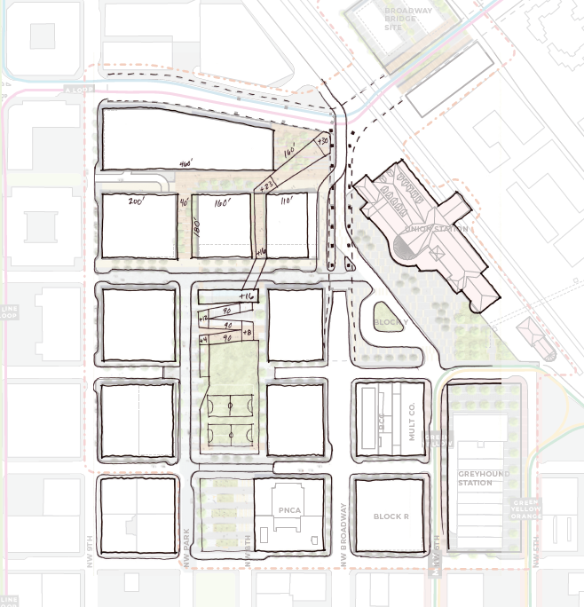

Portland’s Next Prosperous Place
Foster economic opportunities and wealth creation
Major employment opportunities
Retail main street
~6,000 construction jobs
Business technical assistance & workforce development
Quality job standards for janitorial and security services
Anchor Employer Recruitment Opportunity
Regional Transportation
Hub
Affordable Main Street
(Commercial & Residential)
Small Business /
Market Activation
Community Programming and Integration of Nature
PNCA
Notes:
As envisioned, this project will foster economic opportunity for people of color and women, through quality jobs, small business opportunities, and from construction through operations.
This map shows the site plan with anticipated uses -including prioritizing small business opportunities along the Main Street – NW Johnson.
The Northern end will provide opportunities for anchor employers and a diversity of office and retail uses.
The private development will create approximately 6,000 construction jobs and include workforce diversity and apprenticeship requirements as well as the use of at least 20% MWDBE firms.
The City’s infrastructure work and Prosper's demolition of the USPS facility will align with the City’s CBA standards – normally reserved for projects over $25M - and will result in augmented COEP 1% contributions to support business technical assistance & workforce development.
I’ll also highlight Continuum’s willingness to the use of responsible contractors in all commercial buildings for janitorial and security services on site
This designation ensures they provide good wages and benefits, prioritize worker safety, and allow for employees to have a voice on the job.

Slide 14
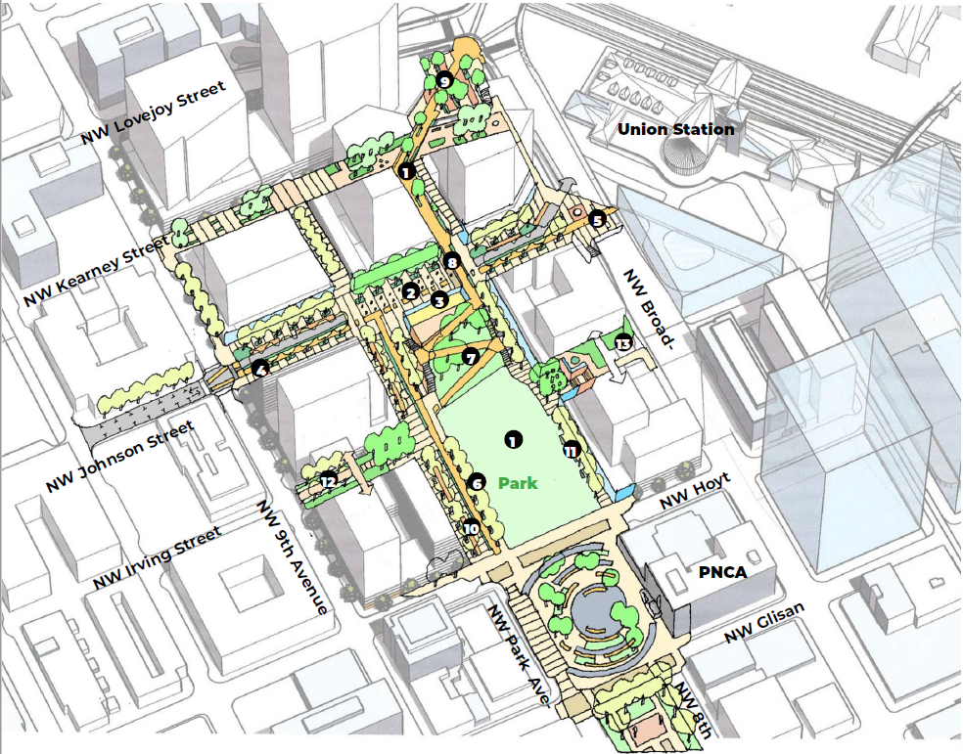





Portland’s Next Connected Place
Create a unique and stunning space that attracts, welcomes and reflects diversity and is accessible to the broader community
Two additional North Park Blocks plus PNCA Park
Extension of NW Kearney, NW Park Ave and NW Johnson, including cycle track
Bike and ped connectivity via the Green Loop extension
85% Non-SOV modal target
Notes:
The Broadway Corridor site is at the heart of a transportation network that includes light rail, streetcar, and bus, as well as the Union Station.
Our vision builds on this infrastructure to create a unique, accessible, diverse and stunning space that increases connections to people across the region.
We foresee a new terminus to the North Park Blocks with a large gathering area that feels welcoming to all ages and abilities, fosters a space for community interaction, and allows for different activities and needs.
We envision a people- and pedestrian-friendly public realm with the extension of NW Kearney, Park Ave and Johnson, which will encourage east-west ped and bike traffic.
A similar north-south connection via the Green Loop that climbs from street grade to the Broadway/Lovejoy ramp will help meet a goal of 70-85% non-single-occupancy-vehicle trips by 2035
while creating a signature Portland element that connects east Portland and the Broadway Bridge directly into the North Park Blocks.

Slide 15
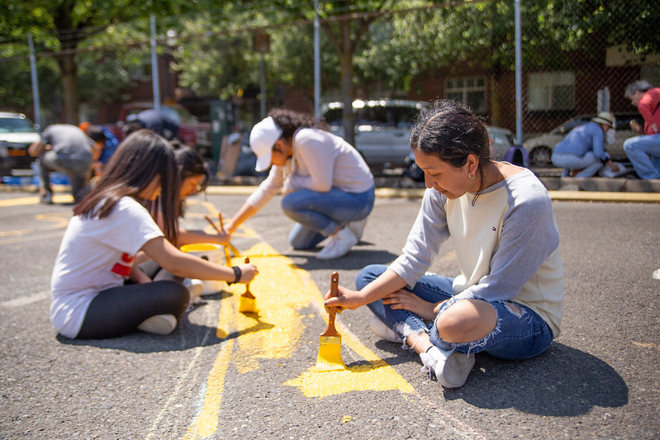


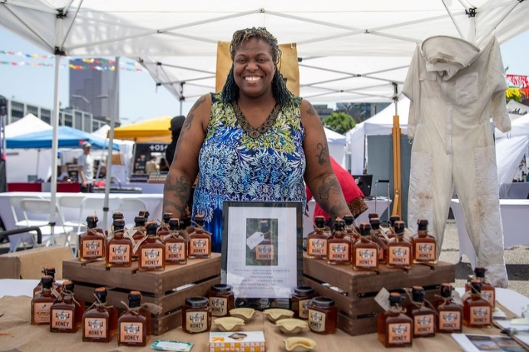
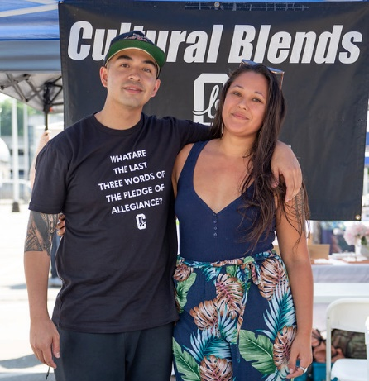
Portland’s Next Inclusive Place
Promote social equity, reduce disparities and extend community benefits.
High-quality affordable housing (720 units)
  Community space & programming
  Public art
Affordable Commercial Tenanting
  Oversight model that includes community voices
Notes:
We have also thought long and hard about the people that will live, work and play in this place.
And how to ensure that it is intentionally and overtly welcoming and accessible to people of different races, ages, household sizes, and incomes.
Building on the Framework Plan, our vision includes a firm commitment to 720 affordable housing units – at site adjacent to the district’s central amenities.
We have planned for community space for programming and for public art that will honor and reflect the history of this neighborhood while celebrating and empowering diverse communities.
We’ve committed to creating opportunities that foster wealth creation for diverse, local businesses; and to pursuing property investment and ownership structures to increase asset development for communities of color.
And, in a less visible – put equally important way, our approach to development and accountability will model partnership and inclusion.
We intend to create an oversight model that supports implementation of this plan and includes community voices along side developers and contractors through construction and build out of the site.
Photos: Summer 2019 My People’s Market at the USPS site.
Top: kids mural project; bottom L: Lee Hedgmon, Barreled Bee Honey; bottom R: Troy Douglass, Cultural Blends streetwear brand (& friend?)

Slide 16
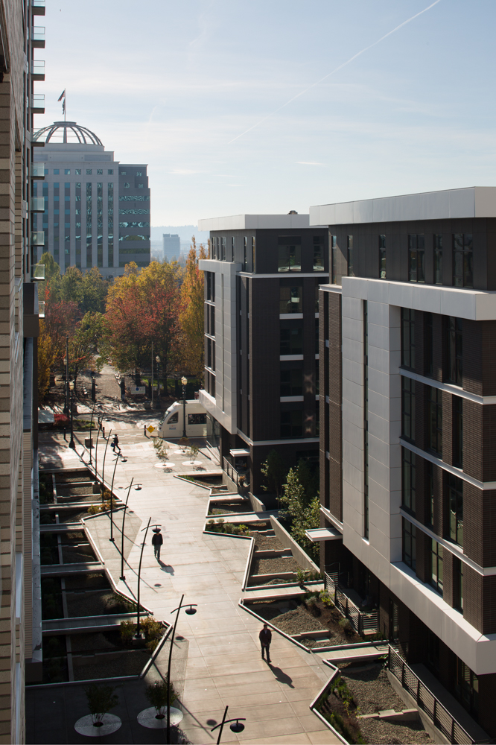



Portland’s Next Resilient Place
Demonstrate leadership in sustainability
High environmental standards in project design, construction and development
Transportation demand management
Alternative energy strategy striving for net zero carbon
20% open space via parks and green loop
LEED Gold certification on new private development
Notes:
And, finally, this project will further the City’s climate action and resilience objectives through high environmental standards in project design, construction and development.
Starting with a requirement that all new development achieve LEED Gold standards or better
We are working to identify alternative energy strategies that strive for 100% renewables with the long range Climate Action Target of net zero carbon,
And we know transportation demand management – from parking pricing or transit incentives - will be an important compliment to the infrastructure investments.
Photo: Hassalo on Eighth

Slide 17
Partnerships & Implementation
“I believe that we have an opportunity to influence the next generation of development of the City and I want be part of it.”
James Paulson,
JMPDX LLC, Worksystems Inc. Board, and Steering Committee Member
Notes:
With a vision so large, we know that no one entity can bring it to life.
Partnership and collaboration have been essential to get us to this point – and, I think it’s safe to say – an even broader team will be needed to deliver on that plan over the next 20 years.

Slide 18
Project Partners
Project Components
City Partnerships
  Portland Housing Bureau
  Infrastructure Bureaus – PBOT, Parks, BES, Water
  Office of Management & Finance
Community Partnerships
  Steering Committee
  Community Benefit Agreement / Healthy Communities Coalition
  Development Partnerships
    Continuum Partners
    Future Affordable Housing Developers
  Sustainable Energy Infrastructure
  Portland General Electric
  Northwest Natural Gas
  Bureau of Planning & Sustainability
  Consultant Team
    ZGF
    Place
    WLR Consulting
    Randy Blazak
    Akana
    Arup
    Toole Design Group
    Kittelson
    Brightworks
    KPFF
    Rider Levett Bucknall
    Project for Public Spaces
    EcoNorthwest
    Studio Jelly
    Lara Media
    Collaborative Design + Innovation
    Jones Lange LaSalle
    Puttman Infrastructure
    Estalano Advisors
Notes:
We are deeply appreciative of the partners that have walked with us thus far.
We want to recognize the enormous investment of time and talent by our City Partners from PHB and PBOT to BPS, BDS, Parks, BES, Water and OMF.
From an Affordable Housing Strategy to planning for open space, Green Loop, or street designs to detailed engineering and financing discussions about utility upgrades, construction, or procurement for the City’s infrastructure investments, each of these Bureaus have contributed creativity and commitment to create a shared City approach.
We want to acknowledge and appreciate the instrumental role Heathy Communities Coalition has played to setting our path.
HCC let us know early on in the process that they intended to negotiate a CBA for this development so we've been on this journey together for three years
They've made a positive difference at each step along the way and we appreciate their partnership – and Vivian’s leadership throughout
.
Continuum Partners was selected as our development advisor based on their experience and commitment to triple-bottom line development.
They have been at and stayed at the table over the past two years.
Their advice has been invaluable in the process working through issues from truing up costs to design solutions.
We appreciate their commitment to finding implementable ways for the private sector to push the envelope on community benefit outcomes.
We appreciate the ingenuity that PGE, NWN and BPS have brought to the table to together identify a market-based approach to reducing carbon reliance.
And we’ve been supported by a mighty team of consultants - listed here – that has presented and spoken to Portland’s many neighborhoods, encouraged and digested public feedback, created beautiful renderings, investigated the history, advised us on feasibility and brought their unique design talents and vision to this project.

Slide 19




Implementation Framework
Master Plan Land Use Approval
Design Commission
Disposition & Development Agreement
Continuum, Prosper Portland
Community Benefits Agreement
Healthy Communities Coalition, Prosper Portland, Portland Housing Bureau
Intergovernmental Agreements & Land Transfer
City of Portland Bureaus: Parks, Transportation, Environmental Services, Water, Housing
Notes:
As we’ve briefed you and your staff, we’ve often used the analogy of trying to land four airplanes at once as we prepare to kick off implementation of the vision.
Because we’re in active negotiations – meaning we haven't yet fully landed on some key terms - I’ll just touch on the scope of the agreements.
The Master Plan is currently in for review by Design Commission and will establish infrastructure standards and building envelopes within which development can occur.
The Disposition and Development between Continuum and Prosper will focus on the sale of the properties of the northern end of the USPS site over the next decade together with related development, infrastructure and CBA requirements.
Since summer 2019, Prosper, HCC, and Continuum have met to negotiate a Community Benefits Agreement (CBA) that will reflect both public and private commitments – some of which will be carried on to the DDA and IGAs.
We are currently working on reaching tentative agreement on a term sheet that would speak to:
Construction equity
Operations
Affordable housing
Sustainability
Business equity
Tenanting and
Oversight
And finally, public infrastructure and affordable housing land transfer commitments will be executed via individual Intergovernmental Agreements (IGAs)– with pHB, PBOT, Parks, BES and Water.
These agreements will detail funding and finance responsibilities by public and private parties, relevant elements of the CBA, and delivery expectations.

Slide 20
Public – Private Investment
NW Johnson, Kearney, Park Ave, Off-site Signals = $30.5M
Off-site utilities = $5M
Open Space = $9M
Green Loop = $32M
Market Rate Residential & Commercial Development $1B
Notes:
As a true public/private/community partnership, the elements of the agreement are closely tied to and must align with one another.
We cannot accomplish the vision we’ve set forth today without significant private commitment and capital to execute on those outcomes.
We anticipate that our development partners will need to secure about $1B in outside capital to deliver on this project over the next 15-20 years.
Public investment in site acquisition and preparation is around $125M – which is essentially supported by River District Tax Increment
Future public and private investments in streets, open space and utilities will be about $75M. And are working with Bureau partners to align public infrastructure financing – like SDCs - to public infrastructure priorities, as well as to identify private infrastructure financing mechanisms like Local Improvement Districts.
Shannon will speak separately about the capital required to deliver on affordable housing so that is not included in this chart.
The yellow portion – currently TBD – represents those particular community benefits that will require additional investment with tools outside of the City or private sector’s conventional means and will need to be found from land sales or bringing other additional resources to bear.
We look forward to engaging with Council further at the Feb 4 work session to review agreement negotiations and investment scenarios in further detail and to receive direction from Council.

Slide 21
“The only thing that’s really going to do it is people. People being involved in owning their community.”
Next Steps
Participant in Low-Income Residents Focus Group
Notes:
We wanted to close our section today with some specifics around immediate next steps that Council and the community can expect on the project.

Slide 22




Coming Soon
City Council Executive Session – Feb. 4
Design Commission Master Plan Hearings
– Spring 2020
City Council Action – Spring 2020
Finalize and Implement the Interim Activation Plan – Summer 2020
USPS Retail Relocation & Building Demolition Contracts – 2020 through 2021
Notes:
We'll be back to discuss the negotiations in an executive session on Feb 4 with you - when we’ll be seeking input on key terms of the agreements.
This spring, Design Commission will hold hearings on the master plan and we'll bring the key DDA, CBA and IGA terms sheet to you for your consideration.
We're also moving forward with interim activation plan, re locating the USPS retail to the adjacent garage and pursusing demolition of the vacant buildings.
So, with that, I'd like to hand it over to Shannon to discuss the affordable housing strategy for the site.

Slide 23
“Is it for the people who are already existing and living in those high-rise apartments and can already afford the area? Or are we going to welcome a new breed of income in that area that will actually be able to afford to live in that area? I want to be able to come down there as well, I want to be able to feel like it’s not out of my league.”
Affordable Housing
Focus Group Participant

Slide 24
Affordable Housing Commitments
PHB invested $14.5M to acquire 16% of development rights to help finance housing that thoughtfully engages the community and is responsive to different household types and needs. The strategy has shifted but the goal remains the same.
 | 2016 | 2020
Estimated Affordable Housing Units | 720 units total | 720 units total
Est. Inclusionary Housing Affordable Units | 187 IH units | 80 IH units
Est. PHB-Financed Affordable Housing Units | 533 units | 640 units
% Residential Units affordable at 60% AMI or less | 30% | >30%
Note: The IH units/sf is an estimate and will flux with private development program.
The estimated number of PHB built affordable units is calculated as the conceptual bldg. gsf / 875 sf.
Notes:
PHB

Slide 25
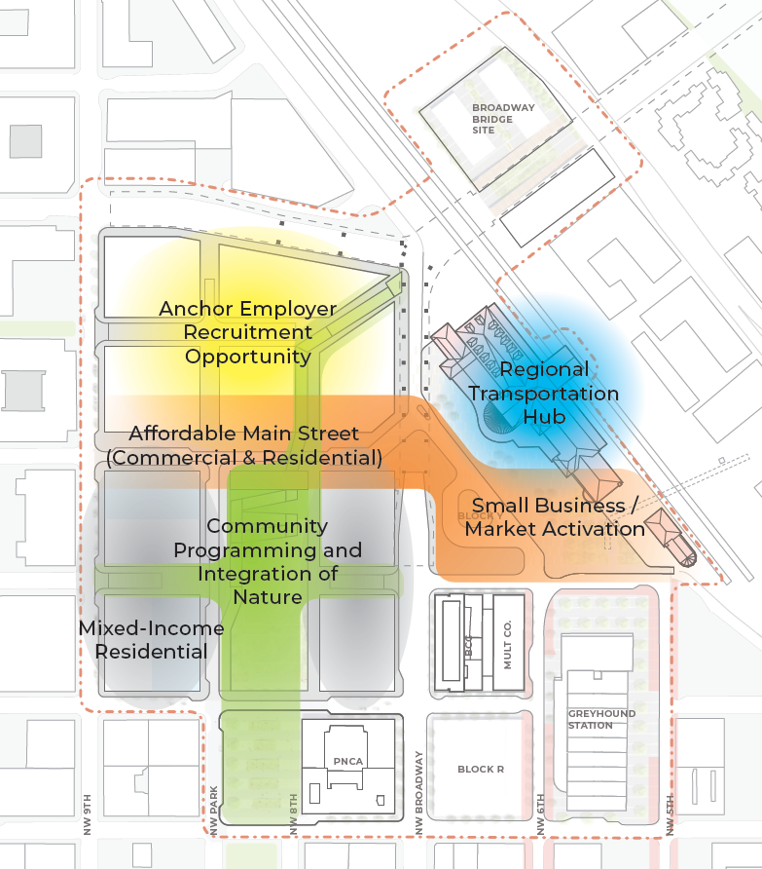
PHB Parcel Selection Criteria
Integrate and Connect Affordable Housing
Values & Goals
Meet shared goal of 720 affordable housing units
Provide for a range of household types and needs
Maximize connectivity and proximity to site amenities and public spaces
Cost effective development
Resident livability and quality of life
Notes:
PHB

Slide 26
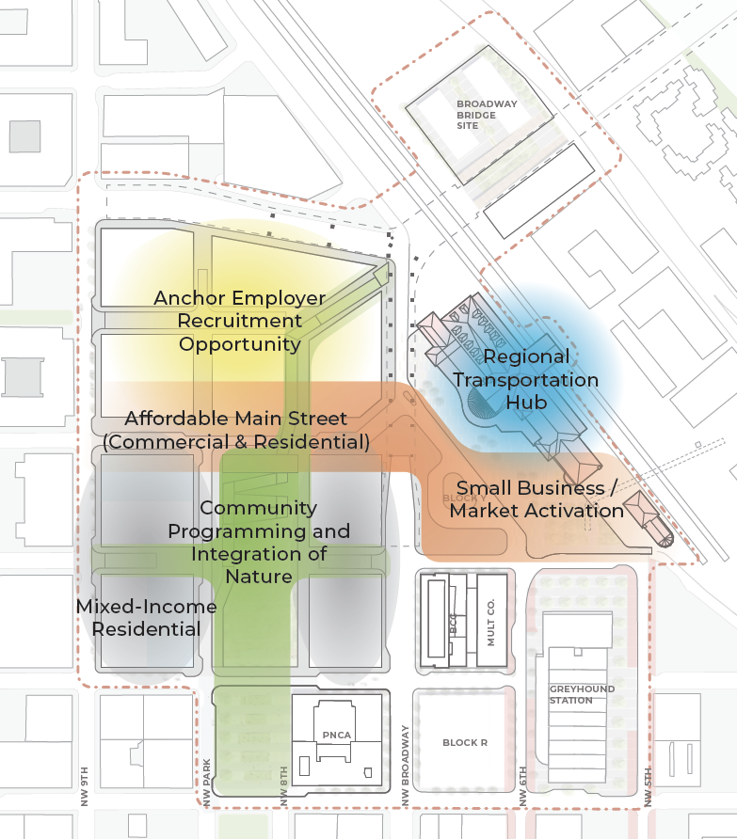
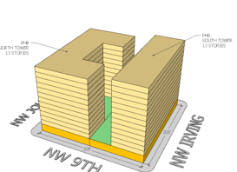
PHB Parcel Selection: Full Block
North Tower
13 stories
252 Total Units
South Tower
13 stories
188 Total Units
Total Units = 440
~80 Units via Inclusionary Housing¹
~ Need Additional 200 units
PHB
PHB
¹The IH units/sf is an estimate and will flux with private development program.
The estimated number of PHB built affordable units is calculated as the conceptual bldg. gsf / 875 sf.
Notes:
PHB

Slide 27
Affordable Housing Land Options
Naito / Broadway
Naito / Broadway Bridge and/or Block R
200 Units
Meets the Values & Goals
Meets shared goal of 720 affordable housing units
Provides a range of household types
Maximizes connectivity and proximity to site amenities and public spaces
Cost effective development
Resident livability and quality of life
PHB
PHB
Block R
Notes:
PHB

Slide 28
Affordable Housing Cost Estimates
 | Masterplan
Estimated Affordable Housing Units | 720 units total
Estimated Inclusionary Housing Affordable Units | 80 IH units
Estimated PHB-Financed Affordable Housing Units | 640 units
Note: All estimated sources of funds based on 2019 market conditions and dollar values
Notes:
PHB

Slide 29
Invited Testimony & Discussion

Slide 30
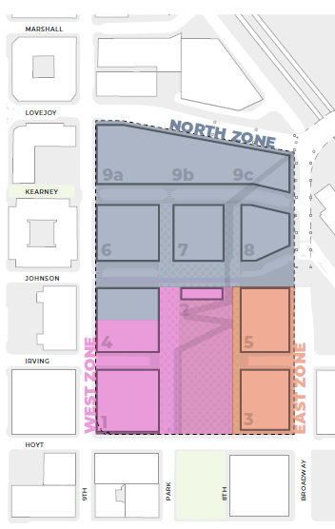


Phasing
NORTH ZONE (~2020-2030)
Provides street and utility infrastructure necessary to support future phases
Accommodates relocation of USPS Retail
EAST ZONE (~2025 – 2035)
Anticipated concurrent to central park space
USPS
Retail
WEST ZONE (~2025 – 2035)
Requires relocation of USPS Retail and demolition of parking structure
Includes central park space and completion of Green Loop
Garage
Notes:
Fortunately, we don’t need to invest 100% of the resources today.
The project will build out in 2-3 phases after we first move the USPS function into the on-site parking garage and demolish the vacant buildings.
The first phase will build out over about 10 years and include key street and utility infrastructure as well as accommodate the final location of the USPS retail.
Build out of the west zone includes the central park space and completion of the green loop and requires demolition of the parking structure.
We anticipate the East zone will be built out concurrent to the central park space as well within the next 15 years.

Slide 31
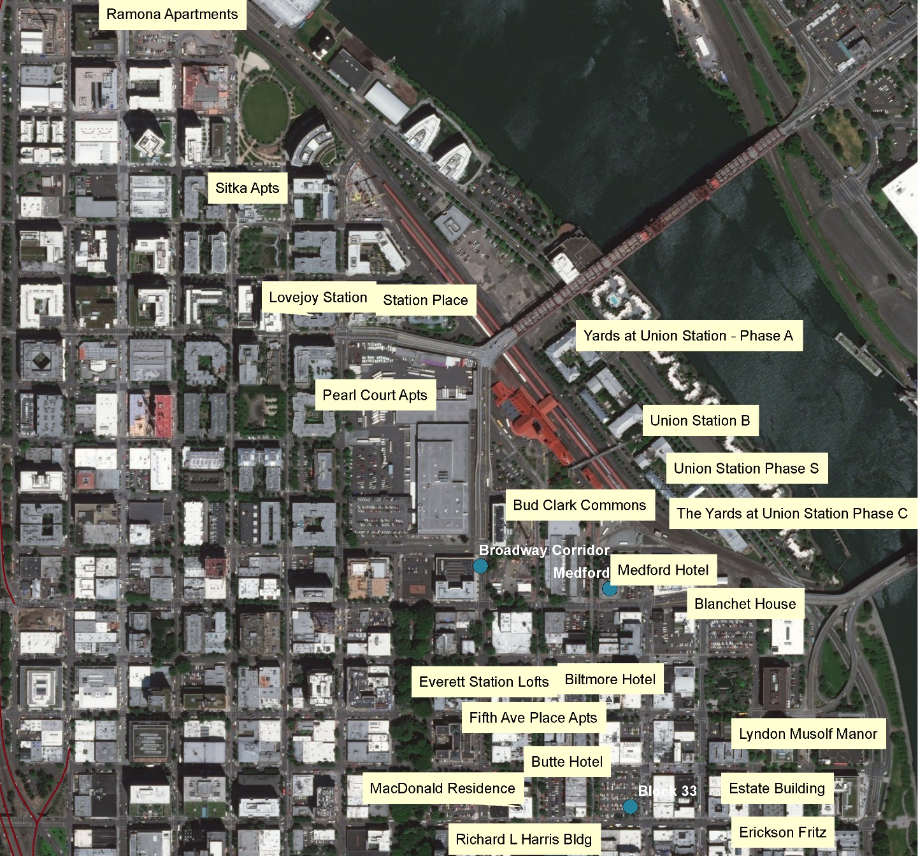
OUR PARTNERS / NEIGHBORS
Notes:
PHB

Slide 32
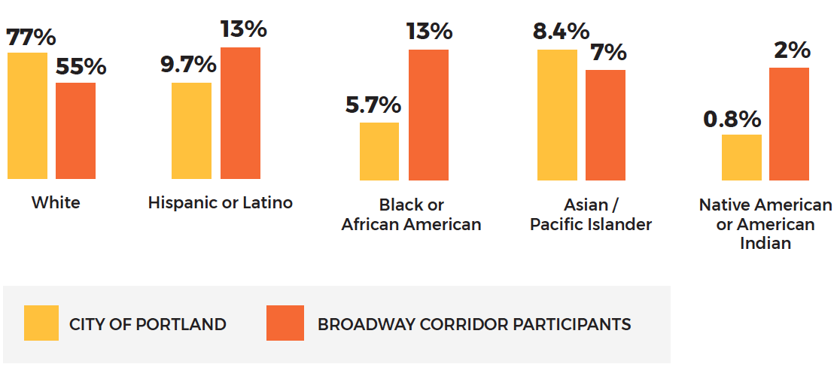
Community Engagement
1,004
TOTAL ATTENDEES
RACE & ETHNICITY

Slide 33
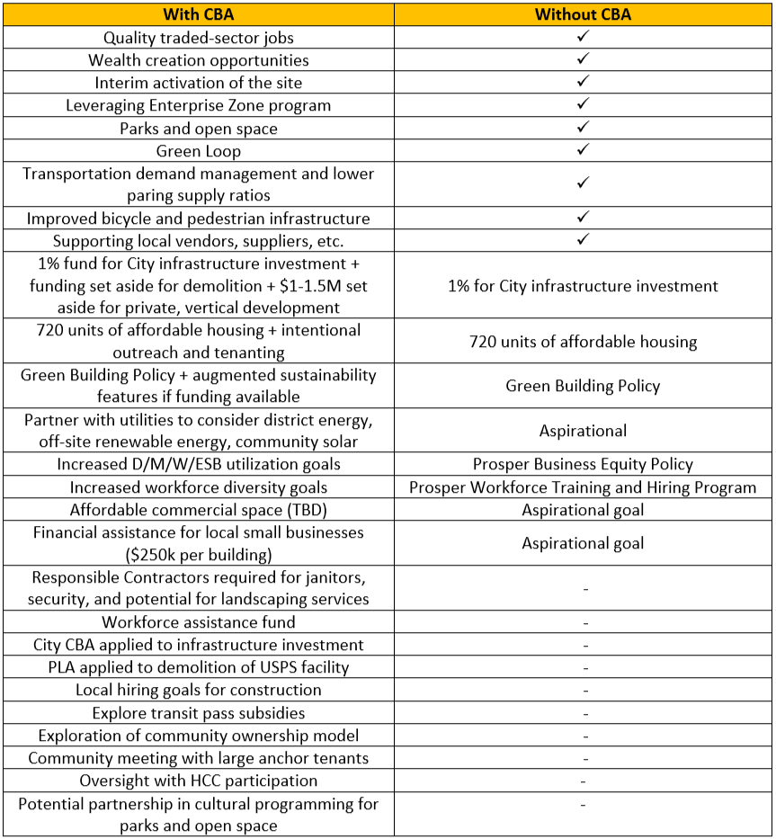
Notes:
. , which will involve compromise.
HCC has conveyed they want to see the CBA 1) apply to the entire Broadway Corridor, 2) include a workforce agreement on all elements of construction (including prevailing wage) and ensure specified job standards for janitors, security, and building engineers, 3) include the City and Continuum a signatories, and 4) contain a legal framework for enforcement and accountability.
Prosper and Continuum have been working diligently to be responsive to these points from the coalition and many of their requests are captured within the draft term sheet all parties are working on.
We have a few negotiations remaining and are committed to reaching tentative agreement on a CBA term sheet that will deliver equitable outcomes for our community, allows for financially viable development, balances the many interests and desires for this site, and recognizes the current uncertainty of elements of the development that will occur on the site.

