Slide 1
Invasive Species Strategy 2020-2030
Dominic Maze & Rachel Felice Bureau of Environmental Services | Portland Parks & Recreation

Slide 2
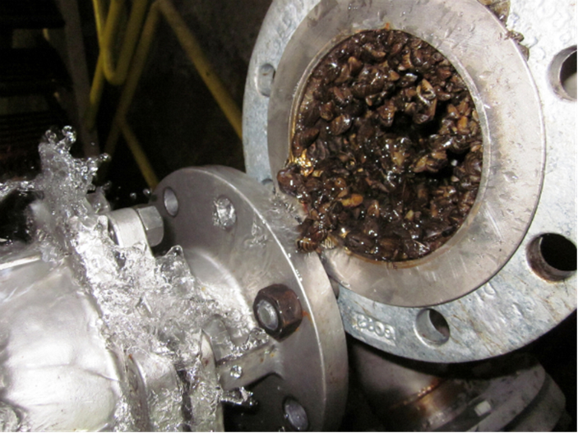
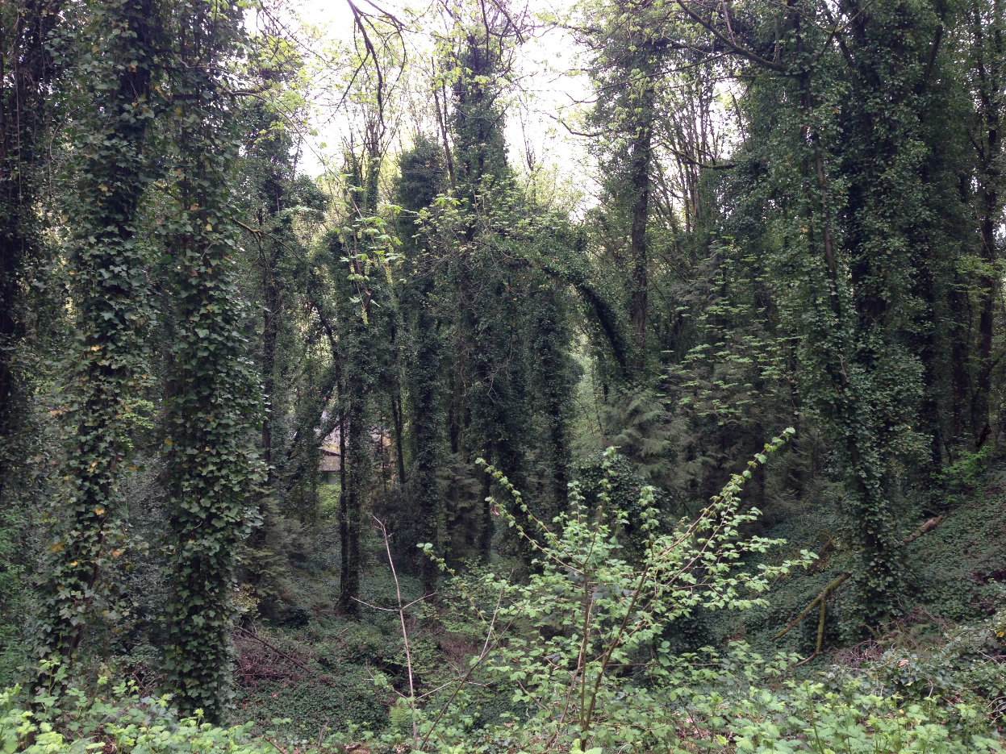
Why Invasive Species?
$120B/yr in US
A dramatic change in habitat conditions
Portland a national leader in invasive species management
Suite of species on Portland’s doorstep
Risk to green and grey assets
Notes:
Define invasive species: plants and animal that come from other parts of the world that wreak havoc on our native habitats, human health and infrastructure.
120 billion and $1 saved via prevention for every $35 in future costs (ODA).

Slide 3
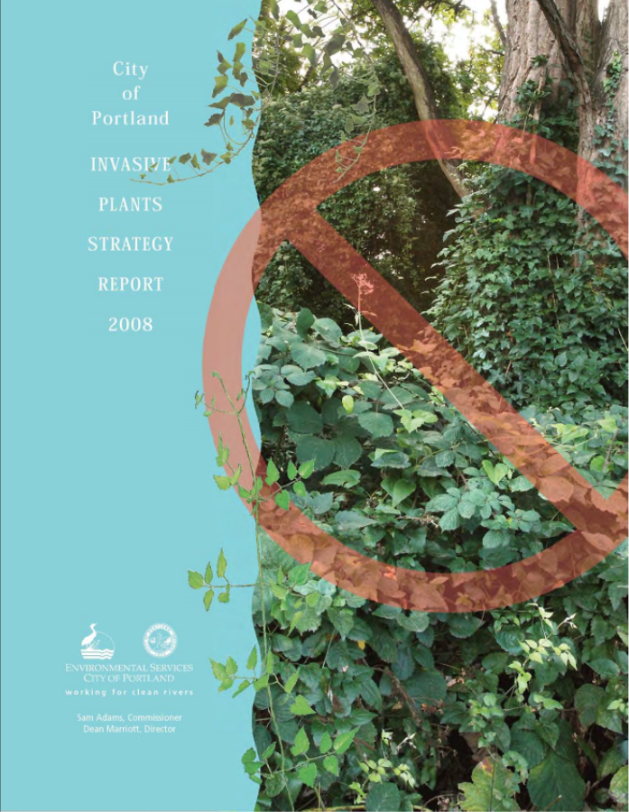
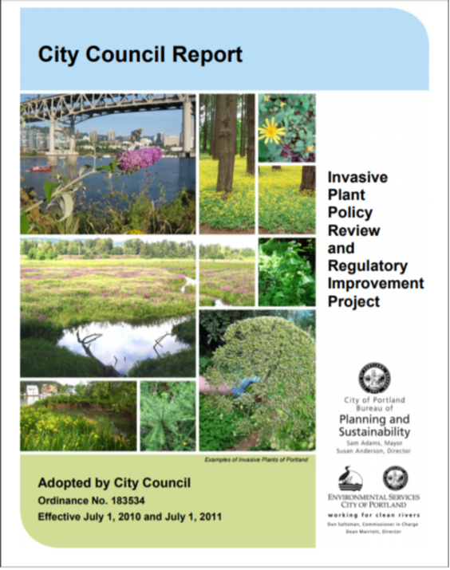
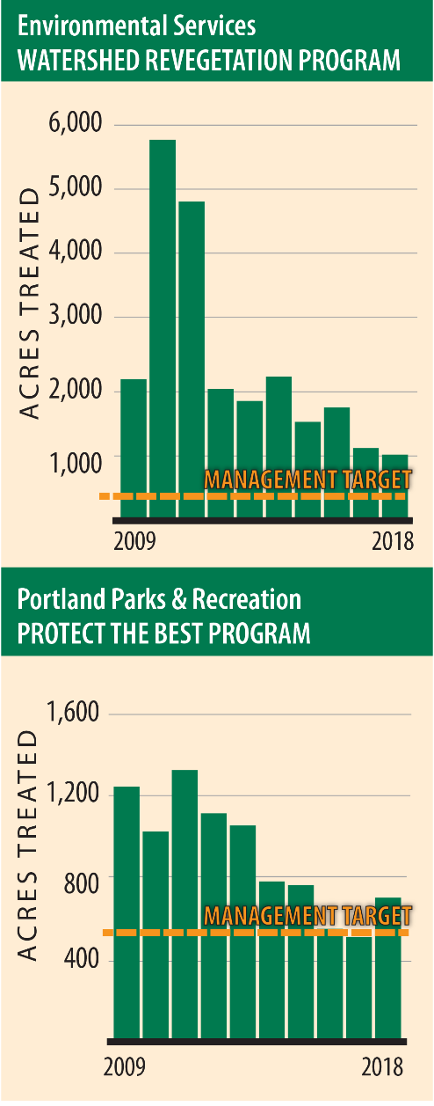
A Decade of Success
2008 Invasive Plants Strategy
Guiding document on vegetation management
Extensive community outreach employed
90% of actions accomplished
Modified code (Titles 11, 29, 33)
Notes:
This council unanimously directed BES to develop an invasive plants strategy in 2005. 7 bureaus completed this work in 2008, Unanimously adopted in 2009 by Council

Slide 4
Notes:
Here we have an animation showing PP&R’s Protect the Best Program (previously co-funded with BES) in action over he last decade plus in Forest Park. The Program works all over the City but this is a great visual of how much work has been accomplished.
This shows WHY so many of Parks have looked so good in the last few years and how big the investment is.

Slide 5
Invasive Species Strategy 2020-2030
Relies on partnerships
BLM,
USDA
ODA, ODF, OISC
Metro, 4Co. CWMA, SWCDs, WIN, CWS, WIN
Friends Groups, Watershed Councils, Port of Portland, OHSU, Forest Park Conservancy, Audubon

Slide 6
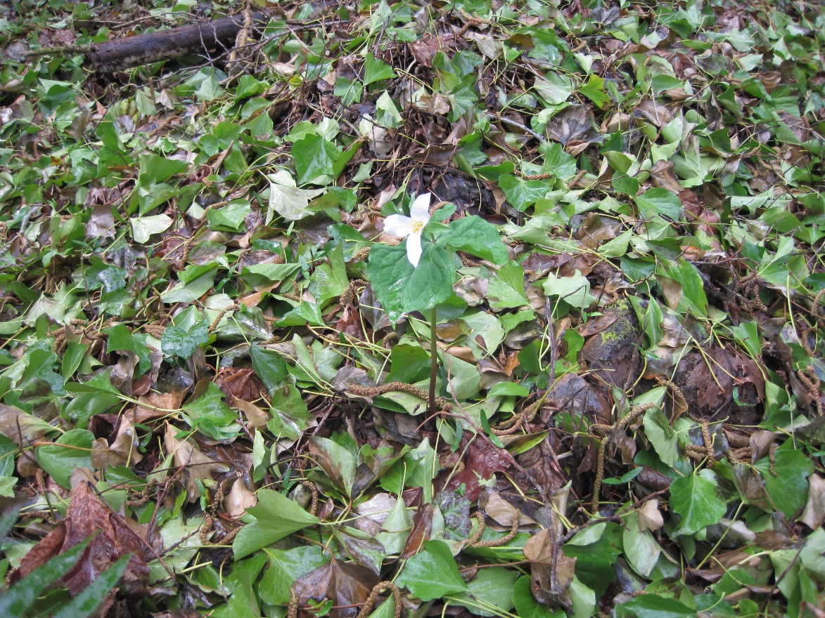
Invasive Species Strategy 2020-2030
Protects our investments
Crafted by 6 bureaus
Asset management approach
Green and grey
Notes:
With our partners at the local, state and federal levels, the new Invasive Species Strategy details how the City will protect our investments and be preventative, rather than just reactive.
Crafted by 6 bureaus.
Employs an asset management approach to assist in identifying what risks are out there and how these risks might damage our natural areas and infrastructure.
Since IS affect both green and grey assets, this is an important early step for the City in standardizing how we value these two types of assets.

Slide 7
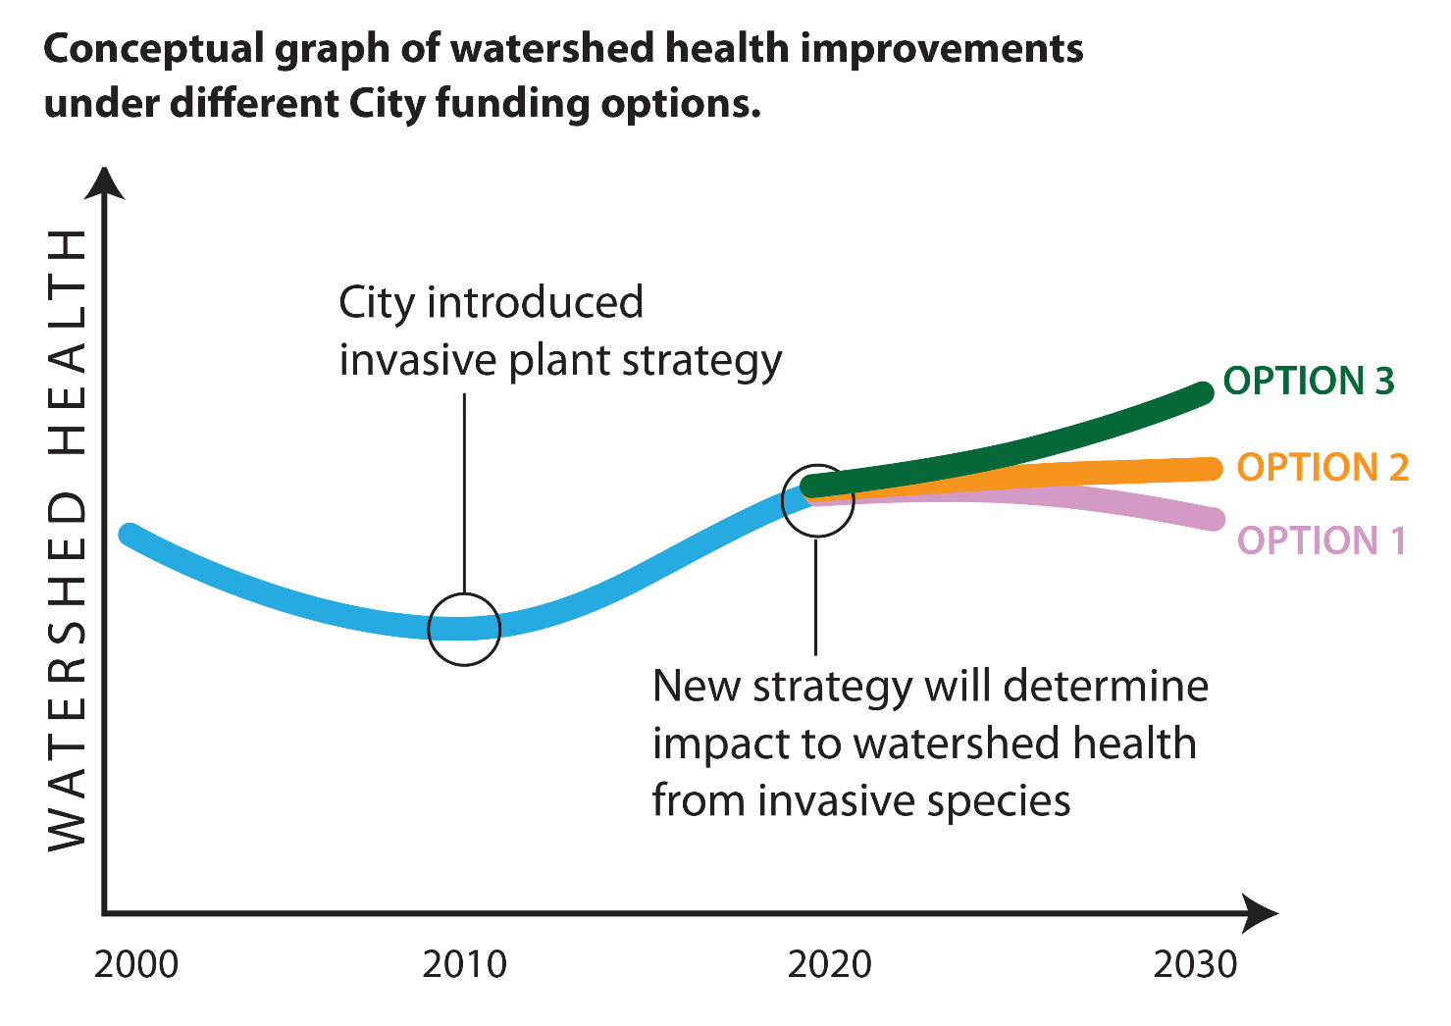
Potential Investments
Developed resource objectives for BES and PP&R
3 options
Notes:
Leveraging Fed, state, and regional capacity, we have developed three potential investment scenarios
As you can see in this conceptual graph of watershed health, the investment the City made in the Invasive Species strategy in 2008 resulted in an increase in watershed health as measured by various City programs.
Today we are at crossroads due to the increase pressures of climate change, increased population and increased movement of people and good worldwide, which are the main ways invasive species arrive in our area
Option one details the City’s current level of investment for invasive species work, but due to the pressures we just mentioned, this will result in a loss of investment in all of the work that has been accomplished over the last decade plus. It is also a reactive approach and not preventative in nature.
Option 2: modest increase over current investment levels, protects our investments we have made as a City over this time, helping to prevent invasive species that threaten grey infrastructure and expanding the focus to include animal species.
Option 3: Similar to option 2 but capabilities are significantly expanded, particularly in natural areas managed by PP&R

Slide 8
Rising to the Challenge
6 goals, workplan, success metrics
Detailed regulatory and pathways analysis
Proactive vs. reactive
Cost savings
Notes:
[Picture: dense stand of wapato, an important first food, in the Columbia Slough.]
Not only have we identified three potential investment levels, we have developed 6 goals that reflect City policy, objectives, partner input and community needs.
We will be better poised to address the invasive species currently in our area, protect our investments against future plant and animal invaders and engage diverse community members in the stewardship of our shared natural spaces.

Slide 9
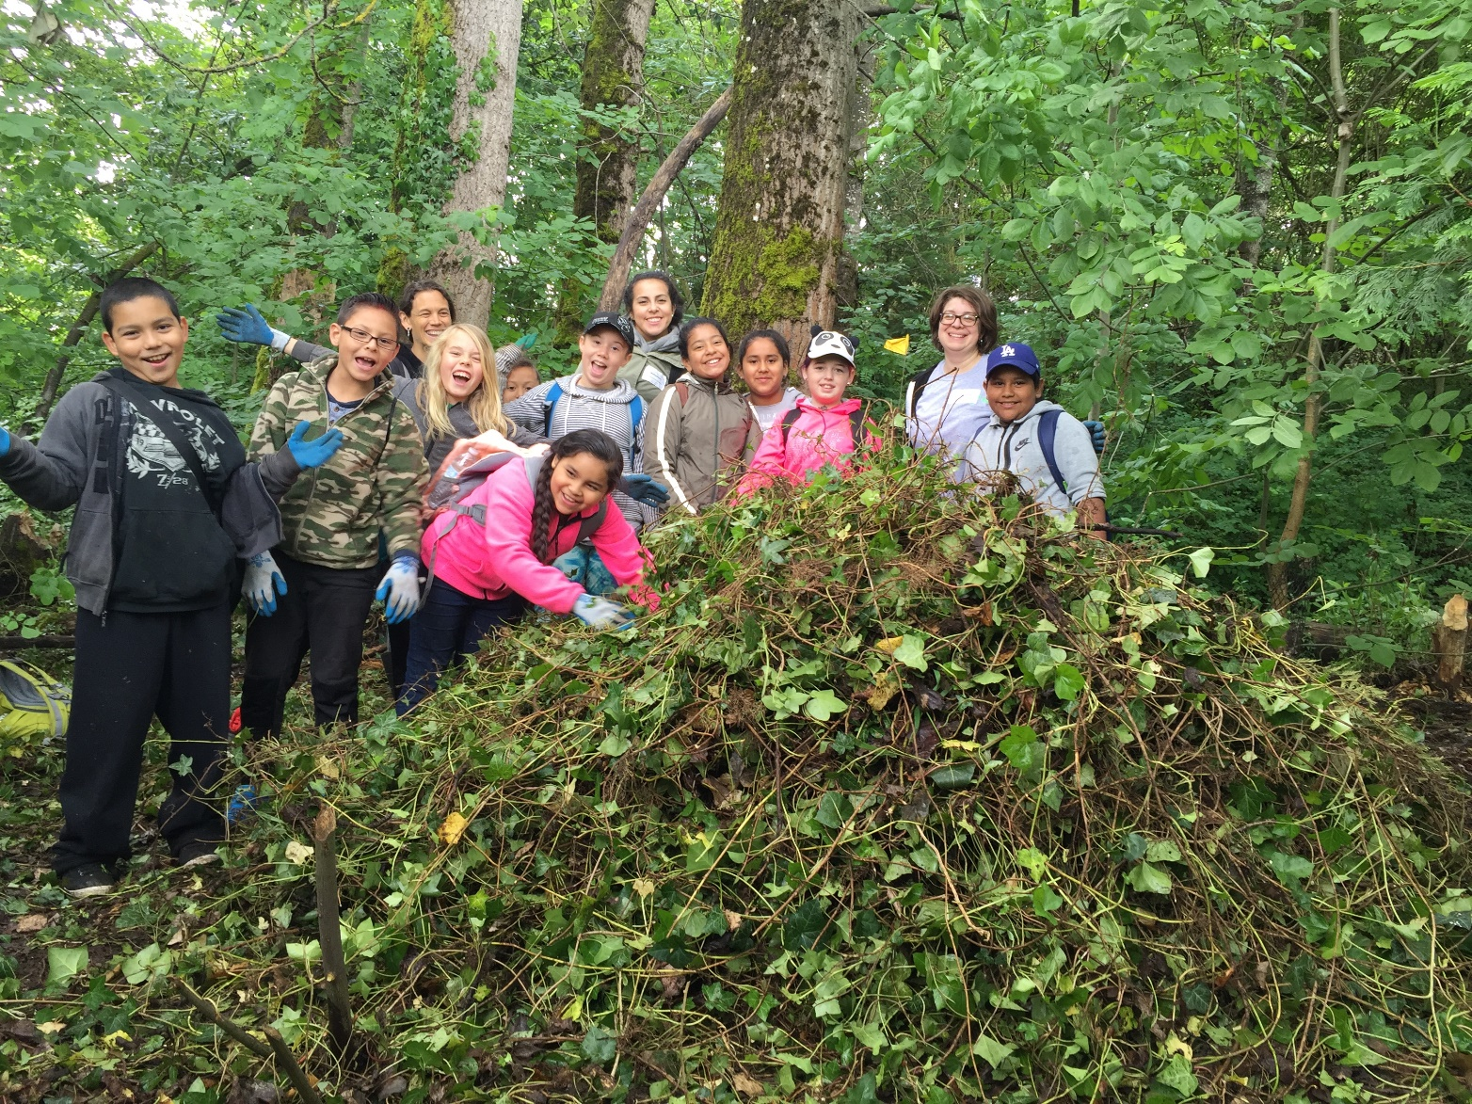
Thank you

