Slide 1
Updating Portland’s Renewable Fuels Standard Kyle Diesner, Bureau of Planning and Sustainability Emily Sandy, Bureau of Development Services
Notes:
Thank you Mayor Wheeler, Commissioners. For the record, I’m Kyle Diesner, Climate Action Program coordinator, Bureau of Planning and Sustainability. We’re here today to talk about the need to update Portland’s Renewable Fuel Standard.

Slide 2
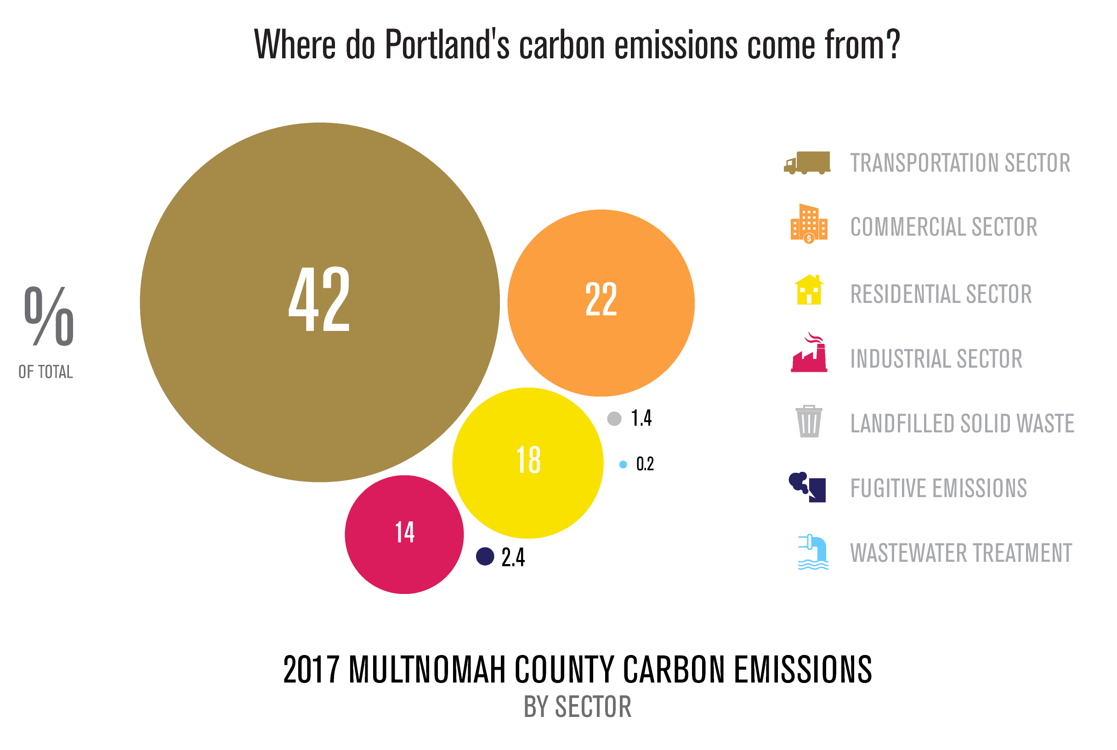
2017 Total emissions are 7,701,120 MT CO2e
Notes:
Portland’s local carbon emissions are dominated by transportation, accounting for 42% of local emissions. These emissions come from driving passenger vehicles, transportation of goods, diesel buses, and other off road mobile equipment, like construction. Transportation is the only sector where emissions have increased over 1990 levels. Today, emissions from transportation have increased 14% over their lowest levels in 2012. The trend is moving in the wrong direction.

Slide 3
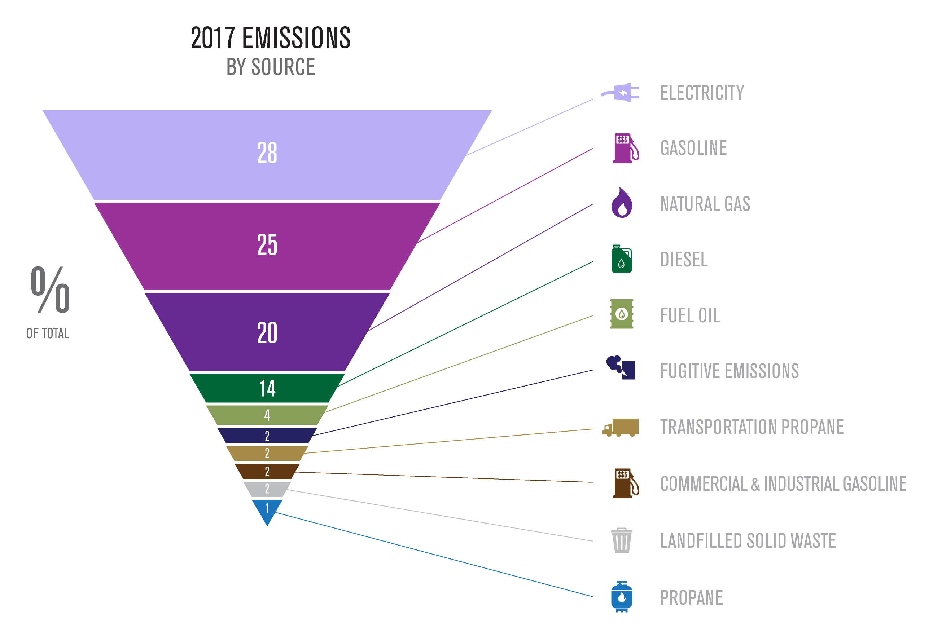
Notes:
This chart shows Portland’s carbon emissions by source. You can see that gasoline is the 2nd largest source of Portland’s carbon emissions, accounting for 25% of total emissions and diesel fuel is the 4th largest source at 14%. These emissions and their share would be higher today, if not for Portland Renewable Fuel Standard.

Slide 4
How to Reduce Transportation Emissions?
Three-pronged approach by City of Portland:
Reduce consumption - reduce number of car trips and mode shift to transit and active transportation
Plan smart communities - affordable, walkable, connected and complete neighborhoods so Portlanders can live close to work.
Use clean energy – for trips that remain, reduce impact by transitioning to electric and renewable fuels
Notes:
Fortunately, we know how to reduce transportation sector emissions and the City is taking steps. The 1st step is for all of us to do our part in reducing consumption of transportation fuels. We can do this by reducing the number of single occupancy vehicle trips, by shifting to active transportation and public transit, and reducing our vehicle miles travelled. PBOT has estimated that to meet our 2030 targets each and every Portlander will need to reduce their driving of internal combustion engines by 50%.
Second, we need to continue to plan for smart and connected communities, that are affordable, walkable, and transit connected. This requires continuing the approach adopted in the 2035 Comprehensive Plan and passing important policies like Residential Infill and Better Housing By Design. Our work on land use planning should enable more Portlanders to live closer to where they work.
Lastly, and why we’re here today, all trips that remain must be decarbonized, by transitioning to electric vehicles and renewable fuels.

Slide 5
Notes:
Here you can see the impact of the RFS on reducing consumption of gasoline in Multnomah County. The RFS corresponds to a 10% reduction in sales of gasoline since 2008, the volume offset directly by ethanol.
This policy was so successful, that the State of Oregon adopted the same standards (House Bill 2210) for all ethanol and biodiesel sold in Oregon and phased in the requirements from 2007-2011. Portland intentionally left the RFS in place, in case State requirements were rescinded or there was a need to take a different approach at the local level. Our rising transportation emissions have elevated the need for more aggressive local policies.
I’m going to hand this off to my colleague at BDS, Emily Sandy, to talk about the RFS standard as it exits today.

Slide 6
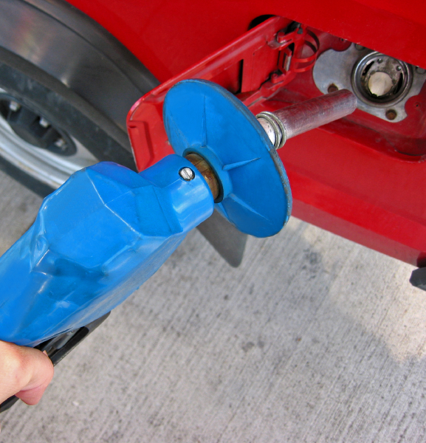
Portland’s Renewable Fuels Standard
What’s required by PCC 16.60?
Portland fuel suppliers must provide a minimum volume of biofuel (biodiesel and ethanol) blended with all transportation fuels sold in the City of Portland.
5% biodiesel in every gallon of diesel fuel (B5)
10% ethanol in every gallon of gasoline (E10)
Notes:
Emily Sandy – For the record, My name is Emily Sandy, Bureau of Development Services.
Portland was the first city in the united states to adopt local renewable fuel standard in 2006. The renewable fuel standard requires fuel suppliers in Portland to provide a minimum volume of biofuel (biodiesel and ethanol) blended with all transportation fuels sold in the City of Portland. This means that every gallon of diesel fuel includes 5% biodiesel and every gallon of gasoline contains 10% ethanol.
The RFS also includes exclusions for fuels produced from Palm oil, and qualifying feedstocks for biodiesel to promote local production.

Slide 7
Portland’s RFS Timeline
2006: RFS was passed by Council
2007: RFS requirements implemented
2009: Administration transferred to Water
2010: Suspended implementation of B10
2012: Administration transferred back to BDS
To Present: BDS receives reports from fuel suppliers and responds to inquiries.
Notes:
The Renewable Fuel Standard was passed in 2006 with the adoption of PCC Chapter 16.60
It assigned administration and enforcement to the Bureau of Development Services, and authorized BDS to promulgate administrative rule to enforce.
Administrative Rules were adopted in 2007
In 2009, due to the economic recession and budget cuts at BDS, the RFS was transferred to the Water Bureau for temporary implementation.
In 2010, also due to the economic recession, the Water Bureau suspended the RFS requirement to increase the biodiesel blend to 10% biodiesel.
The RFS was transferred back to BDS in 2012. Since that time, BDS has been collecting Qualifying Feedstock Origin Declarations forms from fuel suppliers that verify compliance with the requirements, and responding to public inquiries.
In 2018, BPS initiated discussions with BDS to transfer responsibility for administering and enforcing Chapter 16.60 and the associated administrative rule.
BDS is fully supportive of this transfer. BPS has the technical expertise to enforce, monitor, and amend these requirements as needed, and the requirements are clearly in line with BPS' mission.
I’m going to hand back to Kyle Diesner to talk about more recent developments in fuel markets and next steps for the RFS at BPS.

Slide 8
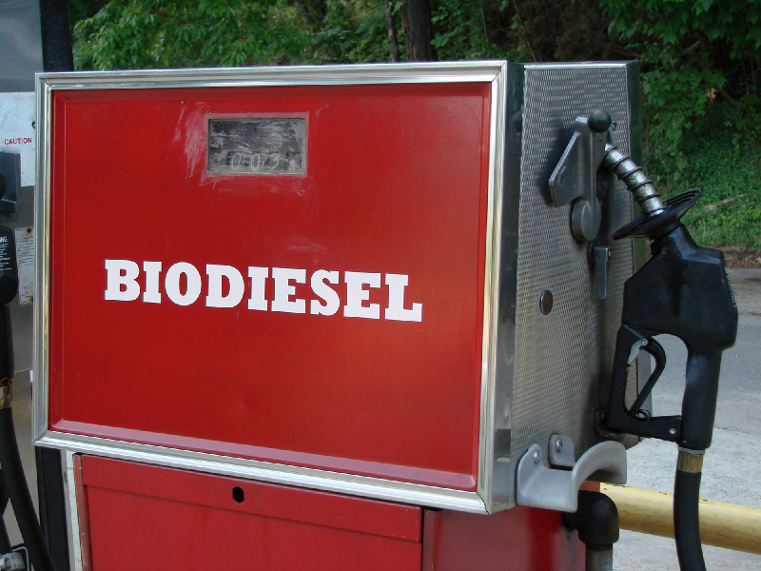
Recent Changes in Fuel Markets
Market for domestic biofuel production has expanded.
New biofuels don’t meet the definitions as defined in PCC 16.60.
The Oregon Clean Fuels Program was implemented in 2016.
Clean Fuels program has 284 different approved feedstock pathways for renewable fuels in Oregon.
Notes:
Market for domestic biofuel production has expanded since 2007. Including new production practices like co-processing of biofuels in fossil fuel production facilities.
New emergent biofuels, like Renewable Diesel, have been developed that don’t meet the definitions for biofuels as defined in PCC 16.60.
The 2015 Oregon Legislature passed SB 324 allowing DEQ to fully implement the Clean Fuels Program in 2016. The Clean Fuels program is intended to reduce the average carbon intensity of Oregon’s transportation fuels by 10 percent over a 10-year period. The program is basically a cap and trade program for transportation fuels. This approach is complementary to a local RFS – which is a volumetric standard. While the Clean Fuels program seeks to reduce a share of Oregon's emissions across the state, the local volumetric standard ensures that higher blends of biofuels are used directly here in Portland.
The local market has grown so much since 2007, that the State Clean Fuels program has 284 different approved fuels. Oregon DEQ certifies fuels on a lifecycle basis depending on their feedstock and production practices.

Slide 9
Lifecycle Carbon Emissions by Fuel (gCO₂e/MJ)
Notes:
The work at Oregon DEQ and also at the California Air Resources Board have demonstrated that not all biofuels are equal. It’s critical that as we promote the increased use of biofuels, we do so on the basis of Lifecyle carbon emissions.
This chart shows lifecycle carbon emissions for approved fuels in Oregon. The data is shown as a carbon intensity - in grams of CO2 equivalents per mega joule – or total carbon emissions per unit of energy.
A lifecycle analysis considers total carbon emissions produced from the full Lifecyle of the fuel, not just tailpipe emissions from vehicles. For example Feedstocks are grown (corn, soy, waste grease collected), harvested, and transported to a production facility. Biofuels are then produced from these feedstocks along with byproducts such as animal feed or corn oil. The fuel is then transported to fuel suppliers. When the fuel arrives in Portland it is blended at the Rack with gasoline or diesel by the fuel supplier and distributed to fueling stations across the City. This lifecycle assessment looks at the total carbon emissions produced throughout the process, so this includes natural gas used for fertilizer, land use changes like deforestation. Looking at fuels by carbon intensity allows us to identify the most environmentally beneficial fuels, not just those with lower tailpipe emissions.
Here you can see the range of carbon intensities for biodiesel and ethanol that have been approved in the State of Oregon for the Clean Fuels Program, as compared to the top two – gasoline and diesel. For example, today the biodiesel at the bottom, with the lowest lifecycle carbon emissions, is produced from waste products, like waste cooking oils and greases. These are collected and processed by local companies, like Sequential Biofuels, to create low carbon biodiesel.
You’ll also notice the lowest carbon ethanol in Portland is from cellulosic corn products. This “cellulosic” material cannot be used as food, so it doesn’t reduce food production, but is a bi-product. We expect non-edible plant material, rather than corn, will become the dominant source of ethanol in the future.
You’ll also notice that even the highest carbon intensity biofuels are still lower than diesel and gasoline. In addition, biofuels are not made from fossilized carbon, so there is no net increase in greenhouse gas emissions from their use. These are called biogenic emissions, or emissions that are part of the natural carbon cycle and do not lead to a net increase in greenhouse gas emissions, as would be caused from the combustion of fossilized carbon like gasoline and diesel fuel.

Slide 10
Emission Reductions
The RFS to date has reduced local carbon emissions by 2.8 million metric tons CO2e.
Or
Avoiding 7 billion miles driven by the average car.
Notes:
In Portland the RFS to date has had a significant effect on reducing local emissions from transportation, even with low volume bio blends. For the 10 years the RFS has been in effect, it has reduced local emissions by 2.8 million metric tons of CO2e. That is about 40% of Portland’s annual carbon emissions. The reduction is the equivalent to 7 billion miles driven by the average gasoline powered passenger vehicle.
So, the RFS has demonstrated how we can reduce local transportation emissions, and we’re already doing this in a way that supports Oregon’s local economy. The RFS will remain a key strategy for Portland to reduce transportation sector emissions, along with electrification, mode shift to transit and active transportation, reduced vehicle miles travelled, and land us planning so people live closer to where they work.

Slide 11
Updating Portland’s RFS
Transfer authority to administer existing PCC Chapter 16.60 and Administrative Rule from BDS to BPS.
Research on market trends and biofuel forecasts
Research technical feasibility and limitations to expanding biofuels
Stakeholder engagement with industry and frontline communities.
Identify policy options for Council consideration
Notes:
Next steps……

Slide 12
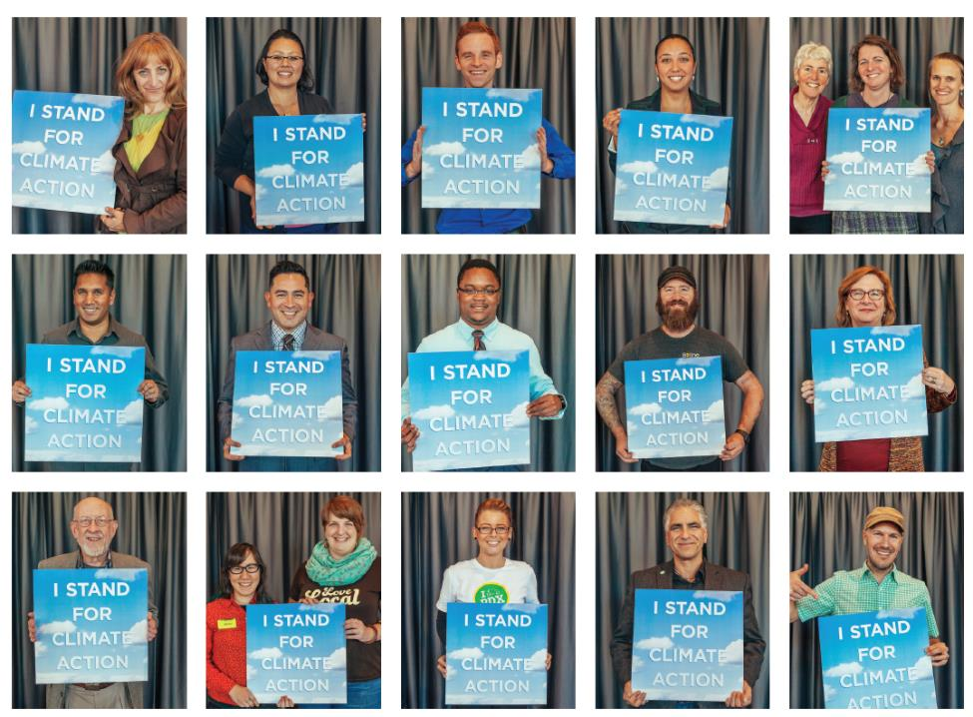
Thank you!
Any questions?
Notes:
Lastly, I'll just conclude by saying that, following this item you'll consider re-adopting the remanded ordinance restricting bulk fossil fuel terminals. We wanted to bring this item before you today to demonstrate how these pieces fit together. As we limit new capacity for fossil fuels, we're expanding opportunities for renewable fuel development and electrification – a key prong in our strategy to reduce transportation sector emissions. I look forward to returning in 2020 with recommendations. Thanks you.

