Slide 1
Homelessness and Urban Camping Impact Reduction Program (HUCIRP)
Lucas Hillier, Program Manager
Jonathan Lewis, Program Coordinator

Slide 2
Reporting Process
Assessment Process
Campsite Cleanup Coordination

Slide 3
Program Commitment
HUCIRP is committed to addressing the camps that pose the greatest risk to public health and safety.
One Point of Contact is designed to better identify where those camps exist.

Slide 4
One Point of Contact
Provides one single place to submit reports of issues regarding camping or garbage.
Previous years members of the community would not know who to call for what issue– this system is intended to simplify the process to report.
Individuals can submit reports using either the City’s Campsite Report Form, PDX Reporter or by calling City/County Information & Referral at 503-823-4000.
HUCIRP receives and reviews every incident and works with partners to help address issue.

Slide 5
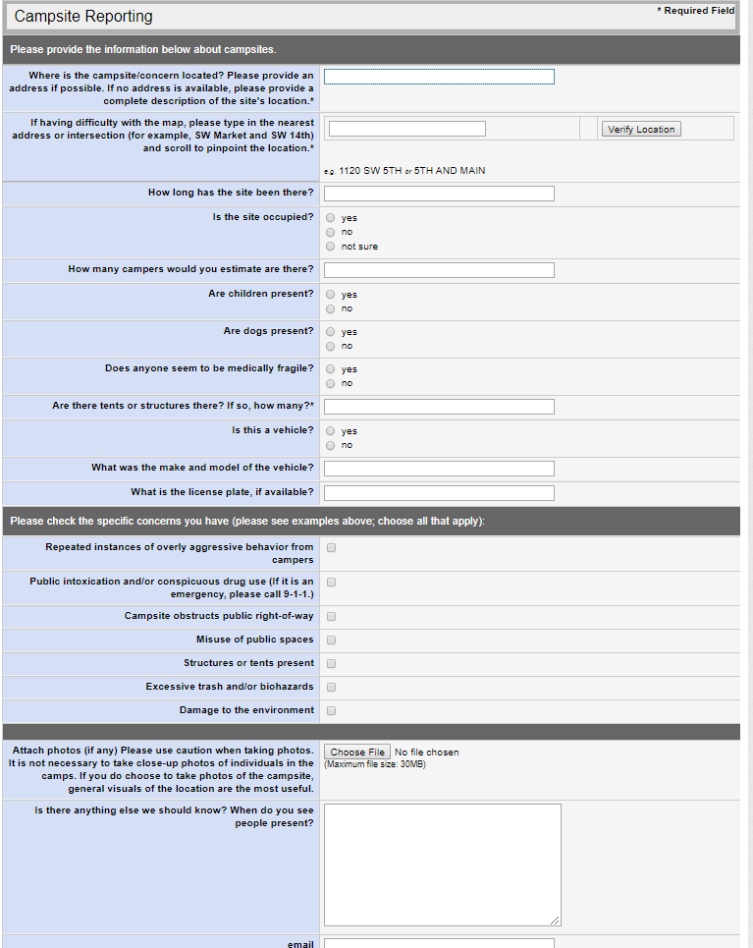
Campsite Report Form
https://www.portlandoregon.gov/campsites
Locations– Be specific! Enter nearest cross street and use map to pinpoint exact location.
Pictures can be helpful to show location. General visuals only. No need to get up close and personal.
Every incident is reviewed.
HUCIRP recommends filing a new report once or twice a week.
Follow up questions may be sent to reportpdx@portlandoregon.gov.

Slide 6
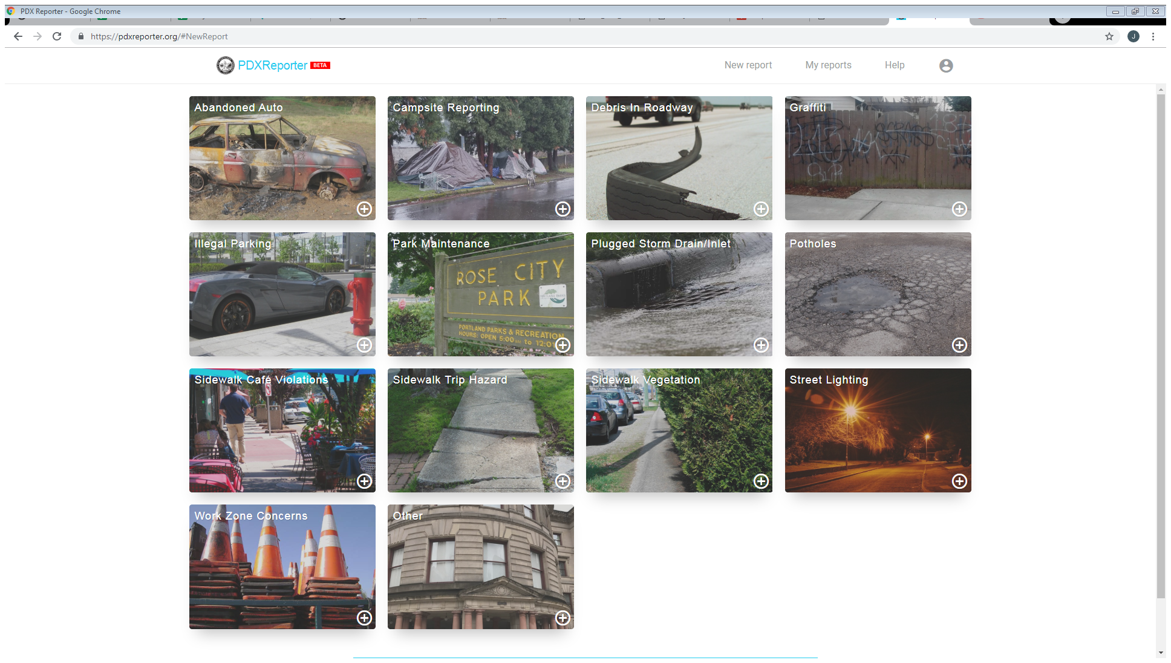
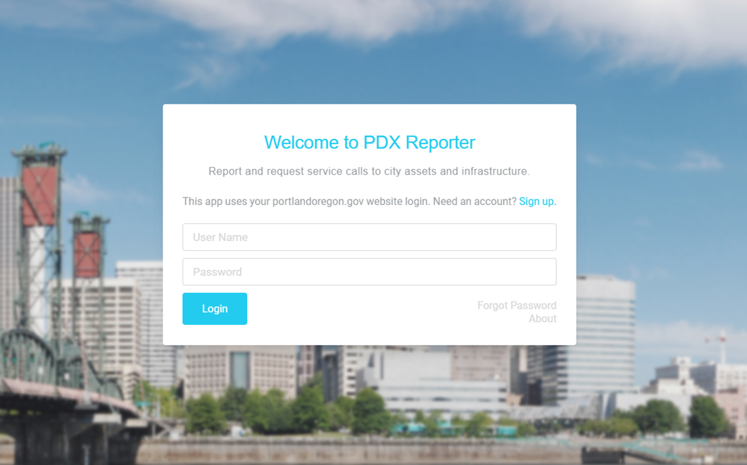
PDX Reporter
https://pdxreporter.org

Slide 7
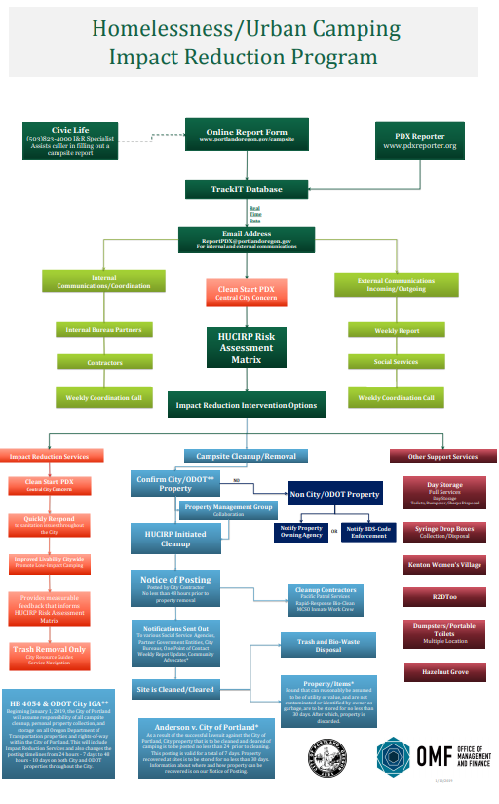
What happens after I submit a campsite report?
https://www.portlandoregon.gov/toolkit

Slide 8
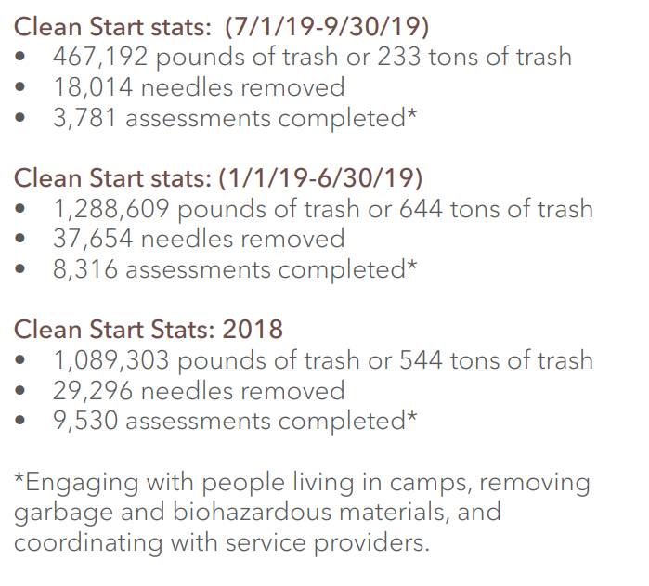
Clean Start
Homeless to work program operated by Central City Concern
First responders to most reports
Respond to issues within 12-36 hours
Pick up camper-identified garbage and other debris
Conducts on-site assessments of camps

Slide 9
Posting Criteria
Conspicuous Drug Use/Paraphernalia
Amount of Trash Debris
Proximity to School, Park, Business, or Private Residence
Environmental Impact
Restricts ADA Access
Posted No Trespassing
Size of Camp
Violence/Crime Being Reported
Blocking Public Access
Restricts Maintenance

Slide 10
Campsite Posting Notices
Required to give notice anytime the City seeks to collect personal property
  Anderson v. City of Portland, Civ. No. 08-1447-AA– Anderson Settlement Agreement
City has one vendor they use to post/clean camps and store property collected following cleanup
Timeline for posting is now 48 hours to 10 days on all City/ODOT properties throughout the City of Portland
  City of Portland/ODOT Intergovernmental Agreement (IGA)
Internal/External Coordination of Cleanup
  Property Owning Bureaus/ODOT
  Social Services

Slide 11
Reports and Posting Statistics
In January through June 2019, 15% of all sites assessed were posted for cleanup.
  HUCIRP received 19,772 reports.*
  Clean Start assessed 8,316 campsites and removed 644 tons of garbage. Assessments include engaging with people living in camps, collecting garbage and biohazardous materials, and coordinating with service providers.
  City Vendors performed 1,276 cleanups where personal property was collected.
*Approximately 11,456 of the reports received were duplicates of the same incident.

Slide 12
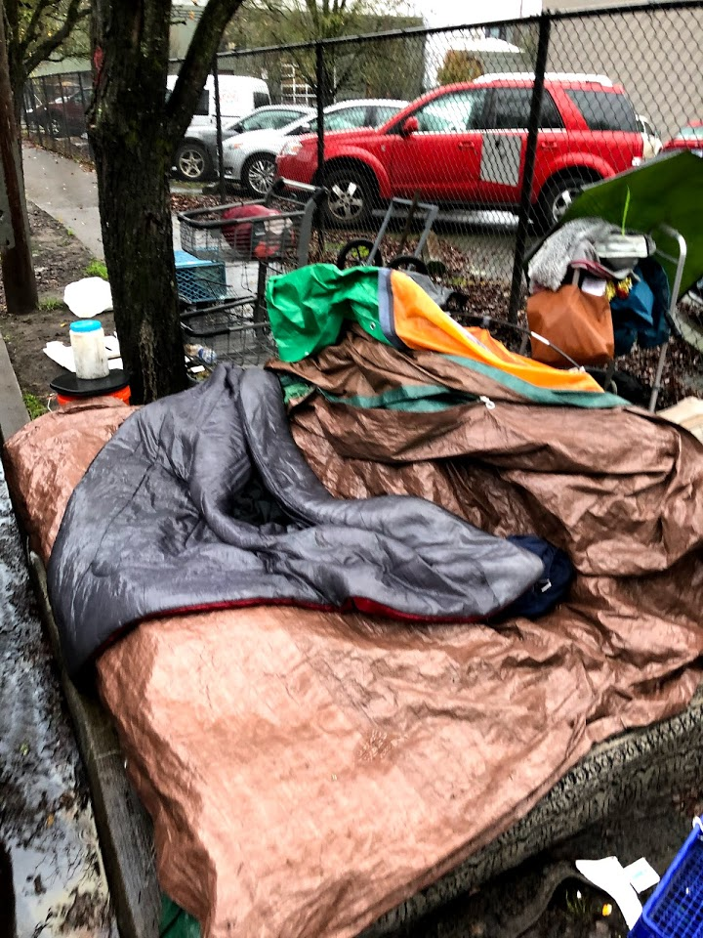
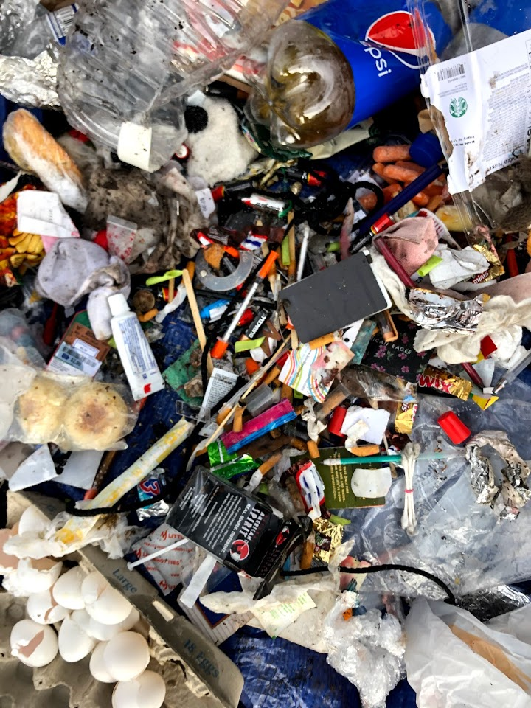
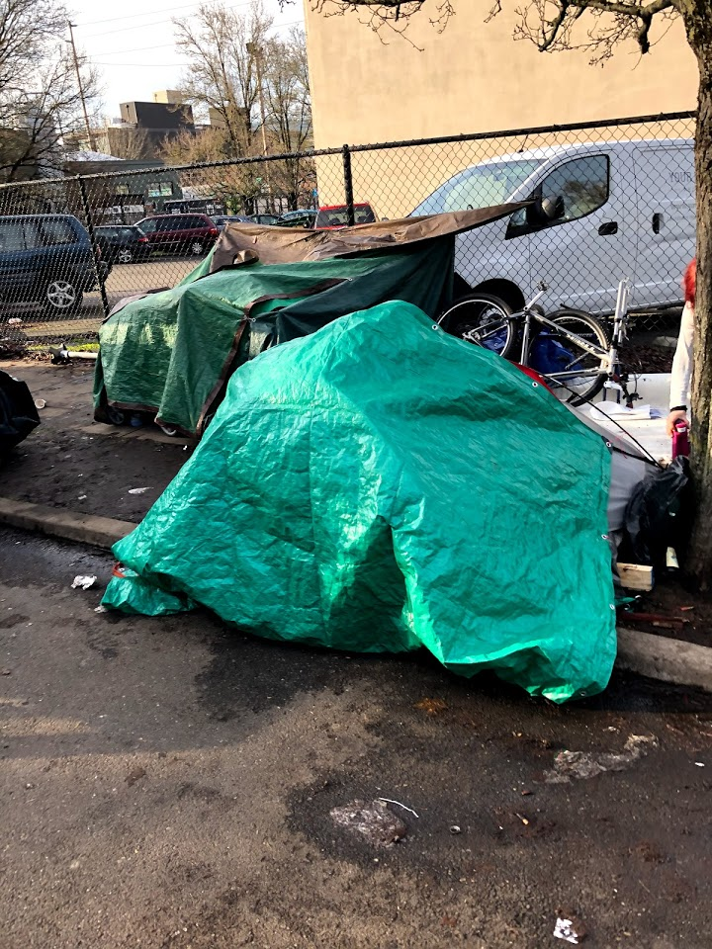
Posted Site Example

Slide 13
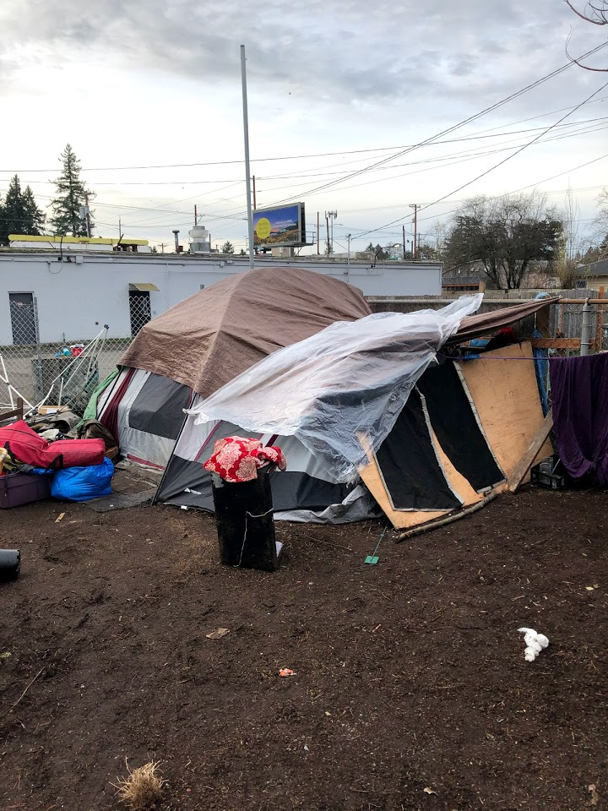
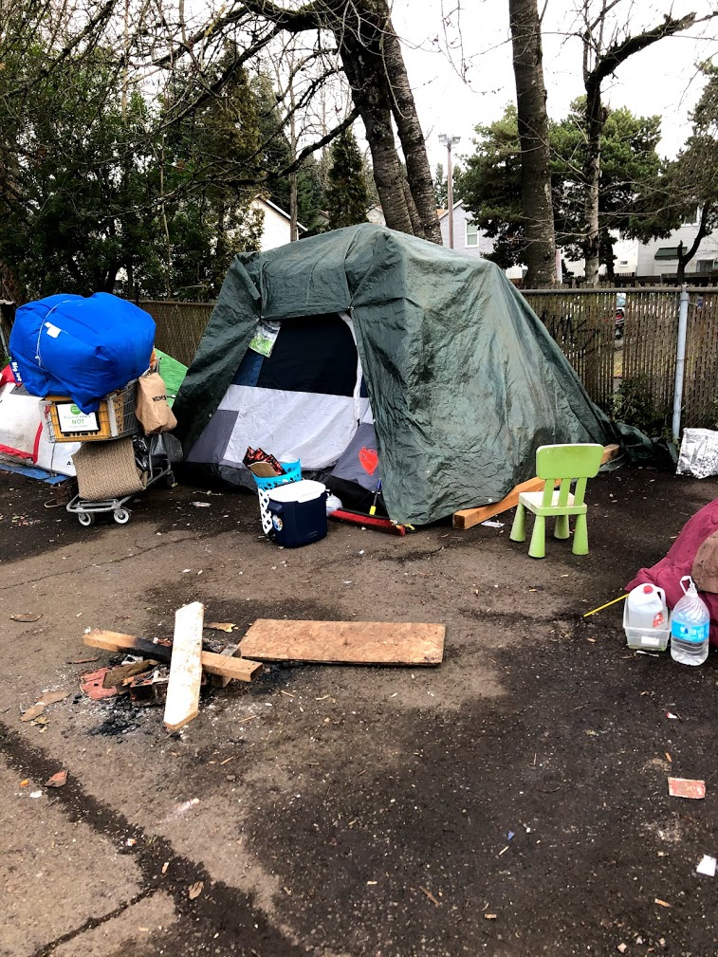
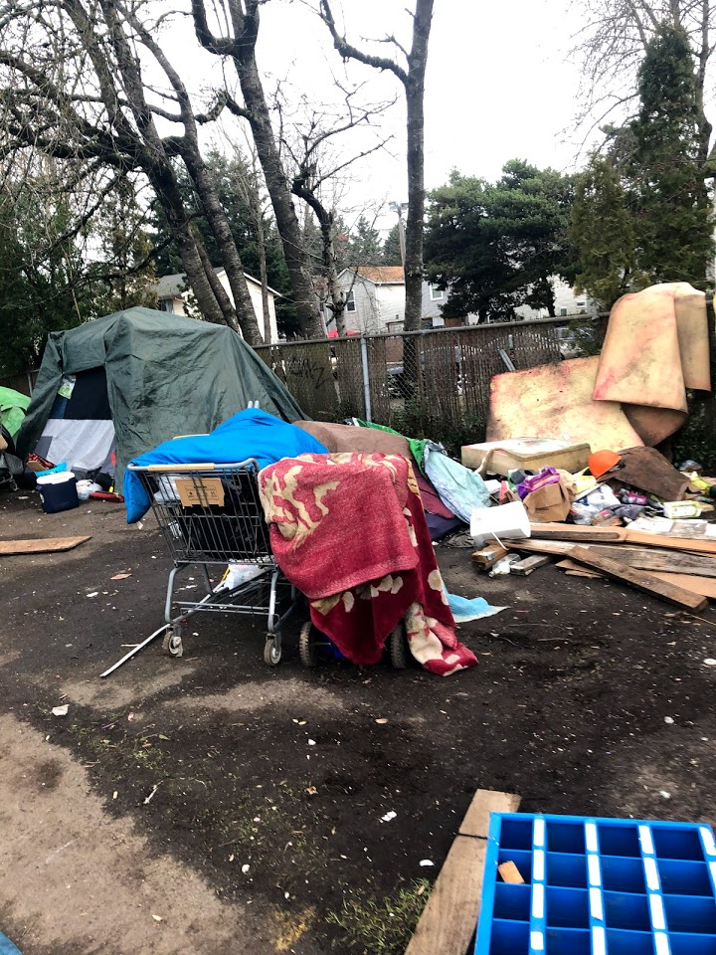
Posted Site Example

Slide 14
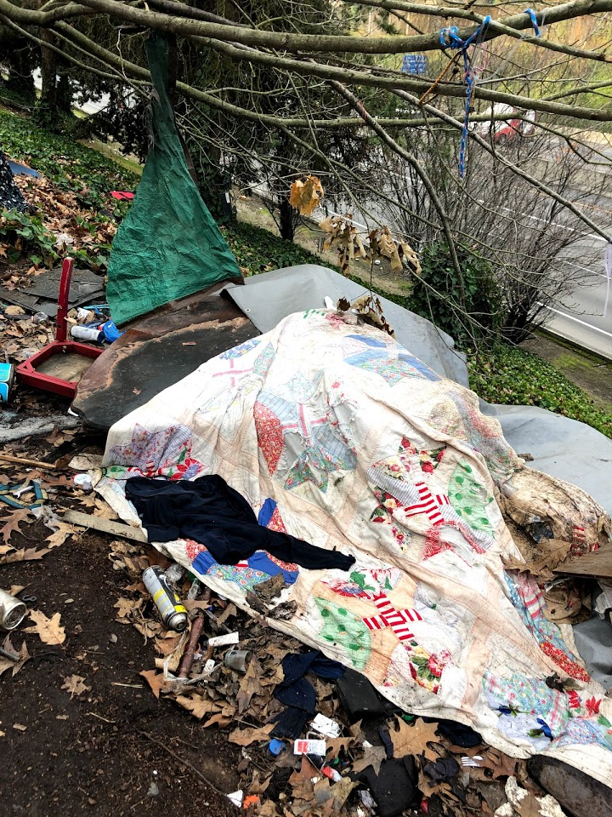
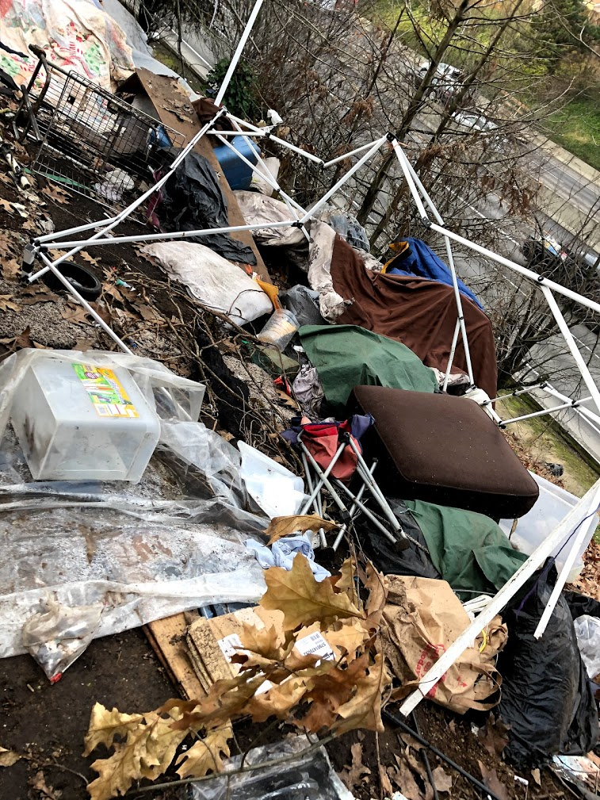
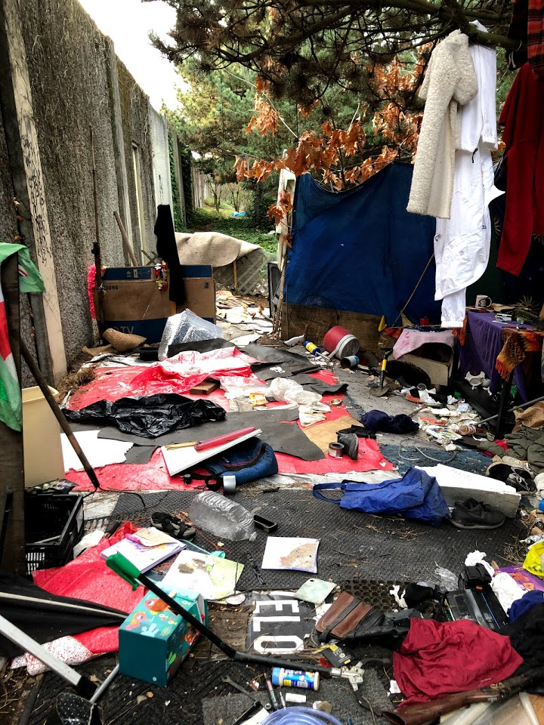
Posted Site Example

Slide 15
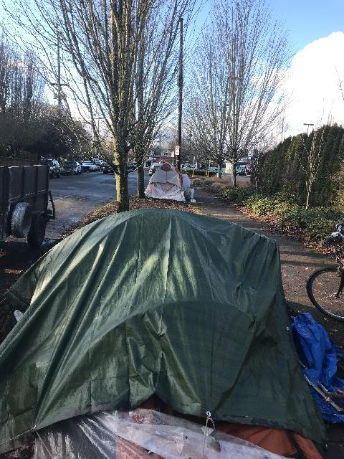
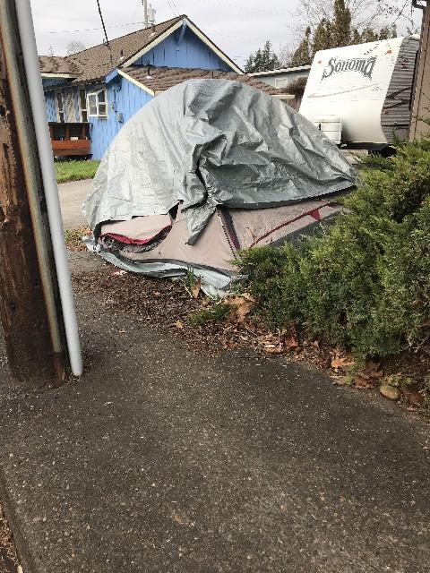
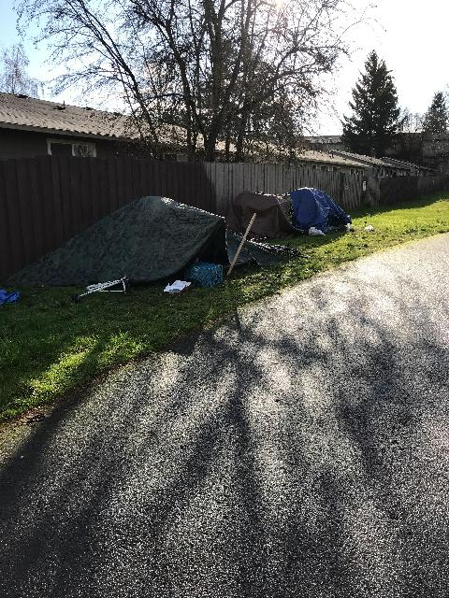
Posting Criteria Unmet

Slide 16
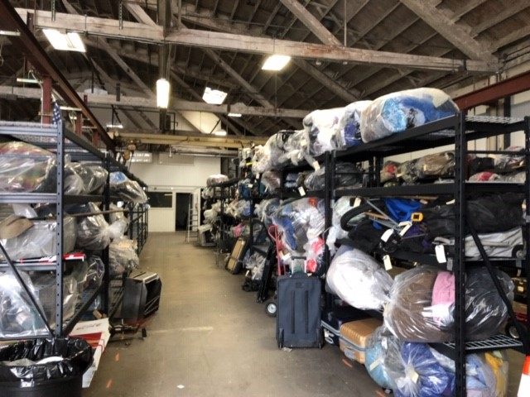
Storage Warehouse

Slide 17
Process Recap
Report
Clean Start
Engage with campers, pick up garbage/biohazardous materials, conduct assessment
HUCIRP Incident Review
Posting Notice
Notify Social Service Providers
Coordination with Internal/External Partners
Cleanup
Property Removal/Inventory/Storage
Storage Facility in Inner SE, near Orange Max Line

Slide 18
Navigation Team
Multi-disciplinary group of outreach workers who go to areas where high-impact camping exists.
Team offers access to services including shelter, health supports, transportation assistance, identification and benefits assistance, and housing and rental assistance.
Navigation Team reviews data from One Point of Contact to determine locations that are high impact.

Slide 19
Navigation Team Outcome Totals
January Through October 2019 Totals– 8 sites
Number of individuals engaged | 443
Number assessed for supportive housing | 162
Number of individuals helped into shelter | 81
Number of individuals helps to receive ID’s | 179
Number of individuals helped to receive birth certificates | 61
Number of individuals signed up for the Oregon Health Plan | 74
Number of individuals helped to receive glasses | 7
Number of individuals helped into substance abuse treatment | 15
Number of individuals given housing referrals | 22

Slide 20
HUCIRP
Performance Measures
 | FY 16-17 | FY 17-18 | FY 18-19 | FY 19-20
Number of Campsite Reports Received | 17,293 | 25,460 | 35,005 | 23,931**
Number of Campsite Cleanups Performed | 571 | 3,122 | 2,828 | 1,017*
Tons of Garbage Collected |  | 1,301 | 1,954 | 1,223*
Number of Needles Collected | 8,215 | 346,793 | 457,461 | 27,498*
*Through September 30, 2019 **Through December 31, 2019

Slide 21

HUCIRP IS NOT DESIGNED TO SOLVE HOMELESSNESS

Slide 22
City of Portland’s HUCIRP and City/County Joint Office of Homeless Services (JOHS)
City of Portland’s HUCIRP
Works with JOHS, Outreach, and Police as well as property owning bureaus
Manages public spaces owned by the City and ODOT throughout the City of Portland
Conducts Coordinated Campsite Cleanup in compliance with the Anderson Settlement Agreement and the IGA with ODOT
City/County JOHS
Oversees the delivery of services to people experiencing homelessness in Multnomah County
Responsible for shelter developments and other programs aimed at improving access to services for houseless individuals

Slide 23
Thank you

