Slide 1
Proposed Amendment to Title 11, Trees, to Extend Sunset Date for Certain Tree Preservation Regulations in Development Situations on Private Property
City Council Hearing
November 13, 2019

Slide 2
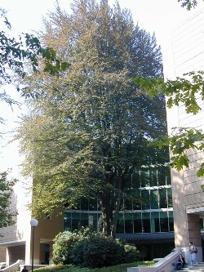
Order of Presentation
Summary of Proposal
Process
History
2016 Amendments
2016-2019 Data
Further Considerations

Slide 3
Summary of Proposal
Extend Sunset Date for Certain Tree Preservation Regulations Two Years:
From December 31, 2019 to December 31, 2021
Note on Scope
Applies to regulations for Private Trees in Development Situations (not City Trees, or Street Trees, or Trees in Non-development Situations).
Does not pertain to when tree preservation regulations are triggered, or when a site or tree is exempt from tree preservation regulations.***
Presentation/discussion will refer to trees (assume non-exempt trees on non-exempt sites)

Slide 4
Process
Planning and Sustainability Commission Hearing and Recommendation (September 24, 2019)
Urban Forestry Commission Hearing and Recommendation (October 17, 2019)
City Council Hearing and Decision
(November 13, 2019)

Slide 5
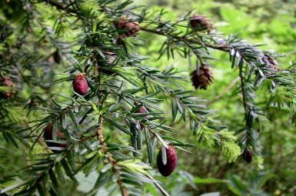
History
Title 11 effective January 1, 2015
Mid-2015, community concern regarding especially large sized trees being removed in association with development projects
Commissioner Fritz (PP&R Commissioner in Charge) requested fast-track amendments to Title 11 to address issue
Early Proposals Presented to Tree Code Oversight Advisory Committee (OAC), Urban Forestry Commission (UFC), Development Review Advisory Committee (DRAC), and City Bureaus. No other community engagement
Amendments effective May, 2016

Slide 6
2016 Amendments
 | Description | 2015 Code | 2016 Amendments
1 | Mitigation Fee In-lieu Applies to All Large Trees Removed OR Only Trees Removed that are Subject to 1/3 Preservation Standard? | 1/3 preservation standard; can be met by paying a fee lieu of preservation | Up to 36”= 1/3 preservation standard; can be met by paying a fee in lieu of preservation. 36” or greater=All must be preserved; can be met by paying a fee in lieu of preservation; can be used to meet 1/3 preservation standard.
2 | Mitigation Fee In-Lieu of Preservation Structure | Flat fee per tree not preserve, regardless of tree size (cost to plant and maintain 2 replacement trees) | Graduated fee in lieu of preservation 12-20”= (cost of (2) 2-inch trees) 20-36”= (cost of (4) 2-inch trees) 36” plus= inch-per-inch
3 | Notice Requirements | None | For removal of trees 36” plus: 45 day posted notice and Neighborhood Association notice
4 | Applicability to City and Street Trees | No (Admin Rule) | No (Admin Rule)
5 | Sunset Date | N/a | December 31, 2019
6 | Affordable Housing Exemption | None | Exempt from fee-in lieu for 36” plus

Slide 7
2016-2019 Data
36” or Larger Trees Removed and Preserved
 | Pre-Amendment (2015) | Post-Amendment (Average/Year) | %Change
# Non-exempt 36” + Trees Removed: | 42 | 15 | -64%
#36” + Trees Preserved | 91 | 156 | 71%
Issued Permits and Fees In-Lieu Collected
 | Pre-Amendment (2015) | Post-Amendment (Average/Year) | %Change
# Issued Permits | 6,843 | 6,588 | -4%
Fee In Lieu of Preservation Revenue | $200,400 | $462,376 | 131%

Slide 8
Potential Further Considerations
Who is impacted? Positively or negatively? Who pays? Who benefits?
It is effective at preserving large sized trees specifically when the tree is affected by proposed development?
Does the notification process work?
Are thresholds and tools correct? Does it appropriately value mid-sizes of trees?
Does the affordable housing exemption fit with how other City regulations consider affordable housing development?
What is the effect on housing development overall and the provision of middle housing?
How are City priorities balanced when they conflict or do not align?

Slide 9
Commission Recommendations
Planning and Sustainability Commission: Extend sunset date of 2016 amendments to December 31, 2021
Urge City Council to fully fund further work on these and potentially other amendments with appropriate data analysis and focus on equity.
In further work, consider applying the 2016 amendments to street trees
Urban Forestry Commission: Extend sunset date of 2016 amendments to December 31, 2021 or for the duration of a declared Climate Emergency (UFC)
Expressed urgency of climate change

Slide 10
Actions
Request for Action Today:
Adopt recommendation to extend sunset date of 2016 amendments to December 31, 2021 (PSC)
OR
Adopt recommendation to extend sunset date of 2016 amendments to December 31, 2021 or for the duration of a declared Climate Emergency (UFC)
Staff alternate to UFC recommendation: Adopt 2016 amendments without a sunset date

Slide 11
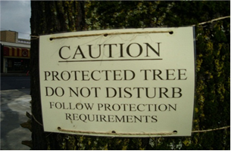
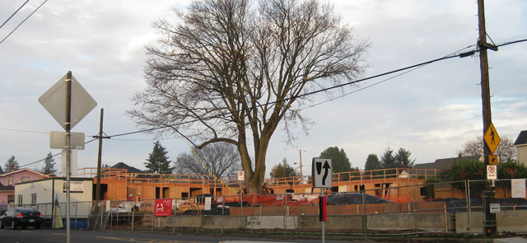
Testimony and Questions

