Slide 1
Office of management & finance Bureau of Revenue and Financial Services
The City of Portland’s Comprehensive Annual Financial Report for FY 2018-19
Presented by
Michelle Kirby, Interim Chief Financial Officer
Ashley Tuttle, Accounting Supervisor Financial Reporting
Notes:
AT
Good afternoon Mayor Wheeler and Members of the City Council.
For the record, my name is Ashley Tuttle. I am the Accounting Supervisor for Financial Reporting, with the Bureau of Revenue & Financial Services.
Also presenting this afternoon is Michelle Kirby, Interim Chief Financial Officer and Bureau Director.

Slide 2
Presentation Agenda
Present the City’s Comprehensive Annual Financial Report (CAFR) for FY 2018-19
Discuss CAFR highlights and financial trends from the past 10 years
Observations regarding aspects of the City’s long-term fiscal health
Notes:
AT
Today we will be presenting to you the Comprehensive Annual Financial Report, also known as the “CAFR”, for the fiscal year ended June 30, 2019.
We will be discussing highlights and financial trends from the CAFR, and will be presenting you with additional information regarding the City’s long-term fiscal health.

Slide 3
Prepared by the BRFS Accounting Division
Notes:
AT –
Copies of the CAFR have been delivered to each one of your offices, if you’ve had a chance to look through it you will notice that it’s quite thick ☺ The preparation of the annual CAFR is an extensive project which requires a group effort to make it a success. Involvement is needed from all the City’s bureaus, the City Auditors office, and our independent auditors Moss Adams to ensure the timely and successful completion of this report.
The Accounting Division of the Bureau of Revenue and Financial Services is responsible for preparing the CAFR, ensuring its accuracy, and working with the auditors throughout the process. Several of the Accounting Division team members are here today, and I’d like to take a moment to recognize them for their hard work and dedication to the success of this project. These are the people who make it come together!

Slide 4
Timing of the CAFR
The FY 2018-19 CAFR published on October 30th
2nd year in a row published within 4 months of fiscal year-end
Benefits of timely reporting:
National leader in financial reporting
Popular Annual Financial Report (PAFR)
Summarized financial information, easy to read format
Translated into four languages for greater community outreach
Notes:
AT
For the past six years steady and significant progress has been made to reduce the amount of time required to publish the CAFR, and ensure the timely reporting of financial information. This is the second year in a row that the City’s CAFR has been published on October 30th, which is 4 months from the end of the fiscal year.
You may be asking why is this an important achievement? First of all, timeliness is a major objective of financial reporting, in that it ensures the information is relevant and useful for decision making. It also establishes the City as a national leader in providing timely financial information to the community and other interested users of the CAFR.
In addition, preparing the CAFR in less time allows the Accounting Division the time to focus on other reporting initiatives, such as the Popular Annual Financial Report (PAFR) which was created and published for the first time 4 years ago. The PAFR is also translated into Russian, Spanish, Vietnamese and Chinese for greater community outreach. Over the past four years we have gotten better at not only creating a report that is visually appealing and readable for everyone, we have also improved our outreach and community involvement. Looking into other means of communicating this information and distributing the report, we have partnered with other bureaus that have more connection to the community, to assist us in getting this report out. The PAFR will be completed in the next few weeks.

Slide 5
Highlights of the FY 2018-19 CAFR
External Auditors (Moss Adams) issued an “Unmodified Opinion” on the financial statements, and found no weaknesses or deficiencies in the City’s accounting processes
CAFR complies with State Law, and generally accepted accounting principles (GAAP)
City received the GFOA Award for Excellence in Financial Reporting for the 38th consecutive year for the CAFR; and also received GFOA award for the PAFR
City unlimited tax general obligation bonds remain rated “Aaa”
Notes:
AT
Now we will discuss highlights of the FY2018-19 CAFR.
The “good news” (as you already heard) is that our external auditors gave the City an unmodified (or clean) opinion, and found no weaknesses or deficiencies in the City’s accounting processes. In addition, the CAFR complies with state law, and generally accepted accounting principles.
We received the Government Finance Officers Association (GFOA) “Award for Excellence in Financial Reporting” for the 38th consecutive year, as well as receiving the GFOA award for the PAFR.
The City’s bond rating for unlimited tax general obligation bonds remain rated “Aaa” from Moody’s Investors Service. A triple A credit rating is important because it allows the City to borrow at lower interest rates, saving millions of dollars per year in interest expense. This rating was confirmed in May 2019.
Now I will turn the presentation over to Michelle Kirby for a look at some financial trends.

Slide 6
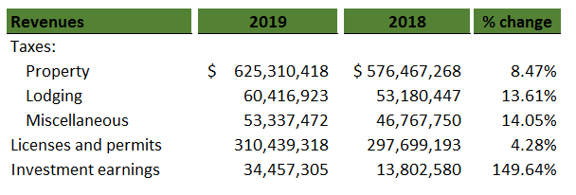
Current Financial Condition
Revenue Growth
Notes:
MK –

Slide 7
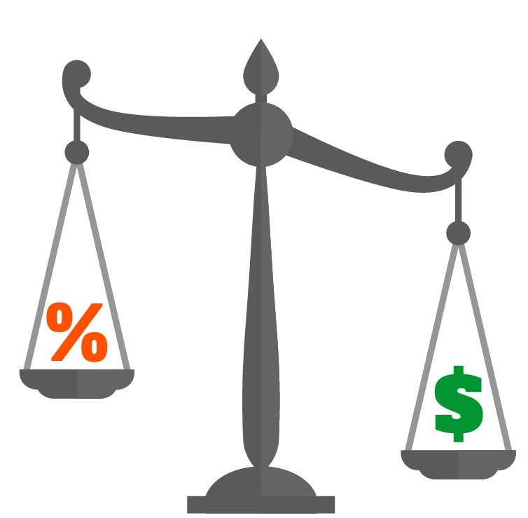
Future Challenges
Obligation categories
Personnel
Infrastructure
Legacy liabilities
Notes:
MK –
While the current financial condition of the City is strong, there are long-term financial obligations that must be addressed and managed. The City is facing several challenges which underscore the need for a long-range view in evaluating our financial sustainability.
Escalating PERS costs, newly negotiated labor contracts, and inflation are continuing to put increased pressure on the City’s personnel costs.
Strategic and consistent investment in the City’s capital assets, technology, and infrastructure (including the funding of replacement reserves) is critical to ensuring sustained delivery of public services.
In addition, the need to fund the City’s share of certain legacy liabilities adds to the long term funding challenges.

Slide 8
What is Net Position?
Assets – Liabilities = Net Position
Amounts are calculated with a long term focus
Factors which decrease net position
Increasing liabilities without offset capital asset or reserve
Reduced asset value exceeding new capital investment
Notes:
MK
Over the past couple of years, we have had a number of discussions with you about the City’s Net Position, particularly those things that can cause a decline in the trend.
As a reminder, Financial Net Position, in general terms, represents the net of the City’s Assets (what it owns) minus its Liabilities (what it owes). Net position reflects the overall net worth of the City at a specific point in time, and serves as a useful gauge of a government’s financial health.
Important distinction (reminder)……….. The dollar amounts, used to calculate net position have a long term focus .
Factors decreasing Net Position:
Increases in liabilities or obligations without an offsetting capital asset or dedicated reserve.
Depreciation of our capital asset value that exceeds new investment in capital investments.

Slide 9
Business-type Activities Net Position Ten-year trend (long term outlook)
Notes:
MK (data from CAFR Statistical section - page 390)
Government-wide financial statements present financial information separately for Governmental Activities and Business-type Activities. Here we are looking at the net position trend for the Business-type activities. The category of business-type activities include the Sewage Disposal and Water Services enterprise funds.
Enterprise funds account for the operations of self-supporting activities rendered to the public on a user charged fee basis. Enterprise funds are required to have a long term outlook which is built into their rate structure. That is why we see a favorable trend line over the past 10 years.

Slide 10
Governmental Activities Net Position Ten-year trend (long term outlook)
Notes:
MK (data from CAFR Statistical section - page 390)
I mentioned previously that Government-wide financial statements present financial information separately for Governmental Activities and Business-type Activities. Here we are now looking at the net position trend for the City’s Governmental Activities. Governmental activities are primarily supported by taxes and intergovernmental revenues, and this category includes the General Fund, and all Special Revenue, Debt Service and Capital Projects Funds.
While the governmental type funds are managed and budgeted based on near-term inflows and outflows of spendable resources, GAAP require a full-accrual, or long-term, outlook in the Government-wide statements in the CAFR. Here we can see the difference in the trend line from the previous slide, which shows funds that are managed with long term outlook.
Discuss the reasons for the decline…….. FPDR, Capital Assets (PBOT infrastructure).

Slide 11
Governmental Activities Capital Assets
Notes:
MK -
Discuss decline in infrastructure (green), last couple years has seen an increase in “construction in progress” due to Portland Bldg reconstruction, which accounts for the purple.
(CAFR MD&A, pg. 36, explanation)

Slide 12
Strategies to ensure long-term fiscal stability
Policies regarding regular reserving and increased commitment to infrastructure investments
Allocate one-time money to long-term liabilities and obligations
Identify opportunities to share costs with partners
Increased awareness of future costs and funding of reserves.
Notes:
MK
(Discuss the specifics of the above.)

Slide 13
Summary
The City’s CAFR for FY 2018-19 demonstrates full compliance with all required accounting procedures and standards
The City’s current financial position is strong
The City is facing a growing set of financial issues that will impact its long-term fiscal health
Long-term financial stability requires a long-term focus
Notes:
MK
The City’s CAFR for FYE 2019 complies with all required accounting standards and practices:
--Our external auditors have given the City an unmodified opinion
--No audit deficiencies have been noted
Current credit ratings are reflective of the City’s fiscal strength. The unlimited tax GO debt remains rated AAA by Moody’s investment Services and was confirmed in May 2019.
Current Financial Position:
The City has seen record revenue growth over the past serval years. Increases in Property taxes, lodging and other taxes, reflect the strong local economy. Also, interest rates and strong investment performance accounts for a notable increase investment earnings in FY 2019 over the prior fiscal year. However, the CAFR represents a financial snapshot at a point of time. Future growth will likely be at more moderate levels.
Long-term financial stability requires a long-term focus. We’ve taken good preliminary steps, but must stay the course to ensure the City’s financial health remains strong into the future.

