Slide 1

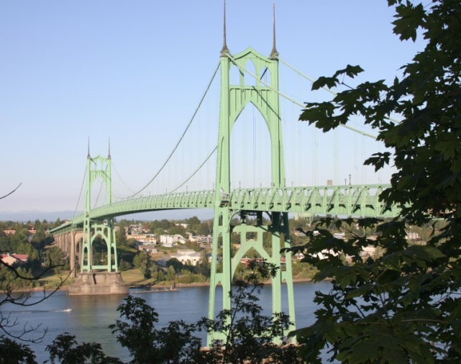
Arbor Lodge - Kenton Sewer Rehabilitation Project
Council Item 1095
Portland City Council | November 27, 2019
Joe Dvorak, P.E.,
Principal Engineer
Daniel Boatman, P.E.,
Project Manager
Notes:
Good morning as Joe stated, my name is Daniel Boatman. I am a Project Manager and designer at BES.
We are here asking for authorization to advertise the Arbor Lodge – Kenton Sewer Rehabilitation contract estimated at $5,350,000

Slide 2
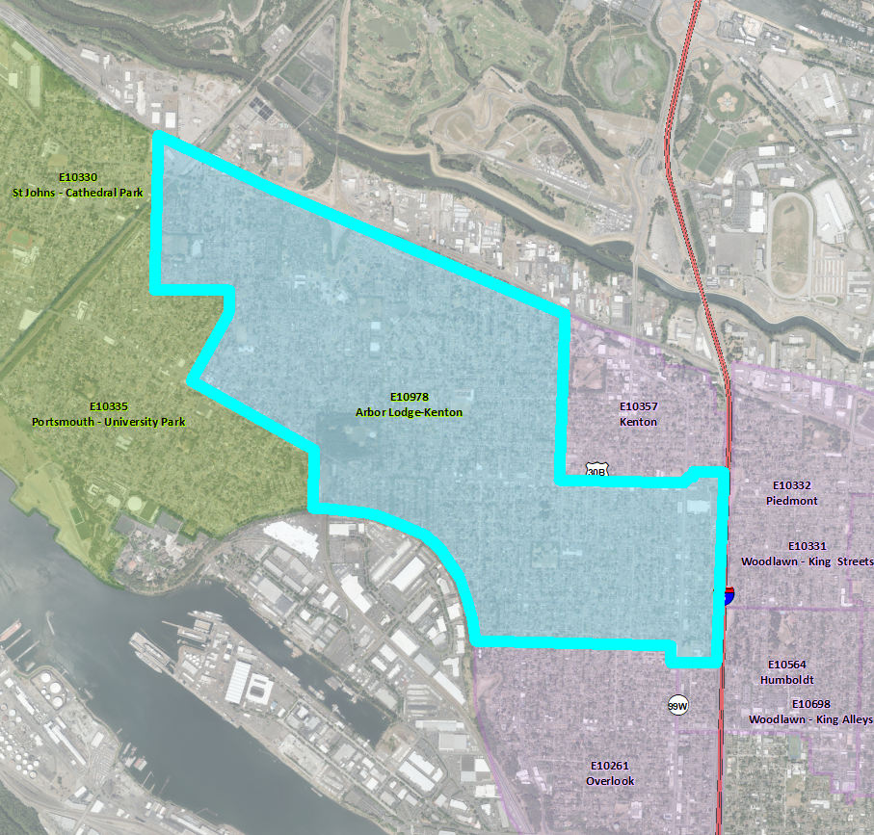

Project Overview
Arbor Lodge - Kenton
Sewer Rehabilitation
Approx. 12,500 feet of 6”-30” diameter pipe
Average age of sewer mains is 83 years old
Approx. 3,000 feet of sanitary service laterals
1,400 feet of sanitary sewer extensions
Notes:
This project will: Increase sewer system capacity and reliability, and Protect public health, property, and the environment by reducing the risk of sewage releases and sewer backups.

Slide 3
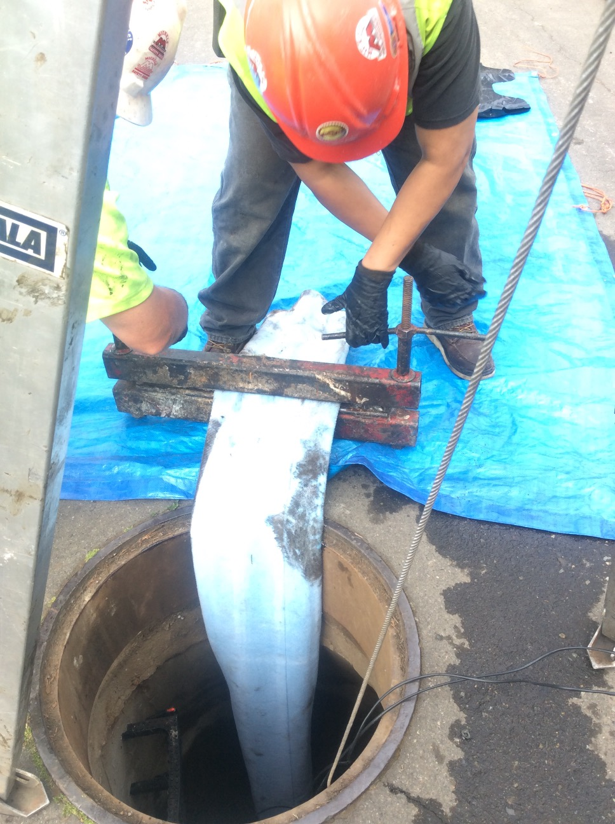
Construction Methods and Scope
Open trench excavation and replacement
Trenchless Rehabilitation
Notes:
Trenchless to reduce impacts and restoration.
Method ft %
CIPP 5614 45.1%
SR for CIPP 70 0.6%
SR Only 20 0.2%
PB 796 6.4%
Sect-CIPP 27 0.2%
OC 5912 47.5%
TOTAL 12439
NCS 1368
TOTAL REHAB 11071

Slide 4
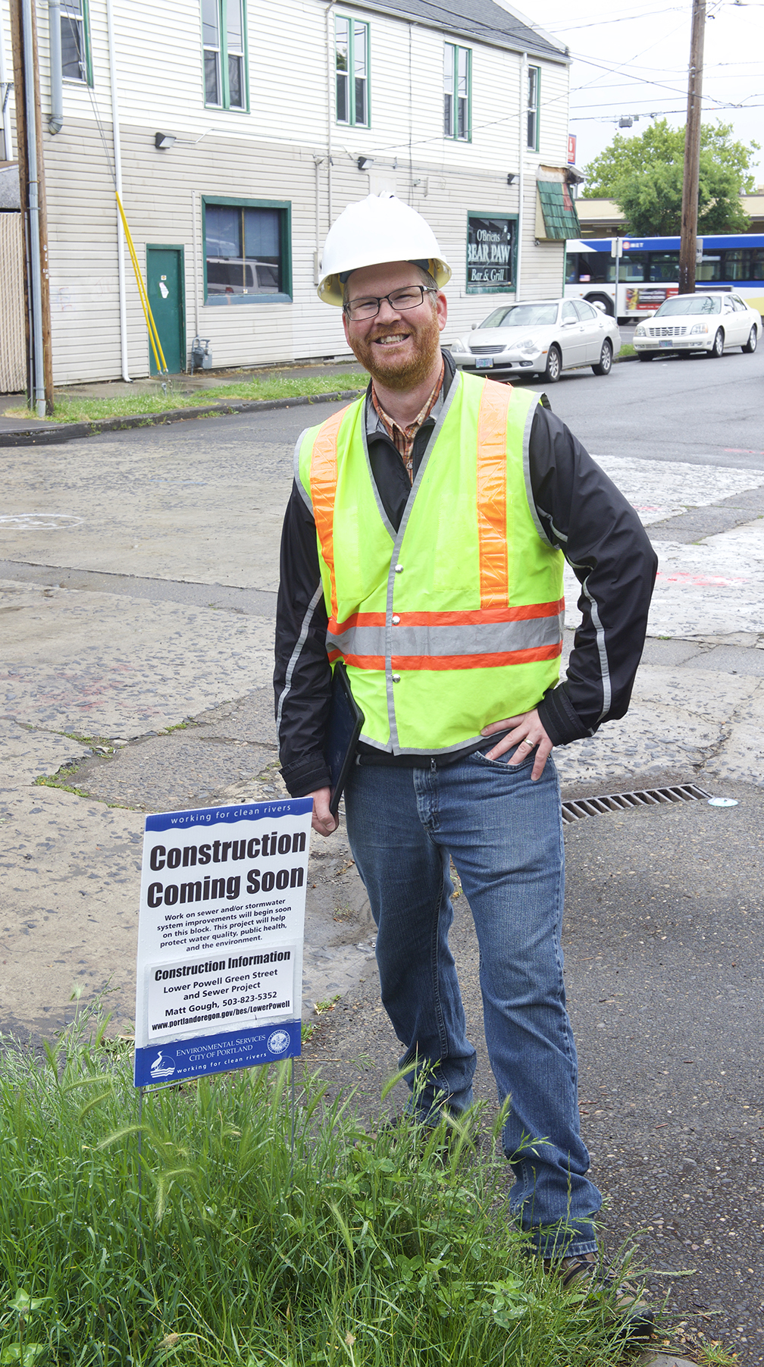
Public Outreach & Impacts
Project Notifications
  Flyers, email updates, project webpage, Nextdoor, face to face
  Multiple public presentations
  Focused outreach to communities with limited English proficiency
Extended Work Hours
  Alaska St, Chautauqua Blvd, Greeley Ave
Night Work
  Rosa Parks Way

Slide 5
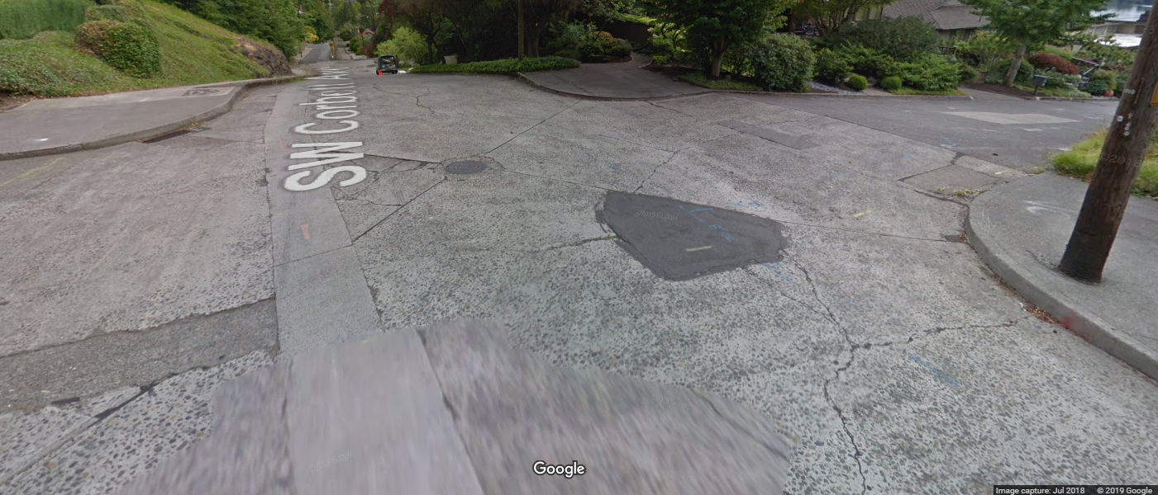
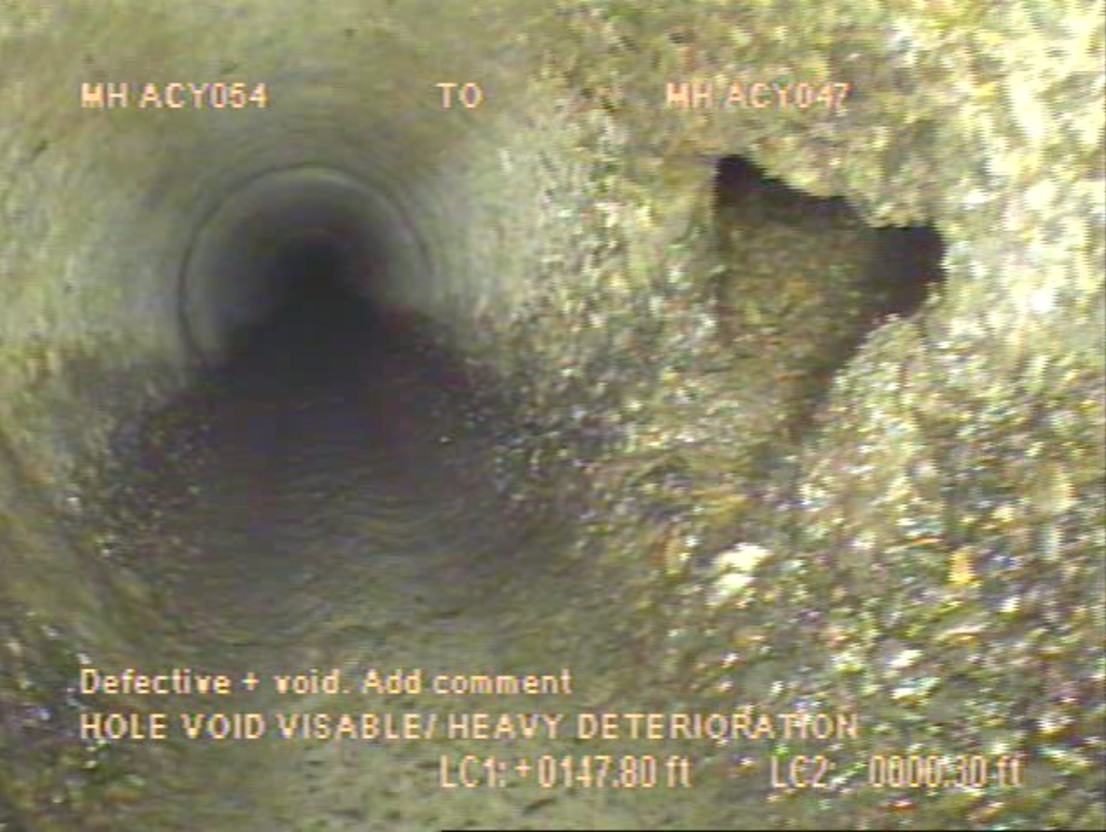
Engineer’s Estimate & Schedule
Engineer’s Estimate:
$5,350,000
High Confidence Level
Advertise Project:
January 2020
Begin Construction:
May 2020
Construction Duration:
365 calendar days

Slide 6
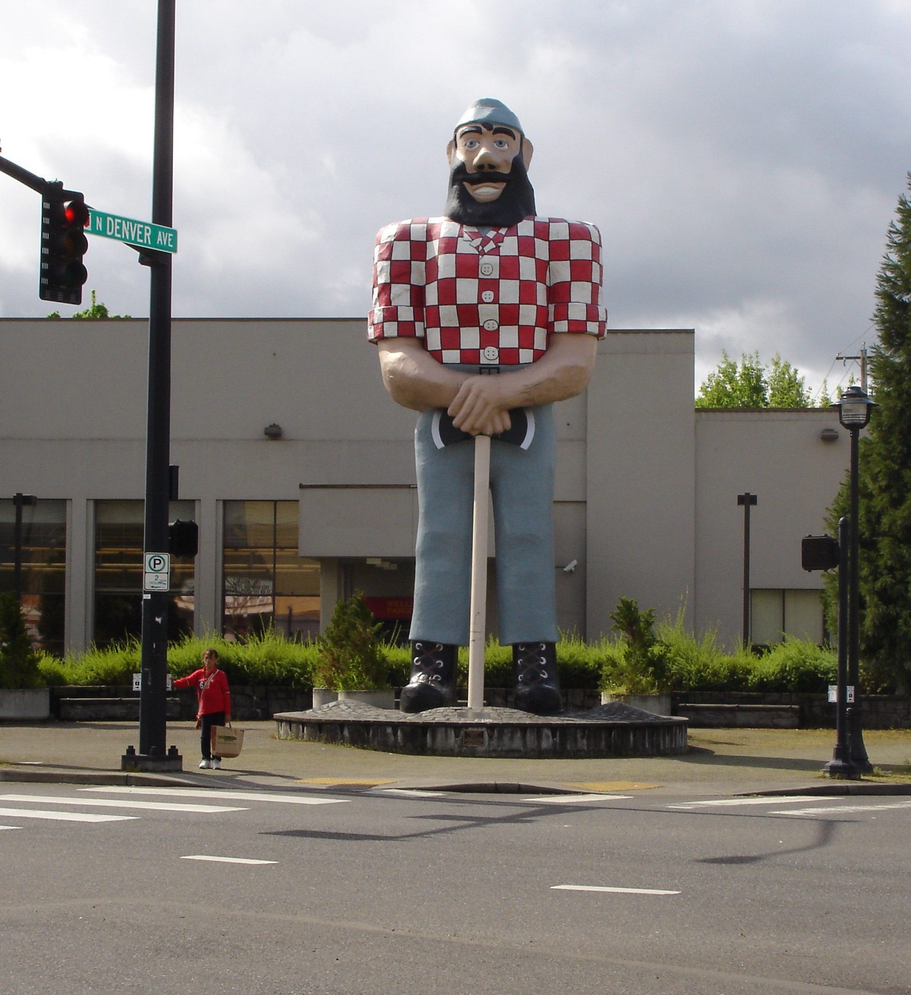
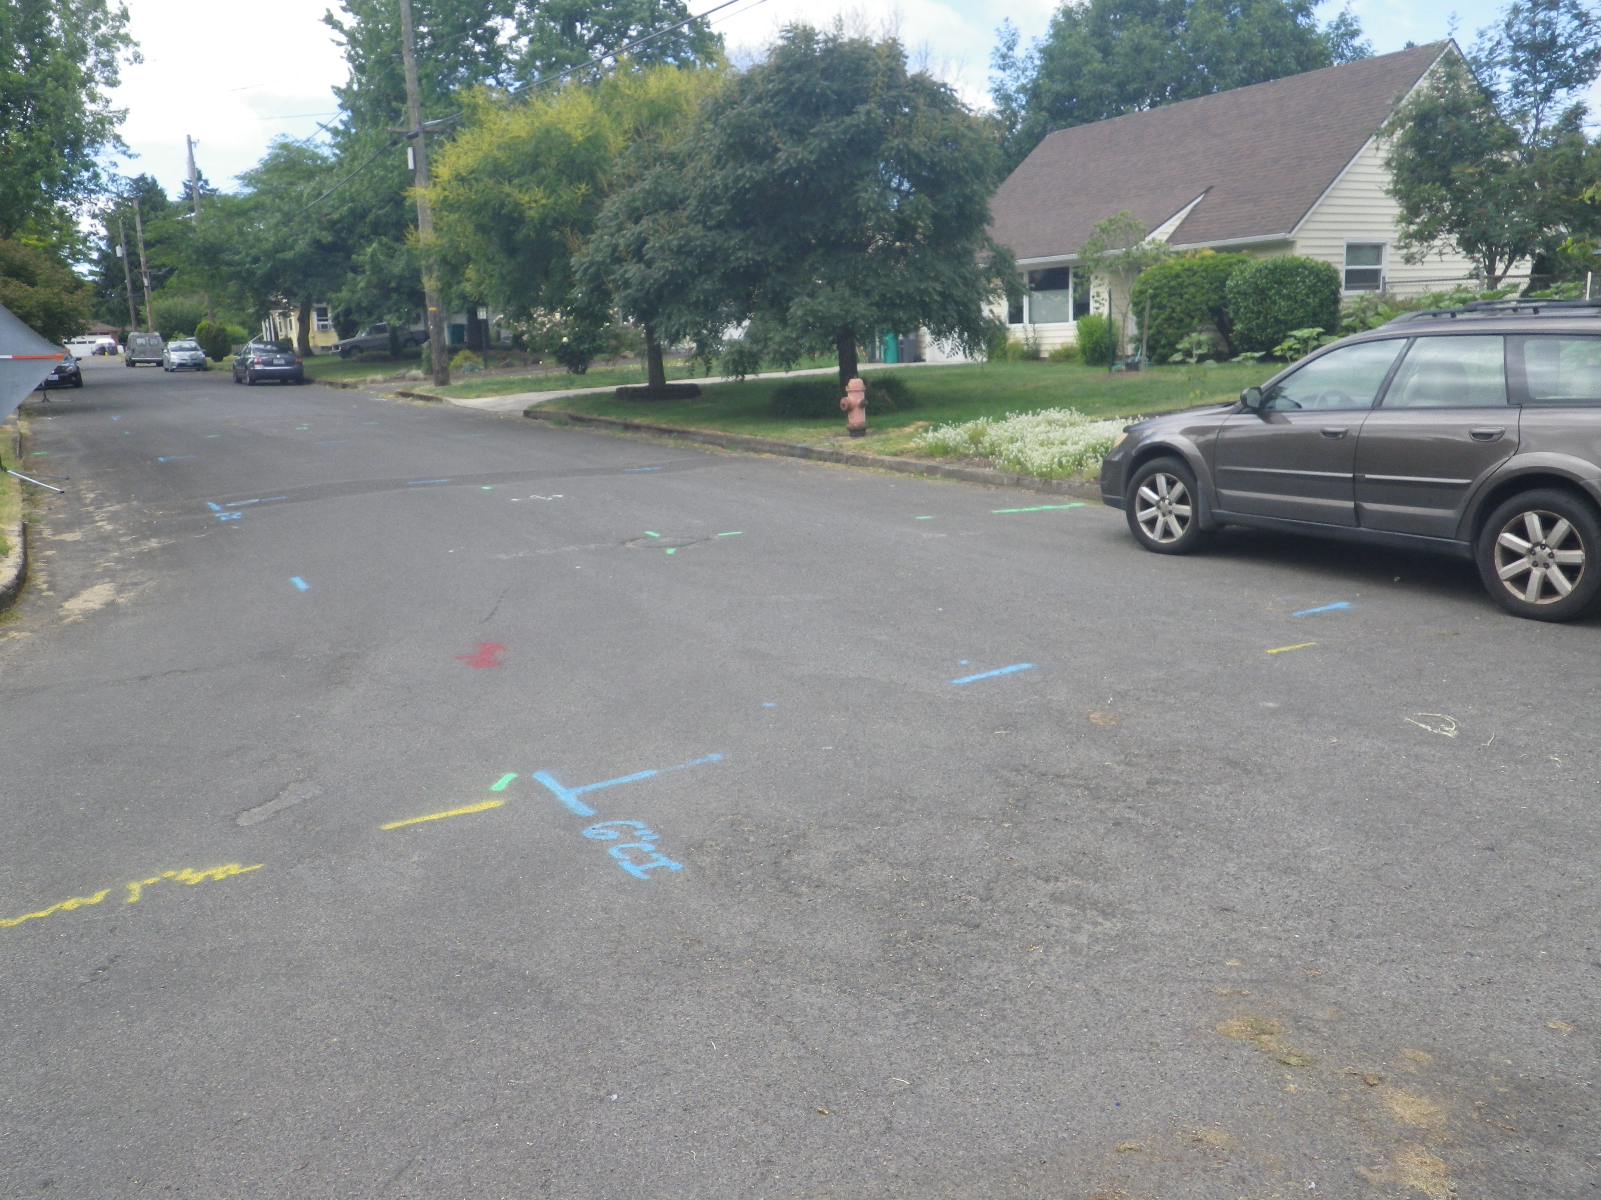
Questions?

