Slide 1

SWTrails SWIM
Testimony to
Portland City Council
Don Baack
Glenn Bridger
December 5, 2019

Slide 2
Purpose/Need: Sidewalk Disparity
Area | Centerline Miles of street | Miles with Sidewalks | Miles Without Sidewalks | Percent of streets w/ Sidewalks
East Portland | 397 | 269 | 128 | 62%
SWNI | 280 | 70 | 210 | 25%
Source: PBOT Transportation Planner, Nick Falbo: 12/3/2019

Slide 3
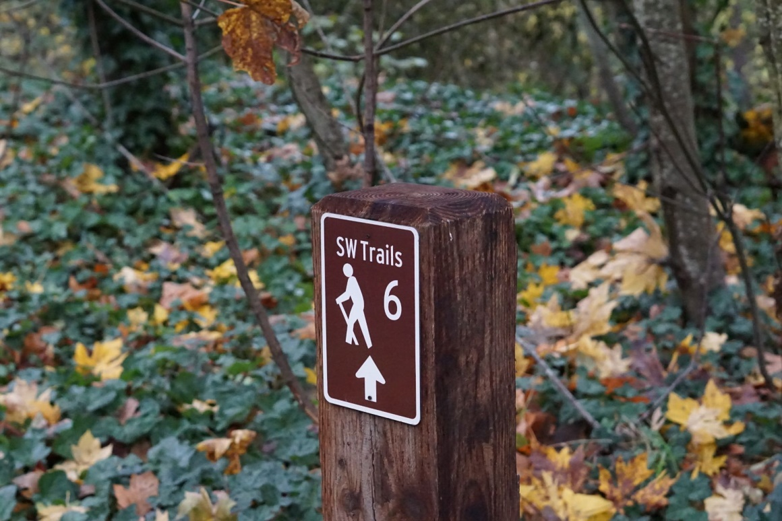
Minor adjustments to the Urban Trail Network
Plan adopted in 2000
Conditions have changed
Need for updates to SWTrails Network:
  Walking Maps
  Wayfinding Signage
Comments to PedPDX
Comments to SWIM
Where to Next?

Slide 4
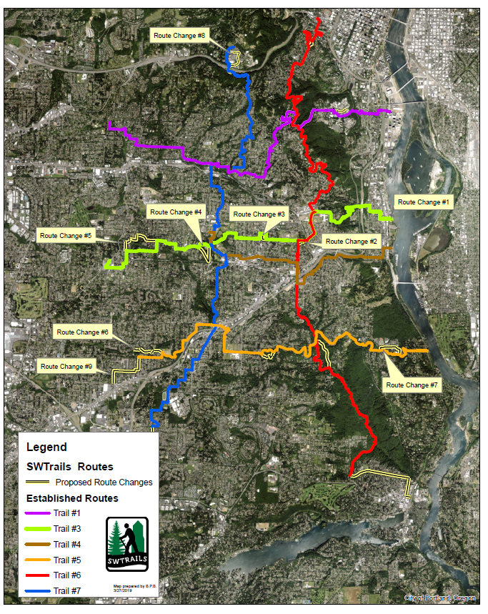
Overview Map

Slide 5
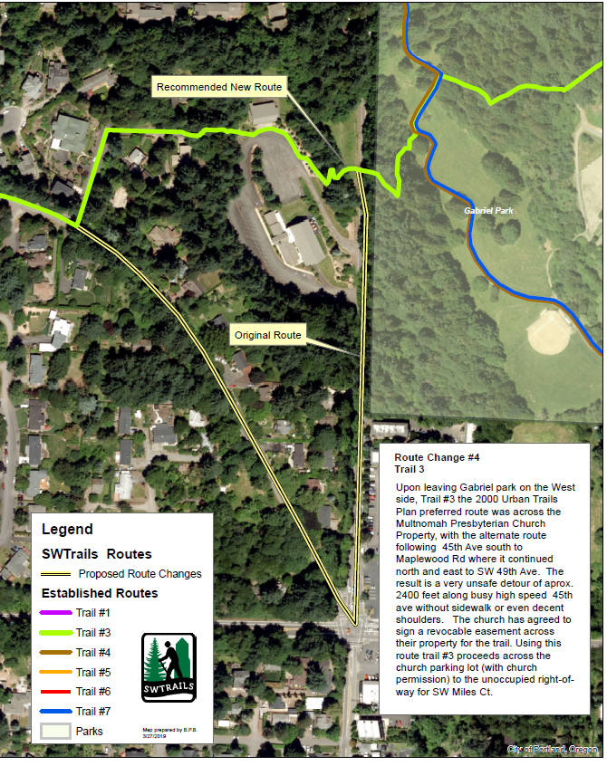
Example:
45Th Ave at Gabriel Park

Slide 6
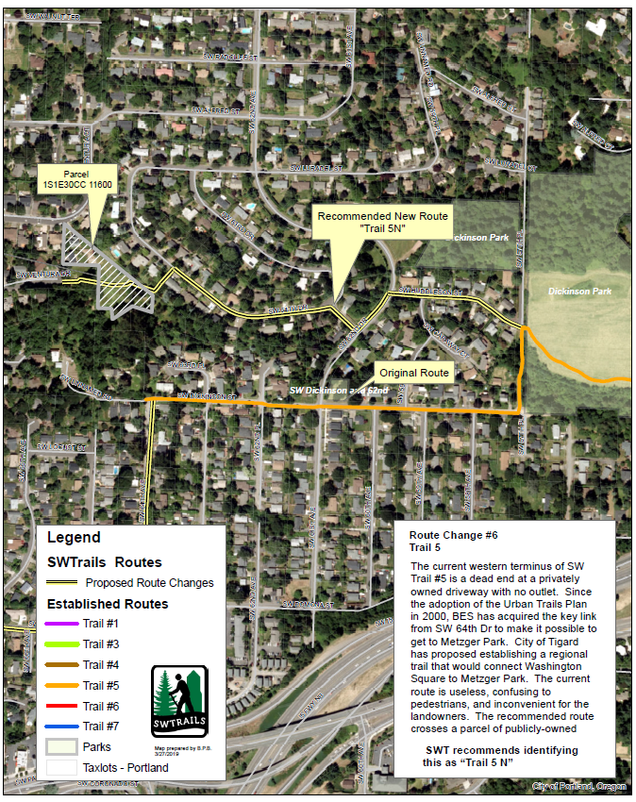
Example:
Ash Creek N.A.

Slide 7
Detailed maps are available at:
  https://swtrails.org/trails/gis-mapping/2019-route-changes/

