Slide 1
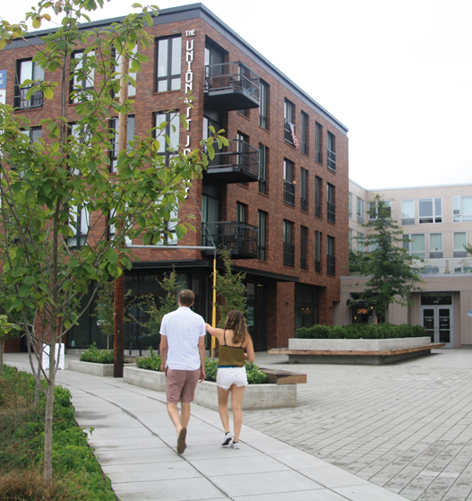
Work Session 2 Design Commission December 5, 2019
DOZA
Design Overlay Zone Amendments

Slide 2
Agenda
5 min
Intro and Disclosures
Katherine Schultz, Planning and Sustainability Commission
Summary of Testimony
and Orientation to the Design Guidelines
Proposal: Portland Citywide Design Guidelines
QUALITY AND RESILIENCE
08: Thoughtful Site Design
09: Design for Quality
10: Design for Resilience
10 min
5 min
(~ 90 min total)
30 min
30 min
30 min

Slide 3
Snapshot of Testimony

Slide 4
What’s in the DOZA Proposed Draft?
Volume 1: Staff Report
Volume 2: Code and Map Amendments
Volume 3: Portland Citywide Design Guidelines
Volume 4: Appendices (portlandoregon.gov/bps/doza)
Appendix A: BDS Administrative Improvements
Appendix B: Housing Affordability Memo (February 6, 2017)
Appendix C: What We Heard Report
Appendix D: Consultant Testing of Draft Standards and Guidelines

Slide 5
DOZA Proposals
PURPOSE of the Design overlay zone
MAP of where the Design overlay zone applies
THRESHOLDS for reviewing projects
PROCESS for reviewing projects
TOOLS for evaluating projects
Portland Citywide Design Guidelines
Design Standards

Slide 6
1. Purpose of Design Overlay Zone
Ensures that Portland is a city designed for people.
Supports the city’s evolution within current and emerging centers.
Promotes design excellence through tools that:
Build on context by enhancing the distinctive physical, natural, historic and cultural qualities of the location while accommodating growth and change;
Contribute to a public realm that encourages social interaction and fosters inclusivity in people’s daily experience; and
Promotes quality and long-term resilience in the face of changing demographics, climate and economy.

Slide 7
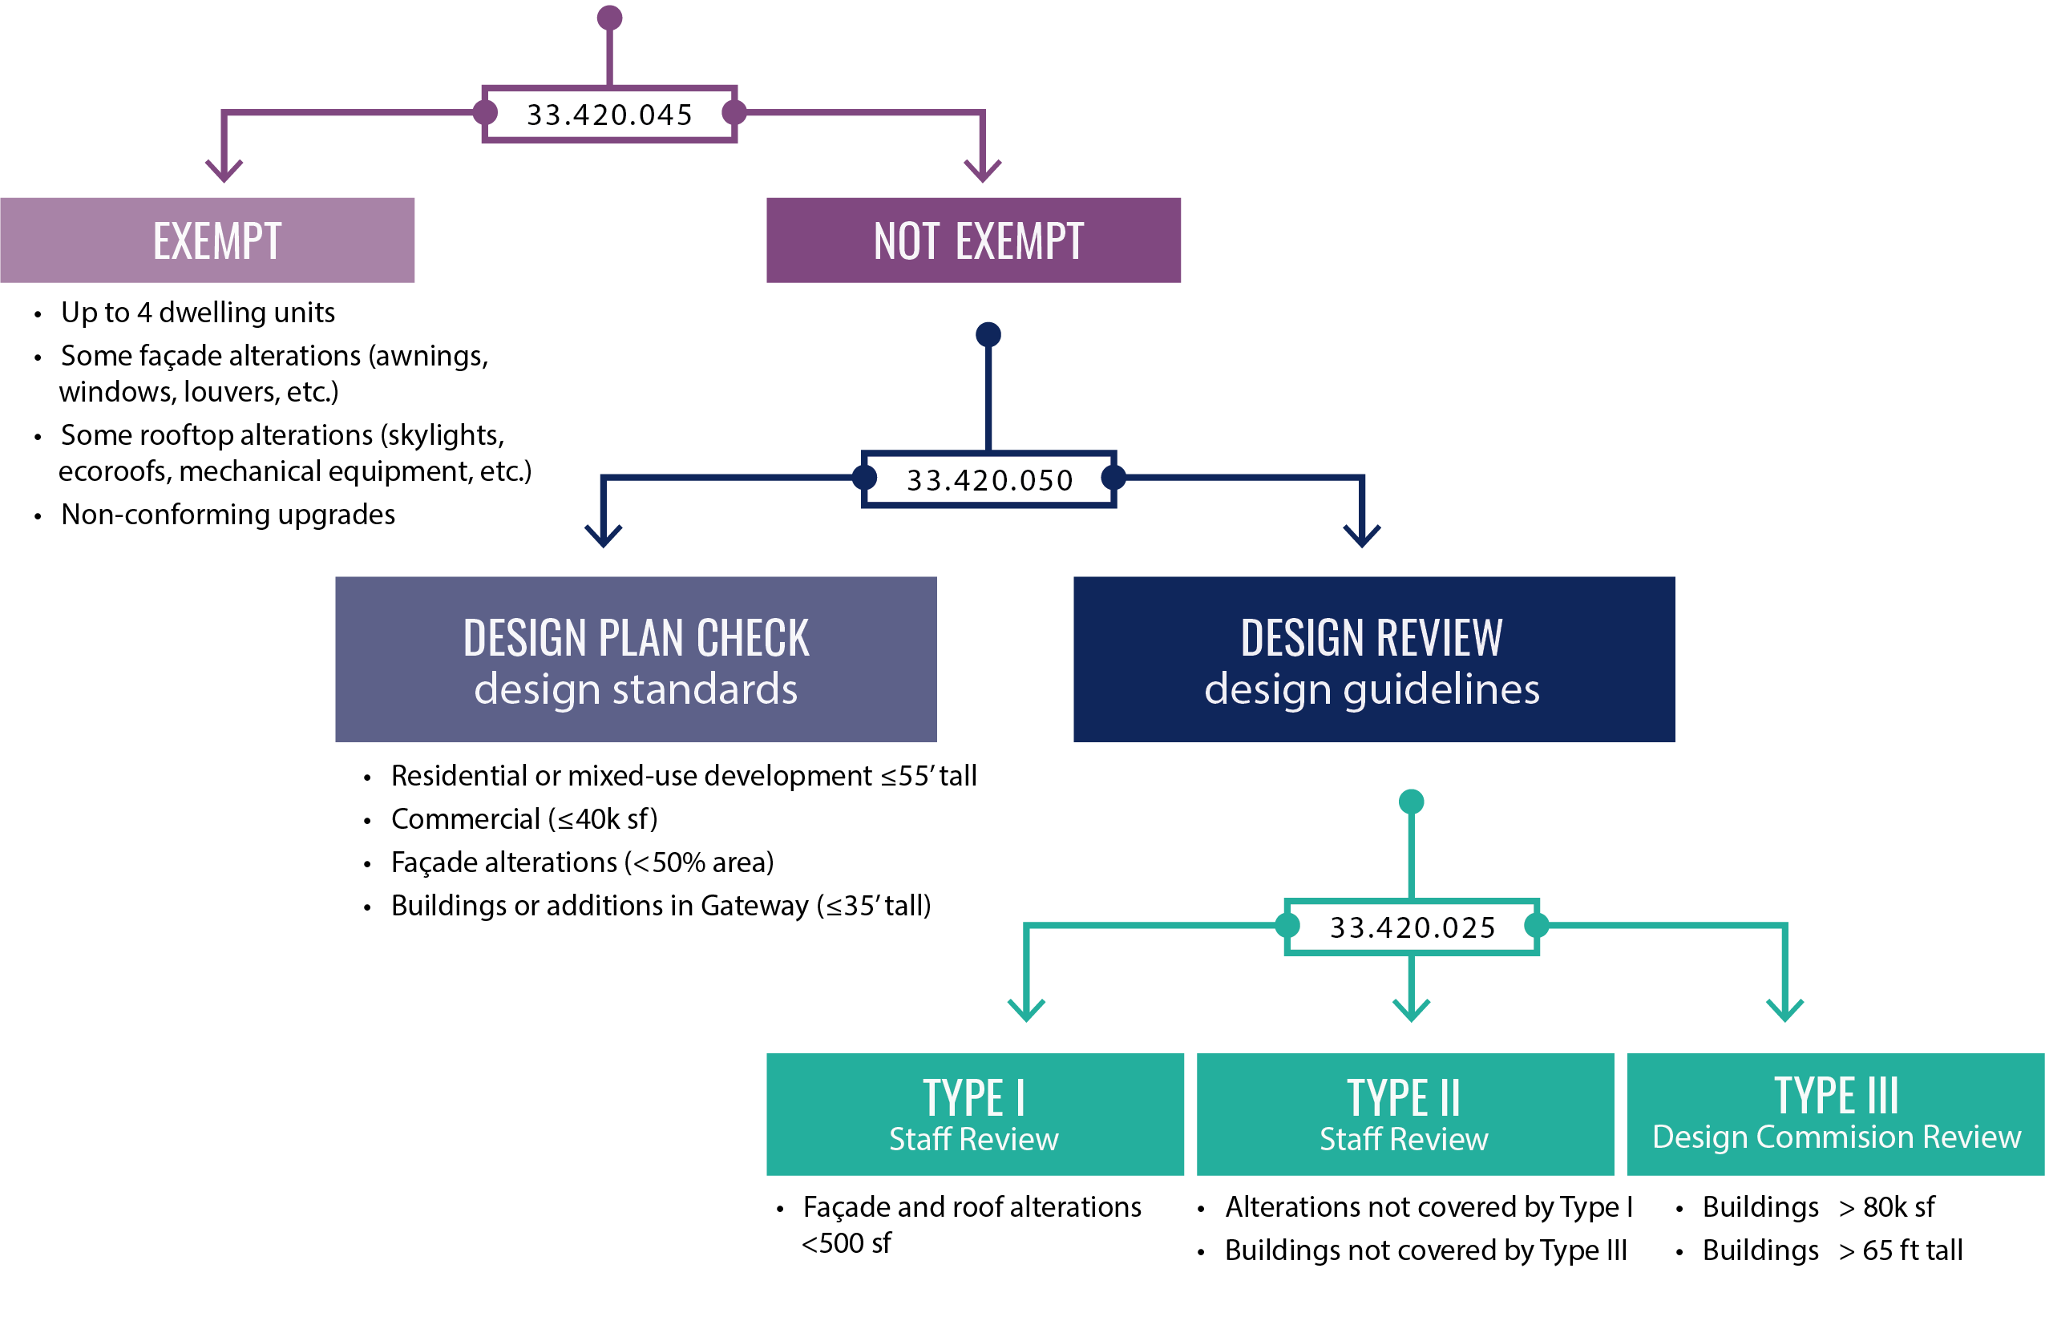
3a. THRESHOLDS for outside Central City

Slide 8
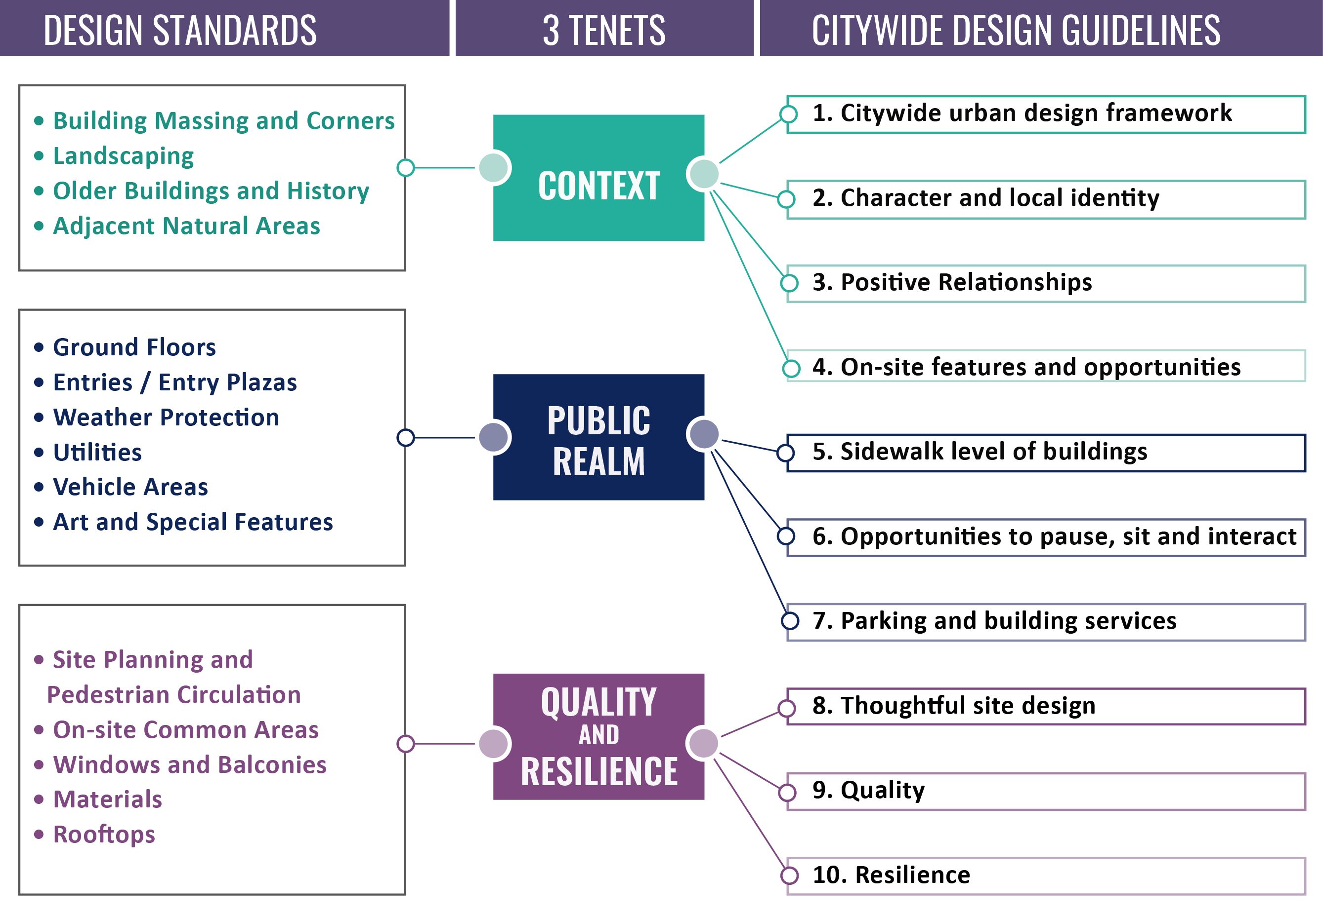
5. TOOLS for reviewing projects

Slide 9
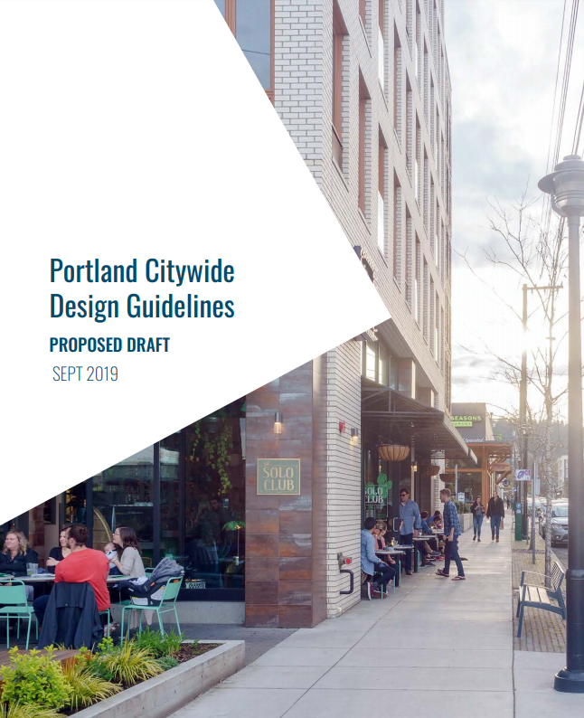
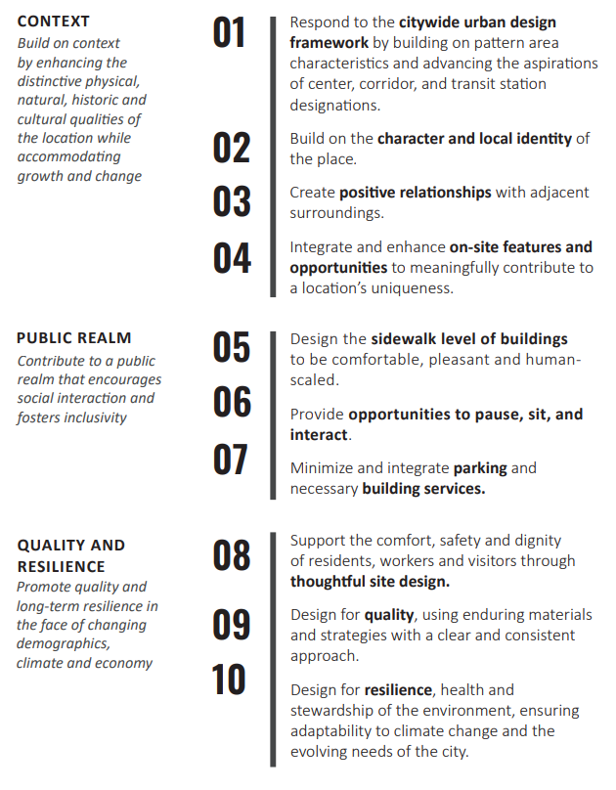

Slide 10
Points of Discussion
C
B
A

Slide 11
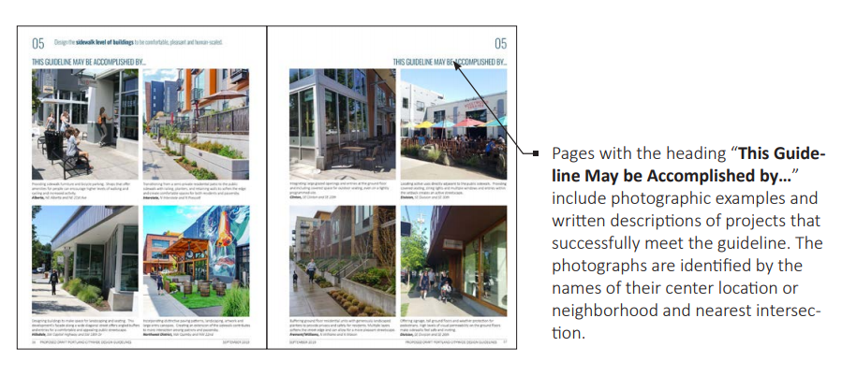
Points of Discussion
D

Slide 12
Overarching Questions for Guidelines
Do the guidelines support the TENET* laid out in the Purpose statement?
Is there something missing within the guidelines that would better support the TENET*?
*Context, Public Realm, Quality and Resilience
Promote quality and long-term resilience in the face of changing demographics, climate and economy

Slide 13
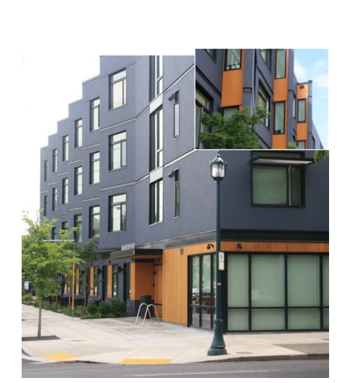
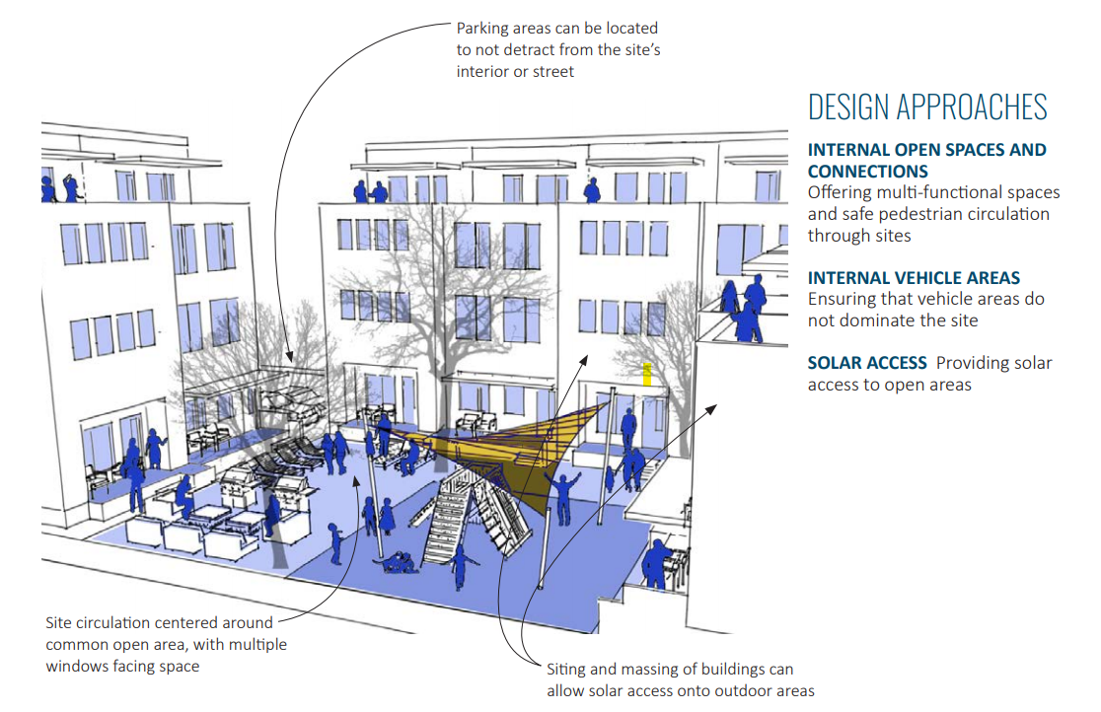
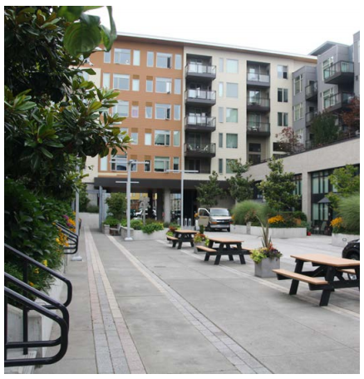

Slide 14
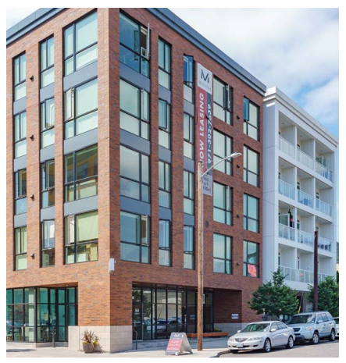
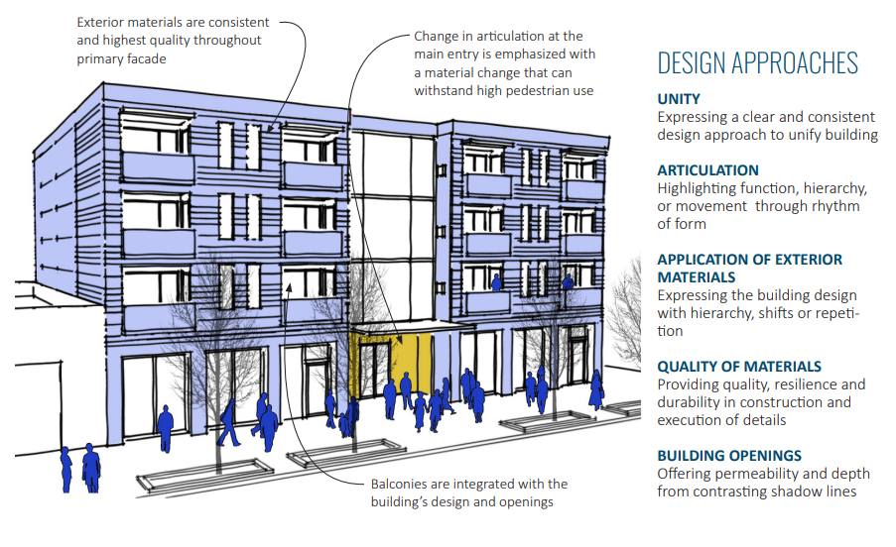
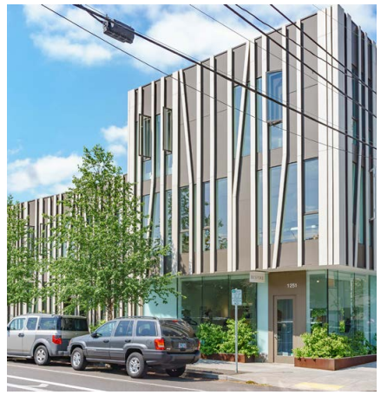

Slide 15
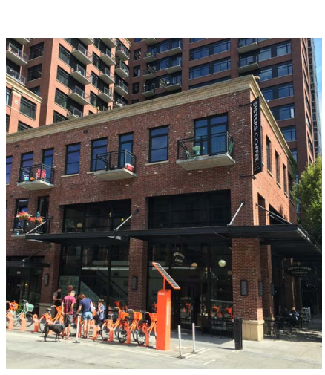
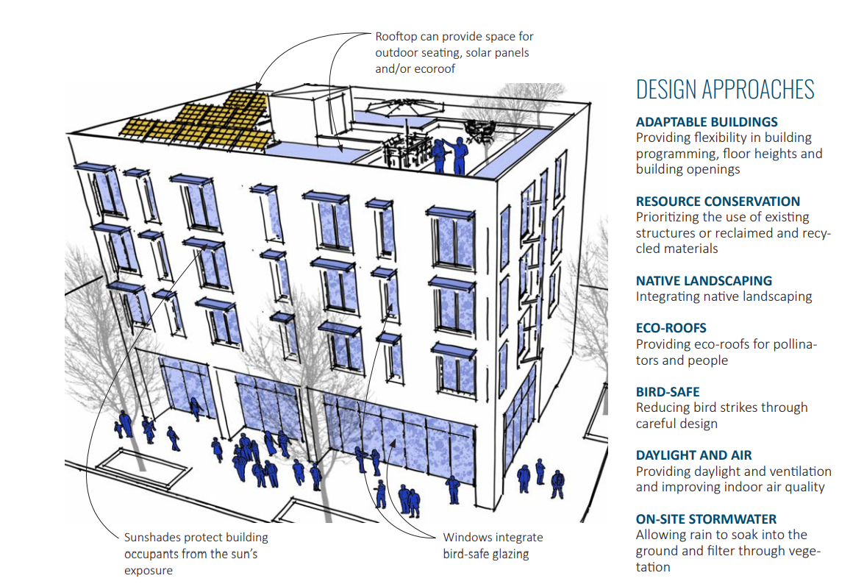
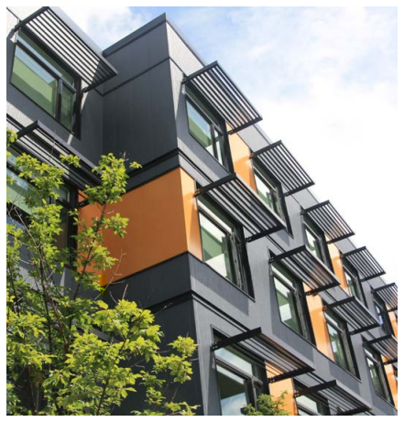

Slide 16
Next Steps
Action | Date
Work Session 3: Public Realm Guidelines 5, 6, 7 | December 19
Work Session 4: Context Guidelines 1, 2, 3, 4 | January 9
3x3 Check-In PSC: Kat, Ben and Mike Design Commission: Julie, Jessica and Sam | Week of January 13
Work Session 5: Wrap-up and Introduction pages Potential Vote | February 13 (tentative)

Slide 18
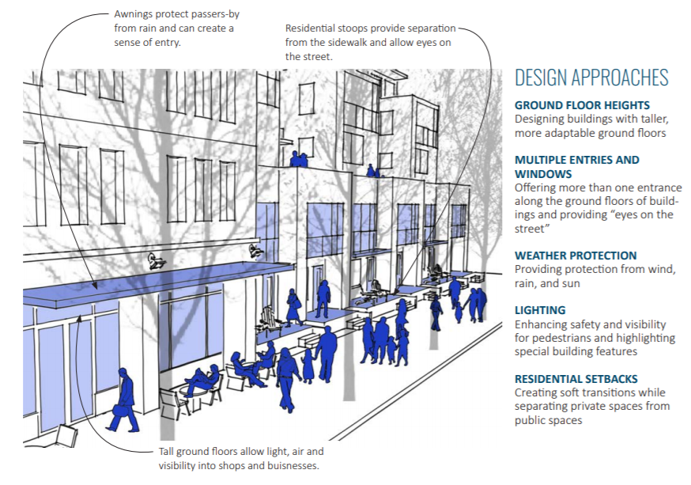
5. TOOLS – Crosswalk
Portland Citywide Design Guidelines

Slide 19
5. TOOLS – Crosswalk
Design Standards
Portland Citywide Design Guidelines
Required:
Ground Floor Ht: 12 ft comm. or 10 ft .
Exterior Lighting
Weather Protection at Main Entrance
Optional:
Ground Floor Ht (3 pts): 15 ft comm. or 12 ft res.
Ground Floor Commercial Space (2 pts):
Provide 1500 sf for sites > 10,000 sf site area
Oversized Street-Facing Opening (2 pts)
Residential Entrance Standards (2 pts)

