Slide 1
Bull Run Filtration Projects
Adopting priority values, expectations, and a recommended option. Authorizing an on-site design services contract.
November 13, 2019 : Mike Stuhr Director | Gabriel Solmer Deputy Director
David Peters Program Manager | Cristina Nieves Senior Policy Advisor, Comm. Fritz
Notes:
[MIKE]
Hello. Thanks you for the time to present today. I’m Mike Stuhr, the director of the Water Bureau. Joining me are Gabe Solmer, our deputy director, David Peters, the program manager for the project, and Cristina Nieves from Commissioner Fritz’s office will be providing an overview of the resolution later on in the presentation.

Slide 2
TODAY’S ACTIONS CONSIDER
Adopting priority values, expectations and a recommended option for the Bull Run Filtration Project. Resolution
Authorizing the on-site design services for the Bull Run Filtration Facility. Ordinance
Notes:
[MIKE]
Today’s presentation does four things: 1) provides a recap of where the project has been, 2) provides a project schedule, 3) frames the project values that will drive the project moving forward, and 4) provides a recommended budget option for the resolution.
We will also provide a short presentation on the Council ordinance that will authorize the design contractor for the Bull Run Filtration project.

Slide 3
RECENT HISTORY
Bilateral Compliance Agreement with the Oregon Health Authority, sets schedule and filtration as treatment
DECEMBER 2017
City Council Work Session
SEPTEMBER 2019
Cryptosporidium detections begin
2017
DECEMBER 2018
City Council Resolution No. 37402 decided on location, technology, capacity, and procurement method for future filtration facility
AUGUST 2017
City Council Resolution No. 37309 chooses filtration as the selected treatment option
Notes:
[MIKE]
First a quick recap. You’ll remember a few of these items:
--We first started receiving crypto reports in 2017, prompting the City Council to take action and chooses filtration as the selected treatment option in August 2017.
--In December 2017, we finalized the Bilateral Compliance Agreement with the Oregon Health Authority, setting a schedule until 2027 and setting filtration as the treatment option.
--Late last year, in December 2018, City Council decided on the location, technology, capacity, and procurement method for the future filtration facility.
--Then, two months ago, we held a work session with you to discuss project updates related to planning and budget.

Slide 4
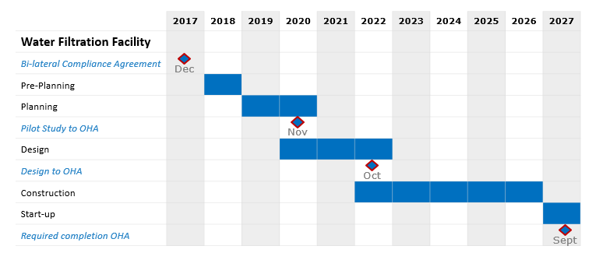
PROJECT SCHEDULE: BIG PICTURE
Notes:
[MIKE]
Looking at the full project timeline, you’ll see we’re still in the planning stages at the yellow line. There is still a lot of work to do. These early planning stages have provided the opportunity to get under the hood, fine-tune things like cost estimates, and have a good grasp on what will be needed for design and construction.
As we’ve done throughout the project, we will continue to provide updates to Council on project milestones and checkpoints. Today is just one of many conversations that we’ll have.
In the near-term, we’ll be back two times in 2020:
--Spring 2020: to discuss the design contract for pipelines work and the CM/GC PTE services contract
--June 2020: for a check-in on the project budget, which will happen each year.

Slide 5




PRIORITY VALUES
WATER QUALITY
Provide safe, reliable, drinking water to a large population in the metropolitan area
RESILIENCE
Advance the Water Bureau’s ongoing efforts to provide a more resilient system
COMMUNITY & ENVIRONMENT
Implement project in a manner that is sensitive to community and environmental impacts
VALUE & COST
Provide best value for customers
Notes:
[MIKE]
Switching gears. From the very beginning, this project has been informed by 4 priority values that we’re hoping to formalize here today:
--Water Quality: providing safe, reliable drinking water to a large population in the Portland metro area.
--Resilience: advancing the Water Bureau’s ongoing efforts to provide a more resilient system.
--Community and Environment: we’re working to implement the project in a manner that is sensitive to community and environmental impacts.
--Value & Cost: our goal is to always provide the best value for our rate payers.
These values are integrated into this work in a variety of ways. For example [note the icon for each slide and how each following slide connects to a value]

Slide 6
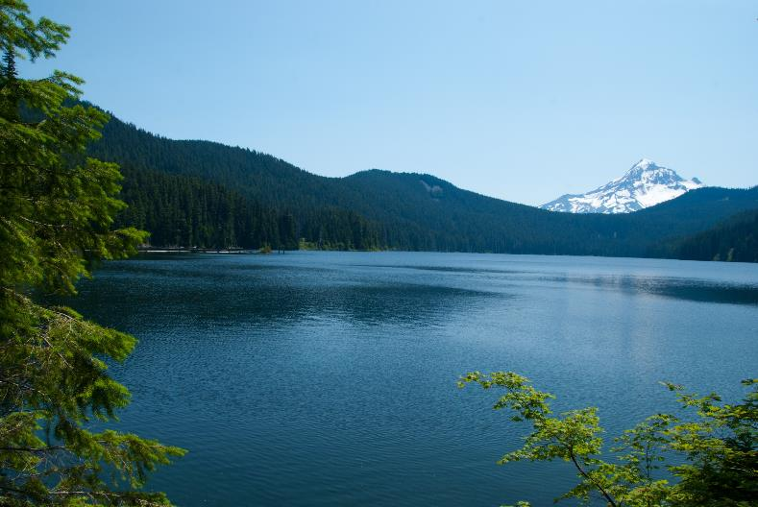
WATER QUALITY: City Council investment and project values in action
Making Portland’s water safer by removing microorganisms
Making our Bull Run supply more reliable
Allowing Bull Run to be used after an emergency, such as a fire, turbidity, landslide, or major rain or wind storms
Preparing us to respond to future regulations
Notes:
[MIKE]
You’ll see here how our Water Quality values guide the benefits of this project. These were also all points that the Council considered when choosing the treatment option.

Slide 7
WATER QUALITY: treatment provides
multiple barriers for potential
contaminants
Contaminant
Turbidity |  | l | l
Pathogens | l | l | l | l
Dissolved Metals | l |  |  | l
Organics | l | l
Tastes and Odors | l | l
Algae / Algal Toxins | l |  | l | l
Notes:
[MIKE]
Tie into WQ value. A quick way to read this: more dots are better. Also, all boxes rely on each other.
The “pathogens” includes cryptosporidium.

Slide 8
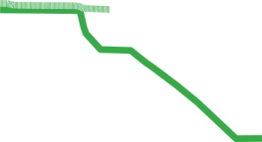

RESILIENCE: recommended option is guided by priority values
Raw Water Pipelines
Finished Water Pipelines
Filtration Facility
145 mgd
Rapid Mix
Filters
Inlet
Flocculation
Sedimentation
Clearwell
Ozone
Two pipes & two-pipe tunnel
6 gpm/sf
16 MG
Two pipes
Notes:
[MIKE]
Tie into resilience value.
Two pipes in, two pipes out talking point.
Turn over to Gabe…

Slide 9
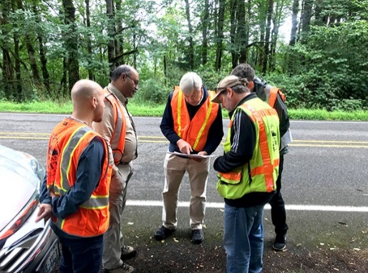
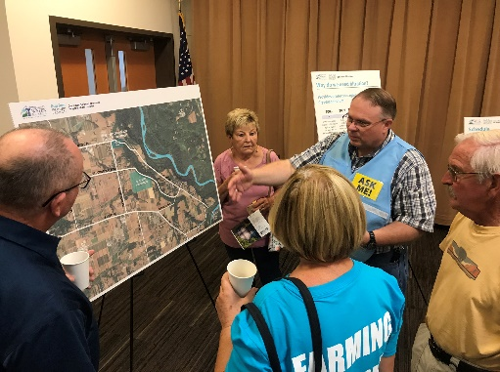
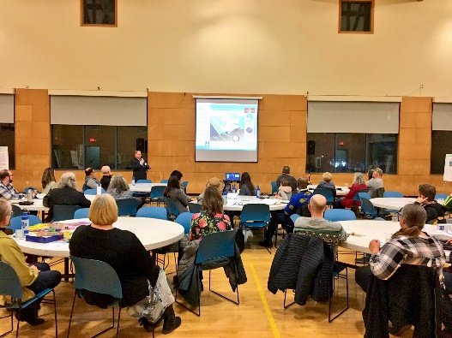
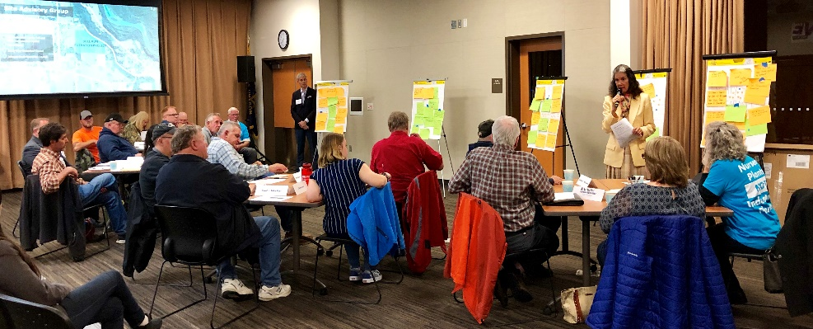
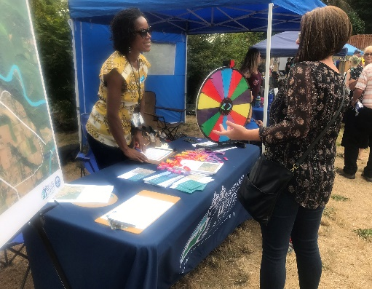
COMMUNITY & ENVIRONMENT: informed by project values
Land use/permitting process
Environmental reviews
Cultural resources review
Ongoing public engagement
Notes:
[GABE]
Tie into community value. Another guiding principle of this work.
Throughout, we are prioritizing environmental considerations and an extensive public outreach and communications effort. We see some of the community members here today and we appreciate their engagement and participation in this process, should they choose to do so. We’ve also spent time individually and one-on-one with many property owners in the community and we always appreciate working with them.
PUB and CUB
In the interest of time I will not read through every group we have met with, but I will make a shameless plug for both our website, where you can get up to date information about all aspects of the project, and a plug for our excellent community engagement team, including Community Outreach and Information Representative Bonita Oswald and Public Information Officer Jaymee Cuti.
The Portland Water Bureau has been working to reach out to organizations to share information about our projects and get feedback about potential topics for future conversations. We have met with the following agencies. (Those in bold are participating in the Site Advisory Group):
East Multnomah Soil and Water Conservation District
Johnson Creek Watershed Council Interjurisdictional Advisory Board
Wholesale Water Managers
Multnomah County Planning
Clackamas County Government Affairs
City of Gresham Government Affairs
Surface Nursery
NW Steelheaders
Multnomah County Health Department
OHSU
We continue to be in contact with the following agencies and have offered to come speak with their organizations.
Clackamas County Planning
Multnomah County Board of Commissioners
Clackamas County Board of Commissioners
Sandy River Watershed Council
City of Sandy
Sandy River Basin Partners
Pleasant Home Water District
Rockwood Water District
Bull Run Community Planning Organization
Multnomah County Rural Fire District 10
City of Gresham, Fire and Emergency Services
Oregon Trail Academy
At the Partner meeting last week we presented project info to the following groups:
Latino Network
Self Enhancement Incorporated
Human Solutions
Impact Northwest
Native American Youth and Family Center
IRCO Asian Family Svcs.
IRCO Africa House
El Programma Hispano Catolico
Home Forward
I am meeting with Corbett Friday to further discuss other opportunities with these groups and Financial Assistance. We are also exploring the concept of setting up information/activity tables at Community Centers next year.

Slide 10
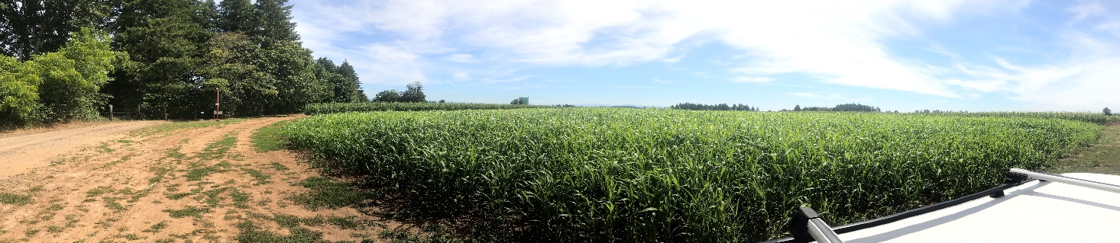
COMMUNITY & ENVIRONMENT: filtration plant location
95-acre property purchased in 1975 by Portland for a future filtration facility
Site is at the right elevation and location
Zoning allows for a filtration facility
Site is large enough to provide a buffer around the facility for neighbors
Notes:
[GABE]
As a quick recap as part of the important community and environmental values that guide our work, part of your December 2018 decision chose to located the facility on a 95-acre property already owned by the City.
The location is ideal for the reasons on the slide.
We’ve heard some conversations about the site, and that is certainly a driving issue for the neighbors. So we wanted to touch on why the site was selected – and it really does come down to the elegant design of a gravity-fed system. This location allows us to continue to receive that water into town by gravity.
Turn back to Mike…

Slide 11


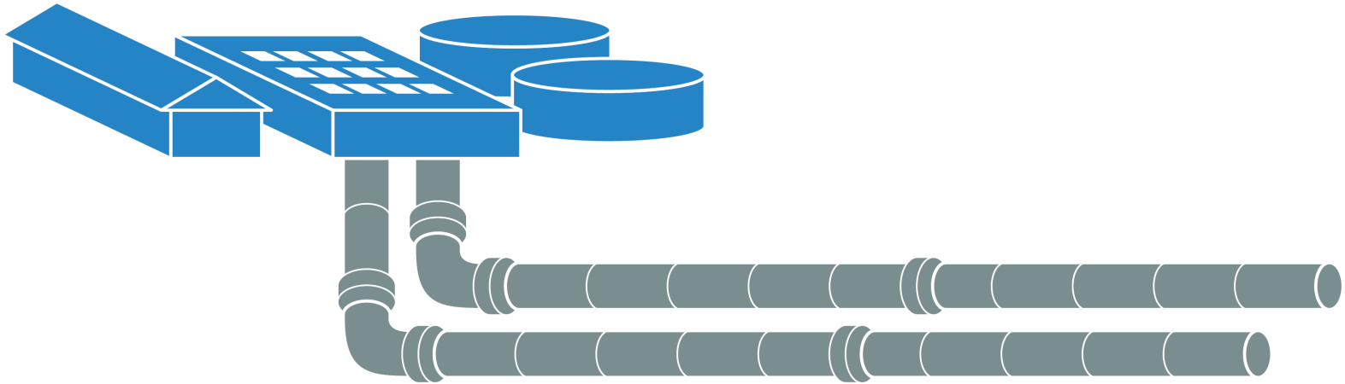

VALUE & COST: project budget
Filtration Facility
Planning &
Program Management
Design
Construction
Pipelines
Total project budget: ~ $820M
Notes:
[BACK TO MIKE]
Tie into cost value.
Before we dive into the budget, I wanted to take a moment to clarify how we arrived at our estimate and where we’re at now. [use as an opportunity to clarify misinformation, share big picture perspective of how this is a common practice with all major capital infrastructure projects]. We also appreciate that there will be scrutiny any time that large construction project costs are involved, and we’re sensitive to this which is why we’ve built in regular updates and touchpoints with the Council and PUB throughout, so that all of our findings and decisions are open and transparent—much like what we’ve done throughout.
We also heard your direction and found opportunities for reductions. The reduction in the project budget from the full implementation discussed at the filtration work session is $30 million, reducing the plant capacity to 145 mgd.
Brief mention again of how budgets and cost estimates are created for major capital infrastructure projects.
City services is city project management cost.
Council approved program management contract with Brown & Caldwell in 2018.
Today, we are asking Council to approve the design contract with Stantec.
Plant construction costs and pipeline costs are as estimated. (reiterate the confidence level)
Accuracy range -30% to +50%
Design has not started
No budget included for:
Program contingency
Property acquisition
Mitigation allowance
Unescalated values used in this presentation.
Back to Gabe…

Slide 12
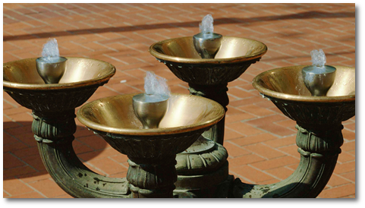
VALUE & COST: commitment to managing rate impacts
Water Infrastructure Financing and Innovation Act (WIFIA) would:
+finance 49% of the project
+lock current low rates
+provide flexible repayment terms
Variety of Water Bureau financial assistance programs available
Mayor’s Budget Guidance: seek efficiencies in bureau operations and programs to manage rate impacts
Notes:
[GABE]
Tie into cost value.
The planning phase of this project has allowed us to roll up our sleeves and look for rate impact options. Also, as a statement to the EPA’s confidence in the Water Bureau’s ability to deliver a project such as this, we have been invited to apply for a WIFIA loan. You may have seen Senator Merkley's press release.
WIFIA is an EPA program that offers financing for water infrastructure projects.
Financing up to 49% of the project costs plus contingencies.
Fix rate at closing. Rate is equal to the US Treasury rate of similar maturity.
Flexible repayment terms that includes customized repayment schedules, long repayment period (up to 35 years after project completion), and deferred payment
WIFIA will keep financing costs to the project lower as bond rates are likely to be higher in a few years when construction begins and cash flow for the project increases.
The flexible repayment terms will allow us to phase in rate increases over longer period of time and help us manage rate impacts to all our customers.
Other rate impact solutions include:
--Our Financial Assistance Program
We will continue to explore enhancements to financial assistance programs to further assist customers in need.
--Seek efficiencies in our bureau budget
We will meet the mayor’s budget guidance to limit rate impacts to customers.
Current forecast was 7.4%, with $820M low confidence cost would take us to 9.0%, following mayor guidance we will be at 8.6%. With WIFIA, we will be negotiating a loan agreement with terms that will allow us to drop the rates even lower to benefit our ratepayers (depends on the terms of the loan – needs to be balanced between impacts to ratepayers now and the future, when the debt is deferred to, when we draw on the money, what the interest rates ) Our goal is to negotiate the terms of the loan that will allow us to maximize benefits to our ratepayers. April to turn in our application and early fall to finish negotiations.
We’ve already talked to others about how they did (Miami Dade, TVWD/Hillsboro)
8.6%
[TURN OVER TO CRISTINA]

Slide 13
RESOLUTION
Adopting priority values, expectations and a recommended option for the Bull Run Filtration Project
Notes:
[CRISTINA]
This resolution is a follow up to the work session that was held in September.
Opportunity for all of Council to weigh-in on the implementation of the Bull Run Filtration project
Acknowledge that many concerns have been raised
The impact of this decision will have a large impact
We considered several values: water quality, resiliency/redundancy, cost and benefit, and impact on the local community near the future site of the filtration plant
Given the risk of failure and the likelihood that we will need a system that is more resilient against potential natural disasters and the requirement by the LT2 rule, we are proposing the Council primarily consider water quality and resiliency, though all other values will still be a part of the design
So, while we are required to treat our water, we now have an opportunity to go above and beyond
This means a design closer to the full implementation option but will potentially cost less (reference visuals)
using a target capacity of 145 million gallons per day to meet most projected demands through 2045
using ozone to remove organics that increases the lifespan of the water system and improves water quality
mitigates impact to the neighbors, decreasing the length of time for construction compared to the phased approach
using two pipes coming in and out of the plant creating redundancy if one pipe must be taken off-line and increasing resiliency and reliability of the filtration plant (this includes the replacement of 100-year old conduit)
We acknowledge this is a difficult decision and a complex project
Although we are working within many constraints, specifically time constraints we want to build something that will increase the resiliency AND reliability of a system that over 1 million people depend on now and more will in the future

Slide 14
FILTRATION RESOLUTION
Follow up from September Council Work Session
WATER QUALITY
Provide safe, reliable, drinking water to a large population in the metropolitan area
RESILIENCE
Advance the Water Bureau’s ongoing efforts to provide a more resilient system
COMMUNITY & ENVIRONMENT
Implement project in a manner that is sensitive to community and environmental impacts
VALUE & COST
Provide best value for customers
Notes:
[CRISTINA]
This resolution is a follow up to the work session that was held in September
Opportunity for all of Council to weigh-in on the implementation of the Bull Run Filtration project
Acknowledge that many concerns have been raised
The impact of this decision will have a large impact
We considered several values: water quality, resiliency/redundancy, cost and benefit, and impact on the local community near the future site of the filtration plant
Given the risk of failure and the likelihood that we will need a system that is more resilient against potential natural disasters and the requirement by the LT2 rule, we are proposing the Council primarily consider water quality and resiliency, though all other values will still be a part of the design
So, while we are required to treat our water, we now have an opportunity to go above and beyond
This means a design closer to the full implementation option but will potentially cost less (reference visuals)
using a target capacity of 145 million gallons per day to meet most projected demands through 2045
using ozone to remove organics that increases the lifespan of the water system and improves water quality
mitigates impact to the neighbors, decreasing the length of time for construction compared to the phased approach
using two pipes coming in and out of the plant creating redundancy if one pipe must be taken off-line and increasing resiliency and reliability of the filtration plant (this includes the replacement of 100-year old conduit)
We acknowledge this is a difficult decision and a complex project
Although we are working within many constraints, specifically time constraints we want to build something that will increase the resiliency AND reliability of a system that over 1 million people depend on now and more will in the future
Turn over to Dave…

Slide 15
ON-SITE DESIGN SERVICES CONTRACT
Council ordinance
Notes:
[DAVID]

Slide 16
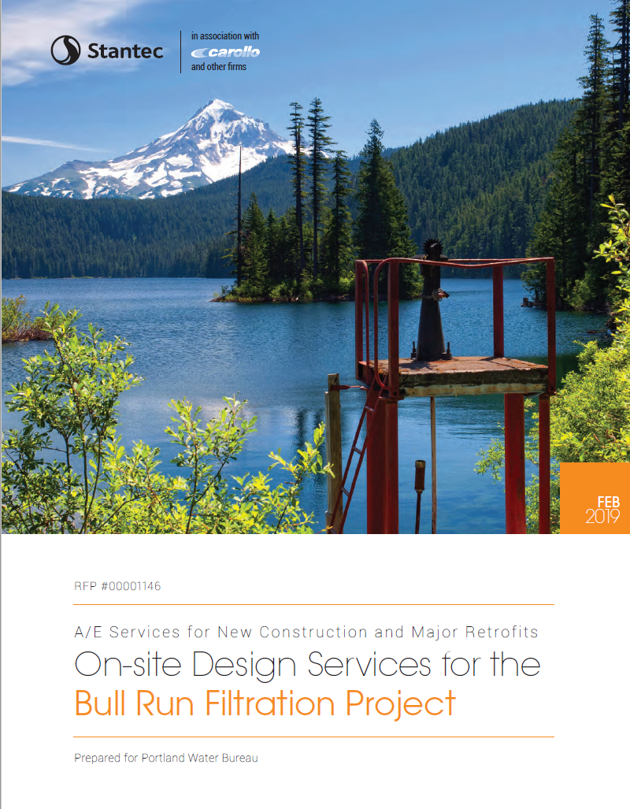
Formal PTE* Request for Proposal process
2 proposals received
Stantec Consulting Services, Inc. was selected
5-year contract with
possible 5-year extension
On-site Design Services Contract
*PTE = professional, technical, expert or professional services
Notes:
[DAVID]

Slide 17
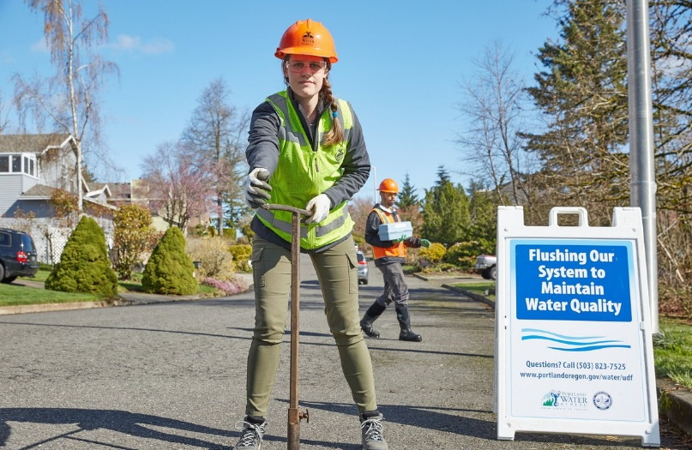

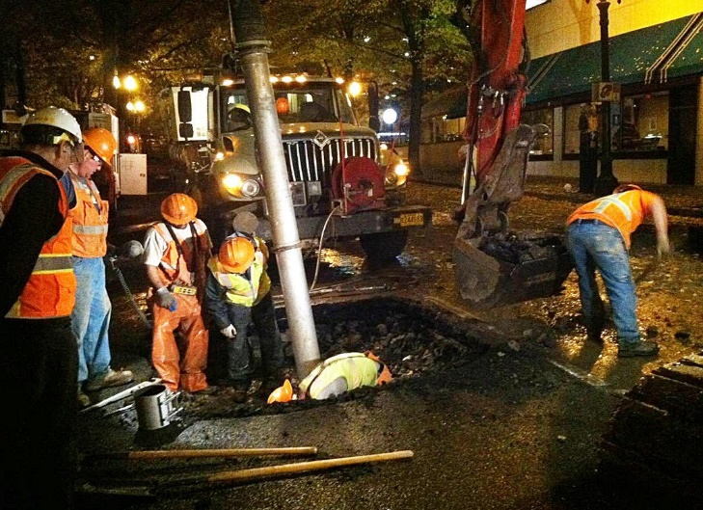
On-site Design Services Contract D/M/W/ESB Participation
20% D/M/W/ESB* participation
  Estimated to be $10,200,000
  $9,400,000 committed to D/M/W* participation
* D/M/W/ESB – disadvantaged, minority, women and emerging small business
Notes:
[DAVID]
Verbally mention specific MWESB if needed. Standard city amount, and committed to.
Contract proposal has committed to…

Slide 18
RECOMMENDATION: RECAP
Adopt priority values, expectations and a recommended option for the Bull Run Filtration Project.
Authorize execution of the on-site design services contract with Stantec.
Notes:
[MIKE]
To wrap up: today we recommend two actions: 1) adopting the values, expectations and recommended option that we’ve presented for the Bull Run Filtration Project. And 2) Authorize executing the on-site design services contract with Stantec as we move forward into the design phase of the project.

Slide 19

Questions?
Stay current at portlandoregon.gov/bullrunprojects
Notes:
[MIKE]
Thanks for your time. Folks don’t need to only track City Council meetings to stay current on what’s happening with our project. They can also bookmark our project webpage and sign up for project emails and updates throughout the year.
We’ll now open up with any questions.

