Slide 1
*1078 Accept a grant in the amount of $3,140,000 from TriMet and authorize Intergovernmental Agreement for Central City in Motion projects improving transit speed and reliability (Ordinance)

Slide 2
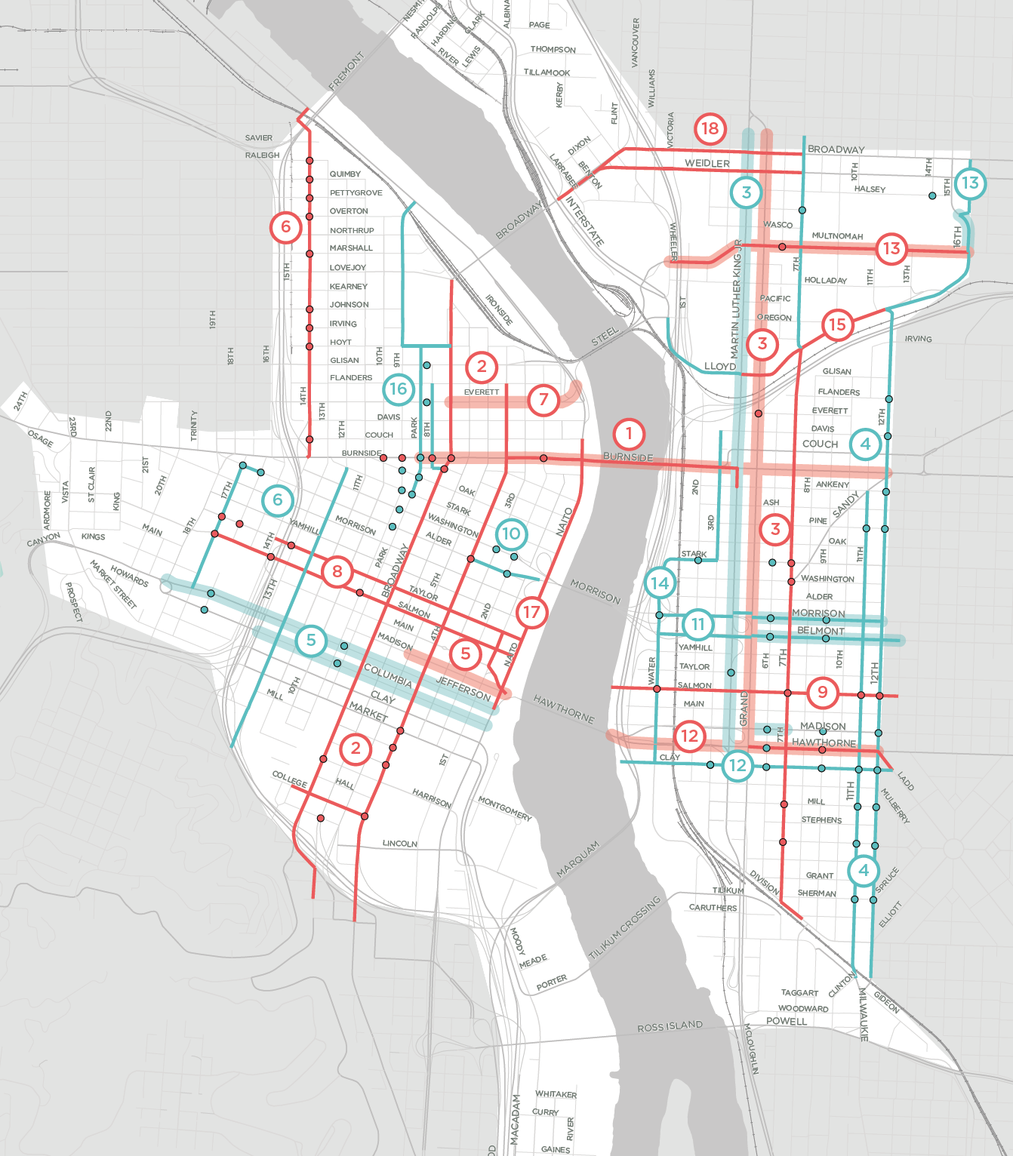
PROJECTS FUNDED BY THIS IGA
#7 - NW EVERETT:
New bus lane serving 6 bus lines approaching the Steel Bridge.
#5 - SW MADISON:
New bus/bike lane serving 5 bus lines approaching the Hawthorne Bridge.
#5 - SW MADISON PHASE II:
Phase II will extend the bus/bike lane one block west once the Portland Building is complete
#1 – BURNSIDE:
Phase 1 of Burnside project will stripe buffered bike lanes and an eastbound bus lane across the bridge.
#1 – E BURNSIDE to 12th:
Phase 2 of Burnside project will extend eastbound bus lane to 12th
COMPLETED CCIM PROJECTS
UPCOMING CCIM PROJECTS

Slide 3
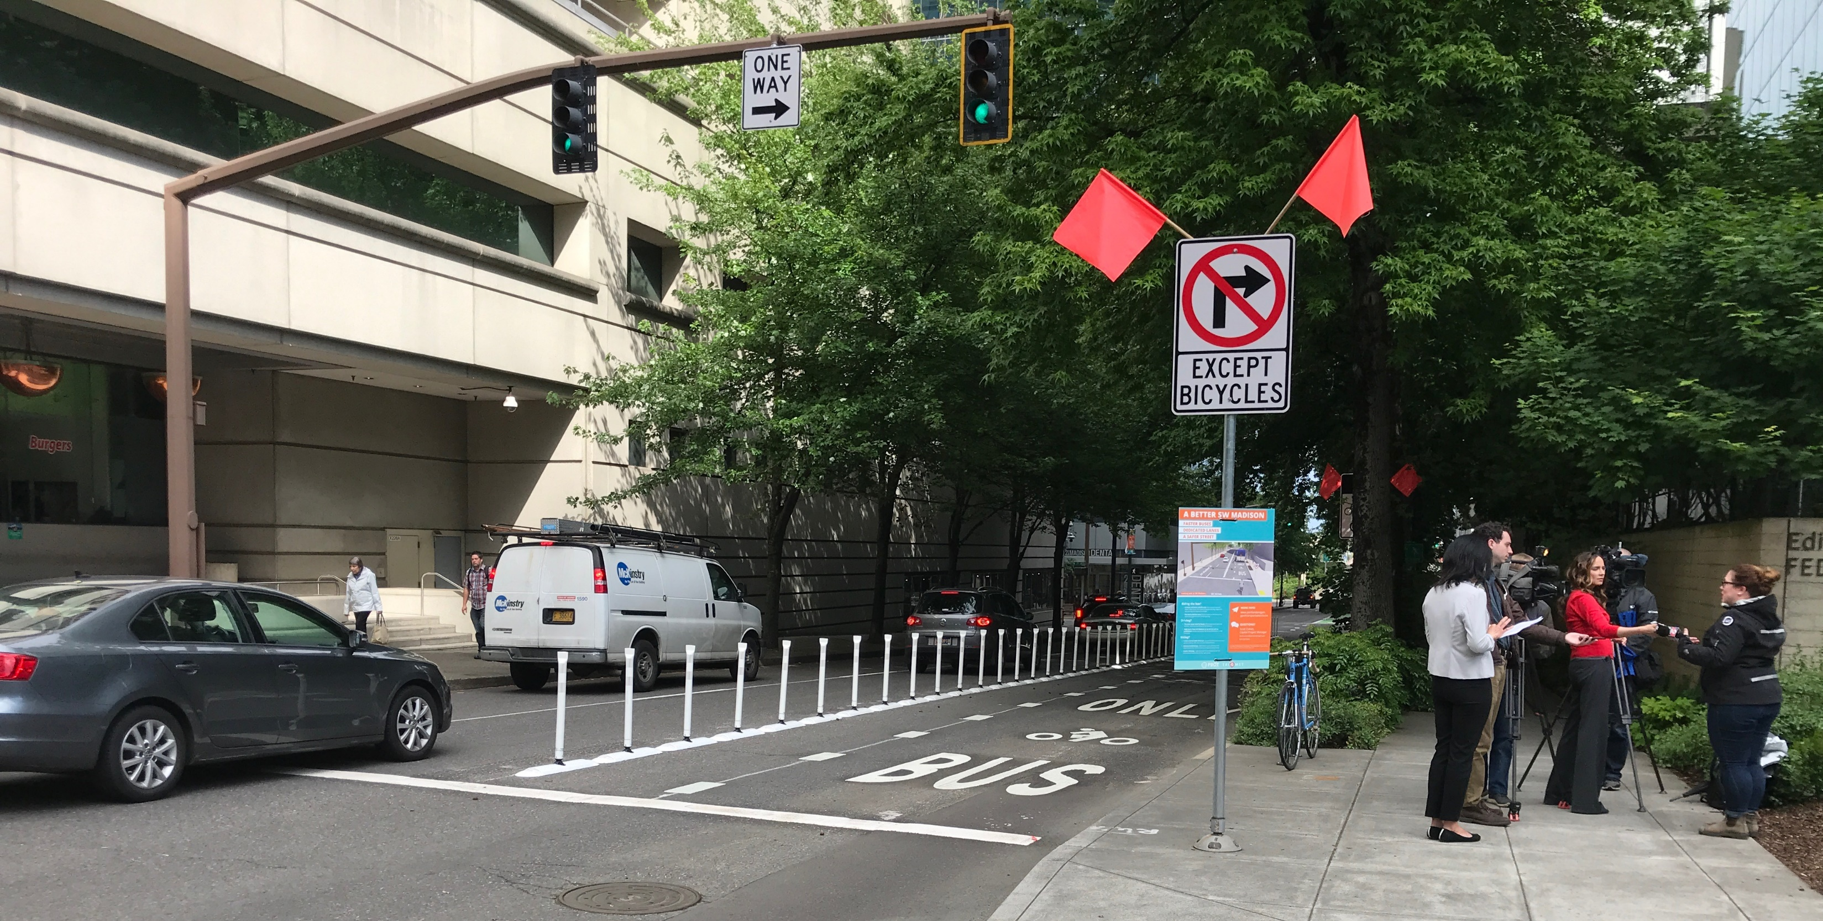
SW MADISON BUS/BIKE LANE:
Installed May, 2018
Runs from SW 4th Avenue to Naito Parkway and serves TriMet lines 2, 6, 10, and 14
To be extended one block west to SW 5th post-completion of Portland Building

Slide 4
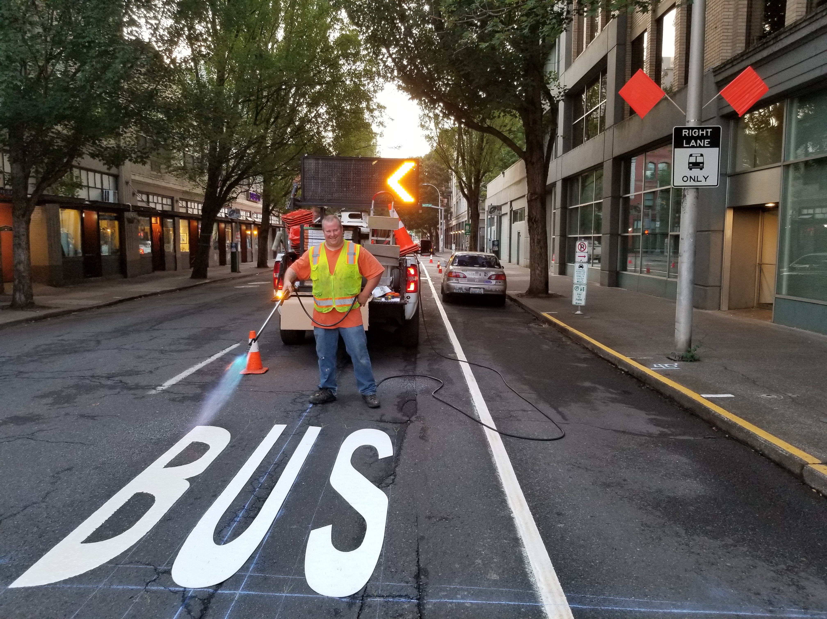
NW EVERETT BUS LANE
Installed August, 2019
Runs from NW Broadway to the Steel Bridge and serves 6 TriMet bus lines

Slide 5
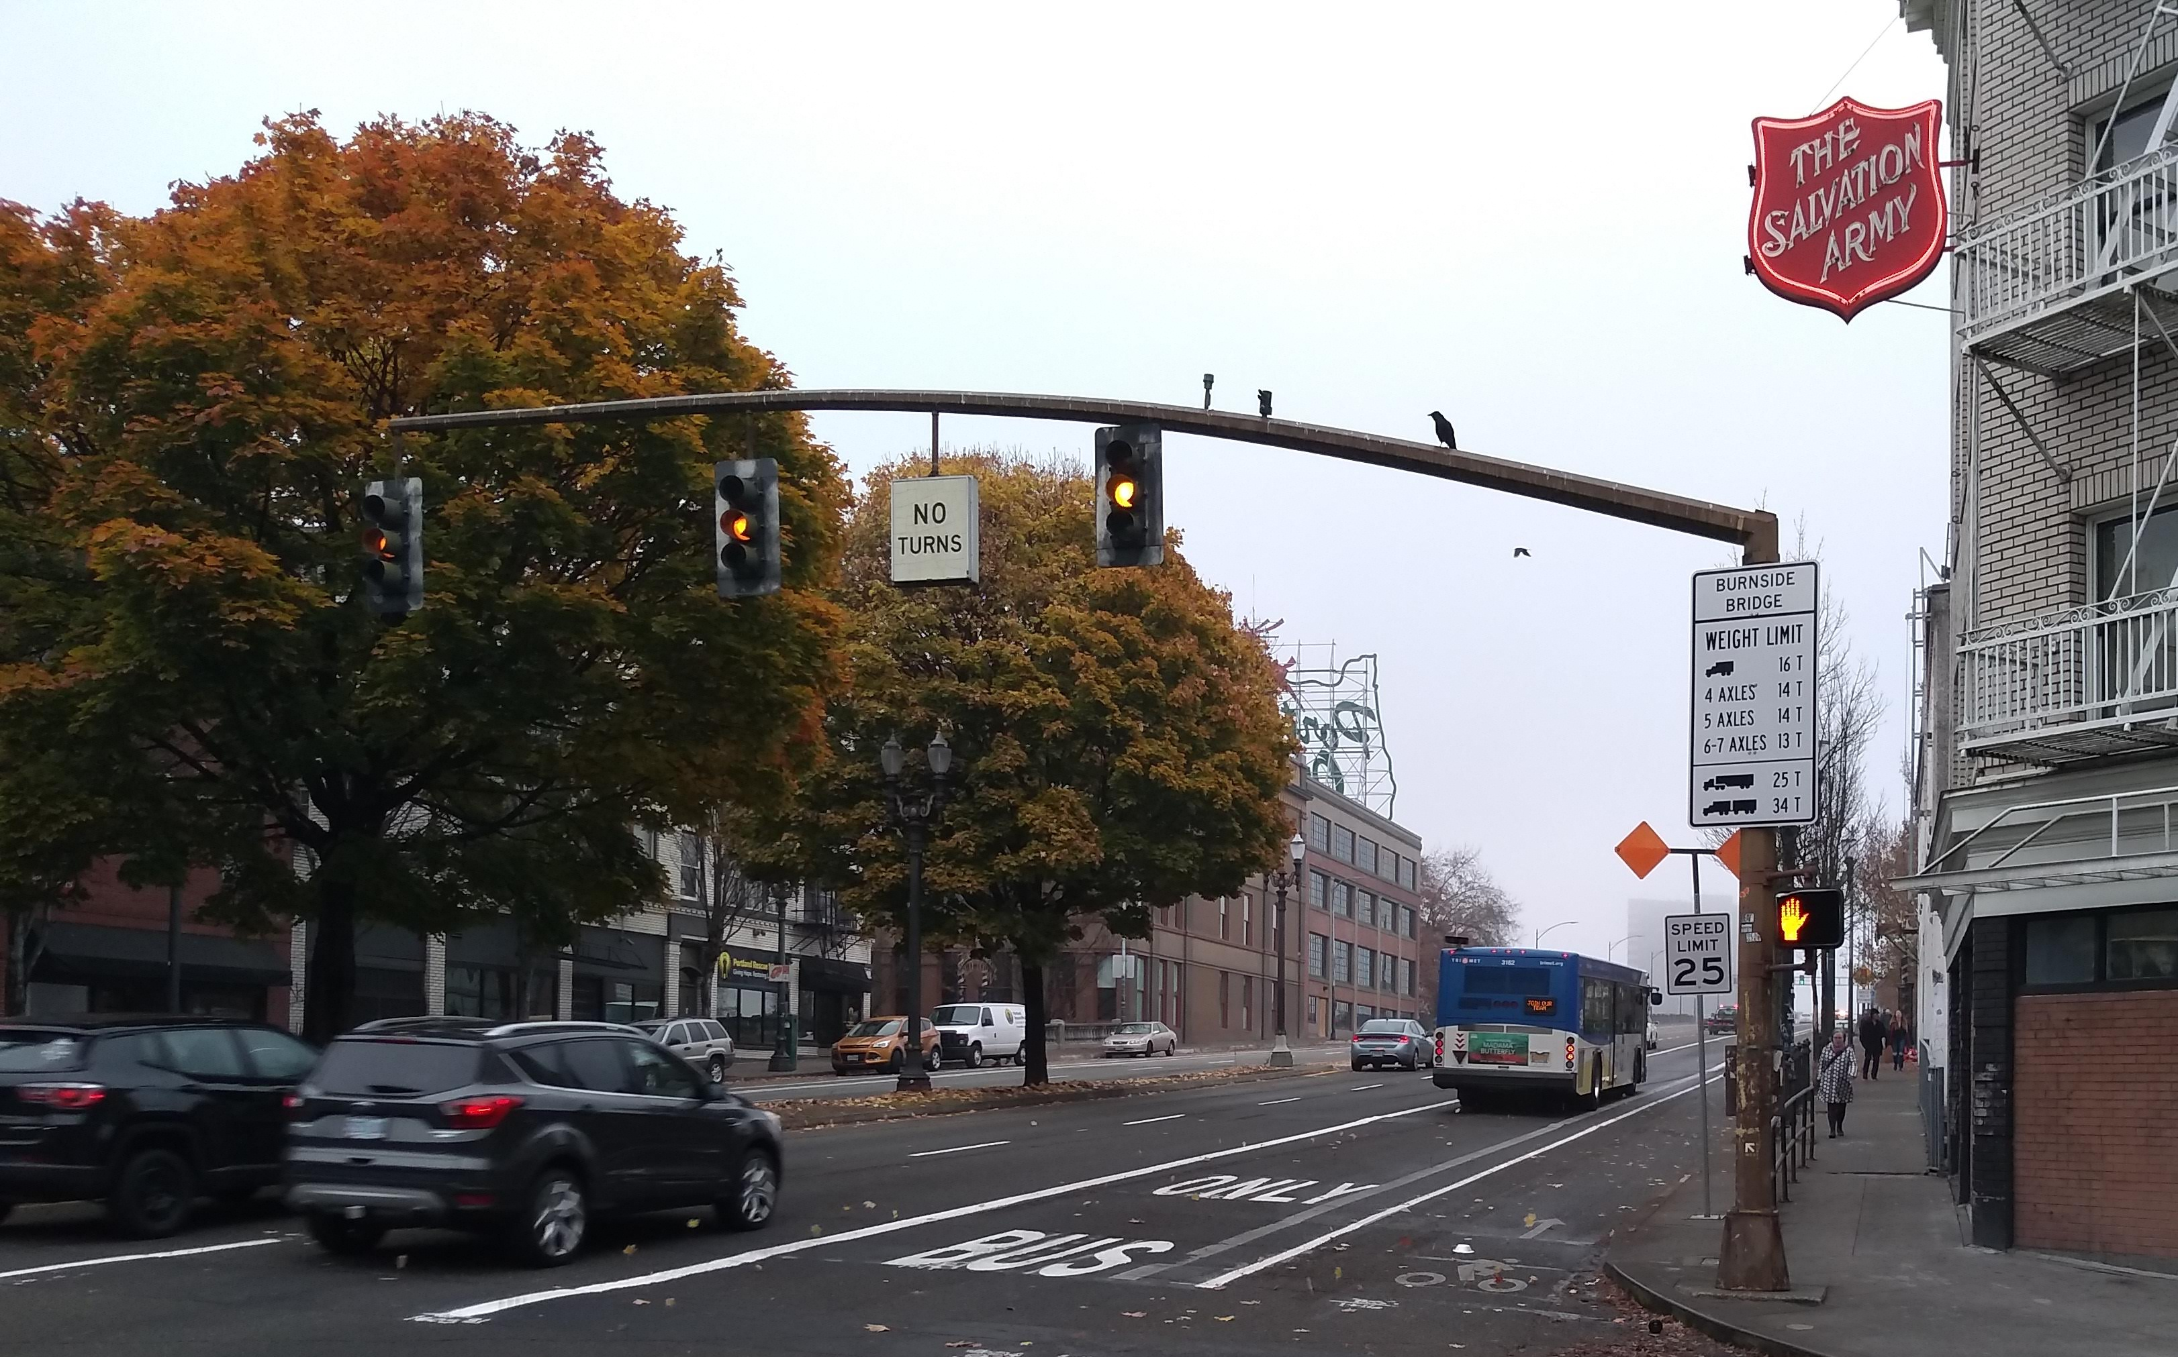
BURNSIDE BRIDGE BUS LANE, BIKE LANES
Installed November, 2019 and serves 3 TriMet bus lines
Buffers bike lanes and adds wands

Slide 6
E BURNSIDE BUS LANE EXTENSION
Extends Burnside bus lane to 12th Avenue
Rebuilds signal at E Burnside and MLK

Slide 7
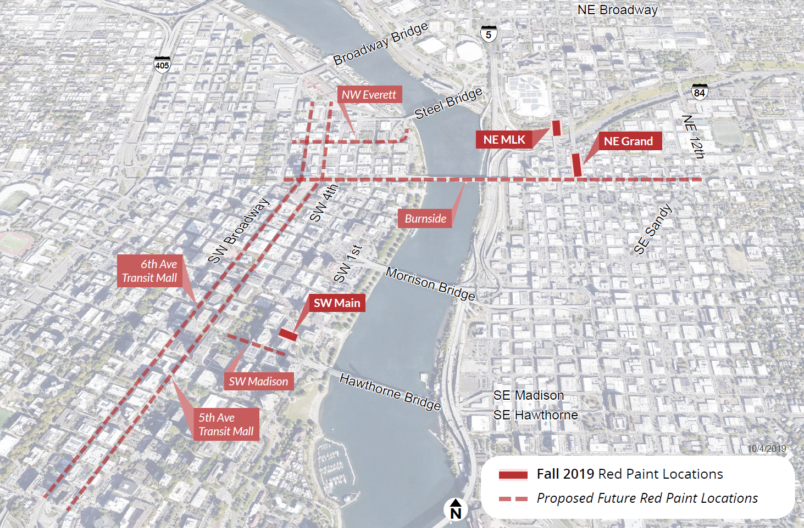
RED PAVEMENT MARKINGS
Testing compliance and performance of adding red markings to bus lanes
Markings currently installed at SW Main, NE MLK, and NE Grand

Slide 8
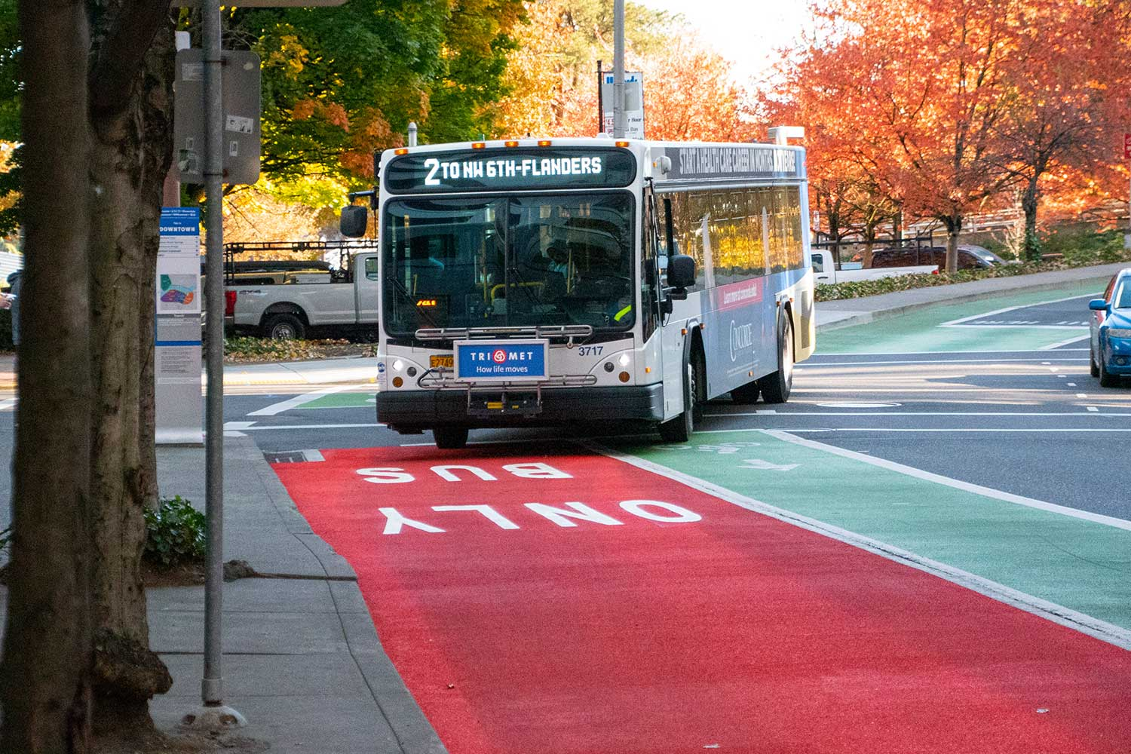
RED PAVEMENT MARKINGS
Testing compliance and performance of adding red markings to bus lanes
Markings currently installed at SW Main, NE MLK, and NE Grand

Slide 9
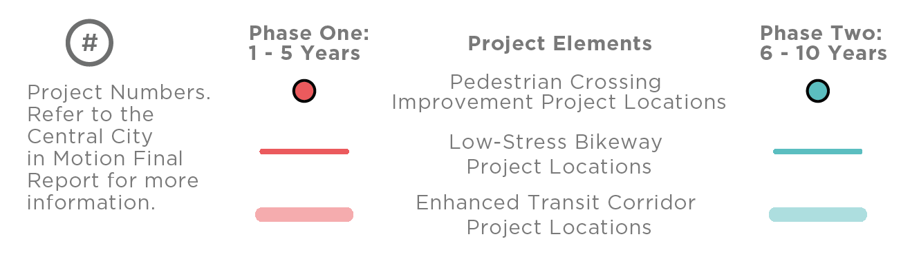
CENTRAL CITY IN MOTION
Project Manager: Gabriel Graff
Phone: 503-823-5291
Email: Gabriel.Graff@portlandoregon.gov

