Slide 1
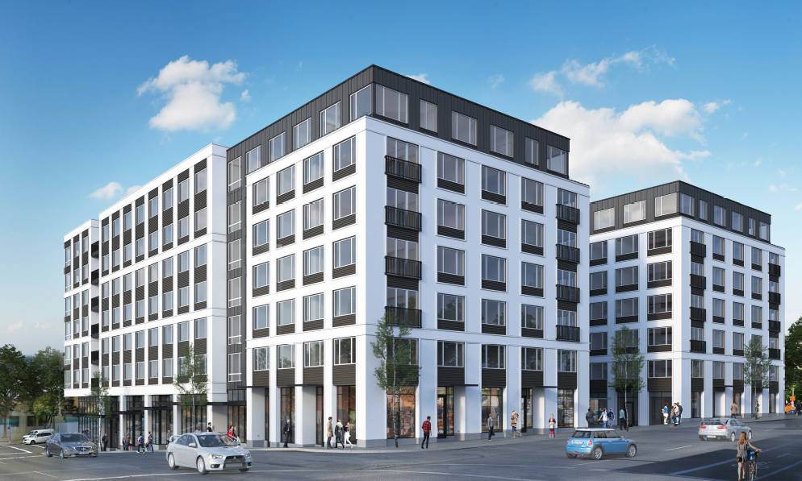
City of Portland
Design Commission
Type III Land Use Review
LU 19-208247 DZMAD
1120 SE Morrison
November 21, 2019
Staff Presentation

Slide 2
Context
Location
Zoning
Approval Criteria
Context
Program Overview
Project History
Modifications | Adjustments
Applicant Presentation
Approvability Items
Context
Public Realm
Quality & Permanence
Modifications | Adjustments
Staff Recommendation
Conditions of Approval
Next Steps

Slide 3
Context

Slide 4
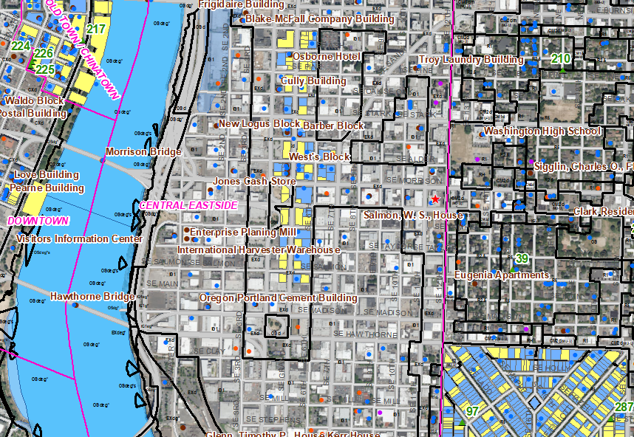
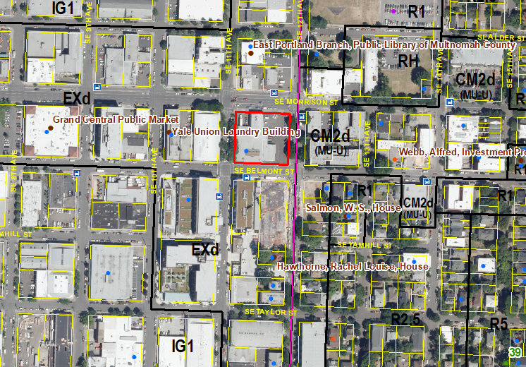
Location
Central City Plan District
Central Eastside Subdistrict

Slide 5
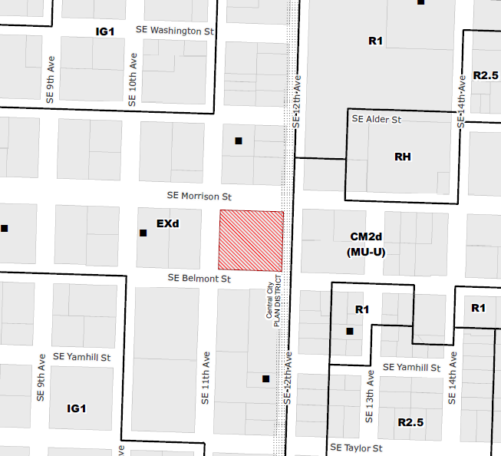
Zoning
Base Zone:
EX, Central Employment
Overlay:
Design Overlay
Floor Area Ratio:
3:1 base; 6:1 bonus with inclusionary housing
Height:
50’ max; 125’ with bonus

Slide 6
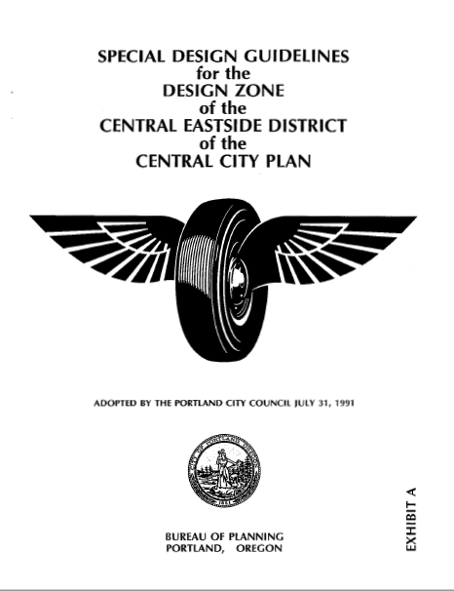
Approval Criteria
Central City Fundamental Design Guidelines
Special Design Guidelines for the Design Zone of the Central Eastside District of the Central City Plan
33.825.040 Modifications That Will Better Meet Design Review Requirements
33.805.040 [Adjustment] Approval criteria

Slide 7
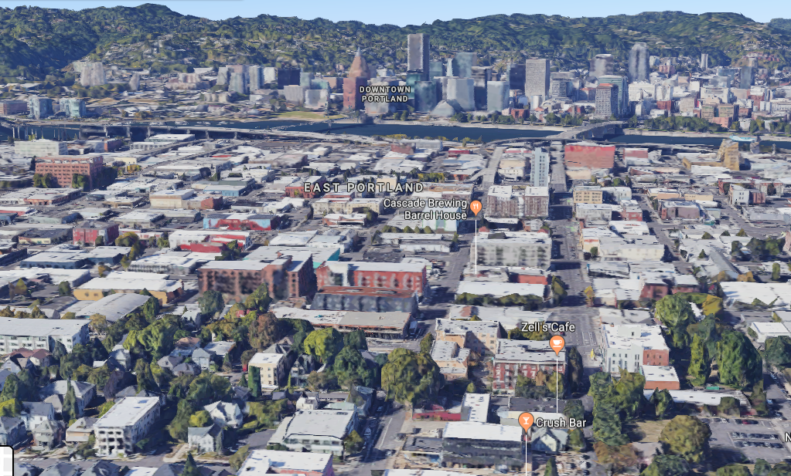
Context
Bound by:
SE 12th Ave on east
SE Morrison St on north
SE 11th Ave on west
SE Belmont St on south
SE Belmont
SE Morrison

Slide 8
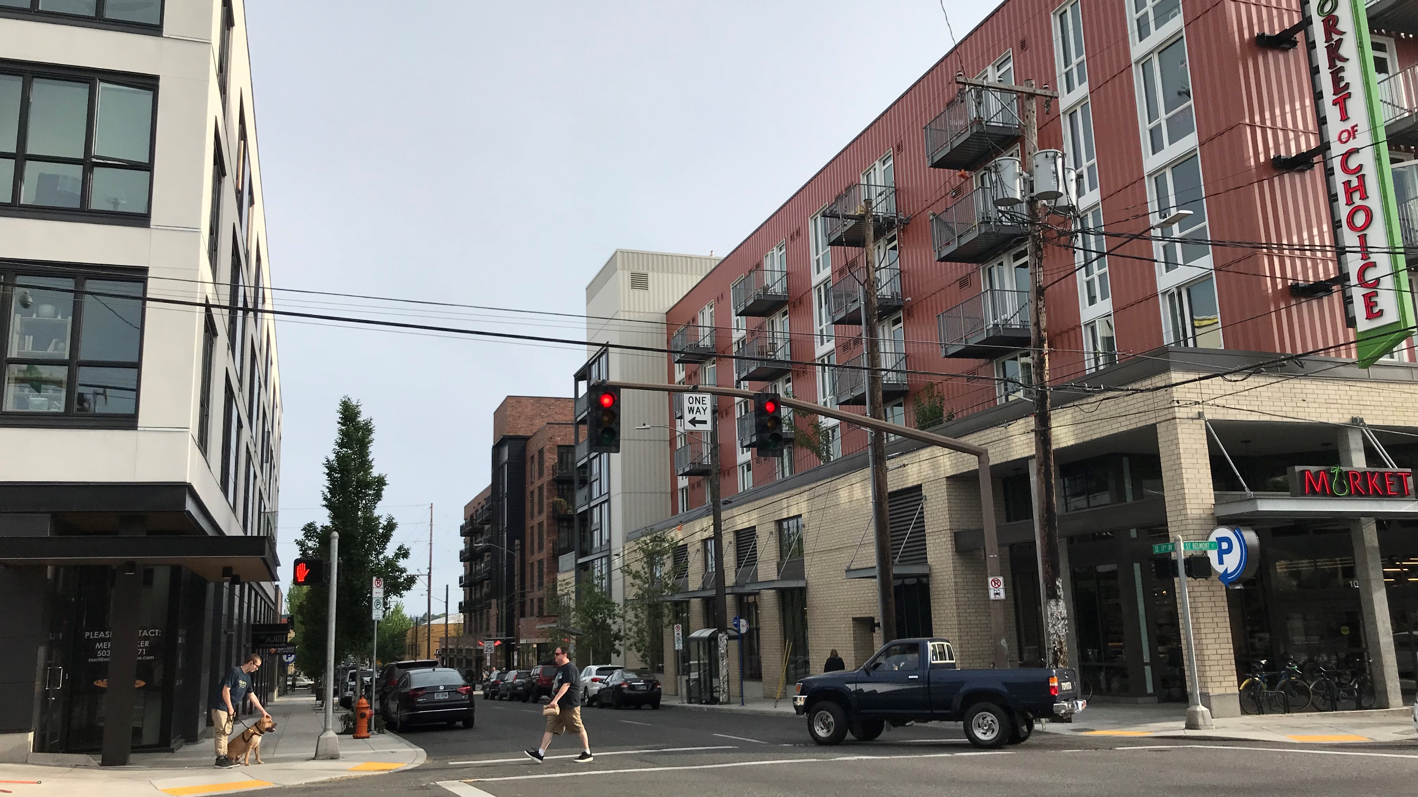
Context
Looking S on SE 11th Ave: Goat Blocks

Slide 9
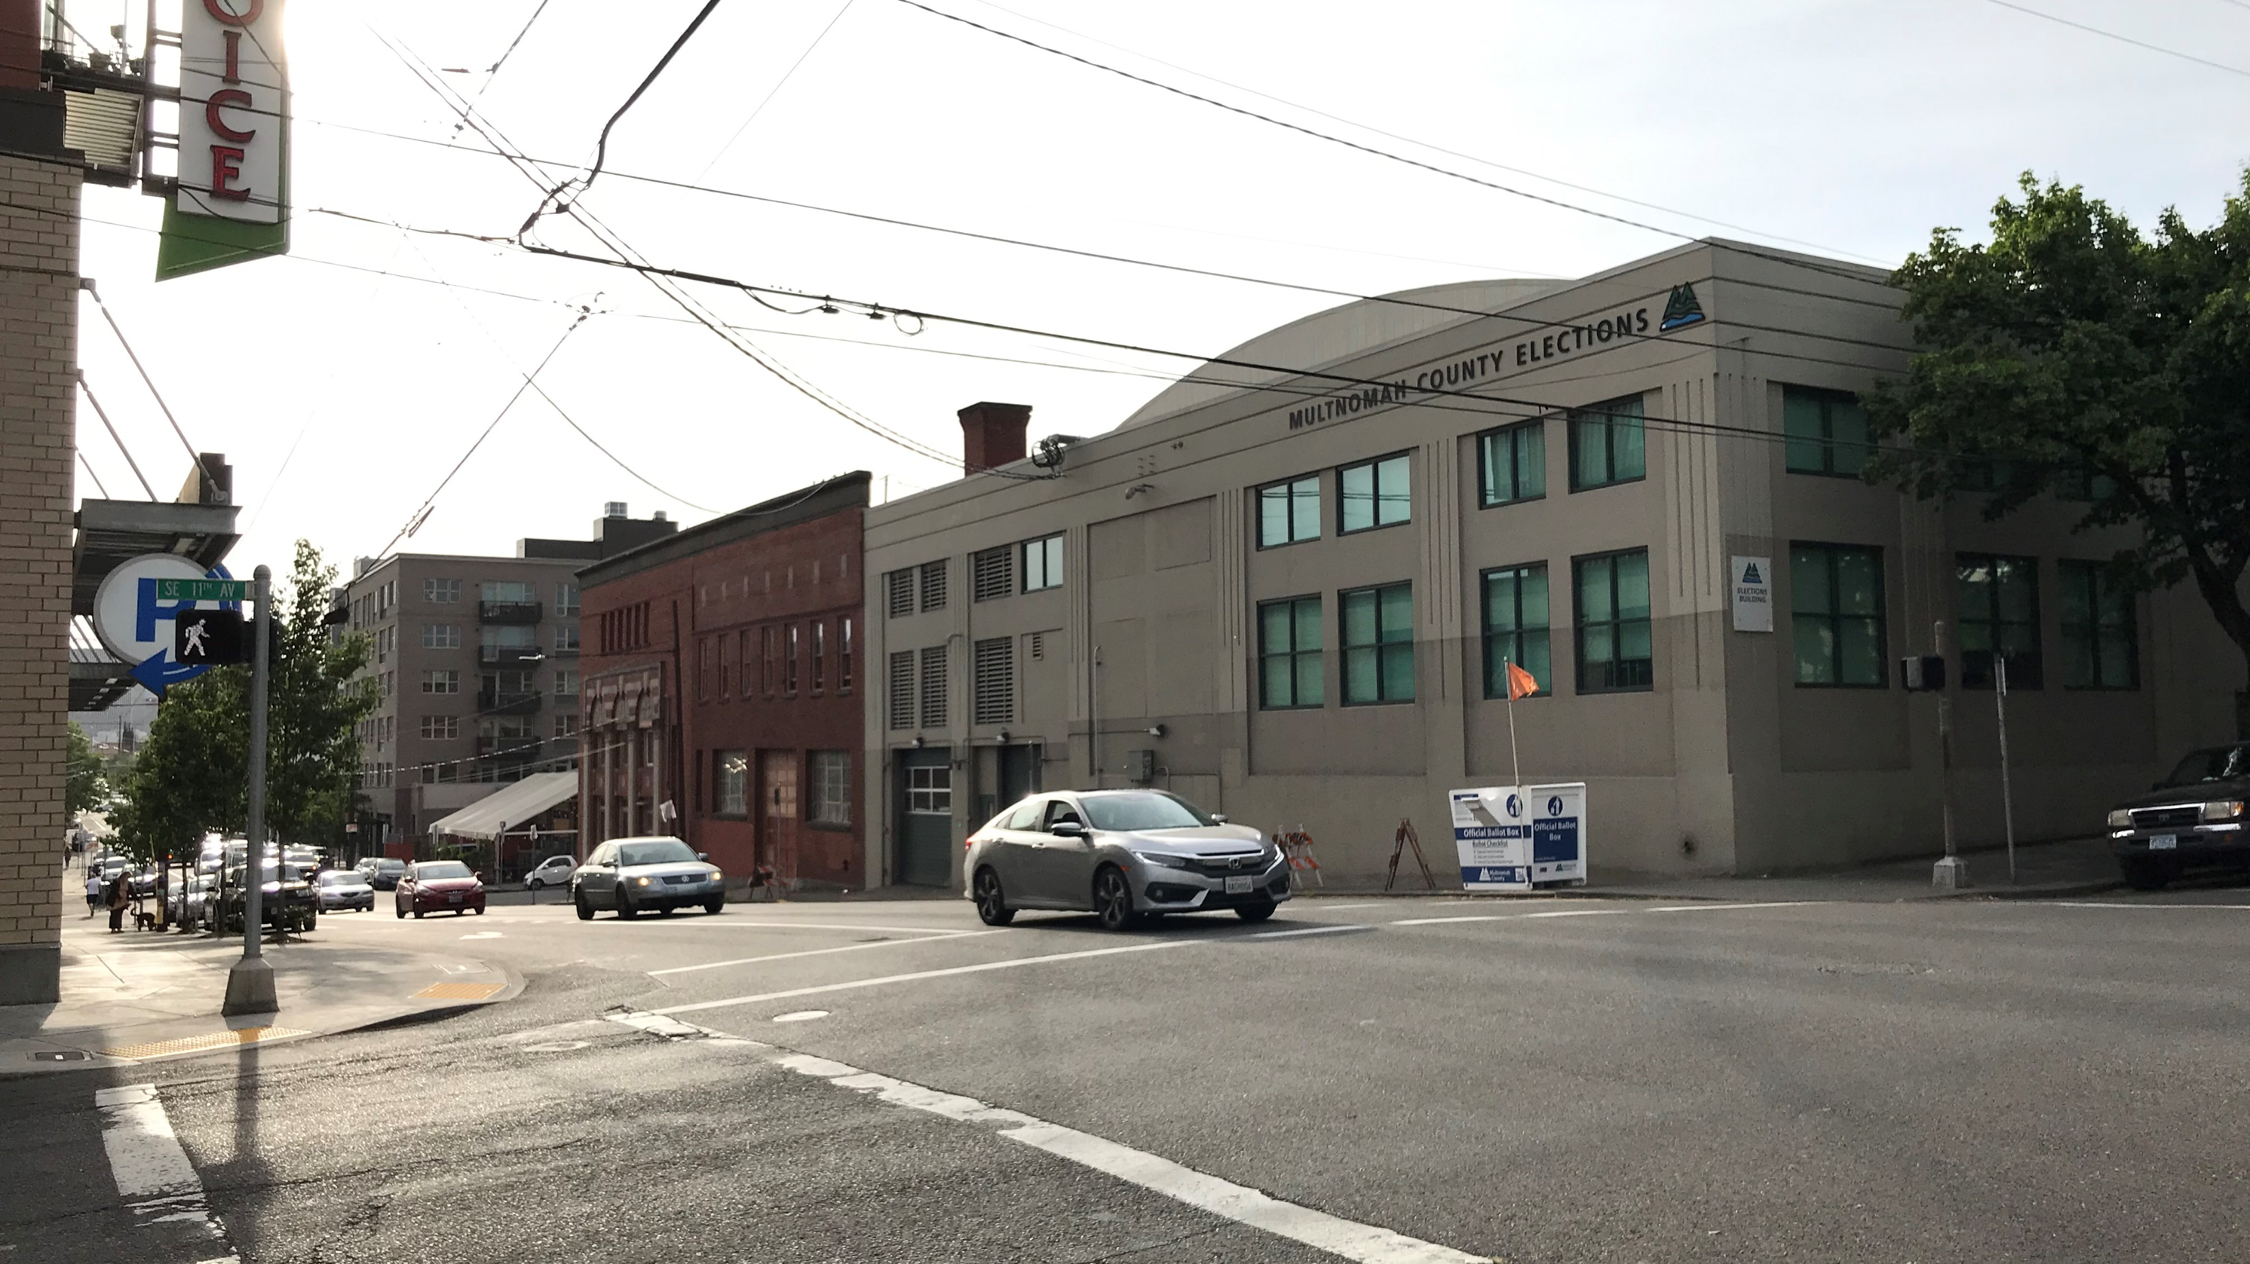
Context
Looking W on SE Belmont: Multnomah County Elections building immediately across SE 11th, Yale Union Laundry adjacent

Slide 10
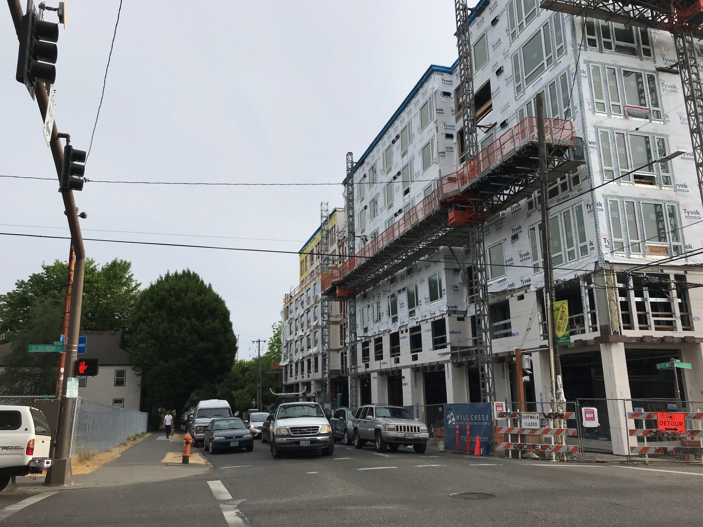
Context
Looking S on SE 12th Ave: Modera Belmont under construction

Slide 11
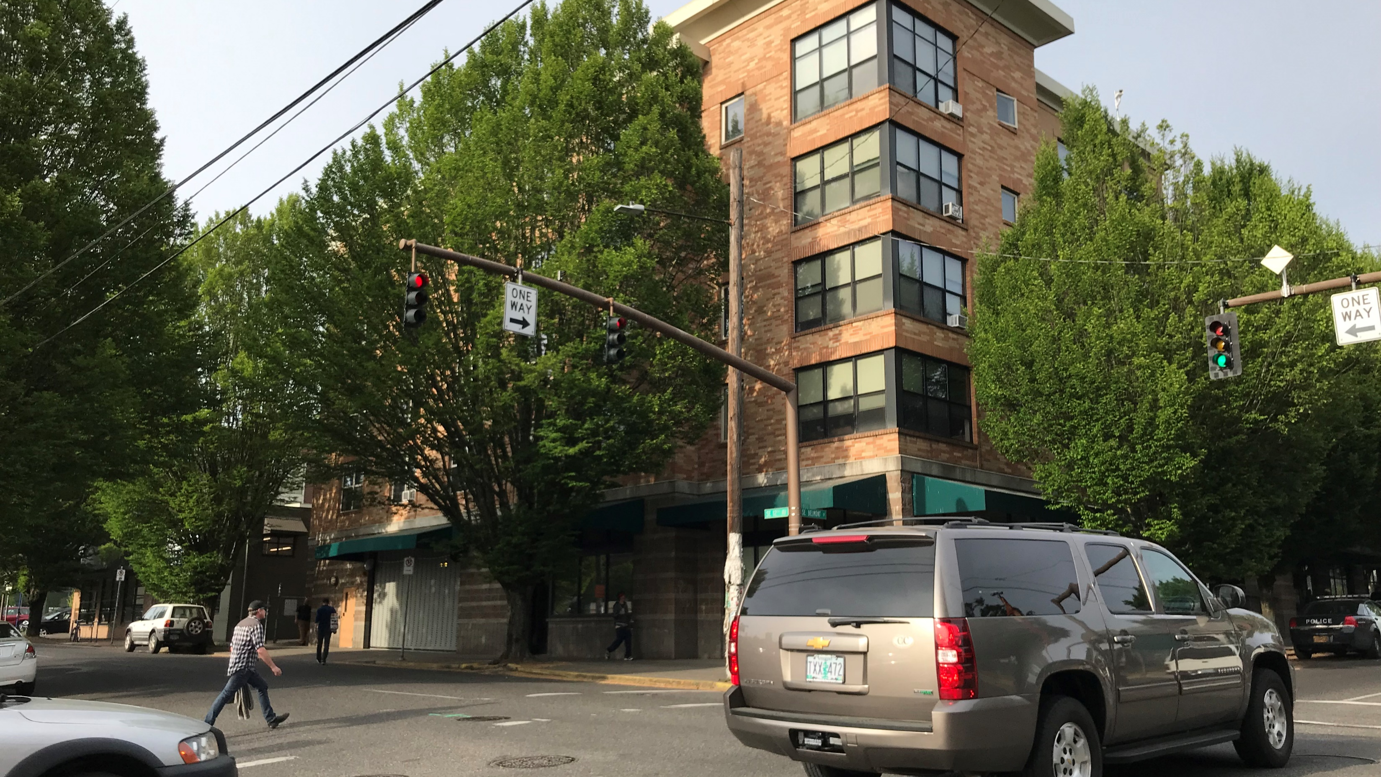
Context
Looking NE across SE 12th and Belmont

Slide 12
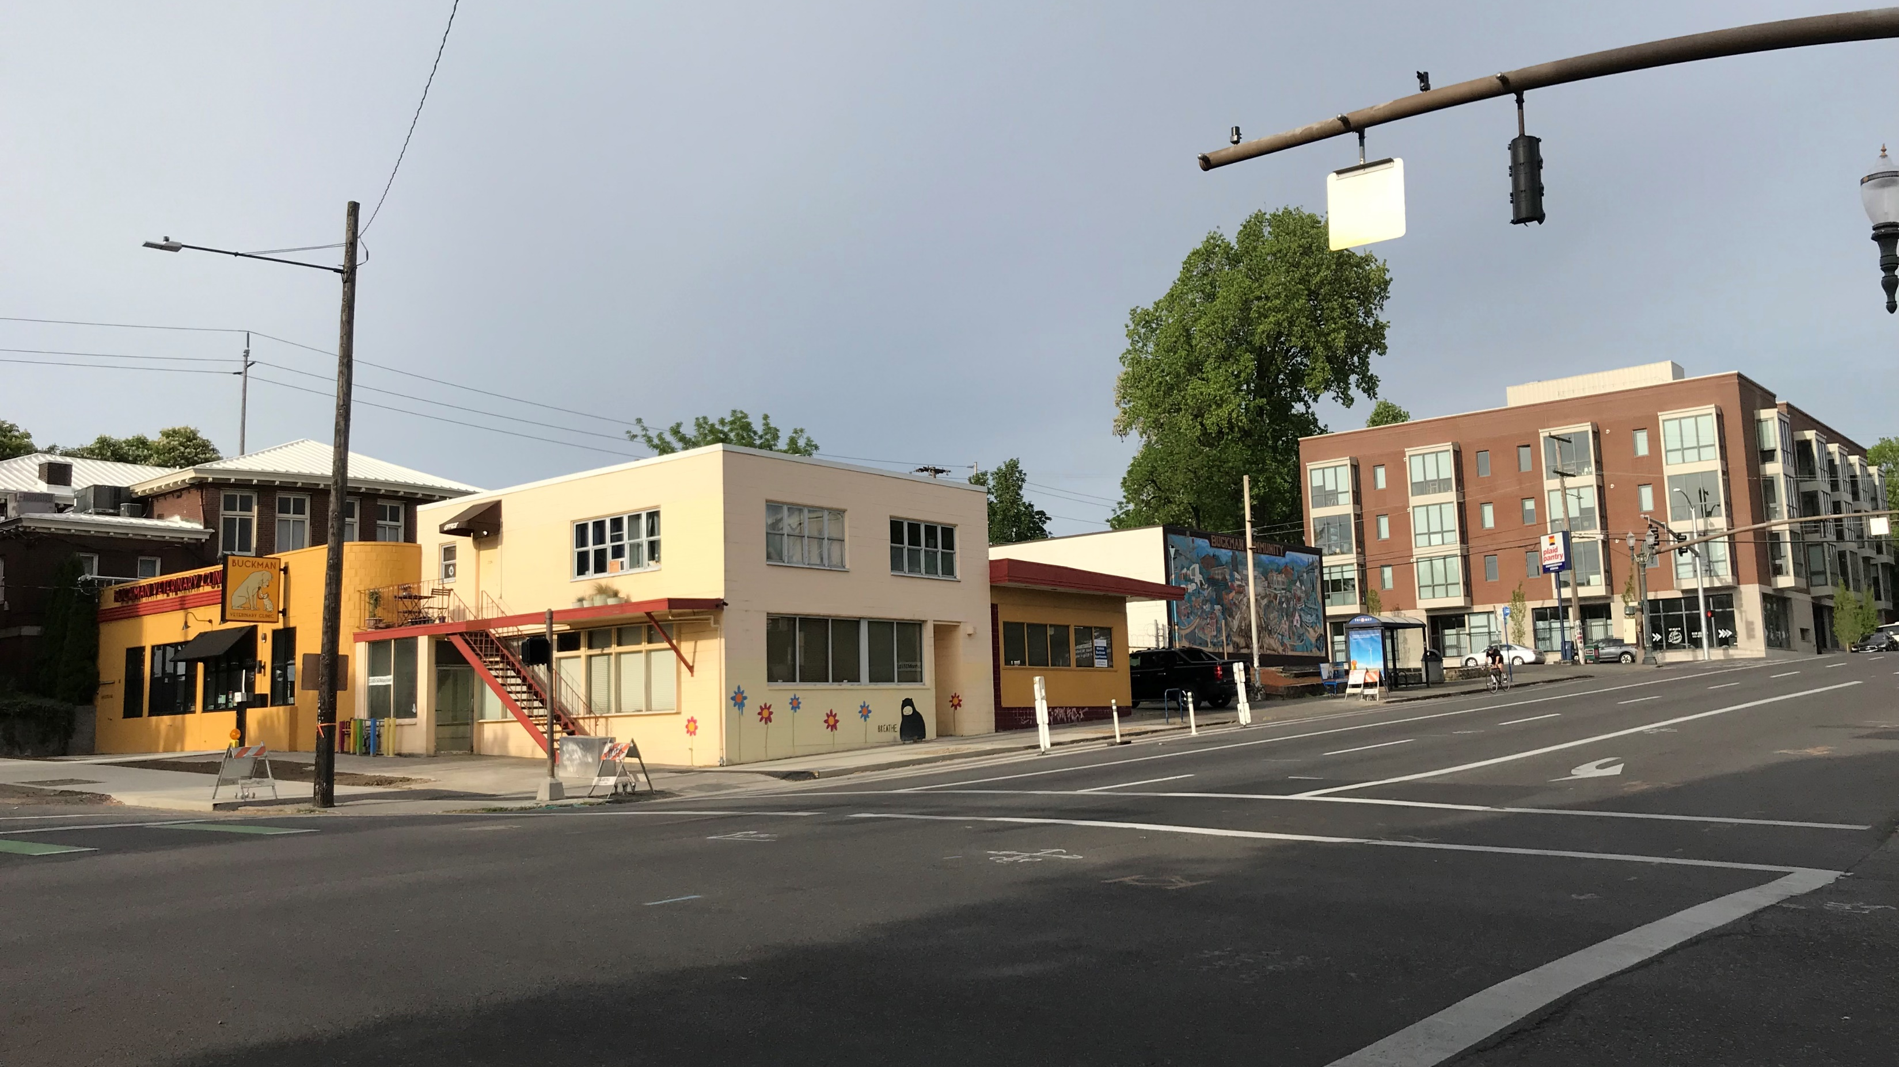
Context
Looking NE across SE 11th and Morrison

Slide 13
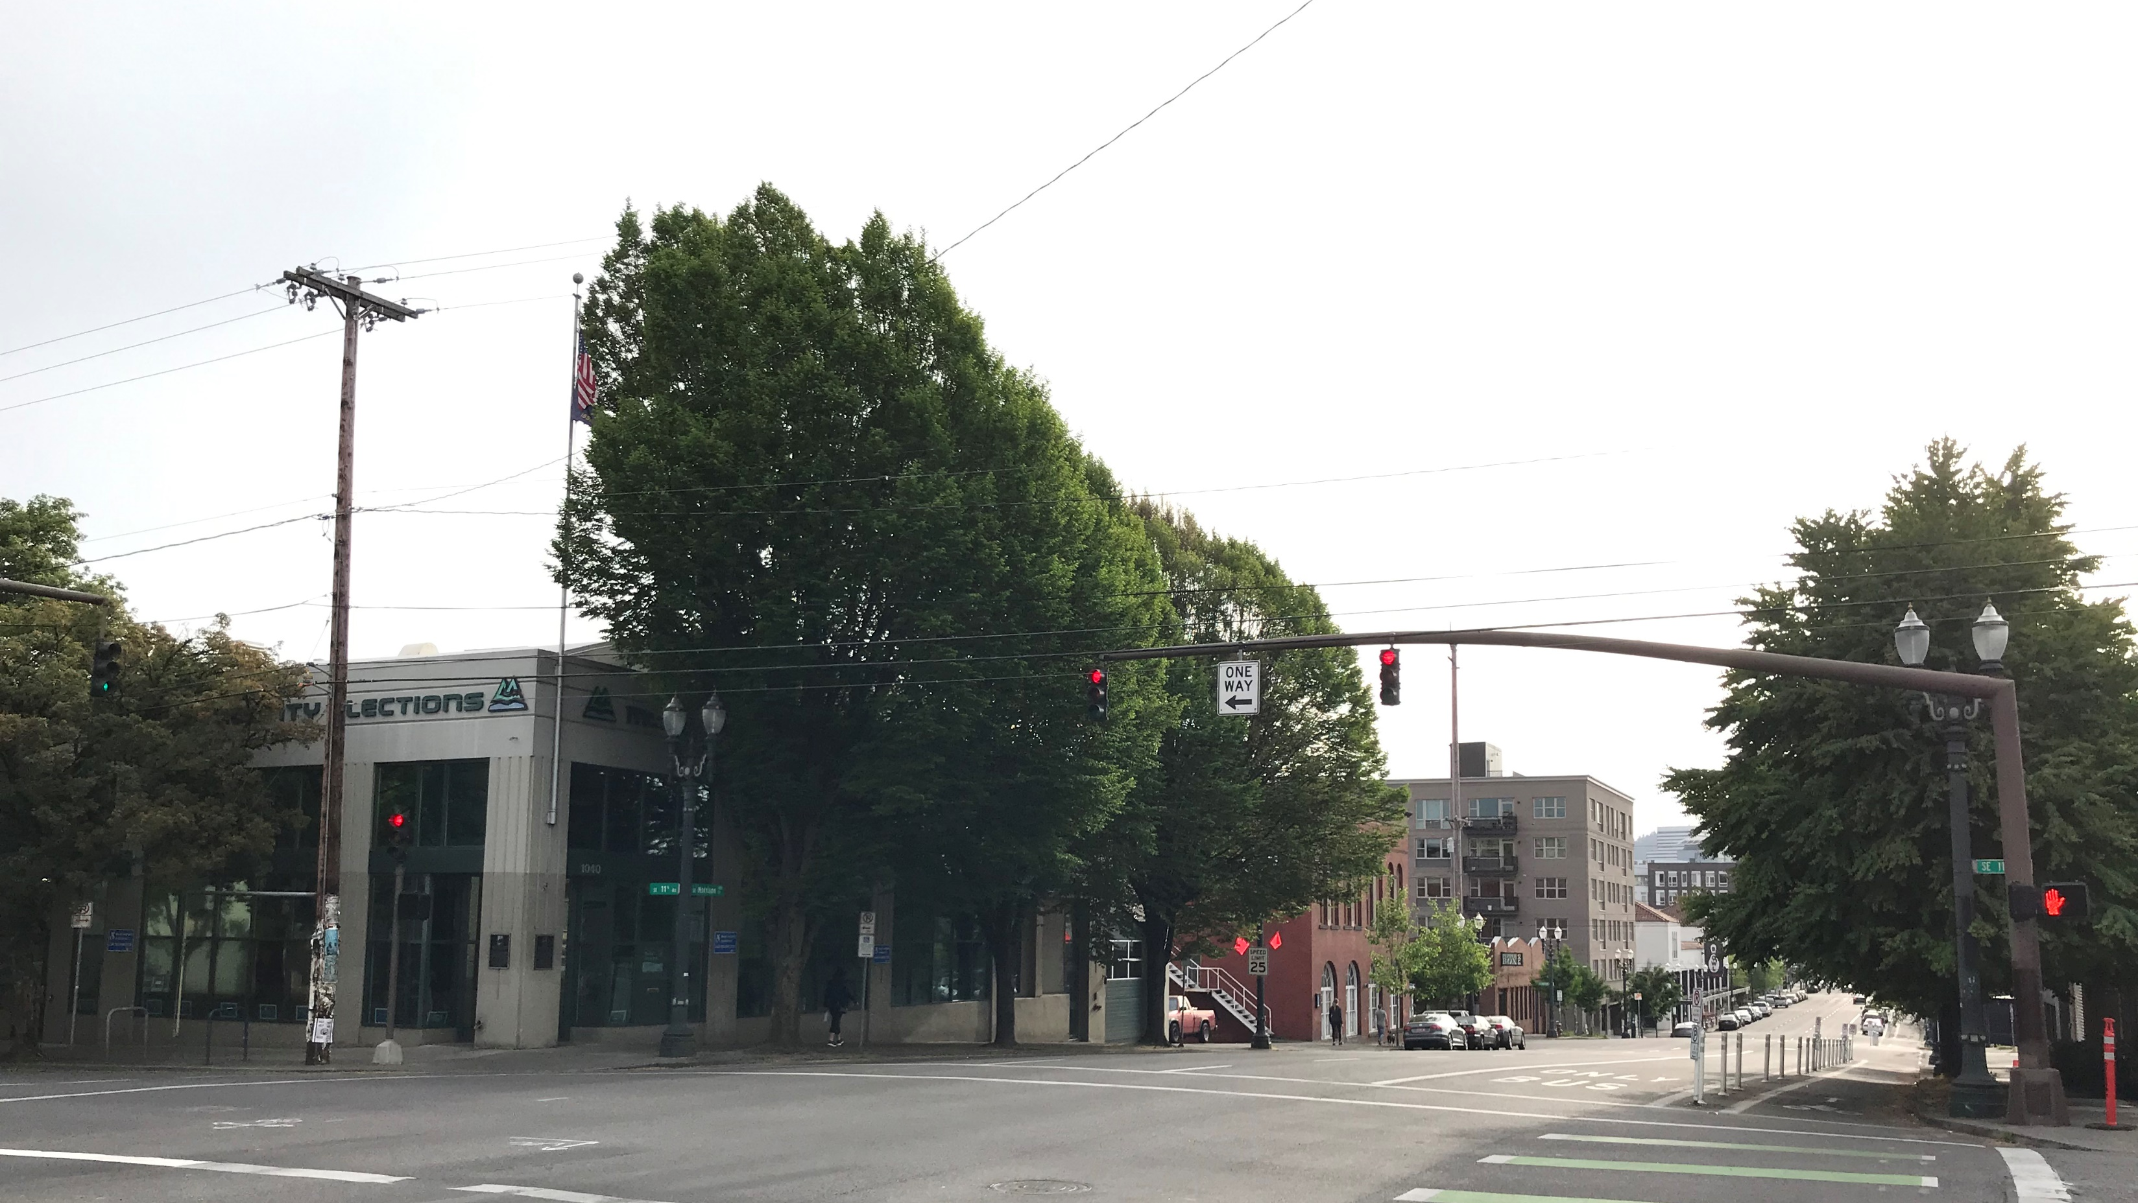
Context
Looking W on SE Morrison: Multnomah County Elections building, Yale Union Laundry building adjacent

Slide 14
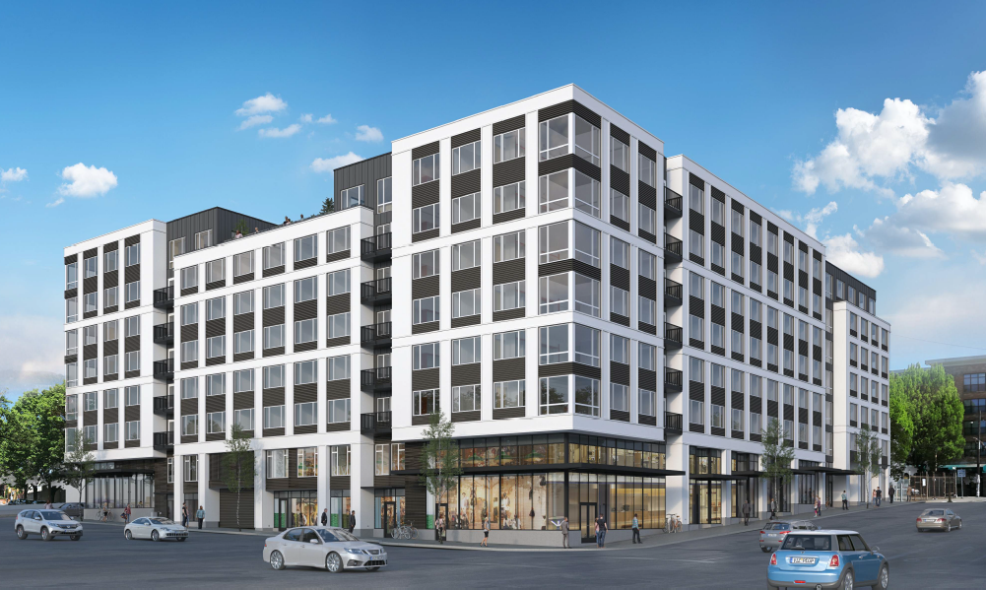
Program Overview
247 residential units
Ground floor retail (10,761 sf)
175 parking spaces

Slide 15
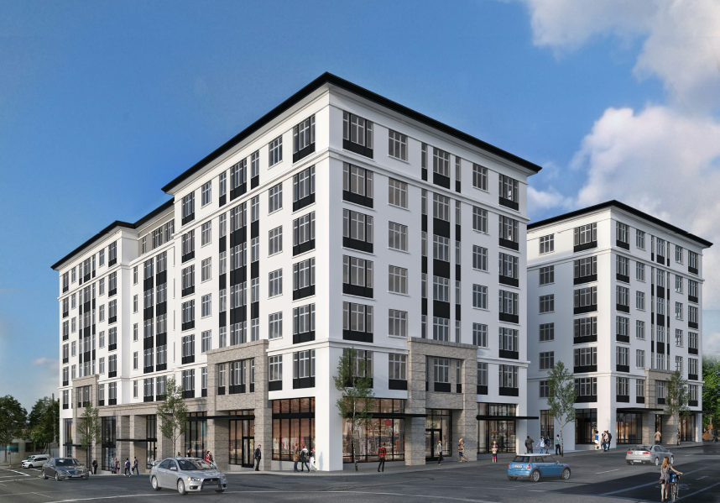
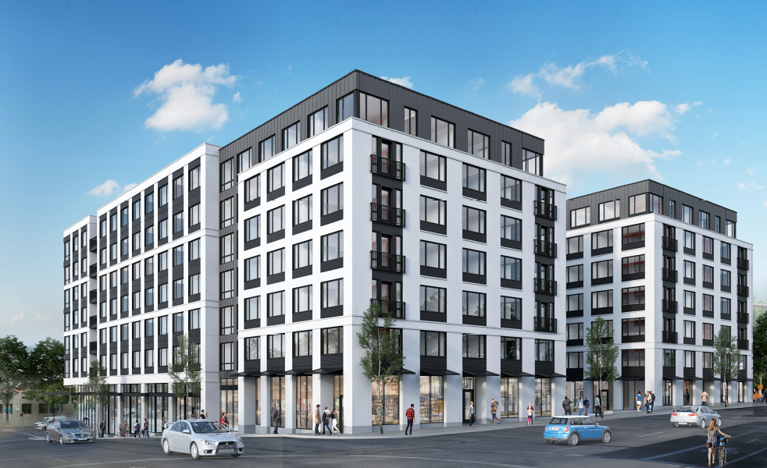
Project History
Pre-App – April 9, 2019
DAR 1 – May 16, 2019
DAR 2 – July 18, 2019
DAR 2
DAR 1

Slide 16
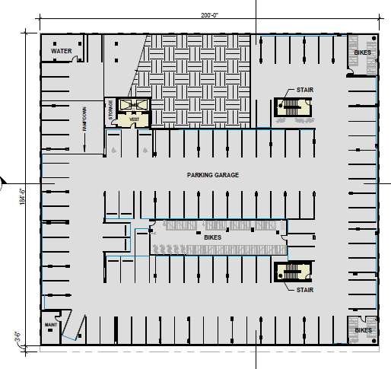
Modifications
1. 33.266.130.F.2 – vehicle parking space width
2. 33.266.220.C.3.b – bicycle parking space width
Modification 1
The Standard: Vehicle parking spaces shall be 8’-6” wide.
The Purpose: The parking area layout standards are intended to promote safe circulation within the parking area, provide for the effective management of stormwater runoff from vehicle areas, and provide for convenient entry and exit of vehicles.
The Proposal: To reduce the width of some parking spaces by 8”.

Slide 17
Modifications
1. 33.266.130.F.2 – vehicle parking space width
2. 33.266.220.C.3.b – bicycle parking space width
Modification 2
The Standard: Bicycle parking spaces shall be 24” wide.
The Purpose: These standards ensure that required bicycle parking is designed so that bicycles may be securely locked without undue inconvenience and will be reasonably safeguarded from intentional or accidental damage.
The Proposal: To reduce the width of long-term bicycle parking spaces to 18”.

Slide 18
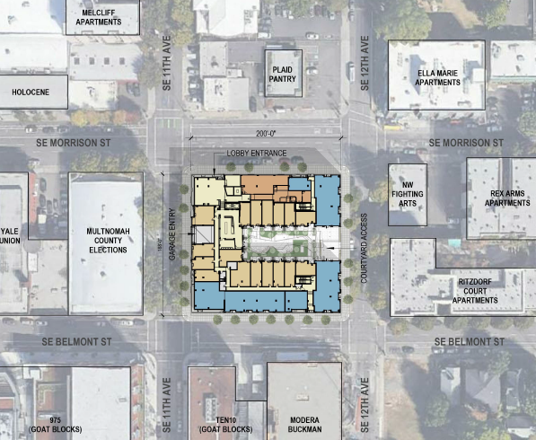
Adjustments
33.510.263.B.2.a(3) – vehicle access
City Bikeway
Major Emergency Response
City Walkway
Major Transit Priority Street
Transit Access Street
Priority Truck Street Major Truck Street
Adjustment 1
The Standard: Vehicle access is not allowed on a Major Truck street (SE 11th)
The Purpose: The purpose of the parking and loading access regulations is to ensure the safety of pedestrians, bicyclists, and motorists, to avoid significant adverse impact on transit operations, and to ensure that the transportation system functions efficiently...
The Proposal: To allow vehicle access on SE 11th.

Slide 19
Applicant Presentation

Slide 20
Discussion Topics

Slide 21
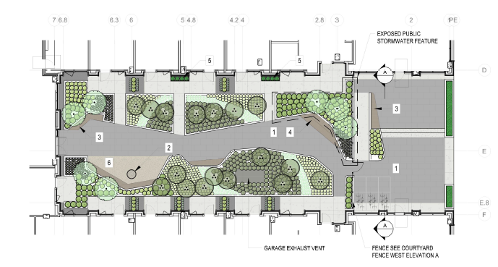
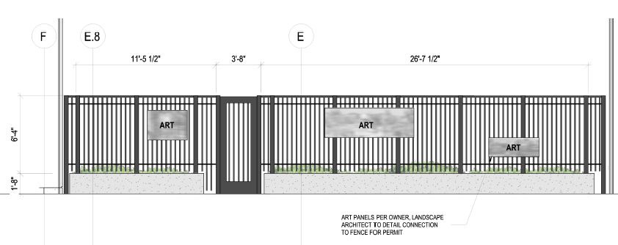
Context
1. Art & Water Features
Issue 1
A5-4 – Incorporate Works of Art. Incorporate works of art into development projects.
A5-5 – Incorporate Water Features. Enhance the quality of public spaces by incorporating water features.
Condition D added: The applicant shall provide details at the November 21, 2019 hearing for the proposed art and exposed stormwater management features.

Slide 22
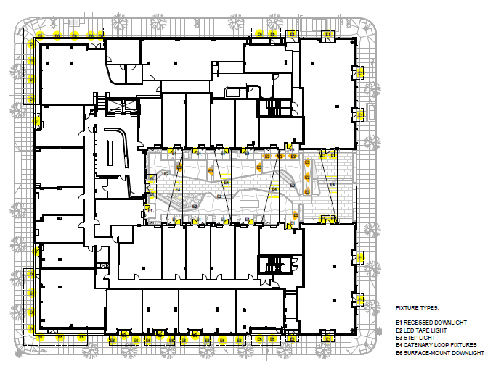
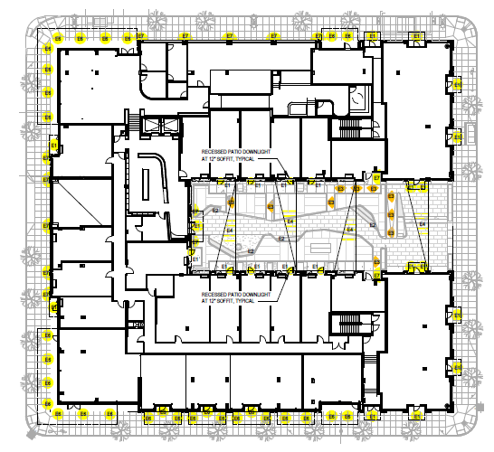
Public Realm
2. Lighting
Issue 2
C12 – Integrate Exterior Lighting. Integrate exterior lighting and its staging or structural components with the building’s overall design concept. Use exterior lighting to highlight the building’s architecture, being sensitive to its impacts on the skyline at night.
Condition E added: Sconce light fixtures shall be added to the five columns of the central volume on SE Morrison, at the five columns of the central volume on SE 11th, and at the courtyard entrances.

Slide 23
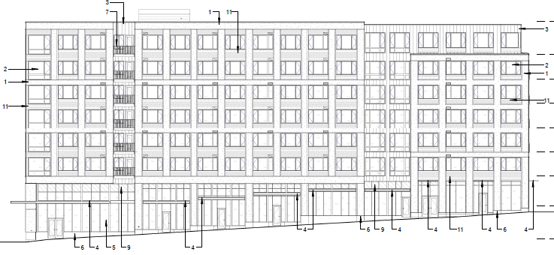
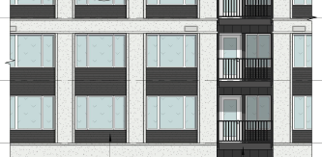
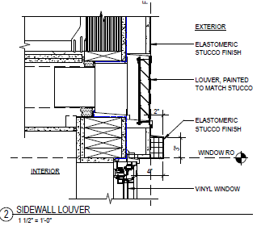
Quality & Permanence
3. Vents
4. Metal Gauge
Issue 3
C2 – Promote Quality and Permanence in Development. Use design principles and building materials that promote quality and permanence.
C5 – Design for Coherency. Integrate the differs building and design elements including, but not limited to, construction materials, roofs, entrances, as well as window, door, sign, and lighting systems, to achieve a coherent composition.
Condition F added: All louver vents shall either be integrated behind the perforated boxed-rib metal panel or within the fenestration pattern.

Slide 24
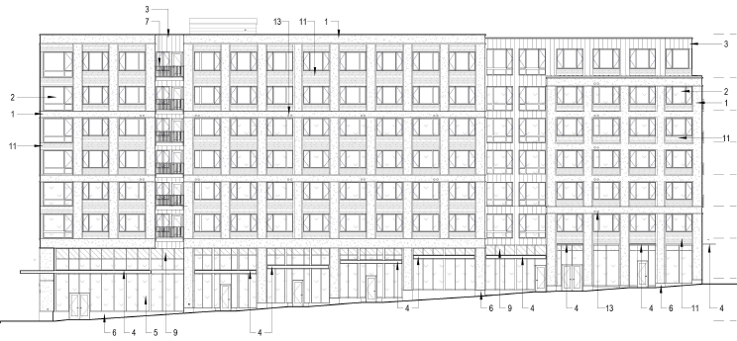
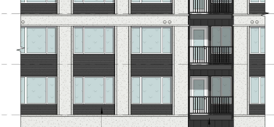
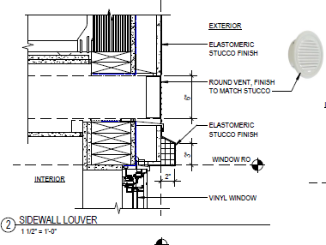
Quality & Permanence
3. Vents
4. Metal Gauge
Issue 3
C2 – Promote Quality and Permanence in Development. Use design principles and building materials that promote quality and permanence.
C5 – Design for Coherency. Integrate the differs building and design elements including, but not limited to, construction materials, roofs, entrances, as well as window, door, sign, and lighting systems, to achieve a coherent composition.
Condition F added: All louver vents shall either be integrated behind the perforated boxed-rib metal panel or within the fenestration pattern.

Slide 25
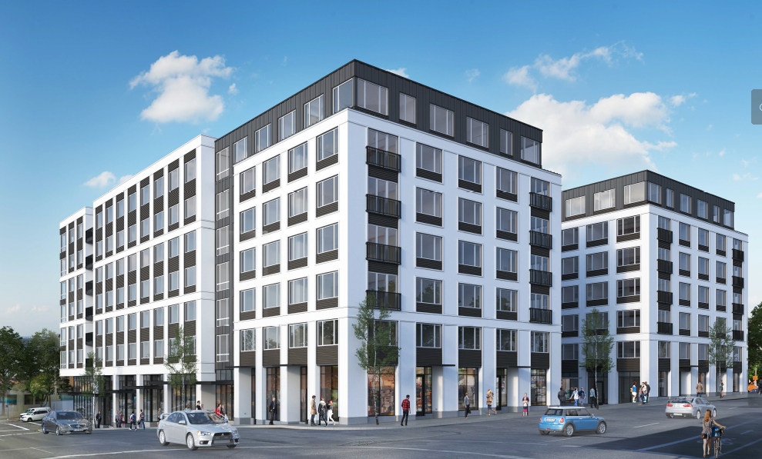
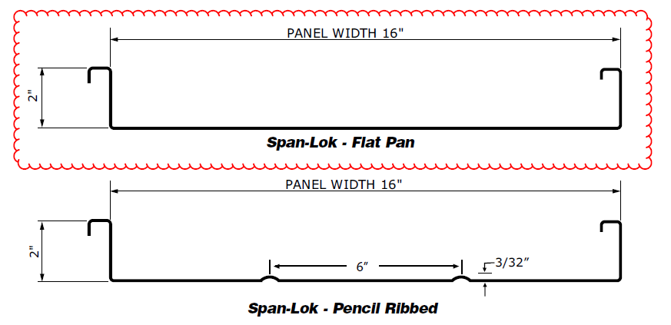
Quality & Permanence
3. Vents
4. Metal Gauge
Issue 4
C2 – Promote Quality and Permanence in Development. Use design principles and building materials that promote quality and permanence.
C5 – Design for Coherency. Integrate the differs building and design elements including, but not limited to, construction materials, roofs, entrances, as well as window, door, sign, and lighting systems, to achieve a coherent composition.
Condition G added: The “flat pan” standing seam metal panel shall have a minimum gauge of 20 or be 22-gauge and “pencil ribbed” with the ribs at 6” on center.

Slide 26
Staff Recommendations

Slide 27
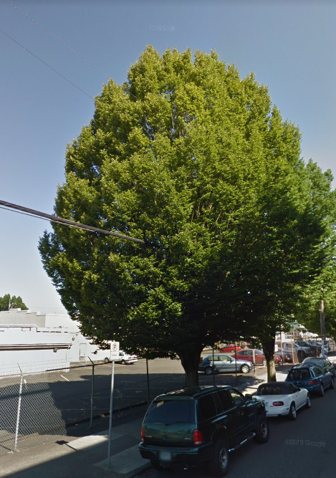
Staff Recommendation
Staff recommends Approval with Conditions, including both Modifications and Adjustment.
Standard conditions A, B, and C.
Condition D - The applicant shall provide details at the November 21, 2019 hearing for the proposed art and exposed stormwater management features.
Condition E - Sconce light fixtures shall be added to the five columns of the central volume on SE Morrison, at the five columns of the central volume on SE 11th, and at the courtyard entrances.
Condition F - All louver vents shall either be integrated behind the perforated boxed-rib metal panel or within the fenestration pattern.
Condition G - The “flat pan” standing seam metal panel shall have a minimum gauge of 20 or be 22-gauge and “pencil ribbed” with the ribs at 6” on center.
Condition H – The 16” hornbeam street tree located on SE 12th Ave must be preserved and protected; if evidence is provided the tree cannot be retained, this must be reviewed by Urban Forestry who must approve the tree removal before the Public Works Permit is issued.

Slide 28
Next steps
Commission Options
Support Staff Recommendation with revised, added, and/ or deleted conditions;
Reject Staff Recommendation and request applicant return with revisions; or
Reject Staff Recommendation and request staff return with recommendation of Denial.

Slide 29
Questions

